Slide 1
Windows as a Virtual Desktop
Brett Gagnon, 7/20/2020
INFO.4800 Project Based Information Systems

Slide 2
AGENDA
Controversy
Recommendation
Benefits and Evidence
Conclusion
Sources

Slide 3
Should Windows replace their standard operating system for the Windows Virtual Desktop?
CONTROVERSY:
Pros:
Offers the windows desktop experience to a much larger audience
Cons:
Performance concerns with limited power of a host machine & Security concerns

Slide 4
RECOMMENDATION:
Windows should transition their traditional OS into a Virtual Desktop
Increase Cost Efficiency
Improve Data Management
Improve Security
Increase Flexibility for Remote Work
Simplify Management

Slide 5
1. INCREASE COST EFFICIENCY
Having Windows as a Virtual Desktop reduces Desktop Management, Infrastructure and Support Costs
Managing and upkeeping PC’s is expensive
It’s much cheaper to provide an employee with a thin client than a new computer
Lowers risk of needing to replace a device
Offers flexibility such as a BYOD policy
“From an IT perspective, virtual desktops help reduce the time it takes to provision new desktops, and they also help to decrease desktop management and support costs. Experts estimate that maintaining and managing PC hardware and software accounts for 50-70% percent of the total cost of ownership of a typical PC. Companies often turn to virtual desktops to cut these IT labor costs.” [1]
- New Horizons Learning Solutions

Slide 6
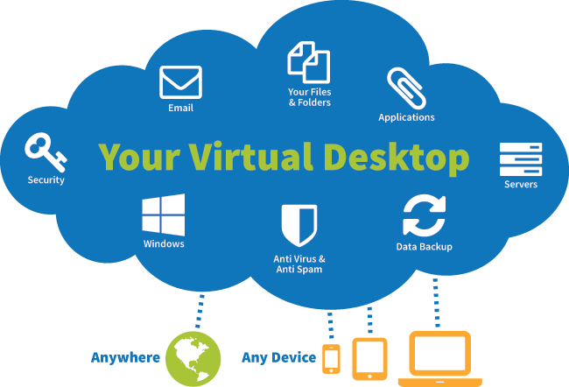
1. INCREASE COST EFFICIENCY
Having Windows as a Virtual Desktop Simplifies Outsourcing
Remote workers can access the WVD from any device
Removes the process of setting up and shipping out PC’s to employees
Saves Time & Mailing Fees
Avoids Security loopholes
“With Virtual Desktop Infrastructure, outsourcing is a straightforward process. You can have your remote workers access your company’s virtual desktop with any device. The best part is that this wouldn’t create any security loopholes and you can determine the level of access that each person has on your VDI platform.” [2]
- File Cloud
[3]

Slide 7
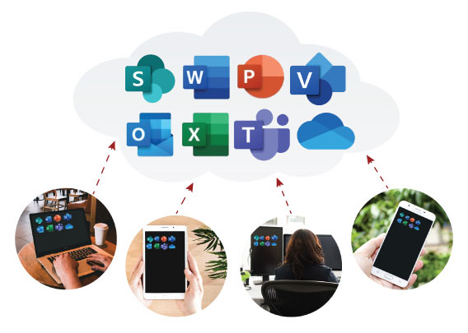
2. IMPROVE DATA MANAGEMENT
Having Windows as a Virtual Desktop Provides Access to Much Larger Storage Space
The cloud offers a much larger capacity than hard drives
Data is always backed up and available on the cloud
Eliminates accessibility issues
Particularly helpful for work involving mobile devices which tend to have smaller storage capabilities
“The cloud’s capacity isn’t infinite, but it’s close. By using virtual desktop technology, each user will have access to a much greater storage space for applications and files than they would have on a hard drive on their device. This is particularly important if you work with mobile devices, such as smartphones or tablets, as they don’t tend to have large storage capabilities” [4]
-Jose Tobias, AusumCloud
[5]

Slide 8
2. IMPROVE DATA MANAGEMENT
Having Windows as a Virtual Desktop Simplifies Maintenance
Removes the need to maintain hardware
Saves space
Saves power consumption
Eliminates lost or corrupted files
Eliminates risk of hardware damage affecting data
“Every year, companies spend thousands of dollars on data management and security. If your organization is looking to cut cost on data management and security, VDI is the way to go. Instead of maintaining a massive data center and a lot of drives and other hardware which do not only take space but consume power, you can move to VDI and host your server in the cloud. A virtual desktop system will not only make your work more flexible but also reduce costs and provide better security for your data. You do not have to deal with lost or corrupted files anymore. What’s more, your workers will have no accessibility issues” [2]
- File Cloud

Slide 9
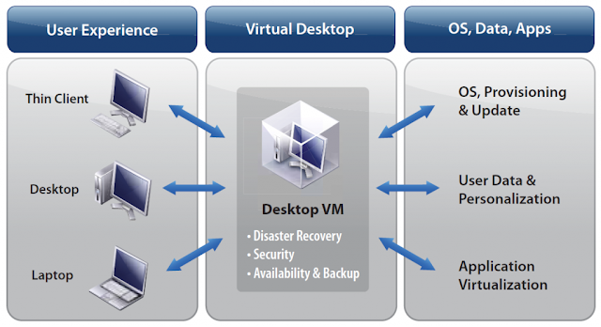
3. IMPROVE SECURITY
Having Windows as a Virtual Desktop Provides Dynamically Created Virtual Workspaces
This ensures that end users execute the latest approved software as the virtualized Desktop package is created from IT software libraries
Audit teams can readily validate end-user activity and evaluate the effectiveness of security controls
Helps meet PCI Data Security Standards Council’s top four milestones for prioritizing PCI DSS compliance efforts
Removes sensitive authentication and cardholder data
Protects the internal network
Secures Payment card applications
Monitors and controls access to systems
[7]

Slide 10
3. IMPROVE SECURITY
Having Windows as a Virtual Desktop Lowers Cost of Disaster Recovery and Business Continuity
Financial enterprises cannot afford significant business disruptions
Eliminates office infrastructure unavailability
Reduces drops in employee productivity caused by security incidents
Provides ability to work from home during an event like Coronavirus
Sensitive Data remains in the data center where security can protect against leaks
Virtual workspaces secure remote user access to the network by isolating VPN clients and browsers on the endpoint
“The security benefits of VDI in the data center are clear: IT controls software configurations, assuring that users execute software with the latest patches and upgrades applied; sensitive data remains in the data center where security teams can protect against theft and easily audit the infrastructure; and operations can more easily control a security incident.” [6] -Eric Ogren, The Ogren Group

Slide 11
4. INCREASE FLEXIBILITY FOR REMOTE WORK
Having Windows as a Virtual Desktop Promotes Employee Health and Productivity
A Stanford Study shows that with remote workers, there was a work productivity boost equal to a full day’s work
Remote workers take fewer sick days
50% decrease in employee attrition
Working remotely eliminates commuting, lunch rushes, long hours in the office
Limits exposure to potentially sick co-workers
Creates a better work-life balance and allows for more time for Family
“With no commute, no lunch rush, and no long hours in the office away from family or friends, working remotely can improve the health and wellness of employees by reducing stress—and limiting exposure to potentially sick coworkers… It’s clear that the advantages of remote work help keep employees happy, engaged, and fulfilled.” [8]
- WeWork

Slide 12
4. INCREASE FLEXIBILITY FOR REMOTE WORK
Having Windows as a Virtual Desktop Increases Business Competitiveness
Helps a business’s ability to attract and retain top talent
Remote work can play a positive role in offering a sense of personal recognition between employer and employee
35% of employees would change jobs if it meant the ability to work off-site full-time
Up to 43% of U.S. employees spend at least some of their time working outside of the office
Stanford study shows that remote workers allowed the participating company to save nearly 2000$ per employee on its office space rent costs
“According to an estimate in Forbes, in 2018, 50 percent of the U.S. workforce was projected to be remote; across the pond, Europe’s remote workers have grown from 7.7 percent to 9.8 percent in the past decade. Providing employees with the flexibility to work where and when they want cuts across all industries and company sizes. In fact, many of today’s top companies offer full, half, or partial remote work.” [8]
- WeWork

Slide 13
5. SIMPLIFY MANAGEMENT
Having Windows as a Virtual Desktop Provides Automatic Updates
With a Virtual Desktop everything is centrally managed, stored, and secured
Eliminates the need for Application Installations, Updates, Patches, Backing up Files, Scanning for Viruses, and Maintaining and Upgrading Hardware
Desktop virtualization helps to streamline management of software assets
“Since everything is centrally managed, stored and secured, virtual desktops eliminate the need to install, update and patch applications, back up files and scan for viruses on individual client devices. Desktop virtualization also helps to streamline management of software assets.” [1] -NH Learning Solutions

Slide 14
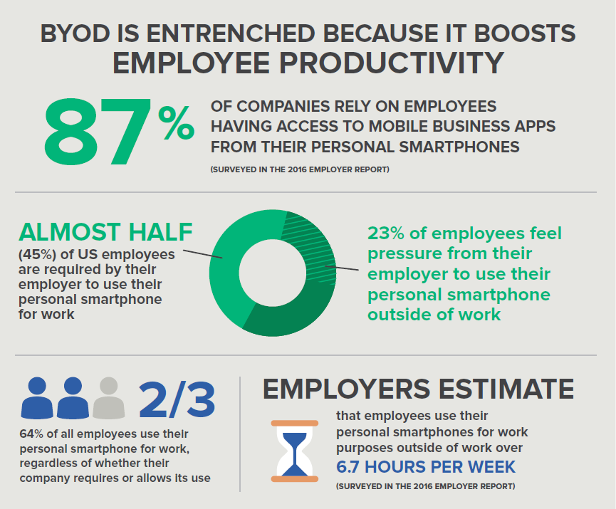
5. SIMPLIFY MANAGEMENT
Having Windows as a Virtual Desktop Provides Workability from Numerous Devices
Removes hardware limitations because hardware is centralized
Employees can access applications or documents from multiple devices
Allows for necessary data to be accessed from anywhere
Eliminates the risk of a defective device prohibiting work
Allows workers using thin-clients to complete work requiring hardware their devices may not have
Allows business to take advantage of the BYOD trend
[9]

Slide 15
CONCLUSION:
Transitioning Windows into a Virtual Desktop is best for our organization, because of:
Reductions in cost, risk, and time spent creating new infrastructure
Improved Data Management and Security
Increased Flexibility for Remote Work and Easier Outsourcing
More Simplified Overall Management

Slide 16
SOURCES
NH Learning Solutions, Feb. 2017, “4 Key Benefits of Desktop Virtualization” <https://nhlearningsolutions.com/blog/4-key-benefits-of-desktop-virtualization/>
File Cloud Blog, Mar. 2019, “5 Ways VDI Can Help Your Company to Cut Costs” <https://www.getfilecloud.com/blog/2019/03/5-ways-vdi-can-help-your-company-to-cut-costs/>
Jason Samuel, May 2019, “The How to Build A Windows Virtual Desktop (VDI) Experience Properly Cheat Sheet” https://www.jasonsamuel.com/the-how-to-build-a-windows-virtual-desktop-vdi-experience-properly-cheat-sheet/
Jose Tobias, Ausum Cloud, Mar. 2019, “Virtual desktop: 6 advantages of uploading your virtual desktop to the cloud” https://ausum.cloud/en/blog/desktop-service/2019/virtual-desktop-advantages-uploading-your-virtual-desktop-cloud
Technology Seed, Feb. 2020, “Windows Virtual Desktop”
https://tseed.com/windows-virtual-desktop-wvd/

Slide 17
SOURCES
Eric Ogren, TechTarget, Nov. 2009, “Security benefits of virtual desktop infrastructures”
https://searchsecurity.techtarget.com/tip/Security-benefits-of-virtual-desktop-infrastructures
Benefits of VDI image
https://www.lightedways.com/2019/03/virtual-desktop-infrastructure.html
WeWork, May 2020, “The benefits of remote work for both employees and managers”
https://www.wework.com/ideas/worklife/benefits-of-working-remotely
BYOD image
https://www.ezcomputersolutions.com/blog/the-pros-cons-of-byod/
10. Taranpreet Singh, Ace Cloud Hosting, May 2019, “5 Key Benefits of Hosted Virtual Desktops for Your Business”
https://www.acecloudhosting.com/blog/benefits-hosted-virtual-desktops/
11. Adam Hickman, Junko Sasaki, Gallup, Apr. 2017, “Can You Manage Employees You Rarely See?”
https://www.gallup.com/workplace/236372/manage-employees rarely.aspx?g_source=link_newsv9&g_campaign=item_207539&g_medium=copy

