Slide 1
VAAST_PY and positional weightings
Steven Flygare

Slide 2
Outline
Benchmarking
Current issues in VAAST
VAAST_PY
Positional Weightings

Slide 3
Benchmarking VAAST performance
Randomly choose known disease genes from OMIM
Randomly insert one or more published disease causing variants for that gene into a personal exome
Assay the ability of VAAST, SIFT¹ and ANNOVAR² to identify the disease gene in a genome-wide screen
Repeat for 100 different genes under a variety of different scenarios, e.g. dominant, recessive, various case cohort sizes etc.
¹ Kumar, P., Henikoff, S. & Ng, P.C. Nat Protoc 4, 1073-81 (2009).
² Wang, K., Li, M. & Hakonarson, H. Nucleic Acids Res 38, e164 (2010).
Notes:
OMIM – online mendelian inheritance in man database that contains known disease causing variants

Slide 4
Ranks for 100 different rare recessive diseases
100
1, 2, or 3 unrelated individuals
All individuals are compound heterozygotes
No two contain the same allele
Ranks out of 21,000 genes
80
60
Number of Genes
40
20
1
2
3
0
SIFT
Notes:
Sift is not the right tool for this type of job

Slide 5
Ranks for 100 different rare recessive diseases
100
80
60
Number of Genes
40
20
1
2
3
1
2
3
0
SIFT
ANNOVAR

Slide 6
Ranks for 100 different rare recessive diseases
100
80
60
Number of Genes
40
20
1
2
3
1
2
3
1
2
3
0
SIFT
ANNOVAR
VAAST2.0

Slide 7
Impact of more variants (SNV only)
100
80
60
Number of Genes
40
20
1
2
3
3+
1
2
3
3+
0
ANNOVAR
VAAST2.0
Notes:
3 unrelated individuals, exome sequenced, aligned and called against hg19. Still restricting to SNV only data. HG18 target – 17343 variants. HG18 background – 160461. HG19 targets ~ 1 million. HG19 background ~ 30 Million.
HGMD – also contains known disease causing variants, but privately maintained and curated, pay per view

Slide 8
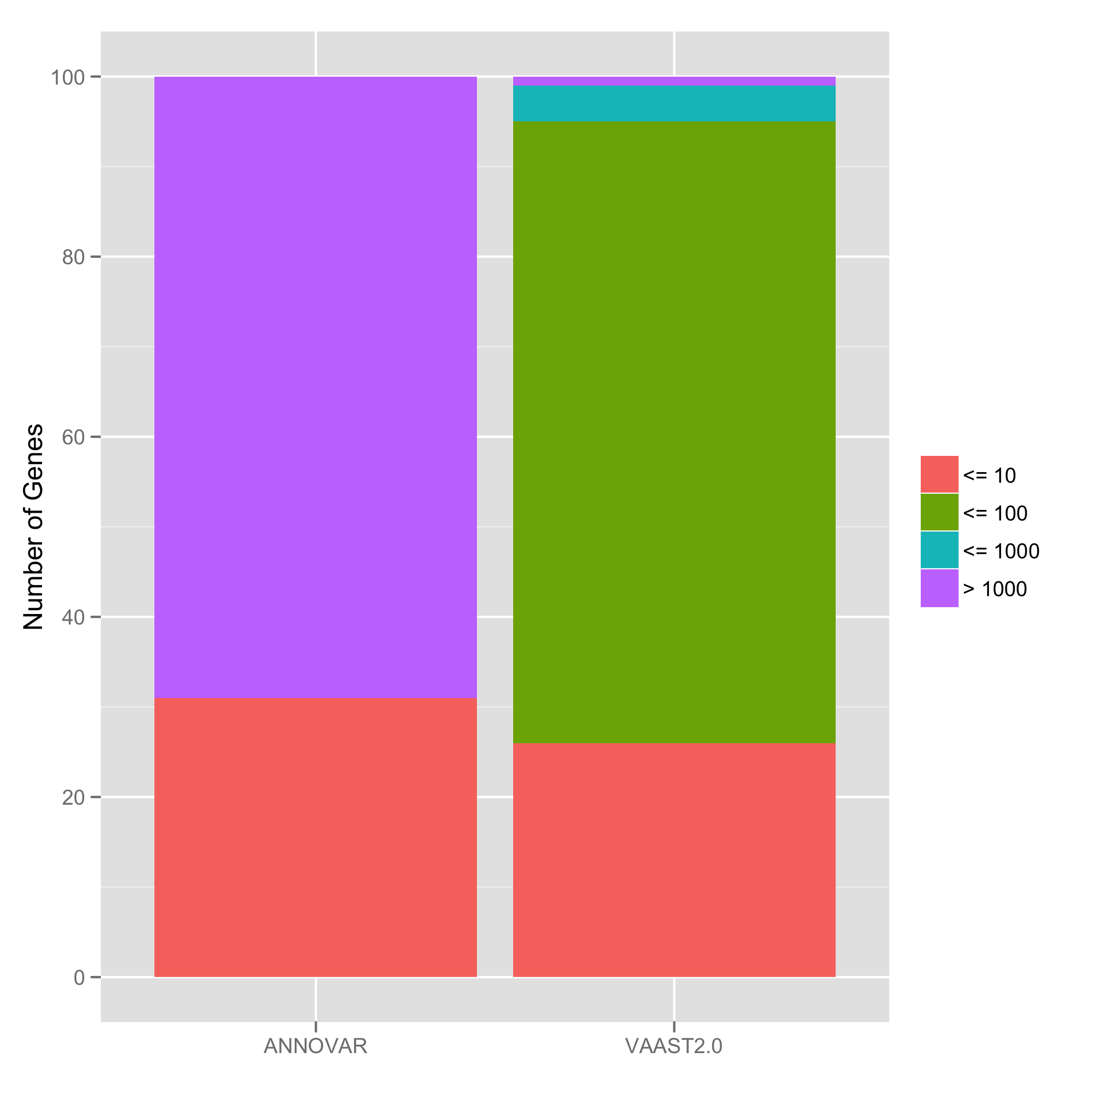
Adding Indels further diminish performance
Targets were called from exome data
HGMD variants doped into targets
VAAST runtime ~ 110 min w/ 40 cpus
VAAST peak memory usage ~ 45GB
HG19 data with 3 unrelated individuals and indels
Notes:
--less_ram could be used but it increases the run time

Slide 9
Current Issues in VAAST
Implementation issues
  Runtimes
  Memory usage (especially in parallelization)
False positives
  Benchmarking results with omim/hgmd variants shows disease causing genes not ranked first
Notes:
After explaining slide, talk about before moving on to possible solutions, talk about the need to understand what VAAST is doing. The implementation issues

Slide 10
Implementation solution: VAAST_PY
New implementation of VAAST
  Uses the parallel python module to handle parallel processes
  Memory is managed via tabix
Notes:
VAAST_PY because it is written in python.
Parallel Python is extremely good at efficient distribution of work
Tabix is a dependency, but it is a light and relatively well known package. Shouldn’t be an onerous dependency.

Slide 11
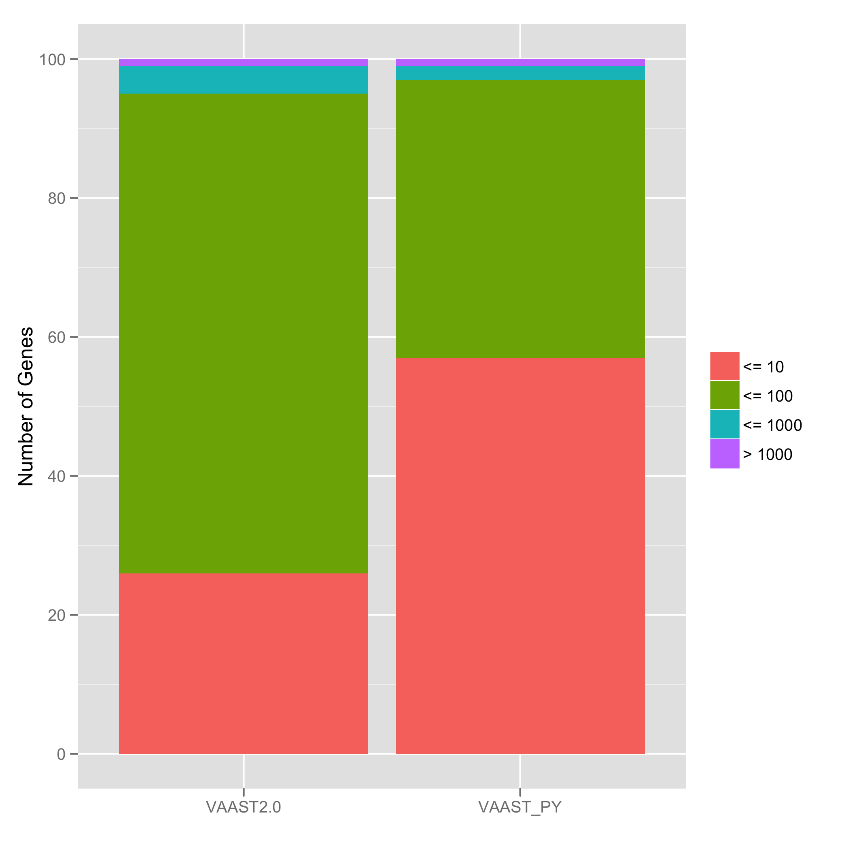
Strengths of VAAST_PY
Runtime ~ 25 minutes w/ 40 cpus
Memory usage ~ 2 GB
Still plenty of room for improvement
HG19 data with 3 unrelated individuals and indels
Notes:
Attribute improvement to minor bug fixes and differences in interpretation

Slide 12
False Positives in VAAST
Some genes can carry / tolerate a lot of variants. Examples: MUC family and TTN
Many variants are not real e.g. false positives – if you had the variant you’d be dead

Slide 13
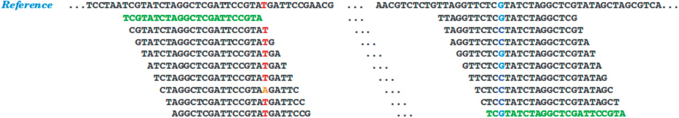

Genome Mappability
Lee H , and Schatz M C Bioinformatics 2012;28:2097-2105
© The Author(s) 2012. Published by Oxford University Press.
Notes:
The top sequence represents the reference genome, with many individual reads mapped to the sequence beneath. The left highlighted column illustrates a homozygous substitution and the right highlighted column illustrates a heterozygous substitution. Two green reads are same sequence, which means the read can be mapped to multiple position. Consequently the origination is ambiguous

Slide 14
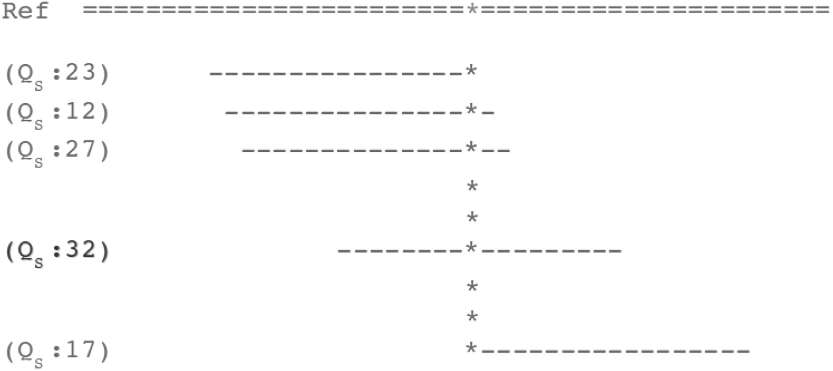
Genome Mappability Score
Lee H , and Schatz M C Bioinformatics 2012;28:2097-2105
© The Author(s) 2012. Published by Oxford University Press.
Notes:
The GMS examines and combines the individual mapping quality scores for all possible reads related to specific position

Slide 15
Genome Mappability Score (GMS)
“The GMS is a weighted probability that any read could be unambiguously mapped to a given position” (Lee and Schatz, 2012)
Genomic dark matter – unmappable regions
Mutations hidden in the genomic dark matter may contribute importantly to disease processes
Didn’t improve rankings when applied in VAAST
Notes:
GMS was computed via simulation on the reference genome

Slide 16
VQSR – variant quality score recalibration
Process developed by the Broad Institute – part of the GATK package
VQSLOD value is added to VCF file
  Log odds ratio of being a true variant vs a false variant
  Gaussian mixture model
    Looks at relationships between different variant quality metrics to identify true / false variants
  Train using dbSNP, HapMap, 1000G
Notes:
For example mapping quality rank-sum and haplotype score, quality divided by depth,

Slide 17
Tranches are used to partition variants
Notes:
I chose to cutoff the data once 99% of the true variants were allowed.

Slide 18
Tranche filtering increases power
HG19 data with 3 unrelated individuals and indels
Notes:
Put space betweeen vaast2.0 and vaast_py. This also highlights the importance of good variant calling.

Slide 19
Genome position adjacency
How likely is one base to look like any other base when aligning short reads?
Count the number of times reads can ambiguously align to a position in the genome
Calculate by allowing reads to align up to 10 times and then tracking the different places where the same read goes
We call these counts adjacencies

Slide 20
Adjacencies
AATCGCGAATCGCG
AAACGCGAATCGCGAAAGGCCTCTCTGGATTTGCAATCGCGAATTGCGCCGCGAATATAT
A->T
T->T
T->C
In this toy example all the bases where the read can align to would have an adjacency value of 2
Weight all variant site VAAST scores by the percentile of the adjacency score
Notes:
These can be thought of as refined mapping quality scores.

Slide 21
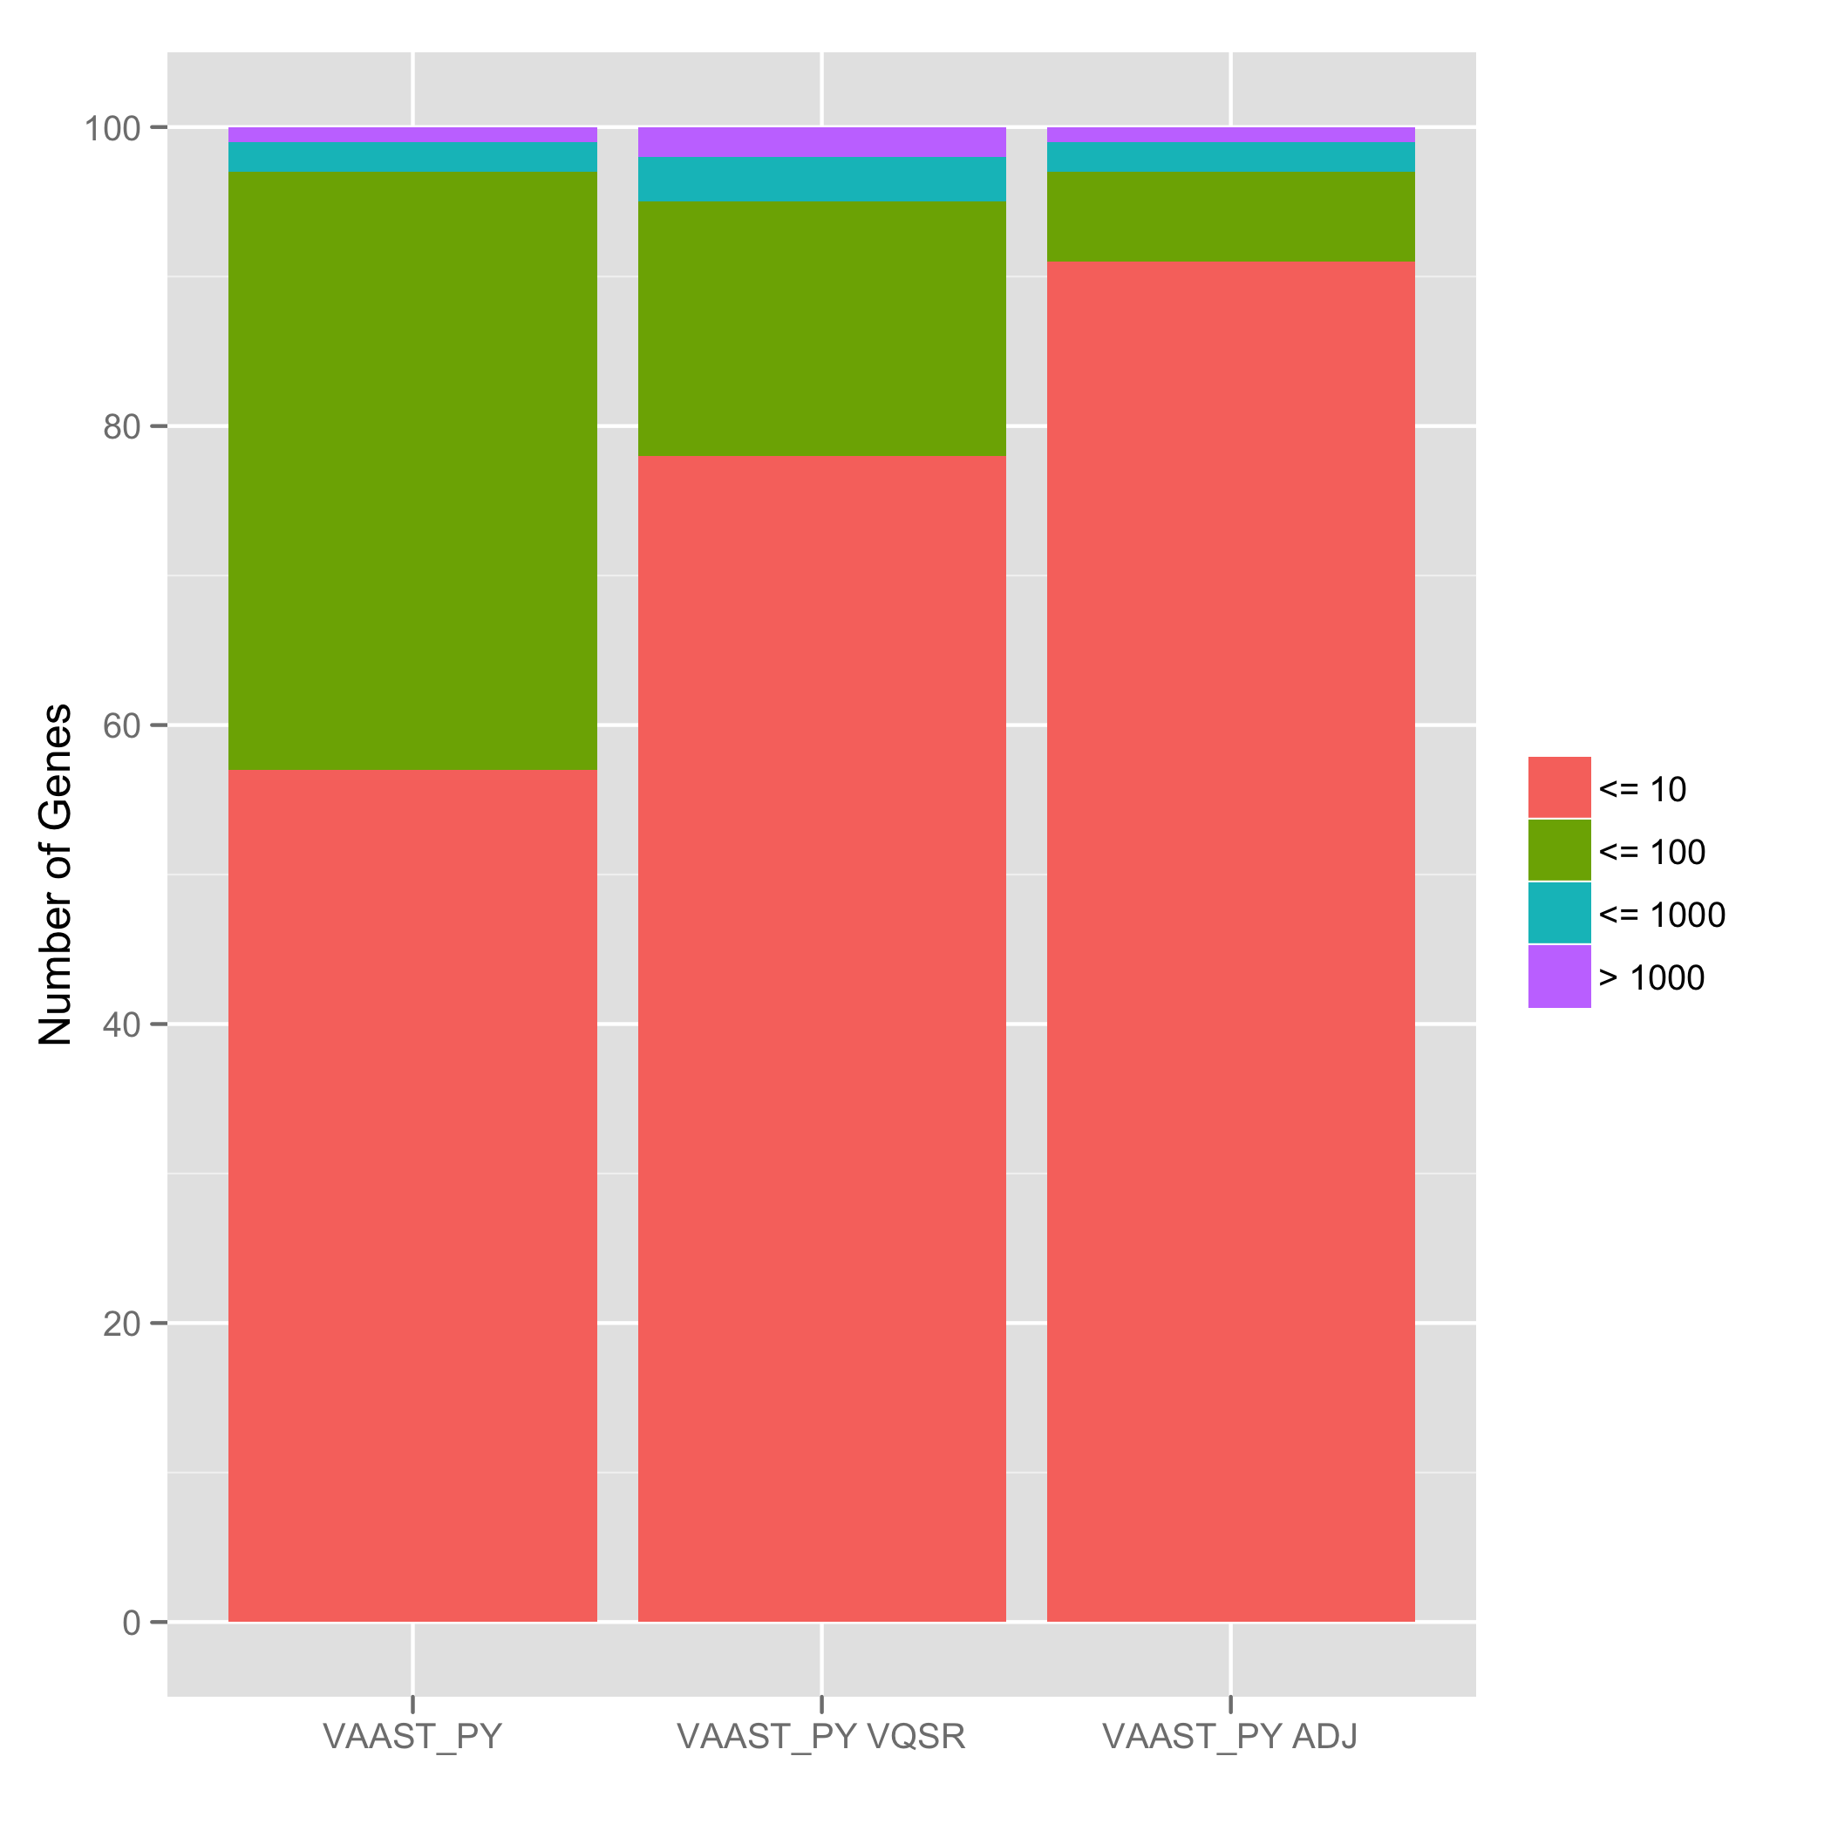
Adjacencies increase power
The adjacency information greatly increased VAAST’s power
False positive problem is beginning to lessen
HG19 data with 3 unrelated individuals and indels

Slide 22
Performance review
100
80
60
Number of Genes
40
20
1
2
3
3+
1
2
3
3+
0
ANNOVAR
VAAST2.0
Notes:
3 unrelated individuals, exome sequenced, aligned and called against hg19. Still restricting to SNV only data. HG18 target – 17343 variants. HG18 background – 160461. HG19 targets ~ 1 million. HG19 background ~ 30 Million.

Slide 23
More variants make searching harder
100
80
60
Number of Genes
40
20
1
2
3
3+
1
2
3
3+
0
ANNOVAR
VAAST2.0
Notes:
3 unrelated individuals, exome sequenced, aligned and called against hg19. Still restricting to SNV only data. HG18 target – 17343 variants. HG18 background – 160461. HG19 targets ~ 1 million. HG19 background ~ 30 Million.

Slide 24
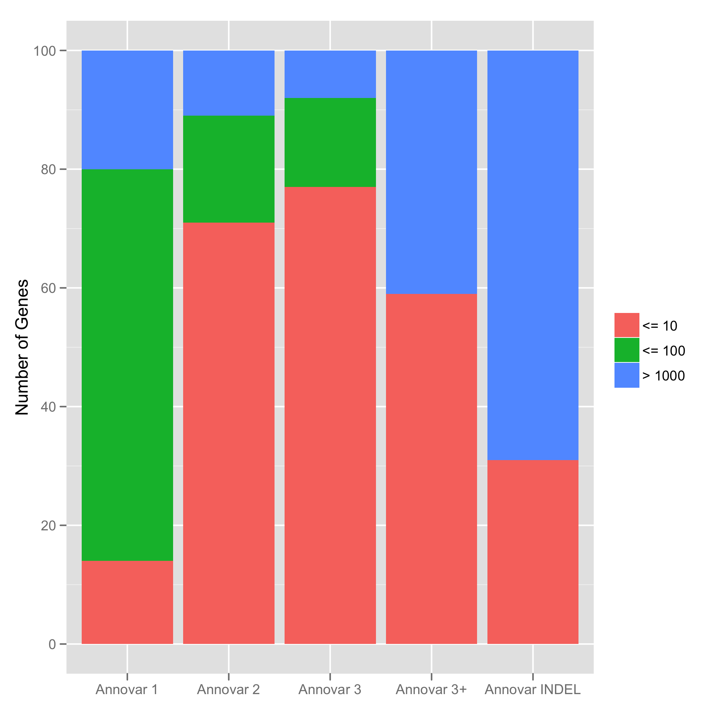
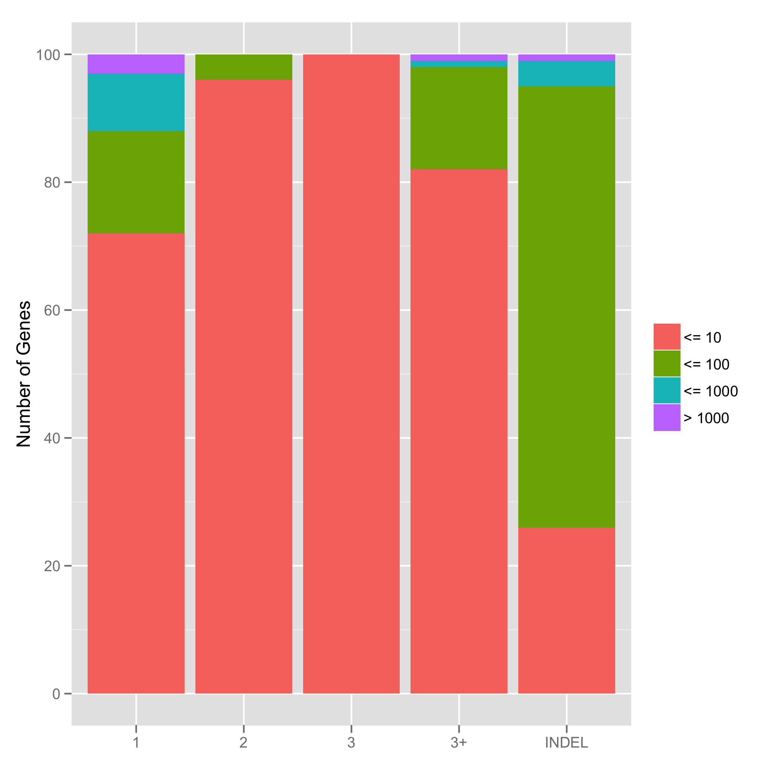
Indels further increase the difficulty
1
2
3
3+
INDEL
1
2
3
3+
INDEL
ANNOVAR
VAAST2.0
Notes:
3 unrelated individuals, exome sequenced, aligned and called against hg19. Still restricting to SNV only data. HG18 target – 17343 variants. HG18 background – 160461. HG19 targets ~ 1 million. HG19 background ~ 30 Million.

Slide 25
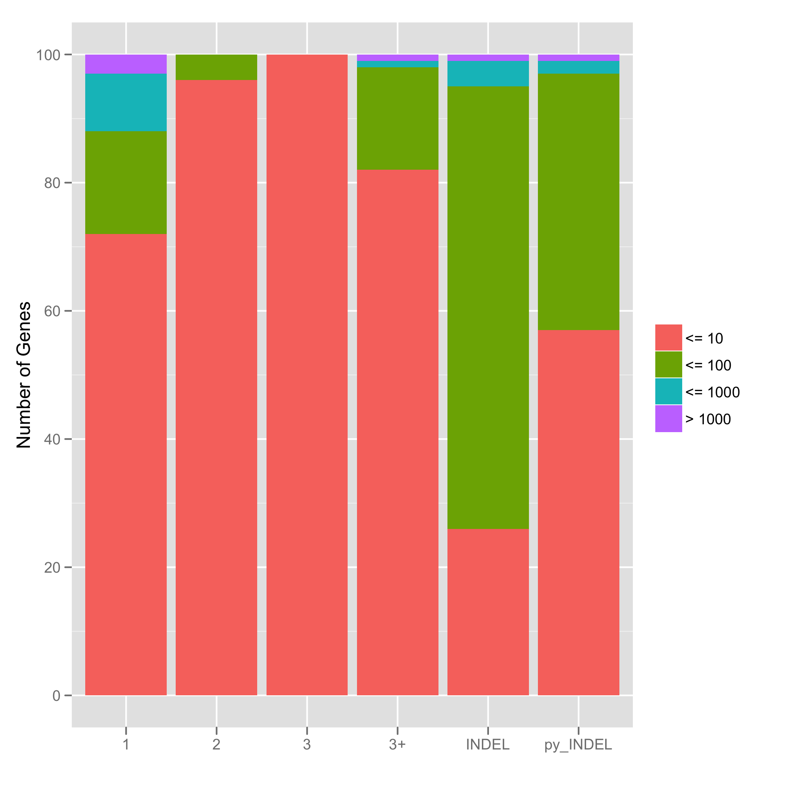
VAAST_PY is powerful and fast
1
2
3
3+
INDEL
1
2
3
3+
INDEL
INDEL
ANNOVAR
VAAST2.0
VAAST_PY

Slide 26

VQSR increases VAAST’s power
1
2
3
3+
INDEL
1
2
3
3+
INDEL
INDEL
VQSR
ANNOVAR
VAAST2.0
VAAST_PY
Notes:
3 unrelated individuals, exome sequenced, aligned and called against hg19. Still restricting to SNV only data. HG18 target – 17343 variants. HG18 background – 160461. HG19 targets ~ 1 million. HG19 background ~ 30 Million.

Slide 27
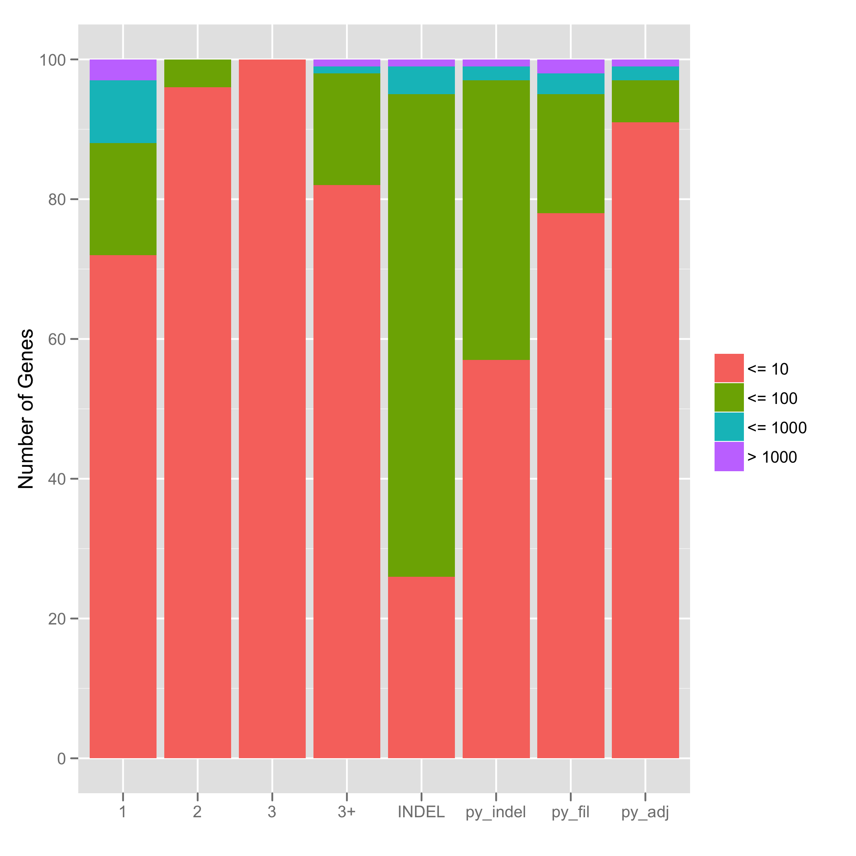
Adjacencies increase power
1
2
3
3+
INDEL
1
2
3
3+
INDEL
INDEL
VQSR
ADJ
ANNOVAR
VAAST2.0
VAAST_PY
Notes:
3 unrelated individuals, exome sequenced, aligned and called against hg19. Still restricting to SNV only data. HG18 target – 17343 variants. HG18 background – 160461. HG19 targets ~ 1 million. HG19 background ~ 30 Million.

Slide 28
Summary
Decent solution to time / memory problem
False positive problem persists, but we have promising solutions
Bottom Line – VAAST is doing really well

