Slide 1

Affondiamo i microservizi nella Birra

Slide 2


Purchases
Warehouse

Slide 3
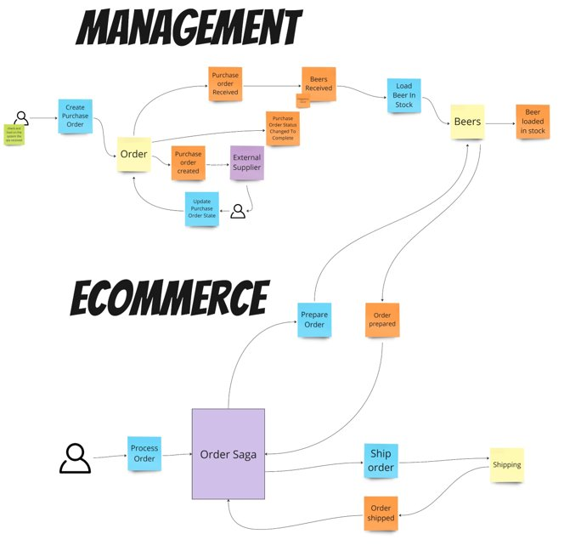
NewVantage Report
30/06/2023 – WorkingSoftware

Slide 4

NewVantage Report
The lowest level of knowledge is when we make a lot of decisions about the future system
Microservices
Serverless
Monolithic
SOA
It’s easy to make things complicated, but it’s complicated to make them simple
EDA
30/06/2023 – WorkingSoftware

Slide 5

Risk comes from not knowing what you are doing
(Warren Buffet)
The only way to decrease ignorance is to increase understanding

Slide 6
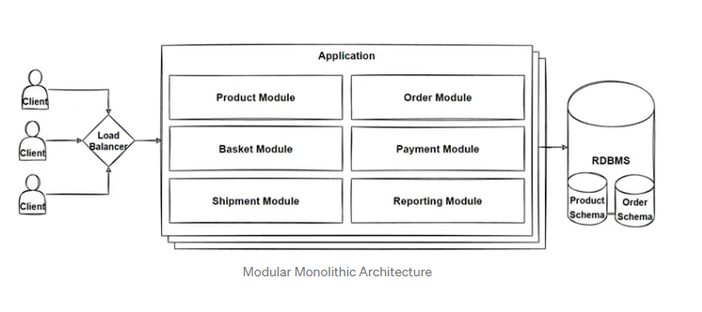

Slide 7

Hands-On Learning

Slide 8
Failure Symptoms
Azure AppService provides fully managed hosting for web applications including websites and web APIs
AKS
App Service
Azure Kubernetes Service (AKS) provides a fully managed Kubernetes option in Azure
Container App
Azure Container Apps enables you to build serverless services based on containers
30/06/2023 – WorkingSoftware

