Slide 1
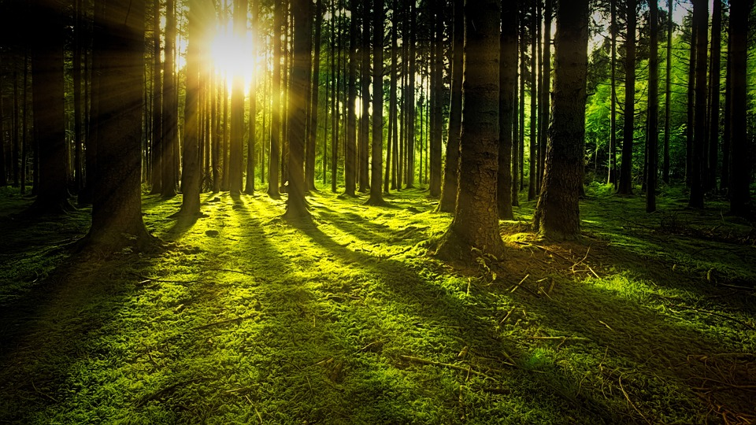
Final Group Project - DBAS3017
Shay Gillis, Jack Fierlbeck, and Bradley Horne
December 13, 2022

Slide 2
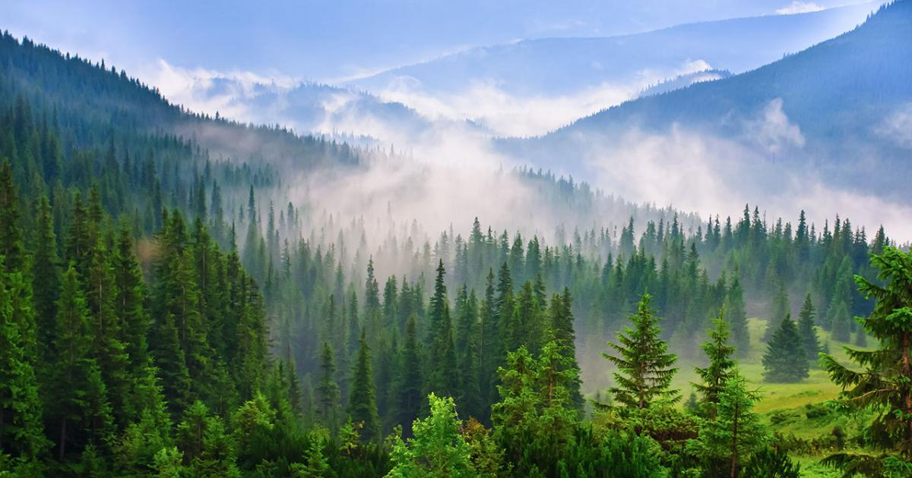
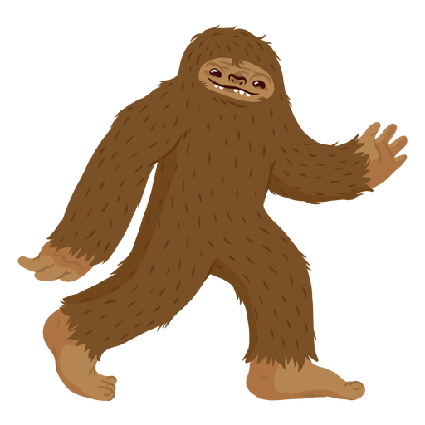
Introduction
What is our topic for our Data Visualization Final Project?
bigfoot png - Bing images
This Photo by Unknown author is licensed under CC BY-NC-ND.

Slide 3
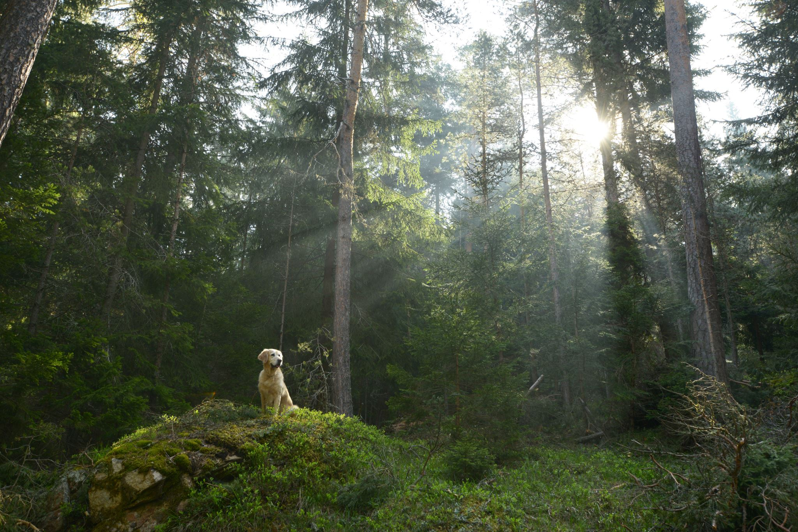
What do you already know about Bigfoot?

Slide 4
You may be wondering: Haven’t sightings gone down since the creation of smartphones?

Slide 5

Insights gained from the Sightings vs Smartphones Graph
He is aware of human evolution
Becoming more calculated on how he travels around
?

Slide 6
Where is Bigfoot now?

Slide 7
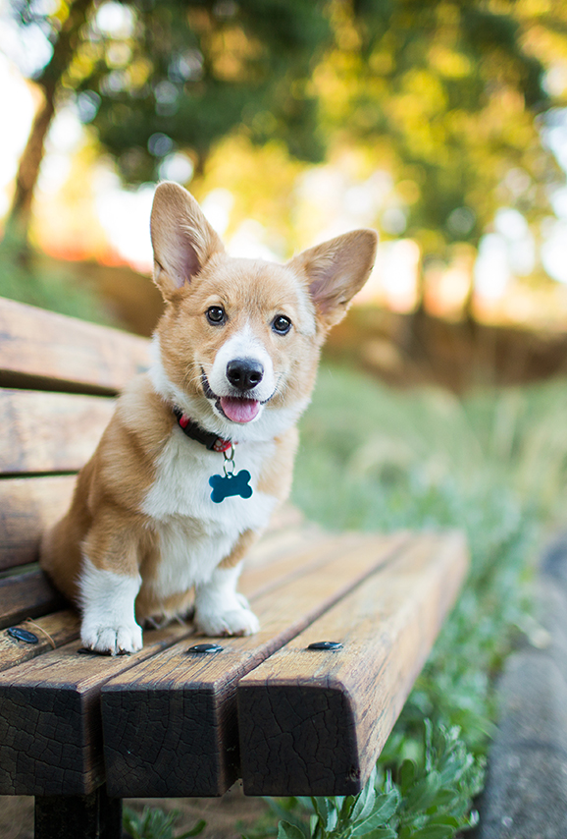
What Season does Bigfoot enjoy the most?

Slide 8
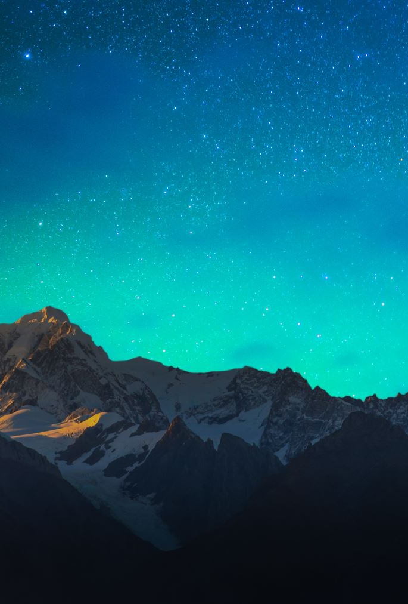
Insights Gained from Summer being Bigfoots favourite season
Our theory: He is also the yeti in the winter when he gets he molts his winter coat, similar to the snow shoe hares.
Stay tuned next semester…

Slide 9
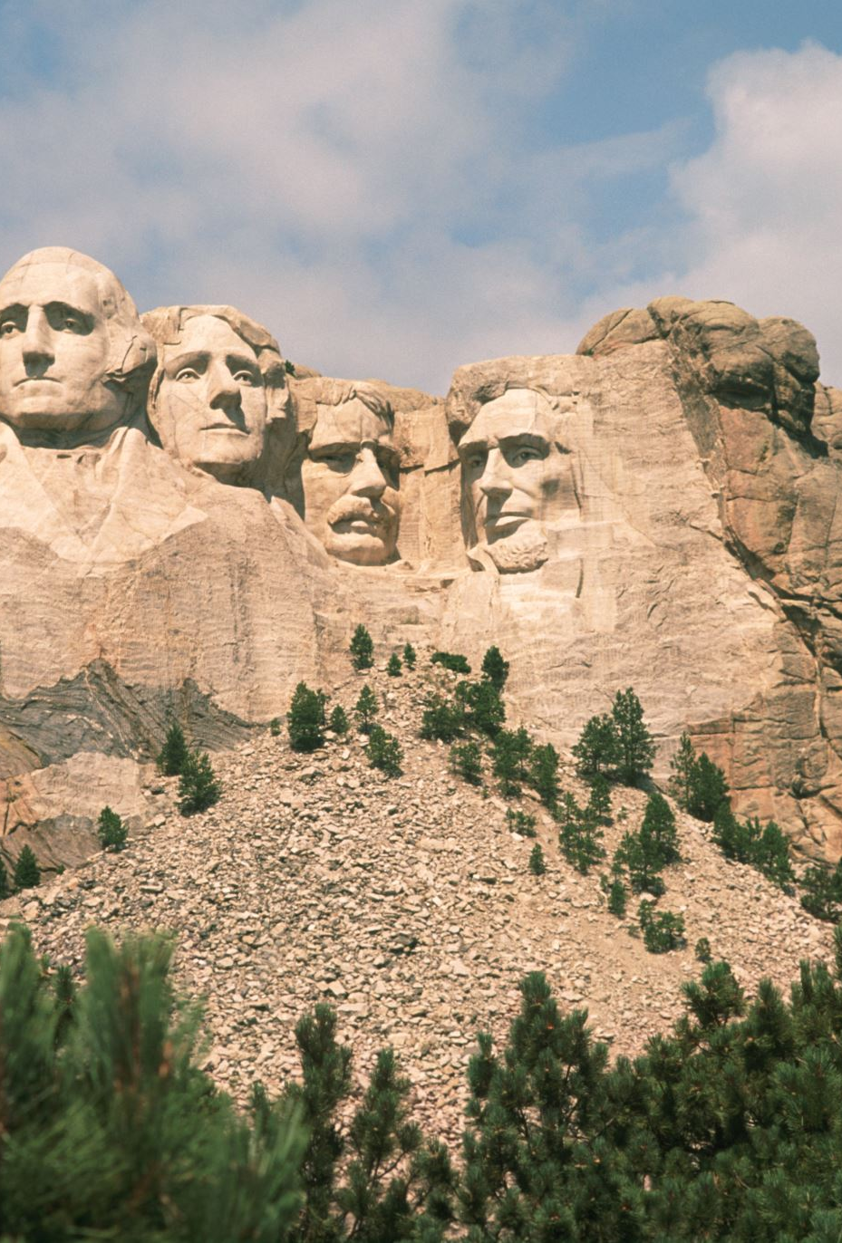
Where has Bigfoot been?

Slide 10
His Frequent Hangouts

Slide 11
Bigfoot wants to be president

Slide 12
Bigfoot is a Greek God
There is a report in our data stating “Mt. Olympus Incident” which means, he has been to Mount Olympus. Multiple witnesses attested to this.

Slide 13
Bigfoot (The Greek Olympian) loves the Olympics

Slide 14
How often are follow up reports created? And when are we Seeing him?

Slide 15
Conclusions

