Slide 1
Chip Category
Strategic Analysis Report
Prepared for: Julia — Category Manager
Quantium Virtual Experience Program | April 2025
$2.1M
246K
72K
+17%
Total Sales
Transactions
Customers
Trial Uplift

Slide 2
Agenda
01
Executive Summary
Key findings and recommendations upfront
02
Customer & Sales Analysis
Segment performance, brands, and purchasing patterns
03
Trial Store Performance
Experimentation results across 3 trial stores
04
Recommendations
Strategic next steps for the next half year

Slide 3
Executive Summary
Our top-line findings and strategic recommendation
▲ Sales are healthy & growing
★ Kettle dominates the market
✔ Trial stores show positive uplift
Older Families (Budget) and Young Singles/Couples (Mainstream) drive the most revenue. The chip category generates over $2.1M annually with consistent month-on-month performance.
Kettle brand generates nearly double the sales of the next competitor ($390K). The top 5 brands account for the vast majority of category revenue.
All 3 trial stores recorded +12% to +26% sales uplift during the Feb–Apr 2019 trial period — a consistent signal that warrants a broader rollout.
RECOMMENDATION: Proceed with phased rollout of the trial layout to stores with similar profiles. Prioritise Kettle and family-segment promotions to maximise category revenue.

Slide 4
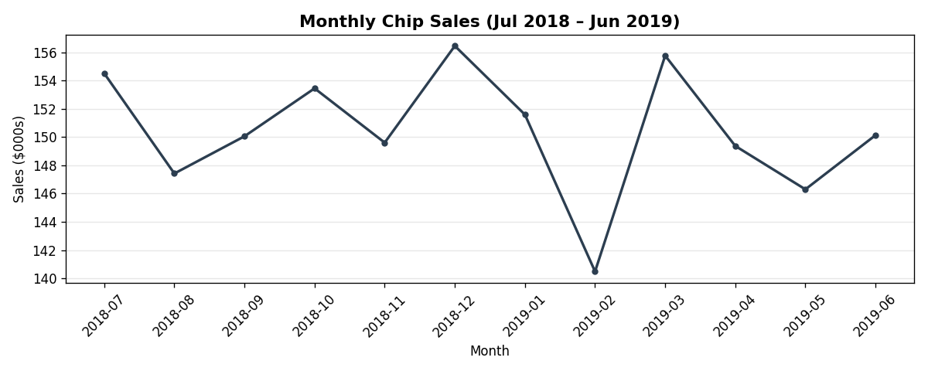
Monthly Sales Trend — Jul 2018 to Jun 2019
📌 Sales are consistent year-round (~$186K/month) with a clear December peak driven by festive season demand. January shows a typical post-holiday dip.

Slide 5
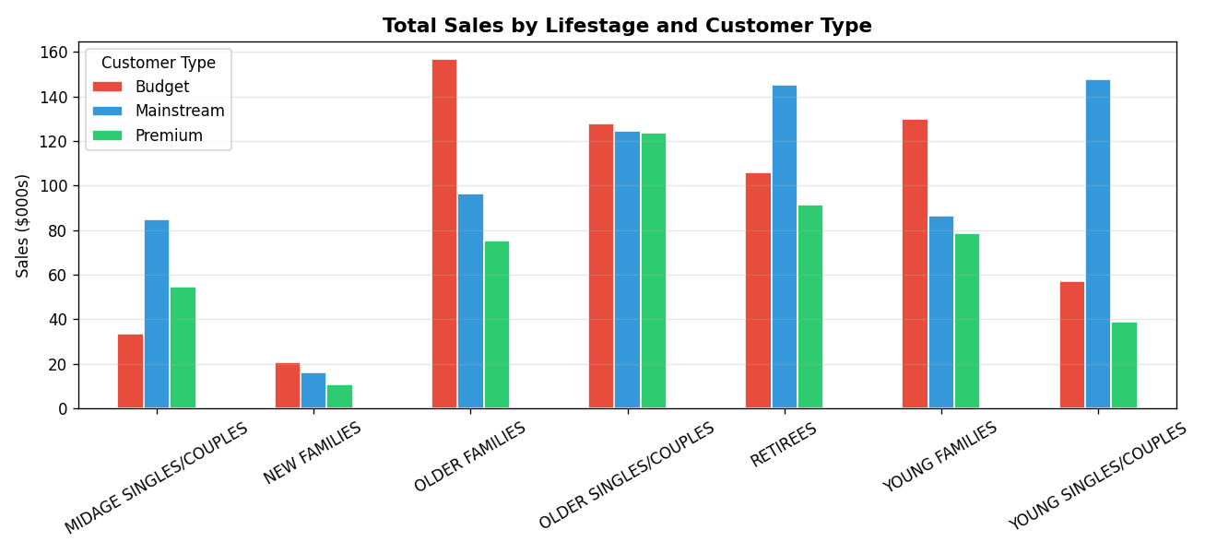
Sales by Customer Segment
#1 Segment
#2 Segment
Key Insight
Older Families (Budget)
Young Singles (Mainstream)
Budget & Mainstream dominate over Premium

Slide 6
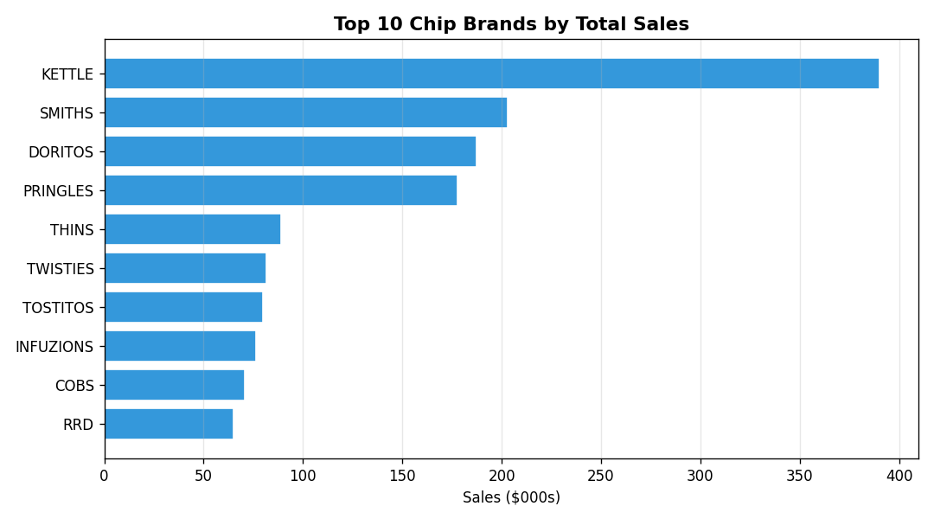
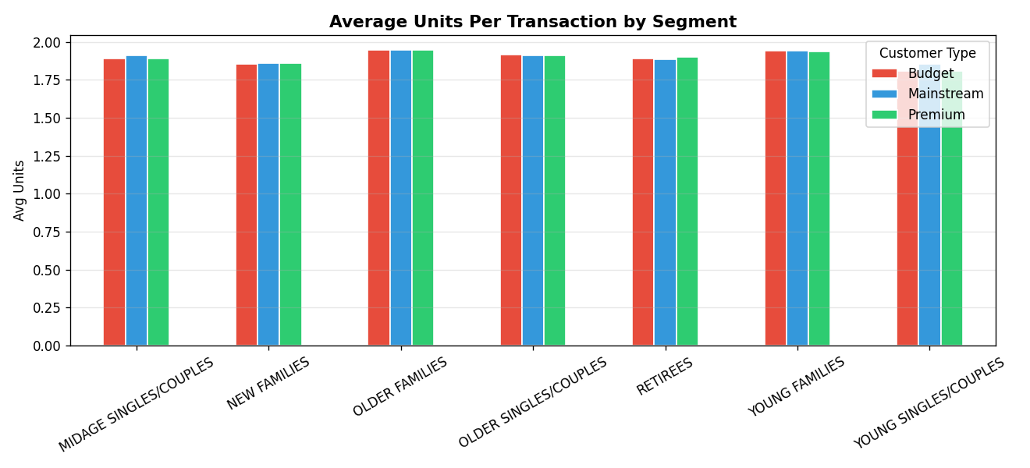
Brand Performance & Purchase Behaviour
Kettle leads with $390K — nearly 2x Smiths. Stock availability for Kettle is critical to category health.
Young & Older Families buy more units per trip — ideal targets for multi-pack promotions.

Slide 7
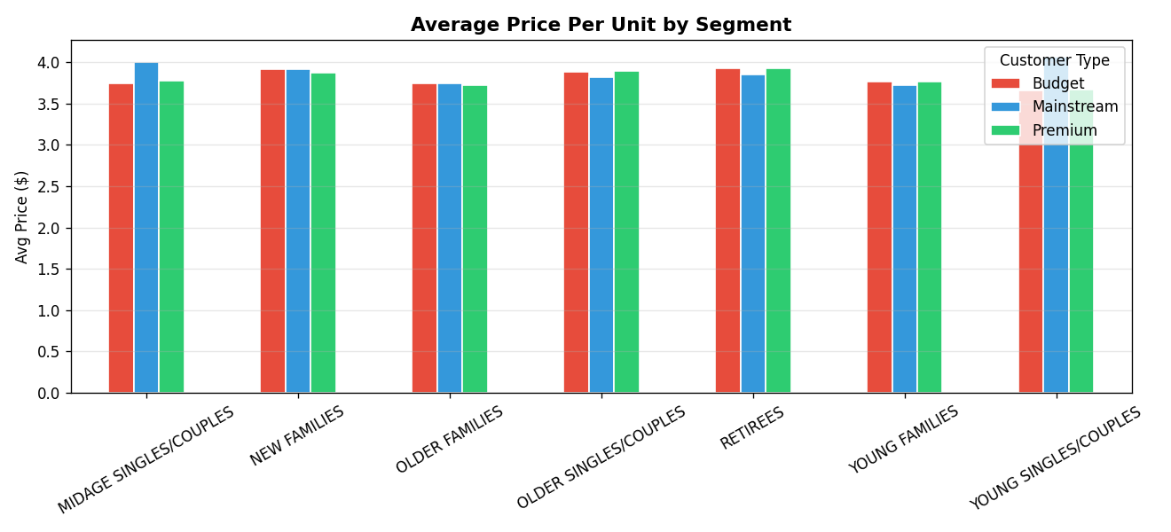
Price Per Unit Analysis
⚠ Counterintuitive finding: Mainstream customers pay equal or more per unit than Premium customers. This suggests Mainstream buyers are less price-sensitive and more brand/impulse driven — respond better to in-store visibility than discounts.

Slide 8
Trial Store Results
February — April 2019 | Stores 77, 86, 88
Store 77
Trial: $259 /mo
+26.2%
vs Store 233
Control: $205 /mo
Store 86
Trial: $929 /mo
+13.2%
vs Store 155
Control: $821 /mo
Store 88
Trial: $1,429 /mo
+12.2%
vs Store 125
Control: $1,273 /mo

Slide 9
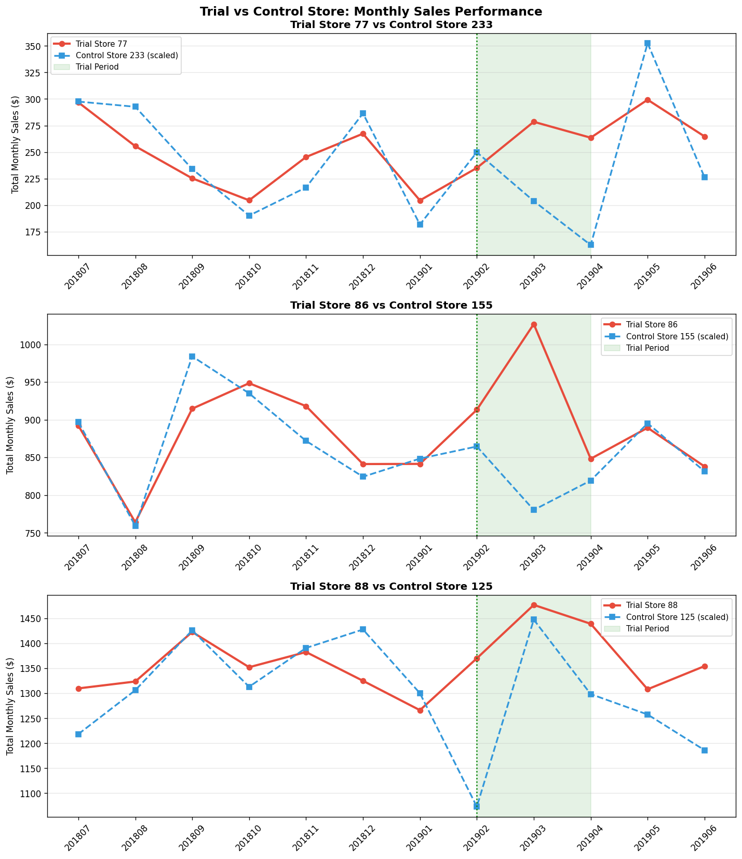
Trial vs Control: Monthly Sales Performance
Green shading = trial period (Feb–Apr 2019) | Red = trial store | Blue dashed = scaled control store

Slide 10
Recommendations & Next Steps
1
Phased Store Rollout
4
Mainstream Visibility Strategy
Extend the trial layout to stores with profiles similar to Store 77 first. The +26% uplift in a smaller store is the strongest signal to act on.
Mainstream customers are not price-sensitive — invest in in-store displays and positioning over discounts for this segment.
2
Double Down on Kettle & Top Brands
5
December Seasonal Push
Ensure strong Kettle availability and prime shelf placement. Kettle alone drives nearly $400K — a stock-out is a direct revenue loss.
Plan promotional activity for November–December to capitalise on the annual festive demand spike in the chip category.
3
Family Multi-Pack Promotions
Young and Older Families buy more units per trip. Launch bundle promotions targeting these segments to increase basket size.

Slide 11
Thank You
Questions & Discussion
Believe Akintola | Quantium Virtual Experience | Forage
Data source: QVI Transaction Data & QVI Purchase Behaviour | Analysis period: Jul 2018 – Jun 2019

