Slide 1

Employment Opportunities vs. HPI
Examining the relationship between Job opportunities and housing affordability.
Brian French

Slide 2

The Data
The House Pricing Index (HPI) is a pricing index that measures the changes in value of single family housing within the US. The data is from the Federal Housing Finance Agency (FHFA) which is the organization in charge of regulating the home loan industry. HPI for all regions start at 100 for the year being measured.
Data on employment was collected from the U.S. Bureau of Labor Statistics and focuses on nonfarm work. It focuses specifically on work in the private sector and government agencies. Work excluded includes active military, farm workers, private employees, and non-profit employees.

Slide 3

The Why
There is a housing affordability crisis within the United States. Some report that home prices are growing faster than income in 80% of markets. (Lloyd)
This is a know issue but how does job growth affect the overall affordability within these markets?
It is my hypothesis that the areas with the largest amount of job growth also experienced the largest decrease in housing affordability.

Slide 4
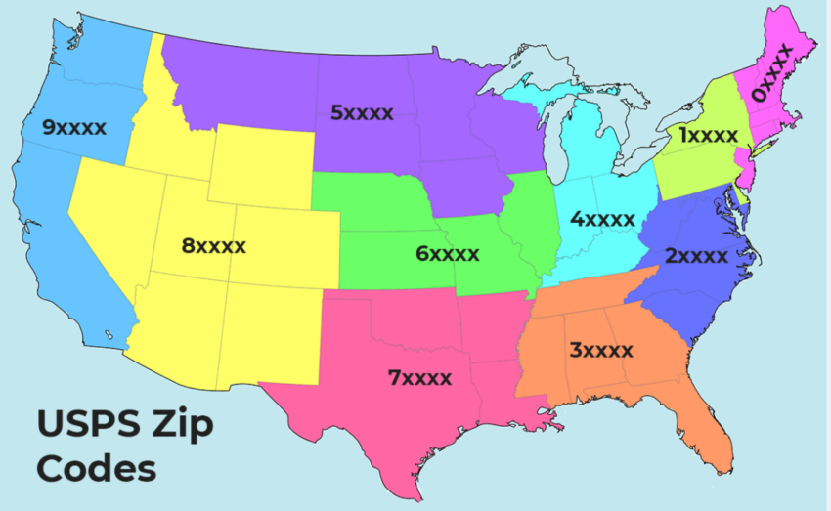
In order to study this, the U.S. was divided into 10 regions based off the first digit in the zipcode
Notes:
The years focused on include 2000-2020, in particular how years 2000-2010 compare to 2010-2020.
Regions include
0xxxx=New England
1xxxx=Northeast
2xxxx=Mid Atlantic
3xxxx=Southeast
4xxxx=Midwest
5xxxx=Northen Plains
6xxxx=Plains
7xxxx=South Central
8xxxx=West
9xxxx=Pacific

Slide 5
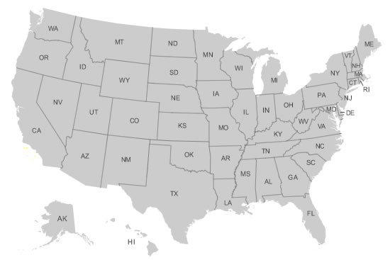
2000-2020 -Nonfarm work growth occurred at 0.35% year by year -National growth overall of 7.5% -HPI increased an average of 1.1% year by year -National increase overall of 79.8%

Slide 6
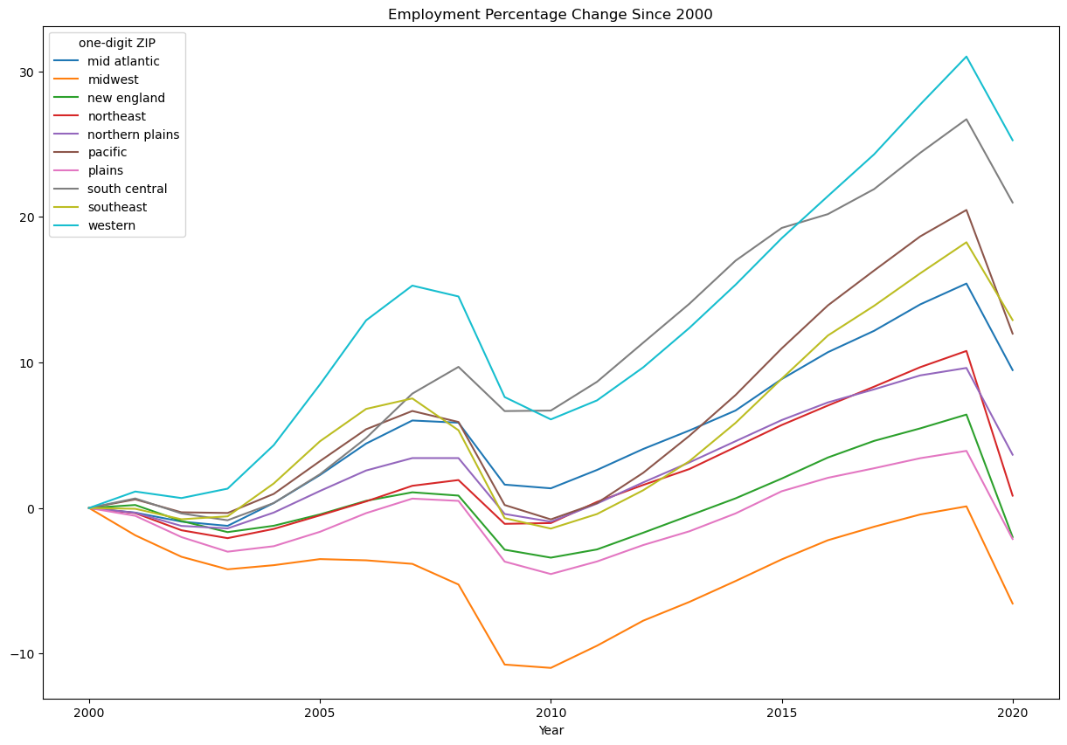
Notes:
Employment decreased avg of (-0.90%) years 2000-2010, Years 2010-2020 experienced 9.14% increase in growth.

Slide 7
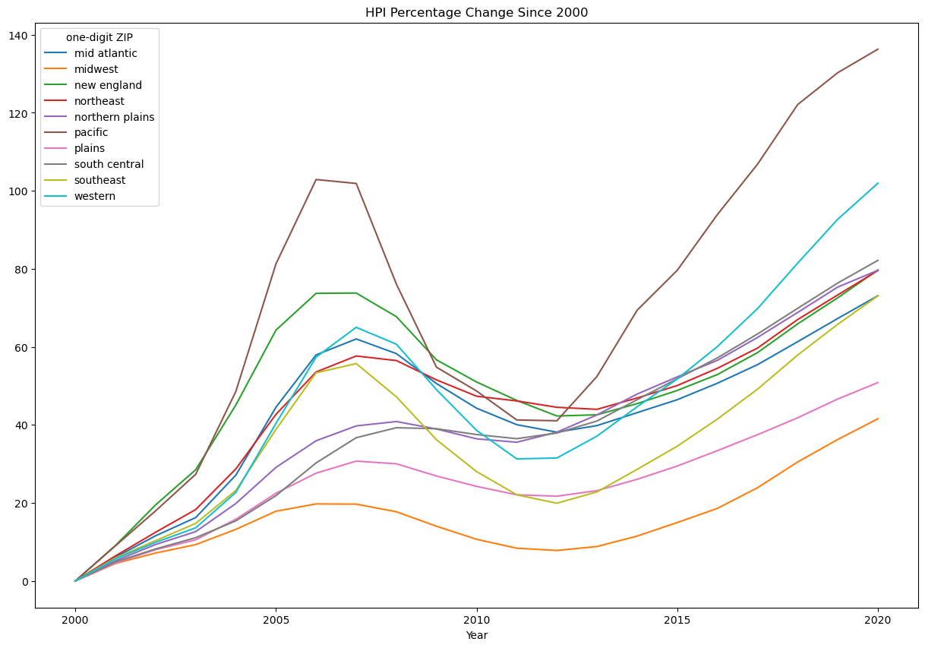
Notes:
HPI increased an AVG of 36.67% years 2000-2010, Years 2010-2020 HPI increased less at 31.42%

Slide 8
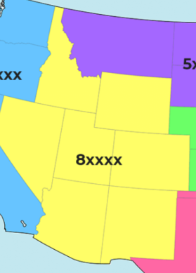
Western Arizona (AZ), Colorado (CO), Idaho (ID), New Mexico (NM), Nevada (NV), Utah (UT), Wyoming (WY)
0.93
HPI to Job Correlation
*2000-2020
11.99%
Job creation increase
2010-2020
*as compared to 2000-2010
45.7%
HPI increase 2010-2020
*7.12 increase over 2000-2010
Notes:
HPI 2000-2010 38.59%
HPI 2010-2020 45.71%
Jobs 2000-2010 6.09%
Jobs 2010-2020 18.08%

Slide 9
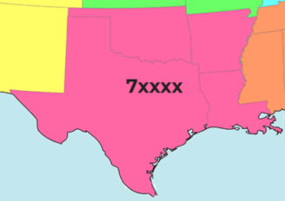
South Central Arkansas (AR), Louisiana (LA), Oklahoma (OK), Texas (TX)
0.95
HPI to Job Correlation
6.71%
Job creation increase
2010-2020
*as compared to 2000-2010
32.5%
HPI increase 2010-2020
*5.05 decrease over 2000-2010
Notes:
HPI 2000-2010 37.52%
HPI 2010-2020 32.47%
Jobs 2000-2010 6.69%
Jobs 2010-2020 13.4%

Slide 10
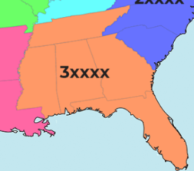
Southeast Alabama (AL), Florida (FL), Georgia (GA), Mississippi (MS), Tennessee (TN)
0.82
HPI to Job Correlation
15.95%
Job creation increase
2010-2020
*as compared to 2000-2010
35.2%
HPI increase 2010-2020
*7.17 increase over 2000-2010
Notes:
HPI 2000-2010 28.02%
HPI 2010-2020 35.19%
Jobs 2000-2010 -1.42%
Jobs 2010-2020 14.53%

Slide 11
Conclusions

