Slide 1

Employment Opportunities vs. HPI
Examining the relationship between Job opportunities and housing affordability.
NSS DA8
-Brian French
Notes:
Housing has become increasingly unaffordable for a large section of the US population. This has been true especially in areas like Nashville, TN or Huntsville, AL. With area like Nashville and Huntsville experiencing so much job growth it got me thinking about relationship exists between job growth and housing cost.

Slide 2

The Data
The House Pricing Index (HPI)
Bureau of Labor Statistics
Notes:
HPI def:
is a pricing index that measures the changes in value of single family housing within the US. As the price of homes in an area increase, the HPI increases. The data is from the Federal Housing Finance Agency (FHFA) which is the organization in charge of regulating the home loan industry. HPI for all regions start at 100 for the year being measured. Indexes are calibrated using appraisal values and sales prices for mortgages bought or guaranteed by Fannie Mae and Freddie Mac. Data is not seasonally adjusted and NOT adjusted for inflation.
Labor:
focuses on nonfarm work. It focuses specifically on work in the private sector and government agencies. Work excluded includes active military, farm workers, private employees, and non-profit employees.

Slide 3

Data Questions
Regional stats
Correlation Job/HPI
Largest change
Region investment
Notes:
Regional growth: What areas have the most employment? What areas have the highest HPI growth? Are these areas the same areas?
Correlation Job/HPI: What is the correlational relationship between job growth and HPI? (Expected to be a strong positive relationship) Does job growth have a significant impact on housing affordability?
Largest change: What areas experienced the largest change in HPI and employment? Are these areas the same as areas with the most employment and highest HPI?
Region Investment: Based on the data for this period of time, what areas would deliver somewhere that is relatively affordable and experiencing high levels of employment and HPI growth?

Slide 4
Audience
Resource Investment
Construction
Real Estate
Households
Notes:
Resource Investment: Companies looking to relocate or open new locations may want to focus on higher growth areas (employment) and could consider if the area offers affordable housing for their employees.
Construction: Construction may want to pour resources into areas with higher levels of job growth since there will likely be an increased demand for housing
Real Estate: Investors looking at properties may be interested in areas that have relatively low HPI and relatively high job growth as this would maximize investment return.
Households: Families looking to relocate may want an area that is affordable and has increased opportunity for work.

Slide 5
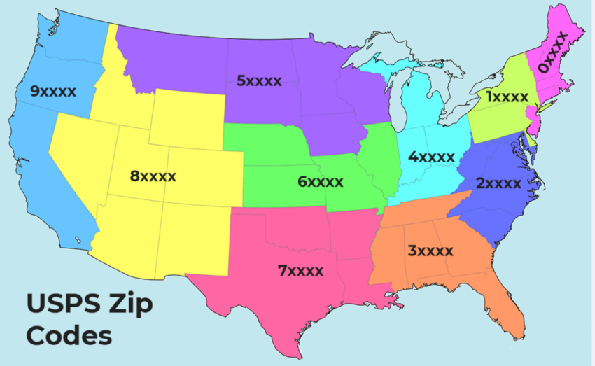
Notes:
In order to study this, the U.S. was divided into 10 regions based off the first digit in the zipcode
The years focused on include 2000-2020
Regions include
0xxxx=New England
1xxxx=Northeast
2xxxx=Mid Atlantic
3xxxx=Southeast
4xxxx=Midwest
5xxxx=Northen Plains
6xxxx=Plains
7xxxx=South Central
8xxxx=West
9xxxx=Pacific

Slide 6
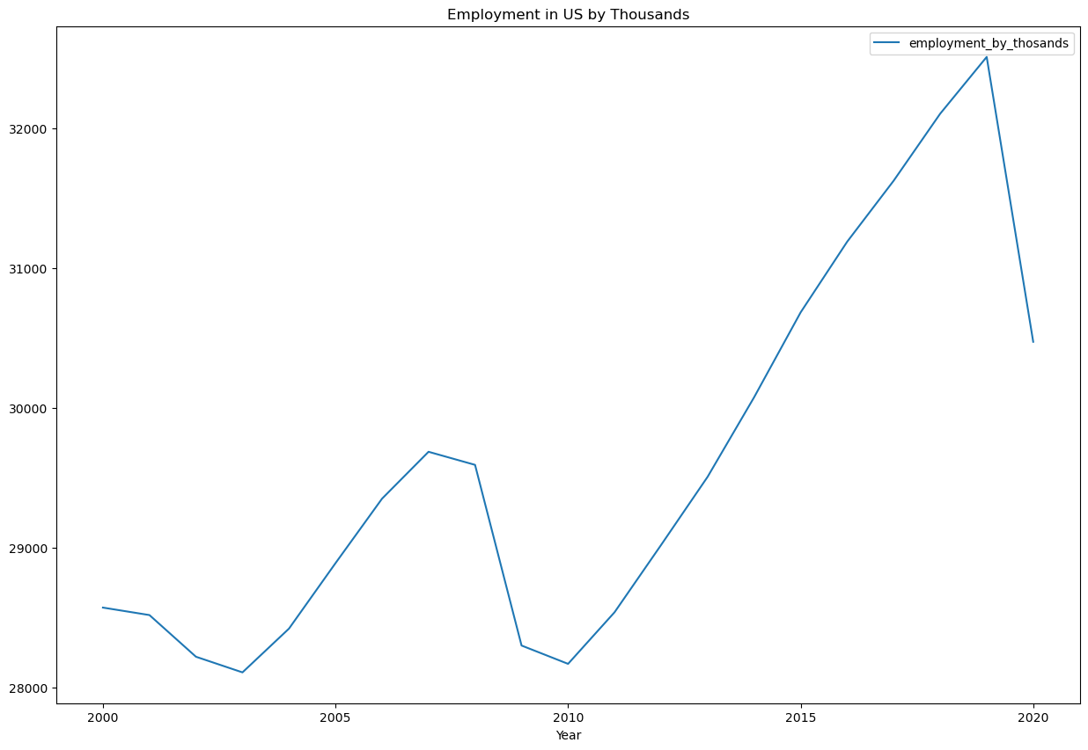
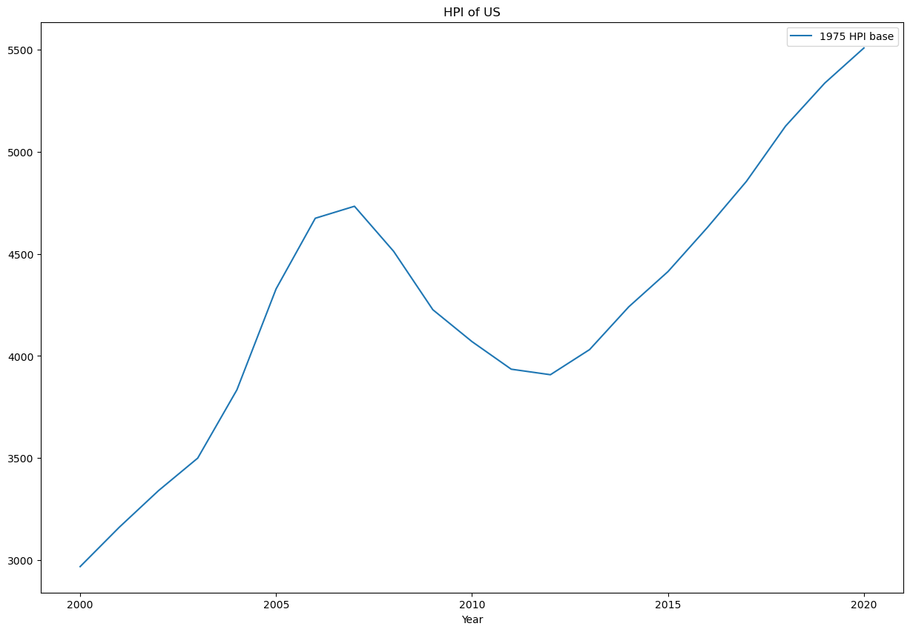
National Averages
0.65 corr
7.5% job
79.8% HPI
Notes:
As you can see there is a slight correlation between employment numbers and HPI. There is a .65 correlation which would be considered a moderate correlation. Overall (with the 2020 drop) the nation increased employment 7.5% and HPI increased 79.8%.

Slide 7
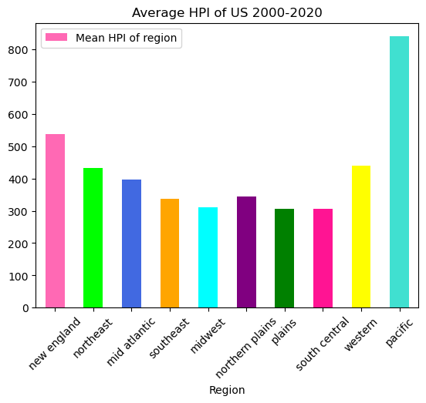
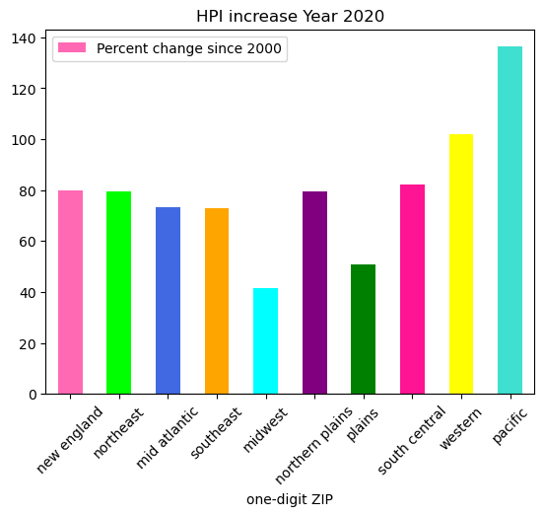
National Averages
Notes:
The pacific region leads the country in the highest HPI followed by new England and the western regions.
The pacific also had the largest HPI increase from 2000, although this time it is followed by western 2nd, and south central 3rd. The areas with the highest HPI’s are not the same as the areas with the highest increase.

Slide 8
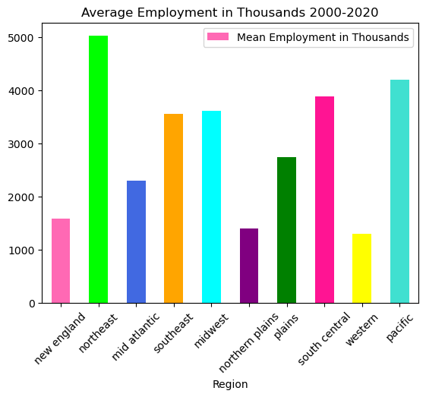
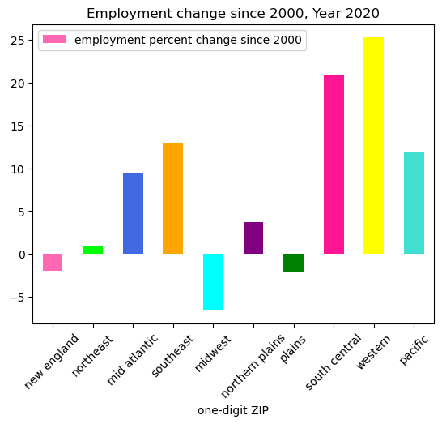
National Averages
Notes:
The area with the most overall employment includes the northeast 1st, pacific 2nd, and south central 3rd.
The areas with the largest employment changes are not the same as the areas with the most employed. The Northeast has almost not changed at all while the western, followed by south central, and southeast follow.
We’re going to explore the areas with the largest change in employment which include western, south central, and southeast as well as the outlier the northeast.

Slide 9
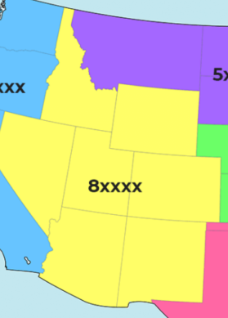
Western 2000-2020 Arizona (AZ), Colorado (CO), Idaho (ID), New Mexico (NM), Nevada (NV), Utah (UT), Wyoming (WY)
National AVG
0.65 Corr
7.5% job
79.8% HPI
0.93
HPI to Job Correlation
25.26%
Job increase
101.94%
HPI increase
Notes:
This area experienced the highest job increase and a realitvely high HPI increase.
The correlation between HPI and Job growth is strong, especially when compared to the national average.

Slide 10
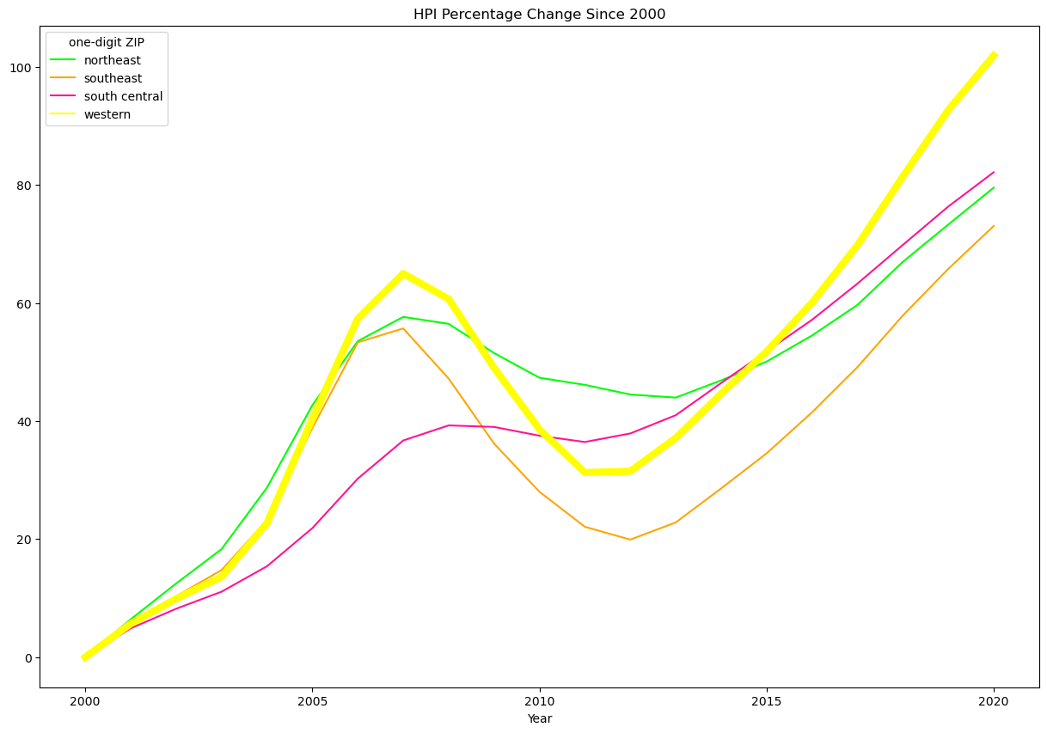
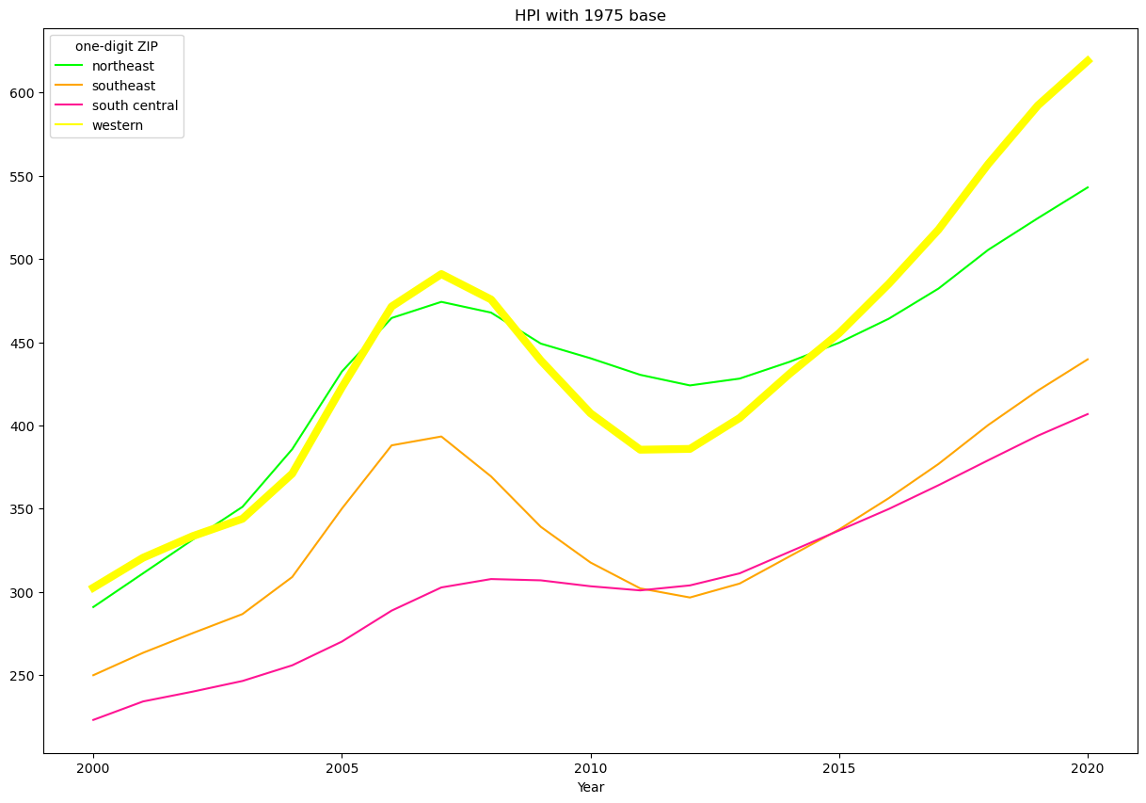
Western 2000-2020 Arizona (AZ), Colorado (CO), Idaho (ID), New Mexico (NM), Nevada (NV), Utah (UT), Wyoming (WY)
Notes:
These are two graphs comparing the HPI change since 2000, vs the overall HPI with a base of 1975.
Results here are expected. The region has the highest increase in employment and also leads in increase of HPI as well as overall HPI.

Slide 11
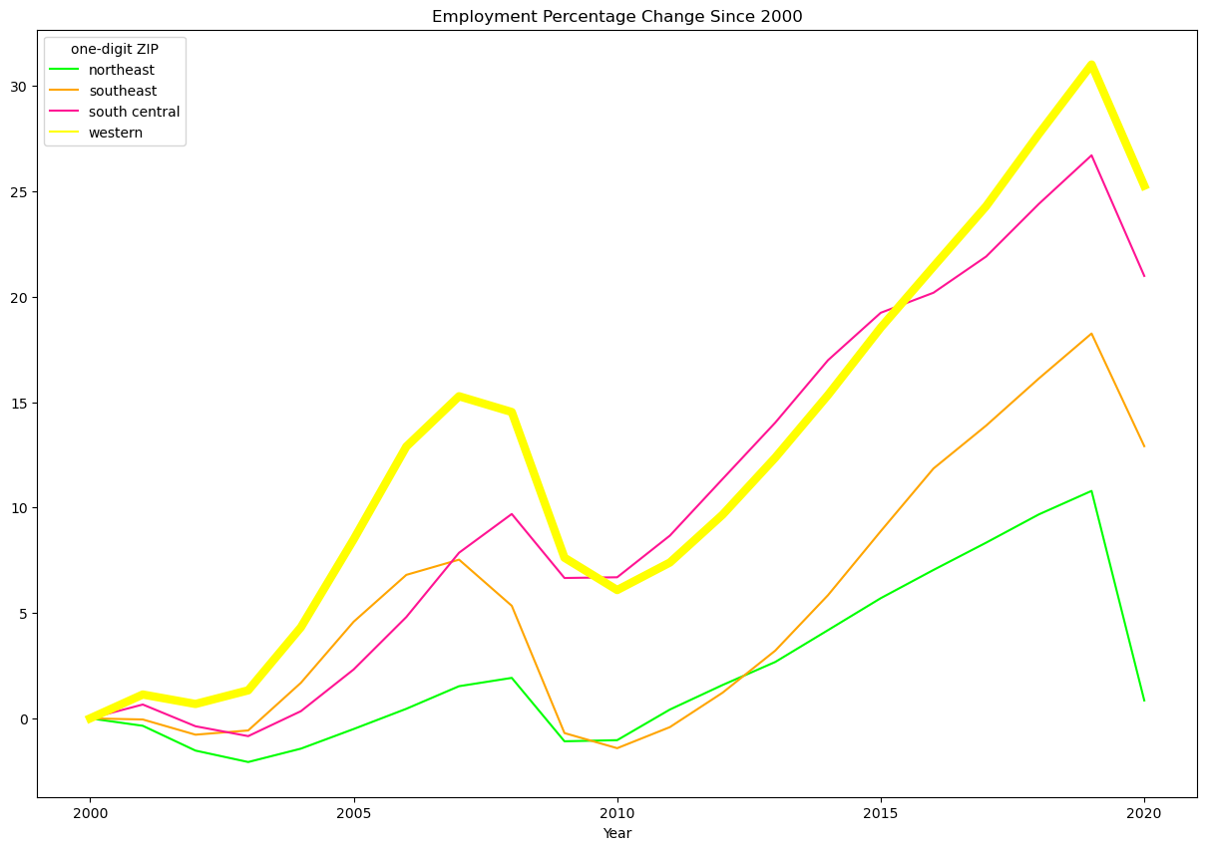
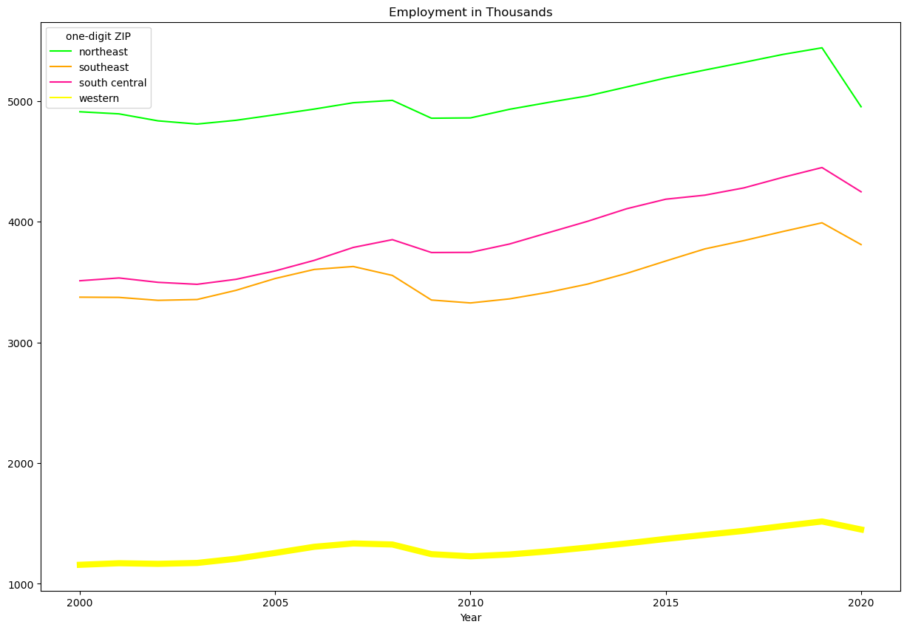
Western 2000-2020 Arizona (AZ), Colorado (CO), Idaho (ID), New Mexico (NM), Nevada (NV), Utah (UT), Wyoming (WY)
Notes:
On the right you can see the employment has increased significantly more than the regions being compared to, as expected.
The right graph shows something unexpected and an important consideration with this region.
The reason year the overall change in employment is so large is because the number of people overall who are employed in the region is smaller. While the increase in employment is significant it is only so because the region itself is so small and maybe not in the context of the whole nation.
The key takeaways from this region are:
-the strong relationship between job growth and HPI may indicate a good potential return for real estate investors and construction companies
-While the correlation is strong the high buy in HPI value could make it difficult for companies to have affordable housing for employees or families being able to afford the area.

Slide 12
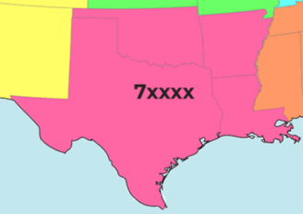
South Central 2000-2020 Arkansas (AR), Louisiana (LA), Oklahoma (OK), Texas (TX)
National AVG
0.65 Corr
7.5% job
79.8% HPI
0.95
HPI to Job Correlation
20.99%
Job increase
82.2%
HPI increase
Notes:
This area had the strongest overall correlation between job growth and HPI. Jobs increased almost 21% and HPI increased 82.2%.

Slide 13
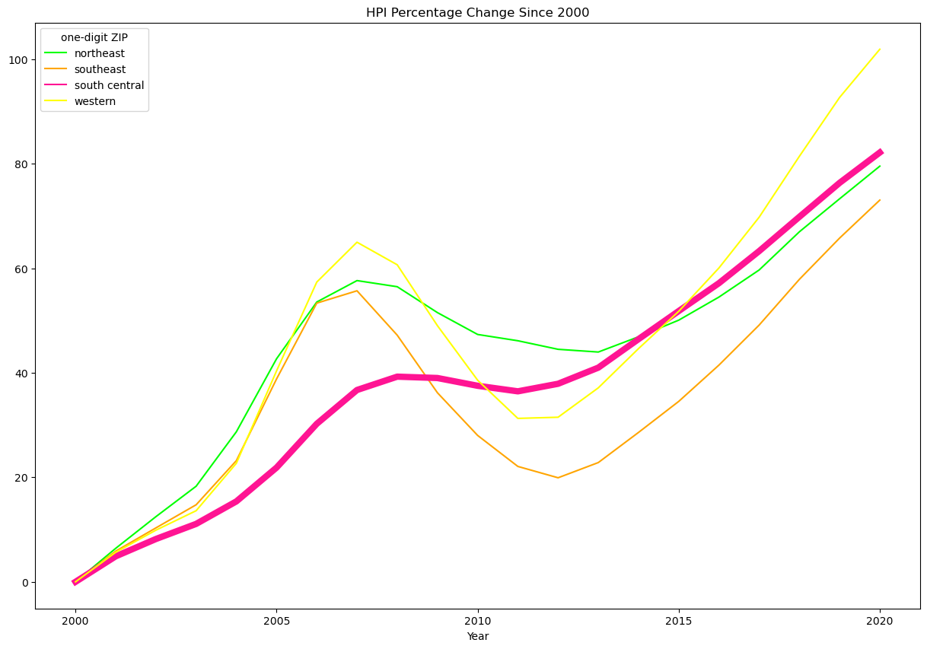
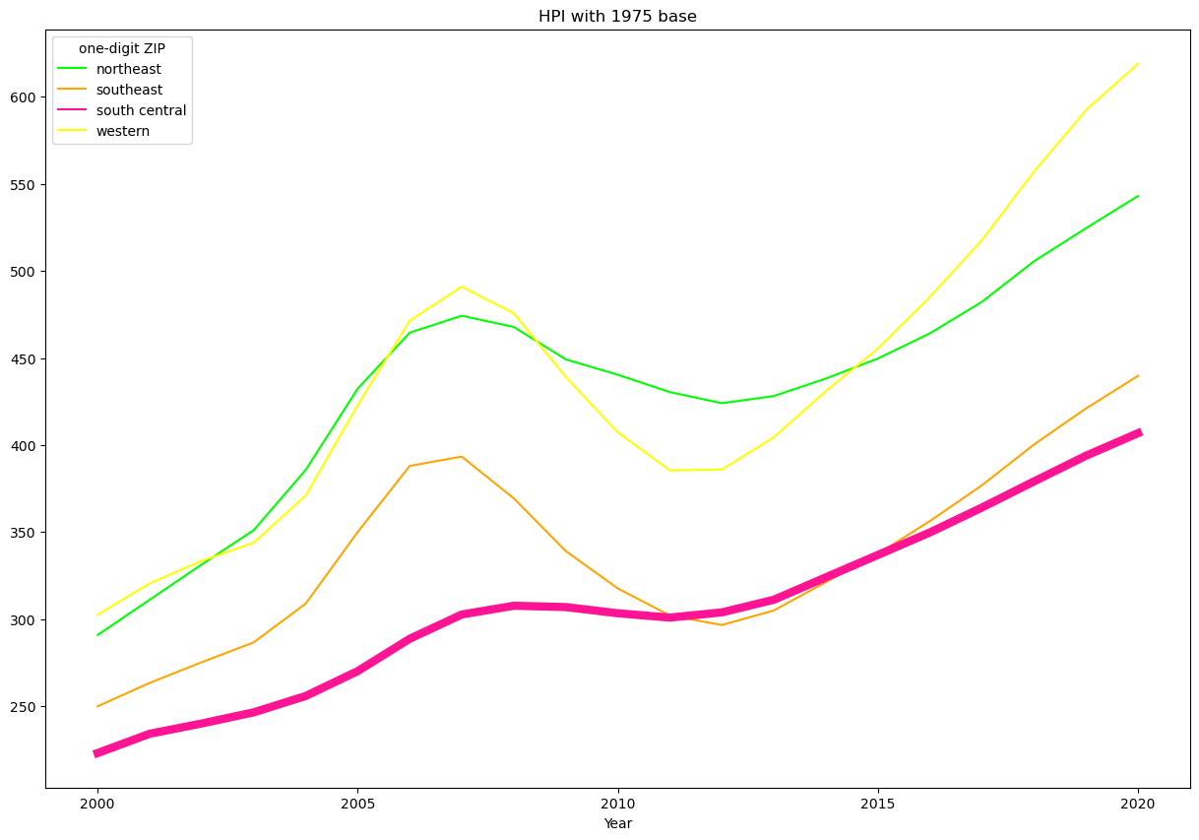
South Central 2000-2020 Arkansas (AR), Louisiana (LA), Oklahoma (OK), Texas (TX)
Notes:
One thing that is significant on both graphs is less of a curve. Overall the region has more stability with HPI pricing.
Even though the region experienced one of the larger increases in HPI, it remains one of the most affordable regions as compared to others.

Slide 14
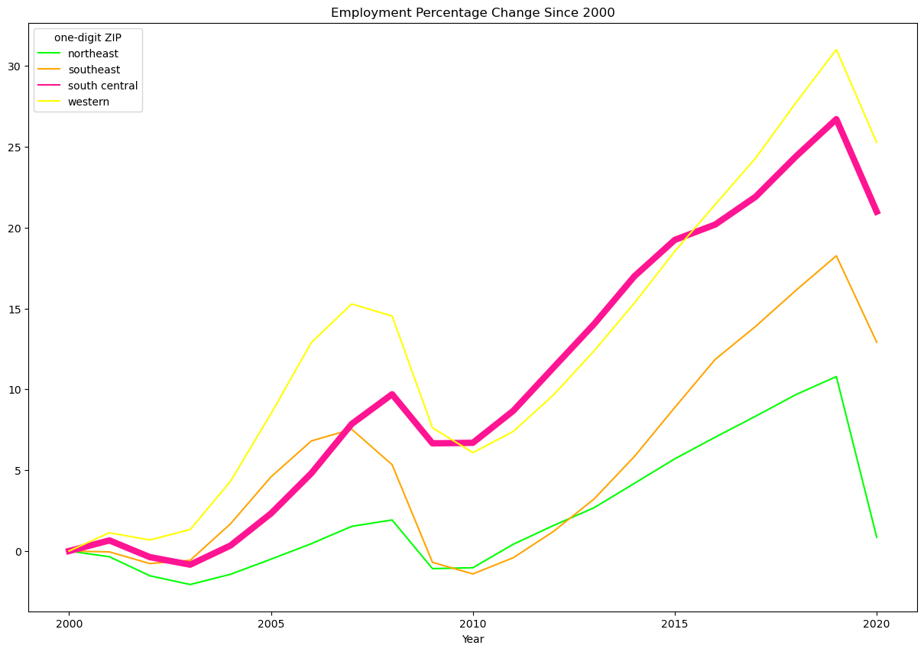
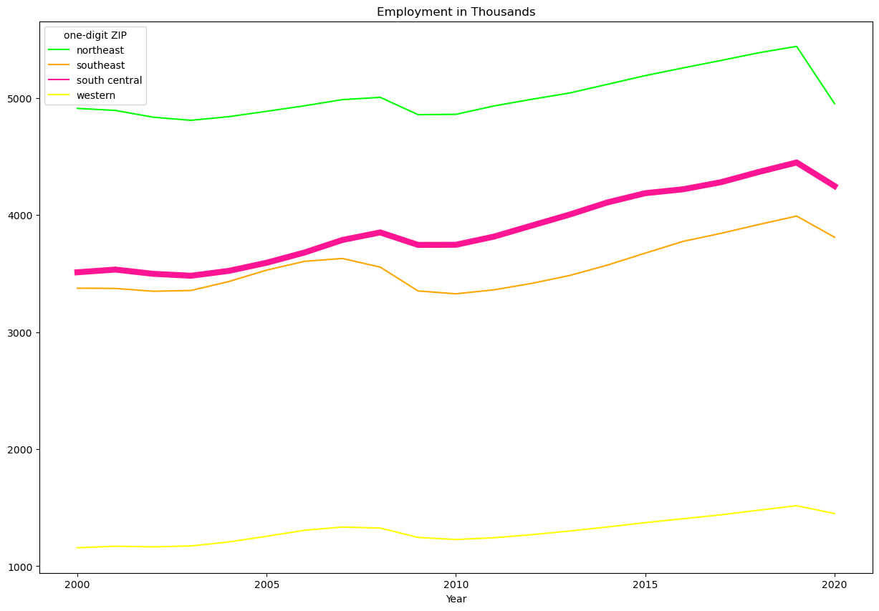
South Central 2000-2020 Arkansas (AR), Louisiana (LA), Oklahoma (OK), Texas (TX)
Notes:
The region has experienced the 2nd highest overall increase in employment and it is also one of the larger employment markets.
The key takeaways from this region are:
-the strong relationship between job growth and HPI indicate a good return for real estate investors and construction companies
-Low HPI value helps make the area more affordable for families
-Companies looking to open branches or stores have both affordable housing for employees as well as high job growth.

Slide 15
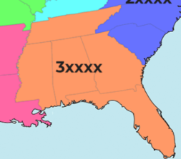
Southeast 2000-2020 Alabama (AL), Florida (FL), Georgia (GA), Mississippi (MS), Tennessee (TN)
National AVG
0.65 Corr
7.5% job
79.8% HPI
0.82
HPI to Job Correlation
12.91%
Job creation increase
73.1%
HPI increase
Notes:
This area had the third highest increase in job growth. This is true while having a significantly lower HPI increase than the national average. The correlation is not as strong as the first two but overall is strong.

Slide 16
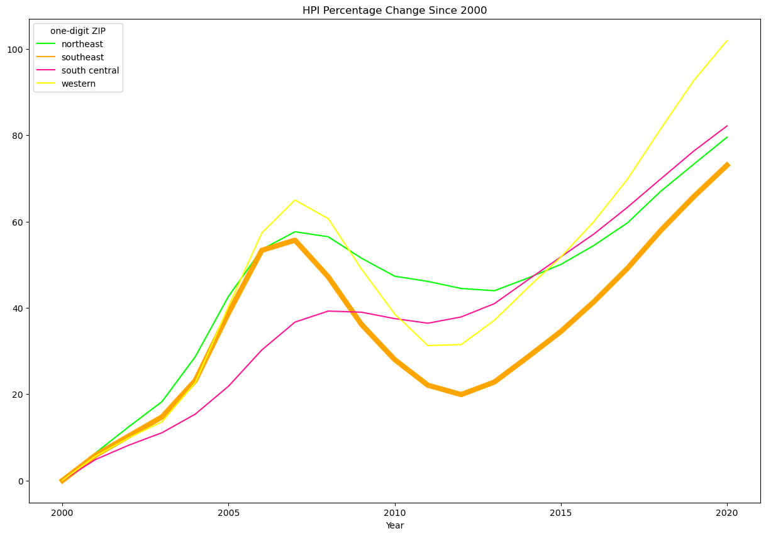
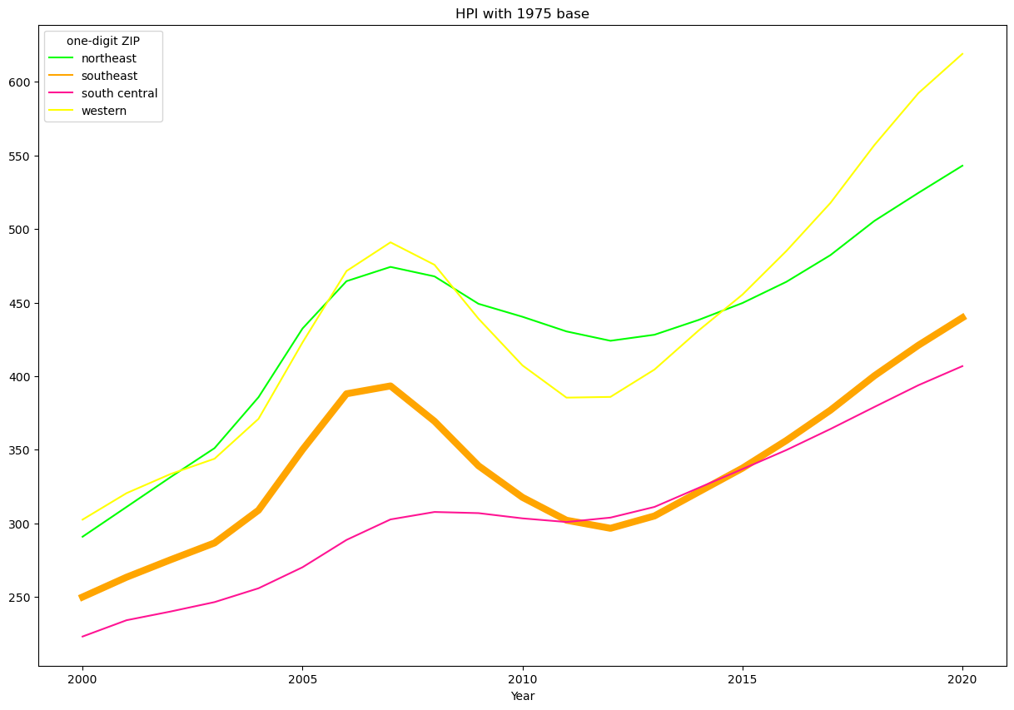
Southeast 2000-2020 Alabama (AL), Florida (FL), Georgia (GA), Mississippi (MS), Tennessee (TN)
Notes:
Compared to these 4 region this region had the lowest HPI increase, although the HPI base is still higher the last.

Slide 17
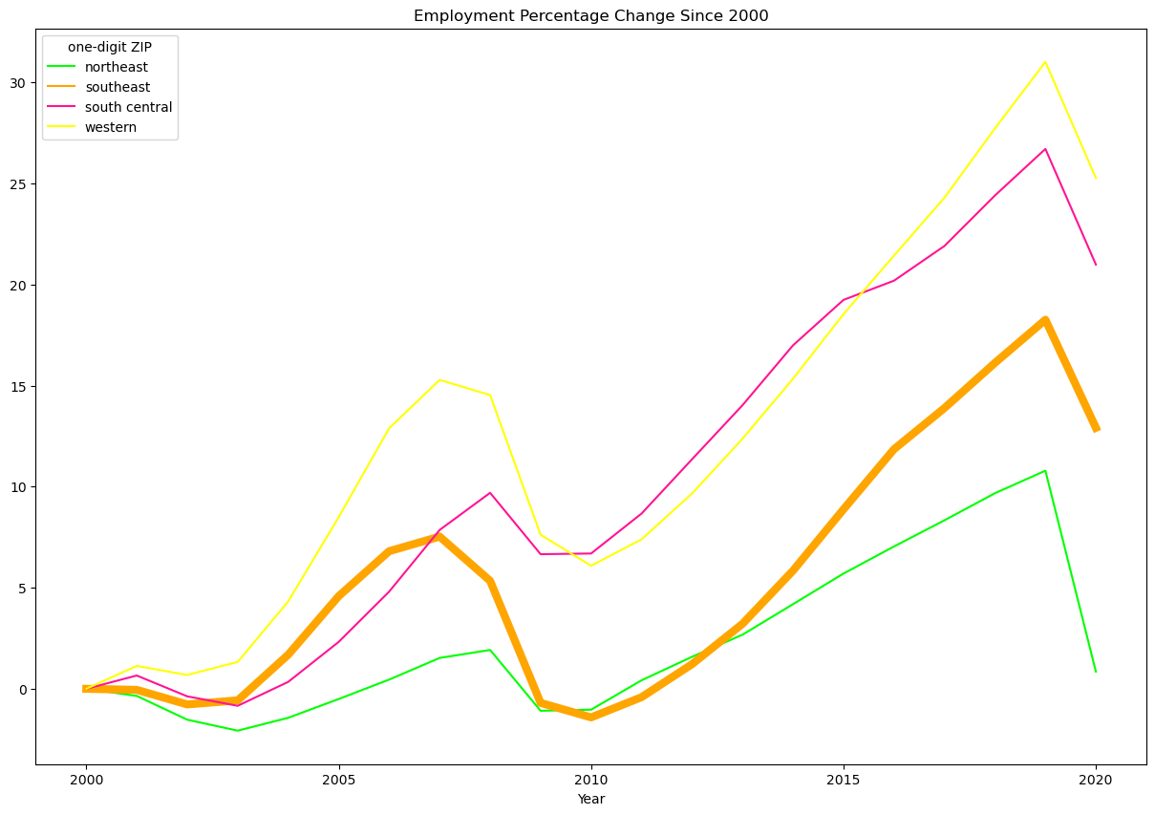
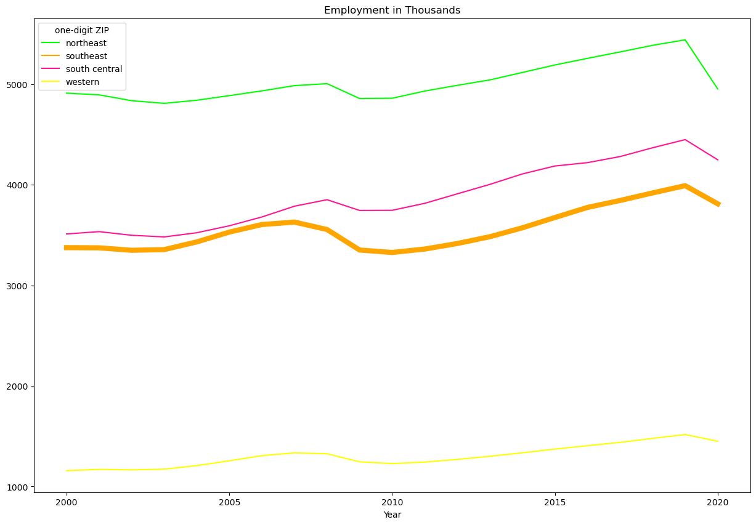
Southeast 2000-2020 Alabama (AL), Florida (FL), Georgia (GA), Mississippi (MS), Tennessee (TN)
Notes:
Historically this region has had higher volatility then the last region. Overall employment is mid pack.
The key takeaways from this region are:
-higher volatility may be a consideration for real estate investors but lower buy in cost may make up for that
-Higher job growth compared to the national average would make this a good region for construction companies
-Affordable housing and stronger than average job growth make this a good area for families and companies.

Slide 18
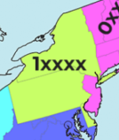
Northeast 2000-2020 Delaware (DE), New York (NY), Pennsylvania (PA)
National AVG
0.65 Corr
7.5% job
79.8% HPI
0.76
HPI to Job Correlation
0.85%
Job increase
79.6%
HPI increase
Notes:
The northeast is an outlier in the data. With only a job increase of 0.85% this falls significantly below the national average.

Slide 19
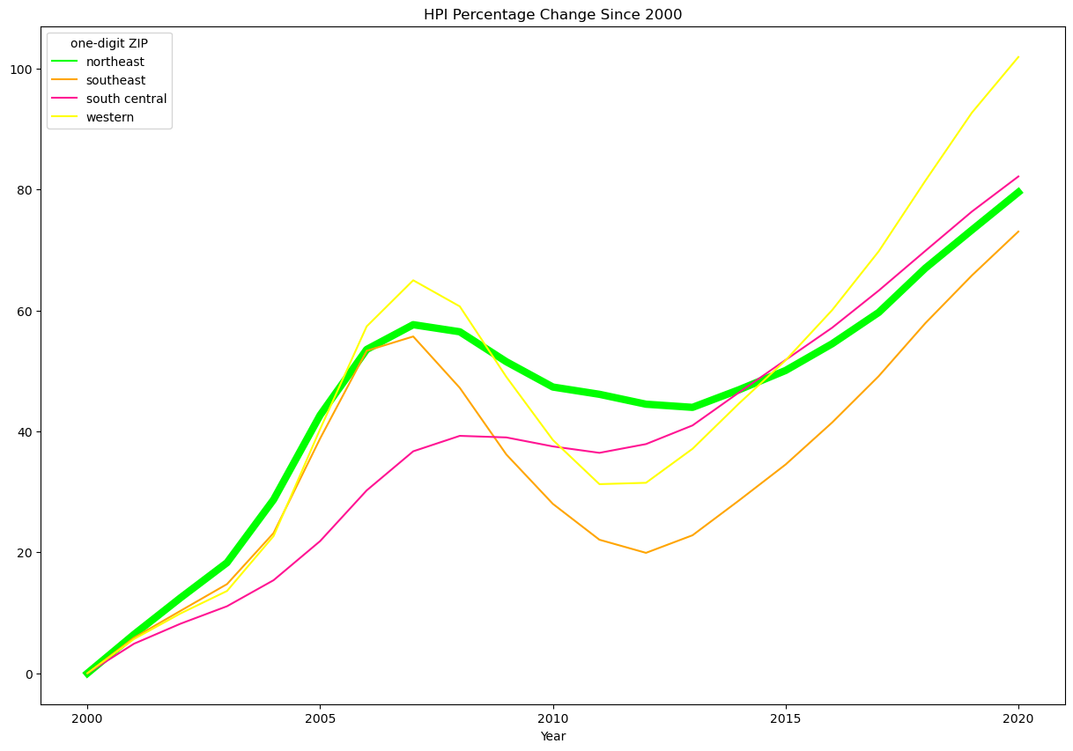
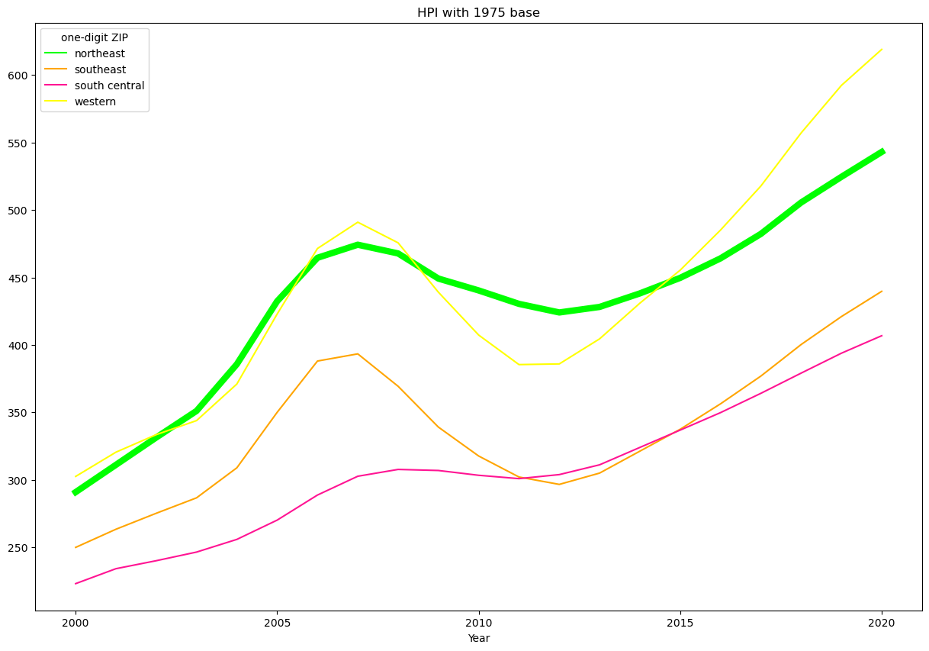
Northeast 2000-2020 Delaware (DE), New York (NY), Pennsylvania (PA)
Notes:
The region experienced about average HPI increase and has an overall higher starting HPI.

Slide 20
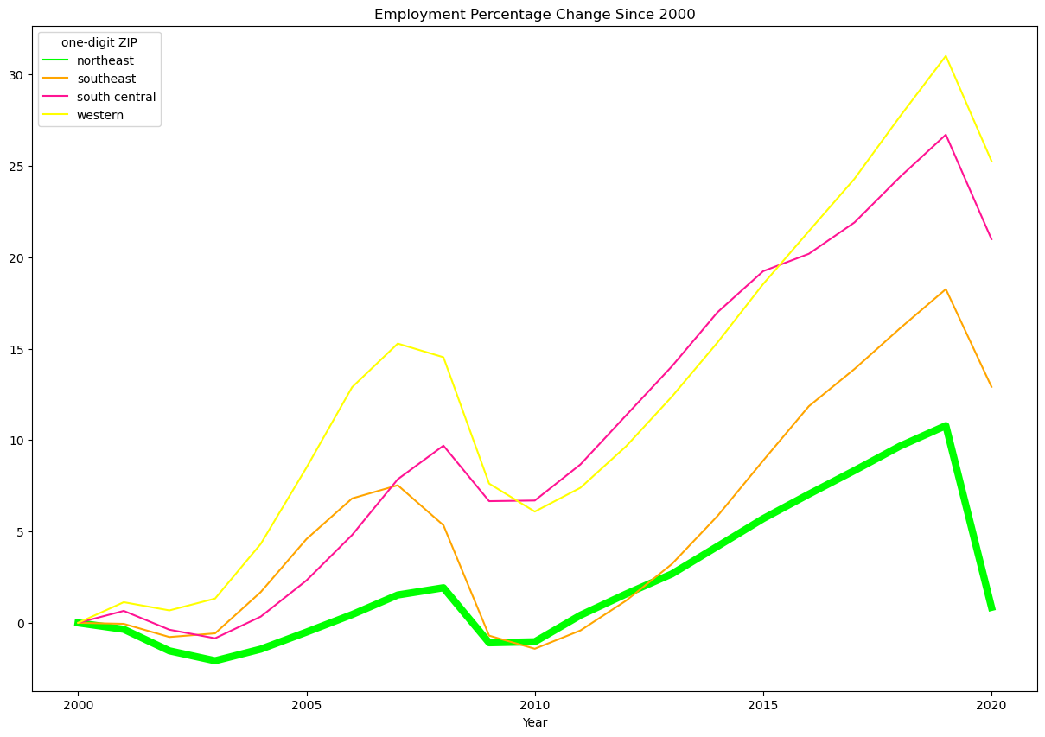
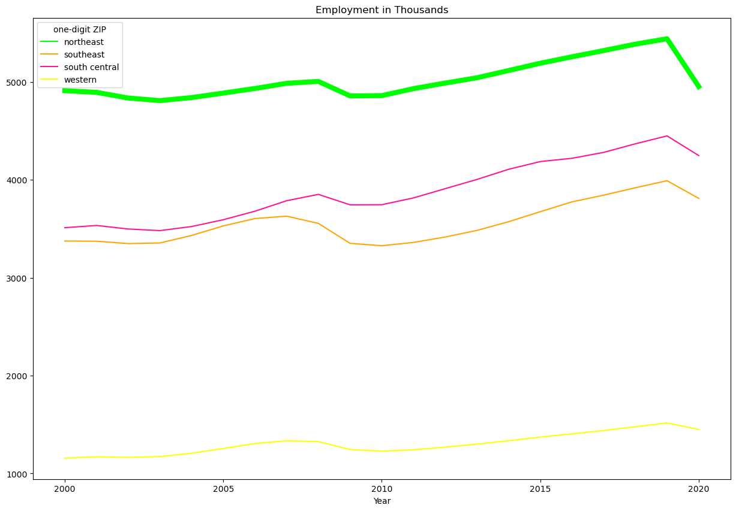
Northeast 2000-2020 Delaware (DE), New York (NY), Pennsylvania (PA)
Notes:
The employment change in the area makes it feel stagnant especially compared to the national average. Even with this being the case the region employs the largest amount of people in the country.
The key takeaways from this region are:
-stagnant job growth and higher HPI may make this region see less of a return in real estate investment
-Little to no job growth would may indicate less of a demand for housing construction in this area
-Higher HPI and little job changing may make this area less desirable for both families and companies.

Slide 21
Conclusions
Highest employment/HPI aren’t the same areas
Moderate correlation with jobs and HPI
Difference between change and size
Areas with potential
Notes:
Regional growth: What areas have the most employment? What areas have the highest HPI? Are these areas the same areas?
-Although there is some crossover the most employment and highest HPI are not the same areas
Correlation Job/HPI: What is the correlational relationship between job growth and HPI? (Expected to be a strong positive relationship) Does job growth have a significant impact on housing affordability?
-Nationally there is a moderate relationship to job and HPI at 0.65, but the regions with the most job growth have a strong positive relationship between job growth and HPI. This can effect affordability negatively but some regions have above average growth and below average HPI increase.
Largest change: What areas experienced the largest change in HPI and employment? Are these areas the same as areas with the most employment and highest HPI?
-The areas with the largest change aren’t necessarily with areas with the highest HPI and most employment.
Region Investment: Based on the data for this period of time, what areas would deliver somewhere that is relatively affordable and experiencing high levels of employment and HPI growth?
-Based on this data, for this period of time, while considering overall/increasing employment and overall/increasing HPI the 2 areas that are more affordable and have available jobs are the south central region first and the southeast region 2nd.

