Slide 1







Slide 2
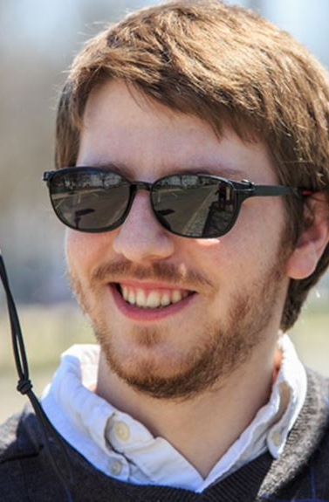

He loves to go at parties, perform standup comedy and learning languages.
He feels akward in conversations, difficult to fall in love, and tired of misunderstandings
THIS IS ALEX.
He‘s social. But has problems to communicate.
He‘s active. But would like to do more with others.
He‘s single. But seeks for emotional connection.
Notes:
See emotions.
Reinforce their social life.
Anxiety that is givin missing the social cues.

Slide 3
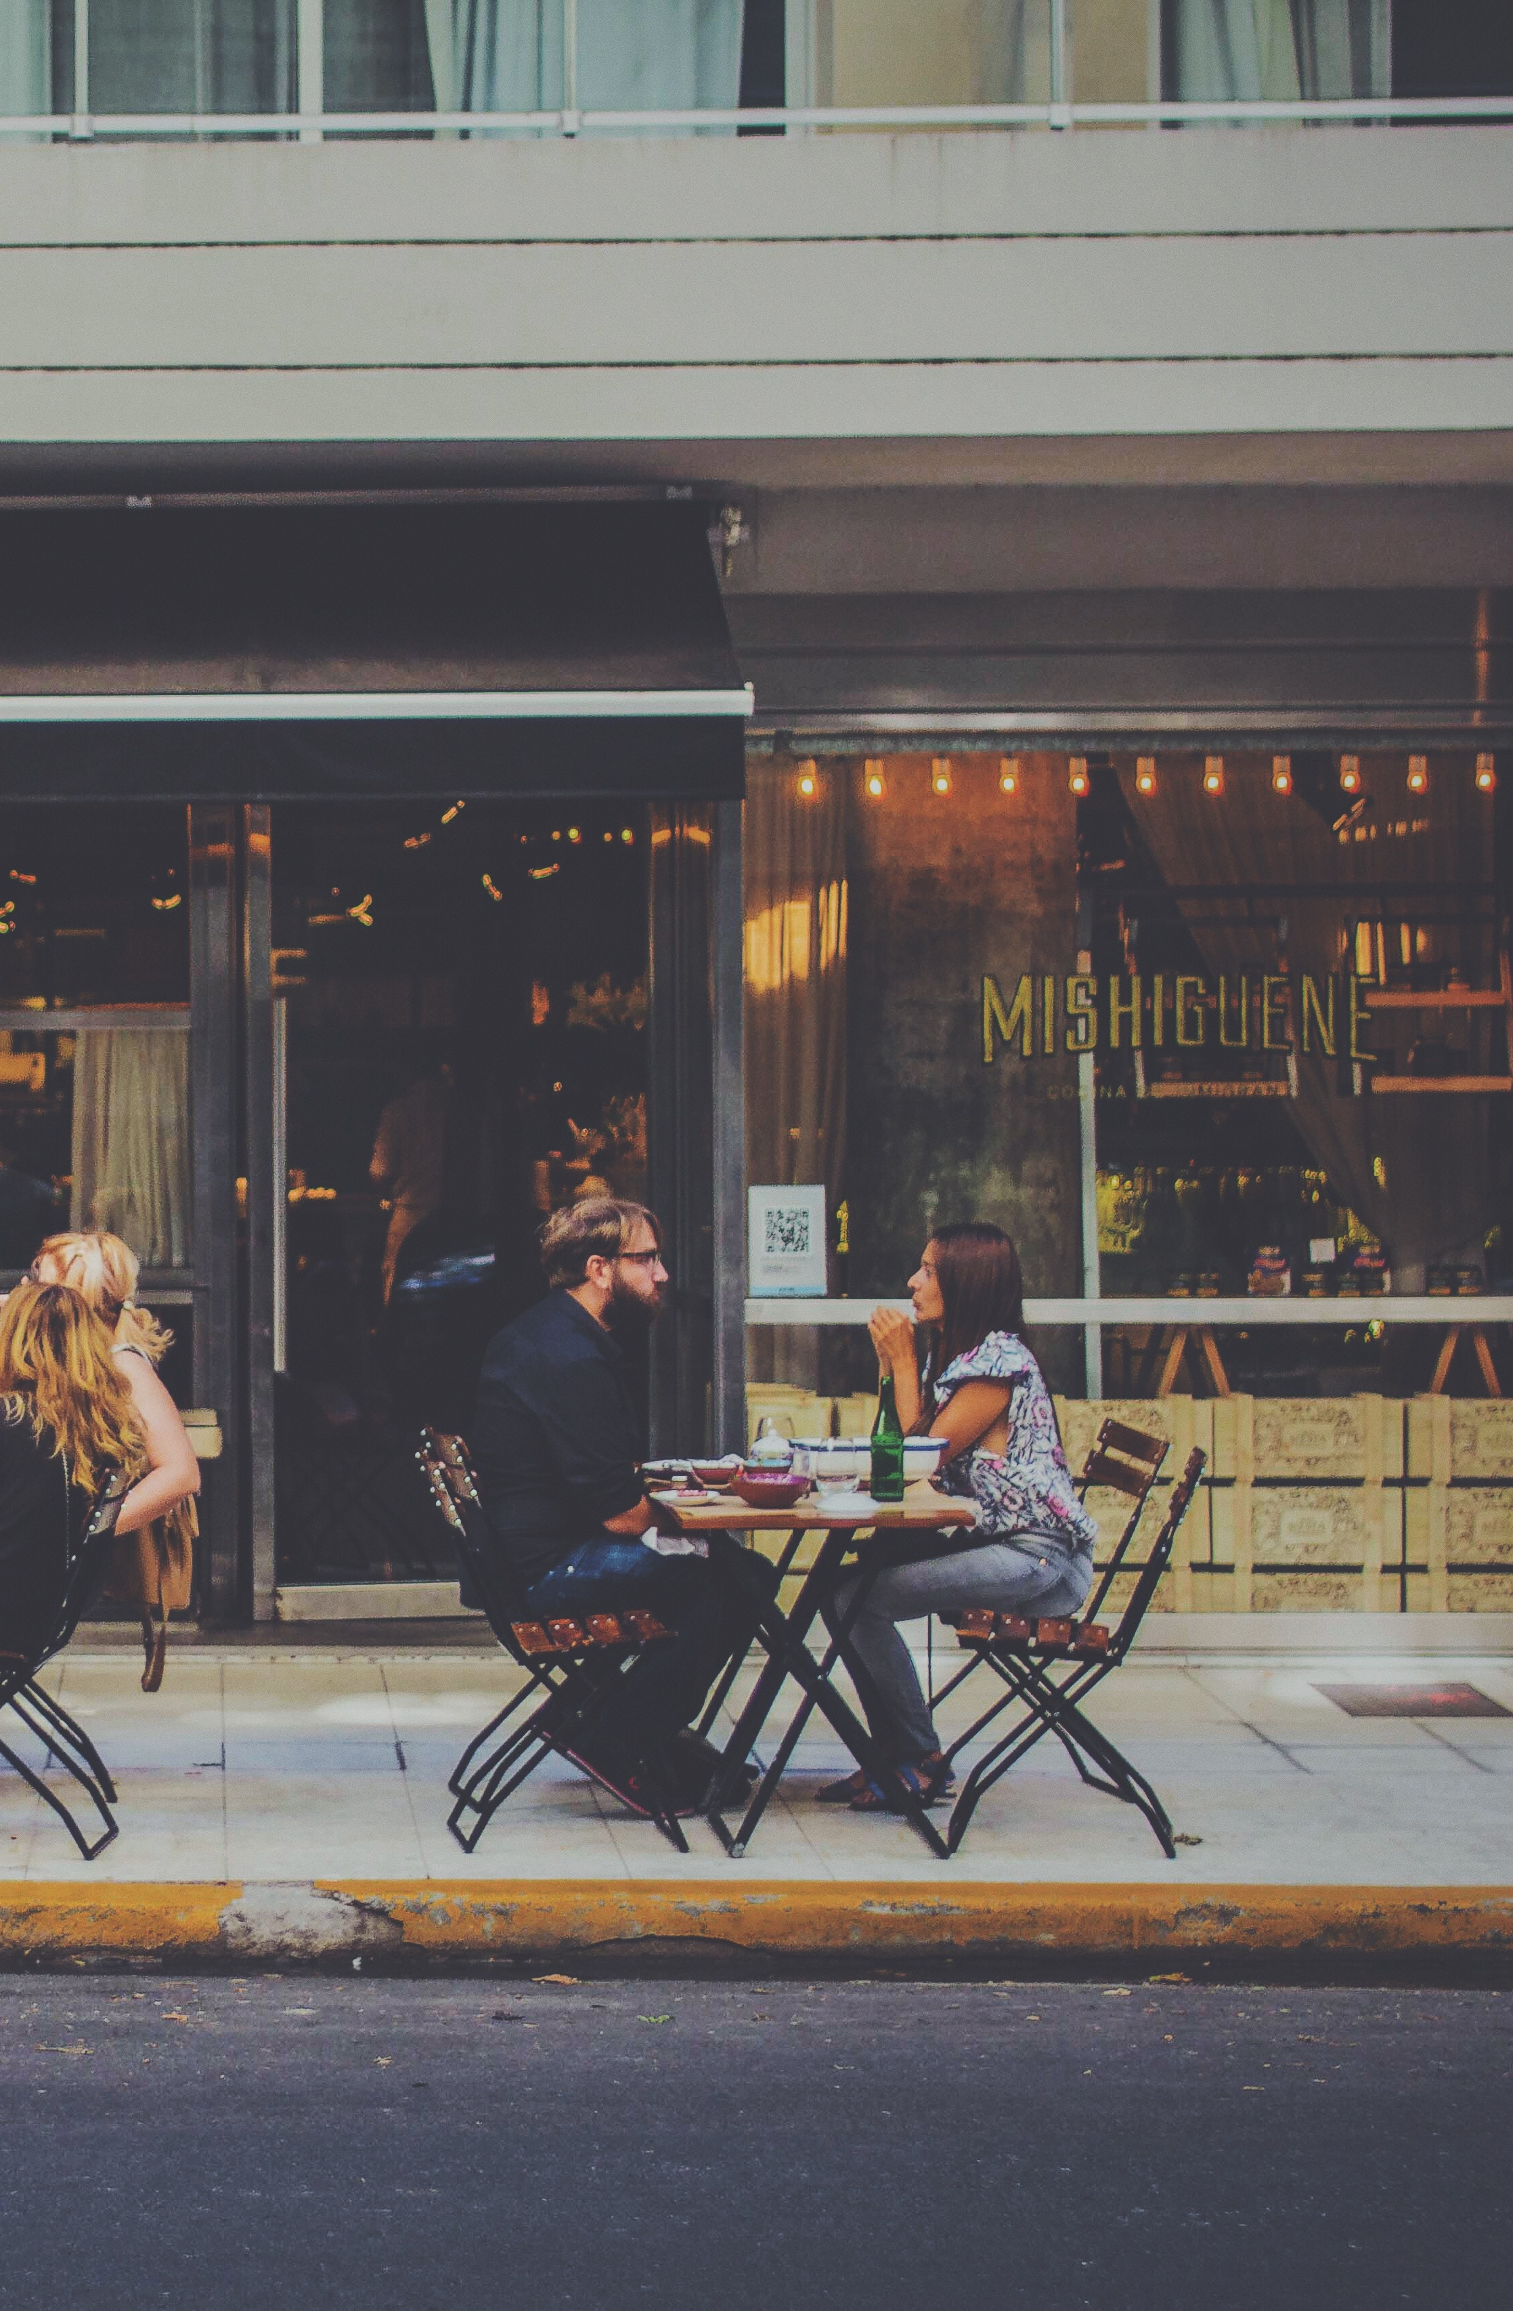
He loves to go at parties, perform standup comedy and learning languages.
He feels akward in conversations, difficult to fall in love, and tired of misunderstandings
COMMUNICATION IS DIFFERENT
WHEN YOU ARE BLIND
He‘d like to:
Know better how people feel. Hearing is not always enough.
Avoid misunderstandings.
Hearing is not always enough.
Connectionect closer emotionally.
He feels sometimes excluded
Notes:
80% of communication.
Ask the jury, ‘why blind people should be deprived for this info?‘

Slide 4
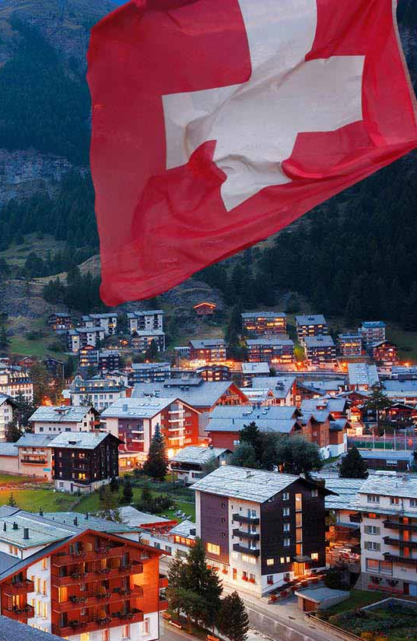
10.000 Fully Blind.
9.000 Autism.
39M Fully Blind people worldwide.
Now imagine the
SIZE OF THE ISSUE!
Notes:
Is it fair that such a big issue? We say no, that‘s why...

Slide 5
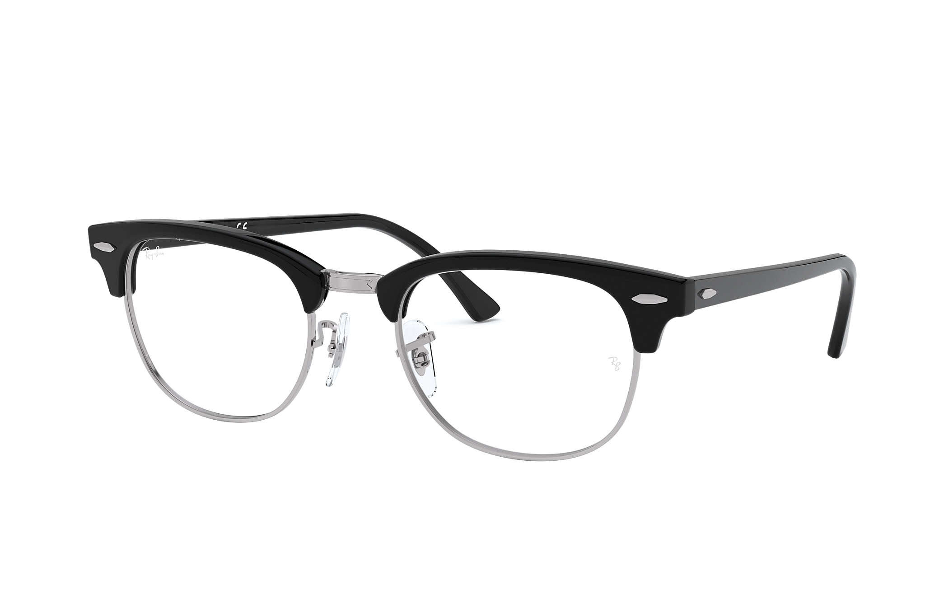

THE TECHNOLOGY
API
API
TTS
Face

Slide 6
DEMO

Slide 7
WHY US

Slide 8
THANK YOU

