Slide 1
Somatic short variant discovery (SNVs + Indels) using GATK best practices workflows PRACTICUM MILESTONE 1
Bioinformatics intern at Yotta Biomed: Briha Ansari
Preceptor: Dr. Sijung Yun.

Slide 2
Goal:
Run GATK pipeline for Somatic short variant discovery (SNVs + Indels) on a single sample from blood (FASTQ file).
Objectives:
Work in a cloud environment to use command line tools.
Data preprocessing for variant discovery.
Somatic short variant discovery (SNVs + Indels) : Generate an annotated VCF file.

Slide 3
Summary of the workflow
Data preprocessing
Raw data: FASTQ
Map to reference
Sort mapped reads
Mark duplicates
Recalibrate base quality scores
Add read groups

Slide 4
Somatic short variant discovery (SNVs + Indels)
Get raw VCF file: Mutect2
Filter variants: FilterMutectCalls
Annotate variants: Annovar

Slide 5
Data Preprocessing
Raw data: FASTQ
#1.allignment
nohup bwa mem -t 8 /common/igenomes/Homo_sapiens/UCSC/hg38/Sequence/BWAIndex/genome.fa SKU100005_R1.fastq.gz SKU100005_R2.fastq.gz > test.sam &
#2.convert SAM to BAM
samtools view -bS alligned_test.sam > alligned_test.bam
#3.sort my BAM files
samtools sort -@ 8 alligned_test.bam -o alligned_sorted.bam
#4.index sorted BAM file
samtools index alligned_sorted.bam
Map to reference
Sort mapped reads

Slide 6
Some considerations:
We can create a smaller bam file to go over the workflow to anticipate and troubleshoot any pitfalls.
It is important to look at the contig order of the reference genome and ensure that they are compatible with the variant files during base recalibration step.
N.B. I realized this later but fortunately there was no discrepancy amongst the contigs format.

Slide 7
Optional: Compare aligned BAM with Sorted aligned BAM
samtools view alligned_test.bam | head
#vs.
samtools view alligned_sorted.bam | head

Slide 8
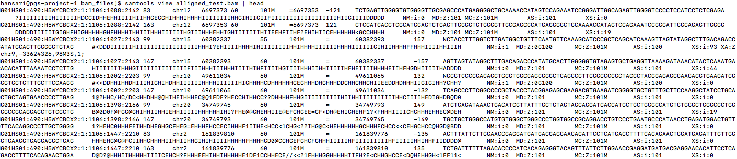
Before sorting

Slide 9
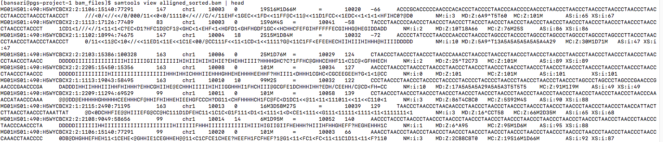
After sorting

Slide 10

Data preprocessing cont..
java -Xmx50g -XX:ParallelGCThreads=7 -jar /usr/local/src/picard_v2.18.22/picard.jar AddOrReplaceReadGroups I=alligned_sorted.bam O=alligned_sorted_RG.bam RGID=1 RGPL=illumina RGSM=SKU100005 RGPU=H5WYCBCX2:1:ACAAGCTA RGLB=lib1
To add a read group, information about the sample such as sequencing technology, sample ID is needed
PU information can be obtained from the header of the FASTQ files.
PU: flowcellID:lane:barcode
Our sample PU:
#PU: H5WYCBCX2:1:ACAAGCTA
Motivation behind adding read groups: This information is used by programs such as PICARD to mark duplicates

Slide 11

Data preprocessing cont..
java -Xmx50g -XX:ParallelGCThreads=7 -jar /usr/local/src/picard_v2.18.22/picard.jar MarkDuplicates I=alligned_sorted_RG.bam O=alligned_sorted_RG_MD.bam M=MarkDuplicates_metrics_used_small_alligned_sorted.txt VALIDATION_STRINGENCY=SILENT
Duplicates can occur during
Library prep (PCR duplicates)
Sequencing (optical duplicates): single amplification clusters are incorrectly detected as multiple clusters
Motivation for marking the duplicates is to account for over representation bias and for GATK to account for duplicates during variant calling

Slide 12

Data preprocessing cont..
Step 1.
gatk BaseRecalibrator -R genome.fa –I alligned_sorted_RG_MD.bam –O alligned_sorted_RG_MD_base_recalibration_1st.table --known-sites dbsnp_146.hg38.vcf.gz --known-sites Mills_and_1000G_gold_standard.indels.hg38.vcf.gz
Step 2. Create recalibrated bam file
gatk ApplyBQSR -R genome.fa –I alligned_sorted_RG_MD.bam --bqsr-recal-file alligned_sorted_RG_MD_base_recalibration_1st.table -O small_alligned_sorted_RG_MD_recal.bam
Step 3. Repeat step 1 again with a recalibrated BAM files
Step 4. Analyze covariates to compare before and after racalibration files
gatk AnalyzeCovariates –before alligned_sorted_RG_MD_base_recalibration_1st.table –after alligned_sorted_RG_MD_base_recalibration_2nd.table -plots AnalyzeCovariates.pdf

Slide 13
Data preprocessing cont..
Motivation for Base quality recalibration:
Machines can over or underestimate base quality scores
During Base quality score recalibration (BQSR) machine learning model is applied to these errors to correct the quality scores.

Slide 14
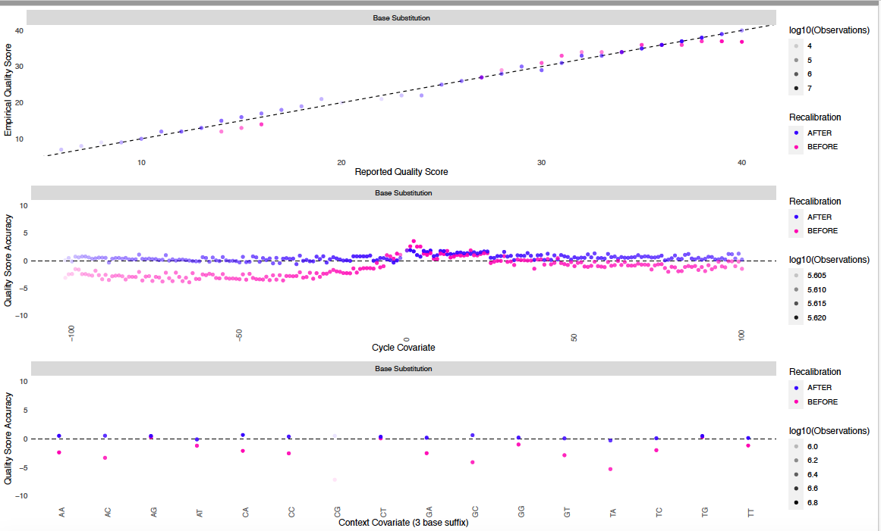
Data preprocessing cont..

Slide 15
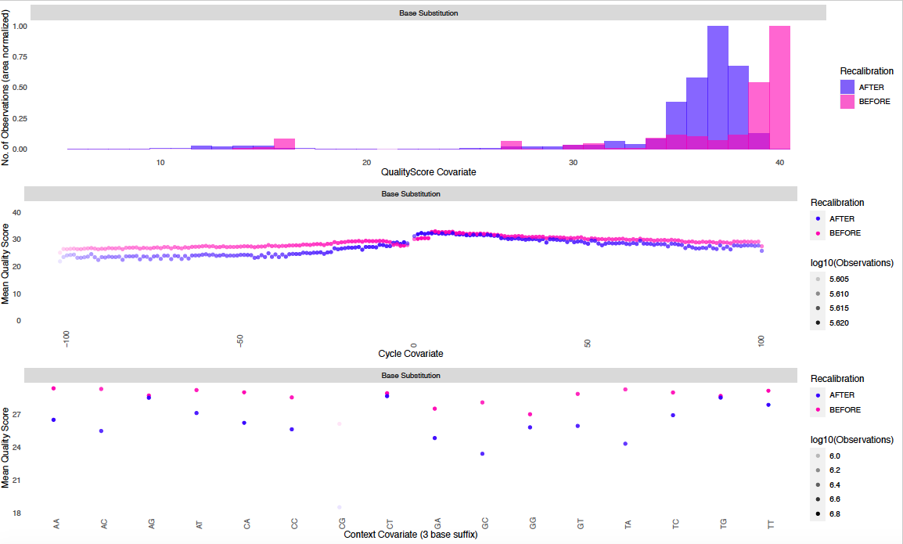
Data preprocessing cont..

Slide 16
Data preprocessing cont..
Some consideration before doing base quality recalibration
Ensure that the contigs in reference genome and known variant VCF files are in the same format.
Prepare reference genome for gatk by indexing (samtools) and creating a sequence dictionary (picard).
Also index the known sites files using the tabix command.

Slide 17
Somatic short variant discovery (SNVs + Indels)
Somatic short variant discovery (SNVs + Indels)
Get raw VCF: Mutect2
Filter variants: FilterMutectCalls
Annotate variants: Annovar

Slide 18
Somatic short variant discovery cont..
Get raw VCF files: Mutect2
gatk Mutect2 -R genome.fa –I alligned_sorted_RG_MD_recal.bam -O unfiltered.vcf
Filter variants: FilterMutectCalls
gatk FilterMutectCalls -R genome.fa –V unfiltered.vcf –O filtered.vcf
Raw VCF files:
Mutect2 applies a Bayesian likelihoods model to generate log odds of an alleles to be somatic variants vs. an errors.
Filtering:
Unlike other tools, FilterMutectCall intrinsically sets a filtering threshold to optimize the F score (an optimum
score that address precision without sacrificing sensitivity. To achieve more sensitivity -f-score-beta can be set to
> 1, and <1 if more precision is desired.
There is an intermediate step to calculate contamination, not done in this workflow since we are dealing
With a normal tissue sample.

Slide 19
Somatic short variant discovery cont..
Annotate variants: Annovar
table_annovar.pl small_filtered.vcf /home/bansari/humandb/ -buildver hg38 -out myanno -remove -protocol refGene,exac03,avsnp147,dbnsfp35c,clinvar_20180603,esp6500siv2_all,kaviar_20150923,1000g2015aug_all,gnomad211_exome,cosmic70,nci60 -operation g,f,f,f,f,f,f,f,f,f,f -nastring . -vcfinput -polish
Motivation behind annotation of VCF files:
To predict the effects of variants including smaller ones such as SNPs and indels as well as larger structural variants.
Important consideration:
Since annotation borrows information from data sources with known variants, all these databases should be downloaded and specified in the command before running the tool.

Slide 20
Qualitative outcomes of my learning
Feel more comfortable with navigating the cloud environment.
Improved troubleshooting by searching online, asking questions.
Feeling more confident to try other types of workflows.

Slide 21
Some hiccups I encountered on the way
Enountered a truncated SAM file error on SAM to BAM conversion.
Tried to figure out how to add read groups, where to find read group information.
Encountered an error during “MarkDuplicates”
Value was put into PairInfoMap more than once
To analyze covariates an updated version of R was needed: I used ftp(filezilla) to tranfer the tables and generate plots on my machine.

Slide 22
Thank you to my preceptor Dr. Yun and Yotta Biomed for this learning opportunity.
Resources I used:
Example pipeline provided by Dr. Yun.
GATK website.
Biostars and other forums.
Literature search.

