Slide 1
Multicore RISC-V Architecture
CPE 333 Project Presentation Brian Santa Maria Kelechi Igwe

Slide 2

Background
Why this project in particular?
Project plan?
Multicore w/ Shared Memory
Multicore architectures require a form of cache coherency
Implement Cache Coherency Protocol
Implement Bus Protocol
Integrate Caches with Pipeline

Slide 3
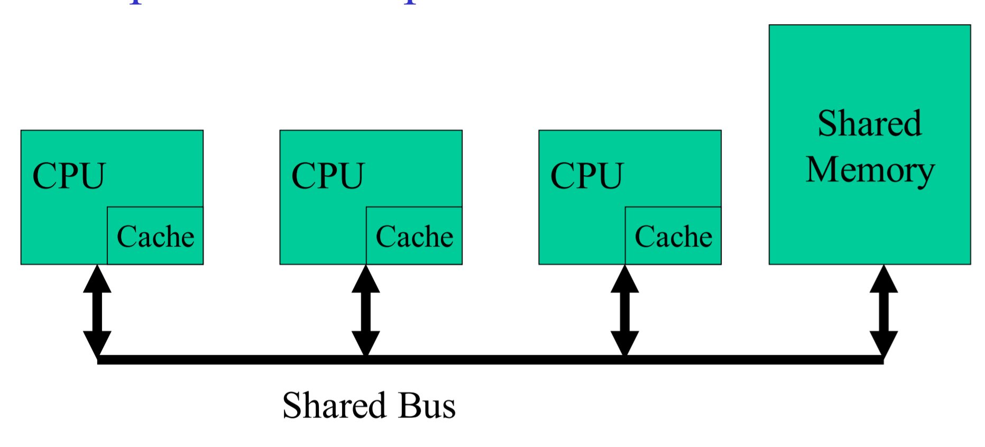
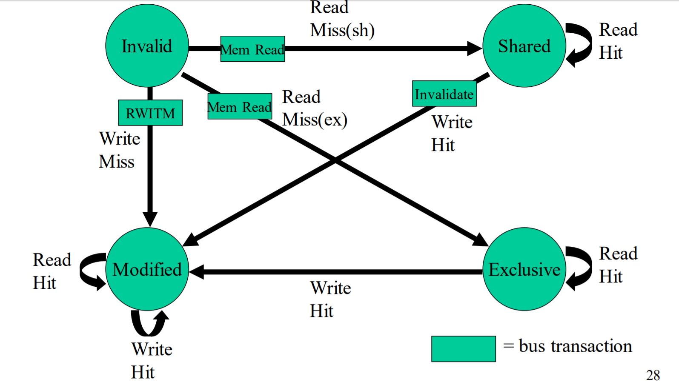
`
MESI
Modified
Exclusive
Shared
Invalid
Simulation Tool:
https://www.scss.tcd.ie/Jeremy.Jones/vivio/caches/MESI.htm
Current Status?

