Slide 1
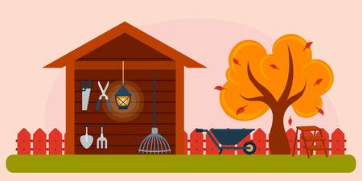
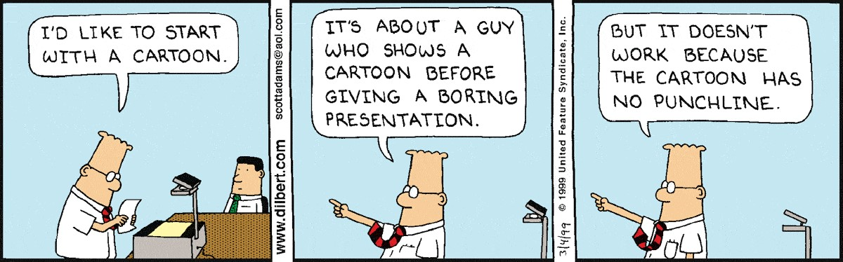
Dan’s Tool Shop
CCGW:
Katelynn Call – Systems Engineer
Brian Callister – The Django Godsend
Cheston Gray – WebDev/Content Maker-upper
Josh Webster – The Test Master & Scrum Lord

Slide 2
Dan’s Tool Shop
Overview:
Main Page
Carousel of pictures
Short description of the projects
Our Projects Page
Descriptions/pictures for each of the projects
Our Tools Page
Description for each of the categories of tools
Contact Us Page
Form for submitting comments to the management
Company information
Map of company location

Slide 3
Dan’s Tool Shop
Overview:
Reservation Page
Reserve tools
Search bar to locate tools
Account Page
List of tools checked out to the user
Customer Information/Fees
Form to update information
Employee Portal
View all user information
View all tool information
Check in tools
Pay Fees

Slide 4
Dan’s Tool Shop
Design Decisions
Change in our class design
2 different classes for tool type and tool
1 class for just Tool
Back-end Language
Started with C#
Had difficulty setting up a database/server
Switched to Python and Django
Built-in server and database
Our group was more familiar with the framework from CS2610

Slide 5
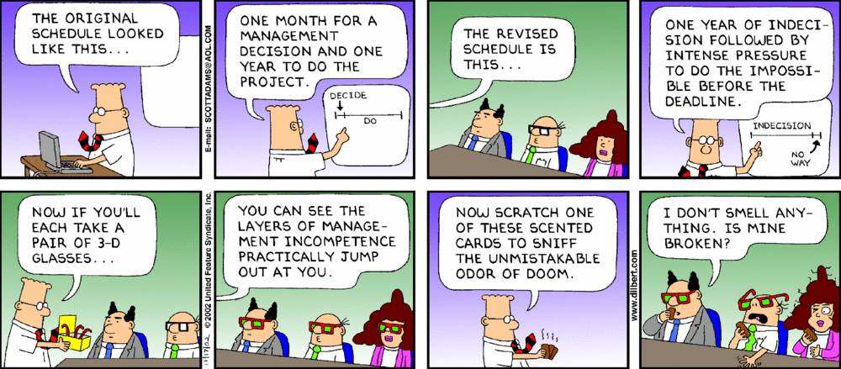
Dan’s Tool Shop
Scrum Practices
Divided our development in 3 sprints
First 2 sprints were not productive due to unpredictable circumstances
Sprints included:
Planning Meeting:
Planning Poker
Choose stories to work on
Retrospective:
Discuss the results of the sprint
Improvements
Had Standups twice a week
Started in person
Switched to group messaging and video calls
Discussed what had been worked on
Personal goals

Slide 6
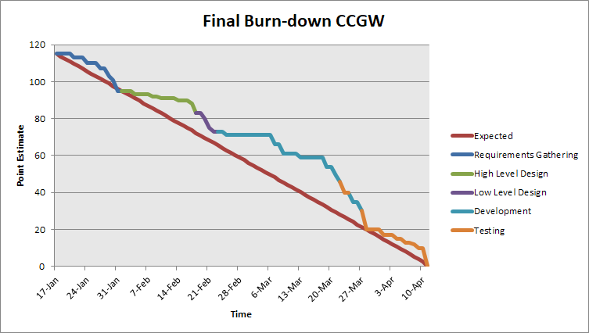
Dan’s Tool Shop
Burndown Chart

Slide 7
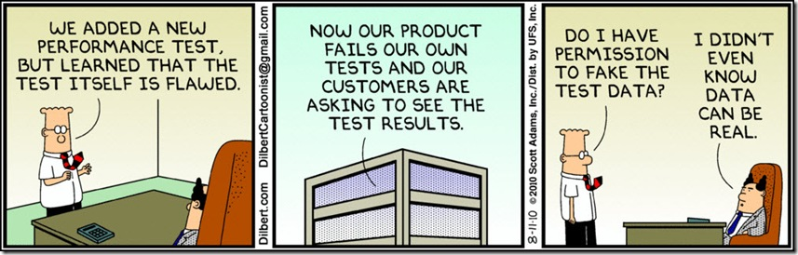
Dan’s Tool Shop
Ready for Deployment:
Our product is a potentially shippable increment that fulfills all requirements as expressed by the owner.
The product went through several testing phases in which all major systems were tested to ensure they worked as intended including:
Page Navigation
Tool Reservation
Account Information/Updating
Submitting Messages

Slide 8
Dan’s Tool Shop
Website Design - Requirements Progression
At the beginning of the project the customer didn’t really have a clear picture of what they wanted their website to look like. After submitting our high-fidelity prototype we received feedback which clarified what the customer had in mind for their websites design. Here are the requirements we gathered from the feedback in their respective FURPS, audience oriented, and MOSCOW categories:
FURPS:
Usability:
A slideshow/carousel on the main page that changes every few seconds.
A tool-shed logo that appears twice on every page (both header and foot).
A contact us page that has a a google map and form to email questions.
A project page that has pictures and descriptions of people using our tools for home remodel.
Audience Oriented:
User:
A contact us page that has a google map and a form to email questions.
A project page that has pictures and descriptions of people using our tools for home remodel.
Nonfunctional:
A slideshow/carousel on the main page that changes every few seconds.
A tool-shed logo that appears twice on every page (both header and foot).
MOSCOW:
Must:
A slideshow/carousel on the main page that changes every few seconds.
A tool-shed logo that appears twice on every page (both header and foot).
A contact us page that has a a google map and form to email questions.
A project page that has pictures and descriptions of people using our tools for home remodel.

Slide 9
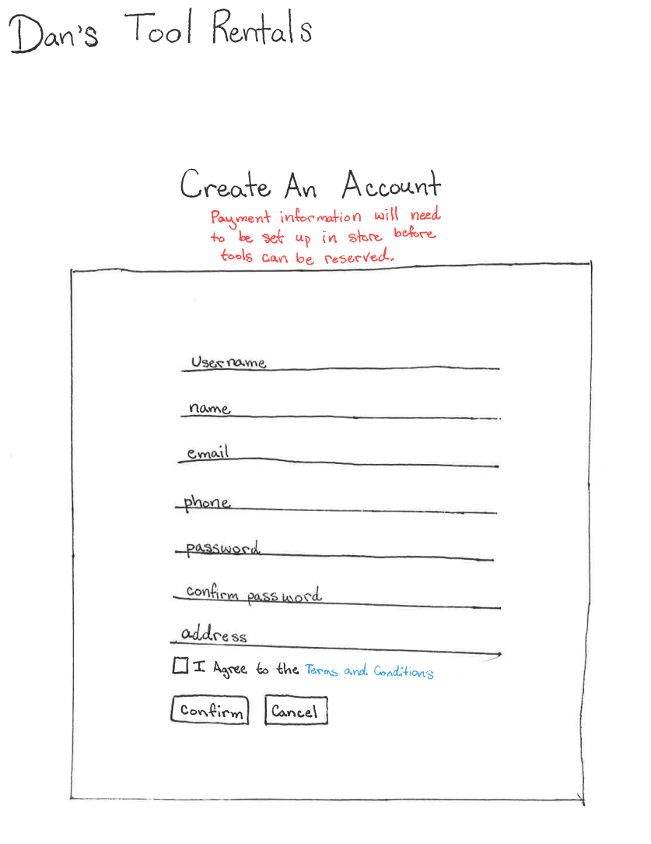
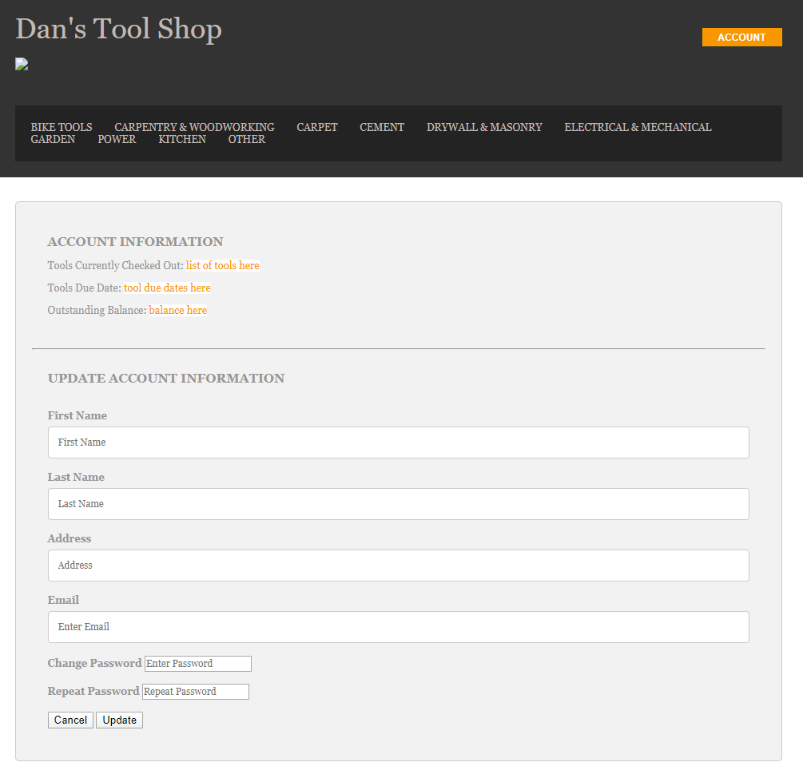
Dan’s Tool Shop
Website Design - Early Prototypes

Slide 10
Dan’s Tool Shop
Website Design - Who did what
Scrum Tasks:
Create a Contact Us page:
Create a form for the customer to fill out. (Cheston)
Add a google map to the page. (Cheston)
Create a modal that displays after the customer makes submission. (Cheston)
Create a Projects page:
Display multiple photos on the page. (Cheston)
For each photo, have a heading and a paragraph describing the project. (Cheston)
Have links from the main page to to each individual project. (Cheston)
Add a slideshow/carousel on the main page that changes every few seconds.
Obtain pictures relevant to the website. (Cheston)
Rearrange the current content on the main page to accommodate the slideshow. (Cheston)
Write the JavaScript that will change the pictures every few seconds. (Cheston)
Simplify the Account page:
Remove unneeded information and links from the page. (Cheston, Katelynn)
Clarify class and Id selectors. (Cheston)
Link the page to the database. (Brian)
Make additions to current pages:
Add a toolshed logo that appears twice on every page. (Cheston)
Remove unnecessary HTML and CSS; fix the pages that aren’t displaying correctly:
Clean up the class and ID selectors and trim down the amount of CSS needed to style the website. (Cheston)
Add JavaScript to navigate between subpages. (Katelynn)
Repair the pages that aren’t displaying properly. (Cheston, Katelynn)
Create Unit Tests to ensure the navigation is correct. (Josh)

Slide 11
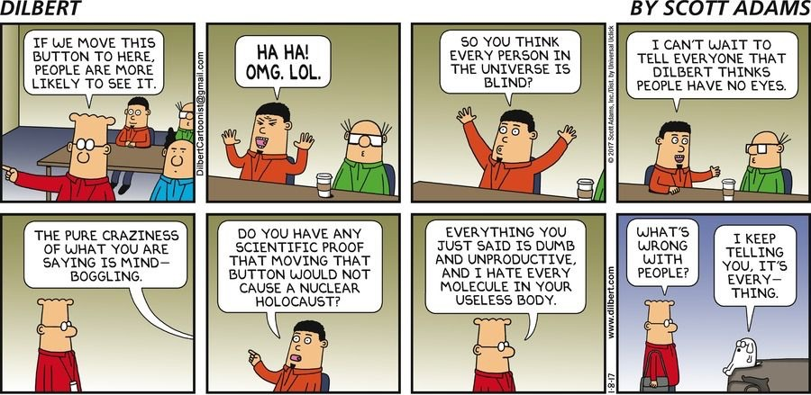
Dan’s Tool Shop
Website Design - Unit Testing
The testing for this requirement included:
Ensure the user was taken to the correct page.
Ensure that all pages are present.
Ensure that the correct template was used.
Ensure correct HTTP responses are returned.

Slide 12
Dan’s Tool Shop
Tool Tracking - Requirements Progression
At the beginning of the project the customer had a pretty descriptive idea of what they wanted when it came to tracking tools. During our first meeting with the customer we recorded the following requirements; which we’ve done our best to satisfy. We’ve listed these requirements into their respective FURPS, audience oriented, and MOSCOW categories:
FURPS:
Functionality:
Way to keep track of where all tools are.
Way to charge for lost tools, and order new tools when broken reasonably.
Way to identify users, as well as who currently has what.
Way to keep track of requests for tools that are broken/requested by not available.
List of tools and tool sets (by category).
Way for employees to check tools in/out, mark as bad/missing, and view user accounts.
Way to audit a tool (see when/who it has been checked out by).
Create a way to keep track of users/tools/checkout system.
Keep track of number of times items have been requested/checked out.
Way to view reports on users/tools/finance.
Audience Oriented:
Business:
Way to keep track of where all tools are.
Way to charge users for lost tools, and order new tools when broken.
Way for employees to check tools in/out, mark as bad/missing/ and view user accounts.
Way to audit a tool (see when/who it has been check out by).
Keep track of number of times items have been requested/check out.

Slide 13
Dan’s Tool Shop
Tool Tracking - Requirements Progression
Audience Oriented (continued):
User:
Way for employees to check tools in/out, mark as bad/missing, and view user accounts.
Functional:
Way to keep track of where all tools are.
Way to identify users, as well as who currently has what.
List of tools and tools sets (by category).
Ways for employees to check tools in/out, mark as bad/missing, and view user accounts.
Way to audit a tool (see when/who it has been checked out by).
Create a way to keep track of users/tools/checkout system.
Keep track of number of times items have been request/checked out.
MOSCOW:
Must:
Way to identify user, as well as who currently has what.
Create a way to keep track of user/tools/checkout system.
Should:
Keep track of number of times items have been requested/checked out.
Could:
Keep track of where all the tools are.
Way to audit a tool (see /when/who it has been checked out by).

Slide 14
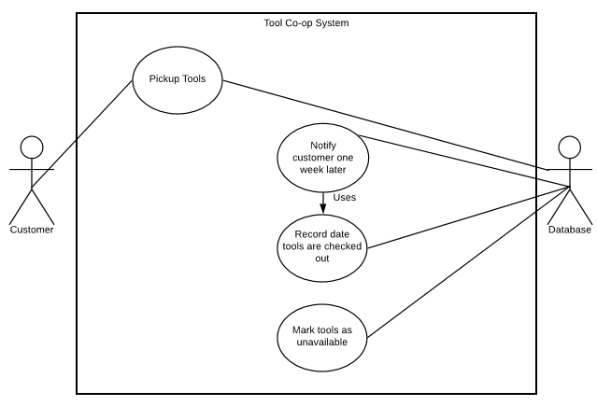
Dan’s Tool Shop
Tool Tracking - Use Case Diagram

Slide 15
Dan’s Tool Shop
Tool Tracking - Who did what
Scrum Tasks:
Database needs to be able to do a variety of things:
Create the models for tools and customer information. (Katelynn)
Way to identify users, as well as who currently has what. (Brian)
Generate a list of tools and tools sets (by category). (Brian)
Way to audit a tool (see when/who it has been checked out by). (Brian)
A way to keep track of users/tools/checkout system. (Brian)
Keep track of number of times items have been request/checked out. (Katelynn)
Employees need to be able to check tools in/out, mark as bad/missing, and view user accounts. (Brian)
Create a page to display all available tools:
The page needs to show all of the categories of tools. (Brian)
Create a page to house all of the tools. (Brian)
Link the page to the database. (Katelynn)
Create Unit Tests to verify that the frontend is communicating correctly with the backend:
Tool creation test. (Josh)
Tool checkout test. (Josh)
Customer creation test. (Josh)
Customer information editing test. (Josh)
Test for each of the Django Views. (Josh)

Slide 16
Dan’s Tool Shop
Tool Tracking - Unit Testing
The testing for this requirement included:
Ensure the tool was updated correctly with the name of the user that checked it out.
Ensure that the number of times the tool was checked out was incremented.
Ensure that each account view displays the tools checked out by that account.

Slide 17
Dan’s Tool Shop
Tool Reserving - Requirements Progression
Similar to the Tools Tracking requirements; the customer had a very clear picture of what features and functionality their tool reserving process would include. We’ve these different requirements into their respective FURPS, audience oriented, and MOSCOW categories:
FURPS:
Functionality:
Way to keep track of requests for tools that are broken/requested but not available.
List of tools and tool sets (by category)
Way for customers to request either online or in-person.
Keep track of number of times items have been requested/checked out.
Usability:
Way for customers to reserve tool sets.
Customers should only be able to check out tools for a week at a time.
Way for customers to request either online or in-person.
Audience Oriented:
Business:
Keep track of number of times items have been requested/checked out
List of customers with checked out tool sets.
Way to keep track of requests for tools that are broken/requested by not available.

Slide 18
Dan’s Tool Shop
Tool Reserving - Requirements Progression
Audience Oriented (continued):
User:
Way for customers to reserve tool sets.
Way for customers to request either online or in-person.
A modal that alerts the user that their submission has been accepted.
This is one of the few requirements that was updated after the second milestone.
Functional:
Way to keep track of requests for tools that are broken/requested by not available.
List of tools and tool sets (by category)
Way for customers to request either online or in-person
Keep track of the number of times items have been requested/checked out.
MOSCOW:
Must:
Way for customers to reserve tool sets.
Way to keep track of requests for tools that are broken/requested by not available.
List of tools and tool sets (by category)
Way for customers to request either online or in-person.
Should:
Keep track of the number of times items have been requested/checked out.

Slide 19
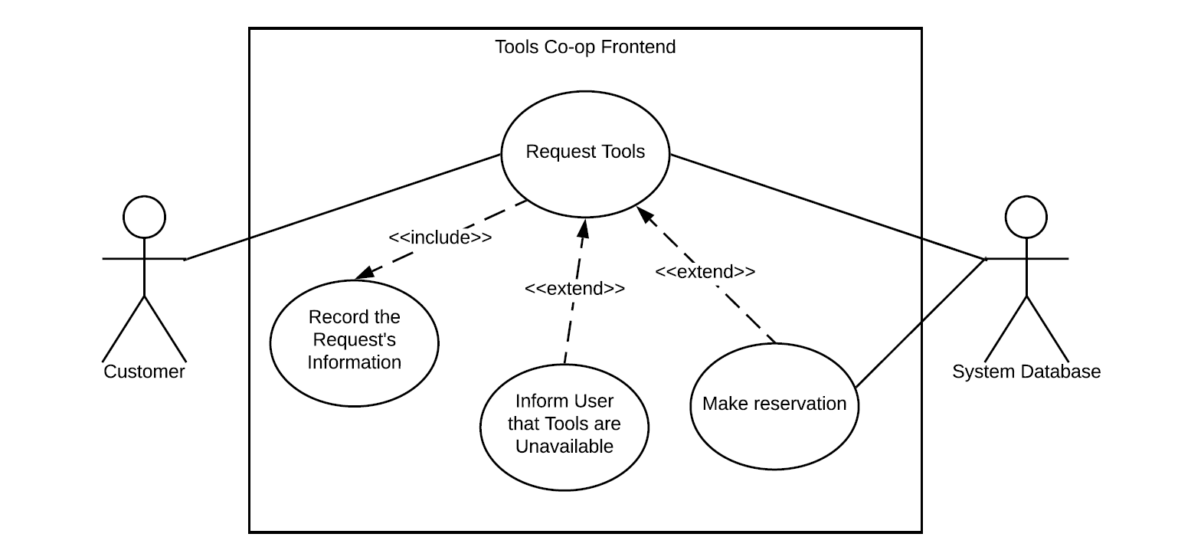
Dan’s Tool Shop
Tool Reserving - Use Case Diagram

Slide 20
Dan’s Tool Shop
Tool Reserving - Who did what
Scrum Tasks:
Create a Reservation Page:
Customers need to be able to reserve tools. (Katelynn)
Increment the number of times that a tool has been requested/checked out. (Katelynn)
Employees need to be able to check tools in/out, mark as bad/missing, and view user accounts. (Brian)
Link the reservation information to the existing tool data:
The reservation page needs to show all available tools by category. (Brian)
The tools should be searchable with a variety of tags. (Brian)
Link the page to the database. (Katelynn)
Set the tools status to reserved when selected. (Katelynn)
Add the tool to the user’s reserved tool list. (Katelynn)
Create Unit Tests to verify that the frontend is communicating correctly with the backend:
Tool reservation test. (Josh)
Customer information editing test. (Josh)
Test for each of the Django Views. (Josh)

Slide 21
Dan’s Tool Shop
Tool Reserving - Unit Testing
The testing for this requirement included:
Ensure the tool is correctly marked as reserved
Ensure that the username of the customer is properly recorded
Ensure that the HTTP response returned from the reservation is a 200 - OK response
Ensure that all relevant fields are updated when a tool is checked out

Slide 22
Dan’s Tool Shop
Works Cited and Resources Used:
Docs.djangoproject.com. 2020. Customizing Authentication In Django. [online] Available at: <https://docs.djangoproject.com/en/dev/topics/auth/customizing/#extending-django-s-default-user> [Accessed April 2020].
En.wikipedia.org. 2020. Django (Web Framework). [online] Available at: <https://en.wikipedia.org/wiki/Django_(web_framework)> [Accessed April 2020].
little_fish and Friendm1, 2020. How To Import Csv Data Into Django Models. [online] Stack Overflow. Available at: <https://stackoverflow.com/questions/2459979/how-to-import-csv-data-into-django-models> [Accessed April 2020].
Os-templates.com. 2020. OS Templates Premium And Free Website Templates. [online] Available at: <https://www.os-templates.com/> [Accessed March 2020].
Sharma, G. and rigdonmr, 2020. Adding Custom Fields To Users In Django. [online] Stack Overflow. Available at: <https://stackoverflow.com/questions/2886987/adding-custom-fields-to-users-in-django> [Accessed April 2020].
Docs.djangoproject.com. 2020. Writing Unit Tests In Django. [online] Available at: <https://docs.djangoproject.com/en/3.0/intro/tutorial05/> [Accessed April 2020].
Docs.djangoproject.com. 2020. Writing Your First Django App. [online] Available at: <https://docs.djangoproject.com/en/3.0/intro/tutorial01/> [Accessed April 2020].

Slide 23
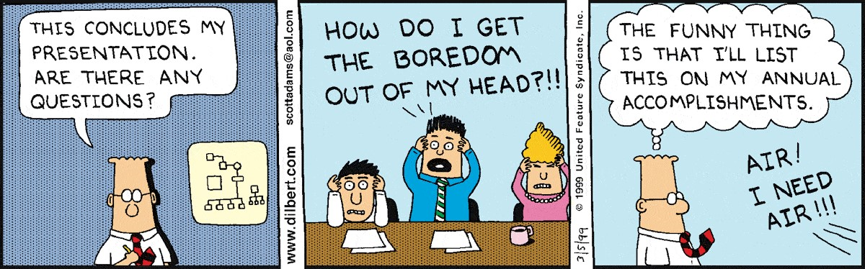
Dan’s Tool Shop
Questions?

