Slide 1



ROADSAFE360
PRESENTATION
HOME
ABOUT
PROJECT
DEMO
RoadSafe360
Intelligent Driver Demerit & Road Safety Management System
Year 8 Project-Based Learning (PBL) Classroom Project
Author: Brian Kareithi and Sir Dilton
VIEW PROJECT
ROADSAFE360 - INTELLIGENT DRIVER DEMERIT & ROAD SAFETY MANAGEMENT SYSTEM

Slide 2

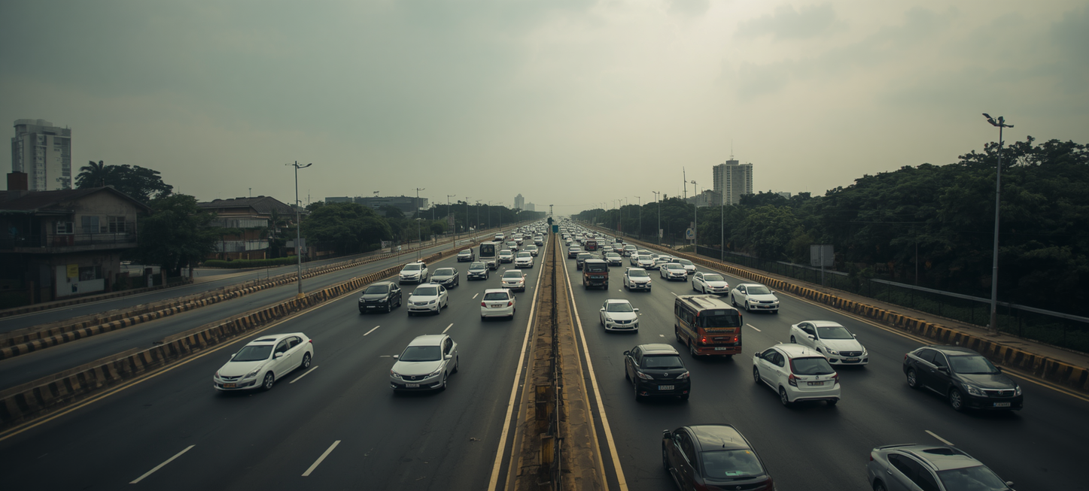
ROADSAFE360
PBL PROJECT
HOME
ABOUT
CHALLENGE
OVERVIEW
The Challenge
Road traffic accidents cause over 1.3 million deaths globally each year. Weak enforcement of driver demerit systems contributes to reckless driving and repeated offences. RoadSafe360 simulates how transport authorities manage driver licensing using demerit points — bringing real-world road safety management into the PBL classroom to teach technology, civic responsibility, and data-driven decision making.
NEXT SLIDE

Slide 3

ROADSAFE360
PRESENTATION
HOME
ABOUT
CONTENT
OTHERS
What is
RoadSafe360?
RoadSafe360 is a full-stack web application simulating driver licence and traffic offence management. It features a role-based platform with four user tiers — Admin, Police, Driver, and Authority — each with a dedicated dashboard. The system covers the full offence lifecycle, appeals processing, digital licences with QR codes, and advanced analytics.
NEXT SLIDE

Slide 4

ROADSAFE360
PRESENTATION
HOME
ABOUT
STACK
OTHERS
Technical
Stack
Framework: Next.js 16 (App Router) |
Frontend: React 19, TypeScript, Tailwind CSS 4 |
Backend: Firebase (Auth, Firestore, Storage) |
Maps: Leaflet + OpenStreetMap |
Charts: Recharts |
Theme: Light/Dark Mode Support

Slide 5

ROADSAFE360
PBL PROJECT
HOME
ABOUT
FEATURES
OTHERS
Key Features
Overview
• Authentication with 4 role-based dashboards
• Driver management & licence tracking
• Traffic offence issuance with GPS & evidence
• Appeals system with status tracking
• Digital licence with QR code & PDF export
• Regional road safety stats
• Reports & analytics exports (PDF, Excel, CSV)
• Real-time notifications & interactive maps

Slide 6
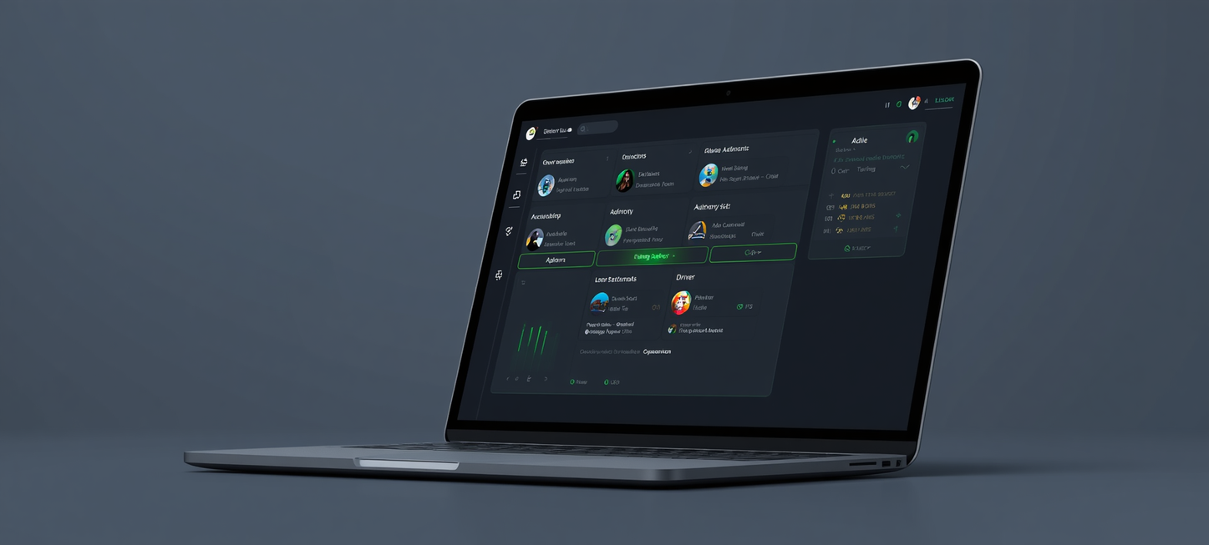
ROADSAFE360
PRESENTATION
HOME
ABOUT
CONTENT
OTHERS
Role-Based Access
🛡️ Admin: Manage drivers, licences & system settings
👮 Police: Issue offences, access cases & appeals
🪪 Driver: View points, offences, appeals & digital licence
📊 Authority: National KPIs, trends & revenue analytics
NEXT SLIDE

Slide 7
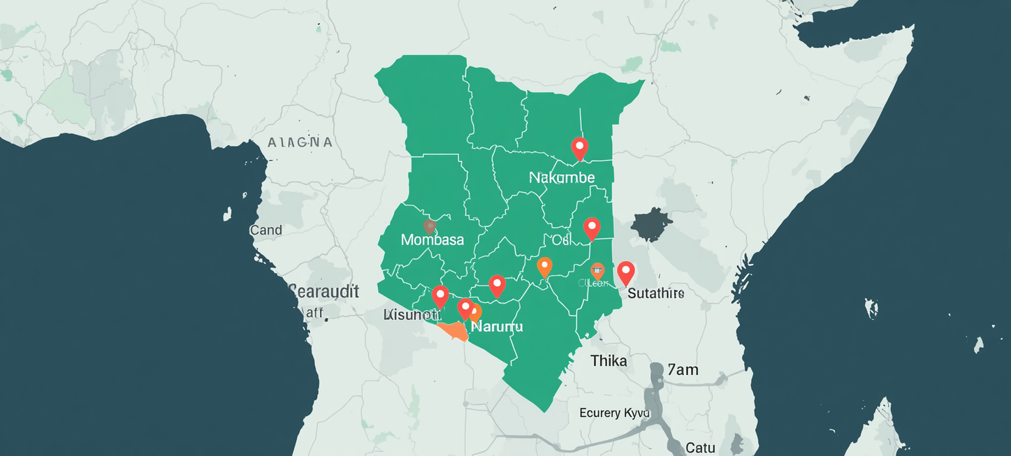
CONSULTING REPORT
PRESENTATION
HOME
ABOUT
CONTENT
OTHERS
Kenyan Road Safety Context
RoadSafe360 is localized for Kenya, using KES currency. Regions covered: Nairobi, Mombasa, Kisumu, Nakuru, Eldoret & Thika. Offence categories include matatu overloading. Seeded with 10 drivers, 12 offence categories & 20 sample offences.
NEXT SLIDE

Slide 8
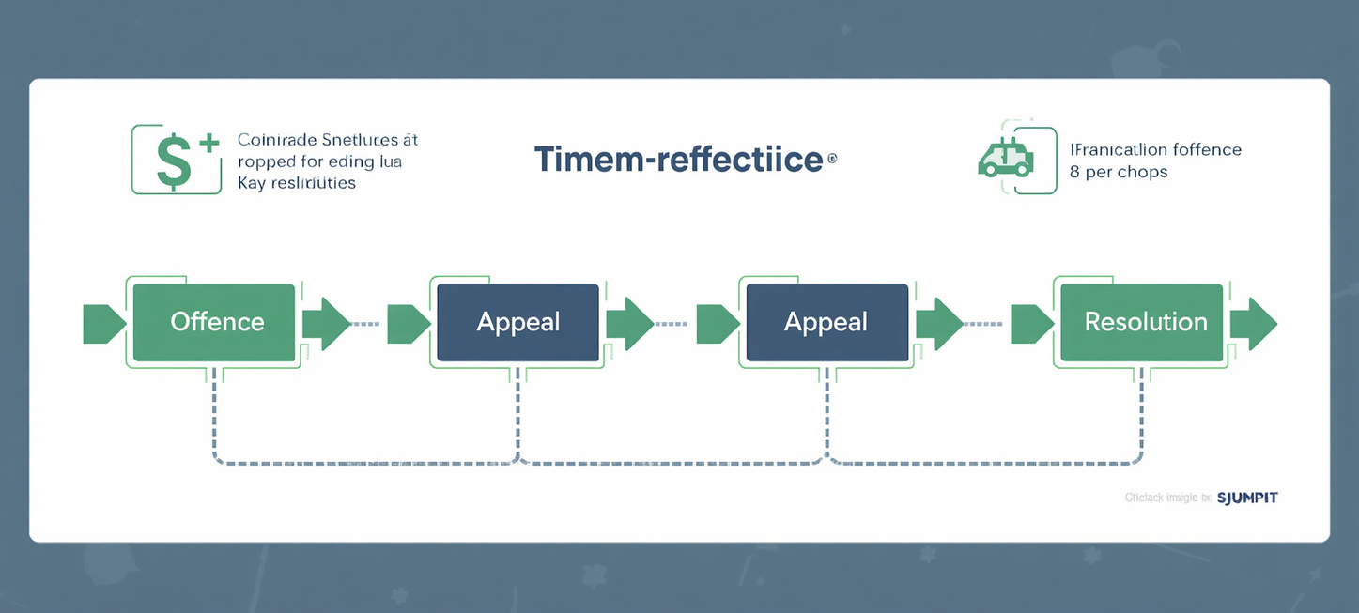
CONSULTING REPORT
PRESENTATION
HOME
ABOUT
CONTENT
OTHERS
Offences & Appeals
Police issue offences with GPS location & photo evidence, triggering automatic demerit point deductions. Drivers can submit appeals with supporting evidence. Appeal statuses progress: Submitted → Under Review → Approved / Rejected. Approved appeals restore deducted points to the driver's licence record.
NEXT SLIDE

Slide 9
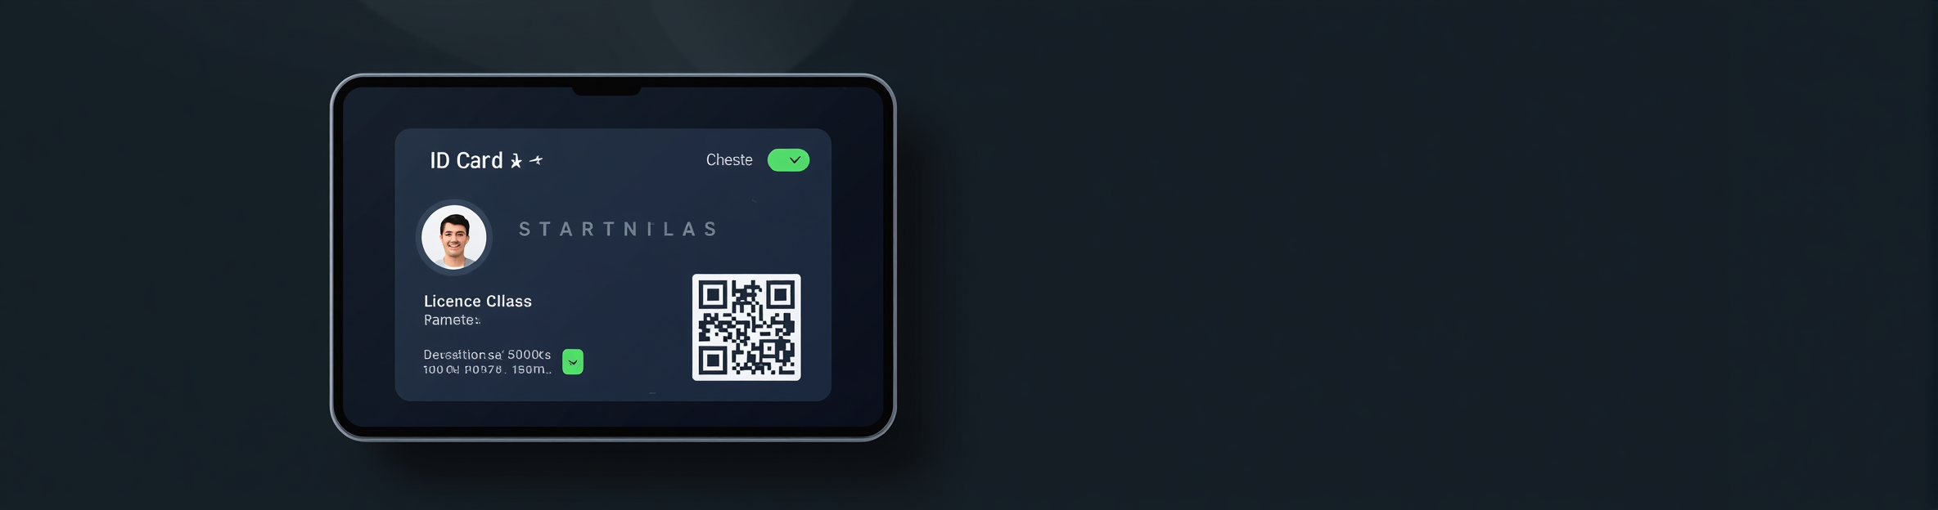
ROADSAFE360
PRESENTATION
HOME
ABOUT
CONTENT
OTHERS
Digital
Licence Module
The Digital Licence module generates a secure, verifiable driver licence card featuring a driver photo, licence class, current demerit points, and a unique QR code for instant verification. Drivers can download and print their licence as a PDF. Emergency contact details and blood group are embedded for safety.

Slide 10

ROADSAFE360
PBL PROJECT
HOME
ABOUT
CONTENT
OTHERS
Interactive
Maps & Location
Powered by Leaflet + OpenStreetMap, RoadSafe360 enables precise GPS-based offence location picking. Officers can click any point on the map or use device geolocation to auto-fill coordinates. Each offence is pinned to a real location, enabling regional analysis and visual crime mapping across Kenya.

Slide 11
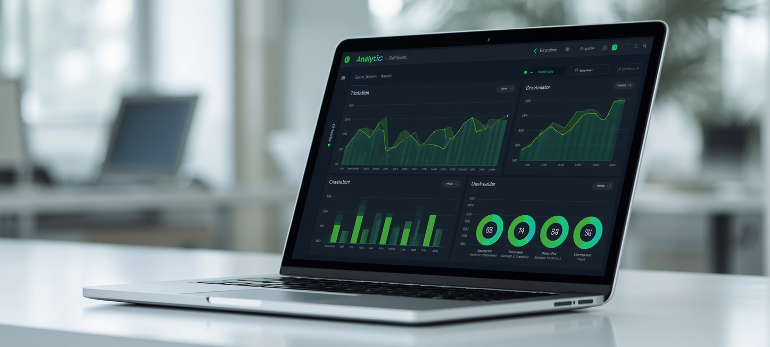
ROADSAFE360
PRESENTATION
HOME
ABOUT
CONTENT
OTHERS
Analytics & Reports
Visualize monthly offence trends with bar, line, and area charts. Track revenue, licence status distribution, and driver risk scores. Export full reports as PDF, Excel, or CSV for deeper analysis and record-keeping.
NEXT SLIDE

Slide 12
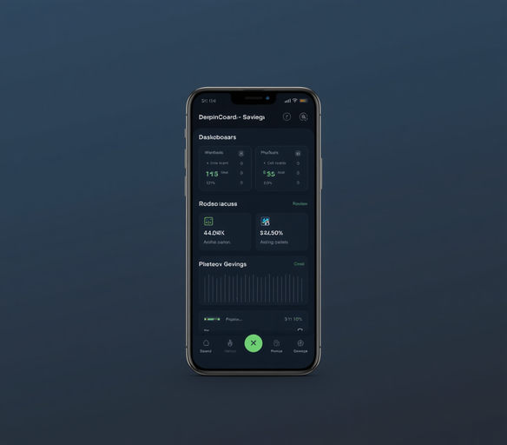
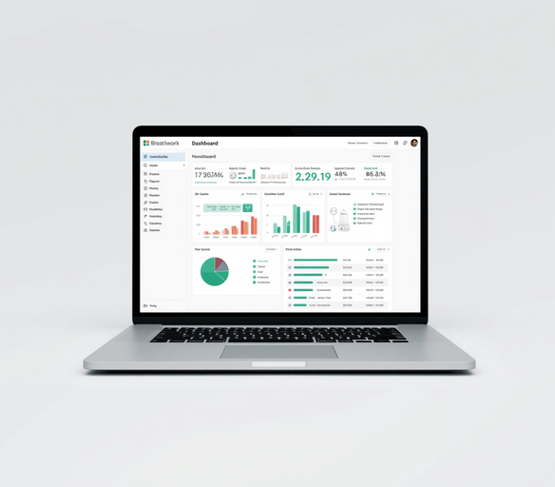
ROADSAFE360
PRESENTATION
HOME
ABOUT
CONTENT
OTHERS
Mobile App &
Website Versions
RoadSafe360 is accessible on both mobile and desktop platforms. The Progressive Web App (PWA) supports offline installation on mobile devices, while the full website delivers a rich dashboard experience for all user roles.
NEXT SLIDE

Slide 13
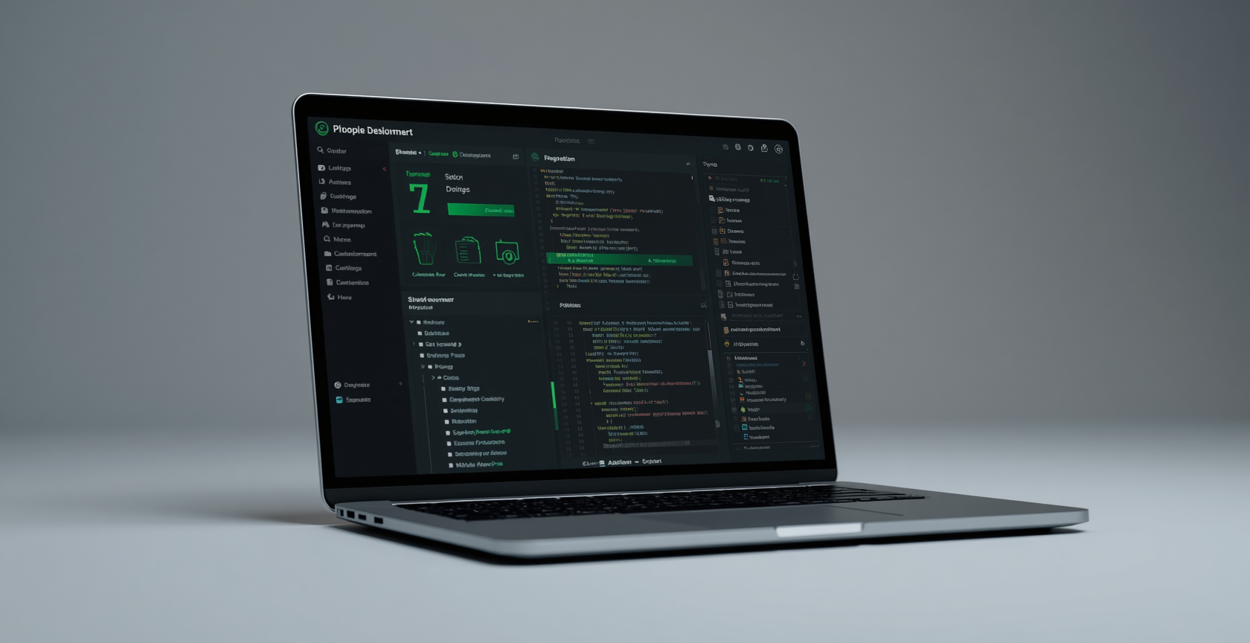

ROADSAFE360
PBL PROJECT
HOME
ABOUT
CONTENT
OTHERS
Deployment & Project Structure
Live Demo: roadsafe-opal.vercel.app
GitHub: github.com/Brian-Kareithi/RoadSafe360
Project Structure:
• /app — Next.js App Router pages
• /components — Reusable UI components
• /contexts — Auth & role contexts
• /firebase — Config & Firestore logic
• /seed — Sample drivers & offences
Hosted on Vercel. Firebase backend requires no .env setup — ready to deploy instantly.
NEXT SLIDE

Slide 14
ROADSAFE360
PRESENTATION
HOME
ABOUT
CONTENT
OTHERS
Educational Value
& Future Work
A PBL classroom tool teaching web development, road safety, and data management. Simulates real-world Kenyan transport systems with regional context, local offences, and live data.
TRY DEMO
Future expansions: more Kenyan regions, mobile app improvements, and AI-driven risk predictions. Explore the system, try the demo, learn road safety smartly!
ROADSAFE360 - INTELLIGENT DRIVER DEMERIT & ROAD SAFETY MANAGEMENT SYSTEM - YEAR 8 PBL PROJECT

Slide 15

ROADSAFE360
PRESENTATION
HOME
ABOUT
CONTENT
OTHERS
Thank You!
GITHUB.COM/BRIAN-KAREITHI/ROADSAFE360
ROADSAFE-OPAL.VERCEL.APP

