Slide 1
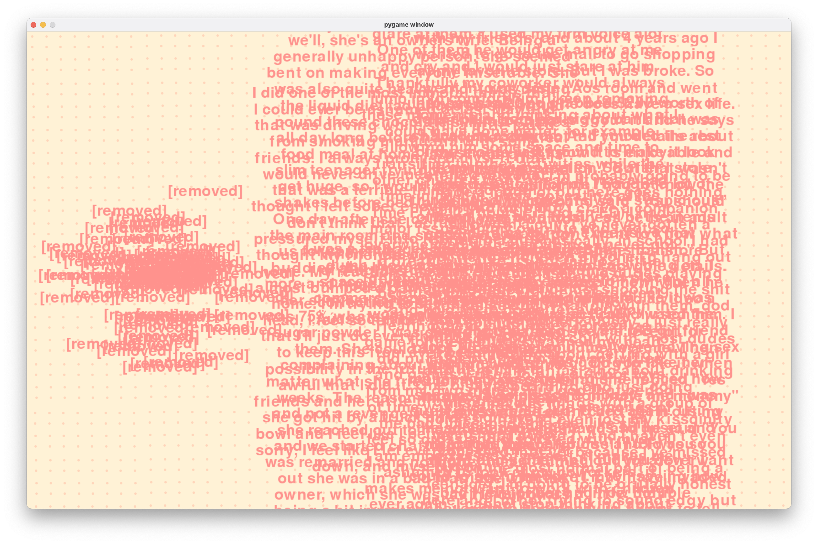
Reddit Comment Contents
Comparing the number of removed comments vs literally ANY other comment

