Slide 1
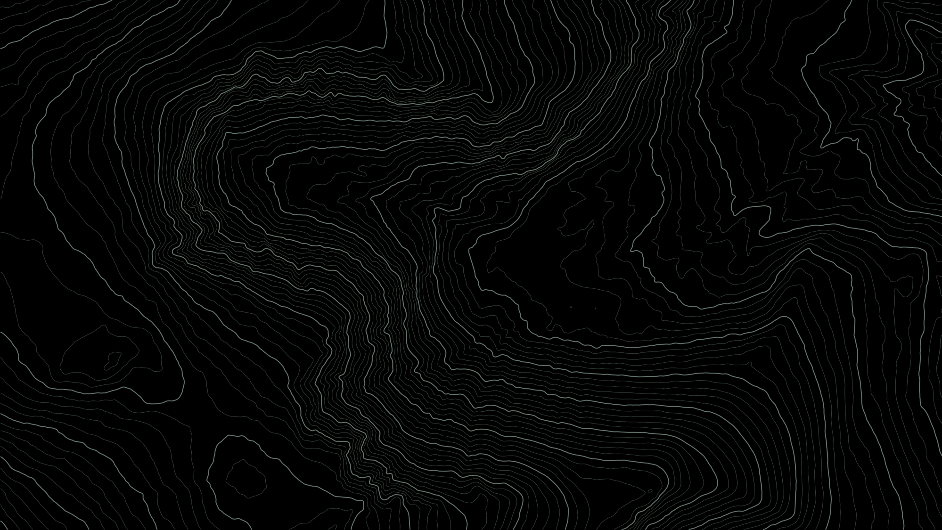
Does Remote Sensing Beat the Trail Map?
MVRL LAB MEETING · 23 OCT 2026
Predicting hiking speed in regions a model has never seen
Brian Zhou
CSE 5999 independent study · Mentors Danni Beaulieu and Tianyi Gao · Advisor Prof. Nathan Jacobs
Background: lidar contours of Mt Washington, NH (USGS 3DEP). Slides made with help from Claude (Anthropic).
Notes:
Hi, I'm Brian. With Danni and Tianyi I'm studying how fast people hike, and whether lidar and other remote sensing can predict it better than the trail map. In five minutes: the problem, the data, two results, and what's next.

Slide 2
GIS still times hikes with a 1993 formula
TOBLER'S HIKING FUNCTION (1993)
CAN THE TRAIL MAP HELP?
v = 6 e^{−3.5 |s + 0.05|} km/h
Share of walked trail with OpenStreetMap's difficulty tag:
96%
s = slope. Fastest, 6 km/h, on a gentle downhill.
Adirondacks
Fit to a textbook table
not to real hikes
1.5%
Green Mountains
Slope is its only input
rocks, roots and brush are ignored
Often the map can't say how hard a trail is.
Notes:
Software that estimates hiking time, like GIS travel-time tools, mostly still uses Tobler's formula from 1993. Speed depends only on slope: fastest, about 6 km/h, on a gentle downhill. Two problems: it was fit to a textbook table, not to real hikes, and slope is its only input. Could the trail map fill the gap? OpenStreetMap has a difficulty tag, but it covers 96% of walked trail in the Adirondacks and only 1.5% in the Green Mountains. (If asked: the tag is sac_scale, the Swiss Alpine Club's grade; flat ground is 5 km/h in Tobler, a 20% climb 2.5 km/h.)

Slide 3
Goal: predict speed in regions the model never saw
WHAT'S BEEN DONE
OUR TEST
Refit the slope curve
with fitness-app data (Campbell et al. 2019, 2022)
Train on 16 regions, predict the 17th. Repeat for each region.
Add map or lidar inputs
Wood et al. 2023; STRIDE 2024; RasterNet (this lab, 2020)
train on 16 regions
test
Four models, same learning, different inputs:
Slope only
like Tobler
Map tags
OSM trail tags
Gap: always tested in the same area they were trained on.
Remote sensing
lidar terrain, vegetation
Both
tags + remote sensing
Notes:
Earlier work either refits the slope curve with data from fitness apps, or adds map and lidar inputs, but it always tests in the same area it trained on. The real use is a place with no data, so that's our test: train on 16 regions, predict the 17th, and repeat for every region. We compare four models that learn the same way but see different inputs: slope only, the map's tags, remote sensing, or both. (If asked: STRIDE is a lidar walking-speed model from timed field walks; RasterNet is our lab's road-speed model from lidar and overhead imagery.)

Slide 4
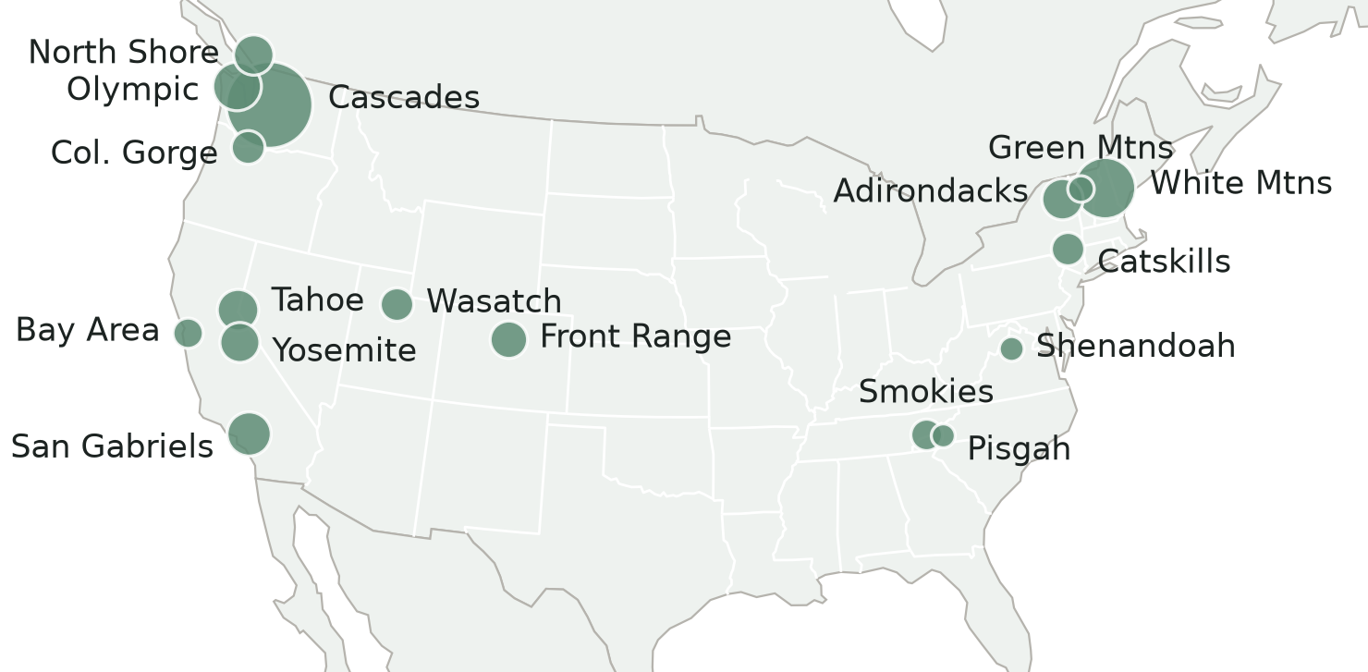
Data: 1,992 real hikes in 17 regions
1,992
hikes, from public GPS traces
290,640
trail segments of 50 m, each with a measured speed
Circle size = hours of walking
Public GPS traces from OpenStreetMap
Clean, remove stops, snap to the trail map
50 m segments with slope, map tags and lidar
Notes:
The data are public GPS tracks that hikers upload to OpenStreetMap, from 17 mountain regions in the US and Canada; bigger circles mean more hours of hiking. I clean each track, remove stops, snap it to the trail map, and cut it into 50-meter pieces, each with a measured speed. That's about 2,000 hikes and 290,000 pieces. (If asked: 14,500 km and 4,700 hours of walking; snapping uses a hidden Markov model, and 85 to 99% of points match, by region.)

Slide 5
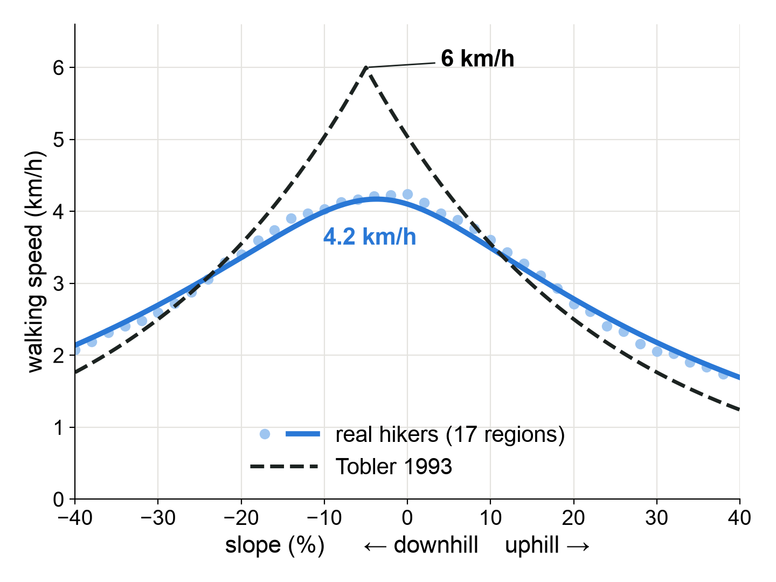
Tobler's formula is too fast for real hikers
4.2 km/h
real hikers' top speed
Tobler says 6 km/h
17 of 17
regions where Tobler predicts worse than a curve fitted to real hikes
Notes:
First result. The dots are real hikers' typical speed at each slope, downhill on the left, uphill on the right; the dashed line is Tobler. Real hikers top out around 4.2 km/h, not 6, so on everyday trail Tobler is about 20% too fast. And it predicts worse than a simple curve fitted to real hikes in all 17 regions. (If asked: going down is 8 to 23% faster than going up for the same hiker on the same trail, while Tobler assumes 42%; overall Tobler scores 12.5% worse.)

Slide 6
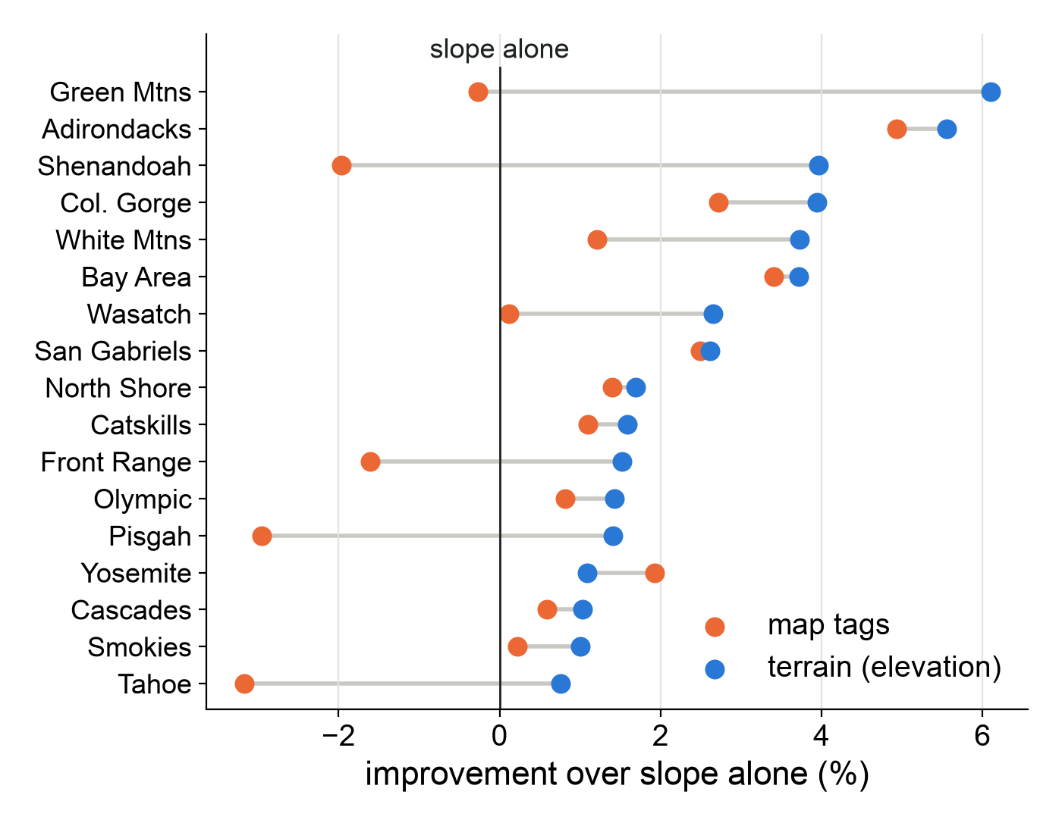
In new regions, terrain beats map tags
16 of 17
new regions where terrain predicts better than map tags
2–3%
terrain's improvement over slope alone
map tags: under 1%
Each row: train on the other 16 regions, test on this one.
Notes:
This is the main result. Each row is one region the model never saw: it learned from the other 16 and was tested on this one. The black line at zero is slope alone, the curve from the last slide; dots to the right are better predictions. Blue adds terrain from lidar elevation maps, mostly the hidden ups and downs inside each 50-meter stretch that the average slope misses. Orange adds what the map says about the trail, like its difficulty grade and surface. Blue beats orange in 16 of 17 regions and is right of zero in every one. Orange is left of zero in five: there, tags learned elsewhere actually misled the model. Overall, terrain is 2 to 3% better than slope alone; tags, under 1%. (If asked why so small: speed is noisy; after slope, a quarter of what's left differs between hikes and the rest from stretch to stretch, and nothing we tried does much better; against Tobler, terrain is about 13% better. The score is CRPS, which grades the whole predicted range of speeds, and RMSE agrees. Terrain's lead over tags is +0.7 to +2.2 points, 95% interval. It holds with every hiker from the test region removed from training. Yosemite, the one exception, isn't investigated yet.)

Slide 7
Next steps
Done so far: the dataset, the four-model comparison and a rough first draft of the paper.
Weeks 10–11
Learn Tobler's constants from terrain, with uncertainty
Week 12, if time
Add aerial imagery (NAIP) with a pretrained encoder
January
Submit the paper to IGARSS 2027 (due 11 Jan)
Question for you: which pretrained encoder would you use for 1 m aerial imagery along trails?
Notes:
So far: the dataset, the four-model comparison, and a rough first draft of the paper. Next, in weeks 10 and 11: keep Tobler's formula, but let a small neural network learn its numbers from the terrain, so smooth and steppy trail get their own numbers. It also says how sure it is. On November 6 we check whether it beats the boosted trees. Week 12, if there's time: add aerial photos through a pretrained image model. Then the paper goes to IGARSS; the deadline is January 11. One question for you: which pretrained encoder would you use for 1-meter aerial imagery along trails? Thank you. (If asked: Why Tobler's form and not just the trees? It gives numbers the field can use, like how Tobler's steepness constant changes from smooth to steppy trail. Why would photos help when the satellite embeddings didn't? They might not: the 10 m embeddings mostly told the model which place it was in, while 1 m photos see the trail itself; the new-region test decides. NAIP covers only the US, so North Shore drops out of that test. The draft was written with Claude's help from our results, and I'm rewriting it in my own words.)

