Slide 1
Heartbeat Monitor with AD8232
Brian Lopez

Slide 2
AIM & ACCOMPLISHMENT
AIM:
To read the heart rate of a human and display the signal in the form of a graph to a PC after some smoothing.
ACCOMPLISHMENT
Implementation of the AD8232 to read in the data from the biomedical sensor pads connected to a person.
Implementation of the HC-05 to obtain the heart rate data and send it to a PC wirelessly.

Slide 3
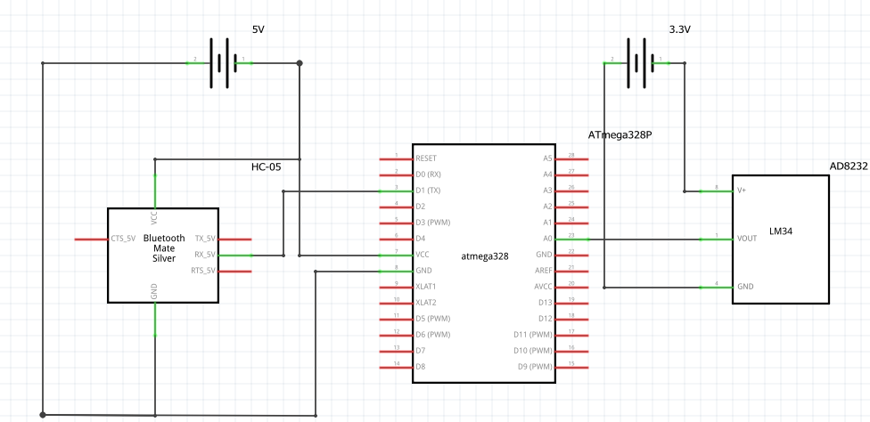
SCHEMATICS
Complete schematics
*note that the LM34 on the left is a placeholder for the AD8232. A schematic for the AD8232 is not available in Fritzing. *

Slide 4
DESIGN STAGES
Components
AVR ATMEGA328p
SparkFunAD8232
HiLetGo HC-05
Interfaces
AD8232 – ATmega328p using ADC
ATmega328p – HC-05 using USART
HC-05 – PC using USART
HOSTs
PC for displaying graph.

Slide 5
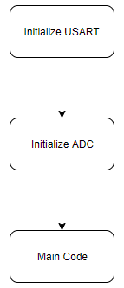
CODE DEVELOPMENT
Initialization
The first task that must be done is to initialize both the ADC to channel 0 and USART with a baud rate of 9600.

Slide 6
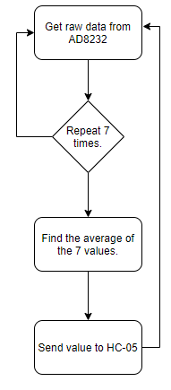
CODE DEVELOPMENT
Data Collection
Collect the raw data from the AD8232 seven times with a small delay in between.
Sum the seven values and find the average of the values.
Send the value to the HC-05

Slide 7
CODE DEVELOPMENT
HC-05 Send Data
The HC-05 will simply receive the heart beat value and send it to the PC through the Bluetooth connection.
Host PC
Receives the data and plots it onto a graph that shows the heart beat in real time.

Slide 8
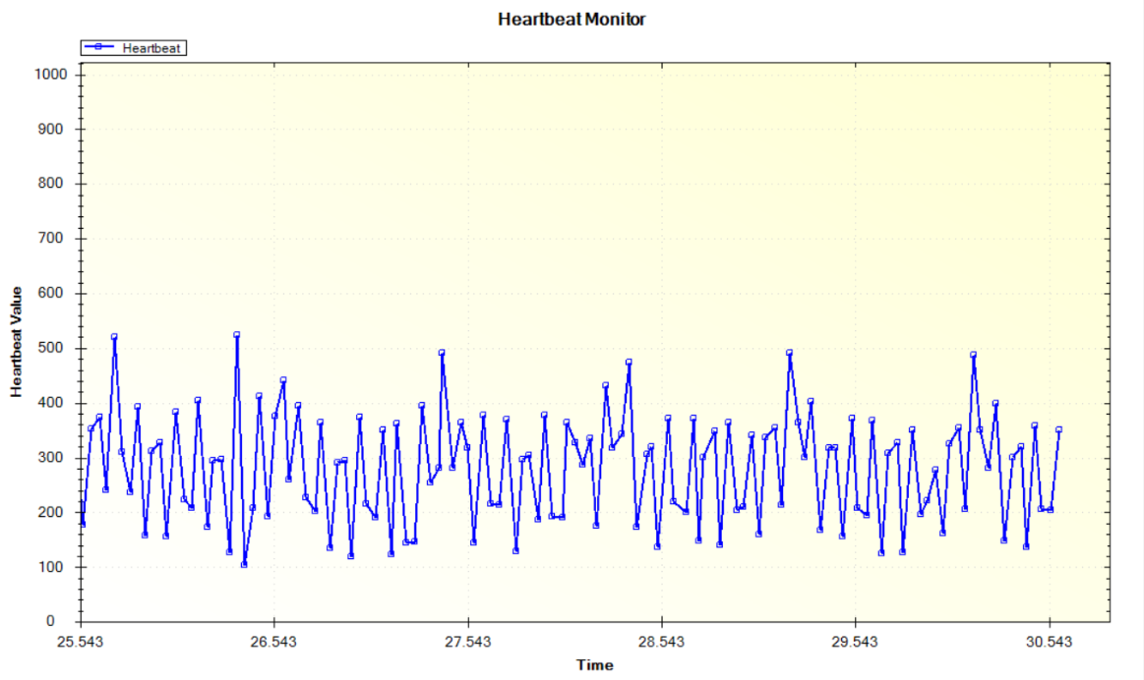
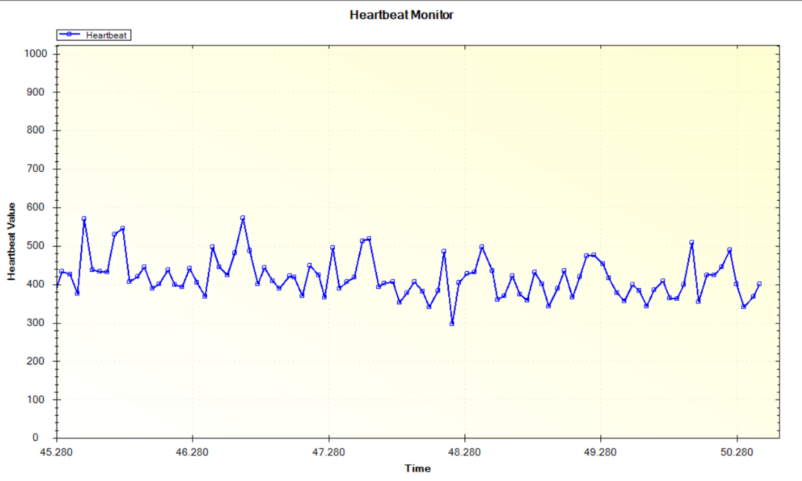
DEMO SNAPSHOT/VIDEO
Video: https://www.youtube.com/watch?v=1x0dk_k_yhs
No Filtering With Filtering

Slide 9
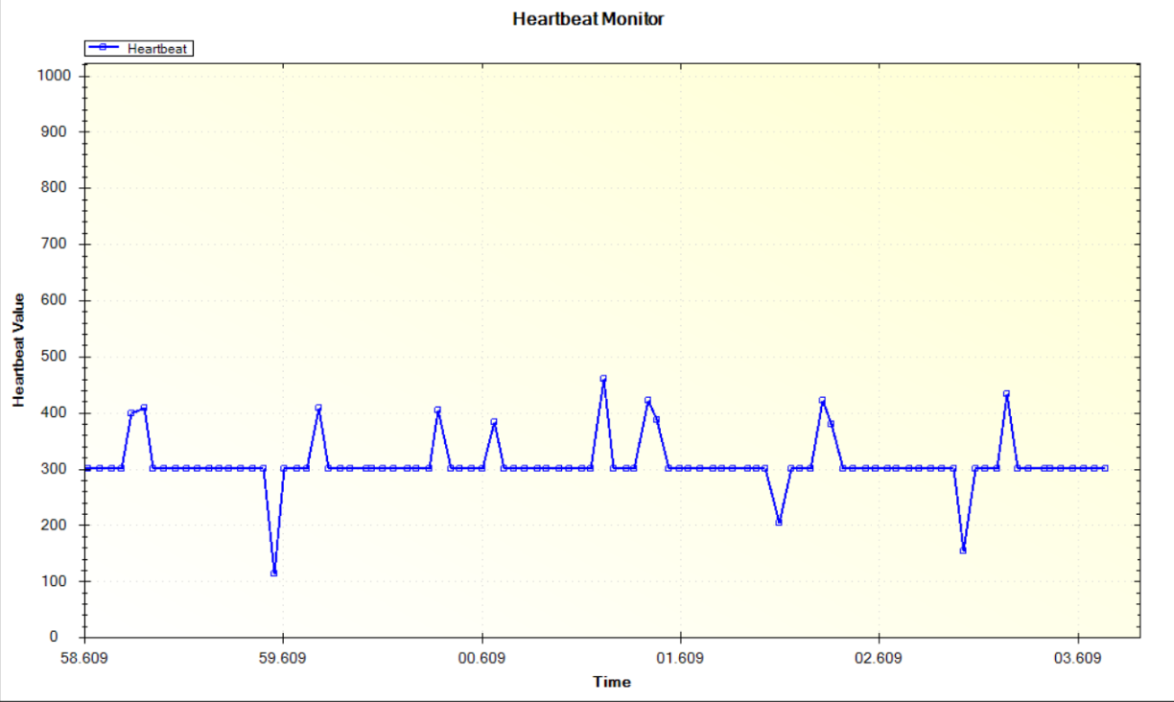
Extra Filtering
A more extreme filtering was also implemented that gets rid of all the jagged values in the middle of the graph. This will only show the P and S peaks.
Can be used to just notice every heart beat the occurs and nothing else.

