Slide 1
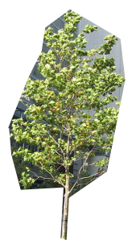
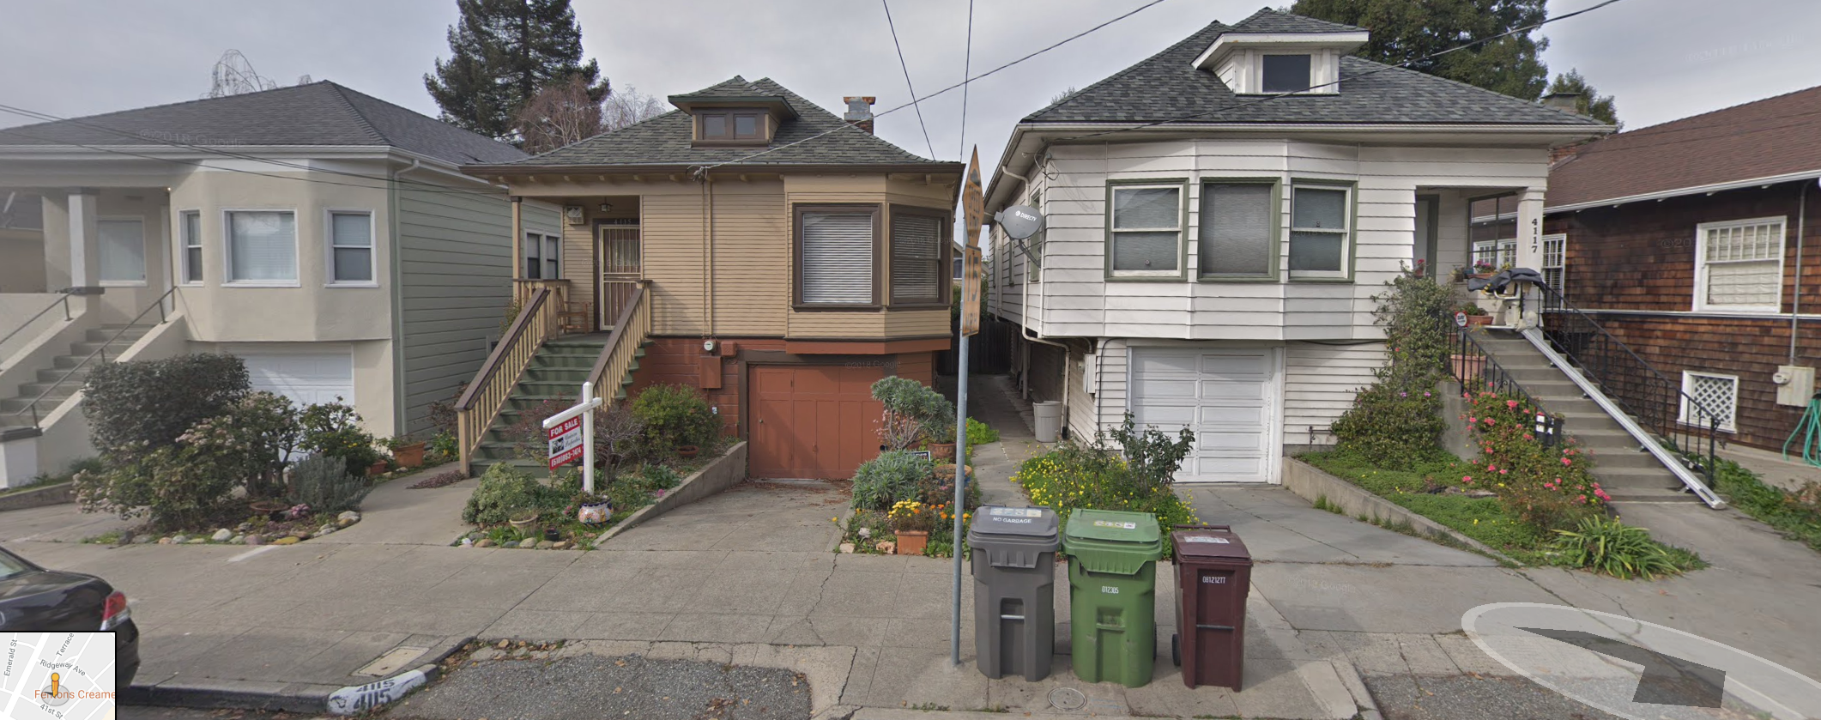
SURF helps to profile the middle building based on metadata of its neighbor using machine learning.

