Slide 1
Human resources slide 1
B&K STOCK MANAGEMENT SYSTEM
By Brian Arnautov & Kishaan Thalayasingam.

Slide 2
Human resources slide 2
Contents
Explanation of what our application is and its usage
Features that we decided to implement
Technologies used and their purpose
How the project tasks were divided amongst us
Difficulties and Ease along the development
Regrets along the way
How we dealt with Git conflicts

Slide 3

Human resources slide 8
What is B&K STOCK MANAGEMENT
Usage and basic functionalities
Stock system that keeps up with a business’s stock of products
Initially and built around for restaurants
Count of all products
Ability to order with working companies
Simple and easy to use

Slide 4





Human resources slide 4
Basic CRUD Operations in the Database
Ability to Create, Read, Update and Delete elements within Tables
Tracking Status of Orders
Different Login Interfaces
Orders and Deliveries will have Status
Depending on Employee position, user will have different controls
Work directly with supplier companies
Search for Products
Assuring that specific products are in stock
Simulation of ordering Products
Features that we decide to implement

Slide 5
Types of Technologies Used
IntelliJ
MVC, Singleton & Abstract Factory Designe Patterns
JDBC
Used to implement the project and to develop the console user interface
-MVC allowed to easily organized our classes.
-Singleton allowed certain to have only one instance
-Abstract Factory aides in creation of many classes
To store data such as products
- To be able to view the status of deliveries and orders

Slide 6


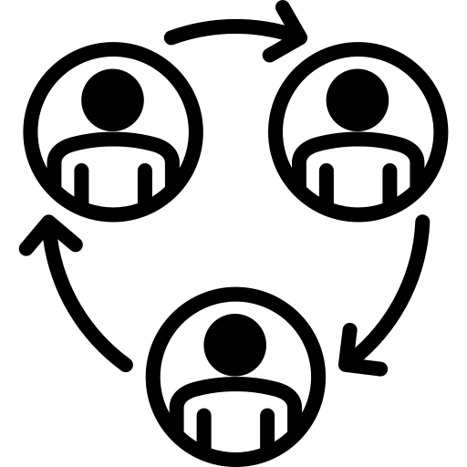

Human resources slide 5
How the Tasks were divided
SQLITE & JDBC
Those proficient with class logic and JDBC
HLAN
Classes
User Interface
Those who comprehend JDBC and can envision the proper interface
Those proficient with class logic that carries on to interface creation

Slide 7
Human resources slide 8
Struggles and Ease
Difficulties:
Logic behind Classes and Database
Creation of readable console output
Time Management
Properly connecting the Java portion & JDBC
Creation of a proper UML
Git Conflicts
Eases:
Creation of Database itself
Creation of the classes
Creation of the views using printf

Slide 8
Human resources slide 1
Regrets
Time Management
Proper GUI interface
Properly assessing how things should be implemented

Slide 9
Human resources slide 10
Thank You

