Slide 1
Docker + Kubernetes

Slide 2
1
Docker Basics
Docker, docker images, and container registry

Slide 3
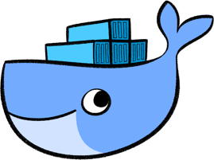
1.1 What is Docker?
Open source containerization platform
Makes it easier and safer to organize containers

Slide 4
1.2 What is a Docker Image?
An image is a bundle of files
Contains all the information needed to set up an operational container

Slide 5
1.3 What is Container Registry
A container registry is a place where you can manage all your image
There are many tools present that can help you analyze your images, scan for vulnerabilities, etc.

Slide 6
2
Why Docker?
What is the benefit of using Docker?

Slide 7
2. What is the benefit of Docker?
You can build containers without Docker, but…
Docker makes it easier to manage containers because of its simple commands
Docker is also more efficient and uses less memory compared to VMs

Slide 8
3
Basic Docker Commands
Start/Stop/Restart/Delete

Slide 9
3.1 Basic Container Commands
Start a Docker container
Stop a Docker Container
Restart a Docker Container
Delete a Docker Container

Slide 10

3.2 Basic Image Commands
Build an image from a Dockerfile
Remove an image

Slide 11
4
Container Practice
Run a new container

Slide 12
4. Run a Docker Container
Follow question 3, write a command to run a docker container that able to fit following requirements a. Mount local path “[your path to root]/data” to container path “/workingdir/data” b. Bind port 80 to 8080 of your local machine (Use “curl 0.0.0.0:8080” to verify result)

Slide 13
5
Kubernetes & Helm
Describe Kubernetes & Helm

Slide 14
5. What is K8s? What is Helm?
While Docker is used to manage containers, Kubernetes is used to organize and scale containerized applications
Helm is like the package manager for Kubernetes. It helps developers organize all the related files of a Kubernetes application into a chart datastructure.

Slide 15
6
Kubernetes & Helm
Benefits of Kubernetes & Helm

Slide 16
6. Benefits of K8s and Helm
K8s allows companies to control and automate deployment/updates and scale applications across multi-cloud environments.
Helm removes the need of having separate YAML files for each workload and instead it can deploy the application to the cluster for you via a Helm Chart

Slide 17
7
Kubernetes Components
Node/Service/Pod/Ingress/Namespace/Helm

Slide 18
7.1 What is a Pod in K8s?
A pod is the smallest structure in Kubernetes.
It contains a group of one or more containers, with shared storage and network resources, and a specification for how to run the containers.

Slide 19
7.2 What is a Service in K8s?
Since every pod has its own IP address, and pods are ephemeral (他們很常掛掉), when a pod dies, a new pod replaces the original one, but it has a different IP address than the original one.
That’s why we need services, which provide a stable, persistent IP address for a pod.
K8s services also automatically balances workload between pods.

Slide 20
7.3 What is a Namespace in K8s?
Kubernetes clusters are basically a group of nodes.
Clusters are comprised of one master node and a number of worker nodes.

Slide 21
7.4 What is a Node in K8s?
A node is a structure in Kubernetes that holds one or more pods.
Separate pods do not generally share anything even if running on the same physical node.

Slide 22
7.5 What is a Cluster in K8s?
Kubernetes clusters are basically a group of nodes.
Clusters are comprised of one master node and a number of worker nodes.

Slide 23
7.6 What is Ingress in K8s?
An API object that provides routing rules to manage external users' access to the services in a Kubernetes cluster
With Ingress, you can easily set up rules for routing traffic without creating a bunch of Load Balancers or exposing each service on the node.

Slide 24
8
Accessing a K8s Cluster

Slide 25
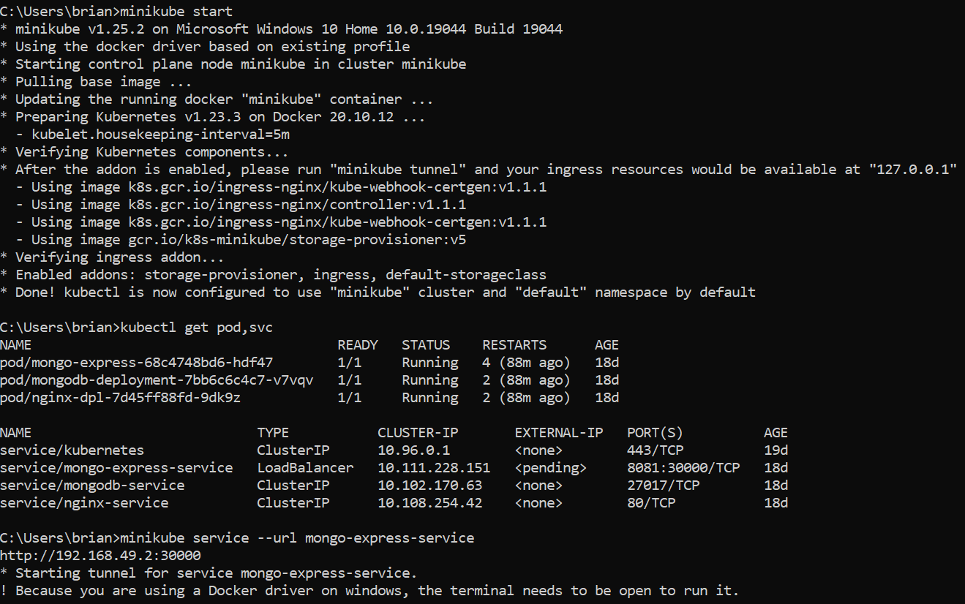
8 Accessing a Cluster

Slide 26
9
Get the Logs of a Pod

Slide 27
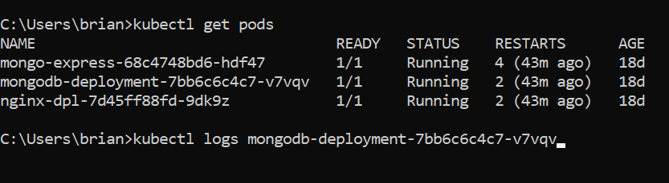
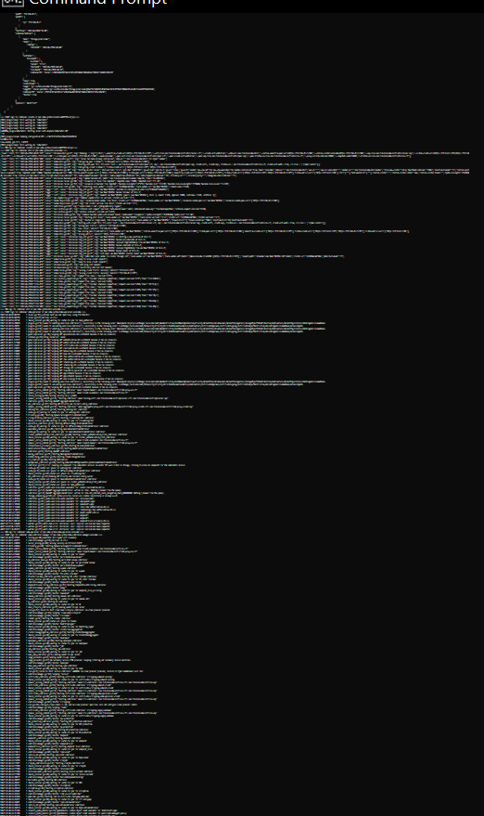
9 Get the Logs of a Pod

Slide 28
10
Details of a Resource

Slide 29
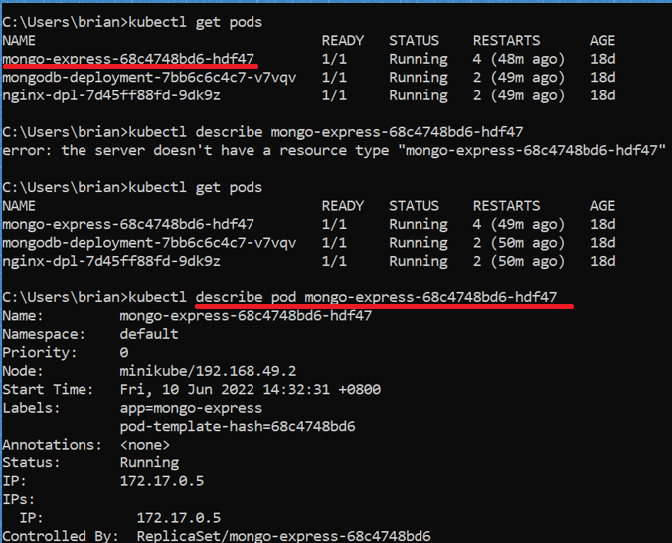
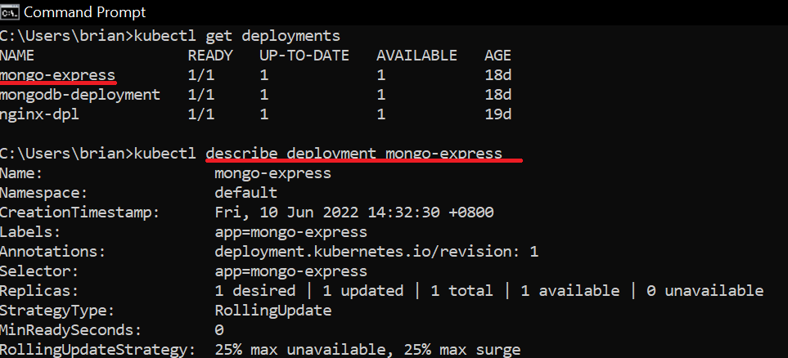
10. The “describe” command

Slide 30
Thanks!

