Slide 1
Data Science Salary Analysis
Prepared for the CEO
By Brian D’Alelio
11/28/2025

Slide 2
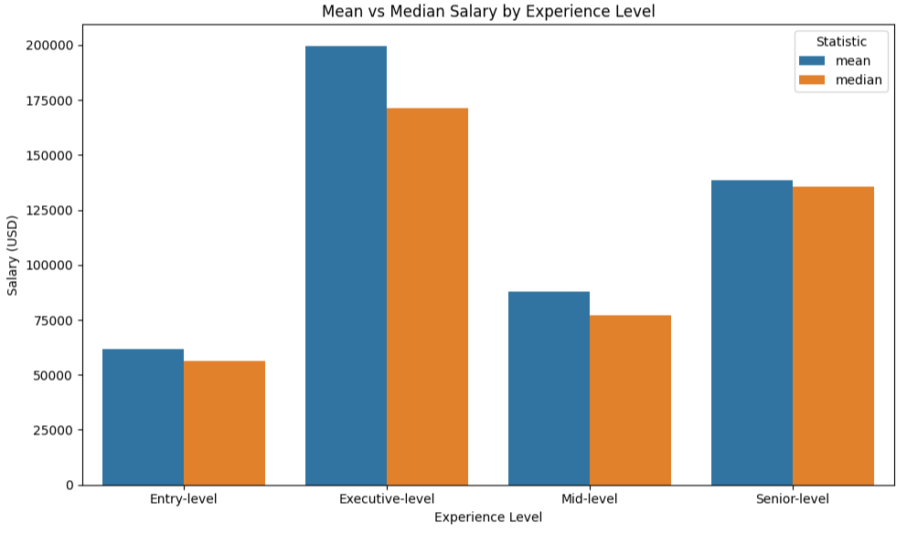
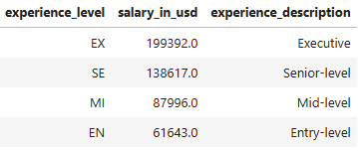
Salaries Rise Sharply with Experience

Slide 3
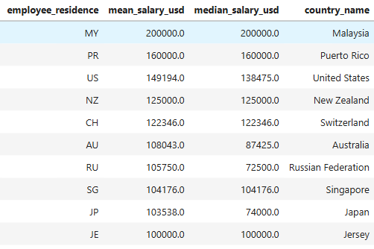
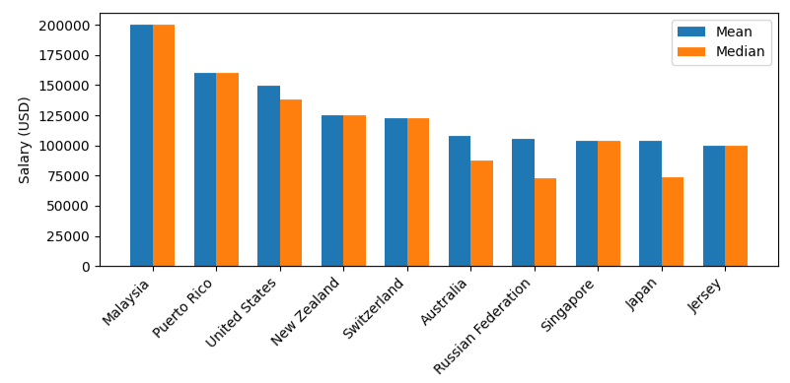
U.S. Salaries Rank Among the Highest Worldwide

Slide 4


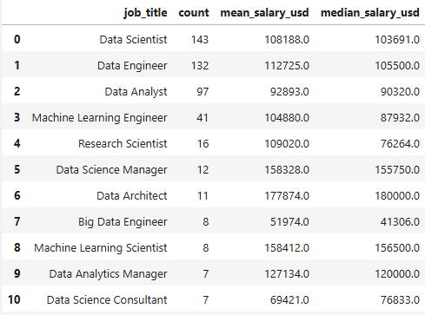
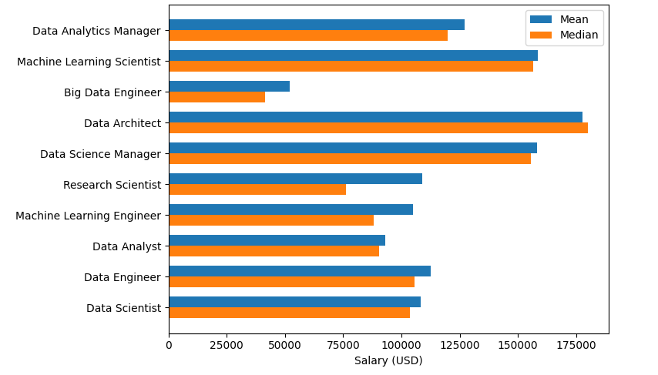
Compensation by Job Title and Conclusion
To hire someone who can drive data science within the entire organization and potentially grow a team in the future, the realistic competitive range is $130,000-$150,000 USD.
Our analysis suggests we are targeting a senior-level data scientist, and this range aligns with both global market data and the compensation norms for similar roles.

