Slide 1
Bluetooth and Wireless PAN
IEEE 802.15
Wireless Networking
Lecture 6

Slide 2
References
Price, R. (2006), Fundamentals of Wireless Networking. Chapter 7: Bluetooth and Wireless Personal Area Networks
Schiller, J.H. (2003), Mobile Communications, Second Chapter 7: Wireless LAN
www.bluetooth.org
www.bluetooth.com

Slide 3
Objectives
Understand the Bluetooth technology and its operation
Understand the WPAN concepts and the IEEE 802.15 standards
Review WPAN technology

Slide 4
Types of Networks
Personal Area Network (PAN)
Connects computing and other devices in the immediate vicinity of an individual to support the activities of that individual
Home Area Network (HAN)
Network limited to the immediate vicinity, inside and outside, of a home that connects a wide range of devices

Slide 5
Bluetooth

Slide 6
Bluetooth – Basic Idea
Basic idea
Universal radio interface for ad-hoc wireless connectivity
Interconnecting computer and peripherals, handheld devices, PDAs, cell phones – replacement of IrDA
Embedded in other devices, goal: 5€/device (already < 1€)
Short range (10 m), low power consumption, license-free 2.45 GHz ISM
Voice and data transmission, approx. 1 Mbit/s gross data rate

Slide 7
Bluetooth - History
History
1994: Ericsson (Mattison/Haartsen), “MC-link” project
Renaming of the project: Bluetooth according to Harald “Blåtand” Gormsen [son of Gorm], King of Denmark in the 10th century
1998: foundation of Bluetooth SIG, www.bluetooth.org
1999: erection of a rune stone at Ercisson/Lund ;-)
2001: first consumer products for mass market, spec. version 1.1 released
2005: 5 million chips/week

Slide 8
Bluetooth Special Interest Group
The Bluetooth standard is developed, managed, and controlled by the Bluetooth Special Interest Group (SIG)
Original founding members: Ericsson, Intel, IBM, Nokia, Toshiba
Added promoters: 3Com, Agere (was: Lucent), Microsoft, Motorola
> 10000 members
Common specification and certification of products

Slide 9


Bluetooth was named after a Danish king, Harold
Blatand, who had the nickname of Bluetooth. He had an
uncharacteristically dark beard and a fondness for
blueberries, which stained his teeth blue. King Blatand
united Denmark and Norway in the same way it
was hoped that Bluetooth would unite the
mobile communications world.
Dr. Japp Haartsen and Dr. Sven Mattisson are credited with being the co-inventors of the Bluetooth technology.
Notes:
Telefonaktiebolaget LM Ericsson
In 1994, Ericsson, as this company is more commonly known around the world, decided to develop a low-power, low-cost radio interface that could be built into cellular telephones, mobile phones, portable computers, and their accessories to replace the need for connecting cables. However, during the ongoing engineering of this technology, it was discovered that the interface could also serve as a universal bridge that could be used to form private ad-hoc groups of linked devices. Ericsson engineers Dr. Japp Haartsen and Dr. Sven Mattisson (shown below) are credited with being the co-inventors of the Bluetooth technology.
In 1998, Ericsson joined with other companies interested in pursuing this new technology, which had been designated as Bluetooth, to form the Bluetooth Special Interest Group (SIG). The original SIG companies are Ericsson, IBM, Intel, Nokia, and Toshiba. Today the SIG also includes thousands of associate companies interested in promoting Bluetooth technology.

Slide 10
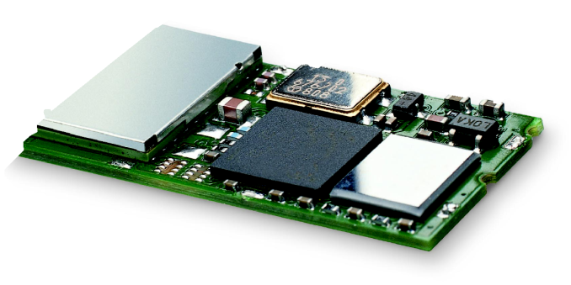
Bluetooth Application Module
An integrated microprocessor module with protocols necessary to create ad-hoc connections with other Bluetooth devices
A Bluetooth application module

Slide 11
Bluetooth Characteristics
2.4 GHz ISM band, 79 RF channels, 1 MHz carrier spacing
Channel 0: 2402 MHz … channel 78: 2480 MHz
G-FSK modulation, 1-100 mW transmit power
FHSS and TDD
Frequency hopping with 1600 hops/s
Hopping sequence in a pseudo random fashion, determined by a master
Time division duplex for send/receive separation

Slide 12
Bluetooth Characteristics
Voice link – SCO (Synchronous Connection Oriented)
FEC (forward error correction), no retransmission, 64 kbit/s duplex, point-to-point, circuit switched
Data link – ACL (Asynchronous ConnectionLess)
Asynchronous, fast acknowledge, point-to-multipoint, up to 433.9 kbit/s symmetric or 723.2/57.6 kbit/s asymmetric, packet switched
Topology
Overlapping piconets (stars) forming a scatternet

Slide 13
Bluetooth Versions
Bluetooth 1.1
initial stable commercial standard
Bluetooth 1.2
Data rate = 721kbits/s
Bluetooth 2.0 (2004)
EDR (enhanced date rate) of 3.0 Mbit/s
lower power consumption

Slide 14
Bluetooth Versions
Bluetooth 2.1 (2007)
better pairing support, e.g. using NFC
improved security
Bluetooth 3.0 + HS (2009)
Bluetooth 2.1 + IEEE 802.11a/g = 54 Mbit/s
Bluetooth 4.0
The Bluetooth SIG has just completed the Bluetooth Core Specification version 4.0, which includes Classic Bluetooth, Bluetooth high speed and Bluetooth low energy protocols. Bluetooth high speed is based on Wi-Fi, and Classic Bluetooth consists of legacy Bluetooth protocols.

Slide 15
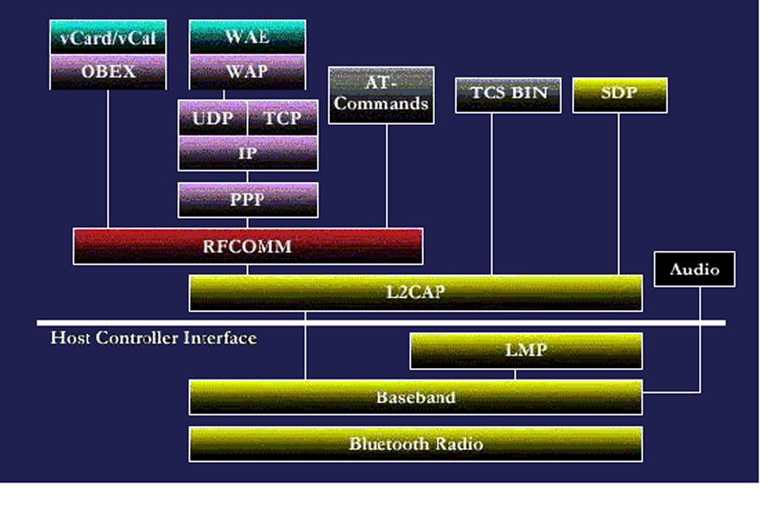
Bluetooth Protocol Architecture
The protocols shown in gold are Bluetooth-specific protocols and those shown in green, purple, and grey are standard telephony and networking protocols.

Slide 16
Operational Layers
Radio frequency communications
The Radio layer of the Bluetooth specification defines the operations of the Bluetooth transceiver (transmitter/receiver) operating in the 2.4 GHz Industrial, Scientific, and Medical (ISM) radio frequency band. Corresponds to OSI Physical layer.
Baseband communications
The Bluetooth Link Controller (LC) controls the functions of baseband protocols and media access and link control functions. Provides links to and from other communication services, including error correction, hop selection and Bluetooth security. Corresponds to OSI Media Access Control (MAC) sublayer.

Slide 17
Operational Layers
Link management
The Bluetooth Link Manager Protocol (LMP) is used by devices to create, setup, and control links to other devices.
Logical link control
The Bluetooth Logical Link Control and Adaptation Protocol (L2CAP) provides high-level multiplexing, packet segmentation and reassembly, and the management of quality of service (QoS) data. Corresponds to OSI Logical Link Control (LLC) sublayer.

Slide 18
Operational Layers
Serial port emulation
The Bluetooth RFCOMM layer emulates the function of serial ports through the L2CAP protocol. RFCOMM is a cable replacement protocol that creates a virtual serial port for RF communications
Service discovery
The Service Discovery Protocol (SDP) allows applications to discover the services provided by or available on another Bluetooth device and to determine the characteristics of available services.

Slide 19
Bluetooth Transmitter Classes
Transmitters are divided in Class 1, Class 2 (the default), and Class 3
Class | Range | Transmission Power
 |  | Maximum | Minimum
1 | 100 meters | 100 mW | 1mW
2 | 10 meters | 2.5 mW | 0.25 mW
3 | 10 centimeters | 1 mW | None

Slide 20
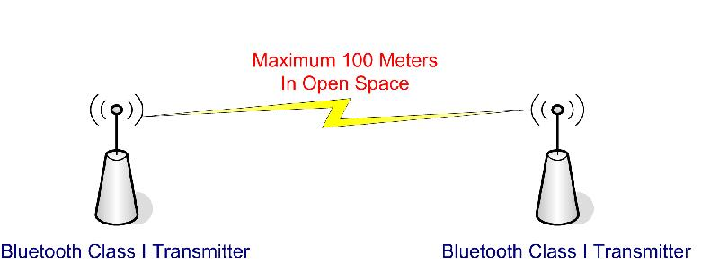
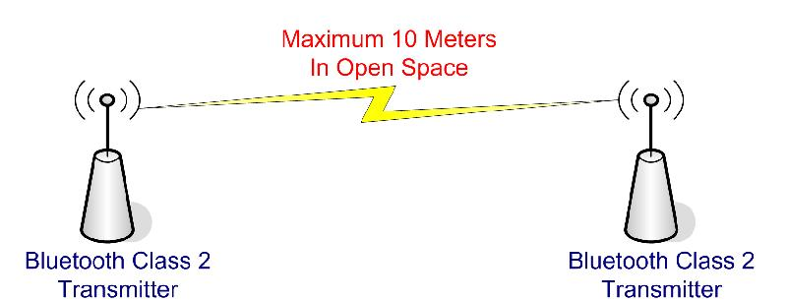
Bluetooth Classes

Slide 21
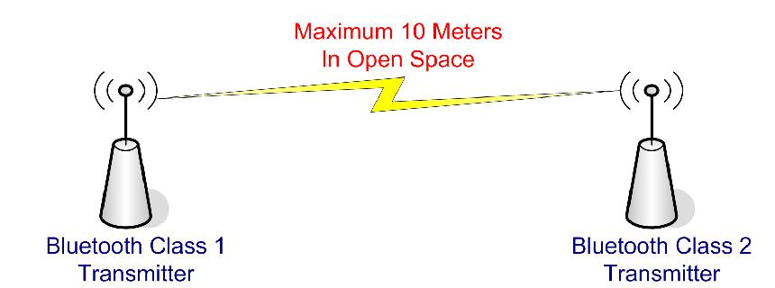
Transmitter Range
The strength of the power source and the environment both affect the actual range
Two Bluetooth devices with different transmitters use the range of the lowest class.

Slide 22
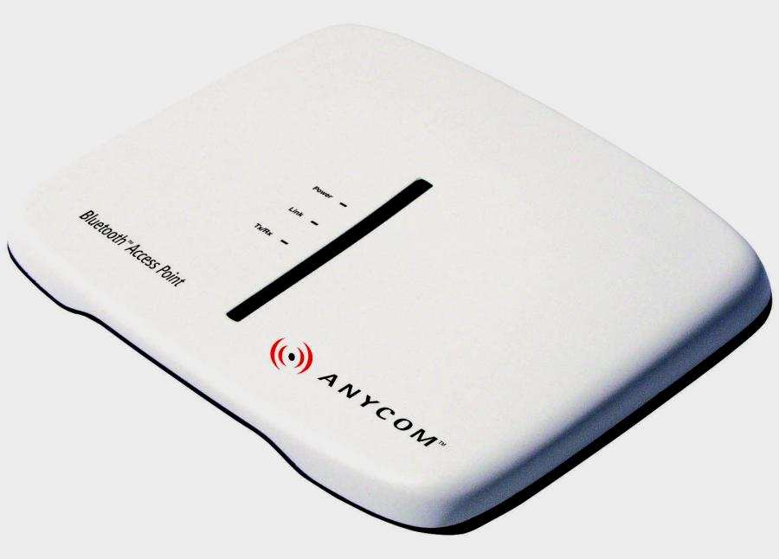
Bluetooth Networking
Ad-hoc networks created through a discovery process
A Bluetooth network is called a piconet
Each piconet may contain up to 8 devices
Two or more interconnected piconets are called scatternets
Devices in different piconets communicate through other devices
May connect into a wired network through an access point

Slide 23
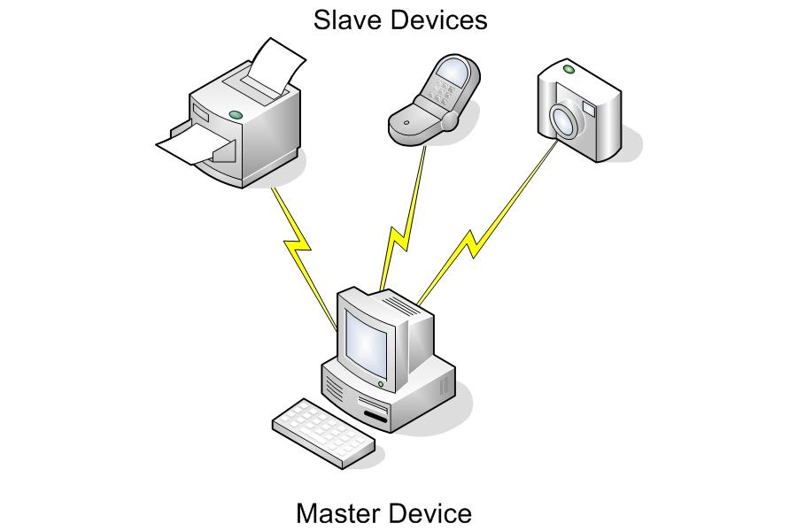
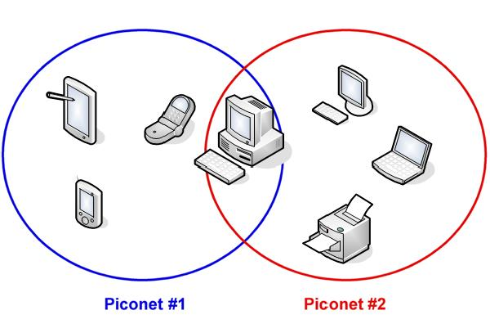
Piconet and Scatternet
A Bluetooth piconet.
One or more piconets combine to form a scatternet.

Slide 24
Master and Slave
Initially when two devices form a piconet, the device initiating the link is the master and the discovered device is the slave
Each device has a unique clock signal, or hopping sequence, and address
The slave adopts the clock signal of its master, which determines its hopping sequence
Therefore master determines hopping pattern, slaves have to synchronise

Slide 25
Master and Slave
Each piconet has a unique hopping pattern
A device may participate in more than one piconet, but cannot be a master in both
If the master leaves a piconet, then a new master must be elected
Any Bluetooth device may be a master or slave

Slide 26
Master and Slave
A master device actively scans for slave devices and when it detects one in its range, it can invite the device to join a piconet as a slave, or…
A master device can passively wait for slaves to contact it and then invite the slave to join the piconet as a slave
Participation in a piconet = synchronization to hopping sequence
Each piconet has one master and up to 7 simultaneous slaves (> 200 could be parked)

Slide 27
Piconet
P
S
S
M
P
SB
S
P
SB
M=Master
S=Slave
P=Parked
SB=Standby

Slide 28
Scatternets
A group of between two and ten non-synchronized piconets that connect through a common device that serves as a bridge between the piconets
Occurs when a master or slave becomes a slave in another piconet
To communicate across a scatternet, a device must support point-to-multipoint communications
Communication between piconets is achieved by devices jumping back and forth between the piconets

Slide 29
Scatternets
Since, piconets are not synchronized, communicating from one end of the network to the other can be virtually impossible at times.
Piconets can be formed and dissolved quickly and frequently.

Slide 30
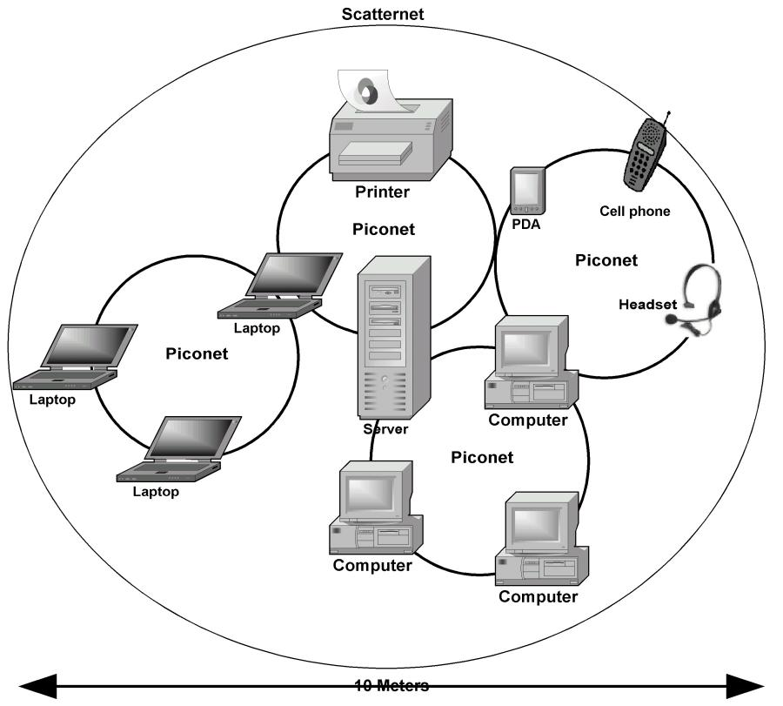
WPAN
A scatternet can cluster several piconets into a WPAN.

Slide 31
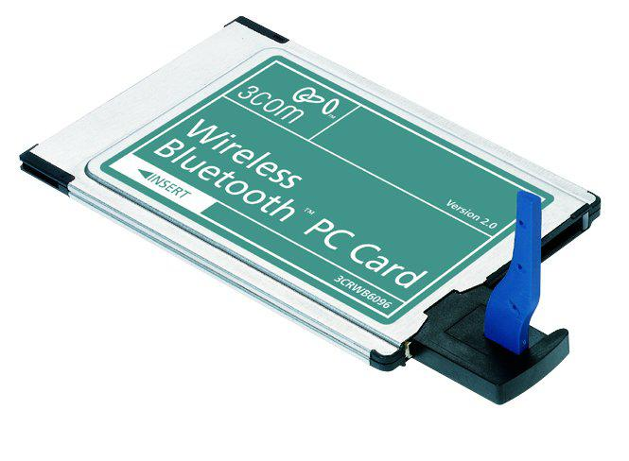
Connecting Bluetooth Devices
Many Bluetooth devices continuously scan for other devices
Others require the user to activate the discovery (masters) or search (slaves)
A USB Bluetooth Adapter provides Bluetooth capability to a PC. Photo courtesy of Novell, Inc.

Slide 32
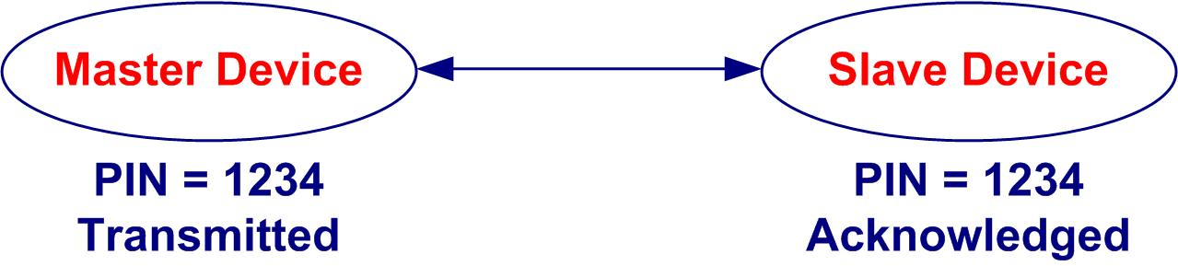
PIN Codes
Personal identification number (PIN) codes are used for security to limit who can connect to a Bluetooth device
Some Bluetooth devices require the master device to provide a preset PIN code to establish a connection.

Slide 33
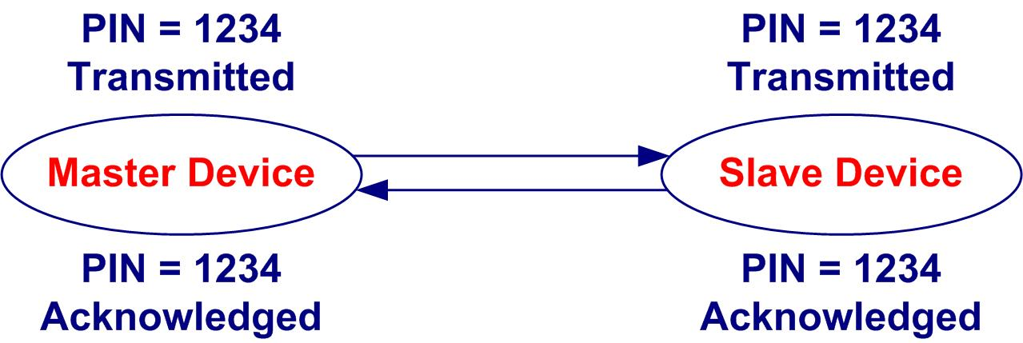
Pairing
Pairing uses PIN codes specified by the user
Pairing uses a user-defined PIN-code to be exchanged between two Bluetooth devices.
Notes:
Bluejacking and Toothing
Some seemingly harmless activities have become popular among Bluetooth users, especially those that gather in fairly crowded places: Bluejacking and Toothing.
Bluejacking involves sending messages from a Bluetooth device to any other nearby Bluetooth devices, surprising the recipient. There’s even a website dedicated to this activity: www.bluejackq.com.
Toothing is a bit more goal-oriented than bluejacking. In toothing, like bluejacking, the communications are to other Bluetooth users in an immediate (10 meters), but the objective is not for surprise as much as it is to arrange for casual meetings and perhaps even a date.

Slide 34
Bluetooth Profiles
Bluetooth applications follow guidelines defined as Bluetooth profiles
Ensure interoperability between devices that provide the same or similar applications
Notes:
Note
There are new Bluetooth profiles in development at any time. If you wish to keep current with the profiles, you should visit the Bluetooth News web pages (www.bluetooth.com/news/) regularly.

Slide 35
Bluetooth Profiles
Applications
Protocols
Example Profiles
Advanced Audio Distribution
PAN
Audio Video Remote Control
Basic Printing
Basic Imaging
Extended Service Discovery
Generic Audio Video Distribution
Hands Free
Hardcopy Cable Replacement
Profiles
Notes:
Note
There are new Bluetooth profiles in development at any time. If you wish to keep current with the profiles, you should visit the Bluetooth News web pages (www.bluetooth.com/news/) regularly.

Slide 36
Bluetooth Profiles
Profile | Defines
Generic Access Profile | The use of the link controller and the Link Manager Protocol
Audio/Video Remote Control Profile | The features and procedures that ensure interoperability between Bluetooth devices with audio/video control functions
Extended Service Discovery Profile | How Bluetooth devices use the Service Discovery Protocol (SDP) to discover other devices with Universal Plug and Play (UPnP) services
Service Discovery Application Profile | The features and procedures for a Bluetooth application to discover services in other Bluetooth devices
Notes:
See the Bluetooth tutorials provided by PaloWireless at www.palowireless.com.
To see a more complete list of Bluetooth profiles, as well as a very good summary on the Bluetooth technology, visit www.trust.com/service/help/bluetooth.

Slide 37
Bluetooth Profiles
Profile | Defines
Personal Area Network Profile | How two or more Bluetooth devices form an ad-hoc network and access a remote network through a network access point
Serial Port Profile | How the RFCOMM serial port emulator is used in Bluetooth devices
Headset Profile | The duplex link to a Bluetooth headset that is controlled by an audio gateway, such as a mobile phone
Hands-Free Profile | The means for the remote control and voice connections of hands-free devices, such as a cell phone connected to a Bluetooth in-car kit

Slide 38
Bluetooth Profiles
Profile | Defines
Dial-Up Network Profile | The Bluetooth link to a dial-up modem
FAX Profile | How to transfer a FAX over a Bluetooth link
LAN Access Profile | How Bluetooth devices access a LAN through the Point-to-Point Protocol (PPP) and how PPP is used to create a network between two Bluetooth device
SIM Access Profile | The protocols and procedures used to access a SIM card over a Bluetooth link

Slide 39
Bluetooth Profiles
Profile | Defines
Generic Object Exchange Profile | How a Bluetooth device uses OBEX for file transfer, object push, and data synchronization
File Transfer Profile | How data files are transferred between Bluetooth devices
Object Push Profile | The processes used to push files from a Bluetooth server to a Bluetooth client
Synchronization Profile | The processes used to synchronize files and data between two Bluetooth devices
Basic Imaging Profile | The Bluetooth services and device features required to exchange JPEG images

Slide 40
Bluetooth Profiles
Profile | Defines
Basic Printing Profile | The device requirements for Bluetooth-enabled printers
Generic Audio/Video Distribution Profile | A generic definition for distributing audio/video content between Bluetooth devices over an ACL channel
Advanced Audio Distribution Profile | The protocols and procedures used to distribute high quality audio content
Video Distribution Profile | The device requirements to transfer video content between two Bluetooth devices

Slide 41
Bluetooth Profiles
Profile | Defines
Hard Copy Cable Replacement Profile | The device requirement to print or scan documents on a Bluetooth-enabled device
Cordless Telephone Profile | How telephone calls are forwarded to a Bluetooth cordless telephone
Intercom Profile | Voice communications over short-ranges between Bluetooth devices
Notes:
Subscriber Identification Module (SIM) Cards
A SIM card is inserted into any mobile phone or other communications device employing Global System for Mobile Communications (GSM). The SIM card is a small plug-in circuit board identifies the device, the service subscriber, security data, and provides memory for storing personal data, such as telephone numbers and other personal directory information.

Slide 42
Bluetooth vs. Infrared (IR)
Characteristic | Bluetooth | Infrared (IR)
Bandwidth | 1 Mbps | 4 Mbps or 16 Mbps
Range | 10 to 100 meters | Less than 1 meter
Environment | Can move around objects | Requires line of sight
Convenience | May connect to unwanted devices | Must position devices in LoS
Interference | Many devices operate in the same frequency range | Interference is unlikely and may be used on airplanes
Number of devices | Supports many devices | Connects only two devices
Cost | Inexpensive | More expensive to add
Control | Automatic scanning for devices | Must manually control connections

Slide 43
WPAN Concepts IEEE 802.15 Standards

Slide 44
IEEE 802.15
The Institute for Electrical and Electronics Engineers (IEEE) formed the 802.15 Working Group for Wireless Personal Area Networks (WPAN) in 1999
Task Group | Focus
802.15.1 | Wireless PAN
802.15.2 | Coexistence of PANs
802.15.3 | High data rate PAN (2.4 GHz – 55 Mbps)
802.15.4 | ZigBee low data rate PAN

Slide 45
802.15.1
Defines the lower layer transport functions of Bluetooth
Baseband is the media access control (MAC) layer
Link Manager Protocol (LMP) performs link setup, authentication, configuration, and discovery of other devices
Logical Link Control and Adaptation Protocol (L2CAP) is the Logical Link Control (LLC) layer providing both connection and connnectionless services
Radio layer defines requirements for Bluetooth transceiver

Slide 46
802.15.2
Facilitates the coexistence of WPANs (802.15) and wireless LANs (802.11)

Slide 47
802.15.3
Now officially called High Rate (HR) Task Group for WPANs
Published standard for high data rates of 20 Mbps or faster

Slide 48
802.15.4 (Zigbee)
Standard for low data rate, low power, low complexity WPAN alternatives that are powered by multi-month to multi-year batteries operating in unlicensed RF bands
Zigbee is well-suited to home temperature and light sensors, security devices and wallmounted switches that are all very simple, low-power, low-cost devices.
Zigbee defines channel rates of 20, 40, 100, and 250 Kbps, depending on the channel frequency.

Slide 49
WPAN Summary
Technology | Data Rate | Range
Bluetooth (Class 1) | 2 Mbps | 100 meters
Bluetooth (Class 2) | 2 Mbps | 10 meters
DFIR | 10 Mbps | Single room
IEEE 802.11n | 200 Mbps | 100 meters
Magnetic Induction (NFC) | 204.8 Kbps | 3 meters
IrDA | 9.6 Kbps to 4 Mbps | 1 meter
ZigBee | Up to 250 Kbps | 30 meters

Slide 50
Summary

Slide 51
Understanding Bluetooth
The Bluetooth Radio layer operates in the 2.4 GHz ISM band.
Bluetooth incorporates an RF transceiver and a full set of networking protocols on a single chip.
The Bluetooth SIG is responsible for the development, promotion, testing, and conformance issues surrounding the Bluetooth technology.
Bluetooth is defined on two levels: PHY and MAC.
A Bluetooth piconet connects up to 8 devices in active mode and up to 255 devices in parked mode. Bluetooth piconets are combined into a scatternet.

Slide 52
Understanding Bluetooth
The Bluetooth specification defines three transmitter classes: Classes 1, 2, and 3, each of which defines a different operating range.
The nominal broadcast range of a Bluetooth Class 2 transmitter, the most commonly used is 10 meters (about 33 feet).
The use of the Bluetooth technology in applications is defined in a series of application profiles.

Slide 53
WPANs and IEEE 802.15
A PAN is built around an area called personal operating space (POS), which is commonly defined as extending up to 10 meters (about 33 feet) in all directions around a person.
The 802.15.1 standard is based on the Bluetooth foundation specifications and defines the lower layer transport functions of Bluetooth: Baseband, LMP, L2CAP and Radio.
The 802.15.2 Coexistence Task Group for WPANs has developed a recommended practices standard that facilitates the coexistence of WPANs (802.15) and wireless LANs (802.11).

Slide 54
Key Terms
Baseband – It is the Media Access Control layer protocol of the Bluetooth specification and it lies on top of the Bluetooth Radio layer in the Bluetooth stack.
Bluetooth – It is an RF communications standard used to form ad-hoc PANs within a 10-meter range. It is primarily a cable-replacement technology.
HAN – Home Area Network (HAN) is a communications network limited to the immediate vicinity of a home.
HCI – Host Controller Interface (HCI) provides a command interface between the baseband controller and the LM.
IEEE 802.15 – This Task Group establishes standards in the personal networking area.
L2CAP – It resides on Layer 2 and provides the link functions for the Baseband protocol.

Slide 55
Key Terms
LMP – Link Manager Protocol (LMP) performs the link setup, configuration, and authentication process within the Bluetooth stack.
Piconet – An ad-hoc Bluetooth network is called a piconet, which can include up to eight devices, regardless of the device type or its Bluetooth application.
POS – A Personal Area Network (PAN) is built around an area called Personal Operating Space (POS).
Scatternet – A scatternet is formed when two or up to ten piconets are connected through one or more common devices.
SDP – Service Discovery Protocol (SDP) provides the means for applications to discover the services provided by or available on another Bluetooth device.

Slide 56
Key Terms
SIG – Special Interest Group (SIG) – Bluetooth SIG is responsible for the development, promotion, testing, and conformance issues surrounding the Bluetooth technology.
WPAN – A Wireless Personal Area Network (WPAN) involves several computing and peripheral devices that are able to communicate to form a single ad-hoc system.

