Slide 1
WCT CD1 NTU CVSD Tool Flow
DE9 Nat Huang and He-Jun Chen
DE5 Friedrich Lee

Slide 2
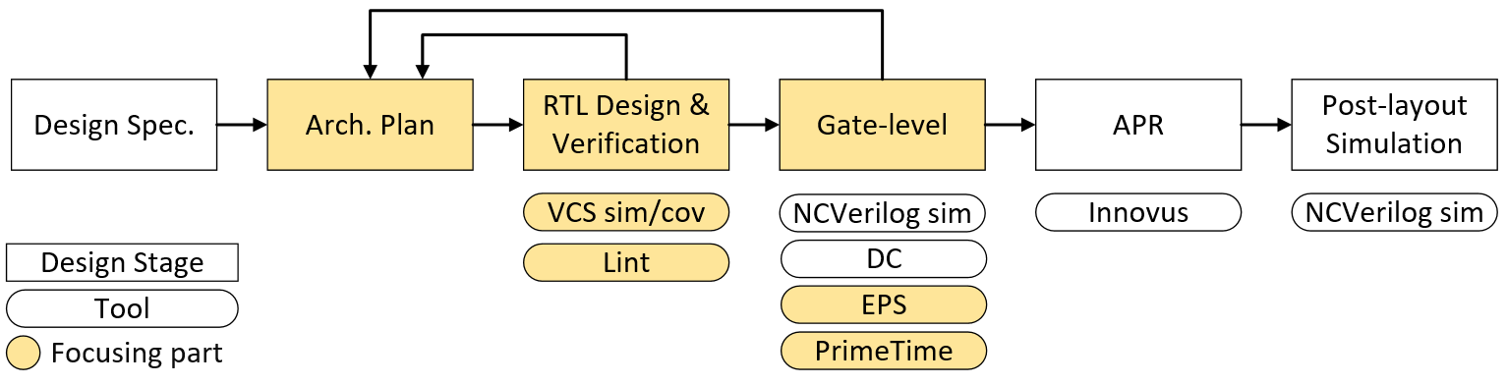
Final Project Design Flow

Slide 3
Architecture Plan
Data/Control flow: architecture
Block diagram
Timing diagram: control dependency
Area estimation: prediction before implement (storage, ALU, and margin ratio)
Verification plan: how to guarantee full function

Slide 4
RTL Design/Verification
RTL coding: flexibility(parameter/generate), readability
Verification testcases (fix/random patterns)
Lint*
Coverage*

Slide 5
RTL Verification – Lint Intro
What is Lint?
A kind of static verification method that checks your RTL source code (no simulation needed) based on a series of rule
Advantages of Lint
No sim pattern needed, easy to apply at early design stage
Save lengthy of debug time due to syntax error / bad coding style
Avoid potential mismatch between simulation and synthesis
Some common checking rules
Unsynthesizable constructs
Unused declarations
Driven and undriven signals
Incorrect usage of blocking and non-blocking assignments
…

Slide 6
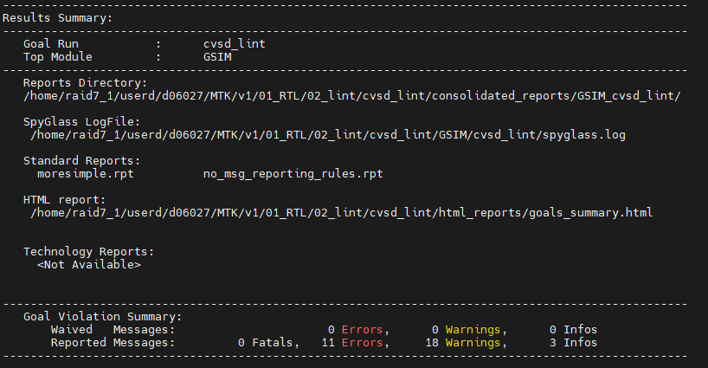
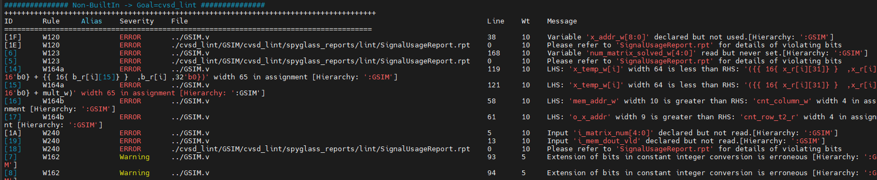
RTL Verification – Lint Flow
In Lint folder
./run_lint
If lint completes successfully, you should see a summary of violation
Check detail report at reports directory
Fix all ERROR and review all WARNING

Slide 7
RTL Verification – Coverage Intro
How do we know if our simulation has covered all scenarios / find all bugs?
Coverage helps quantify the completeness of verification
Code coverage
Cover the design structure
Automatically generated by simulator (line, condition, toggle, branch, FSM)
Does 100% code coverage mean no bug?
In this project, you will try to use line coverage to review your design and verification quality

Slide 8
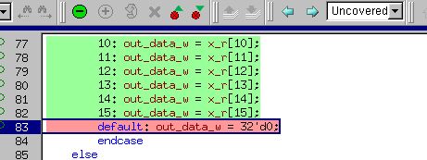
RTL Verification – Coverage Flow
RTL coding → compile and sim with coverage options → coverage report review → RTL signoff
Possible cause of uncovered code
Simulation pattern insufficient → Add pattern
Spec limitation → Review and waive
Logically unreachable code → Modify RTL
./03_run_vcs_sim
./04_run_dve
double click
view uncovered

Slide 9
Gate-level
EPS (Early Phase Synthesis)*
PrimeTime*

Slide 10
Gate-level – EPS Intro & Flow

Slide 11
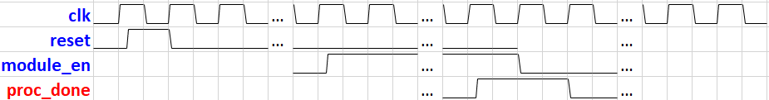
Gate-level – PrimeTime Intro
Analysis type
Average power analysis: no simulation needed, circuit behavior model for early phase analysis
Time-based power analysis: simulation needed, more precise analysis
Analysis result for backend optimization: average power, peak power, max slope, etc.
Use simplified time-based power analysis in final project
IDLE, ACTIVE, IDLE_AFTER_ACTIVE window power
Difference between IDLE and IDLE_AFTER_ACTIVE
IDLE
ACTIVE
IDLE_AFTER_ACTIVE

Slide 12
Gate-level – PrimeTime Flow
Use gate-level waveform for analysis
%> bash try_04_run
Gen 3 reports (try_{idle/active/idle_after_active}.power) by tcl setting
Parsing report and check result on terminal
Suggestion (fix window)
idle window: 1000 ns
Idle_after_active window: 1000 ns
read_vcd option:
-strip_path: set analysis hierarchy, e.g. testbed/u_GSIM
-time: set time window with absolute time, e.g. {0 1000}
-when: set time window satisfying Boolean condition, e.g. {i_module_en}
parsing report:
(A) Idle power: X0
(B) Idle_after_active power: X1
(C) Active power: X2
if (A) & (B) diff < threshold
=== Power diff ration result PASS!!! ===
else
=== Power diff ration result FAIL!!! ===

