Slide 1
Enhancing Operational Efficiency and Patient Experience at HealthFirst Care
Brian McCarthy | Business Analyst

Slide 2
Executive Summary
HealthFirst Care experienced increasing patient complaints related to wait times and communication delays.
Data analysis identified peak scheduling bottlenecks in General Medicine and Cardiology.
Resource utilization analysis showed uneven staff and equipment allocation across departments.
Patient feedback scores were strongly correlated with appointment wait times.
Risk management strategies were developed to address staffing, integration, and operational risks.
Recommendations include automated scheduling, improved communication workflows, and resource optimization.

Slide 3
Introduction
HealthFirst Care launched an operational improvement initiative to enhance patient experience.
The analysis focused on reducing delays, optimizing resource usage, and improving stakeholder communication.
Business Analysis methods were applied using BRD, RTM, stakeholder analysis, and risk assessment frameworks.
Operational datasets were analyzed using pivot tables and dashboards.
Current-state (As-Is) and future-state (To-Be) workflows were evaluated.
Recommendations were developed to support data-driven decision-making.

Slide 4
Business Objectives
Reduce patient wait times by 25%.
Improve patient satisfaction scores across all departments.
Optimize utilization of medical resources and staff.
Improve communication between hospital stakeholders.
Standardize appointment scheduling workflows.
Support leadership with dashboard-driven operational insights.

Slide 5
Business Requirement Document (BRD)
Problem Statement: Patients experience long wait times and inconsistent service quality.
Key Requirement: Implement centralized scheduling and resource tracking.
Key Requirement: Improve communication between staff and departments.
Constraint: Limited budget and existing legacy systems.
Constraint: Staff availability and training timelines.
Acceptance Criteria: 25% reduction in average wait time and improved feedback scores.

Slide 6
Requirement Traceability Matrix (RTM)
REQ-001: Reduce appointment delays (Must Have).
REQ-002: Improve patient communication workflows (Should Have).
REQ-003: Optimize resource allocation (Must Have).
REQ-004: Implement reporting dashboards (Could Have).
REQ-005: Enhance stakeholder visibility into operations (Should Have).

Slide 7
Stakeholder Analysis & Engagement Plan
Key stakeholders include hospital executives, doctors, nurses, administrative staff, and patients.
Executives hold high influence and require weekly progress updates.
Doctors and nurses require workflow alignment and process training.
Patients are primary beneficiaries and require transparent communication.
Engagement strategies include workshops, feedback sessions, and pilot testing.
Communication channels include dashboards, email summaries, and status meetings.

Slide 8
Scope Management Plan
In Scope: Scheduling optimization, resource tracking, and operational reporting.
Out of Scope: Clinical treatment changes and external vendor systems.
Assumption: Existing hospital systems support integration requirements.
Constraint: Limited project budget and timeline.
WBS Phases: Requirements, Analysis, Design, Testing, Deployment.
Scope changes require stakeholder approval and impact assessment.

Slide 9
Process Mapping
As-Is Process: Manual appointment scheduling caused delays and inconsistent updates.
To-Be Process: Automated scheduling with real-time notifications and dashboard monitoring.
As-Is Process: Reactive resource allocation led to department bottlenecks.
To-Be Process: Predictive resource planning improves efficiency and availability.

Slide 10
Advanced Process Mapping
BPMN workflows clarified patient scheduling, approvals, and escalation paths.
Swimlane diagrams defined stakeholder ownership and responsibilities.
Process mapping reduced ambiguity in operational handoffs.
Improved visibility supports faster issue resolution and accountability.

Slide 11
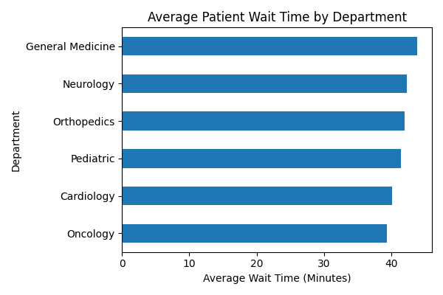
Data Visualization - Wait Time Analysis

Slide 12
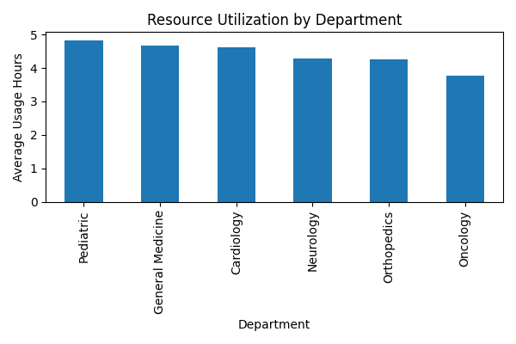
Data Visualization - Resource Utilization

Slide 13
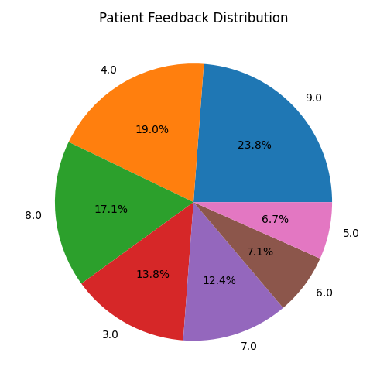
Data Visualization - Patient Feedback

Slide 14
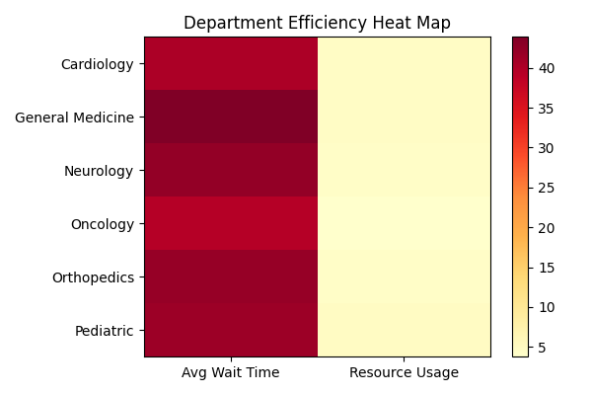
Data Visualization - Department Efficiency Heat Map

Slide 15
Data Analysis Insights
Average patient wait time ranged from 39.4 to 43.9 minutes across departments.
Cardiology and General Medicine experienced the highest scheduling pressure.
Resource utilization data identified uneven equipment and staffing usage.
Higher wait times corresponded with lower patient satisfaction scores.
Operational bottlenecks were concentrated during peak appointment periods.

Slide 16
Risk Assessment Plan
Operational Risk: Scheduling system downtime may disrupt patient appointments.
Technology Risk: Legacy system integration may delay implementation.
Resource Risk: Limited staffing could impact rollout timelines.
Compliance Risk: Patient data privacy must remain protected.
Mitigation strategies include phased deployment and staff training.
Risk assessment matrices were used to prioritize corrective actions.

Slide 17
Risk Mitigation Plan
Implement phased deployment to reduce operational disruption.
Establish backup scheduling procedures for downtime events.
Conduct user training sessions before rollout.
Monitor KPIs through dashboards and weekly governance reviews.
Use contingency staffing plans during peak operational periods.
Prioritize high-severity risks for immediate mitigation.

Slide 18
Key Findings
Long patient wait times significantly reduced satisfaction scores.
Resource utilization patterns revealed operational inefficiencies across departments.
Improved communication and automation can reduce bottlenecks and improve patient experience.

Slide 19
Key Recommendations
Deploy centralized appointment scheduling software.
Implement real-time operational dashboards for leadership visibility.
Improve staff coordination through standardized communication workflows.
Adopt predictive resource allocation and staffing models.

Slide 20
Conclusion
The analysis identified operational inefficiencies impacting patient experience.
Data-driven insights supported targeted recommendations for process optimization.
Risk management planning improved implementation readiness.
Operational dashboards and automation are expected to improve efficiency and satisfaction.
The proposed solutions align with HealthFirst Care’s strategic goals.

