Slide 1

An Introduction to the Model-View-ViewModel Pattern
Srsly? Another MV* Pattern?
BrianGenisio@Gmail.com

Slide 2

How I Got Into MVVM

Slide 3
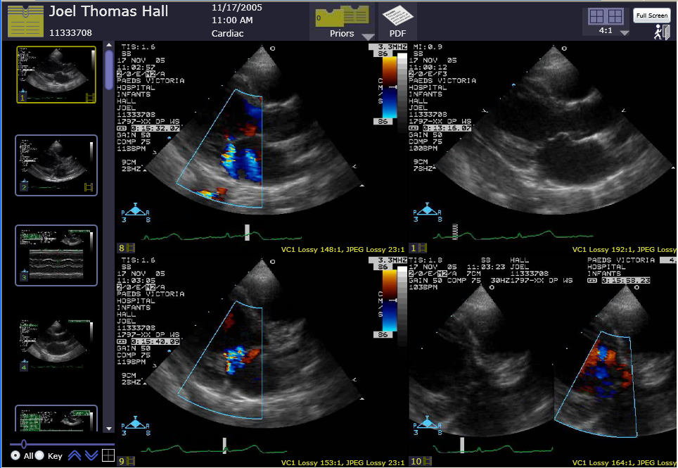
The Healthcare Application
Screenshot of WebStation

Slide 4
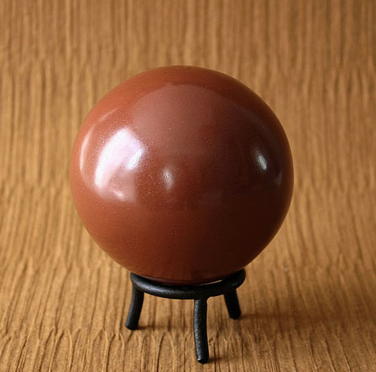
The Generalized Problem
Notes:
Dorodango

Slide 5
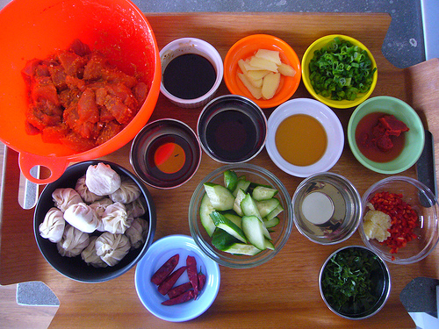
What We Want
Notes:
Hikaru Dorodango

Slide 6
How Do We Achieve that?
View
ViewModel
Model

Slide 7
A More Complete Diagram
Unit Tests
Integration Tests
View
XAML, Code Behind
Behavior
Actions
Bindings
ViewModel
Properties, Commands, View Logic
Data
Events
Model
Service Proxies
Web

Slide 8

Twitter Search Demo Using MVVM

Slide 9

Emerging Technology
We’re still trying to figure out the Best Practices

Slide 10

Standing on the Shoulders of Giants
MVC
MVP
Presenter Model
Martin Fowler
Josh Smith
John Gossman
Sean Wildermuth

Slide 11
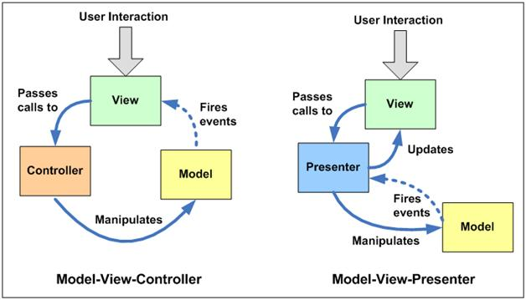
Compared to…

Slide 12

Mini Patterns

Slide 13
NotifyPropertyChanged
public interface INotifyPropertyChanged
{
event PropertyChangedEventHandler
PropertyChanged;
}

Slide 14
Command Pattern
public interface ICommand
{
bool CanExecute(object param);
void Execute(object param);
event EventHandler CanExecuteChanged;
}
public class DelegateCommand : ICommand
{
public DelegateCommand(
Action<object> command,
Predicate<object> canExecute);
}

Slide 15
Event Aggregator Pattern

Slide 16
Attached Behaviors
<TextBlock Foreground=“Red” Width=“200” Behaviors:Update.WhenTextChanged=“True”
/>
TextBlock
FontSize
Foreground
Width
…
Trimming
Behavior

Slide 17
MVVM Guidelines
1. Reduce or eliminate your code-behind
2. Bind all of your UI inputs/outputs to your ViewModel
3. Implement INotifyPropertyChanged on your ViewModel
4. Put your view behavior into the ViewModel
5. Do not put any view state into the model
6. Only bind to a model object if there is no view-specific info
7. When testing, treat ViewModel as the Real UI
8. Avoid events. Use commands instead

Slide 18
Third Party Support
Prism
MVVM Light
Caliburn
Silverlight FX

Slide 19
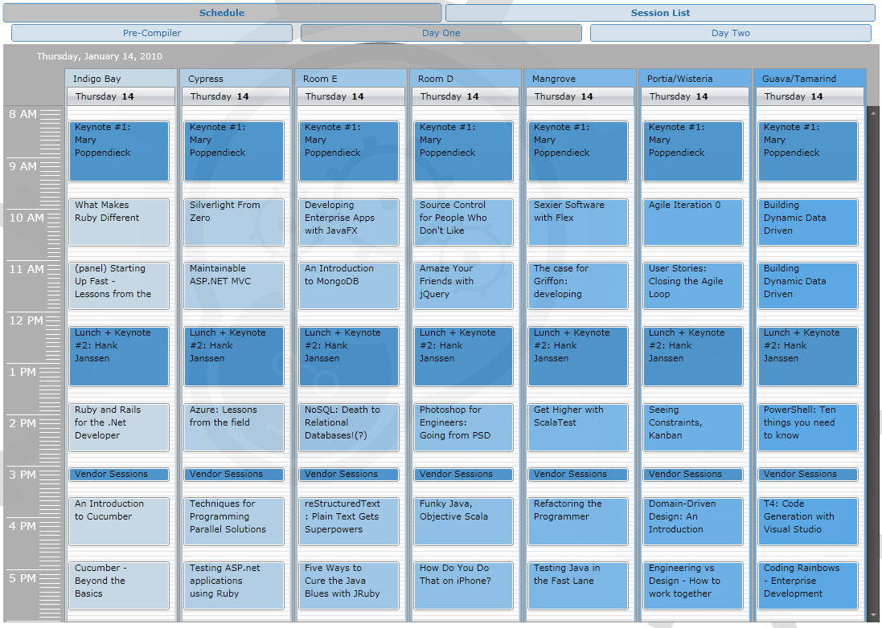
Demo – CodeMash App

Slide 20
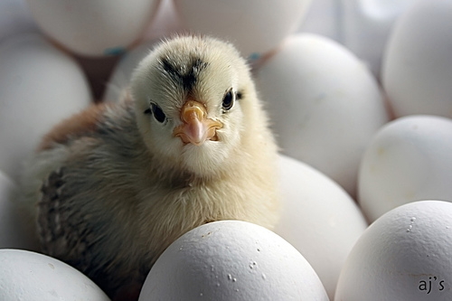
Who Creates the ViewModel?
XAML
View Constructor
Other ViewModel
Marriage
Dependency Injection

Slide 21
Silverlight [Unit|Integration|Functional] Testing
Nunit/Moq
Silverlight UT
White
Telerik WebAI

Slide 22

Contact Info
BrianGenisio@Gmail.com
http://HouseOfBilz.com
http://Twitter.com/BrianGenisio
OPEN SPACES
http://speakerrate.com/briangenisio

