Slide 1
Building
Simple
Data
Stack
Project Brief
This project demonstrate how to implement
a modern data stack, build data pipelines, machine
learning and reporting capabilities using a variety
of tools.
BRIAN GWAYI
Independent Data Lead &
Engineer

Slide 2
First
Things
First !!!
Five Key Questions
I. Where is our data? Source
II. Where do we consolidate our data? Storage
III. How will we get it there? Ingestion
IV. How will we clean it up? Transformation
V. How will we analyze it? Reporting
BRIAN GWAYI
Independent Data Lead &
Engineer

Slide 3

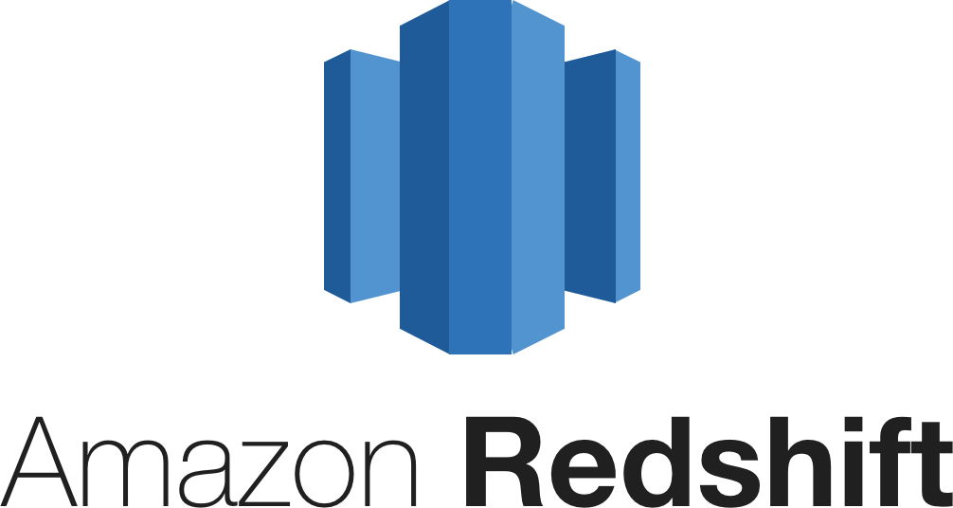





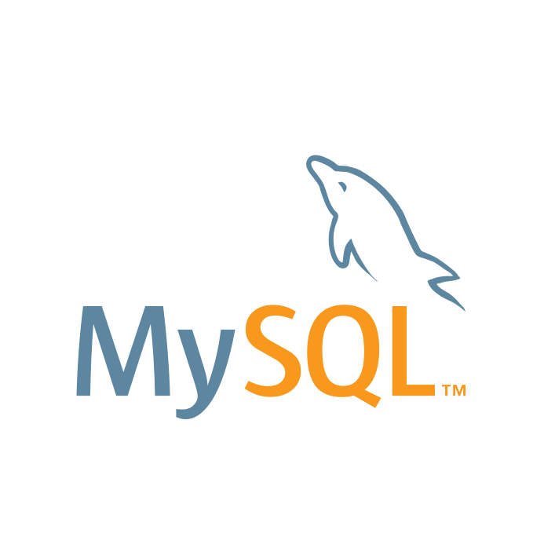

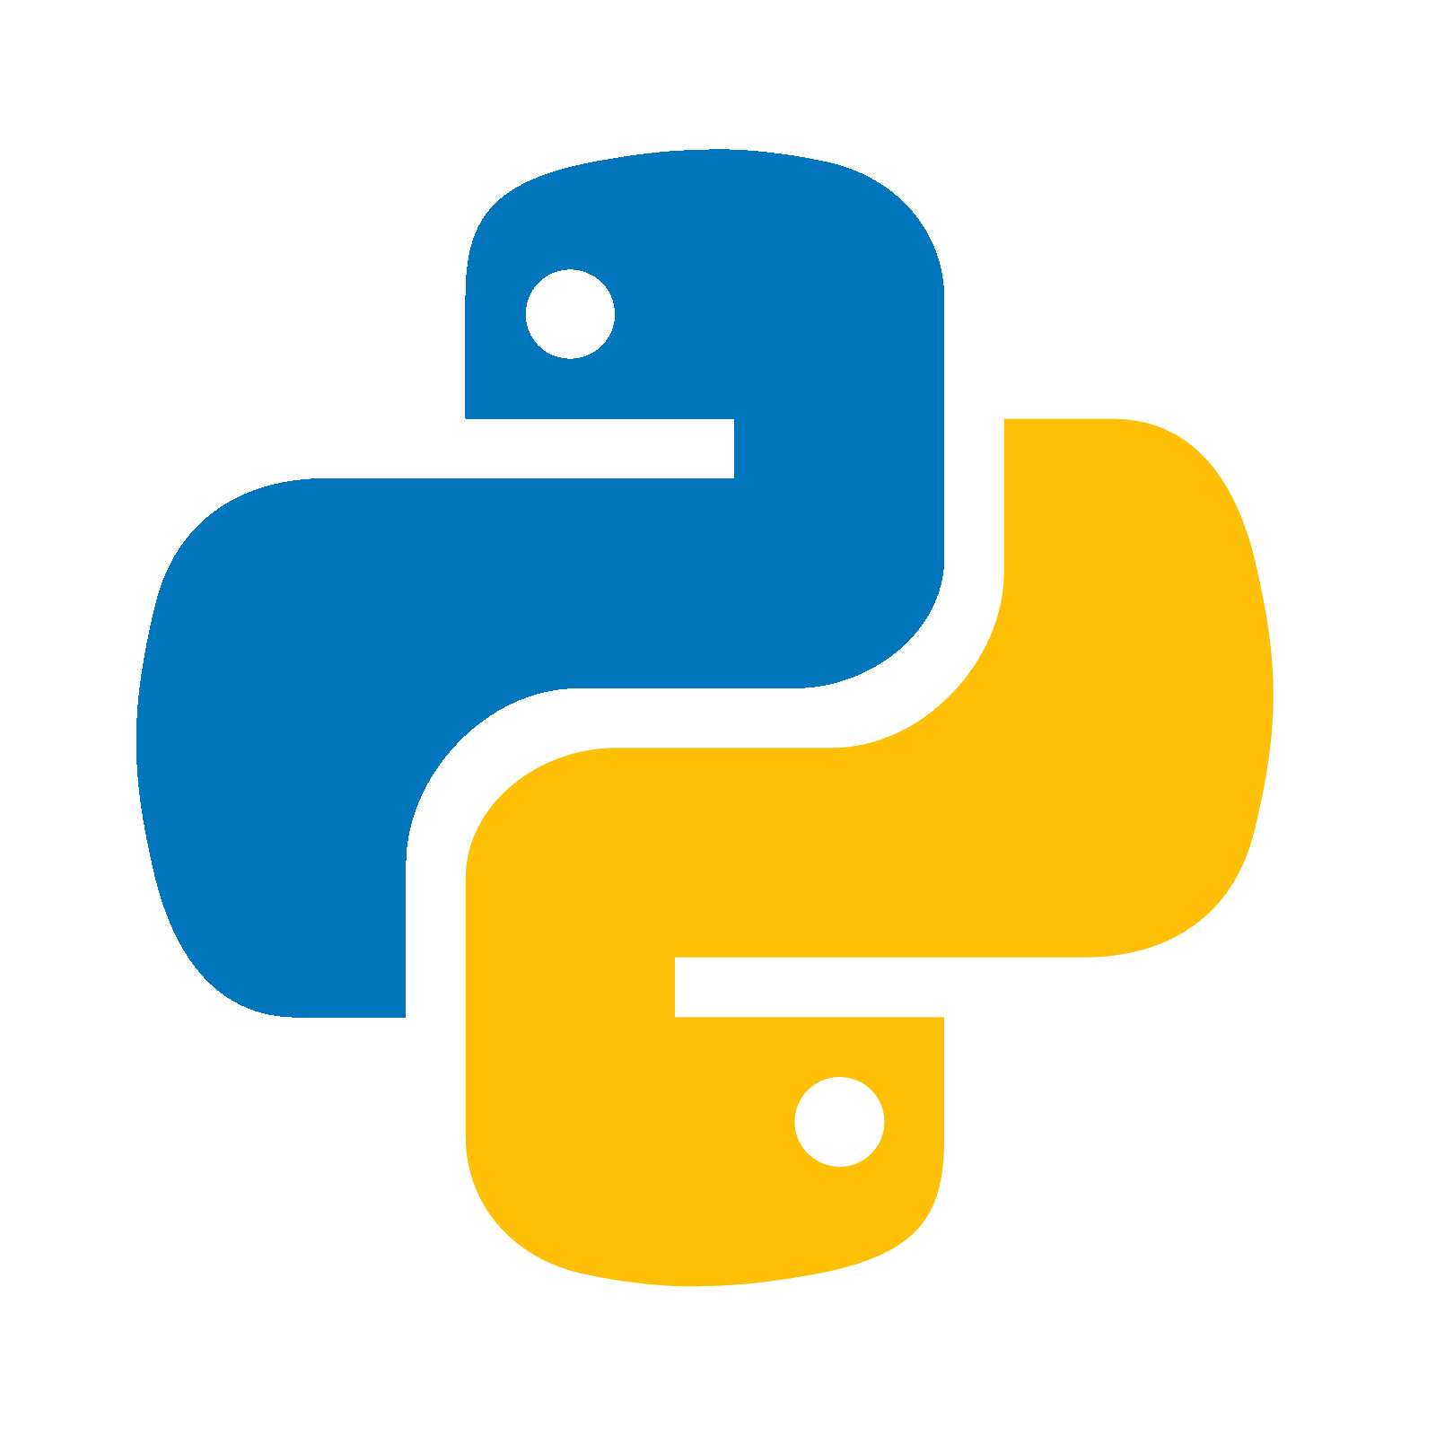

Data Stack Architecture Design
Where is our data?
How will we get it there?
Where do we consolidate our data?
How do we analyze it?
Airflow
PostgreSQL
Transformation
+
Python
Raw
Model
Model

Slide 4
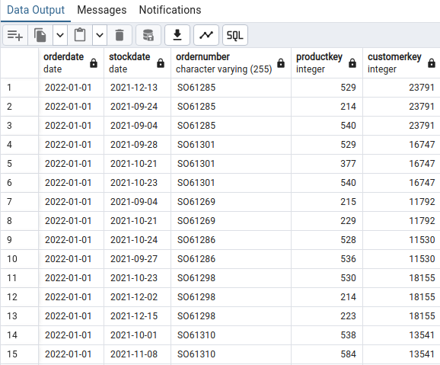
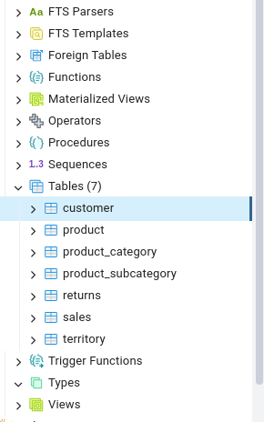
Where is Our Data?
Source : PostgreSQL
Schema : Public
Database_Name: adw_db
Tables_Count : 7
Tables : [customer,
product,
product_category,
returns,
sales,
territory, product_subcategory]

Slide 5
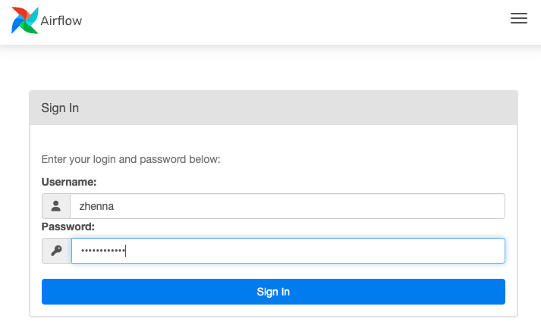
How do we ingest Our Data?
Apache Airflow Webserver UI
Ingestion : Programmatically
Orchestration : Apache Airflow
Apache Airflow Setup
Terminal
$ python3 -m venv airflow-env
$ source airflow-env/bin/activate
$ export AIRFLOW_HOME=~/airflow
$ pip install apache-airflow
$ airflow db init
$ airflow webserver -p 8080
$ airflow sheduler
gwayi

Slide 6
How do we ingest Our Data?
# define a DAG
args{
”owner”:”gwayi”,
"retries": 1,
"retry_delay":timedelta(minutes=5)
}
@dag(
default_arguments = args
Schedule=timedelta(minutes=30),
start_date=datetime(2024, 7, 29),
catchup=False,
tags=['DataOps Team']
)
# install dependencies
pip install google-cloud-bigquery
pip install --upgrade snowflake-connector-python
# importing libraries
from airflow.decorators import dag, task
from datetime import datetime, timedelta
from google.cloud import bigquery
import pandas as pd
import psycopg2

Slide 7
How do we ingest Our Data?
@task()
def get_tables(conn):
"""extract list of tables
in public schema"""
try:
cursor.execute(
f"""SELECT table_name
FROM information_schema.tables
WHERE table_schema = 'public'"""
)
records = cursor.fetchall()
tbls = [x[0] for x in records]
except Exception as e:
print("extract error:" + str(e))
finally:
conn.close()
@task()
def extract|load_bigquery(tbls, conn):
"""loop through tbls then extract & load"""
client = bigquery.Client()
job_config = bigquery.LoadJobConfig(
write_disposition="WRITE_TRUNCATE")
for tbl in tbls:
table_id = f"adventureworks-431609.stg.{tbl}"
sql = f"SELECT * FROM {tbl} WHERE
updated_at >= {ds}'"
df = pd.read_sql(sql, conn)
job = client.load_table_from_dataframe(
df, table_id, job_config=job_config)
job.result()
get_tables = get_tables()
extract_load = extract_load(get_tables)

Slide 8
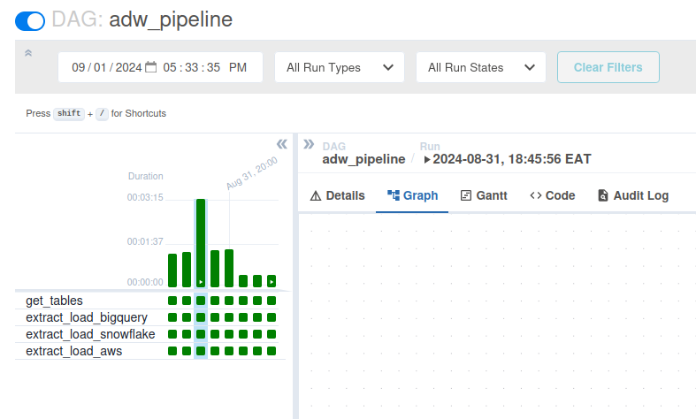
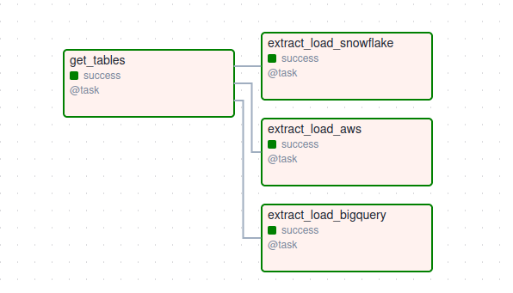
Running the Pipeline – Apache Airflow

Slide 9
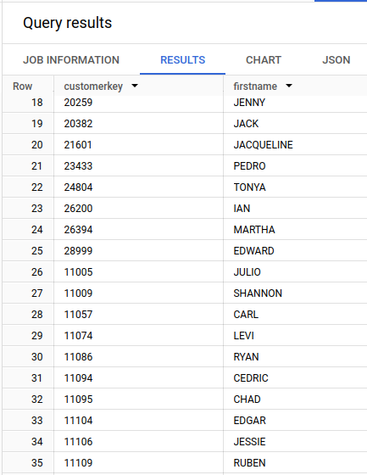
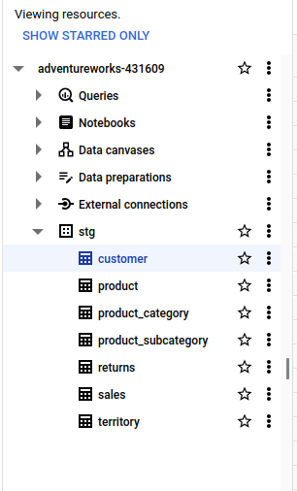
Where do we consolidate Our Data?
Storage : BigQuery
Project : AdventureWorks
Dataset: stg
Tables_Loaded : 7
Tables : [customer,
product,
product_category,
returns,
sales,
territory, product_subcategory]

Slide 10
How do we transform Our Data?
profiles.yml Set up
Join returns
to territory
territory
to product
Product
to product_subcategory
product_subcategory
to productcategory
as returns_wide
Join sales
to territory
territory
to product
Product
to product_subcategory
product_subcategory
to productcategory
as sales_wide
Transformation : dbt
Orchestration : Apache Airflow
Models 3 :
production.sql,
machine_learning.sql,
business_reporting.sql
dbt_adw:
Outputs:
dev:
dataset: stg
job_execution_timeout_seconds: 300
job_retries: 1
keyfile: <json_key_path>
location: US
method: service-account
priority: interactive
project: adventureworks-431609
threads: 10
type: bigquery
target: dev
Set up dbt
pip install dbt-biquery
dbt –version
dbt init dbt_adw
Key Commands
dbt debug, dbt run, dbt run –full-refresh,
dbt seed, dbt test, dbt docs generate

Slide 11
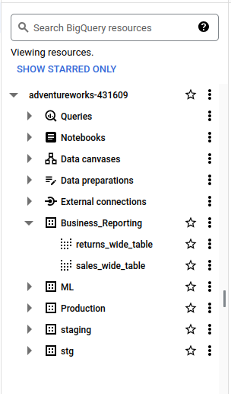
How do we transform Our Data?
# run models
$ dbt run
# generate documentation
$ dbt docs generate
# run seed
$ dbt seed
# run validation
$ dbt test

Slide 12
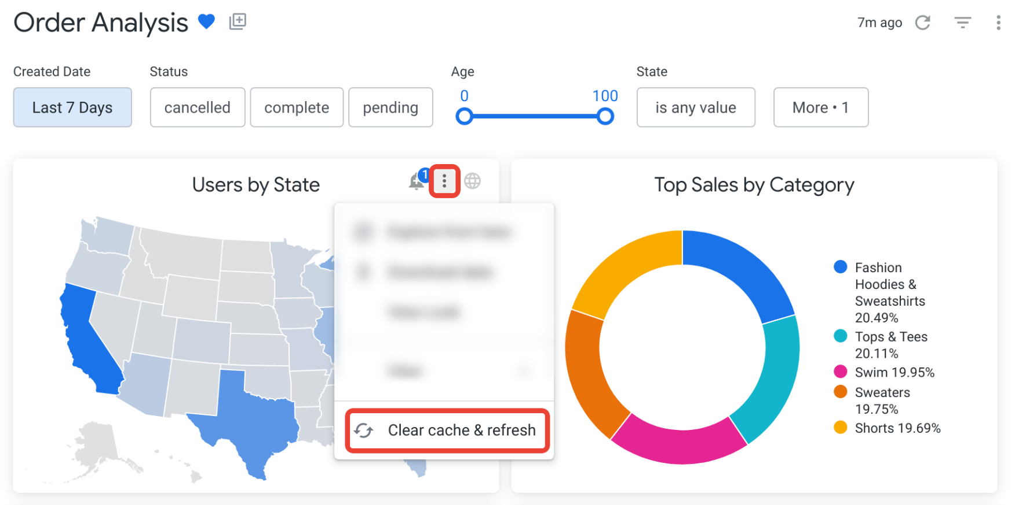
How do we analyze & Report Our Data?
Google Looker Studio

Slide 13
Ultimate
End
Goal
Data + Insights + Action
= Actionable Insights
Data
Insight
Action
What happened/
will happen?
Why did it happened/
will it happen?
What do we do?

Slide 14
Improvements
Connection pooling
import psycopg2
from psycopg2 import pool
# Set up connection pooling
db_pool = psycopg2.pool.SimpleConnectionPool(
1, 20, # min and max connections
dbname='your_db',
user='your_user',
password='your_password',
host='localhost',
port='5432'
)
def extract_data_with_pool(query):
conn = None
try:
conn = db_pool.getconn()
cursor = conn.cursor()
cursor.execute(query)
rows = cursor.fetchall()
for row in rows:
print(row)
return rows
except Exception as e:
print(f"An error occurred: {e}")
finally:
if conn:
db_pool.putconn(conn)
query = 'SELECT * FROM your_table;'
data = extract_data_with_pool(query)
logging

