Slide 1
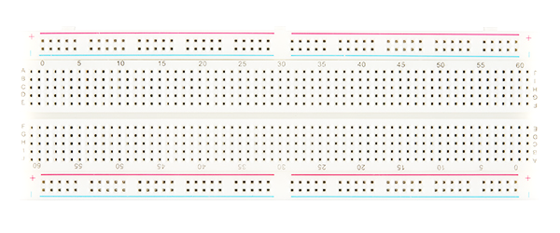
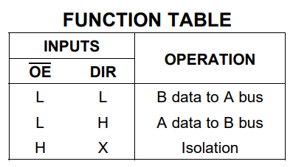
HOST-SIDE (5V)
DATA
CTRL
ADDRESS
FPGA_245_OE
Z80_D0
Z80_D1
Z80_D2
Z80_D3
Z80_D4
Z80_D5
Z80_D6
Z80_D7
FPGA_INTAK
Z80_INTAK
Z80_CLK
FPGA_HCLK
FPGA_RD
Z80_RD
Z80_WR
FPGA_WR
FPGA_A7
Z80_A7
Z80_A6
FPGA_A6
FPGA_A5
Z80_A5
Z80_A4
FPGA_A4
FPGA_A15
Z80_A15
Z80_A14
FPGA_A14
FPGA_A13
Z80_A13
Z80_A12
FPGA_A12
FPGA_A21
Z80_EA21
Z80_EA20
FPGA_E20
FPGA_E19
Z80_EA19
Z80_EA18
FPGA_E18
3V
OE
B1
B2
B3
B4
B5
B6
B7
B8
3V
8Q
8D
7D
7Q
6Q
6D
5D
5Q
LE
3V
8Q
8D
7D
7Q
6Q
6D
5D
5Q
LE
3V
8Q
8D
7D
7Q
6Q
6D
5D
5Q
LE
3V
8Q
8D
7D
7Q
6Q
6D
5D
5Q
LE
DATA
245
CONTROL
373
ADDR_LO
373
ADDR_HI
373
ADDR_EXT
373
DR
A1
A2
A3
A4
A5
A6
A7
A8
GD
OE
1Q
1D
2D
2Q
3Q
3D
4D
4Q
GD
OE
1Q
1D
2D
2Q
3Q
3D
4D
4Q
GD
OE
1Q
1D
2D
2Q
3Q
3D
4D
4Q
GD
OE
1Q
1D
2D
2Q
3Q
3D
4D
4Q
GD
FPGA_245_DIR
FPGA_D0
FPGA_D1
FPGA_D2
FPGA_D3
FPGA_D4
FPGA_D5
FPGA_D6
FPGA_D7
FPGA_RESET
Z80_RESET
Z80_M1
FPGA_M1
FPGA_IORQ
Z80_IORQ
Z80_MREQ
FPGA_MREQ
FPGA_A0
Z80_A0
Z80_A1
FPGA_A1
FPGA_A2
Z80_A2
Z80_A3
FPGA_A3
FPGA_A8
Z80_A8
Z80_A9
FPGA_A9
FPGA_A10
Z80_A10
Z80_A11
FPGA_A11
FPGA_E14
Z80_EA14
Z80_EA15
FPGA_E15
FPGA_E16
Z80_EA16
Z80_EA17
FPGA_E17
Total IO pins required on FPGA: 8 data, 2 data control, 24 address, 8 system control = 42 IO pins
FPGA-SIDE (3.3V)

Slide 2
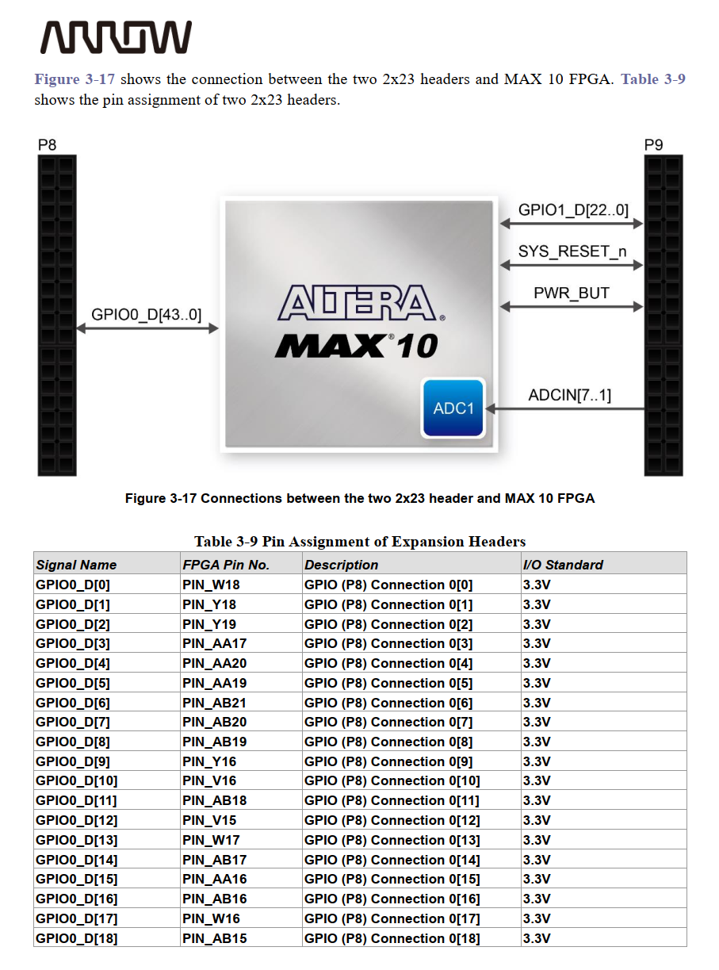
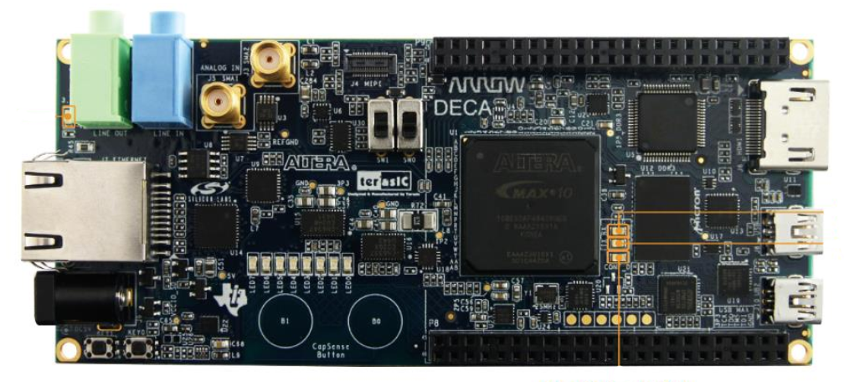
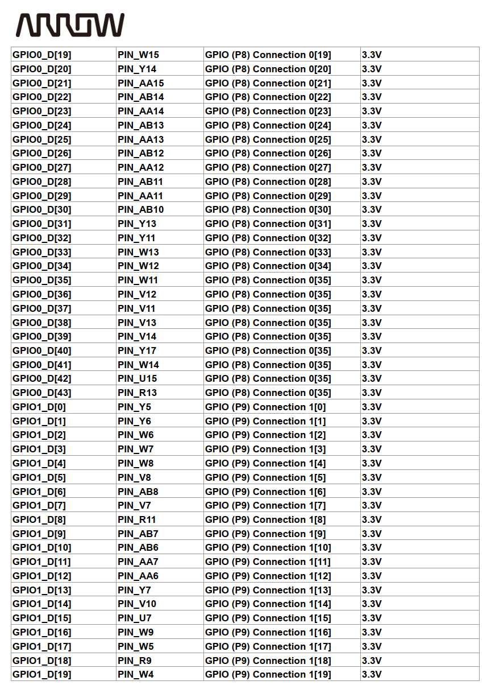
FUNCTION | FPGA Pin No.
 | PIN_W18
 | PIN_Y18
 | PIN_Y19
 | PIN_AA17
 | PIN_AA20
 | PIN_AA19
 | PIN_AB21
 | PIN_AB20
 | PIN_AB19
 | PIN_Y16
 | PIN_V16
 | PIN_AB18
 | PIN_V15
 | PIN_W17
 | PIN_AB17
 | PIN_AA16
 | PIN_AB16
 | PIN_W16
 | PIN_AB15
 | PIN_W15
 | PIN_Y14
 | PIN_AA15
 | PIN_AB14
 | PIN_AA14
 | PIN_AB13
 | PIN_AA13
 | PIN_AB12
 | PIN_AA12
 | PIN_AB11
 | PIN_AA11
 | PIN_AB10
 | PIN_Y13
 | PIN_Y11
 | PIN_W13
 | PIN_W12
 | PIN_W11
 | PIN_V12
 | PIN_V11
 | PIN_V13
 | PIN_V14
 | PIN_Y17
 | PIN_W14
 | PIN_U15
 | PIN_R13
 | PIN_Y5
 | PIN_Y6
 | PIN_W6
 | PIN_W7
 | PIN_W8
 | PIN_V8
 | PIN_AB8
 | PIN_V7
 | PIN_R11
 | PIN_AB7
 | PIN_AB6
 | PIN_AA7
 | PIN_AA6
 | PIN_Y7
 | PIN_V10
 | PIN_U7
 | PIN_W9
 | PIN_W5
 | PIN_R9
 | PIN_W4
P9
P8

