Slide 1
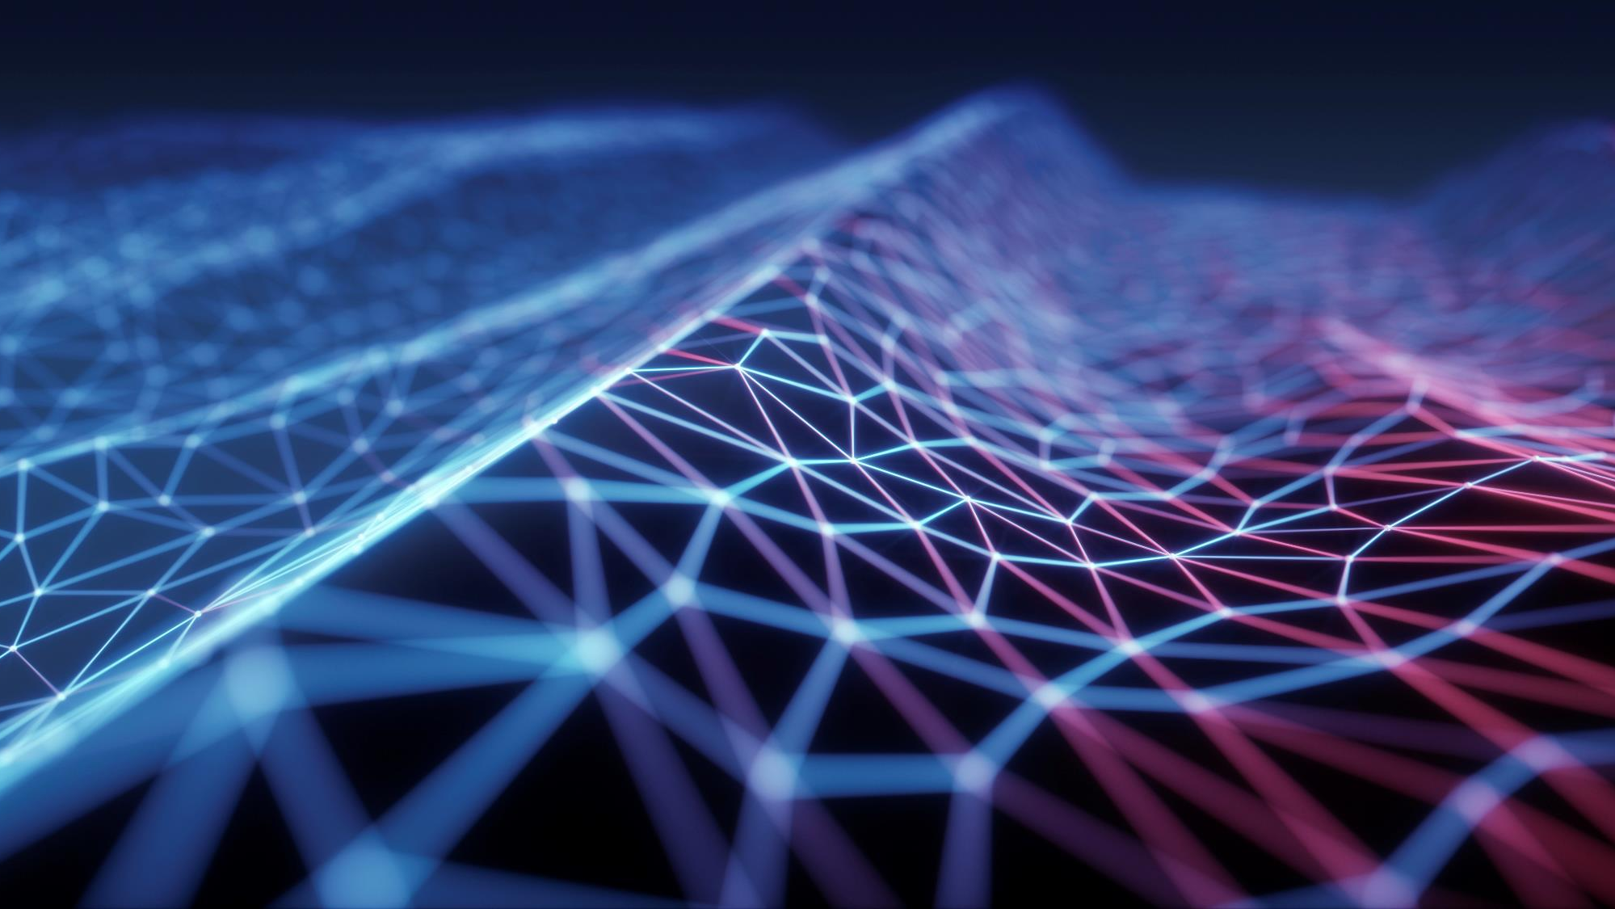
Privacy In A Digital Age
Brian Hare, Associate Teaching Professor
UMKC School of Computing & Engineering
Linda Hall Library “Deeper Dive” series - August 2020 WEEK 1: What are we talking about?

Slide 2
Why Are We Here?
Grew out of UMKC’s “Ethics & Professionalism” course for Computer Science & Information Technology majors
Which has become one of the larger units of the course, and the one that engages students the most
Week 1:
What are we even talking about? Definitions of privacy
Why digital is different
Why anonymity is hard
Week 2:
Surveillance as business model
It’s not “what do they know,” it’s “what don’t they know.”
Week 3:
What can be done? Protecting digital privacy
Trends, Future Directions, Wrap-up

Slide 3
Format, Tech, & Misc.
Presentation about 45 min, 15 min Q/A at end
Use Q/A window to post questions – Eric will be monitoring & will review at the end as time permits.

Slide 4
Why Are We Here?
Perspectives & Definitions of Privacy

Slide 5
What is privacy?
Related to access
Physical proximity
Knowledge about a person
“Zone of inaccessibility”
Harms of too much privacy
Can be cover for illegal activities
Can hide family dysfunction, abuse
Benefits of privacy
Signals that individuals are responsible for themselves
Necessary for personal growth
Allows shutting out the world to focus
Fosters development of trusting & intimate relationships

Slide 6
Is privacy a right?
A natural right?
A ‘prudential’ right?
A violation of some other right?
Warren & Brandeis’ influential article (1890) defined privacy as “the right to be let alone.”
But this doesn’t include covert data gathering. If I point a sensitive microphone at your house so I can hear your conversation, but don’t interfere with you in any way, most would say I’m still violating your privacy.
Public figures may be held to different standards than private citizens
Notes:
Privacy doesn’t fit easily within John Locke’s definitions of natural rights . Alexander Rosenberg: Privacy is a prudential right; we’re better off if we recognize it. Judith Jarvis Thomson: Can’t seem to agree on what privacy is beyond “we know it when we see it.” Every privacy violation is a violation of some other right, such as autonomy. Thus no need for precise definition. Example: changing room photo.
So. Some privacy is needed, but too much is bad, so…..

Slide 7
What degree of privacy is optimal?
Scott McNealy, Sun Microsystems: “You have zero privacy anyway. Get over it.”
Eric Schmidt, Google: “If you don’t want anyone to know you’re doing something, maybe you shouldn’t be doing that thing.”
Former AG James Comey: American privacy has never included the right to exclude the government in all circumstances; access to private information allowed if a warrant is obtained
Very few people want to maintain total privacy in all areas with everyone.
Much of the discussion around privacy centers on control:
Who has access to data?
What’s being done with it? For what purpose?
What oversight or recourse is there?
Notes:
McNealy got rich selling computers & database software to governments. Just saying.
Schmidt had to walk back the comment a bit & took some heat for it—there’s a difference between not wanting anyone to know something & not wanting him (or his company) from knowing it; or, if they know it, what they do with the knowledge.

Slide 8
Ladder of privacy
Spouse
Doctor
Clergy
Siblings
Parents
Close friends
Co-workers
Boss
Neighbors/acquaintances
Strangers
Former spouse, ‘exes,’ rivals

Slide 9
How does personal information get out?
Facebook & social media tags
Cell phone always tracks location for E911 services
Reward/loyalty programs
Mobile apps (BIG source of data leaks)
Facebook login, ‘click here to like’
OnStar & similar services
Medical records, & who can access them
CC & security cameras
New technologies
Facial recognition
Gait recognition
RFID Implants

Slide 10
Example: 2019 Privacy International Study
61% of apps send data to Facebook as soon as they’re opened, whether the user has a Facebook account or not, or is logged on to FB or not.
Often sent unencrypted, easily readable
Medical & fertility-tracking apps include data on diet, alcohol use, sexual activity, symptoms, mood, & other sensitive information—again, sometimes sent unencrypted
Medical data also shared with wzkrt.com, “Wizard Rocket,” a “customer-retention platform that helps consumer brands maximize user lifetime value, optimize key conversion metrics, and boost retention rates.”
That site has since vanished….

Slide 11
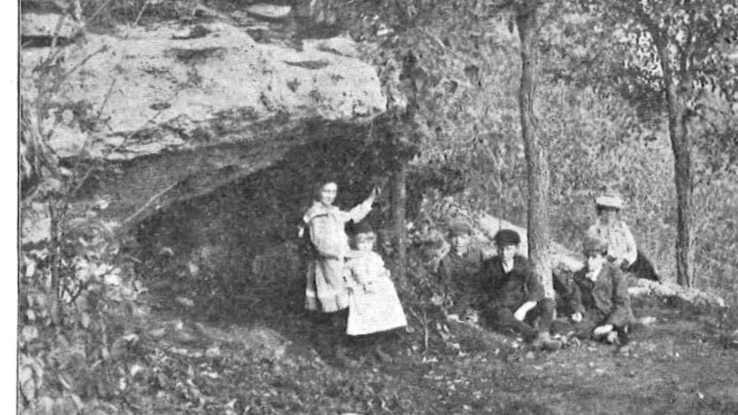
Can you hide from all this?
Not really. For most of us, retreating to a hermit’s cave isn’t an option
Not all use of data is bad!
How to manage it reasonably:
Who has the right to do what
Who authorized it
Accountability
Notes:
Image: https://www.benmoorestudio.com/hermit-cave-restoration--master-plan.html

Slide 12
Why Digital is different
Speed
Scale
Detailed records of location, activity, interest
Analytical Capabilities
At some point, a difference of degree becomes a difference of kind
Notes:
C. G. P. Grey points out, your brain loses a lot of information, what it does remember is lossy, details blur together. Your phone remembers verbatim every text discussion you had including entire conversations you’ve forgotten. You should prefer having your mind read to having your phone read.

Slide 13
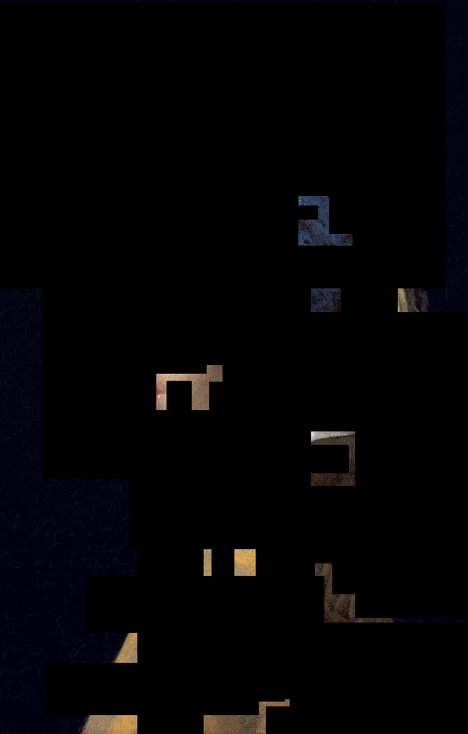
Notes:
The Mosaic Effect: If I have only a few isolated bits of information, that tells me a little, but not much. This data isn’t particularly valuable….

Slide 14
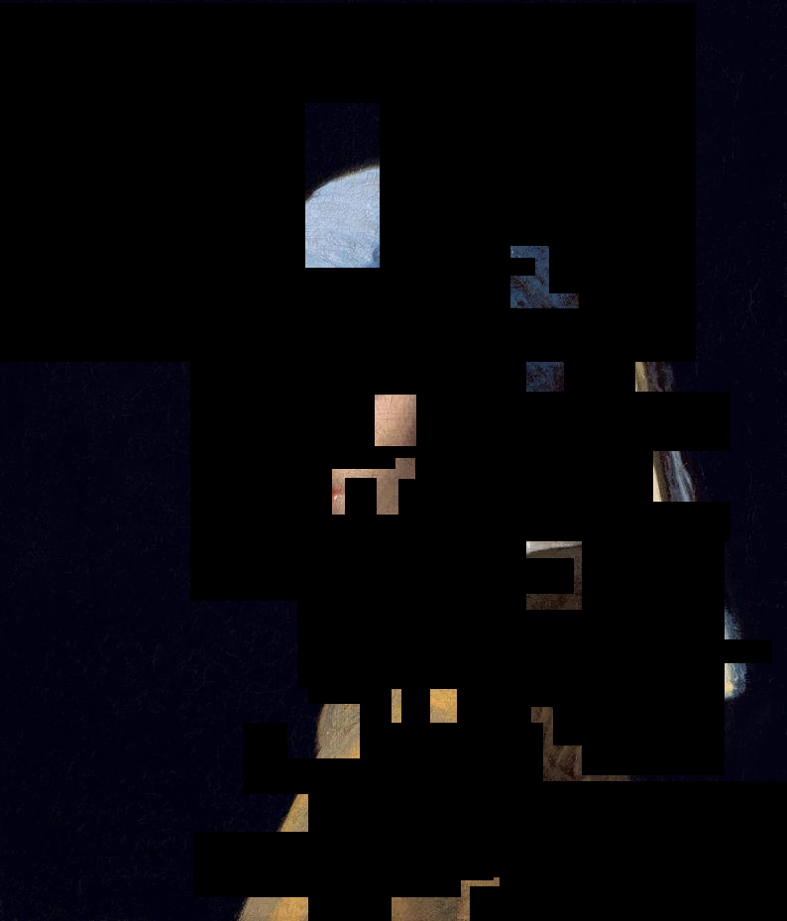
Notes:
But as I gain more data, a little at a time, day by day… browsing history, app usage, purchases, location…

Slide 15
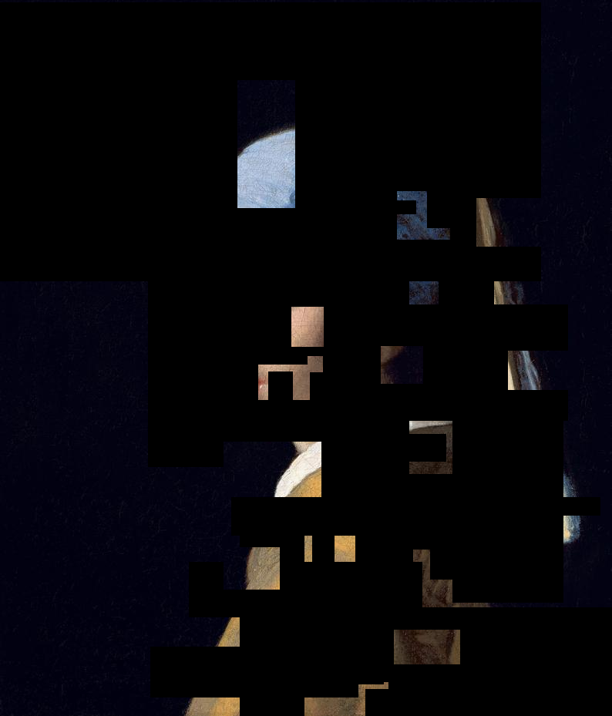
Notes:
A more complete picture starts to emerge….

Slide 16
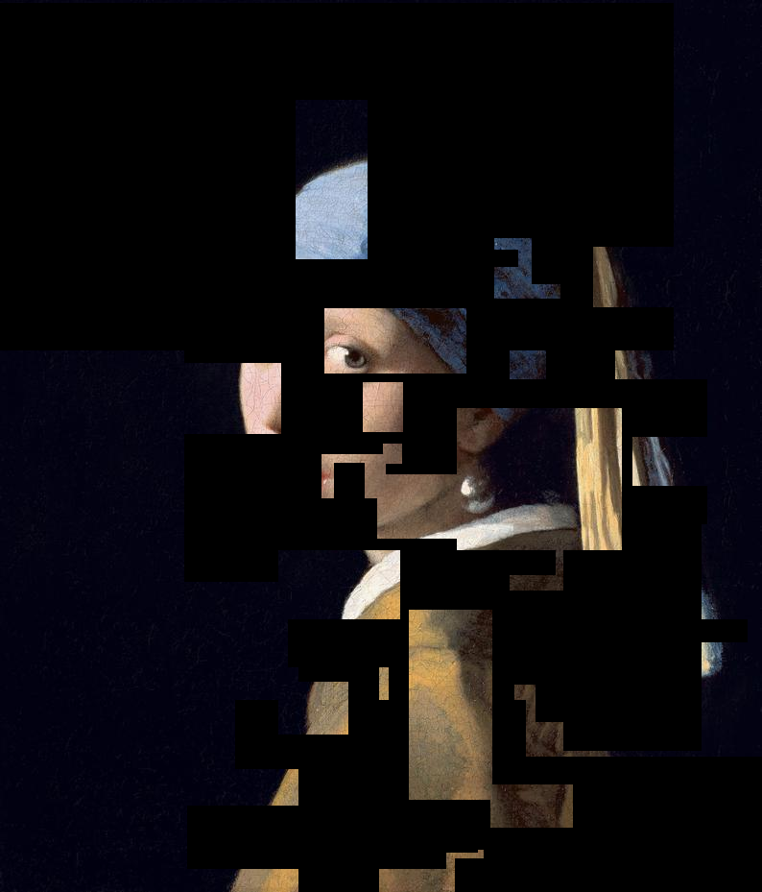
Notes:
Making each bit of information I already have more valuable. The more I have, the more valuable it all becomes

Slide 17
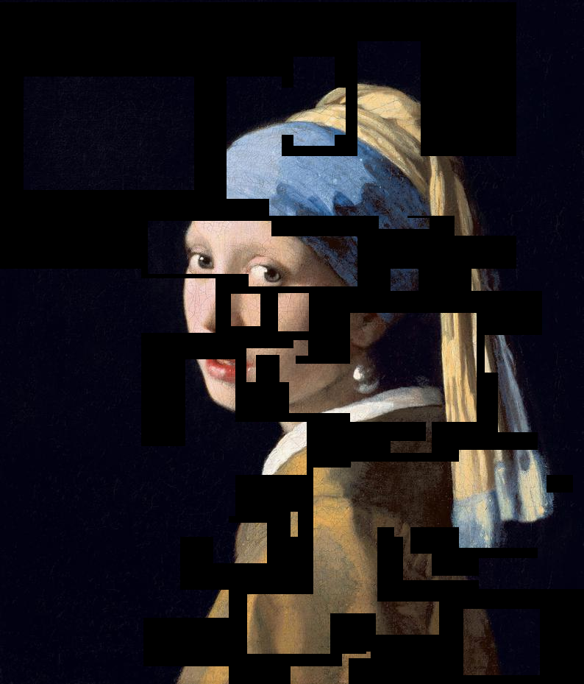
Notes:
I still don’t have the complete picture—I don’t know everything—but I know enough. I can make reasonably-accurate estimates of the data I’m still missing. Particularly since I have similar almost-complete data about other people of the same age, social class, etc.
And if the user requests I delete the data, I can… because I already know about the blue scarf, the pearl earring, etc. In the real world: Political leanings & commitment, religiosity, sexual identity & activity, race, ethnicity, education, income, medical concerns, hobbies, taste in books/movies.
One estimate is that by the time you’ve clicked on ‘Like’ 150 times, Facebook knows you better than your parents do; at 300 likes, they know you better than your spouse does.

Slide 18
There’s no such thing as online anonymity
What can identify you online? Several items, non-identifying in themselves, can be combined
Sex, DOB, ZIP uniquely identifies about 85% of Americans
What fonts are available to your browser can identify you down to about 1 in 100,000 to 1 in 1,000,000
10 most-visited websites are almost unique
Internet address is semi-permanent.
Clicking on an online ad while online sends information about your offline identity to advertiser
GPS location may be embedded in any photo taken on your phone
Login with FB or Google credentials gives access to information about you.
Your internet provider knows every site you visit, and can do what they like with that information
Most sites can produce a ‘digital footprint’ of the device you’re on and can often follow you across devices.
Go on, clear your cache. Clear your cookies. Update your browser settings. Get a new phone. We still know it’s you.

Slide 19
Making data truly anonymous is hard!
Partial information can be combined
Correlations can be taken advantage of—ZIP code leaks information about likely income, ethnicity
Before/after analysis
My medical-data project has access to anonymized records from a clinic – names replaced with random 10-digit numbers
If your car was parked for 2 hours in the clinic parking lot last Wednesday, and your phone was in the building at the same time….
Comparison of Wednesday’s data & Tuesday’s data can let me make some good guesses about your ID number
Particularly if I’ve got this information for more than 1 appointment. You’re probably the only patient who had one appointment on that morning and your next appointment on that afternoon.
Making ‘anonymous’ data that can’t be de-anonymized is an ongoing research problem, far from solved

Slide 20
Why does this happen?
Profit!
This drives sales, page views, & candidates getting elected
Profiles of attitude correlate with likely purchases, political & social views, etc.
Those fun little online quizzes, like “Which Game of Thrones Character Are You?” They gather data.
That you took that quiz, but not the one on which character from Grey’s Anatomy you most resemble, for a start.
Often intended to obtain rough idea about where you fall on several psychological characteristics—Openness to experience, extroversion/introversion, etc.
Based on your demographics & past history, what’s the most you’re likely willing to pay for this product right now? How much of a discount will get you to click “Buy”?
Notes:
The quizzes mentioned here are made up (though I’m sure there are some out there somewhere).
Ads targeted on extroversion/introversion had double the clickthrough rates of generic ads
Openness to Experience correlates fairly strongly with political ideology.
One vacation site showed more expensive options to Mac users than Windows users. (Same prices offered for both in that case, Mac users just got shown more expensive selections) but custom pricing is a goal of many retailers—Amazon certainly does it).

Slide 21
But How accurate can this be?
Certainly not perfectly, as we’ve all had marketing ad/emails “chosen just for you!” that were wildly off-base
But accurate enough.
As with identifiers, several weak indicators together can form a stronger indicator.
Suppose we have 2 political parties, the Gorilla Party & the Leopard Party, each with a roughly equal share of the electorate. I have 10 separate indicators, each of which suggests—with 51% probability—that you support the Leopard Party.
And by the way—”What’s your favorite TV show?” may be one of them.
That’s a pretty weak indicator. But the likelihood that all of those weak indicators are incorrect is substantially less than 1%.
And based on how many of these 10 indicators lean each direction, I can profile you for how committed you probably are to the Leopard Party.
Notes:
Leopard Party v. Gorilla Party idea taken from CGP Grey’s video series, “Voting in the Animal Kingdom.” The videos are about voting methods, not privacy. But if I start talking about Republicans & Democrats, I’m going to annoy someone, possibly everyone.

Slide 22
Who authorized any of this?
Data privacy in USA is lightly regulated
Concerns arose early in dot-com era; by late 1990s, growing consensus that companies were accumulating large amounts of personal information, and this should be regulated to protect privacy
Draft legislation actually being written in 2001
And then 9/11 happened, and the conversation changed almost overnight to “how can we access the data that’s being accumulated”
European privacy law is much stricter, especially since General Data Protection Regulations (GDPR) passed
“This website uses cookies”
Stricter, legally enforceable privacy rights & limits on what data can be collected & where it can be stored
FB, Google Ad Words have significantly lower profit margins in EU as a result

Slide 23
Questions to consider
Zuboff, in The Age of Surveillance Capitalism, identifies 3 major questions:
Knowledge: What is known, and who knows it?
Authority: Who decides which uses are legitimate & which should not be allowed?
Power: Who decides who gets to decide?
If a user has not revealed some personal information, perhaps has explicitly chosen not to reveal it, but it can be deduced—should that information be useable just as if the user had provided it voluntarily?
If a system learns classifications that have racial or gender bias, or systematically makes more errors for some groups than others, what should be done?
There are not technical questions!
Our current circumstances aren’t technologically inevitable—they’re the (sometimes unintended) result of choices we’ve made.
Notes:
Google’s system for screening applications “learned” to mark down women’s applications, as they were less likely to be hired/promoted. The system was programmed not to look at gender, but it marked down applicants who’d attended women’s colleges or played women’s intramural sports, i.e. other indicators of sex. Error rate for facial recognition systems have racial component: < 5% for white males 15-60, up to 40% for black women.

Slide 24
Preview of next week
Deeper dive into data mining techniques
How we got here
How this is done
Surveillance as a business model
Week 3: What can / should be done?
Protecting personal privacy
Political impact
Changing the rules

Slide 25
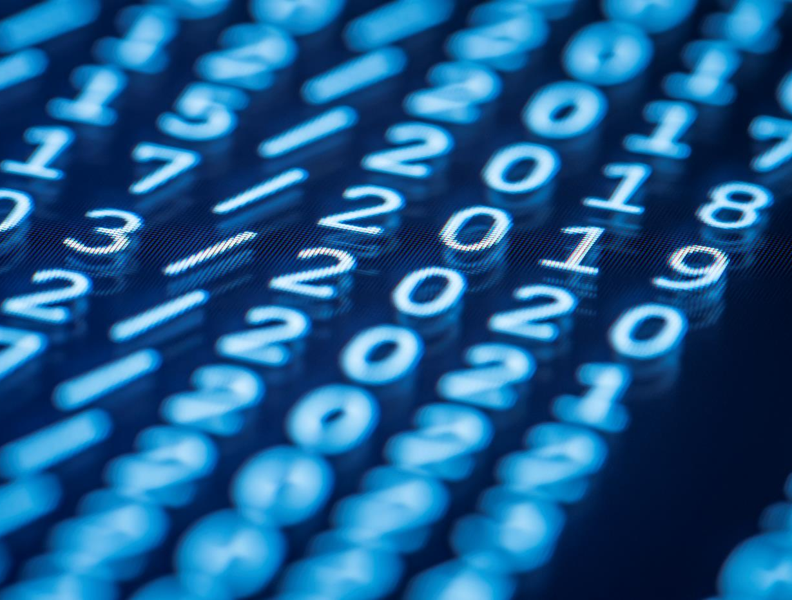
Thank You
The floor is open….

