Slide 1

Privacy In A Digital Age
Brian Hare, Associate Teaching Professor
UMKC School of Computing & Engineering
Linda Hall Library “Deeper Dive” series - August 2020 Week 2: Data Mining

Slide 2
Why Are We Here?
Big Data, Data Mining, and Deep Learning, Oh My!
Surveillance as a business
Networking effects and information bubbles—the goal is engagement, by (almost) any means necessary

Slide 3
A disclaimer before we begin
We’re focusing on the risks, perils, & abuses of data mining. Those are real.
But the benefits of big data & data mining are also very real
Progress on COVID as one example
Identifying risk factors & causes of disease
Personalized medicine & genomics
New research methods in every field, including humanities
It’s not “how can we stop data mining.” It’s “how can we gain the benefits while curtailing the abuses.”
Government abuses certainly happen, and we’ll talk about some of those; corporate abuses are more pervasive and better-documented.
And just for the record, I’m also not opposed to business, profits, or capitalism.

Slide 4
Big Data, Data Mining, and Deep Learning, Oh My!
Advances in technology have made it possible to analyze data at a scale that has never before been possible, so-called Big Data.
Look at what the news websites in Europe—all of them—are posting about this issue, analyze overall sentiment, identify biggest issues
Analyze Twitter—all of it—to see what’s being said about our product
Look at our cellular customers—all of them—and determine where people matching these characteristics do the most online shopping
Look at our radio telescope data over the last 10 years—all of it—to see if we can detect events that we couldn’t before
Data Mining lets us analyze data, often in real time, to identify connections, patterns, or relationships
The data can be structured (a large database of voter records, for example) or unstructured (blog posts, document archives, video posts, web pages) or combined
Deep Learning systems are able to identify patterns we previously couldn’t automate, enabling everything from machine translation to recognizing individuals
How all this works is a separate topic in itself, and currently one of the biggest areas of research. The potential is huge.

Slide 5
How does data get mined?
Search history used to build up profile of interests
Online calendars, contact books
Web pages & YouTube videos viewed builds up profile, incl. comparison of what phrased you searched with & which page/video you selected
This can also be used to improve their performance without profiling the individual, of course
Collaborative filtering: People who watched video X also went on to watch video Y, so provide a link to it
“People who bought _________ also bought:”
Credit reports – information as a commodity
Social network analysis
Who owns information about a transaction? The buyer? The seller? Both?
Opt-in v. opt-out
Notes:
Opt-in: Consumer must explicitly give permission before the organization can share info
Opt-out: Organization can share info until consumer explicitly forbid it
Opt-in is a barrier for new businesses, so direct marketing organizations prefer opt-out

Slide 6

Target-ing the customer
Most people’s shopping habits are consistent, but new parents are changing their shopping habits
Therefore targeting pregnant women is a good way to attract new customers
Target Stores did data mining to identify customers in 2nd trimester of pregnancy, which they could identify from their baby gift registry
Large amounts of unscented lotion, extra-large bags of cotton balls, nutritional supplements & multivitamins
Sent out “Congratulations! Everything for the new mom!” coupon books—including to a 15 yr old
Change of policy regarding what’s in the coupon books (but not the data mining)
Credit card companies identifying poor credit risks
Hardware store identifying products associated with good credit risks
Notes:
The girl’s father went to the local Target & talked to the manager, demanding to know how Target knew his 15 yr old daughter was pregnant before he did. The manager didn’t know, so dad kept pushing with Target. Answer: Target knew her offline identity as she browed the Target website—and been looking at products consistent with pregnancy. Data mining took it from there.
CC companies lowering credit limits because they notice you’re shopping much more at discount stores the last couple of months.
Red-flagging anyone charging at a particular bar (because those who charge at that bar have an 85% chance of missing at least 1 payment in the next year)
Ace hardware identifying felt circles as good credit risks.

Slide 7
Accidental Leaks
Netflix Prize
$1M to anyone who can come up with a significantly better algorithm for predicting user ratings (2006)
Released 100M+ ratings from 500K customers, stripped of private information
Ratings not truly anonymous if a little more information about individuals was available – i.e. Netflix ratings can be a partial identifier
FTC complaint, lawsuit
2010 sequel cancelled

Slide 8
Accidental releases
AOL Search Dataset
Posted 3 months queries from 650,000 users (2006), names replaced with random numbers
Vanity searches (search for own names)
Search for address, real estate sites, etc
NYTimes investigation
Data set taken down but had already been copied & reposted elsewhere

Slide 9
Surveillance as a business

Slide 10
Surveillance capitalism defined
Surveillance Capitalism is:
the collection & analysis of individual user data
to understand & predict individual preferences, wants, & needs,
ideally on a moment-to-moment basis,
so that ever-more-precisely targeted advertising can be directed at them.
The goal is to influence user behavior toward making a sale, whatever that means (buying a product, voting for a candidate, etc)
Note that advertising has often included creating a need the customer didn’t know they had, and selling them the solution – influencing or changing behavior

Slide 11
First-party v. third-party tracking
First-party: Data collected as part of offering a product or service
Amazon knows what you looked at & what you eventually bought
Google knows what you searched for & where you asked Maps to direct you
Facebook knows what you ‘Liked’ & what you commented on
This can be sensitive information, and companies have a long history of mishandling it
Third-party: Data collected on people who aren’t using their services
Facebook’s ‘conversion pixels’ gather information about users of other websites & services
Google tracks user visits to brick-and-mortar stores
Data brokers, advertisers, others track day-to-day internet activity
Web browsers distinguish between 1st-party & 3rd-party data. Most apps do not—to them, data is data. If an app has access to particular data, so does any third-party code running inside it

Slide 12
How did we get here?
2001: Google facing loss of investor confidence after dot-com crash
Abandoned reluctance to embrace advertising
Started analyzing user data to predict click-through rates, taken as an indicator of the ad’s relevance
Same basic idea as PageRank algorithm
As this showed its effectiveness, it was expanded
Data collection added to more services
Information not explicitly provided (or explicitly refused) can still be inferred
2004, IPO: Advertising revenue had increased 3,590%.
About 36-fold increase, in just over 36 months
This model quickly spread and is now used for much, much more than just advertising

Slide 13
How it works, in a nutshell
User enters a search phrase: “Pomeranian puppies”
Quick database search:
Find all ads served up on past searches of ‘Pomeranian puppies’ for other users
If we haven’t encountered that phrase before, do this for each word individually
Give priority to the ones that have been clicked on the most
Select ads to display for this user
Note which ads this user clicks, if any
Also note which returned links the user clicks—they’re more relevant—and the last one the user clicks is probably where they found what they were looking for, so is most relevant
The new part:
Give priority to the ones that have been clicked on the most by users who are similar to this user

Slide 14
How do they identify you?
An identifier should
Point only to you (or your device)
Be relatively permanent/persistent
Be easily accessible
If all 3 aren’t available, 2 will often do
2 or more weak identifiers can be combined into 1 strong identifier
While an identifier may appear anonymous—”afc9297acd930291f”—it can almost always be linked back to real person

Slide 15
What can identify you?
Cookies
HTTP Cookies
Local Storage cookies
IP address
TLS (Transport Layer Security) state
Browser fingerprint/ID
Phone number
IMSI / IMEI numbers
IMSI (International Mobile Subscriber Identity) is on phone’s SIM card
IMEI (International Mobile Equipment Identity) is baked into the hardware
Advertiser ID (usually visible across apps)
MAC address
License plate
Face print
Credit card number
Note that these can be combined. If you get a new phone from a different service, your phone number will probably be unchanged and you’ll soon log in to the same websites, linking the old & new identities

Slide 16
Where does this data go?
Targeted advertising
Google and Facebook control 60% of digital ad market in US
Google, Facebook, Amazon, Twitter offer end to end services so advertisers don’t need access to data
Data brokers allow purchasing user information & uploading that to Google or Facebook; this can bypass anti-discrimination efforts or attempts to avoid malicious targeting
Google combines search history, Gmail data, browsing history into comprehensive picture
Political campaigns, interest groups
CatholicVote used cell-phone location data to determine who had been in a Catholic church, then targeted them with get out the vote ads
Anti-abortion groups have targeted ads at women while they were at abortion clinics
Deep Root Analytics was the source of the largest breach of voter data in US history

Slide 17
Where does the data go?
Social Media & News Sites
Driven by engagement—what will keep you on our site just a little bit longer? (Goal is more advertising revenue.)
Debt collectors, bounty hunters, investigators, bail bond companies
But the data can be bought & abused by anyone
Cities, law enforcement
Many legal limits on collection of data by governments are effectively bypassed
The government can’t collect or retain certain data by law, but the law (written before data brokers) says nothing about buying the data from a private company

Slide 18
Face recognition can identify users in realtime
As of mid-2019, is required to be used for smartphones in China
Used to identify people at higher risk of shoplifting; but models are often racially biased, and recognition less accurate for darker skin
Walgreens testing a system where refrigerated cases don’t have glass doors; rather screens w/ icons showing what’s inside, and display screen for personalized ads based on face recognition
And of course, that you were in that Walgreens at that time shopping for that stuff all becomes more monetizable data

Slide 19
Data Brokers
Data brokers specialize in building large databases of personal information including psychological profiles (“Credit Hungry Card Switcher,” “Disciplined Passive Borrower”) and identity resolution (if you have 1 piece of information about someone, we can provide more detailed data on them)
Cambridge Analytica developed OCEAN scores—openness, conscientiousness, extroversion, agreeableness, and neuroticism—about millions of voters

Slide 20
Realtime Bidding, lookalike communities
Ads placed via real-time bidding; user information exchanged before bidding.
Companies can low-bid to get user data cheaply
Advertisers don’t have direct access to Facebook data, but can advertise to, say, tractor-pull enthusiasts living within 150 miles of Salina KS
When those users click the ad, they’re directed to the advertiser’s website, with information that they came from Facebook after clicking an ad; this can be linked with real-world identity
Advertisers can provide data files about their users & ask Facebook to form a look-alike community, & market to it; again, when they click through, their IRL identity is linked
This process is opaque to everyone except Facebook

Slide 21
What’s the problem?
Movement history can identify habits, political beliefs & activity level, even if user has chosen not to provide this information
99.5% of license-plate searches are not related to law-enforcement interest
“Smart” video doorbells being used by police departments to provide public/private partnership continuous video surveillance of neighborhoods
Facebook has already experimented with altering users’ moods based on what’s in their news feed
Targeted advertising has been used to bypass campaign expenditure limits, anti-discrimination laws
The goal is often explicitly influencing people in ways they don’t realize: “We can engineer the context around a particular behavior and force change that way… We are learning how to write the music, and then we let the music make them dance.”
Note: No one explicitly authorized any of this
Notes:
Uber produced a heat map of hookups: few-block data of NYC neighborhoods, where someone was dropped off at a residential address after 11 PM Saturday & picked up from the same address before 5:30 AM Sunday.

Slide 22
Email from a student
Since my dad passed away the ads have relentless. It was like they knew I was an emotional spender, knew exactly what I would spend money on to feel better (get that hit of endorphins), and what times during the day I would become unstable. It’s been ridiculous!
Notes:
This is all true. But, to be clear….

Slide 23


Notes:
This is not the result of James Bond villains, meeting at the secret base under the volcano, plotting how to turn human misery into profit. It’s less, and somehow more, chilling than that. It’s just a matter of noticing that this person is spending money in about these amounts on these products at this time of day. So if we advertise more products in that category & price range to them at this time of day, they’re likely to click through & buy, which makes a bit more money for the advertiser. The more consistent the pattern, the more desirable the customer is to advertisers. It’s just business.

Slide 24
Profiling, personalization, & politics
Social media sites are driven by engagement—what keeps users returning to the platform
Behavioral science (which these companies definitely study) tells us one of the most effective ways to reinforce behavior is intermittent reinforcement
Variable payoff for desired behavior: Sometimes (usually) relatively minor, occasionally significantly more, and every once in a while, a POW! of a reward
Yeah, kind of like scrolling through your Facebook feed….
As customer profiling improved, focus gradually shifted from “show me today’s news about topics I’m interested in” to “show me news I agree with or that supports my beliefs.”
Because you keep coming back more for those.
This leads to the well-documented information bubble, in which one is never exposed to information one doesn’t like

Slide 25
Profiling, personalization, & politics
This rewards what is most:
Enticing
Salacious
Scandalous
Provocative
Outrageous
It does not reward being:
Accurate
Well-researched
Carefully reasoned
Truthful
It doesn’t have to be truthful, accurate, or much of anything else—only plausible and, above all, entertaining or provocative
Tends to drive discourse toward extremes
Notes:
I know what some of you are thinking right now…. Well, yes, SOME people might fall for that….

Slide 26

Notes:
That weird cousin on my mom’s side would, for example. But I’m far too smart and well-informed for that.
Well… no. No, you’re not. Everyone has their buttons. Everyone has certain things they find more persuasive. And to these techniques, “People who think they’re too clever to be taken in by advertising” is just another demographic. We’ve got a set of ads all ready to go, aimed at people who think they’re too smart to be taken in by ads. And there is a correlation between an information bubble and general intelligence—and it’s positive. The smarter you are, the more careful you have to be about falling into one.
(As an aside, any con artist can confirm, the easiest mark is the person who thinks they’re too smart to be conned.)
Recent article on Sunset Boulevard described Norma Desmond as completely cut off from reality in an information silo she doesn’t even realize she’s in. and that to one degree or another, we’re all Norma Desmond now.

Slide 27
Cambridge Analytica
Robert Mercer’s vision: Use data analytics to help conservative candidates and causes
Formed company, Cambridge Analytica, and hired Aleksandr Kogan to gather over data
Kogan created survey app: “thisisyourdigitallife”
Users had to access app using Facebook Login
Users agreed that app would download information about them and their Facebook friends
Personal data collected from 270,000 people who took surveys and as many as 87 million people who were on their friends’ lists
About 30 million profiles were detailed enough that Cambridge Analytica could combine data with other data they had, creating psychographic profiles
Classified voters over five personality traits: openness, conscientiousness, extroversion, agreeableness, neuroticism
Strategy: target ads based on psychographic profile

Slide 28
Cambridge Analytica
Trump campaign hired Cambridge Analytica in fall 2016 – firm promised to provide names of millions of voters likely to vote for Trump
“Data breach” story broke in spring 2018
Facebook response
Not a breach – everyone who used Kogan’s app had granted their consent, and privacy settings of their friends allowed their information to be shared
Kogan had perpetrated a fraud by sharing data with Cambridge Analytica
Suspended accounts of Kogan and Cambridge Analytica
May 2018: Cambridge Analytica filed for bankruptcy
January 2020: Further review of CA documents show extensive discussion of how to avoid campaign finance limits, use of foreign funds. Similar activity in 6 other countries.

Slide 29
It’s not just your data, it’s also others’
Facebook has since changed its policies on outside researchers having access to user’s friends list (but its own internal use continues)
Ancestry.com, 23&Me, etc., sites get some revenue from user memberships but mostly from allowing drug companies to mine their huge genetic database
Which reveals information about you—and about anyone fairly closely related to you
Who should have access to that information?
One case so far of a police department submitting a sample in order to identify possible suspects—should this be allowed?
UK requires anyone arrested to submit a cheek swab for DNA analysis. Metropolitan Police (London) accused of arbitrary arrests of minorities just to get sample.

Slide 30
It’s not just your computer, your phone, your tablet, and your smart tv….
A big area of development is the “Internet of Things” (IoT)
Smart appliances
Smart light switches
Smart thermostats
Smart speakers
Most have little if any security
Most designed to gather data

Slide 31
Duck season? Rabbit season? No, it’s election season!
Conventional wisdom used to be that about 40% of voters were reliably Republican, 40% reliably Democratic, and American elections were won or lost in the middle 20%
Today elections are mostly about getting out your base—identify people who agree with you, and get them motivated to get out of the house & vote on election day
The simplest ways to motivate someone: Get them scared, or get them angry.
It doesn’t matter whether you do it truthfully or not, you just have to do it. If you convince them you’re the only candidate not controlled by Martians—no one but you & Facebook have to know
Meanwhile identify people likely to vote the other way, & make sure they see stories/ads about how long the lines are likely to be at the polls, does one vote really make a difference, etc.
And again… you may think you’re too smart for this. And you may actually be. But probably not.

Slide 32
Next time
What the individual can do
Professional responsibilities
Regulatory issues

Slide 33
Part my end-of-semester course wrapup
In spite of what I sound like sometimes, I am basically an optimist. I believe tomorrow will be better than today. But I’m not a utopian. I don’t believe the right combination of apps will let us all march together hand in hand into the sunlit uplands. I don’t hold with those who insist that every problem is ultimately a tech problem. Technology can be part of the solution—better technology lets more of us live longer, healthier, happier lives, and has been a huge positive good. But we still have the problems of greed, short-sightedness, perverse incentives, and unintended consequences. Those are not technical problems and seem inherent to the human condition. We will live longer, healthier, happier, more comfortable lives—but we will still have problems.

Slide 34
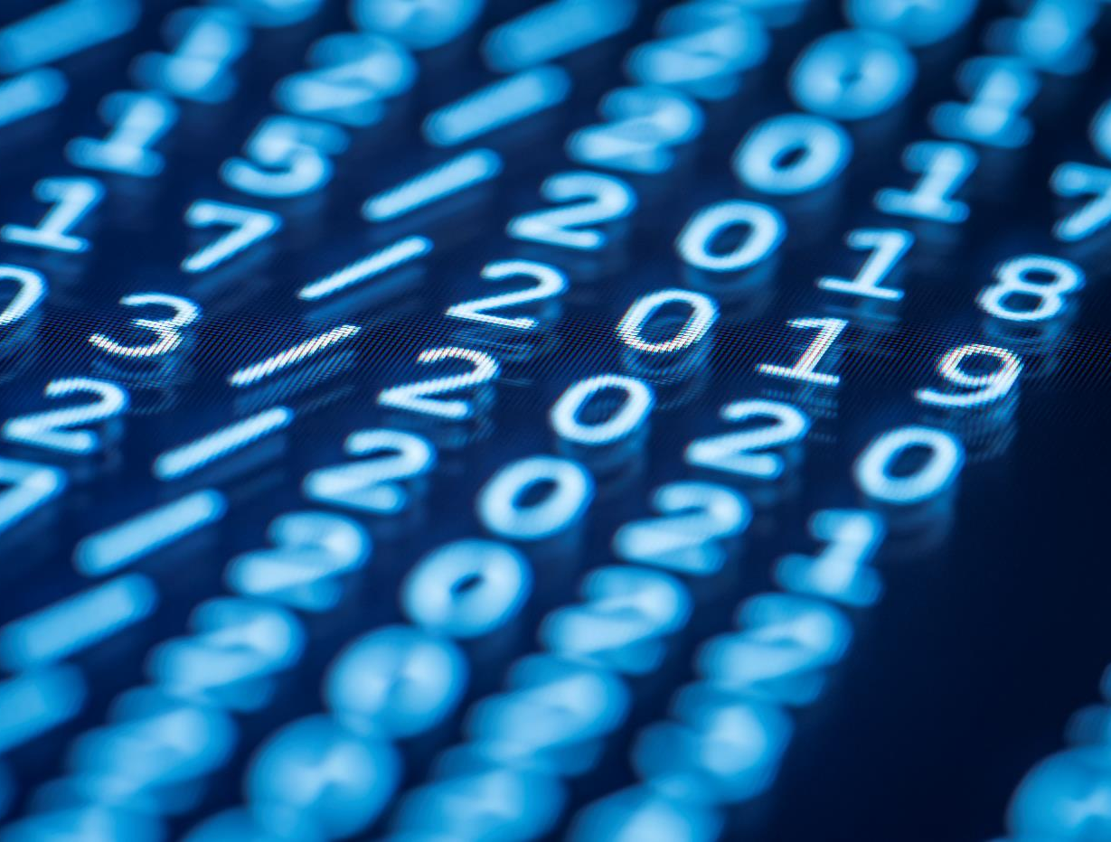
Thank You
The floor is open….

