Slide 1

Privacy In A Digital Age
Brian Hare, Associate Teaching Professor
UMKC School of Computing & Engineering
Linda Hall Library “Deeper Dive” series - August 2020 Week 3: What can I do?

Slide 2
“Tyranny loves surveillance, because it breeds conformity. It means people will only do that which they want other people to know they’re doing—in other words, nothing that is deviant or dissenting or disruptive. It breeds orthodoxy.”
--Glenn Greenwald

Slide 3
Why are we here?
Privacy & The Government
Resources & Options
Future Trends, Antitrust, and Some Speculation

Slide 4
“Who’s watching out for our privacy?”
Privacy law in the US is fairly limited
Serious question whether current laws are adequate for the internet age
Last major update to email privacy was 1986, pre-webmail
Fundamental assumptions of privacy laws also predate internet

Slide 5
It’s not hopeless, though….
Health Insurance Portability & Accountability Act (HIPAA) regulates confidentiality of medical information
Family Educational Records Privacy Act (FERPA) regulates educational records
Employee Polygraph Protection Act of 1988 prevents private employers from using polygraphs (‘lie detectors’) under most conditions
Children’s Online Privacy Protection Act reduces public information gathered from children, online services must have parental consent before collecting any information on children 12 & under
Genetic Information Nondiscrimination Act limits what genetic information can be requested or used in hiring, promoting, setting health insurance rates. Does not apply to life/disability/long-term care insurance.
IRS records private by law
Law mostly regulate what the government can do, release of agency records, or under what circumstances

Slide 6
Fair Credit Reporting Act limits what information can be kept in a credit report
Negative information kept 7 years, except: Bankruptcy 10 years, criminal convictions indefinitely
Fair and Accurate Credit Transactions Act establishes right to a copy of credit report from each agency & opportunity to correct factual errors; allows “fraud alert” in case of identity theft
Financial Services Modernization Act requires notification of privacy policies & opt-out clause

Slide 7
But it’s not great, either
Privacy Act of 1974 only applies to government databases
Only covers databases indexed by a personal identifier
No one agency or officer is in charge of enforcement. It applies to everyone in general, therefore no one in particular
Agencies decide for themselves whether they are exempt from its provisions
IRS has exempted its database of cases it’s investigating
FBI has decided it’s not responsible for reliability of information in National Criminal Information Center database
Agencies can share information as long as it’s “routine”
AG Ashcroft encouraged agencies to interpret “routine” as broadly as possible
No prohibition on contracting with private entity to maintain database on behalf of the government
Notes:
IRS won’t let you ask if they’re investigating you for tax fraud, and if so, send you a summary of what they’ve found so far. NCIC is accessible to almost every law enforcement agency in the country—federal, state, county, municipal. Thousands of people have legitimate access to it & ability to enter information.
Personal identifier: IRS agent under investigation for corruption wanted records relating to him during discovery. Declined on the grounds that the relevant records were indexed by investigating agent, not the target of the investigation

Slide 8
What’s the context?
Police surveillance drones to read license plates of passing vehicles
Public generally OK with this for search-and-rescue or Amber Alert situations, less so with catching speeders
License plate scanners
How long is the data retained? In practice, varies from 48 hours to indefinitely
Should police be collecting data about people who are not criminal suspects?
Government surveillance
Authorization for detection of foreign intelligence agents eventually used to investigate organized crime, anti-war protestors
PATRIOT Act reforms have led to prevention of possible terrorist events; have also been used for general law-enforcement and have at times been badly abused
Often require reasonable cause rather than probable cause, or certification that the information expected to be gained will be useful
Predictive policing
Some jurisdictions have had good results, significant drops in property crime; others have seen positive feedback loops

Slide 9
Recent court decisions
Attaching a small tracking device to a car & recording its movements requires a warrant
If you’re arrested, police can’t automatically go through all the contents of your cell phone
You do not have a right to privacy if you accidentally butt-dial someone
If someone flies a drone with a camera over your house, do you have a right to take a shotgun & shoot it down?

Slide 10
“No Reasonable Expectation of privacy”
Olmstead v. US – Wiretapping did not involve search (of a place) or seizure (of documents), so 4th Amendment didn’t apply
Federal Communications Act of 1934 prohibited warrantless wiretaps
Katz v. US – Warrantless wiretaps not admissible in court
FBI under Hoover maintained 2 sets of files
Smith v. Maryland (1979) – A pen register (which records date/time of call & number dialed but not the contents of the call) did not require a warrant.
Because the number called must be shared with the phone company to complete the call, the caller has “no reasonable expectation of privacy.”
Thus, since you must tell your ISP which web page you want to view, you have no reasonable expectation of privacy regarding your web habits or search history—and the floodgates are open
Serious question whether this is adequate—the decision predates large-scale data mining & the internet—but for now, it’s what we have

Slide 11
So what can I do about it?

Slide 12
Step 1: Don’t Panic
Recognize what you can do, and the limits of what you can do—and those limits are quite real
For example, suppose you decide that for your online purchases, you’ll buy gift cards—with cash--to protect your credit card information.
Well, do that too much, and you trip the data-mining that’s looking for money laundering
And if you have it shipped to your home, they’ll still know who it’s for.
The current state of affairs is that you cannot completely escape data profiling if you’re active online
But there are things you can do to reduce the size of your data footprint and protect your information

Slide 13
Basic Security
Strong passwords
No common names, song lyrics, sports heroes, etc
Mix of characters helps, but password length is largest determinant
Different passwords for each site, and don’t write them down.
Consider use of password manager
2-Factor Authentication where possible
Don’t click links in emails you’re not expecting. If an email claiming to be from your bank asks you to log in, close that mail & type the bank’s web address into the browser manually.
Change default passwords on router
Keep antivirus software up to date
Look for lock icon on web addresses—most sites use https now.
If there’s no lock icon, don’t trust the site with any personal info—it can be read in transit.

Slide 14
Basic Phone Security
Uninstall any app you don’t need
Most apps are designed to gather data
Paid apps may not show you ads but probably still gather data
For each – Check the settings, turn off any “help us improve” checkboxes or data gathering options
This may break some apps. You’ll need to decide if turning the data gathering back on is worth regaining the functionality
Also do this with your smart thermostat, smart TV, smart ______________.
Turn off “automatically connect to Wi-Fi”
Yes, this limits functionality; you may or may not want to do this

Slide 15
Browser Security
Major modern browsers have options for controlling how much data is revealed
Google Chrome, in general, reveals more information than any other browser, even with all privacy options enabled
Tor Browser is by far best on privacy but hardest to use, breaks some sites
“Do Not Track” is helpful, but ultimately it’s a request. Some sites respect it, some don’t.
Clearing cookies & history from time to time is helpful, but limited.
Browser settings should be set to the strictest options that let you accomplish what you need to
Think about whether you really need that feature, or if you really need to take the fun little “How long would you survive in a zombie apocalypse?” quiz.
Social media sites are designed to gather data—that’s why they exist.
In general, with any site, if you’re not paying them for their services, you’re not the customer; you’re the product.

Slide 16
Plug-ins & Extensions
Ad blockers: Helpful, but some sites getting aggressive about “allow us to show you ads or you can’t proceed to the site”
Password managers
Privacy extensions:
Privacy Badger
Ghostery
DuckDuckGo Privacy Essentials
Use DuckDuckGo as your default search engine

Slide 17
Future Directions
“Privacy Enhancing Technologies” provide a technical ‘solution’ that may not meet many users’ concerns
Data analyzed directly on the phone & an encrypted summary sent
It is possible to pool data from multiple users & deduce “user A is similar to user D but not user B” without identifying what makes them similar or who contributed which data
This allows classification of user into various subgroups, but the company can honestly say they haven’t looked at anyone’s private data
These proposals are being developed by large companies and institutions with the goal of “differential privacy,” i.e. the selective release of information to the right people while protecting it from others
See Zuboff’s questions of authority & power: Who decides who ‘the right people’ are, and why do they get to make that decision?

Slide 18
Future directions
We are well past the point that a simple tech fix exists
Classic example of technology making things possible before regulation can keep up—companies can, it’s very profitable, so they do.
These companies want to protect their revenue stream & business model
Breaking news: Congress taking an interest on antitrust grounds
Amazon provides a marketplace, and sells within that marketplace
Google is a buyer of ads, a seller of ads, and a broker of ads
Apple maintains a monopoly on iPhone development—if you have an iPhone app, you must go through their portal and pay them a 30% cut
Facebook appears to have been used to influence elections in violation of numerous laws
Each of these companies have dealt with competition by buying it out & killing it
Antitrust laws were mostly written in the era of the Standard Oil trust, but John D. Rockefeller couldn’t change the course of an election. The “if you’re not paying for it, then by definition you’re not being overcharged and therefore not being harmed” assumption no longer holds.
Notes:
Facebook’s proposals for dealing with false or libelous political ads is to allow users to opt out of all political ads, which a few will, but most won’t—no real disturbance to the revenue stream. When Target is criticized for sending maternity-themed coupon books to 15-year-olds, they respond by reformatting the coupon books, not by stopping the data mining and profiling—it’s just too profitable to walk away from. Also, Siri/Alexa/Google Assistant all send snippets of audio for analysis, including humans listening to it to verify speech-to-text. If a company says “we protect your privacy” and then has employees listening to secretly-made recordings, even just anonymized snippets, is that a deceptive trade practice? Congress is looking into that.

Slide 19
Unresolved questions
Is the “no reasonable expectation of privacy” standard still appropriate?
Privacy policies:
Most users never read the privacy policies of apps & sites they use
On the other hand, doing so for every app/site would take the average user 80+ hours per year; is that reasonable? The average privacy policy can run to 50,000 words (about 10 single-spaced pages).
Is it reasonable to put all responsibility on the user to keep up on latest developments?

Slide 20
What a long, strange journey it’s been
Boundaries are shifting rapidly – what can be done v. what should be done, what is known v. what should be allowed to be known, who gets to decide these issues
This is not a new process
In the early 1800s, ballots were printed by the parties & different colors, so when you dropped your ballot into the ballot box, it was known who you were voting for—after all, why should you be ashamed of who you’re supporting?
On the other hand, if you were beating your children, well, we hardly approve, but won’t violate the privacy of the family to intervene directly
Telephones were originally seen as mostly a tool for business.
Boundaries of what is properly private & what is properly open have gradually shifted as social conditions, economic conditions, & technology have shifted
The Internet and growing use of AI is going to trigger another societal discussion—there is no consensus at present.
Notes:
Telephones were originally seen as mostly a tool for business. Why would you want one in your home? Then anyone can interrupt you, disturbing the peace of your home—you may be in a meal, or spending time with your family. If they want to talk to you, let them come to the door & knock like a civilized person.

Slide 21

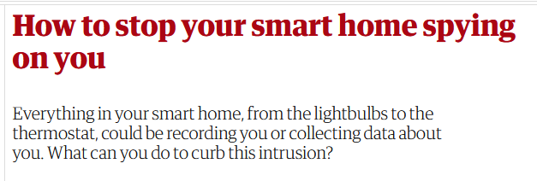

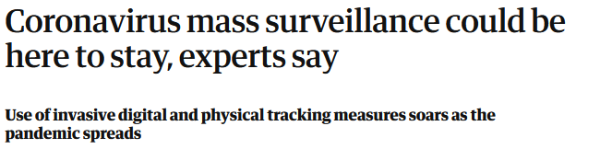

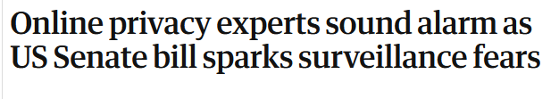
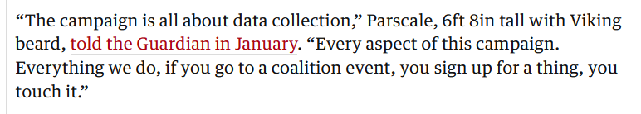
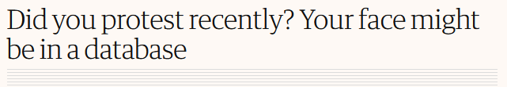
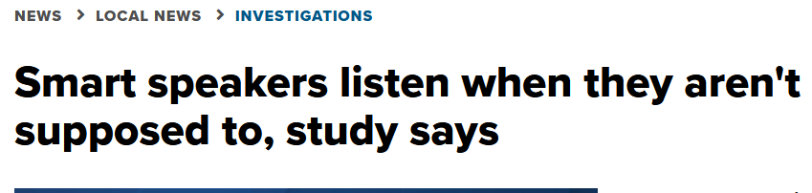
Notes:
Growing awareness that we have an issue here; less consensus on what to do about it.
When James Comey says that end-to-end encryption, which protects citizens’ privacy, also protects the privacy of drug traffickers, human traffickers, and child pornographers, he’s not wrong. Where should the tradeoff lie? We still require warrants, even though police could be more efficient without them.
Some actions individuals can take, but it’s a series of tradeoffs. The more active you are online, the less privacy you’re going to have. At the moment, that’s the bargain.
And of course, it’s getting harder & harder to not be online much & still be a full participant in civic life….
Growing political awareness, probable government action within a few years.
Fasten your seat belts, it might be a bumpy ride.

Slide 22

Thank You
The floor is open….

