Slide 1

FAKE NEWS DETECTION
AIDI 1006 – Assignment 4 April 4 2024
Brian Ritchie and SEMAL SHASTRI

Slide 2
Fake news detection
Objective is to use Azure Machine Learning to run a model to detect whether news is fake news based on a trained model from Hugging Face.
We will use a fake news database with labelled news items to assess the accuracy.

Slide 3
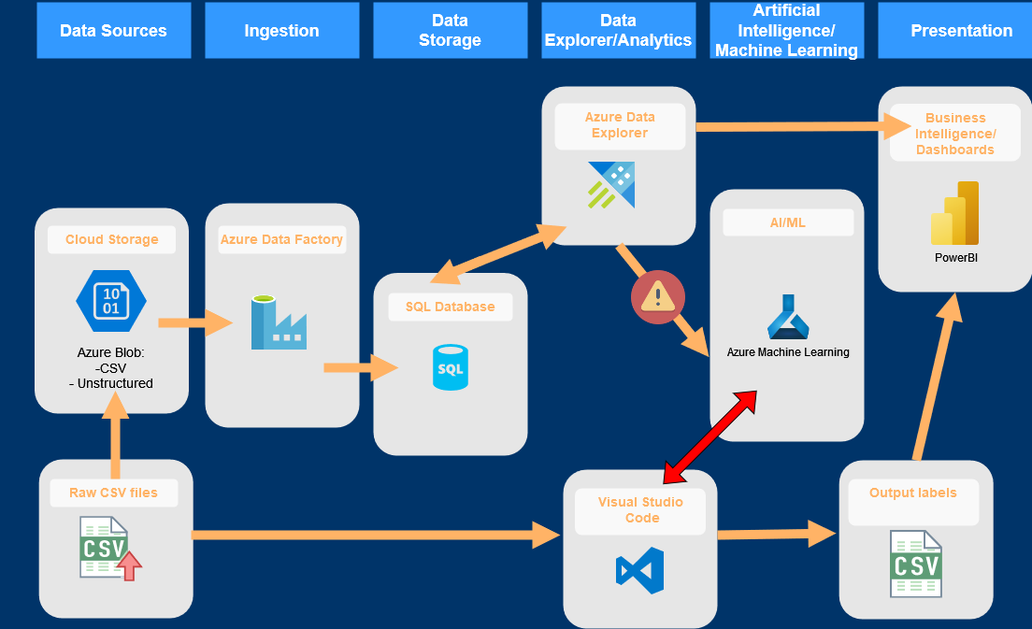
Fake news detection - architecture
Upload raw csv of labeled news items to Azure blob storage
Data loaded through Azure Data Factory and stored in SQL DB
Data was accessed via Azure Data Explorer cluster.
We could not figure out how to link the data directly from Data Explorer to the Machine Learning module
Instead, we used the “consume” code created in AML endpoint to access the model via visual studio code.
The code ran 5,000 tests on the model to determine fake or true label.
The output labels were compared to the input labels in VS Code, achieving 99.8% accuracy

Slide 4
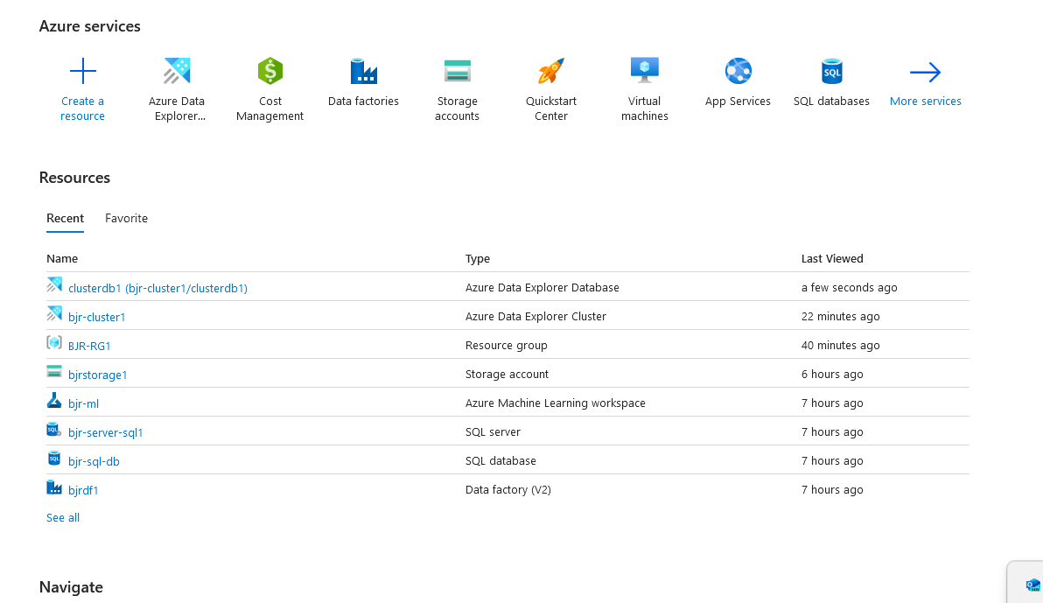
Fake news detection – azure overview
This shows the resources created for this project including the storage, the SQL DB, ADF, Azure machine learning workspace, the Azure data explorer cluster.

Slide 5
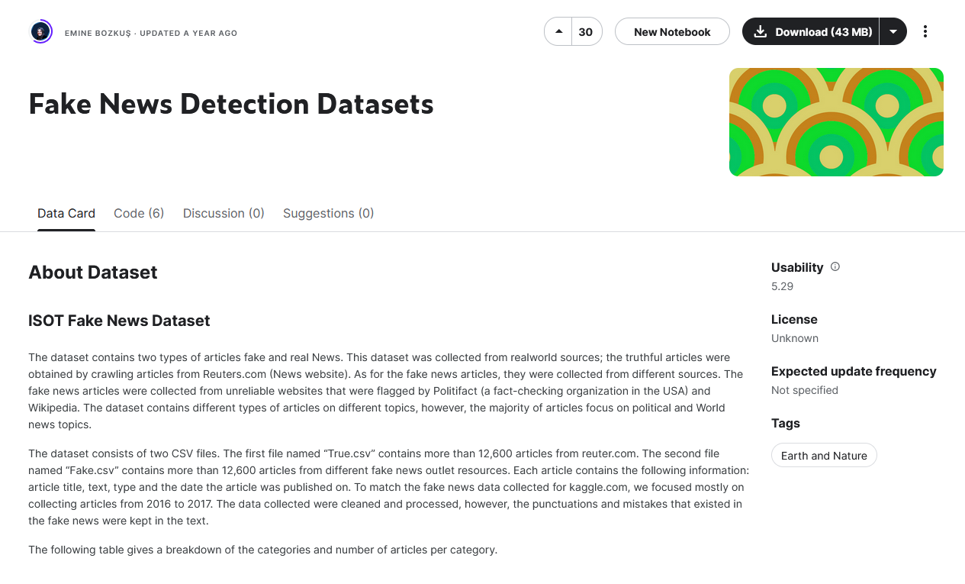
Fake news detection – dataset
The data set was a recent data set updated a year ago which has fake and real news articles in a labeled dataset
The dataset was downloaded from Hugging Face for use in our Azure solution.

Slide 6
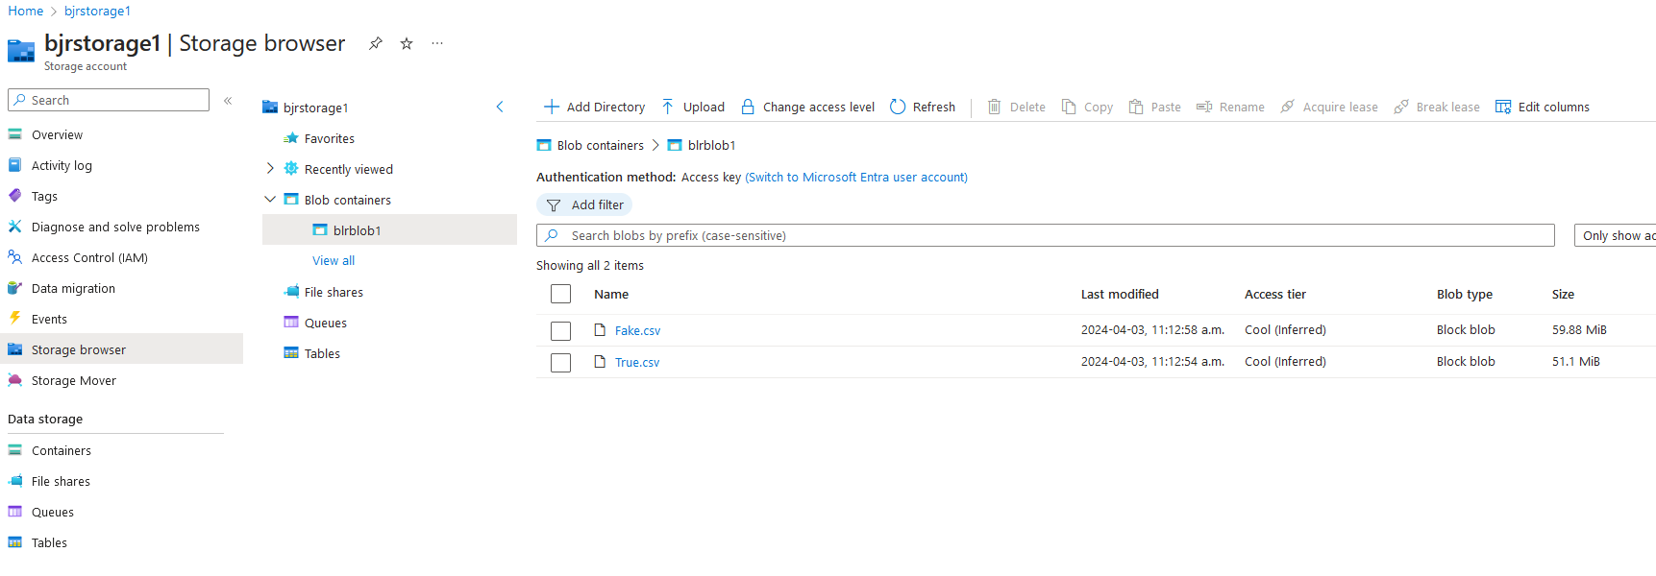
Fake news detection – azure blob storage
A blob storage instance was created to input the csv files, which were downloaded from Hugging face.
The csv files each have ~22,000 news items, one file for fake news and one file for true news
These will be used to test the pretrained model

Slide 7
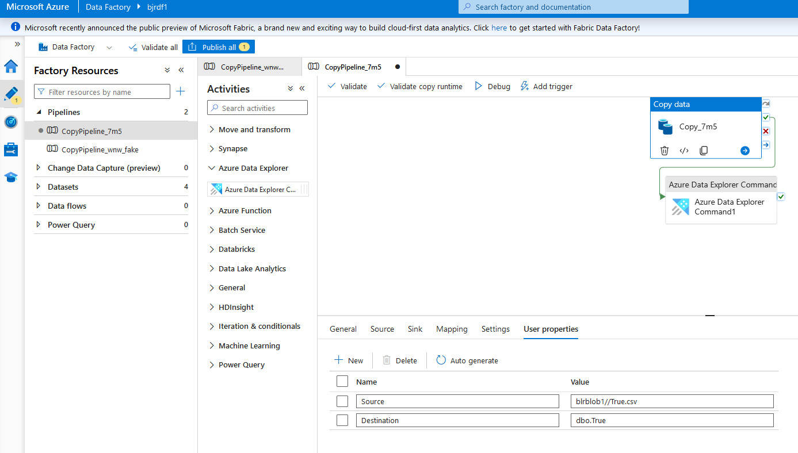
Fake news detection – azure data factory
Azure data factory was used to take the data from the blob storage to the SQL database

Slide 8
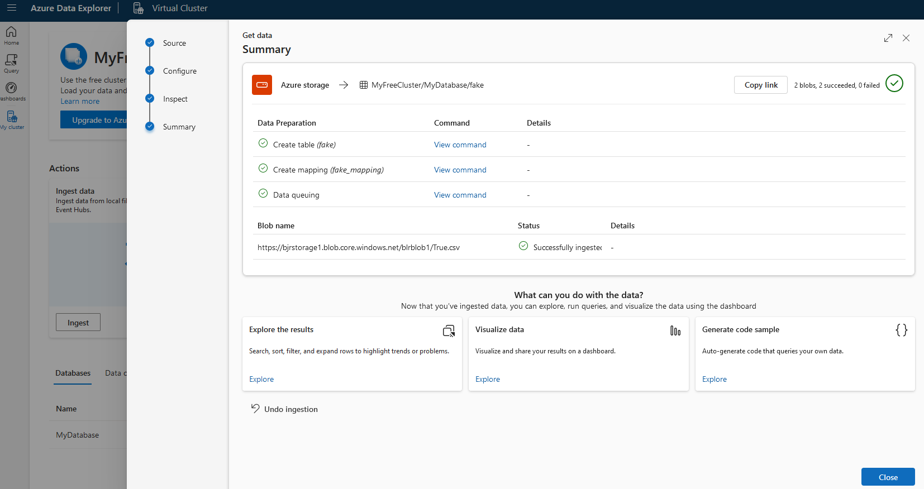
Fake news detection – azure data explorer
Azure data explorer was used to create data tables from the SQL database

Slide 9
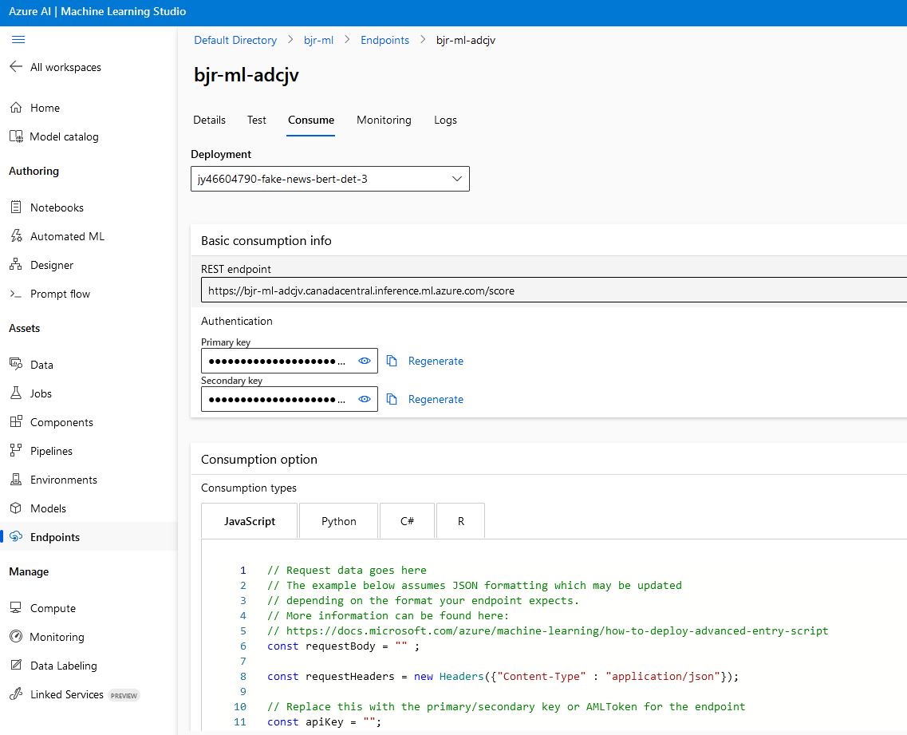
Fake news detection – azure machine learning
A model was selected from the data catalogue to utilize. The model was from Hugging Face and was trained on the Bert transformer for fake news detection.
The model was tested successfully in the Azure platform.
The code from the Consume was used in VS code to run the model.
We were unable to find a way for the ML model to link to the data in the Azure Data Explorer or the SQL database.
So, we went with the VS Code method to run the model.

Slide 10
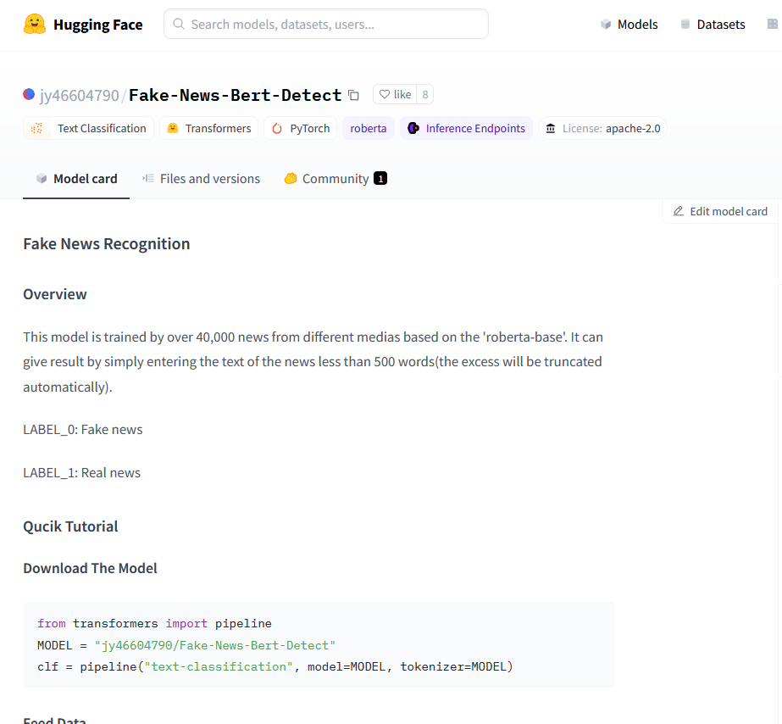
Fake news detection – Hugging face model
A model was selected from the data catalogue to utilize. The model was from Hugging Face and was trained on the Bert transformer for fake news detection.

Slide 11
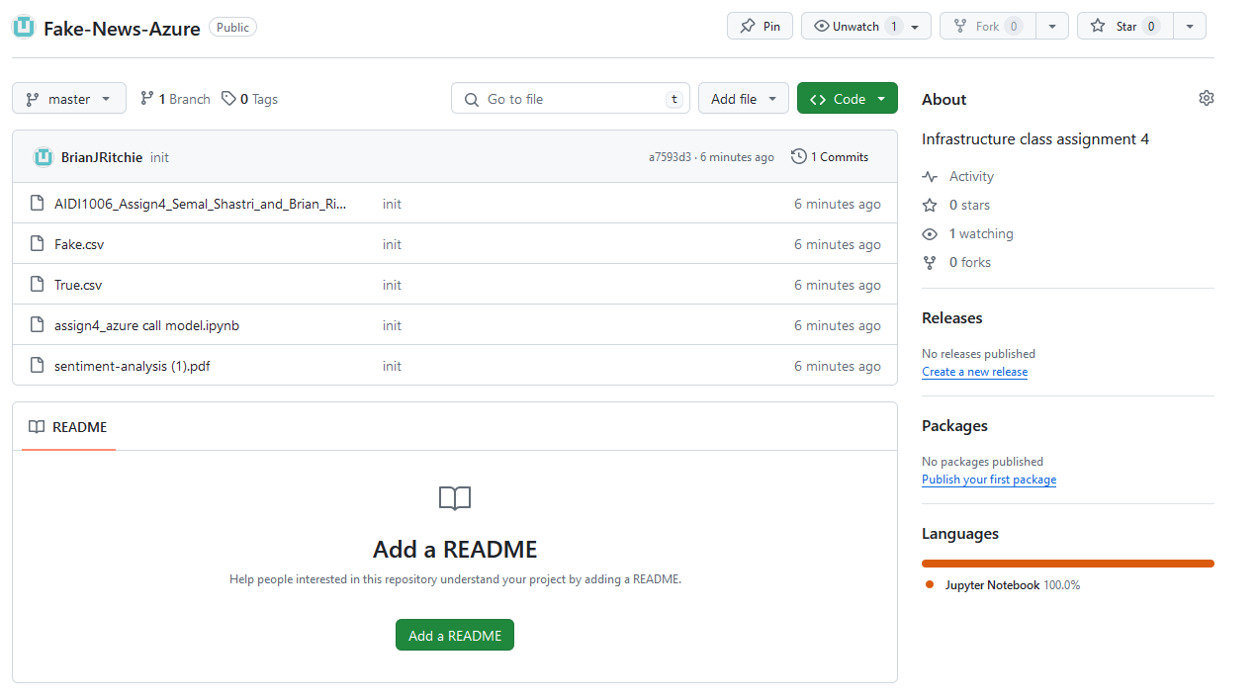
Fake news detection – Github
The code was pushed to the following repository: https://github.com/BrianJRitchie/Fake-News-Azure.git

Slide 12
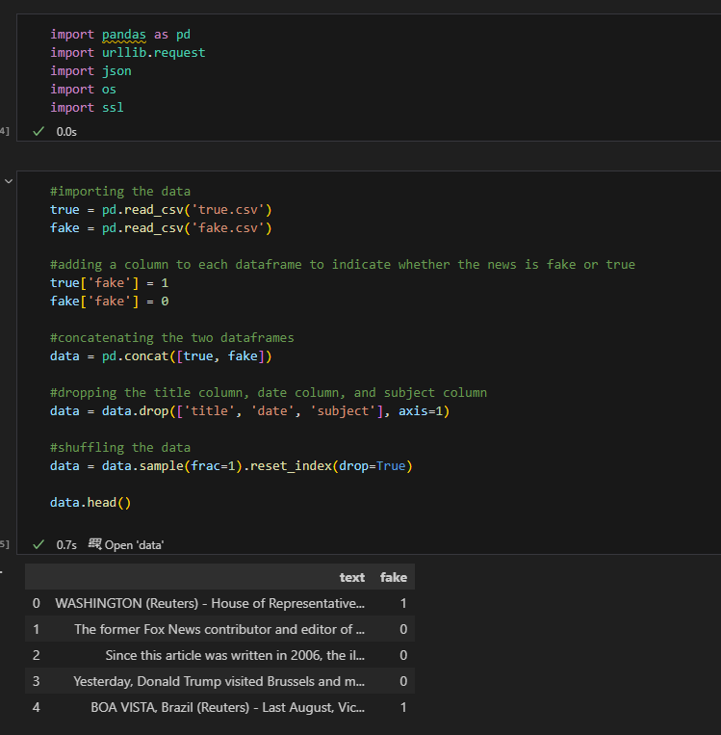
Fake news detection – VS CODE - 1
The first part of the code is importing the data directly from the csv files and preprocessing the data into the correct format.

Slide 13
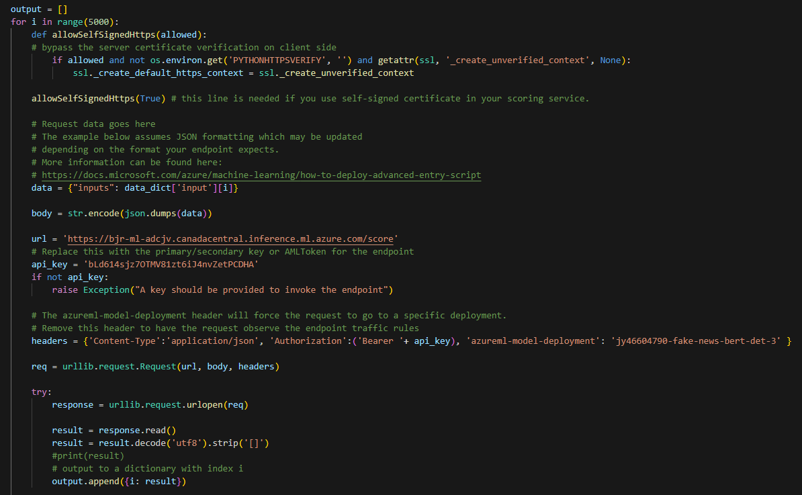
Fake news detection – VS CODE - 2
This part of the code was adapted from the Consume tab of the endpoint for the ML model in Azure.
A loop was created to run the model 5,000 times.
The url and the api_key were imported from the model endpoint
The output variable is used to store the final predicted label and the score.

Slide 14
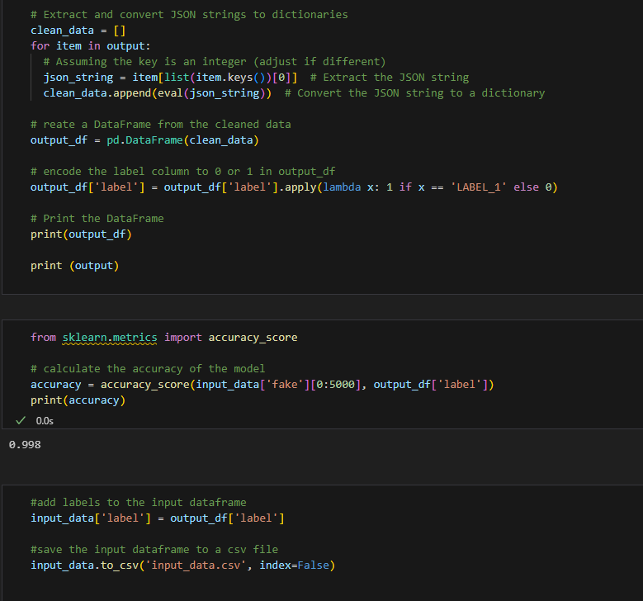
Fake news detection – VS CODE - 3
The output of the model is extracted from the JSON format into a dataframe
The predicted labels were compared to the known labels and the accuracy score was calculated.
The final accuracy for the 5,000 news items was 99.8%

Slide 15
Fake news detection – conclusions
Fake news is a cultural issue that has been worsening with increased use of social media as a primary source for new items.
Detection of whether a news item is true news is an issue that the social media platforms have been forced to address.
Automation of the process is key for the platform ability to deal with this issue.
A pre-trained model from Hugging Face was accessed via Azure for assessing the test news items.
The data WAS loaded and processed in Azure, but we could not determine how to connect the pretrained model with the dataset. So the data was independently loaded into a python notebook while the model was accessed via Azure.
The model worked very well to determine whether the news items were fake or not, delivering a 99.8% accuracy on the 5,000 random news items from the dataset.

Slide 16
Fake news detection – future work
A model could be built from scratch in the Azure framework. However, training of the model would require significant time and horsepower which may have been problematic on a free Azure account.
Other datasets should be tested against the pretrained model. With the high accuracy, we are suspicious that the data set used for testing may have been one of the many used for training the model.
Although the results from the model were very simple, a dashboard could be built to show the accuracy and some of the sample news items. For this assignment, we chose to focus on the modeling and this presentation.

