Slide 1
STP 311 Final_Project

Slide 2
Spotify_data
# A tibble: 6 × 2 `colnames(dat_music)` classes <chr> <chr> 1 track_id character 2 track_name character 3 track_artist character 4 track_popularity integer 5 track_album_id character 6 track_album_name character
While most of the columns are classified correctly, we only correct for “mode” as a factor because it is a 0 or 1 entry.

Slide 3
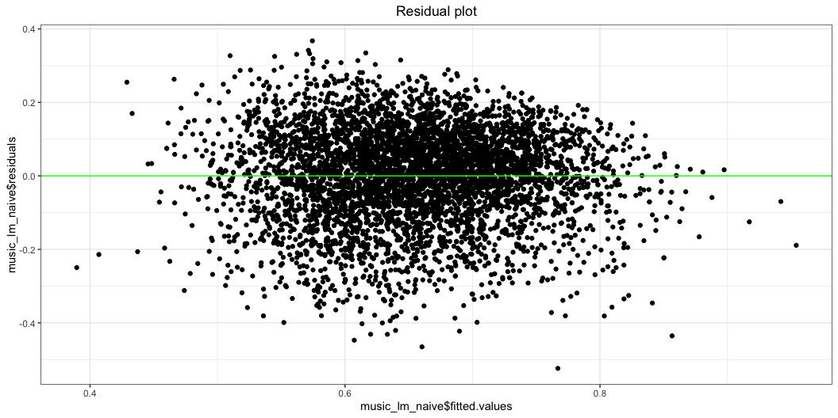
Naive Linear model:
Call: lm(formula = danceability ~ ., data = music_reduced) Residuals: Min 1Q Median 3Q Max -0.52396 -0.07580 0.01318 0.08886 0.36760 Coefficients: Estimate Std. Error t value Pr(>|t|) (Intercept) 8.856e-01 2.031e-02 43.604 < 2e-16 *** track_popularity 2.402e-04 7.498e-05 3.204 0.00136 ** energy -2.431e-01 1.620e-02 -15.011 < 2e-16 *** key1 2.253e-02 7.784e-03 2.894 0.00382 ** key2 -3.113e-03 8.199e-03 -0.380 0.70417 key3 -4.703e-02 1.204e-02 -3.907 9.45e-05 *** key4 -1.109e-02 9.108e-03 -1.217 0.22354 key5 5.416e-03 8.557e-03 0.633 0.52680 key6 -2.692e-03 8.590e-03 -0.313 0.75399 key7 2.622e-03 8.177e-03 0.321 0.74848 key8 -1.502e-03 8.614e-03 -0.174 0.86157 key9 -1.956e-02 8.033e-03 -2.435 0.01494 * key10 8.450e-03 8.867e-03 0.953 0.34065 key11 -5.449e-03 8.314e-03 -0.655 0.51226 loudness 8.474e-03 8.844e-04 9.582 < 2e-16 *** mode1 -1.672e-02 3.824e-03 -4.371 1.26e-05 *** speechiness 2.334e-01 1.853e-02 12.595 < 2e-16 *** acousticness -1.132e-01 9.957e-03 -11.369 < 2e-16 *** instrumentalness 6.350e-02 8.606e-03 7.379 1.86e-13 *** liveness -9.369e-02 1.221e-02 -7.673 2.01e-14 *** valence 2.317e-01 8.044e-03 28.805 < 2e-16 *** tempo -8.231e-04 6.785e-05 -12.132 < 2e-16 *** duration_ms -7.561e-08 3.102e-08 -2.437 0.01483 * --- Signif. codes: 0 '***' 0.001 '**' 0.01 '*' 0.05 '.' 0.1 ' ' 1 Residual standard error: 0.1279 on 4977 degrees of freedom Multiple R-squared: 0.2453, Adjusted R-squared: 0.242 F-statistic: 73.54 on 22 and 4977 DF, p-value: < 2.2e-16

Slide 4
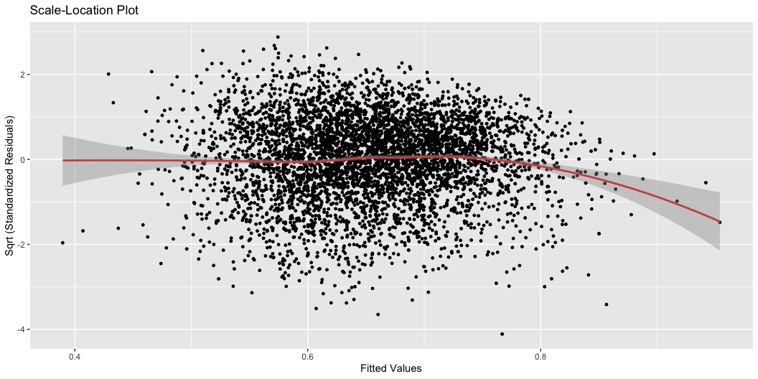

Slide 5
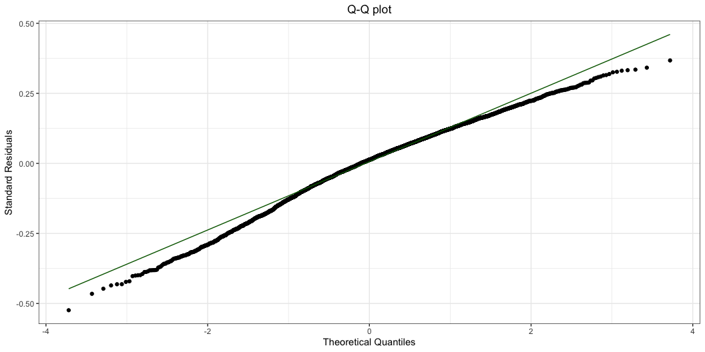

Slide 6
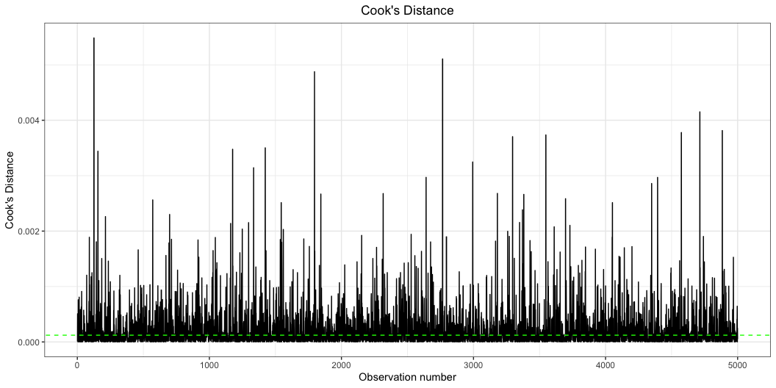
fortify is a ggplot command that generates additional data points on required checking parameters (like cooks distance, etc.)
danceability track_popularity energy key loudness mode speechiness 1 0.886 65 0.626 11 -2.528 0 0.2770 2 0.396 0 0.623 7 -14.327 1 0.0633 3 0.788 5 0.524 3 -8.173 0 0.1100 4 0.402 18 0.219 1 -19.019 1 0.0446 5 0.754 45 0.376 1 -10.142 0 0.3810 6 0.654 2 0.887 1 -1.998 1 0.1150 acousticness instrumentalness liveness valence tempo duration_ms 1 0.2650 0.00e+00 0.0240 0.8560 93.989 196627 2 0.0273 0.00e+00 0.3130 0.3400 81.326 213200 3 0.0658 7.18e-06 0.0934 0.8100 83.084 240600 4 0.6610 2.48e-01 0.0790 0.0673 91.885 324293 5 0.2850 8.29e-04 0.1620 0.2350 81.022 240054 6 0.0588 1.03e-04 0.0849 0.6910 134.998 270222 .hat .sigma .cooksd .fitted .resid .stdresid 1 0.004989134 0.1278957 8.611100e-06 0.8606474 0.025352589 0.19874423 2 0.005791163 0.1278704 5.085694e-04 0.5766956 -0.180695624 -1.41708192 3 0.009093814 0.1278952 2.900258e-05 0.7536793 0.034320660 0.26960348 4 0.006917486 0.1278809 3.586553e-04 0.5406844 -0.138684400 -1.08823096 5 0.004611637 0.1278962 2.028599e-08 0.7527196 0.001280386 0.01003531 6 0.003352698 0.1278945 1.905977e-05 0.7000873 -0.046087262 -0.36099094

Slide 7
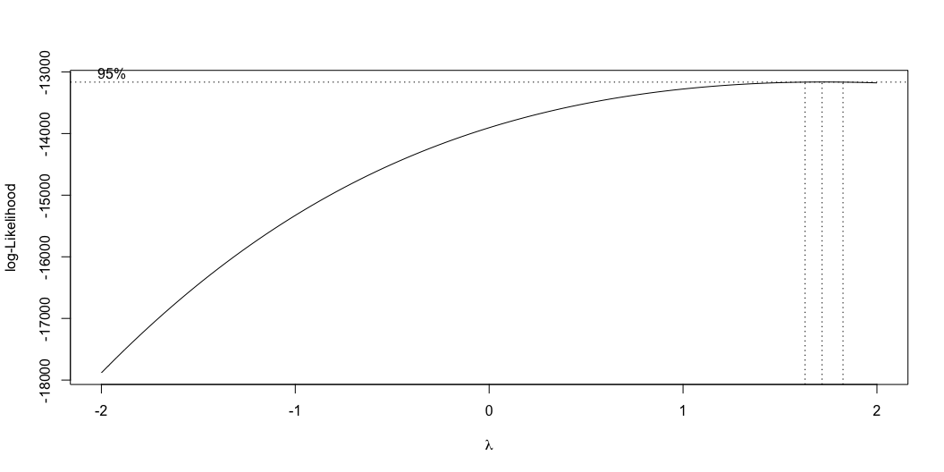
track_id track_name 126 5GR1vgM7Pppp888xQ0Db63 I'm Going to Live My Life track_artist track_popularity track_album_id 126 DJ Screw & The Screwed Up Click 2 7K4OQmcNEpZrTjeyJraEul track_album_name track_album_release_date playlist_name 126 Fallen Soldiers 2008-02-12 3rd Coast Classics playlist_id playlist_genre playlist_subgenre danceability energy 126 1QJ66s6YBZgxMUaVUyrhbo rap southern hip hop 0.399 0.841 key loudness mode speechiness acousticness instrumentalness liveness 126 1 -10.442 1 0.699 0.994 0.901 0.448 valence tempo duration_ms 126 0.773 151.021 46000
Clearly, there is a lot of issues with this model.
Forward Selection Method ------------------------ Candidate Terms: 1 . track_popularity 2 . energy 3 . key 4 . loudness 5 . mode 6 . speechiness 7 . acousticness 8 . instrumentalness 9 . liveness 10 . valence 11 . tempo 12 . duration_ms Step 0: AIC = -4988.786 danceability ~ 1 ------------------------------------------------------------------------------ Variable DF AIC Sum Sq RSS R-Sq Adj. R-Sq ------------------------------------------------------------------------------ valence 1 -5600.927 12.466 95.386 0.116 0.115 speechiness 1 -5139.795 3.250 104.601 0.030 0.030 tempo 1 -5129.393 3.033 104.819 0.028 0.028 key 1 -5060.968 2.013 105.839 0.019 0.016 liveness 1 -5060.834 1.585 106.266 0.015 0.015 track_popularity 1 -5018.599 0.684 107.168 0.006 0.006 duration_ms 1 -5014.939 0.606 107.246 0.006 0.005 energy 1 -5013.342 0.571 107.281 0.005 0.005 mode 1 -5009.026 0.479 107.373 0.004 0.004 acousticness 1 -4999.719 0.279 107.573 0.003 0.002 loudness 1 -4989.569 0.060 107.792 0.001 0.000 instrumentalness 1 -4988.067 0.028 107.824 0.000 0.000 ------------------------------------------------------------------------------ - valence Step 1 : AIC = -5600.927 danceability ~ valence ----------------------------------------------------------------------------- Variable DF AIC Sum Sq RSS R-Sq Adj. R-Sq ----------------------------------------------------------------------------- speechiness 1 -5742.918 2.708 92.678 0.141 0.140 tempo 1 -5739.103 2.637 92.749 0.140 0.140 energy 1 -5706.628 2.033 93.353 0.134 0.134 key 1 -5665.817 1.643 93.743 0.131 0.129 liveness 1 -5673.832 1.418 93.968 0.129 0.128 track_popularity 1 -5626.400 0.523 94.863 0.120 0.120 mode 1 -5623.586 0.469 94.917 0.120 0.120 duration_ms 1 -5621.258 0.425 94.961 0.120 0.119 instrumentalness 1 -5607.403 0.162 95.224 0.117 0.117 acousticness 1 -5606.091 0.137 95.249 0.117 0.116 loudness 1 -5598.948 0.000 95.385 0.116 0.115 ----------------------------------------------------------------------------- - speechiness Step 2 : AIC = -5742.918 danceability ~ valence + speechiness ----------------------------------------------------------------------------- Variable DF AIC Sum Sq RSS R-Sq Adj. R-Sq ----------------------------------------------------------------------------- tempo 1 -5899.082 2.886 89.792 0.167 0.167 energy 1 -5842.242 1.859 90.819 0.158 0.157 liveness 1 -5833.825 1.706 90.972 0.157 0.156 key 1 -5791.165 1.293 91.385 0.153 0.150 track_popularity 1 -5770.396 0.545 92.133 0.146 0.145 mode 1 -5759.204 0.338 92.340 0.144 0.143 instrumentalness 1 -5756.362 0.286 92.392 0.143 0.143 duration_ms 1 -5754.827 0.257 92.421 0.143 0.143 acousticness 1 -5750.122 0.170 92.508 0.142 0.142 loudness 1 -5740.921 0.000 92.678 0.141 0.140 ----------------------------------------------------------------------------- - tempo Step 3 : AIC = -5899.082 danceability ~ valence + speechiness + tempo ----------------------------------------------------------------------------- Variable DF AIC Sum Sq RSS R-Sq Adj. R-Sq ----------------------------------------------------------------------------- liveness 1 -5993.802 1.720 88.072 0.183 0.183 energy 1 -5964.314 1.199 88.593 0.179 0.178 key 1 -5943.285 1.181 88.611 0.178 0.176 track_popularity 1 -5926.058 0.519 89.273 0.172 0.172 acousticness 1 -5918.980 0.392 89.400 0.171 0.170 mode 1 -5915.483 0.330 89.463 0.171 0.170 instrumentalness 1 -5913.911 0.302 89.491 0.170 0.170 duration_ms 1 -5913.221 0.289 89.503 0.170 0.169 loudness 1 -5899.134 0.037 89.756 0.168 0.167 ----------------------------------------------------------------------------- - liveness Step 4 : AIC = -5993.802 danceability ~ valence + speechiness + tempo + liveness ----------------------------------------------------------------------------- Variable DF AIC Sum Sq RSS R-Sq Adj. R-Sq ----------------------------------------------------------------------------- key 1 -6039.010 1.176 86.896 0.194 0.192 energy 1 -6037.150 0.795 87.277 0.191 0.190 acousticness 1 -6020.225 0.499 87.573 0.188 0.187 track_popularity 1 -6016.934 0.442 87.631 0.187 0.187 mode 1 -6010.250 0.324 87.748 0.186 0.186 instrumentalness 1 -6007.150 0.270 87.802 0.186 0.185 duration_ms 1 -6005.635 0.243 87.829 0.186 0.185 loudness 1 -5996.687 0.086 87.986 0.184 0.183 ----------------------------------------------------------------------------- - key Step 5 : AIC = -6039.01 danceability ~ valence + speechiness + tempo + liveness + key ----------------------------------------------------------------------------- Variable DF AIC Sum Sq RSS R-Sq Adj. R-Sq ----------------------------------------------------------------------------- energy 1 -6085.552 0.840 86.057 0.202 0.200 acousticness 1 -6061.953 0.432 86.464 0.198 0.196 track_popularity 1 -6059.568 0.391 86.505 0.198 0.195 mode 1 -6055.784 0.326 86.571 0.197 0.195 instrumentalness 1 -6051.166 0.246 86.651 0.197 0.194 duration_ms 1 -6049.855 0.223 86.673 0.196 0.194 loudness 1 -6040.321 0.058 86.839 0.195 0.192 ----------------------------------------------------------------------------- - energy Step 6 : AIC = -6085.552 danceability ~ valence + speechiness + tempo + liveness + key + energy ----------------------------------------------------------------------------- Variable DF AIC Sum Sq RSS R-Sq Adj. R-Sq ----------------------------------------------------------------------------- acousticness 1 -6187.676 1.774 84.283 0.219 0.216 loudness 1 -6164.477 1.382 84.675 0.215 0.212 mode 1 -6101.955 0.316 85.740 0.205 0.202 track_popularity 1 -6100.476 0.291 85.766 0.205 0.202 instrumentalness 1 -6098.898 0.264 85.793 0.205 0.202 duration_ms 1 -6095.845 0.211 85.845 0.204 0.201 ----------------------------------------------------------------------------- - acousticness Step 7 : AIC = -6187.676 danceability ~ valence + speechiness + tempo + liveness + key + energy + acousticness ----------------------------------------------------------------------------- Variable DF AIC Sum Sq RSS R-Sq Adj. R-Sq ----------------------------------------------------------------------------- loudness 1 -6272.805 1.456 82.827 0.232 0.229 instrumentalness 1 -6207.281 0.363 83.920 0.222 0.219 duration_ms 1 -6206.107 0.344 83.939 0.222 0.219 track_popularity 1 -6205.624 0.336 83.947 0.222 0.219 mode 1 -6203.812 0.305 83.978 0.221 0.219 ----------------------------------------------------------------------------- - loudness Step 8 : AIC = -6272.805 danceability ~ valence + speechiness + tempo + liveness + key + energy + acousticness + loudness ----------------------------------------------------------------------------- Variable DF AIC Sum Sq RSS R-Sq Adj. R-Sq ----------------------------------------------------------------------------- instrumentalness 1 -6320.983 0.827 82.000 0.240 0.237 mode 1 -6288.716 0.296 82.531 0.235 0.232 duration_ms 1 -6279.330 0.141 82.686 0.233 0.230 track_popularity 1 -6278.606 0.129 82.698 0.233 0.230 ----------------------------------------------------------------------------- - instrumentalness Step 9 : AIC = -6320.983 danceability ~ valence + speechiness + tempo + liveness + key + energy + acousticness + loudness + instrumentalness ----------------------------------------------------------------------------- Variable DF AIC Sum Sq RSS R-Sq Adj. R-Sq ----------------------------------------------------------------------------- mode 1 -6337.749 0.307 81.693 0.243 0.240 track_popularity 1 -6330.721 0.192 81.808 0.241 0.238 duration_ms 1 -6327.133 0.134 81.866 0.241 0.238 ----------------------------------------------------------------------------- - mode Step 10 : AIC = -6337.749 danceability ~ valence + speechiness + tempo + liveness + key + energy + acousticness + loudness + instrumentalness + mode ----------------------------------------------------------------------------- Variable DF AIC Sum Sq RSS R-Sq Adj. R-Sq ----------------------------------------------------------------------------- track_popularity 1 -6348.074 0.201 81.492 0.244 0.241 duration_ms 1 -6343.737 0.130 81.562 0.244 0.241 ----------------------------------------------------------------------------- - track_popularity Step 11 : AIC = -6348.074 danceability ~ valence + speechiness + tempo + liveness + key + energy + acousticness + loudness + instrumentalness + mode + track_popularity ------------------------------------------------------------------------ Variable DF AIC Sum Sq RSS R-Sq Adj. R-Sq ------------------------------------------------------------------------ duration_ms 1 -6352.038 0.097 81.395 0.245 0.242 ------------------------------------------------------------------------ - duration_ms Variables Entered: - valence - speechiness - tempo - liveness - key - energy - acousticness - loudness - instrumentalness - mode - track_popularity - duration_ms Final Model Output ------------------ Model Summary -------------------------------------------------------------- R 0.495 RMSE 0.128 R-Squared 0.245 Coef. Var 19.576 Adj. R-Squared 0.242 MSE 0.016 Pred R-Squared 0.238 MAE 0.101 -------------------------------------------------------------- RMSE: Root Mean Square Error MSE: Mean Square Error MAE: Mean Absolute Error ANOVA --------------------------------------------------------------------- Sum of Squares DF Mean Square F Sig. --------------------------------------------------------------------- Regression 26.457 22 1.203 73.535 0.0000 Residual 81.395 4977 0.016 Total 107.852 4999 --------------------------------------------------------------------- Parameter Estimates ---------------------------------------------------------------------------------------------- model Beta Std. Error Std. Beta t Sig lower upper ---------------------------------------------------------------------------------------------- (Intercept) 0.886 0.020 43.604 0.000 0.846 0.925 valence 0.232 0.008 0.373 28.805 0.000 0.216 0.247 speechiness 0.233 0.019 0.159 12.595 0.000 0.197 0.270 tempo -0.001 0.000 -0.152 -12.132 0.000 -0.001 -0.001 liveness -0.094 0.012 -0.096 -7.673 0.000 -0.118 -0.070 key1 0.023 0.008 0.049 2.894 0.004 0.007 0.038 key2 -0.003 0.008 -0.006 -0.380 0.704 -0.019 0.013 key3 -0.047 0.012 -0.054 -3.907 0.000 -0.071 -0.023 key4 -0.011 0.009 -0.019 -1.217 0.224 -0.029 0.007 key5 0.005 0.009 0.010 0.633 0.527 -0.011 0.022 key6 -0.003 0.009 -0.005 -0.313 0.754 -0.020 0.014 key7 0.003 0.008 0.005 0.321 0.748 -0.013 0.019 key8 -0.002 0.009 -0.003 -0.174 0.862 -0.018 0.015 key9 -0.020 0.008 -0.040 -2.435 0.015 -0.035 -0.004 key10 0.008 0.009 0.015 0.953 0.341 -0.009 0.026 key11 -0.005 0.008 -0.011 -0.655 0.512 -0.022 0.011 energy -0.243 0.016 -0.301 -15.011 0.000 -0.275 -0.211 acousticness -0.113 0.010 -0.168 -11.369 0.000 -0.133 -0.094 loudness 0.008 0.001 0.172 9.582 0.000 0.007 0.010 instrumentalness 0.064 0.009 0.096 7.379 0.000 0.047 0.080 mode1 -0.017 0.004 -0.056 -4.371 0.000 -0.024 -0.009 track_popularity 0.000 0.000 0.041 3.204 0.001 0.000 0.000 duration_ms 0.000 0.000 -0.031 -2.437 0.015 0.000 0.000 ----------------------------------------------------------------------------------------------

Slide 8
Forward Stepwise sequence LARS Step 0 : 1 Variables with Variance < eps; dropped for good Computing X'X ..... LARS Step 1 : Variable 2 added Max |corr| = 0; exiting... Computing residuals, RSS etc .....
LARS/Forward Stepwise Call: lars(x = music_matrix, y = music_reduced$track_popularity, type = "stepwise", Call: trace = TRUE, intercept = TRUE) Df Rss Cp 0 1 3137606 NaN 1 2 0 NaN
(Intercept) track_popularity energy key1 key2 key3 key4 key5 key6 key7 [1,] 0 0 0 0 0 0 0 0 0 0 [2,] 0 1 0 0 0 0 0 0 0 0 key8 key9 key10 key11 loudness mode1 speechiness acousticness [1,] 0 0 0 0 0 0 0 0 [2,] 0 0 0 0 0 0 0 0 instrumentalness liveness valence tempo duration_ms [1,] 0 0 0 0 0 [2,] 0 0 0 0 0
Call: lm(formula = music_reduced$track_popularity^(lambda) ~ ., data = music_reduced) Residuals: Min 1Q Median 3Q Max -1138.34 -474.29 -56.22 418.86 1900.07 Coefficients: Estimate Std. Error t value Pr(>|t|) (Intercept) 1.534e+03 1.036e+02 14.810 < 2e-16 *** danceability 2.165e+02 6.322e+01 3.425 0.000620 *** energy -7.493e+02 7.330e+01 -10.223 < 2e-16 *** key1 3.084e+01 3.478e+01 0.887 0.375307 key2 2.244e+01 3.661e+01 0.613 0.539864 key3 -4.420e+01 5.382e+01 -0.821 0.411506 key4 2.986e+01 4.067e+01 0.734 0.462908 key5 4.164e+01 3.820e+01 1.090 0.275817 key6 8.628e+01 3.834e+01 2.251 0.024456 * key7 3.354e+01 3.651e+01 0.919 0.358310 key8 1.116e+02 3.843e+01 2.904 0.003701 ** key9 1.171e+01 3.589e+01 0.326 0.744127 key10 1.362e+02 3.956e+01 3.444 0.000579 *** key11 -1.355e+01 3.712e+01 -0.365 0.715121 loudness 4.343e+01 3.948e+00 11.001 < 2e-16 *** mode1 2.707e+01 1.710e+01 1.583 0.113564 speechiness -2.631e+02 8.396e+01 -3.133 0.001738 ** acousticness 8.324e+01 4.501e+01 1.849 0.064459 . instrumentalness -2.742e+02 3.847e+01 -7.127 1.18e-12 *** liveness -4.585e+01 5.483e+01 -0.836 0.403070 valence 6.673e+01 3.878e+01 1.720 0.085404 . tempo 3.844e-01 3.073e-01 1.251 0.211046 duration_ms -9.087e-04 1.377e-04 -6.600 4.55e-11 *** --- Signif. codes: 0 '***' 0.001 '**' 0.01 '*' 0.05 '.' 0.1 ' ' 1 Residual standard error: 571 on 4977 degrees of freedom Multiple R-squared: 0.07974, Adjusted R-squared: 0.07567 F-statistic: 19.6 on 22 and 4977 DF, p-value: < 2.2e-16
function (text = "", condition = NULL, expr = TRUE, skipCalls = 0L) .Primitive("browser")

