Slide 1
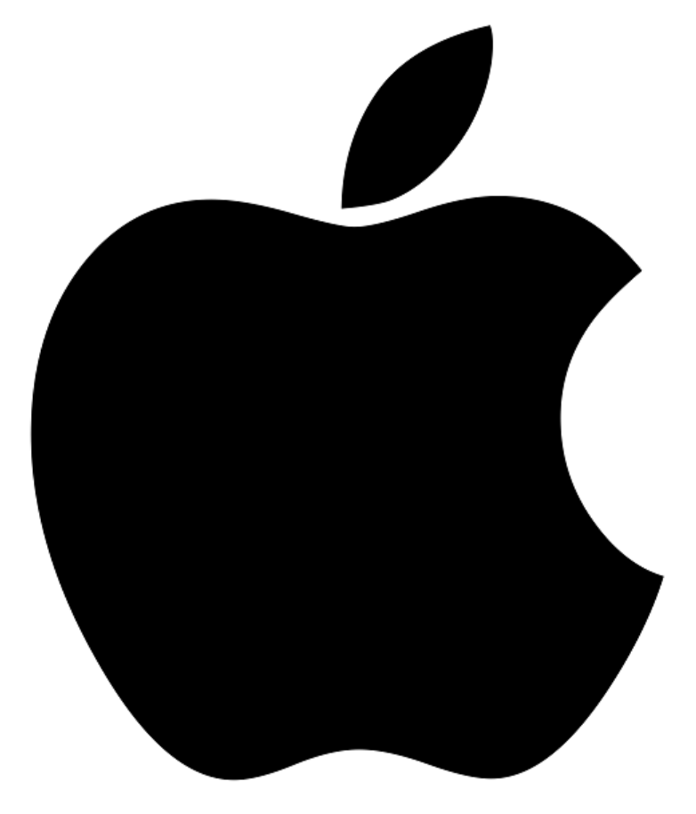
Apple

Slide 2

McDonalds

Slide 3

Louis Vuitton

Slide 4
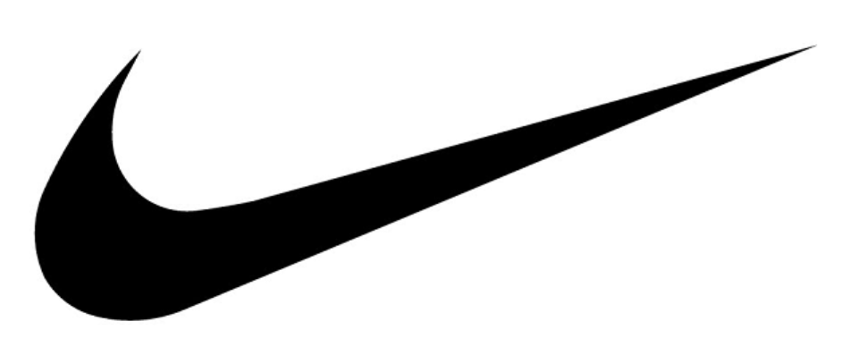
Nike

Slide 5
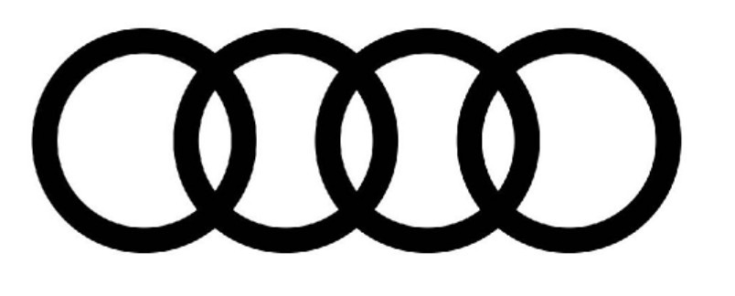
Audi

Slide 6

Microsoft

Slide 7
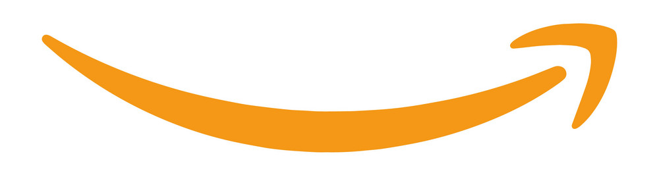
Amazon

Slide 8

Facebook

Slide 9

Coca Cola

Slide 10

Samsung

Slide 11

Walt Disney Pictures

Slide 12

Toyota

Slide 13
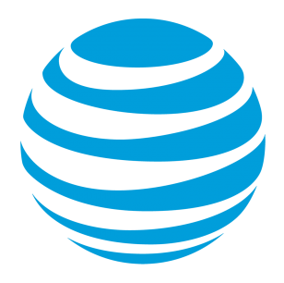
AT&T

Slide 14

Verizon

Slide 15

Intel

Slide 16

Cisco

Slide 17

Mercedes Benz

Slide 18

BMW

Slide 19

Marlboro

Slide 20

Budweiser

Slide 21
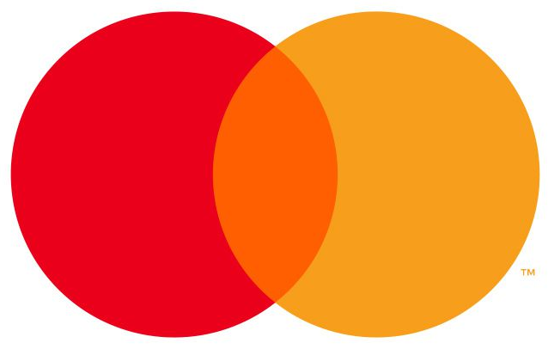
Mastercard

Slide 22
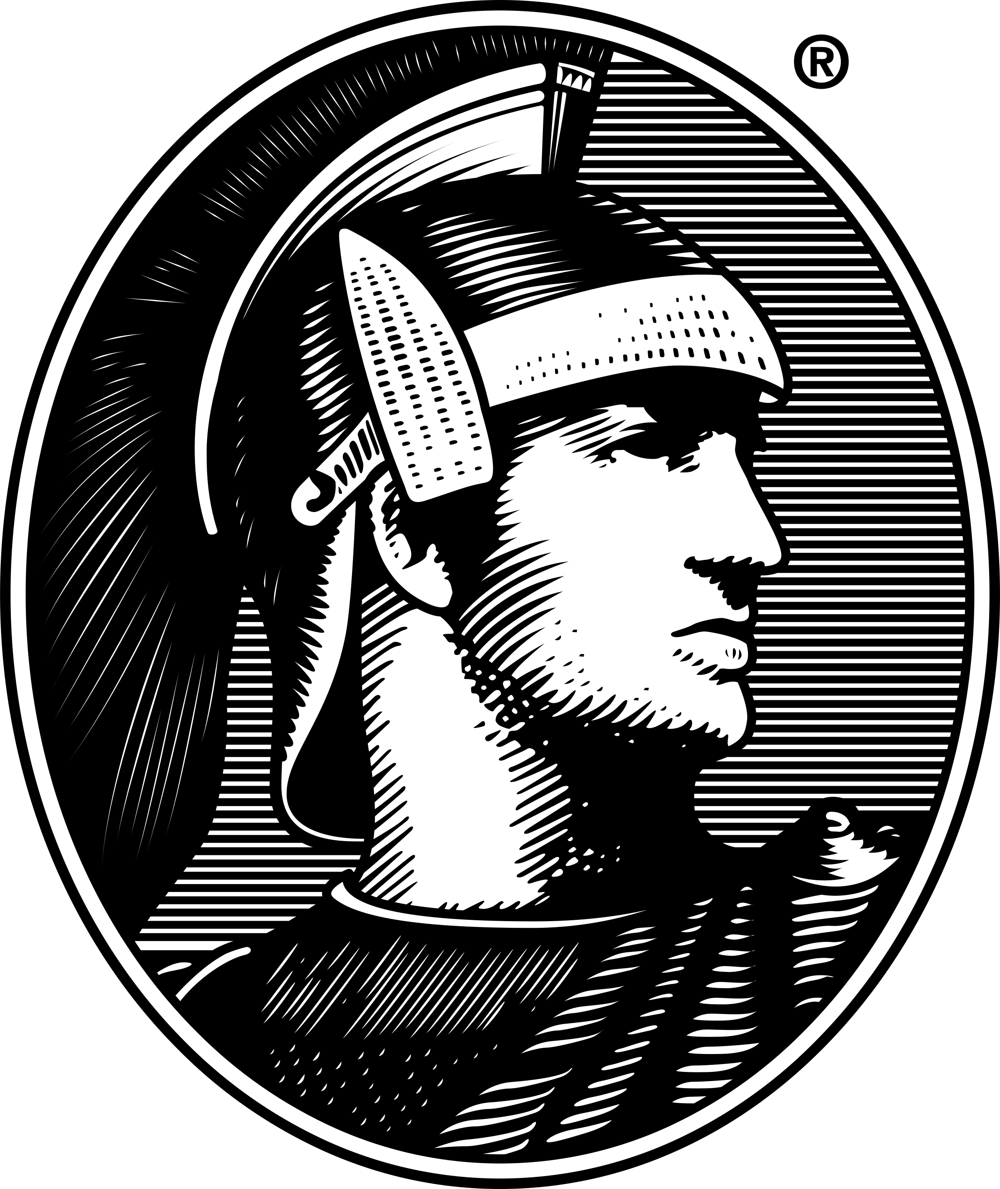
American Express

Slide 23

Walmart

Slide 24

Whole Foods Market

