Slide 1
NYU Bootcamp Data Science
Team Name: “Data Scientists”
Topic: India Air Quality
Name: Brian Lee, Seongjae Jung, Siyu Liao, Grace Zhang & Juehui Jia,
Date and Time: Friday, May 2, 2025. 12pm – 2pm

Slide 2
Table of Contents
Motivation: “Does Delphi have cleaner air due to stricter CNG mandate?”
Temporal Analysis
2-1: Does ‘time’ matter? all India vs Delhi. 1987 – 1989 vs 2003 – 2015. Two-group t-test.
2-2: How much does ‘time’ matter? Time-series component decomposition
Regional Trends: does ‘region’ matter?
Predictive Modelling:
model selection: Random Forest, XGBoost, LSTM
Training optimization (measure: R-squared)
Conclusion

Slide 3
Executive summary
Motivation: “Does Delphi have cleaner air due to stricter CNG mandate?” YES
Temporal Analysis
2-1: Does ‘time’ matter? all India vs Delhi. 1987 – 1989 vs 2003 – 2015. Two-group t-test. YES
2-2: How much does ‘time’ matter? Time-series component decomposition
Regional Trends: does ‘region’ matter? YES
Predictive Modelling:
model selection: Random Forest, XGBoost, LSTM
Training optimization (measure: R-squared 0.63)

Slide 4


1. Policy Impact Exploration
India introduced Euro-style emission norms (BS-I & BS-II) in 2000–2003, with a national roadmap to cleaner fuels and engines via the 2003 Auto Fuel Policy.
Delhi moved stricter, enforcing BS-II early and launching a strict CNG mandate (2001–2003) for all public transport by Supreme Court order.
Focus: Reduce SO₂, NO₂, and PM from vehicles through fuel sulfur reduction, catalytic converters, and engine upgrades.

Slide 5
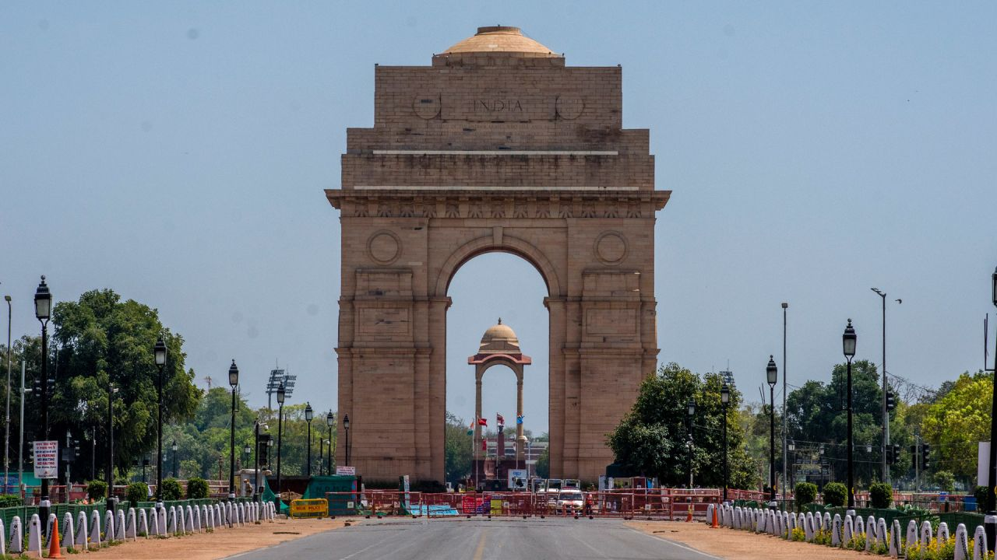
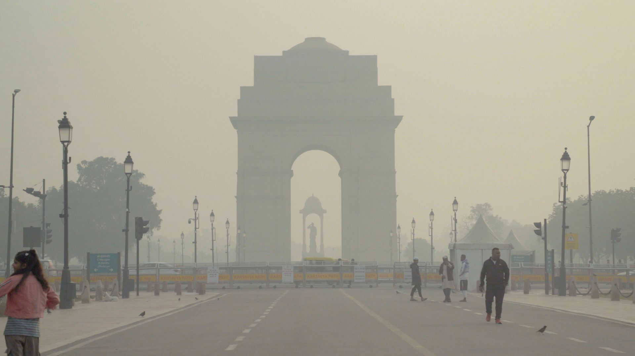
1. Main Question
After Delhi’s 2001-2003 mandate, does Delhi have cleaner air compare to other Indian regions?

Slide 6
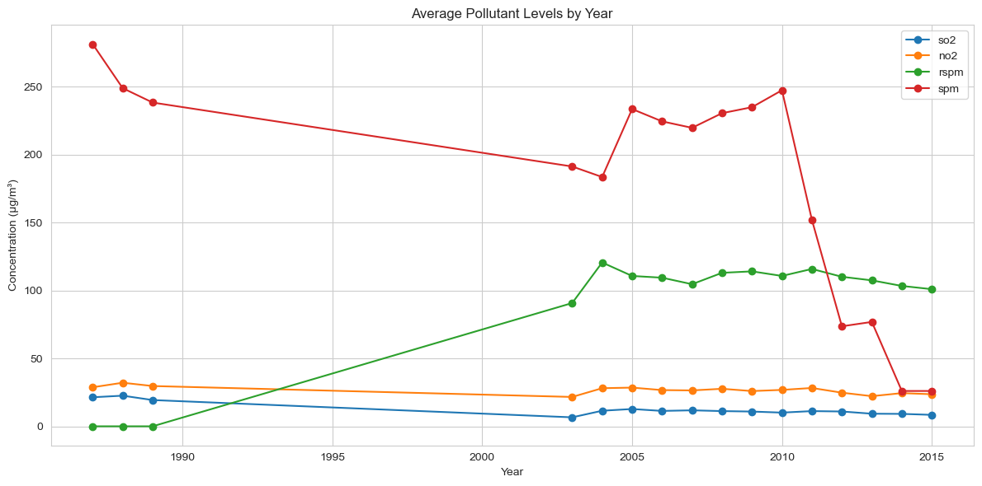
2. Temporal Analysis
Group 1: 1987 – 1989
Group 2: 2003 – 2014

Slide 7
2. Temporal Analysis
Question 2-1: Does ‘time’ matter?
 | Group 1: 1987 – 1989 | Group 2: 2003 – 2014
Across India | Time matters? Yes? No? | Time matters? Yes? No?
Delhi | Time matters? Yes? No? | Time matters? Yes? No?

Slide 8
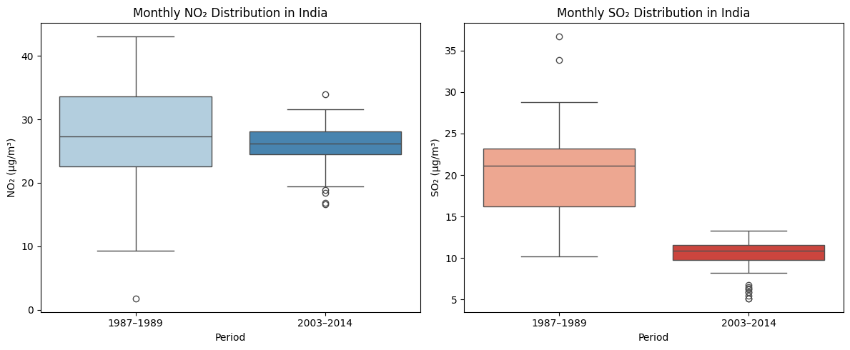









2-1. Temporal Analysis
Analyze air quality trends over the years: all India
Group 1: 1987 – 1989
Group 2: 2003 – 2014

Slide 9
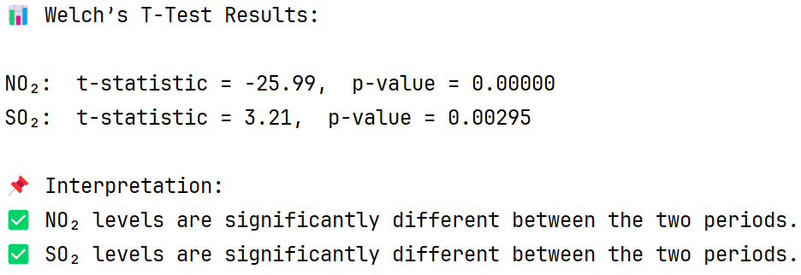
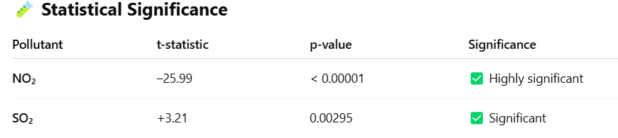
2-1. Temporal Analysis
Question: across India, does ‘time’ matter in explaining the levels of NO2 and SO2?
Answer: Yes. (Evidence: T-Test for two-group)
Group 1: 1987 – 1989
Group 2: 2003 – 2014

Slide 10
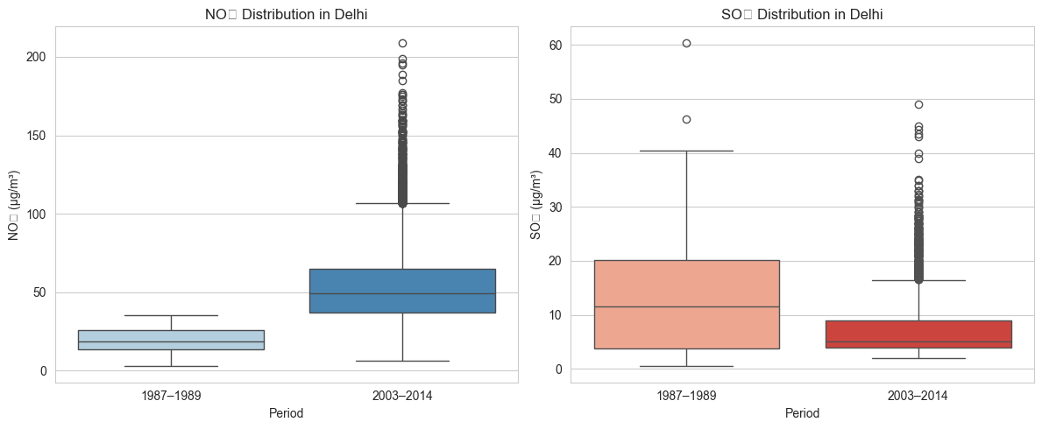





2-1. Temporal Analysis
Analyze air quality trends over the years: Delhi
Group 1: 1987 – 1989
Group 2: 2003 – 2014

Slide 11
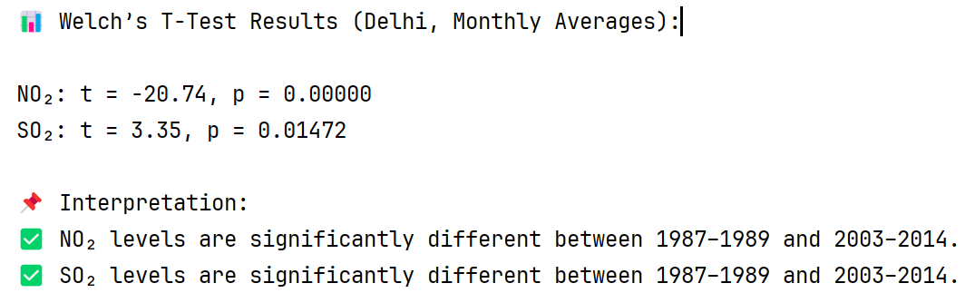
2-1. Temporal Analysis
Question: in Delhi, does ‘time’ matter in explaining the levels of NO2 and SO2?
Answer: Yes. (Evidence: T-Test for two-group)
Group 1: 1987 – 1989
Group 2: 2003 – 2014

Slide 12
2-1. Temporal Analysis
Conclusion 1:
For both across-India and Delhi and both two time-groups, the ‘time’ feature matters, in explaining the variations of SO2 and NO2.
 | Group 1: 1987 – 1989 | Group 2: 2003 – 2014
Across India | Time matters | Time matters
Delhi | Time matters | Time matters

Slide 13
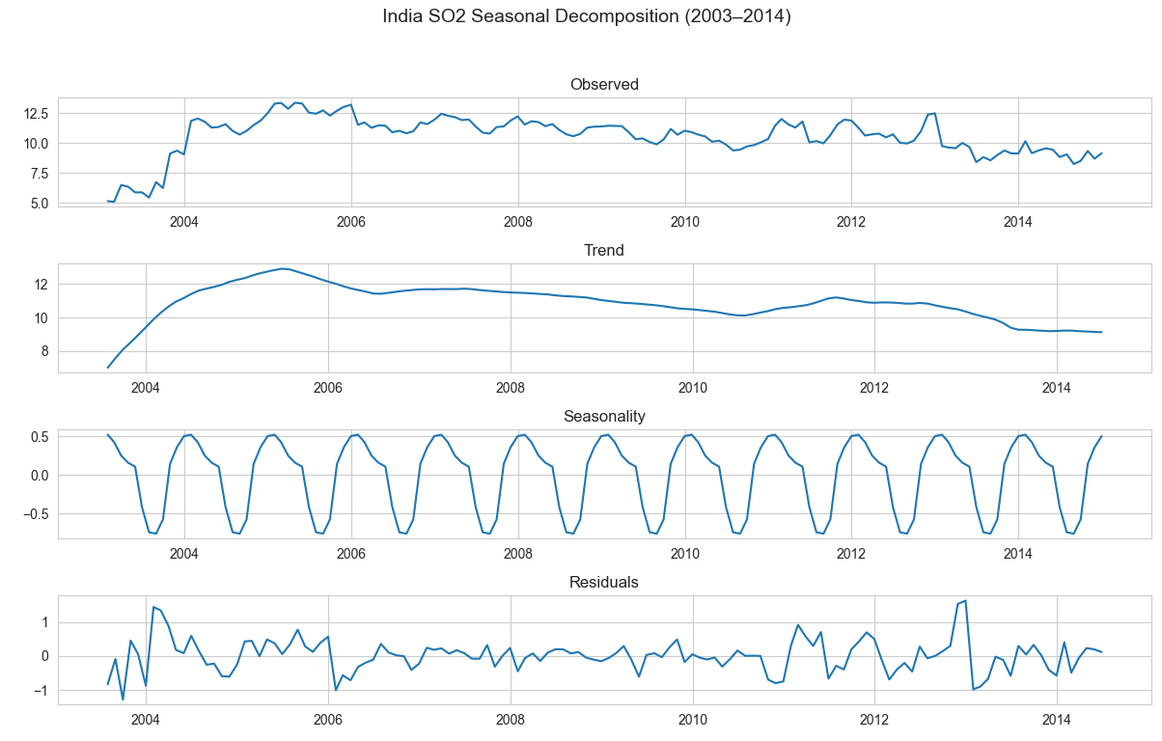



2-2. Temporal Analysis
Question 2-2: How much does ‘time’ matter?
Time – variations = Trend + Seasonality + Residual

Slide 14
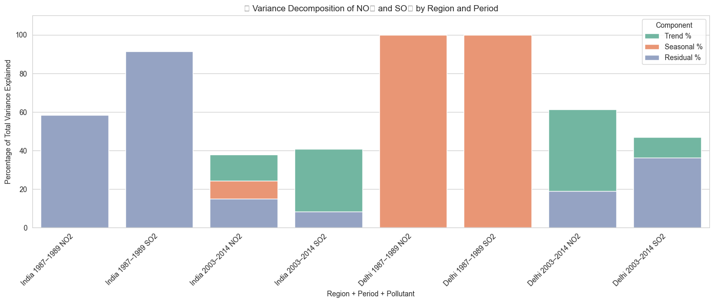
2-2. Temporal Analysis
Question 2-2: How much does ‘time’ matter?
Time1
Time 2
Time1
Time 2
India
Delhi

Slide 15
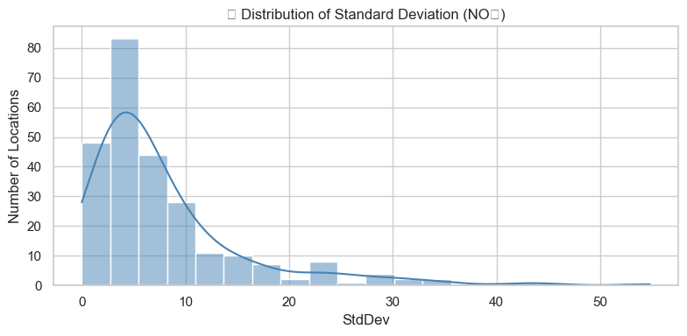
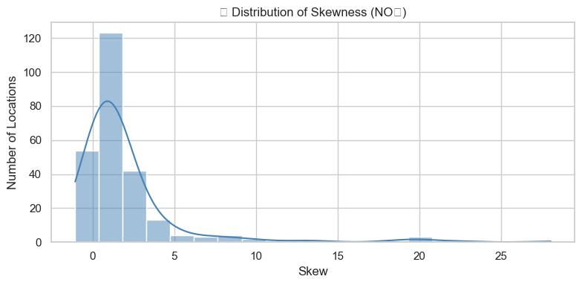
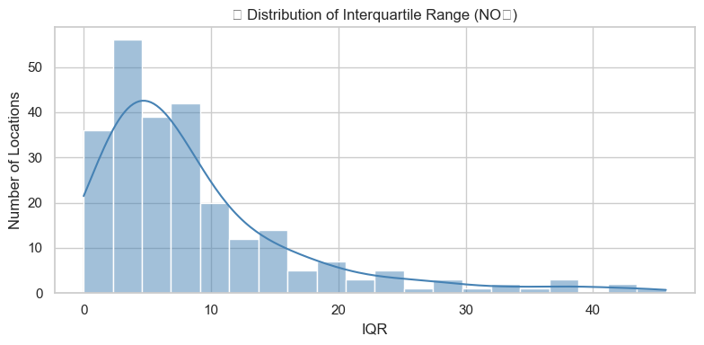
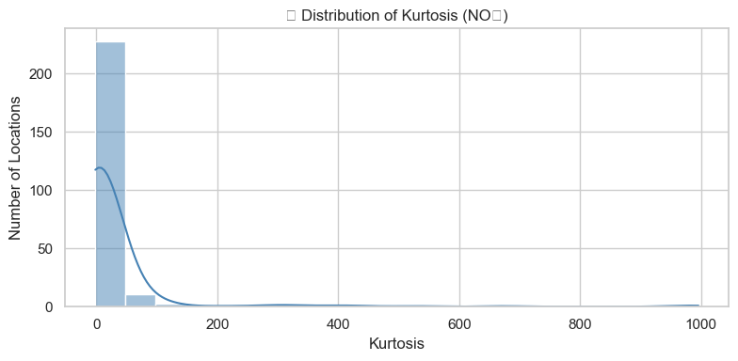
3. Regional Analysis
Measurements for how different by regions:
Standard deviation, skewness, interquartile range, kurtosis

Slide 16
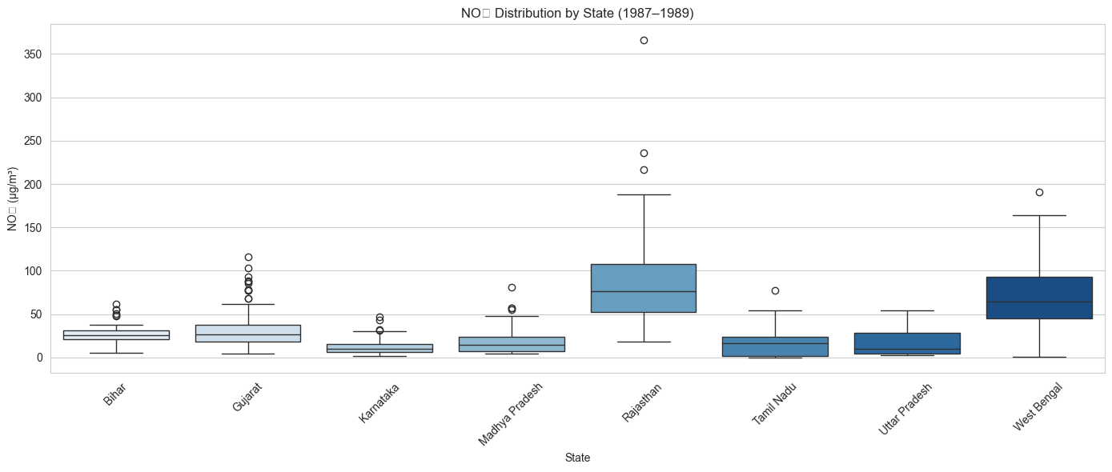
3. Regional Analysis

Slide 17
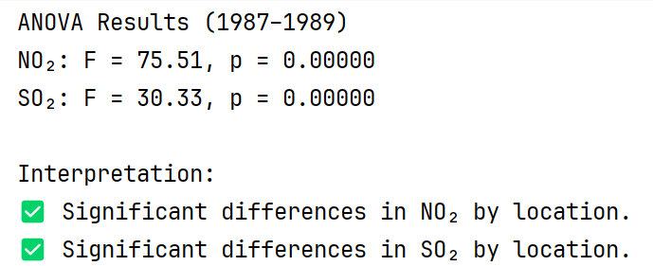
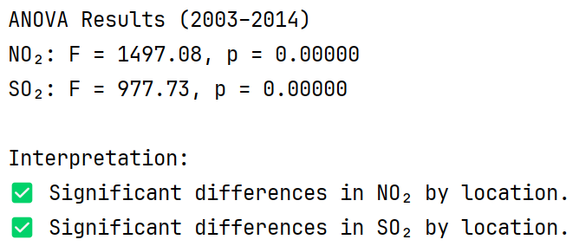







3. Regional Analysis
Question 3: does location matter?
Answer: Yes. For both time periods.
Group 1: 1987 – 1989
Group 2: 2003 – 2014

Slide 18
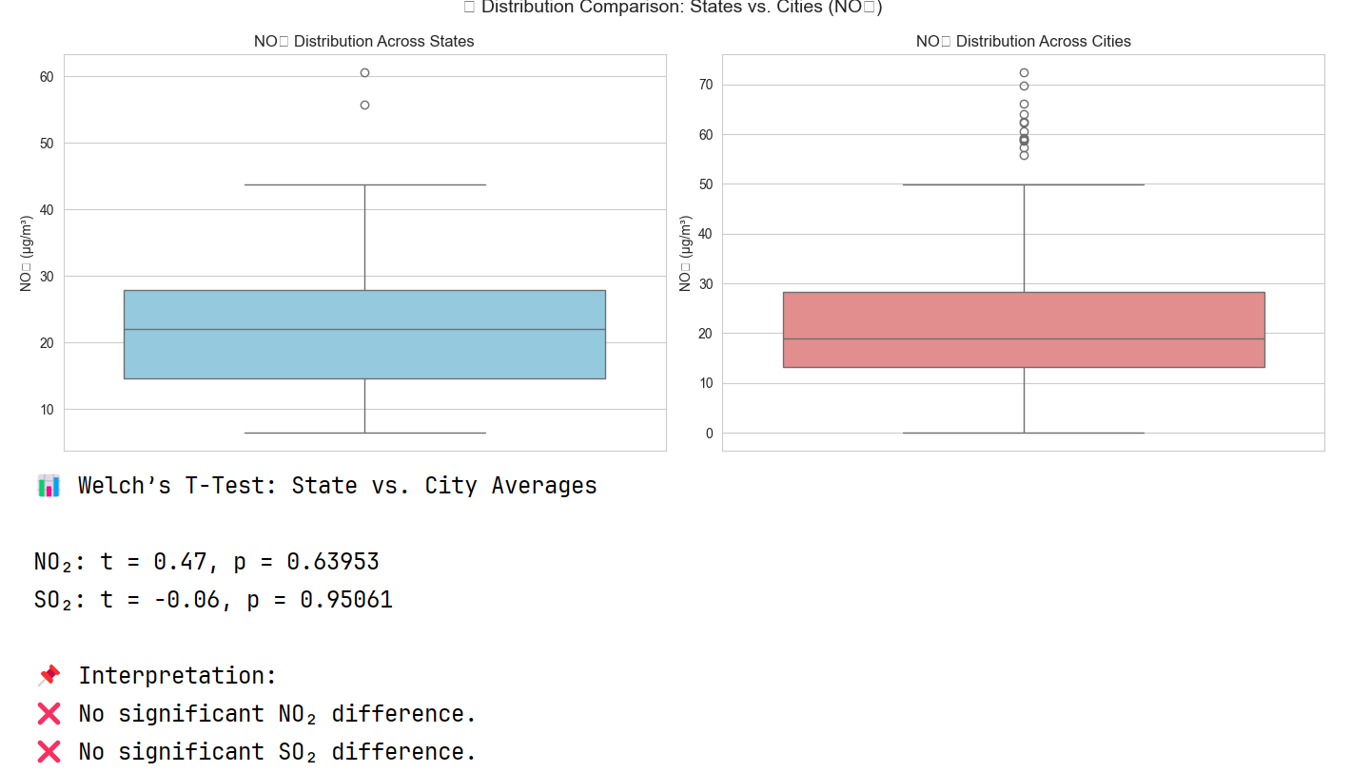
3. Regional Analysis
Question 3: does ‘state’ and ‘city’ distinction matter?
Answer: No

Slide 19
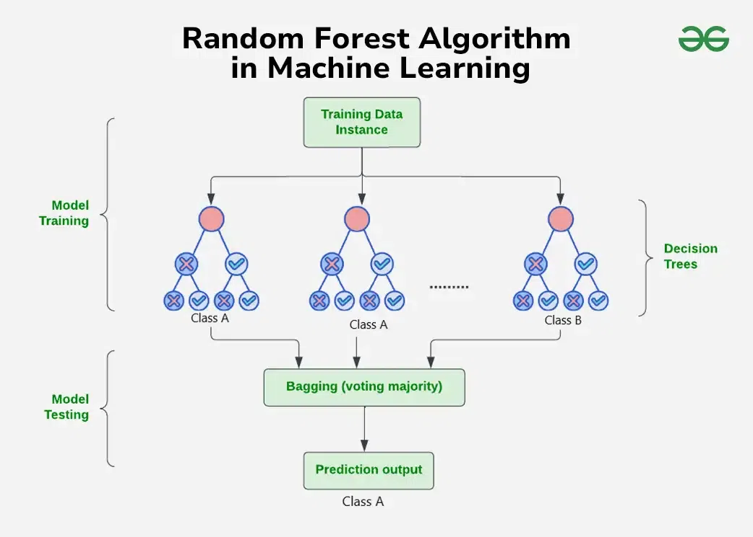
4. Predictive model
Model selection: Random Forest, XGBoost, LSTM
Random Forest is a method that makes decisions by combining the opinions of many “mini-experts.”
Each expert sees different parts of the data, and the final answer is based on what most of them agree on.
Response variables: SO2 or NO2
Features: time(monthly), locations, time-lagged SO2 or NO2

Slide 20
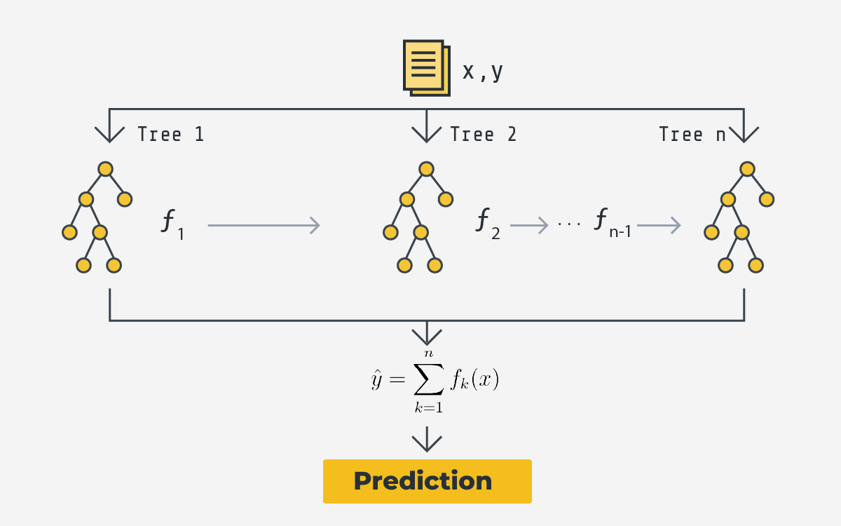
4. Predictive model
Model selection: Random Forest, XGBoost, LSTM
XGBoost is a powerful tool that makes smart predictions by learning from mistakes step by step.
It builds many small decision trees, each one improving on the last, to get the most accurate result possible.
Response variables: SO2 or NO2
Features: time(monthly), locations, time-lagged SO2 or NO2

Slide 21
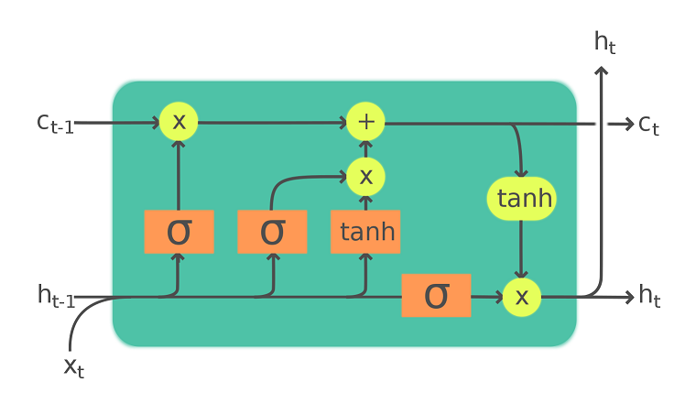
4. Predictive model
Model selection: Random Forest, XGBoost, LSTM
LSTM is a special type of neural network that helps computers remember important information over time, like how we recall key moments in a story.
It’s great for understanding patterns in things like speech, text, or weather by deciding what to remember and what to forget.
Response variables: SO2 or NO2
Features: time(monthly), locations, time-lagged SO2 or NO2

Slide 22
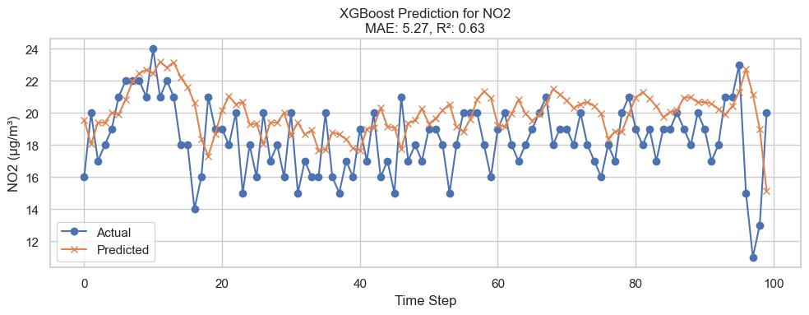
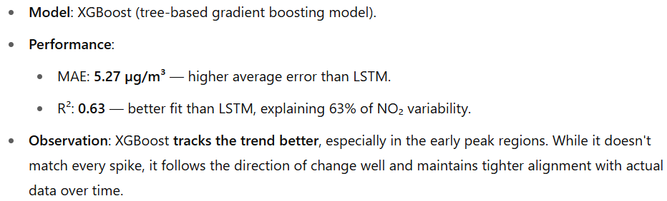
4. Predictive model
Testing predictions vs actuals based on optimized trained model

Slide 23
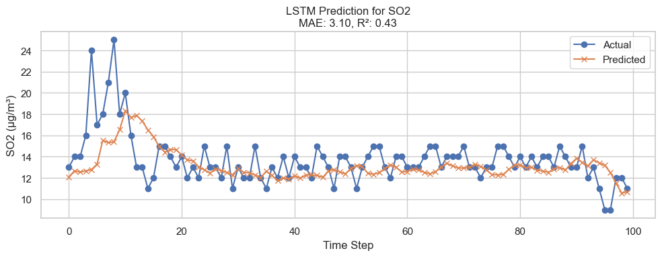
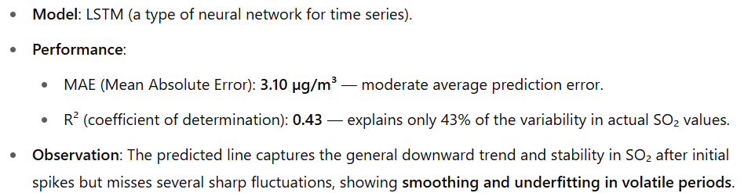
4. Predictive model
Testing predictions vs actuals based on optimized trained model

Slide 24
Conclusion
Motivation: “Does Delphi have cleaner air due to stricter CNG mandate?” YES
Temporal Analysis
2-1: Does ‘time’ matter? all India vs Delhi. 1987 – 1989 vs 2003 – 2015. Two-group t-test. YES
2-2: How much does ‘time’ matter? Time-series component decomposition
Regional Trends: does ‘region’ matter? YES
Predictive Modelling:
model selection: Random Forest, XGBoost, LSTM
Training optimization (measure: R-squared 0.63)

Slide 25
Thank you
Team Name: “Data Scientists”
Name: Brian Lee, Seongjae Jung, Siyu Liao, Grace Zhang & Juehui Jia,
Date and Time: Friday, May 2, 2025. 12pm – 2pm

