Slide 1
Sprint 2
Kevin Herrera, Brian Leung, Ishaan Joshi

Slide 2
Introduction
Project: A Claim Complexity Algorithm for Penser North America, a workers compensation third party administrator in Washington. It scores the complexity of each claim and gives a separate cost estimate. It has machine learning models, a web interface, and an API, and is meant to support decisions. Sprint 2 focused on building a initial demo, and making architectural choices, which will be presented to the client for feedback.
Team:
Kevin is team lead, with full stack development and AI experience.
Brian has experience in ML and Data Science.
Ishaan has experience in Algorithms and Formal Methods.

Slide 3
Sprint Objectives
Sprint 2 goals
1. Make the architecture design decisions
2. Build a working demo: data cleaning → baseline estimates → API → dashboard
3. Get the data and access needed for model work (data, Claude, AWS)
4. Document the design and the test approach
*Goal 3 is only partly met (see Challenges).

Slide 4
Feature Implementation
3a: Claim Scorer, Weights and Backend API
Before: No claim had a complexity score or cost range
After: 0 - 100 complexity score, separate cost range, top 3 reasons, adjustable weights
Testing: 33 test cases on synthetic data
Charter: Two estimates, cost range with confidence, the reasons shown, and weights claim staff can change without retraining
3b: Workload Board
Before: Claim count is not comparable to complexity.
After: Complexity totals and warnings by adjuster, “what if” reassignment preview
Testing: 12 test cases on synthetic data
Charter: Optional item so managers can compare workloads by complexity score

Slide 5
Cost and Risk Insights and Data Pipeline
3c: Cost & Risk Insights and Data Pipeline
Before: No graphical view of cost and complexity for leadership
After: Costs and complexity by employer, Tier 2, loss cause or injury year with charts, trends and an inflation slider.
Testing: 14 test cases on synthetic data
3d: Data Pipeline
Before: Raw claims file had repeated claims
After: Cleans each claim, calculatates factors like time to close, compares it to past closed claims, then gives it a score and cost range. Examiner activity is not counted.
Testing: 24 test cases on synthetic data

Slide 6
Figma Prototype and Client Feedback
Not Applicable: Made our own prototype to get feedback

Slide 7
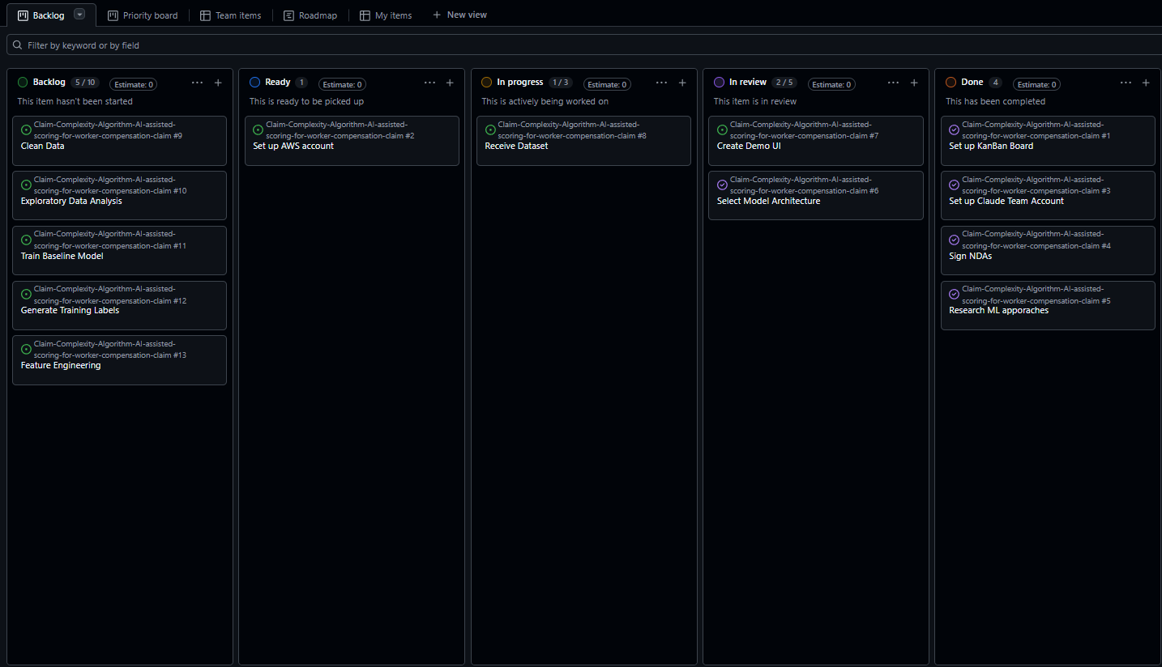
Kanban Overview and Team Contributions
Kanban and issues
- KanBan board is now setup
- For this sprint:
- Kevin created a Demo UI
- As a team, we selected the
model architecture

Slide 8
Website Development
Website platform: not applicable
- Our front end is a custom React + TypeScript dashboard (Vite, Tailwind, Tremor), not a Wix or WordPress site.
- It is covered under Feature Implementation.

Slide 9
Documentation: Architecture,Database,UI, Testing Plans
All design decisions have been documented in Solutions Approach report.

Slide 10
Sprint Achievements and Challenges
Sprint 1 → Sprint 2: progress
| Sprint 1 | Sprint 2 |
| ----------------------------------------------------------- | ---------------------------------------------------------------------------------------------------------------------------- |
| Requirements, research, no code | Architecture decided and documented; working demo (cleaning, baseline, API, 3 dashboards) |
| No access to data, GitHub org, Claude, AWS | GitHub board set up with issues; Claude access granted |
| No data | About half of the data columns received |
Challenges and what we did
- Data delays: Penser's new system launched late, then our mentor Keno was in a car accident. Still waiting on the important half of the columns. → Built what doesn't need real data; tested with synthetic fixtures; designed so the model can be swapped in.
- AWS access not granted. → Deferred Cognito and cloud hosting; developed locally.
- No complexity labels in the data. → Chose Claude-generated labels with a fixed rubric and a human review sample.
Stuck without the data: there is not much more we can do on training and benchmarking until the data arrives.

Slide 11
Next Steps and Sprint Retrospective
Went well
- Architecture decisions documented with alternatives considered
- Progress without data: stable interface lets the model be swapped in later
- Project rules enforced in code (separate estimates, no touch-point features, append-only history)
- Data stayed confidential and local
To improve
- Data dependency: have a fallback for missing columns; escalate delays to more Penser contacts sooner
- Keep issues, milestones, story points, assignees and PR links up to date as we go
- Get Penser's approval on placeholder weights and thresholds
Next sprint
- Get the missing columns; inspect and clean the real data
- Start Claude label generation (after Penser approves sending data) and track the budget against $300–$500
- Benchmark Industry-BERT-Insurance against the baseline; quantile-regression cost range and confidence
- Give the demo to Penser and act on their feedback
- Request AWS access; move toward PostgreSQL and Cognito
- Meet the expert claims handler
- Integration, performance, security and bias testing

Slide 12
Responsible use of Generative AI
How we used it:
Claude Code: pipeline,backend,dashboard,tests,docs and issue drafting.
Part of the system design: labels claim complexity from Penser-approved,sanitized notes
Guardrails in CLUADE.md
No real data shared, synthetic test data only, no AI commits or pushes.
Benefits: faster documentation, code generation, and can help create synthetic data.
Limitations and Accountability:
Accuracy: AI can be wrong so we must review all the outputs.
Privacy: No claim data goes to AI without Penser’s approval.

Slide 13
Conclusion
Thank you
- Penser North America: Joell Parks, Keno Peck, Ritvik Sharma
- We wish Keno a full recovery
- Where we are: design decided, baseline demo working
- What's next: Complete real data → Claude labels → trained model → Penser feedback

