Slide 1

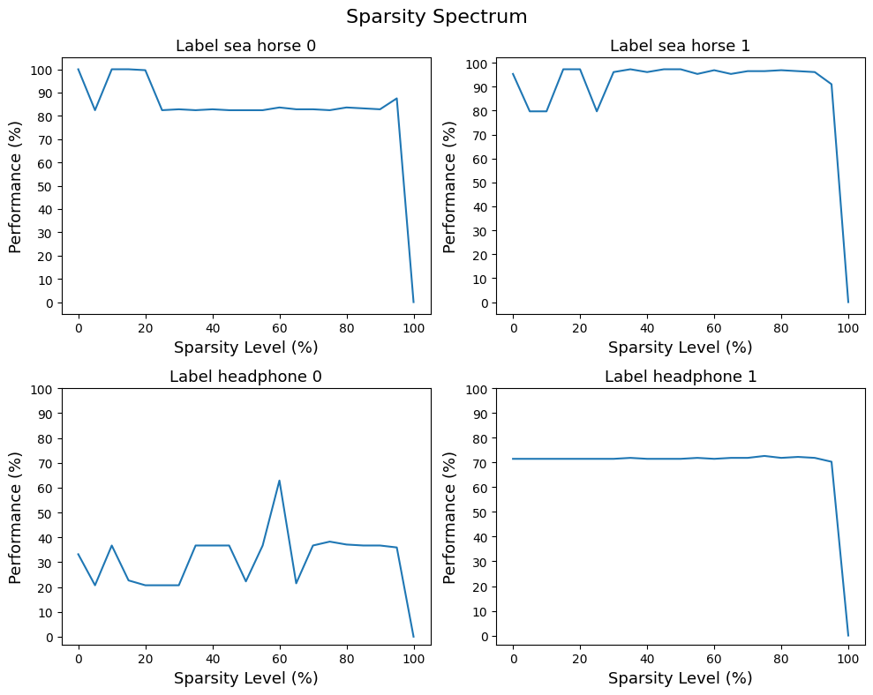
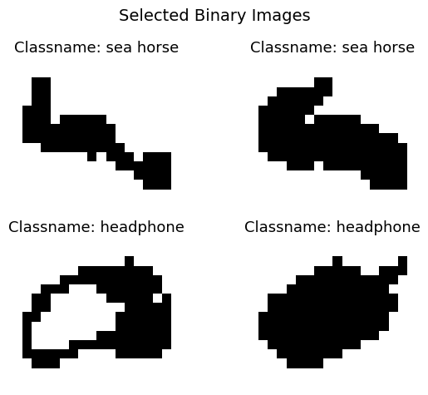
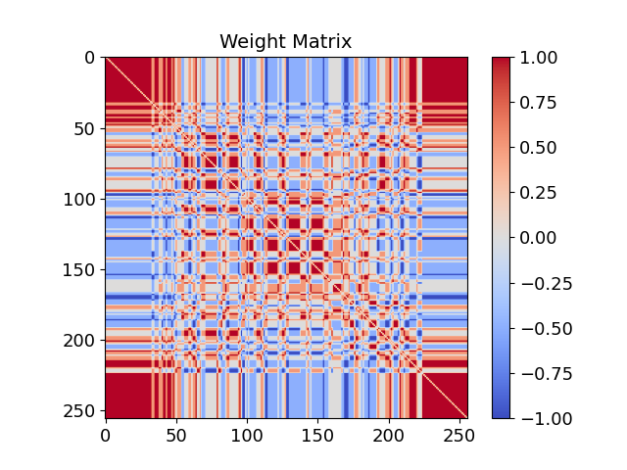
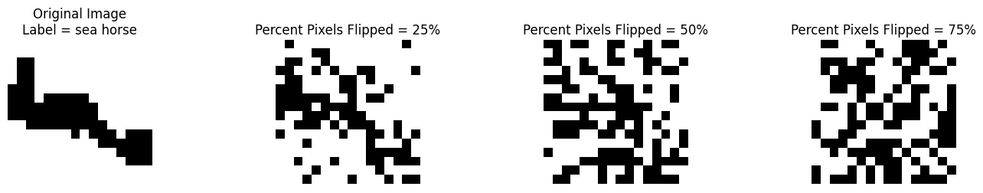
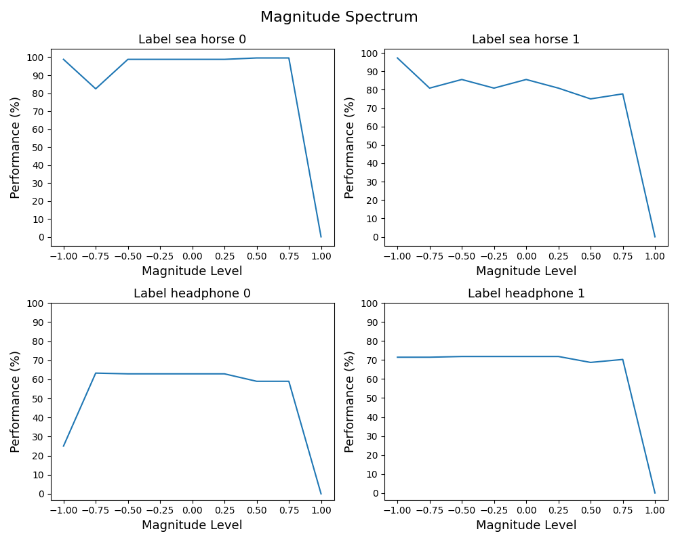
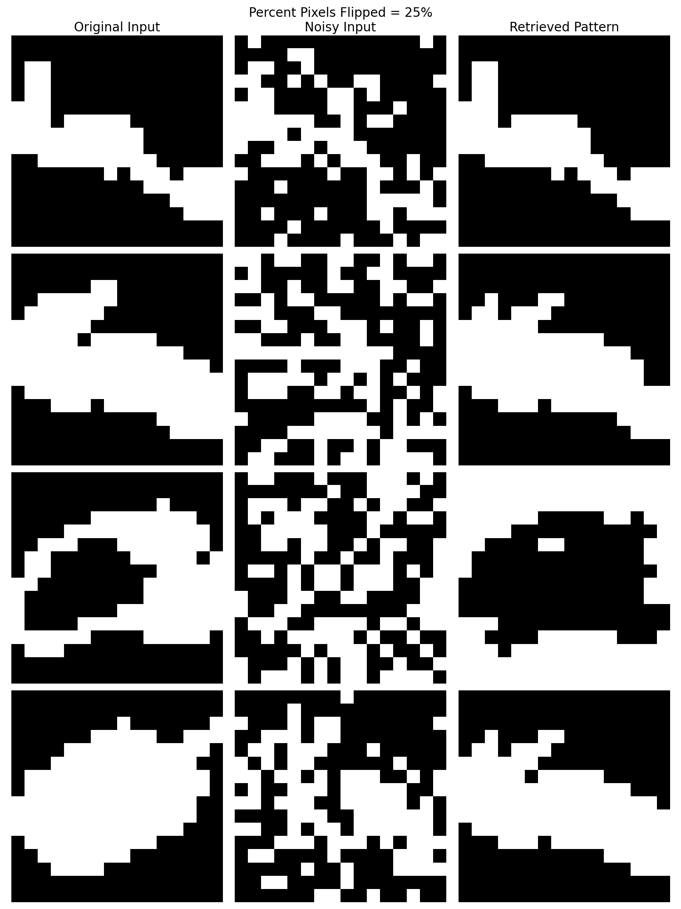
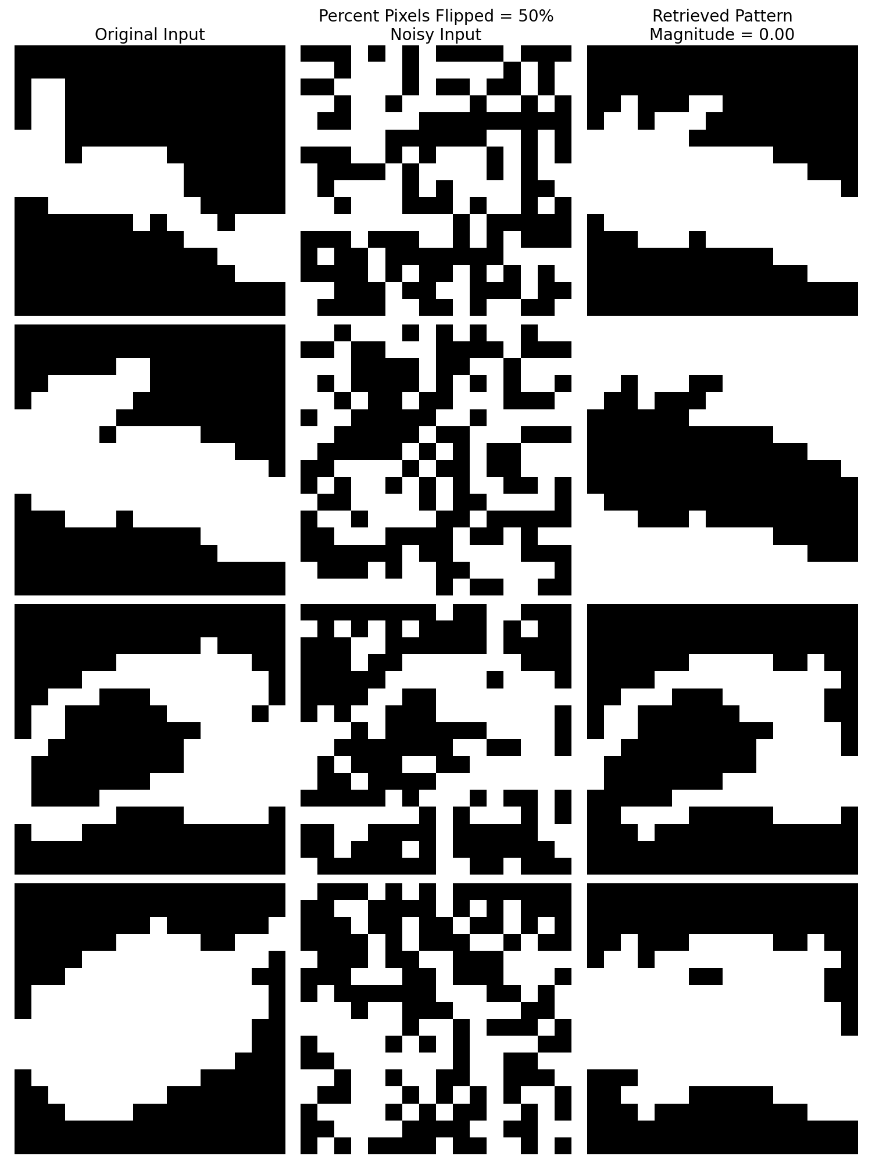
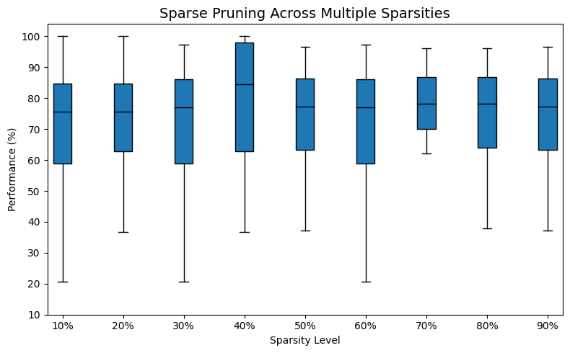
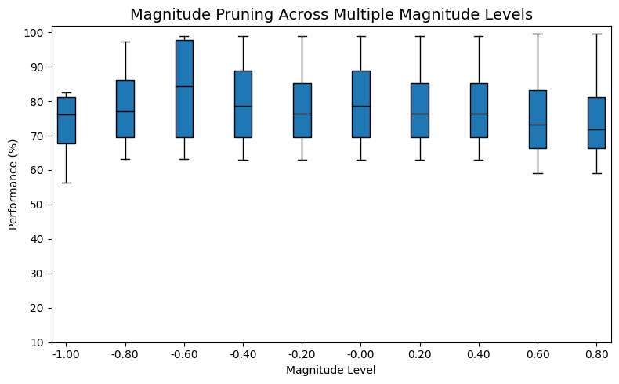
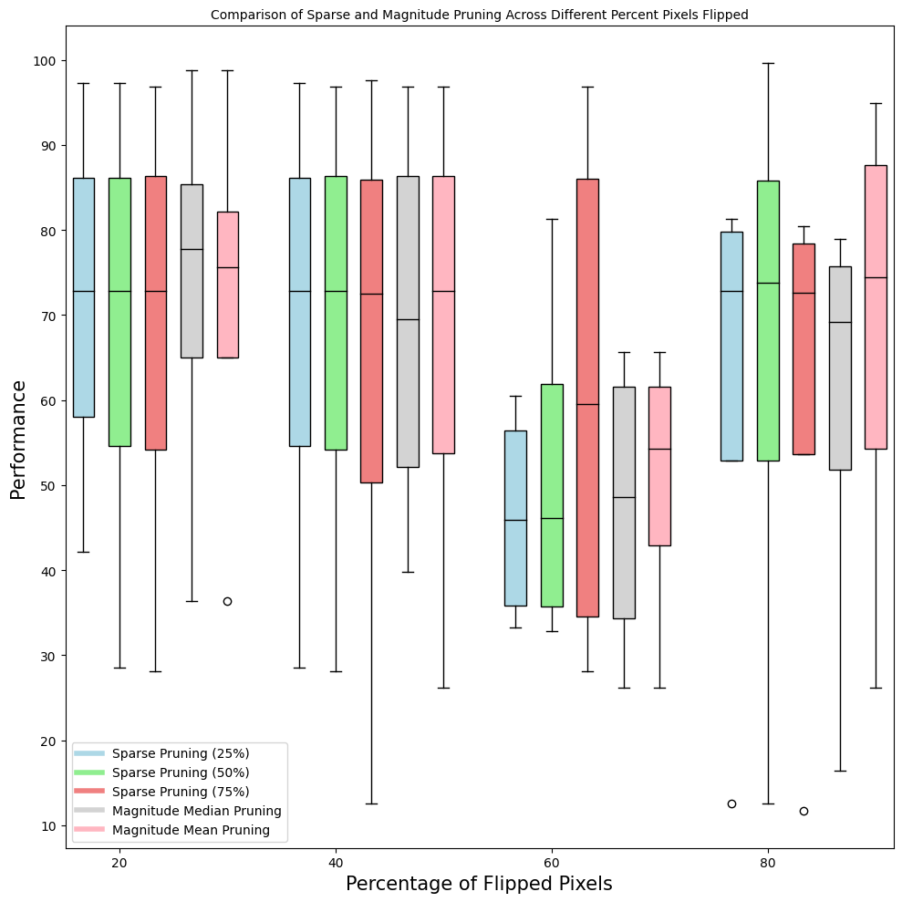
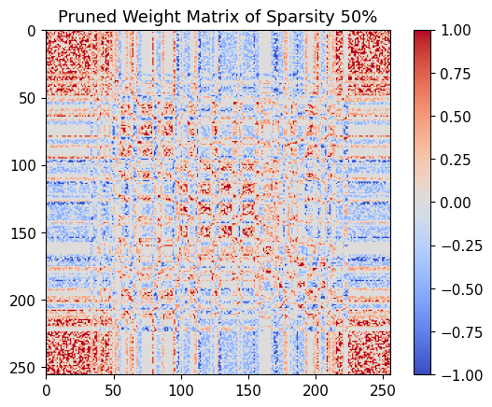
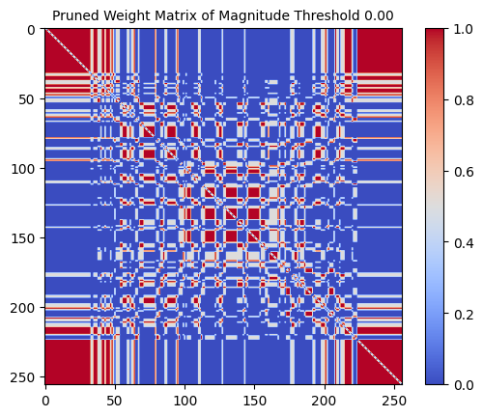
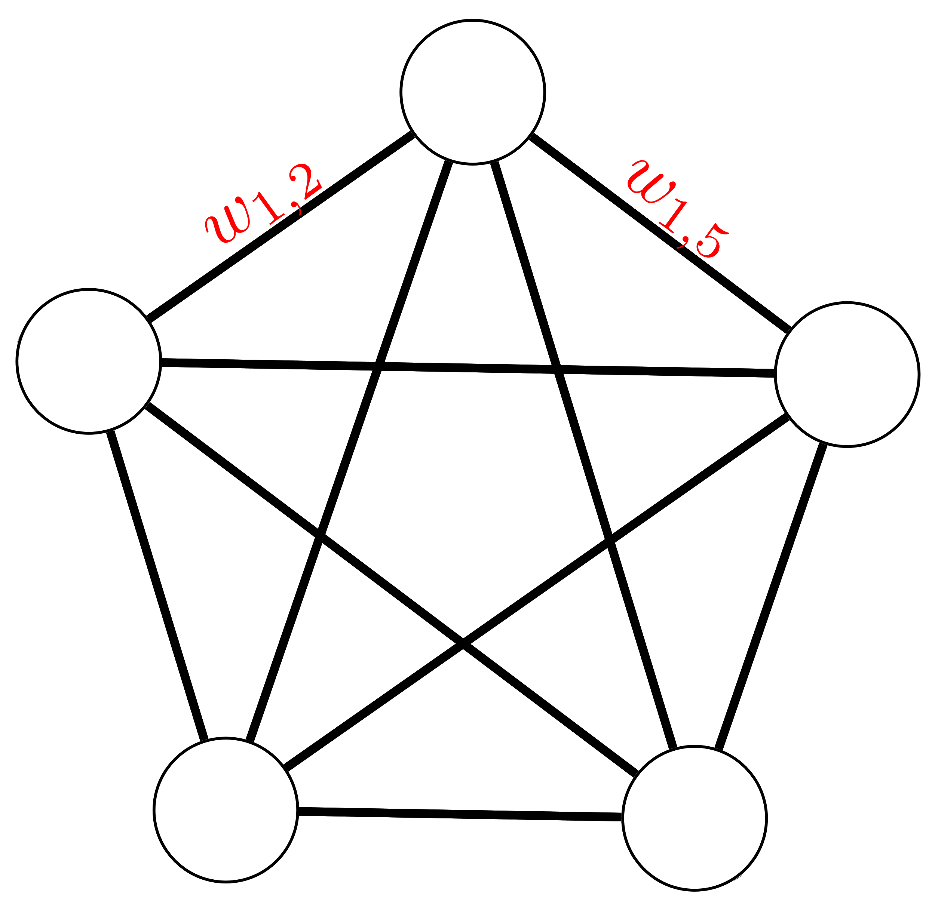
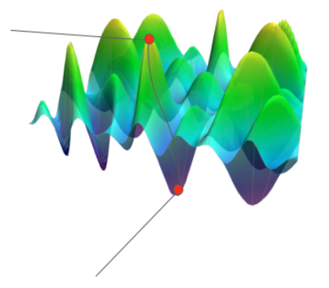
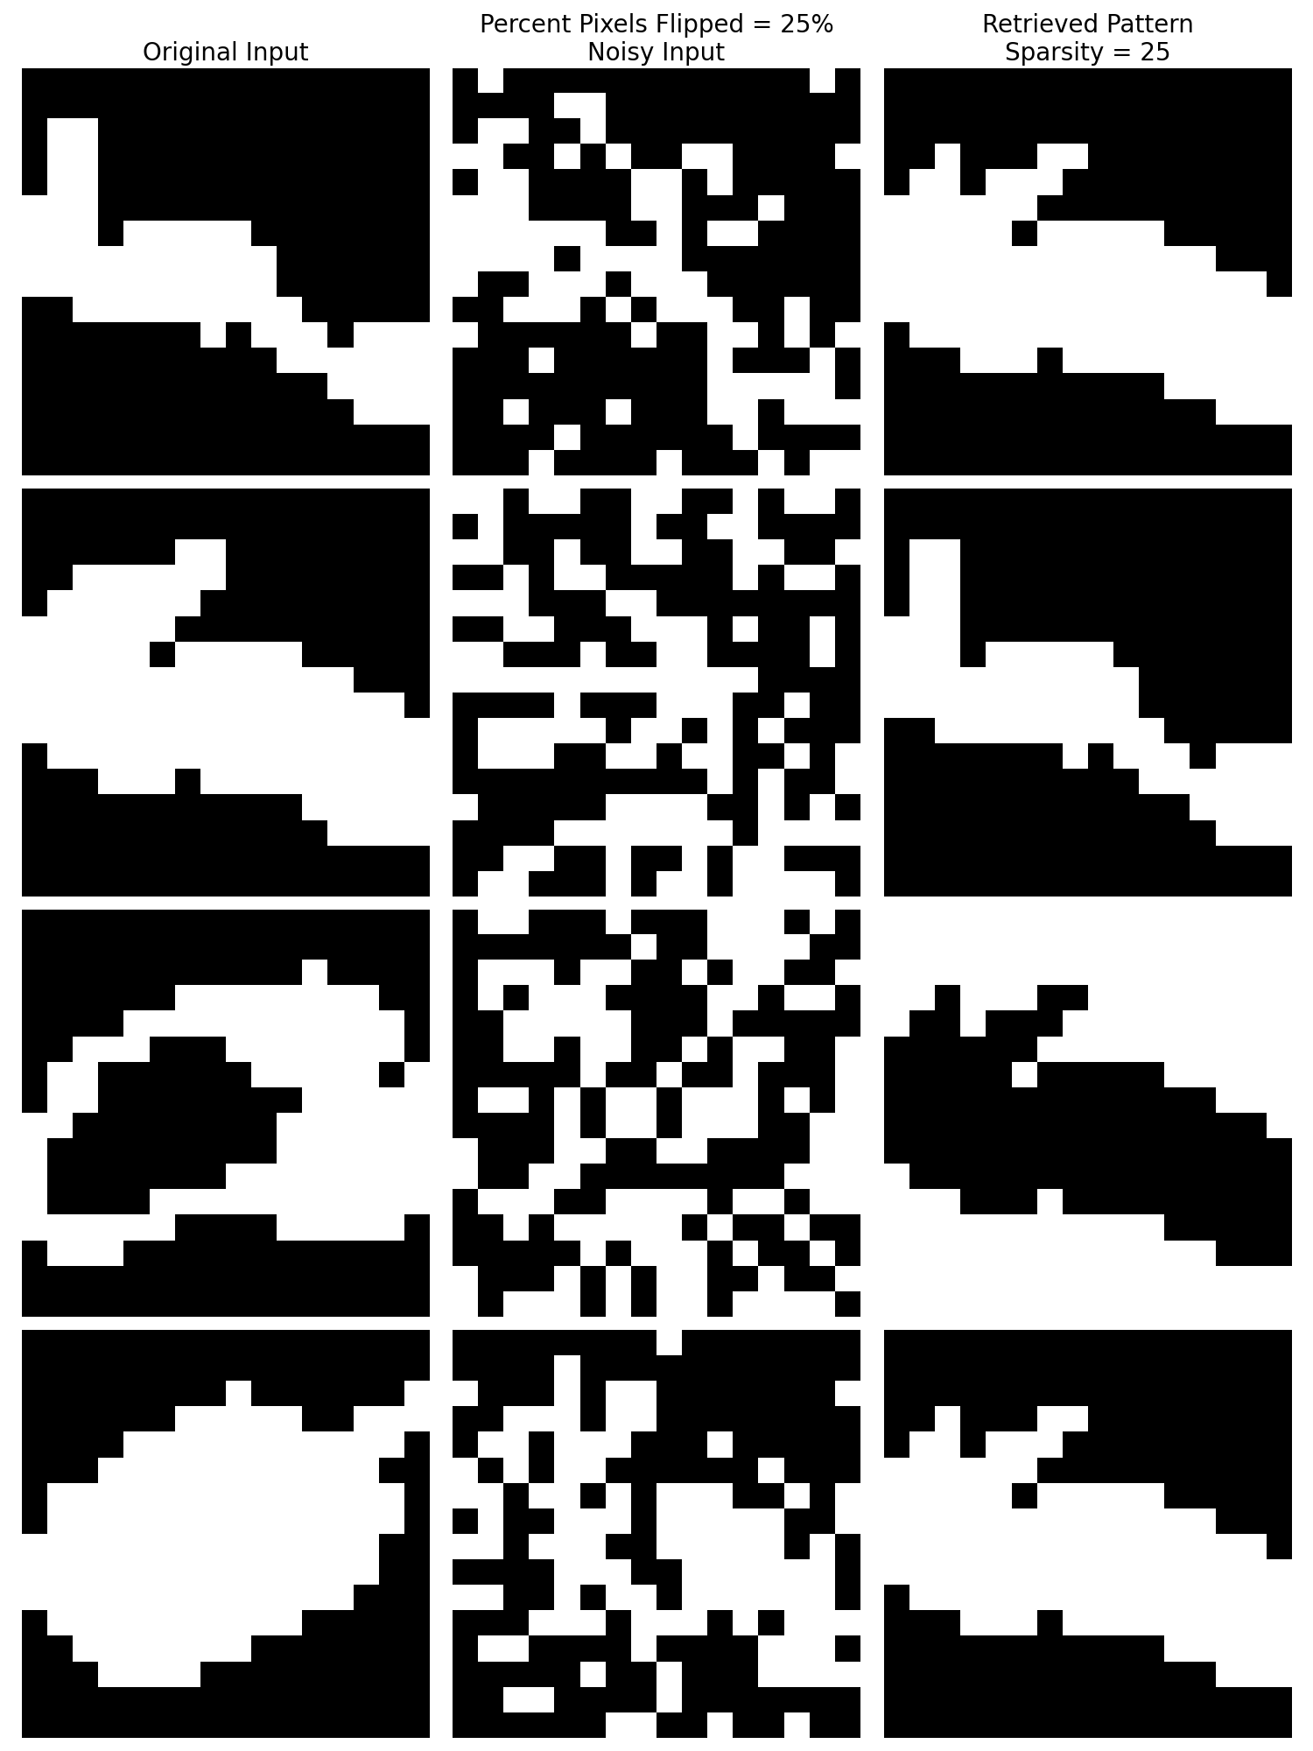
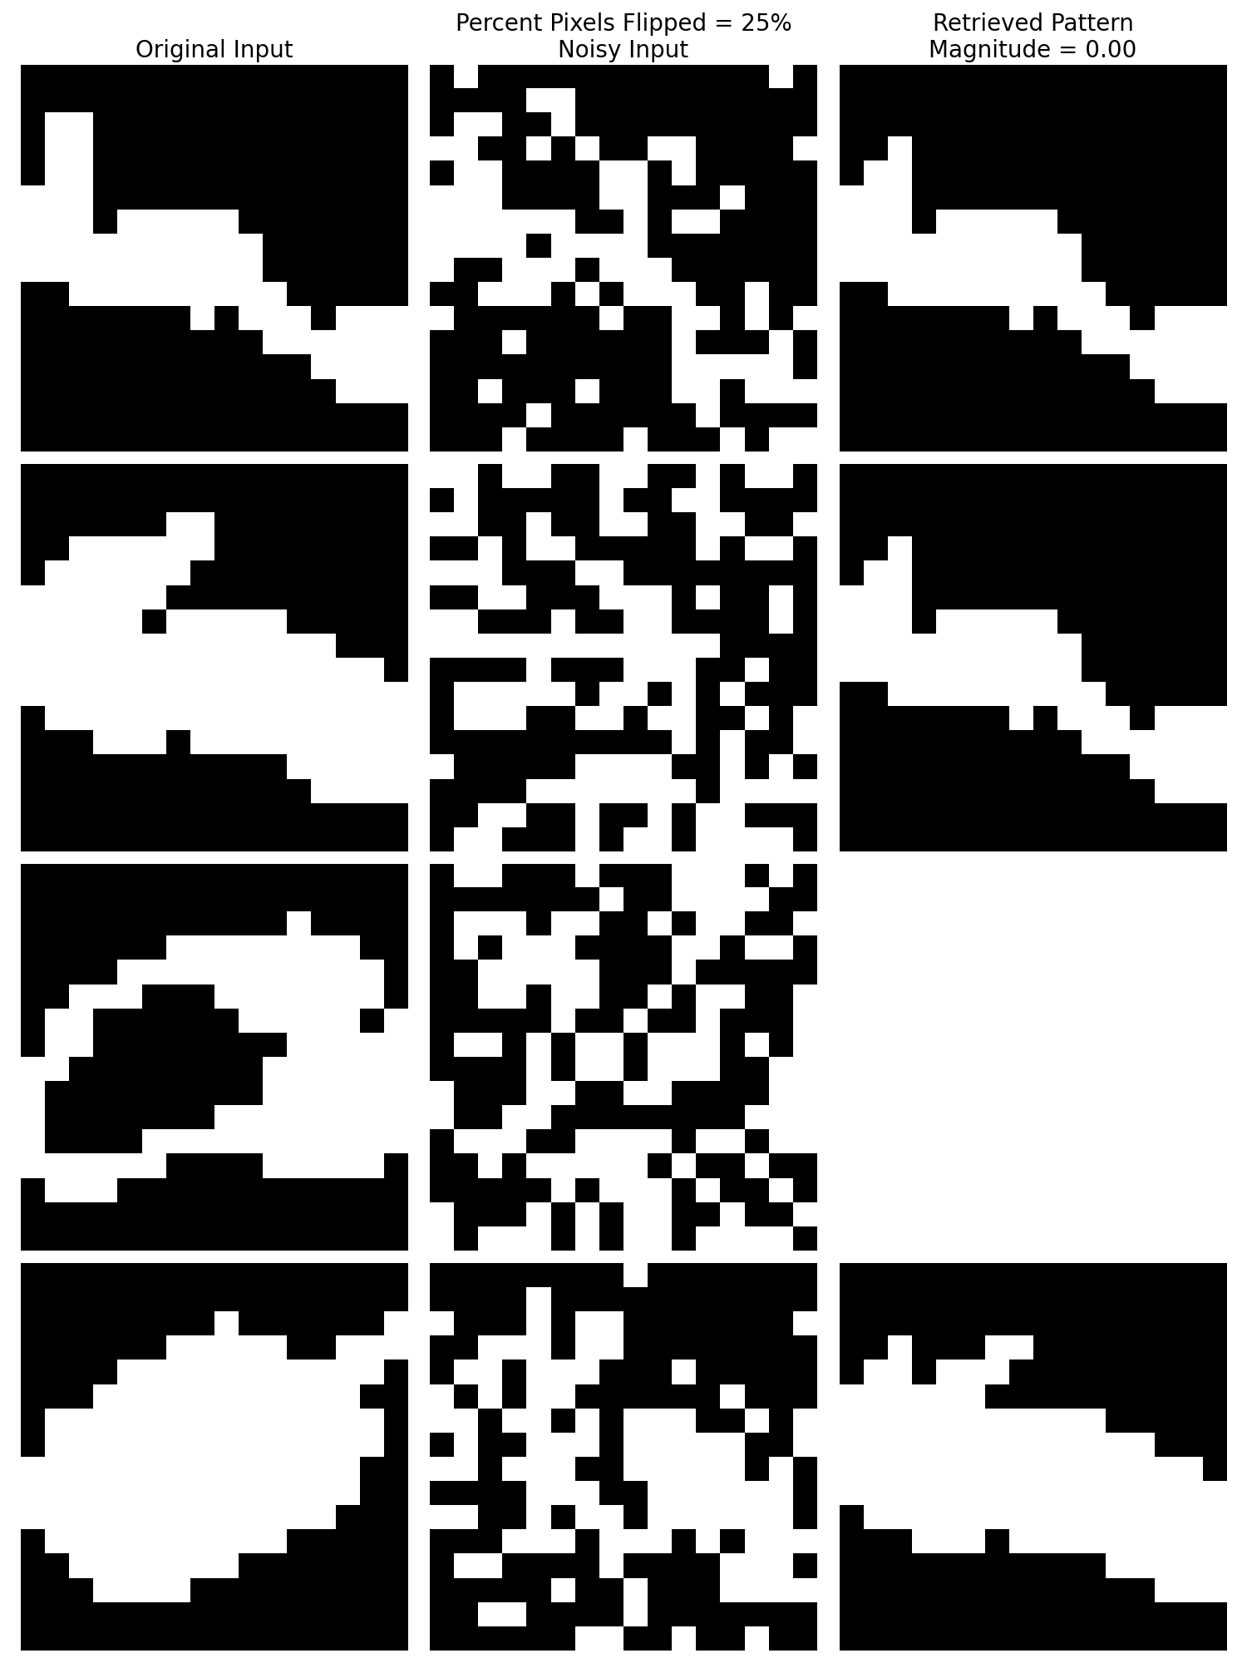





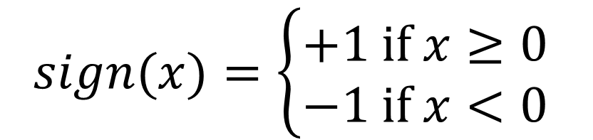

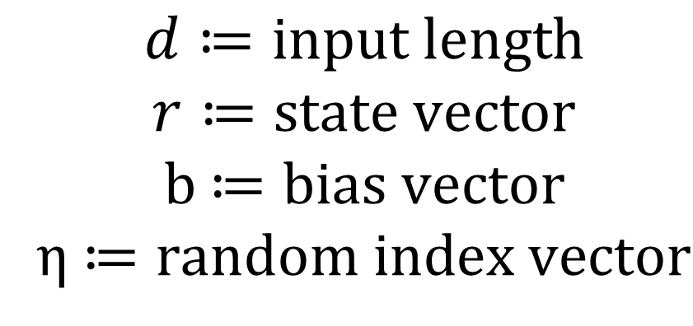

Hopfield Networks: Comparing Sparse and Magnitude Pruning
Brian Li
Center for Neuroscience, University of California, Davis
Abstract
Methods
This research aimed to examine sparse and magnitude pruning in Hopfield networks (HNs). HNs at evenly spaced sparsity and magnitude intervals were tested. The performance of retrieved patterns were evaluated on the number of matching pixels. Various percentages of noise were introduced to evaluate the performance of these pruning methods.
Background
HNs are recurrent artificial neural networks with the ability to store and recall patterns
HNs are content-addressable memory systems, making them capable of retrieving stored patterns when presented with noisy inputs
Hopfield Networks minimize an energy function over time, converging into a stable state that corresponds to a stored pattern
$$d≔input length$$
$$r≔state vector$$
b $≔bias vector$
η $≔random index vector$
$$sign(x)=\left\{\begin{aligned}+1 if x≥0 \\ −1 if x<0\end{aligned}\right.$$
Inputs:
$$x_{i}∈{\left\{−1, 1\right\}}^{d}$$
Weight matrix:
$$W=\sum_{i}{x_{i}x_{i}^{T}}$$
Energy function:
$$E=−\frac{1}{2}r^{T}Wr−b^{T}⋅r$$
Sparse Pruning
Magnitude Pruning
Asynchronous update rule:
$$r\left(t+1\right)=r\left(t\right)+\text{η}(t)∘sign(Wr(t)−b)$$
$$r_{1}$$
Randomly Initialized State
$$r_{2}$$
$$r_{5}$$
$$r_{3}$$
$$r_{4}$$
Objectives
Final Stable State
Results
Discover accurate methods to compare sparse and magnitude pruning of the weight matrix
Investigate the performance of HNs in retrieving 16x16 and 28x28 binary images in the Caltech 101 Silhouettes Data Set
Sparse and magnitude pruning perform roughly the same across various percentages of flipped pixels. This similarity is due to the robustness and redundancy in the weights of the HN that correspond to stored patterns.
Acknowledgements
Thank you to Dr. Chaudhuri for his endless support and insight
Data Availability
GitHub Repository: https://github.com/BrianLi-hello/hopfield-pruning

