Slide 1
VectorCAST/Cover Training

Slide 2
Command line automation
To get help
%VECTORCAST_DIR%\clicast help cover
To create a CCAST_.CFG
%VECTORCAST_DIR%\clicast -lc template GNU_C_46
Or copy it from a master in configuration management
To create a Cover environment with vcdb2vcm’s default name VectorCAST_Coverage
%VECTORCAST_DIR%\ clicast cover env create VectorCAST_Coverage
To add source files from a vcshell.db
%VECTORCAST_DIR%\clicover add_source_vcdb VectorCAST_Coverage vcshell.db filelist.txt
filelist.txt is generated from %VECTORCAST_DIR%\vcdb getfiles
To specify the file that will “include” c_cover_io.c/cpp
%VECTORCAST_DIR%\clicast -eVectorCAST_Coverage cover append_cover_io true -umanager.c
To instrument files (using clicast or clicover)
%VECTORCAST_DIR%\clicover instrument_statement VectorCAST_Coverage database.c manager.c manager_driver.c
%VECTORCAST_DIR%\clicast -lc -e VectorCAST_Coverage -u main.c cover instrument probe_point
To add results
%VECTORCAST_DIR%\clicast -eVectorCAST_Coverage cover RESult Add TESTINSS.dat result_name
To generate a report for one UUT
%VECTORCAST_DIR%\CLICAST -eVectorCAST_Coverage -u manager.c cover report aggregate coverage_report_manager.html

Slide 3
Command line automation for vcshell
To run vcshell as a “wrapper” to “snoop” the build process in compile.bat
%VECTORCAST_DIR%\vcshell.exe [options] cmd /c compile.bat
Do NOT move vcshell.db, instead create it in the required directory
Therefore an option for the vcshell command line will be --db=\path_to\vcshell.db
The vcdb2vcm.py “points to” the vcshell.db so there is no need to move the file anyway.
To run the automation controller to build or add to a VC/Cover environment in a VC/Manage project
%VECTORCAST_DIR%\vpython startautomation.py --interactive
and then choose step 3
OR
%VECTORCAST_DIR%\vpython vcdb2vcm.py build-db True

Slide 4
Command line automation for probe points
To add probe points in a “pp” file
%VECTORCAST_DIR%\CLICAST -eVectorCAST_Coverage Cover PROBE_point ADD_file VectorCAST_Coverage.pp
To create probe points in a “pp” file. Name is VectorCAST_Coverage.pp.
%VECTORCAST_DIR%\CLICAST -eVectorCAST_Coverage Cover Environment Regression_Script
To apply probe points. This updates instrumentation.
%VECTORCAST_DIR%\CLICAST -eVectorCAST_Coverage Cover PROBE_point APPLY
To remove all probe points
%VECTORCAST_DIR%\CLICAST -eVectorCAST_Coverage Cover PROBE_point REMOVE_ALL
To discover probe point ids
Write a python script or program to scan the “pp” file. Match on function name and source unit.
To enable a probe point
%VECTORCAST_DIR%\CLICAST -eVectorCAST_Coverage Cover PROBE_point ENABLE_ID <probe_point_id>
To disable a probe point
%VECTORCAST_DIR%\CLICAST -eVectorCAST_Coverage Cover PROBE_point DISABLE_ID <probe_point_id>
To remove a probe point
%VECTORCAST_DIR%\CLICAST -eVectorCAST_Coverage Cover PROBE_point REMOVE_ID <probe_point_id>
To uninstrument a file to disable PPs – after this re-instrument and perform the ADD_FILE and APPLY operations
%VECTORCAST_DIR%\clicover instrument_none VectorCAST_Coverage manager.c
To restore instrumented files back to the original source, eg to edit a source file
%VECTORCAST_DIR%\manage --project=VectorCAST_Manage --disable-instrument-in-place
To revert the original source back to instrumented files, eg after editing is complete
%VECTORCAST_DIR%\manage --project=VectorCAST_Manage --enable-instrument-in-place

Slide 5
Command line automation for probe points
To list probe points (interim python script)(clicast from 64w)
python.exe vcast_enumerate_probe_points.py --input=cover.vcp
%VECTORCAST_DIR%\clicast -lc -E VectorCAST_Coverage cover PROBE_point Xml pp_list.xml
Probe Point “macro” (from 64w)
The symbol __VCAST_PP_ID__ expands to the PP ID. This can be used, for example, as a parameter in a function call to back-end code as an array lookup index to determine whether the current probe point is “active” where “active” is a runtime concept as distinct from enabled which is an instrument/compile/link/flash concept.
Additional clicast commands to be added to enable and disable probe points available from 64w
%VECTORCAST_DIR%\clicast -lc -E VectorCAST_Coverage cover PROBE_point DISable_id 1
%VECTORCAST_DIR%\ clicast -lc -E VectorCAST_Coverage cover PROBE_point ENAble_id 1
%VECTORCAST_DIR%\clicast -lc -E VectorCAST_Coverage cover PROBE_point REMOVE_Id 1
These three commands are all followed by the apply command
%VECTORCAST_DIR%\clicast -lc -E VectorCAST_Coverage cover PROBE_point apply

Slide 6
Example pp file
Here is an example PP (probe point) file
PROBE_UNIT: bar.c
PROBE_FUNCTION: bar
PROBE_LINE: return 3+1
PROBE_CODE:
/*******Inserted Before**********/
int i ;
END_PROBE_CODE:
PROBE_ID: 4

Slide 7
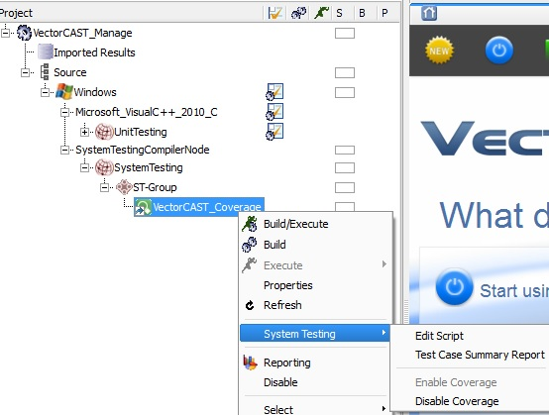
Actions for changed source and header files
To disable coverage ready to change source files
The equivalent manage command line option is on a previous slide
After changing the source file(s) :
Enable the coverage (GUI or equivalent command line option
%VECTORCAST_DIR%\manage --project=VectorCAST_Manage --list-changed-files
%VECTORCAST_DIR%\manage --project=VectorCAST_Manage --build-execute

Slide 8
Embedded Coverage Options
Buffered not Realtime
Because there is no output “path” while we are running
Instrument blocks for statement coverage
Because that uses less code and ram space
Instrument using macros in c_cover.h
Because instrumentation is inline in the UUT, not a function call to c_cover_io, therefore faster and the code space should be smaller for statement coverage, but we should check the linker map to see which gives smaller code for mcdc coverage.

Slide 9
Include paths & compile defines & preprocess cmd & -C
See the following slide for a screenshot
Remove -C as a pre-process option
Because there are lots of comments and the VC parser is faster without them
Compile defines and include paths (-D and -I options ) are added by the vcdb2vcm process as unit options / compilation arguments.
Alternatively they can be added as include directories and defined variables on the tools options c/c++ tab and preprocessor subtab but then they will apply to all units and all Cover environments.

Slide 10
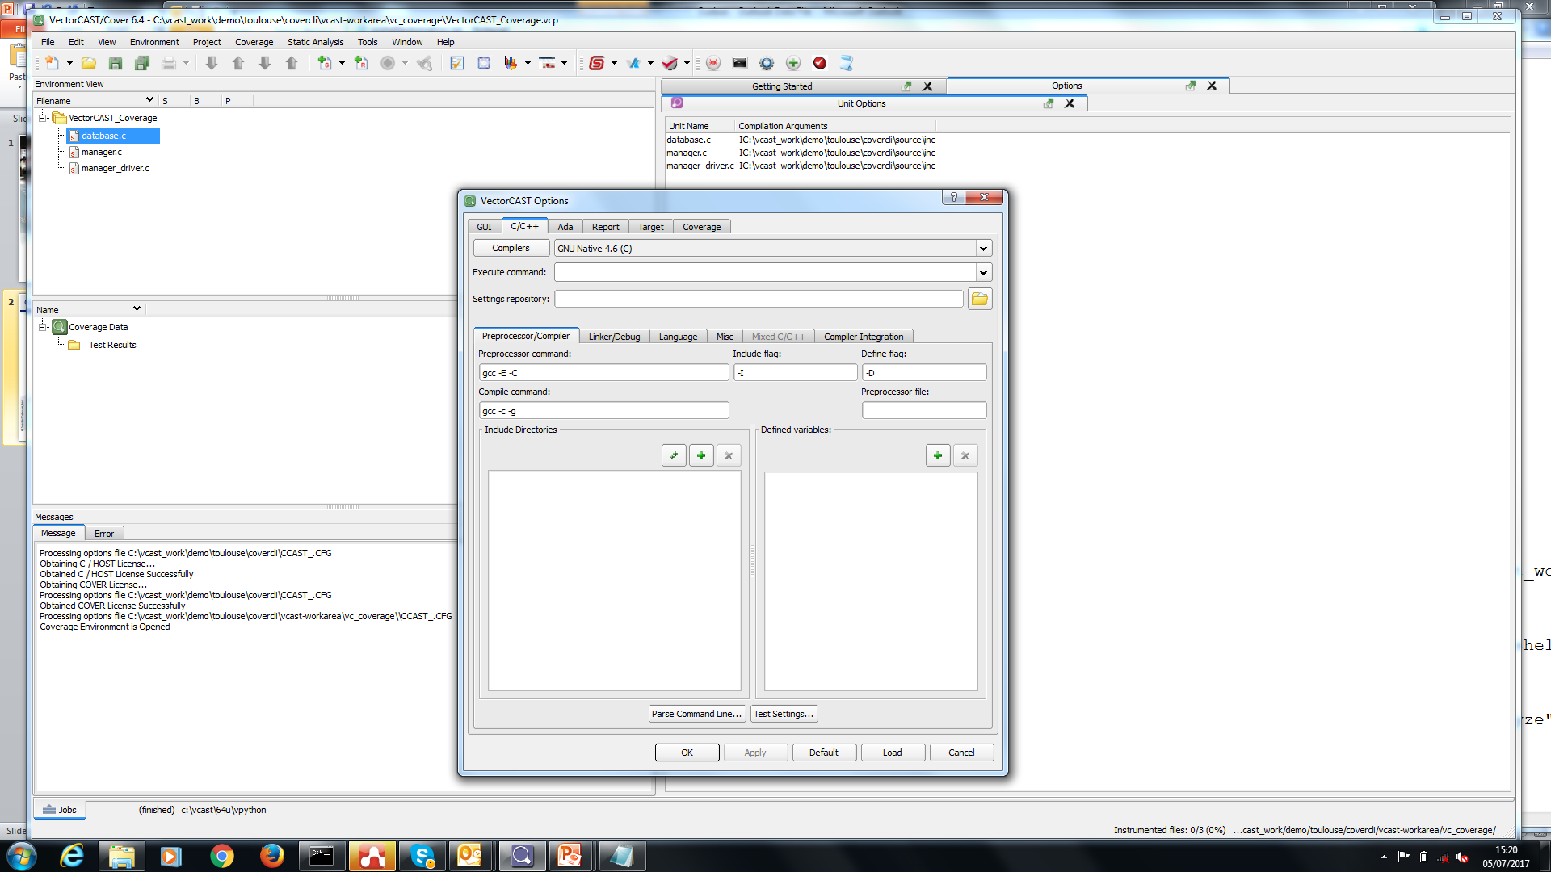
Include paths & compile defines & preprocess cmd & -C

Slide 11
Function coverage or Function Call Coverage ?
The very similar names hide a huge difference in the “implementation machinery”
Each is enabled by a tickbox on the coverage tab
Function coverage is simply a reporting matter
There will be a column in the coverage report and a function has 100% function coverage if we entered it, or otherwise 0% function coverage.
Function call coverage counts the function calls that are made OUT OF a function.
A function has 100% function call coverage if every we have executed every call that exists out of the function to other functions.
Function call coverage requires additional instrumentation, therefore after enabling the choice, we must re-instrument the code.

Slide 12
Adding c_cover_io to the instrumented link
Traditionally we asked the tester to add c_cover_io to the project “make”.
Sometimes that is administratively very difficult.
CARE ! c_cover_io depends on vcast_c_options.h and c_cover.h
vcast_c_options.h changes when we instrument new files or change instrumentation
NEVER move or copy vcast_c_options.h because if you do, sooner or later you will compile c_cover_io with an obsolete copy of the header file.
Instead, ensure the compile uses a “-I” include path directive to point to the cover environment folder
As an alternative, c_cover_io can be included in an instrumented source file
There is a clicast command on p2 of these slides.
Or there is a “main files” option in vcdb2vcm.py
Or we have supplied a python script to be executed via a “post-instrument” batch file
The post-instrument bat file does a #include. That can cause a duplicate definition problem if the instrumented UUT already has a pre-processed expansion of stdio.h because c_cover_io includes this again (so we can solve this by removing the #include “stdio.h” from c_cover_io).
BUT when we use the clicast command or the vcdb2vcm main files option, c_cover_io is preprocessed into the instrumented UUT and this avoids the #include problem.

