Slide 1
Thanks to Fusion Alliance for Providing Pizza!

Slide 2
Choosing a Performance Metric
Brian Connolly
Cincinnati Machine Learning Meetup
6/20/19

Slide 3
Outline
Overview
Some basic metrics
More complicated metrics
Summary
Conclusions

Slide 4
Overview
Performance metrics measure performance
Job performance, app performance, customer engagement, etc.
To pursue the improvement of anything without a well defined performance measure is a waste of time
The performance measure is highly dependent on the task
In a search engine situation, you are worried about whether you’re returning relevant products for a given search term (order)
If you have an app that can detect psychiatric distress you want something like accuracy
In natural language processing tasks you might not have the benefit of knowing the false negative rate, so you might choose something like the F1 measure

Slide 5
Determining a Performance Metric is Not a Data Science Problem
Role of a data scientist is to present stakeholders metrics to choose from
Intuitive
Simple
Comprehensive
This is insanely hard
Some performance metrics are not of interest to stakeholders
e.g., metrics that are many degrees away from revenue
“Downtime”

Slide 6
In My World..
Engineering Metrics
Tell me how my infrastructure is doing
AND everything I’m 100% in control of
Customer Behavior Metrics
Tell me how happy customers are
Description | Metric
Downtime | Time
Lag | Time difference
Customer Traffic | Customers/Hour
Description | Metric
Uplift from charitable promotion | Number of navigations
Engagement | Number of paginations
% people searching and buying things | conversion rate
Quality of Results | Normalized Discounted Cumulative Gain
More stakeholder-driven

Slide 7
Let’s Start Looking at Some Metrics
Suppose a population contains two groups
Signal and background
Buyers versus browsers
Purchased fruit versus rotting fruit
Convenient to think in terms of ‘positive’ and ‘negative’ population
Positive = your ‘target’ (signal)
Negative = your background

Slide 8
Types of Mistakes
Positives are the group you are targeting
Signal
Buyers
Fruit in the Fruit and Vegetables Aisle that will sell
Negatives are the other group
Here, ”Negative” and ”Positive” labels are interchangeable

Slide 9
Suppose then I build an imperfect algorithm to classify individuals in this population into “positives” and “negatives”

Slide 10
Types of Mistakes
True positives (tp) – number of positives my model correctly classified
True negatives (tn) – number of negatives my model correctly classified
False negatives (fn) – number of times my model said something was a negative and it wasn’t
False positives (fp) – number of times my model said something was a positive and it wasn’t

Slide 11
Example: Accuracy

Slide 12
Cool. I’m Done. Oh Wait.
Often false negatives and false positives do not carry the same weight (cost)
Better to have a false positive than a false negative in a cancer diagnosis
The game is then to quantitatively express (e.g., optimize based on) the relative importance of TP’s, TN’s, FP’s and FN’s

Slide 13
Quantifying How Often I Screw Up Positive/Negative Cases
Sensitivity (Recall) = TP/(TP+FN)
Fraction of positives I correctly classify
Specificity = TN/(TN+FP)
Fraction of negatives I correctly classify

Slide 14
Precision
Used as a proxy for specificity
The ‘flip side’ of specificity
By itself precision a bad metric
If data set is highly imbalanced (many negatives) can have a high value for precision but a terrible classifier!
Specificity = TN/(TN+FP)
Precision = TP/(TP+FP)

Slide 15
Sensitivity at 100% Specificity
Suppose I have an app that diagnoses appendicitis
I could send every person who comes through the door to an emergency room, but that’s a lot of money
But I don’t want to miss anybody
Sensitivity at 100% specificity is then a direct measure of my % cost savings

Slide 16
Summary of Specificity, Sensitivity (Recall), Precision
Usually can’t optimize machine learning algorithm on just one of these
Precision sensitive to imbalanced data
If quoting precision need to quote baseline
Specificity is # of times you screw up negative cases
Sensitivity is # of times you screw up positive cases

Slide 17

WELL LA-DE FRICKIN’ DA!

Slide 18
Rest of the Talk
F1
Area Under the Receiver Operating Characteristic
Measures of agreement: Cohen’s Kappa
Lift Charts
Measuring effectiveness of search engines

Slide 19
F1
What if number of true negatives can’t be defined?

Slide 20

Automated Transcription Example
Person: “The Last Jedi is overrated”
Computer Transcription: “The Blast Jedi is overstated”
TP=3
TN=?
FP=2
FN=2
* True negatives = number of words in English language?

Slide 21
F1
Technically
… but it reduces to

Slide 22

Details:
Micro and Macro F1
F1 often used for multi-label data
Micro F1 simply F1 calculated over the entire data set
Macro F1 essentially averages the results from each category
Really uses averages of precision and recall
Categories that rarely appear/classified are not drowned out
 | Bananas | Grapes | Candy | Paper Towels
Customer 1 | X |  | X | X
Customer 2 |  | X | X
Customer 3 | X
Customer 4 | X |  | X
Customer 5 |  | X | X | X
Customer 6 | X | X

Slide 23
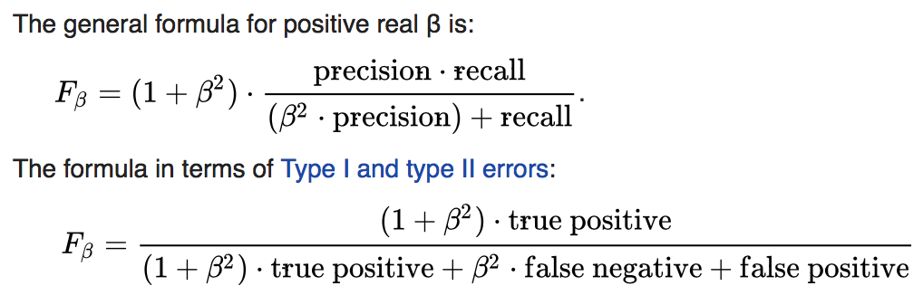
F1 Summary
F1 ‘focuses’ on TP, FN, FP’s
Like precision and accuracy for that matter(!), need to define baseline
Affected by imbalanced data (F1 from a random classifier is not necessarily 0.5)
F1 by itself if meaningless!
F1 often used in the natural language processing (NLP) community – e.g., measure effectiveness in part-of-speech taggers
Great for shared tasks/data challenges/hackathons
In many tasks, tough to get a good F1
Good at separating the wheat from the chaff

Slide 24
Disclaimer
ASR systems usually use word error rate

Slide 25
Area Under the Receiver Operating Characteristic Curve
So far we have concerned ourselves with binary classification problems
But most (machine learning) models produce a real number that is thresholded to output a binary result
Logistic regression model returns a number between 0 and 1, threshold at 0.5
SVM returns a real number thresholded at 0
Neural networks usually produce an output with limits around 0 and 1, thresholded at 0.5

Slide 26
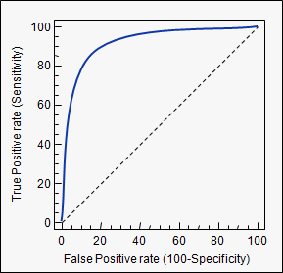
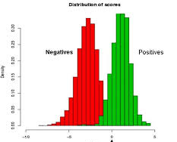
Area Under the Receiver Operating Characteristic Curve
4
3
2
1
May give people a model that produces a number, and then just say, tinker with the threshold however you like depending on your desired sensitivity/specificity
.. but still want present some ‘overall measure’ of performance of the model
Particularly useful in clinical setting where one application may be used in different contexts
1
2
3
4
Machine Learning Output

Slide 27
AROC=1
AROC=0.85
Outputs Random Numbers
(AROC=0.5)

Slide 28
Intuitive Interpretation of AROC
Really a measure of how well a set of values are ordered
Probability that a positive case will have a larger machine learning output value than a negative case
Mann-Whitney U Test

Slide 29
Summary of Area Under Receiver Operating Characteristic
A probability with an intuitive interpretation
Sometimes see precision vs. recall curves – these are different
Simply gives ‘overall’ performance
e.g., useful in clinical setting, where each clinician might want to set their own specificity/sensitivity
On the other hand, doesn’t give direct question ”how often does your classifier screw up?”

Slide 30
Measures of Agreement

Slide 31
Measuring Agreement
The previous measures have assumed a ‘gold standard’
e.g., when calculating accuracy, assume that it can be determined whether or not something has been classified correctly
What if there is no “truth” to compare with?
e.g., two people are filling out a questionnaire: how much do they agree?

Slide 32
Let’s Build Our Own Statistic
Two people are filling out a multiple choice questionnaire: how well do their answers agree?
Naive Approach: define one person as gold standard and simply compute the accuracy (recall accuracy is symmetric)
A = Accuracy

Slide 33
Let’s Build Our Own Statistic
But what if questionnaire only has one possible answer to every question?
A=1
Should give accuracy above what you would obtain from random chance
A = Accuracy

Slide 34
Let’s Build Our Own Statistic
But what if questionnaire only has one possible answer to every question?
A=1
Should give accuracy above what you would obtain from random chance
A-R_{C}
R_{C} = Random Chance Agreement

Slide 35
Let’s Build Our Own Statistic
...But value isn’t necessarily between 0 and 1 (-1 and 1)
A-R_{C}
1-R_{C}
Just the numerator
where A=1
(perfect agreement)
R_{C} = Random Chance Agreement

Slide 36
Cohen’s Kappa

Slide 37
Summary of Cohen’s Kappa
Measure of inter-annotator agreement
Sometimes used to optimize machine learning models that are sensitive to imbalances in the training data
Kippendorff’s alpha a “generalized” version:
Any number of participants
Applicable to nominal, ordinal, interval, and ratio levels of measurement
Handles missing data

Slide 38
Ranking-Related Measures

Slide 39
Lift Charts
Suppose I’m sending out mailers
I have a (machine learning) model that ranks the customers based on how likely they are to respond to my offer
Question: how much time will I save calling the customers in the order suggested by my model vs. randomly contacting folks?

Slide 40
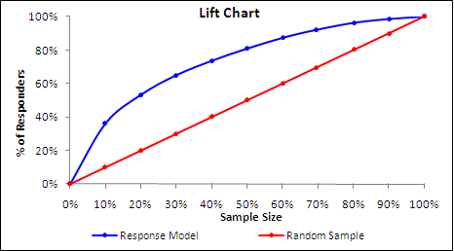
Lift Charts
Rank the customers based on the probability they will respond
Total the fraction of ‘respondents’ as you increase the sample size
If no model, % of respondents will increase linearly with the sample size
Model
No Model

Slide 41
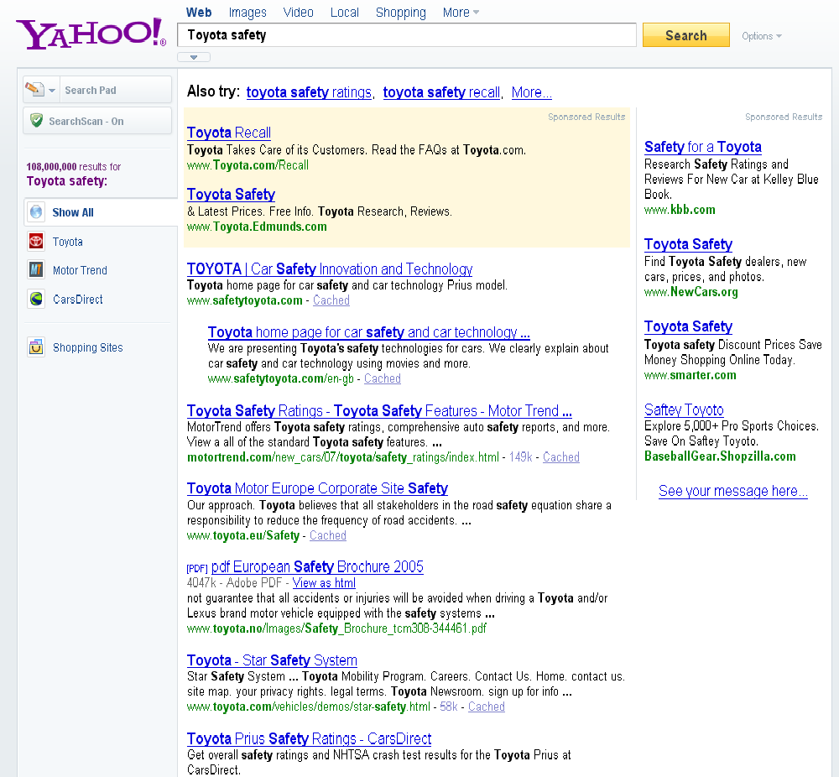
Normalized Discounted Cumulative Gain
Discounted Gain is the “Lift” if I consider “relevancy of the result” instead of “probability of response”
Suppose I have a search engine that returns results based on some query
How do I determine the quality of my search engine?

Slide 42
Normalized Discounted Cumulative Gain
Here’s one way
Have “experts” look at a bunch of search results and rank them
Then compare the search engine rank with their ratings
Note: annotators are not ranking
They’re annotating “grade” results as, say, “awesome” (5), “good” (4), “fair” (3), “bad” (2), “terrible” (1)
Annotated
“grade”
Rank of Search
Engine
Discounted Cumulative Gain (DCG) at rank n
DCG = r₁ + r₂/log₂2 + r₃/log₂3 + … r_{n}/log₂n
We may use any base for the logarithm, e.g., base=b

Slide 43
Normalized Discounted Cumulative Gain
People like numbers between 0 and 1
Normalize it
I rank the ‘grades’ from best to worse (i.e., from 5 to 1)
This would be ‘optimal’ ranking
Figure out what this ‘ideal’ DCG is and divide it by measured DCG score to get nDCG
Annotated
“grade”
Rank of Search
Engine
Discounted Cumulative Gain (DCG) at rank n
DCG = r₁ + r₂/log₂2 + r₃/log₂3 + … r_{n}/log₂n
We may use any base for the logarithm, e.g., base=b

Slide 44
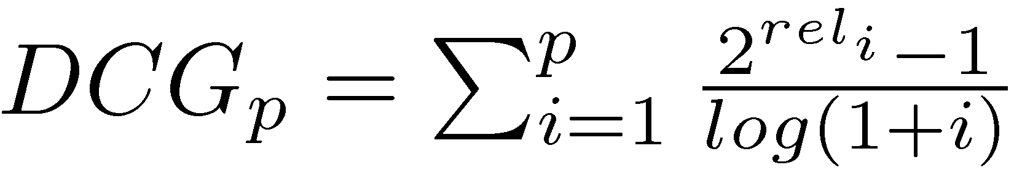
Normalized Discounted Cumulative Gain
Good for relative measures (usually calculate it over many searches, so have variance)
Alternative definition is preferred
Larger weight to results that are graded higher
In reality, this form provides more ‘information’
Danger: all same rank nDCG=1
Scores tend to be high if not many ‘grades’
“Expert” can be hard to define

Slide 45
Summary
Accuracy
Good, but imbalanced data sets will render misleadingly large numbers
F1
Like accuracy, but don’t get any points for identifying negatives correctly
Focuses on what’s happening with the positives you identify
AROC
Gives a more general overview of machine learning performance
Agreement statistics
Cohen’s kappa, Krippendorff’s alpha
Lift Chart
Specific statistic for determining time/cost savings in ranked sampling
Normalized Discounted Cumulative Gain
Search Engines

Slide 46

Things I Didn’t Discuss
Rant about how (statistical) uncertainties should always be attached to performance metrics
Rant how statistics like Cohen’s Kappa and Area Under the Receiver Operating Characteristic can be used to eliminate machine learning training issues due to imbalances in training samples

Slide 47
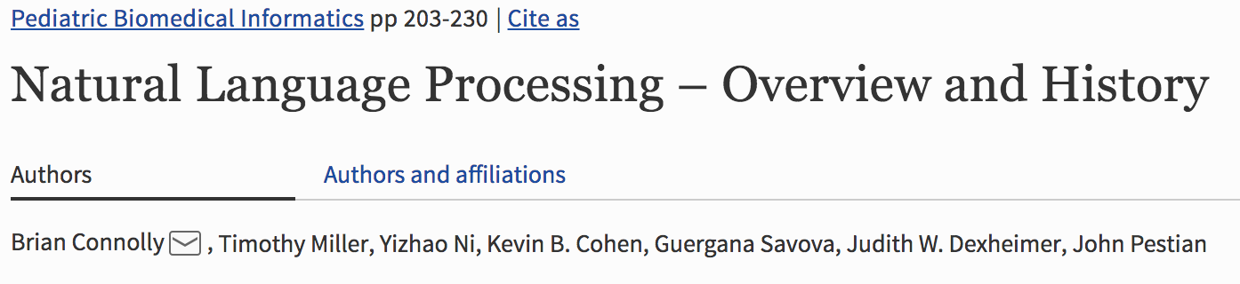
Useful Links
Word Error Rate (performance measures for ASR systems) - https://martin-thoma.com/word-error-rate-calculation/
Lift Charts: https://stats.stackexchange.com/questions/17119/lift-measure-in-data-mining
Normalized Discounted Cumulative Gain:
https://opensourceconnections.com/blog/2018/02/26/ndcg-scorer-in-quepid/
https://web.stanford.edu/class/cs276/
Krippendoff’s alpha:

Slide 48
Conclusions
Choosing a performance measure is, strictly speaking, not a data science problem
Knowledge of them is!
Presented a few performance measures
Github repository (references): https://github.com/BrianMackayConnolly/MachineLearningMeetUpPerformanceMetricsTalk.git

Slide 50
Introduction to Information Retrieval: https://web.stanford.edu/class/cs276/
fair
fair
good
Notes:
https://web.stanford.edu/class/cs276/handouts/EvaluationNew-handout-6-per.pdf

