Slide 1
SUDAN · JJA 2025
FIVE TOWNS
Did the forecast warn
of extreme rain?
01
KHARTOUM
02
KASSALA
03
GEDAREF
Local thresholds, ensemble signals, and the when-and-where of risk in five Sudanese towns.
04
EL OBEID
05
NYALA
AFRICAN SUMMER SCHOOL ON AI FOR WEATHER AND CLIMATE MODELLING 2026
Group project · October 2026
24.25–37.0°E
11.5–16.25°N
ECMWF IFS 49r1 · CMORPH 1998–2024
Notes:
Opening question: did the JJA 2025 ECMWF ensemble produce locally meaningful signals of extreme rainfall in Sudan, and when and where did they appear? The deck follows five towns through Parts A to D, then closes with limits, reflections and the repository tag.

Slide 2
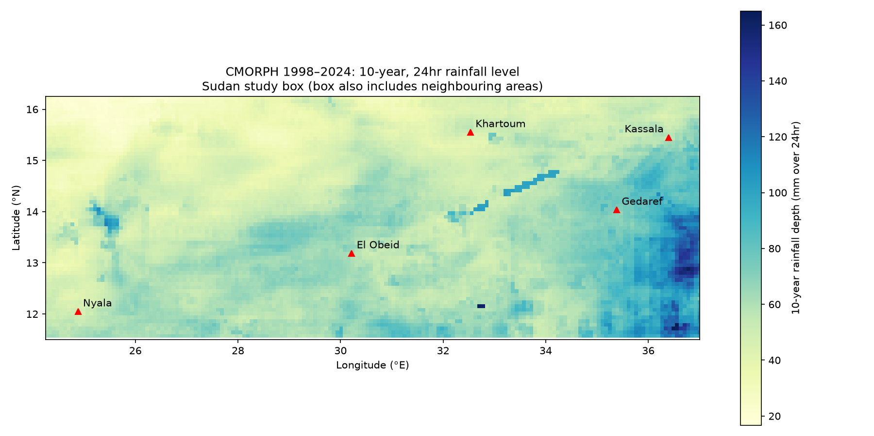
01 / THE PLACE
Five towns across Sudan's rainfall gradient
24-HOUR 2-YEAR LEVEL
Khartoum
23.8
mm/day
capital · Nile confluence
Kassala
37.9
mm/day
eastern border · Gash
Gedaref
53.0
mm/day
rain-fed agriculture
El Obeid
37.2
mm/day
central savanna
Nyala
32.3
mm/day
western Darfur
Background: CMORPH 24-hour 10-year level; dots mark the nearest CMORPH pixel to each town.
WHY THESE TOWNS?
The capital and four state capitals: people, markets, roads.
Rain-fed agriculture and local flood exposure.
A 2.2× spread in the local 2-year level: 23.8–53.0 mm/day.
Sudan JJA 2025 · local rainfall extremes
02 / 12
Notes:
The domain is 24.25–37°E and 11.5–16.25°N. The five towns are the national capital and four state capitals. They span the rainfall gradient from arid Khartoum to the higher local thresholds in Gedaref. The map background is the 10-year level, which is a reference map; the numbers on the right are the 2-year levels used in Parts B–D.

Slide 3
02 / DATA
Two stores, one comparison frame
FORECAST
OBSERVED REFERENCE
ECMWF IFS ensemble
CMORPH return levels
49r1 · JJA 2025 realized store
1998–2024 · 27 annual maxima
MEMBERS
51
RECORD
1998–2024 · 27 years
DAILY STARTS
92 · 1 Jun–31 Aug 2025
PRODUCTS
9 durations × 6 return periods
LEAD TIMES
0–240 h · 65 steps
GRID
~8 km · 550×474 · lat ascending
GRID
0.25° (~28 km) · 321×261
VARIABLE
return_period_precip, mm
VARIABLE
tp cumulative, m → mm
THRESHOLDS
2 / 10 / 50-year · 24 / 48 h
SNAPSHOT
212QY6MDW3RZ7PWD7A2G
SNAPSHOT
309ZYV7EMDMNPD0EDZK0
SHARED COMPARISON FRAME
24-hour totals · mm · strict > · nearest pixel · local 2-year threshold for B/C/D
Source: data.source.coop/e4drr-project virtual stores. Only requested maps/steps are read.
Sudan JJA 2025 · local rainfall extremes
03 / 12
Notes:
The forecast store has 51 members and 92 daily starts from 1 June to 31 August 2025, 0–240 hours, on a 0.25-degree latitude-longitude grid. The forecast variable is cumulative total precipitation in metres, so we difference whole-day leads and convert to millimetres. CMORPH provides return levels from 1998–2024, nine durations by six return periods, on a roughly 8 km grid. Both use strict greater-than and nearest-pixel matching.

Slide 4
03 / METHOD
A common threshold, read four ways
A
OBSERVED
B
DEFINITION
C
TIME
D
SPACE
What is extreme?
How much does the definition matter?
When did the signal appear?
Where was the risk highest?
27 annual maxima → Gumbel fit → local 24-hour 2-year level. 10- and 50-year levels test sensitivity.
16 Jul start: fixed 20 mm vs local 2-year vs 10-year. Count member-days above each threshold.
21 daily starts, 1–21 Jul. Five towns; days 1–10; 51 members; count members above the local 2-year level.
Every forecast grid point. Four stratified starts; days 1–5; probability and season-frequency maps.
OUTPUT
OUTPUT
OUTPUT
OUTPUT
local threshold table
member-day counts
start-date plume
probability + frequency maps
Feeds B, C and D
Uses the A threshold
Uses the A threshold
Uses the A threshold
A sets the reference; B tests the definition; C adds time; D adds space.
Sudan JJA 2025 · local rainfall extremes
04 / 12
Notes:
The four parts share one reference threshold: the local 24-hour 2-year level from CMORPH. A estimates that level. B asks whether the answer changes when the threshold changes. C holds the threshold fixed and adds forecast start date and lead time. D holds the threshold fixed and applies it at every forecast grid point. This is why the parts are comparable rather than four disconnected exercises.

Slide 5
04 / LINEAGE
Borrowed patterns, rewritten for Sudan
WORKSHOP SOURCE
EXERCISE
WHAT WE BORROWED
WHERE IT LANDED
E1–E8
E1–E2
Open a virtual store; read a realized plume
Store access; member reads
Day 2 · python-workshop
E3
Pan vs pencil chunk reads
D: crop region/steps before compute
• Examples were read-only inspiration.
• Analysis scripts live in this repo's scripts/ folder.
• Every figure comes from a committed script.
CMORPH return periods and Gumbel fit
A: local thresholds
E4
E5–E6
xclim heavy days; forecast vs local extremes
B/C: member counts
E7
Review before push
Git checks and reproducibility
E8
Local-threshold probability map
D: regional risk maps
Adapted, not copied.
REPO SCRIPTS
scripts/rainfall_thresholds.py · forecast_threshold_counts.py · forecast_signal_leadtime.py · region_risk_maps.py
Examples inspired the pattern; the Sudan scripts, settings, tests and outputs are ours.
Sudan JJA 2025 · local rainfall extremes
05 / 12
Notes:
The workshop provided eight patterns, but not a ready-made Sudan analysis. We adapted the store-opening and plume pattern from E1/E2, the chunk-read lesson from E3, the return-period logic from E4, the heavy-day and local-threshold counts from E5/E6, the review discipline from E7 and the probability map from E8. The analysis scripts and settings are in this repository, not copied from the workshop.

Slide 6
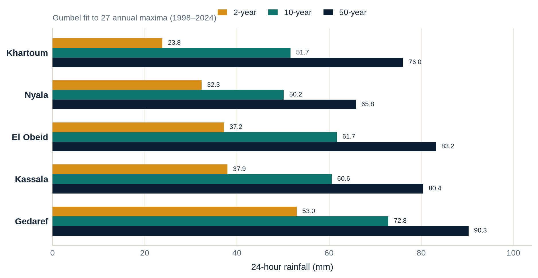
05 / FINDING A
What counts as extreme? It depends where you are.
24-HOUR 2-YEAR LEVEL
23.8–53.0
mm/day across the five towns
• Gedaref is highest; Khartoum is lowest at the 2-year level.
• 50-year levels: 65.8–90.3 mm/day.
• Fit sensitivity: removing the largest year changes the 50-year fit by 3–9%.
24-hour levels, mm. The 2-year level is the primary threshold used in B–D.
A fixed national threshold would misread both ends of this gradient.
Sudan JJA 2025 · local rainfall extremes
06 / 12
Notes:
Part A fits a Gumbel distribution to 27 annual maxima at each town's nearest CMORPH pixel. The 24-hour 2-year level ranges from 23.8 mm/day in Khartoum to 53.0 mm/day in Gedaref, a factor of 2.2. The 10- and 50-year levels are also shown. A fixed national threshold would therefore label very different rainfall amounts as equally extreme.

Slide 7
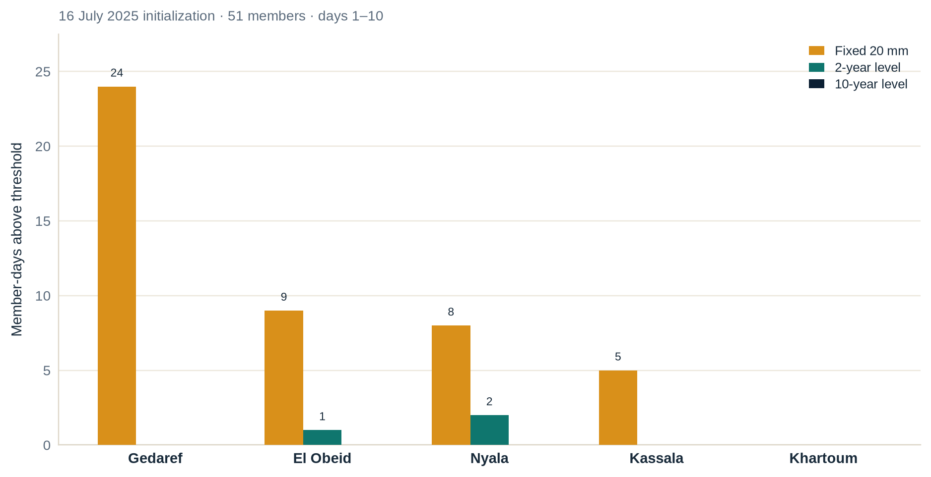
06 / FINDING B
How much does the threshold definition matter?
MEMBER-DAYS ABOVE THRESHOLD
46 → 3 → 0
fixed 20 mm → 2-year → 10-year
• Fixed 20 mm: 46 member-days; Gedaref alone contributes 24.
• Local 2-year: 3 member-days (Nyala 2, El Obeid 1).
• Local 10-year: none.
• The ranking changes: the definition decides whether a warning exists at all.
One 16 July 2025 initialization; member-days summed over forecast days 1–10.
Same forecast, same day — only the threshold changed.
Sudan JJA 2025 · local rainfall extremes
07 / 12
Notes:
Part B holds the forecast fixed at the 16 July initialization and changes only the threshold. A fixed 20 mm/day threshold produces 46 member-days above the threshold. The local 2-year level produces only three, and the 10-year level produces none. The ranking also changes: Gedaref dominates the fixed threshold, while Nyala and El Obeid are the only towns with members above their local 2-year levels. The definition is not cosmetic.

Slide 8
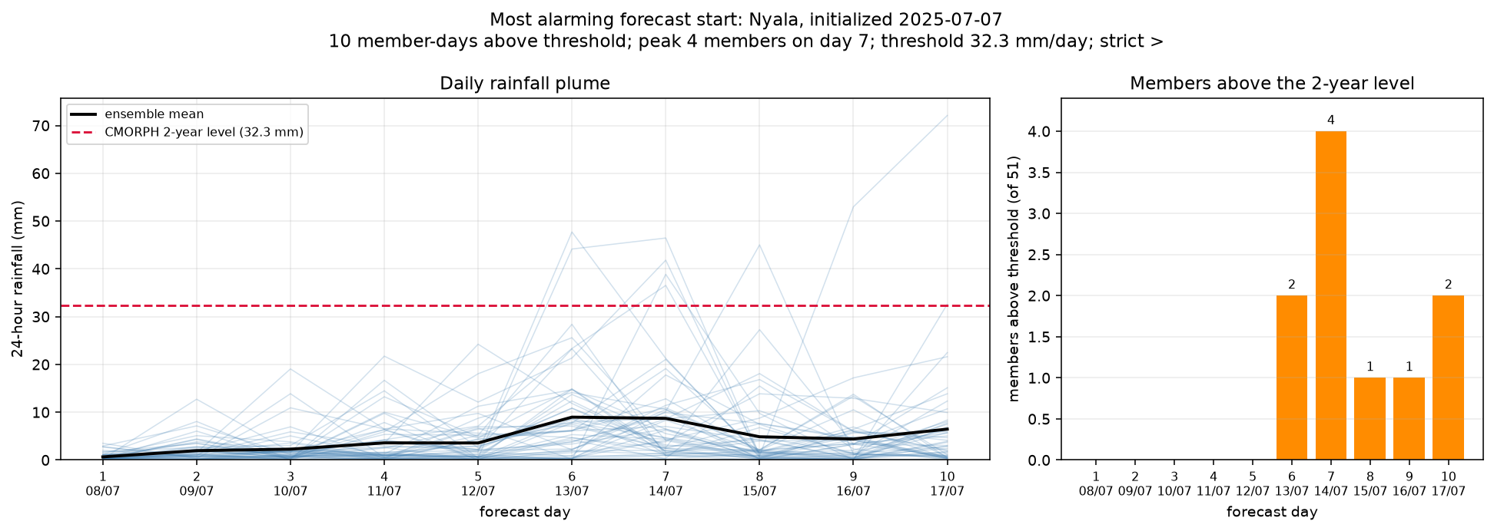
07 / FINDING C
When did the signal appear?
MOST CONSISTENT SIGNAL
20 / 21
Nyala starts with ≥1 member above its 32.3 mm local level.
• 72 member-days, peak 4 members in one day.
• Earliest valid date: Kassala, 4 July — from the 2 July start, day 2.
• Most alarming start: Nyala 7 July — 10 member-days, peak 4 on 14 July.
• Contrast: Khartoum 18/21 starts; Gedaref 3/21.
Nyala · 7 July start · red dashed line = 32.3 mm 2-year level · bars = members above.
Early signal, but the strongest and most consistent was Nyala.
Member counts, not probabilities.
WHEN TO LOOK
4 Jul earliest valid signal (Kassala) · 14 Jul peak (Nyala) · 1–21 Jul start window
Sudan JJA 2025 · local rainfall extremes
08 / 12
Notes:
Part C fixes the local 2-year threshold and looks across 21 daily starts from 1–21 July. Nyala is the most consistent and strongest signal: 20 of 21 starts have at least one member above their local level, with 72 member-days and a peak of four members in a day. Kassala provides the earliest valid calendar date, 4 July, from the 2 July start at day 2. The most alarming individual start is Nyala on 7 July: 10 member-days, peaking at four members on 14 July. These are member counts, not probabilities.

Slide 9
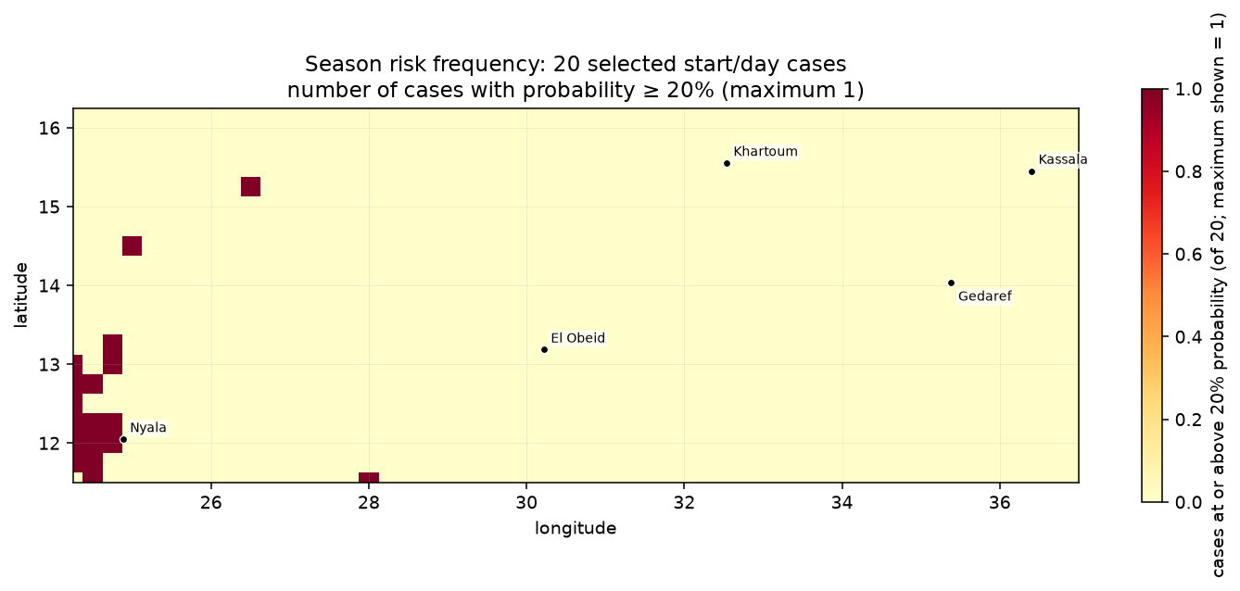
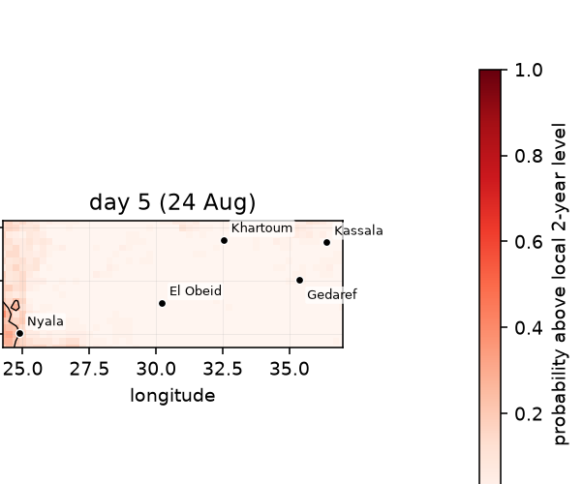
08 / FINDING D
Where was the risk concentrated?
20 cases = 4 starts (3 Jun, 11 Jul, 1 Aug, 19 Aug) × 5 days.
Colour: number of cases with probability ≥20%; maximum 1.
19 Aug 2025 · day 5 (24 Aug) · black contour = 20%.
39.2%
Peak probability
18
Grid cells ≥20%
5 / 20
At a 10% threshold
12.75°N, 24.25°E
19 Aug · day 5
at least once
max frequency 1 of 20
max frequency
same western focus
Sudan JJA 2025 · local rainfall extremes
09 / 12
Notes:
Part D applies the local 2-year threshold at every forecast grid point. Four stratified starts sample the season: 3 June, 11 July, 1 August and 19 August, with days 1–5. The strongest cell is 39.2% at 12.75°N, 24.25°E on day 5 of the 19 August start, valid 24 August. Eighteen cells reached 20% at least once, but no cell did so in more than 1 of 20 cases. The west/south-west near Nyala dominates; the eastern towns stay quiet. A 10% sensitivity run raises the maximum frequency to 5 of 20 cases at 13.0°N, 24.25°E.

Slide 10
09 / LIMITS
What this analysis cannot tell us
01
No 2025 verification
02
Short record, extrapolation
03
Scale mismatch
Observed 2025 rainfall is not in these stores. We describe forecast signals, not confirmed events.
27 annual maxima. 50-year levels are model estimates; removing the largest year moves them 3–9%.
Forecast ~28 km vs CMORPH ~8 km. Nearest pixels do not represent the same area; satellite estimates differ from gauges.
→ Signals, not confirmed events
→ Treat 50-year values as indicative
→ Compare at compatible scales
04
A threshold is not an impact
05
Sampling limits
06
Counts are not probabilities
The 2-year annual-max level is not a crop, flood or infrastructure damage threshold. Only 24-hour totals are used.
Part C covers July only. Part D uses four starts × five days; days within one start are correlated.
Part C counts members; Part D uses the fraction of 51 members. Neither is calibrated or verified here.
→ Pair with impact thresholds
→ Do not extend to the full season
→ Do not read as probability of impact
Next: verify against 2025 observations · calibrate thresholds · extend the sampling window.
Sudan JJA 2025 · local rainfall extremes
10 / 12
Notes:
The most important limitation is that the 2025 observations are absent from these stores. We can describe the forecast signal and its timing, but not verify that the events happened. The 27-year record makes 50-year extrapolation uncertain; the forecast and CMORPH grids differ by a factor of about three; the 2-year annual-maximum level is not an impact threshold; and the Part D sample is four starts by five days, not an exhaustive season.

Slide 11
10 / REFLECTION
From exercise scripts to a reusable workflow
WHAT WE ADAPTED
WHERE THE AGENT HELPED
WHAT WE CHECKED / CORRECTED
• E1/E2 → store access and realized plumes.
• E3 → pan-chunk selection before compute.
• E4 → Gumbel return levels; E5/E6 → member counts.
• E7 → review and version before push.
• E8 → local-threshold probability maps.
• Scaffolding: turned prompts into runnable scripts.
• Refactoring: shared settings, helpers and tests.
• Iteration: plotting, checks and docs.
• Speed: repeated runs and output regeneration.
• Checks: tests, lint and output diffs.
• Units: metres vs millimetres; cumulative vs daily totals.
• Geometry: latitude order, nearest pixels, coverage.
• Validity: all-NaN starts; strict > semantics.
• Interpretation: counts ≠ probabilities; no 2025 verification.
• Reproducibility: fixed settings and committed outputs.
WORKFLOW
Prompt
→
Script
→
Test
→
Figure
→
Review
→
Commit
Day-to-day: reuse this pipeline for any ensemble hazard — local threshold, member counts, when/where maps, reviewed outputs.
The agent accelerates;
the analyst verifies.
Sudan JJA 2025 · local rainfall extremes
11 / 12
Notes:
The workshop exercises were a starting vocabulary, not a finished analysis. We adapted the patterns into scripts with shared settings and tests. The agent was most useful for scaffolding, refactoring, plotting and repeated runs. We had to check units, coordinate order, coverage, all-NaN starts and the strict greater-than semantics, and we had to keep counts separate from probabilities. For day-to-day work, the same pipeline generalises to other ensemble hazards: define a local threshold, count members, map when and where, and version the reviewed outputs.

Slide 12
11 / REPRODUCE
Open, reviewed, reproducible
REPOSITORY
github.com/BrianMburu/acmad-eac-summer-school
AT A GLANCE
OPEN
4
5
FINAL TAG
analyses
towns
final
annotated tag · deck + analysis outputs
27
96
The tag points to the presentation, build script, analysis scripts, figures and CSV outputs.
years observed
tests passing
BUILD AND CHECK
scripts/ · out/ · tests/
uv run --with python-pptx python presentation/build_deck.py
uv run pytest · uvx ruff check scripts tests presentation
Local thresholds turn a generic forecast into a place-specific, time-specific warning.
Questions / discussion · Group project, ACMAD AI summer school 2026
Sudan JJA 2025 · local rainfall extremes
12 / 12
Notes:
The repository is public. The annotated tag final points to this deck, the build script, the four analysis scripts, the figures and the CSV outputs. The README records the methods and numbers; the tests and lint checks are part of the handoff. Closing message: local thresholds are what turn a generic rainfall forecast into a place-specific and time-specific warning.

