Slide 1
Rainfall extremes and forecast warning signals
Sudan towns, CMORPH observations and ECMWF ensemble forecasts
Tasks A–D
Khartoum, Kassala, Gedaref, El Obeid and Nyala
Observed reference: 1998–2024
Forecast season: June–August 2025
1
Notes:
Sources: task_A/grid.json and results.md in task_A through task_D.

Slide 2
Study design and units
Five towns from grid.json
A: 27 annual maxima at 24 h and 6 h, with 2-, 10- and 50-year return levels
B: one forecast start, 16 July 2025, with 51 members and ten daily intervals
C: 21 starts from 6–26 July 2025, with ten daily leads at every town
D: four seasonal starts and five daily leads, giving 20 sampled intervals
Rainfall depth: mm in 24 h. Member counts: out of 51. Probability: ensemble fraction.
2
Notes:
Sources: task_A/results.md, task_B/results.md, task_C/results.md, task_D/results.md.

Slide 3
A: published 24 h return levels
CMORPH 1998–2024, rainfall depth in mm accumulated over 24 h
Town | 2-year | 10-year | 50-year
Khartoum | 23.82 | 51.65 | 76.05
Kassala | 37.95 | 60.56 | 80.39
Gedaref | 52.98 | 72.84 | 90.25
El Obeid | 37.18 | 61.68 | 83.16
Nyala | 32.32 | 50.15 | 65.79
Published CMORPH Gumbel levels supply the thresholds used in the later tasks.
3
Notes:
Source: task_A/thresholds.csv. All values in mm over the stated duration.

Slide 4
A: published 6 h return levels
CMORPH 1998–2024, rainfall depth in mm accumulated over 6 h
Town | 2-year | 10-year | 50-year
Khartoum | 22.32 | 48.71 | 71.85
Kassala | 36.21 | 56.53 | 74.34
Gedaref | 47.33 | 65.85 | 82.08
El Obeid | 33.98 | 56.08 | 75.46
Nyala | 29.12 | 45.98 | 60.77
Published CMORPH Gumbel levels supply the thresholds used in the later tasks.
4
Notes:
Source: task_A/thresholds.csv. All values in mm over the stated duration.

Slide 5
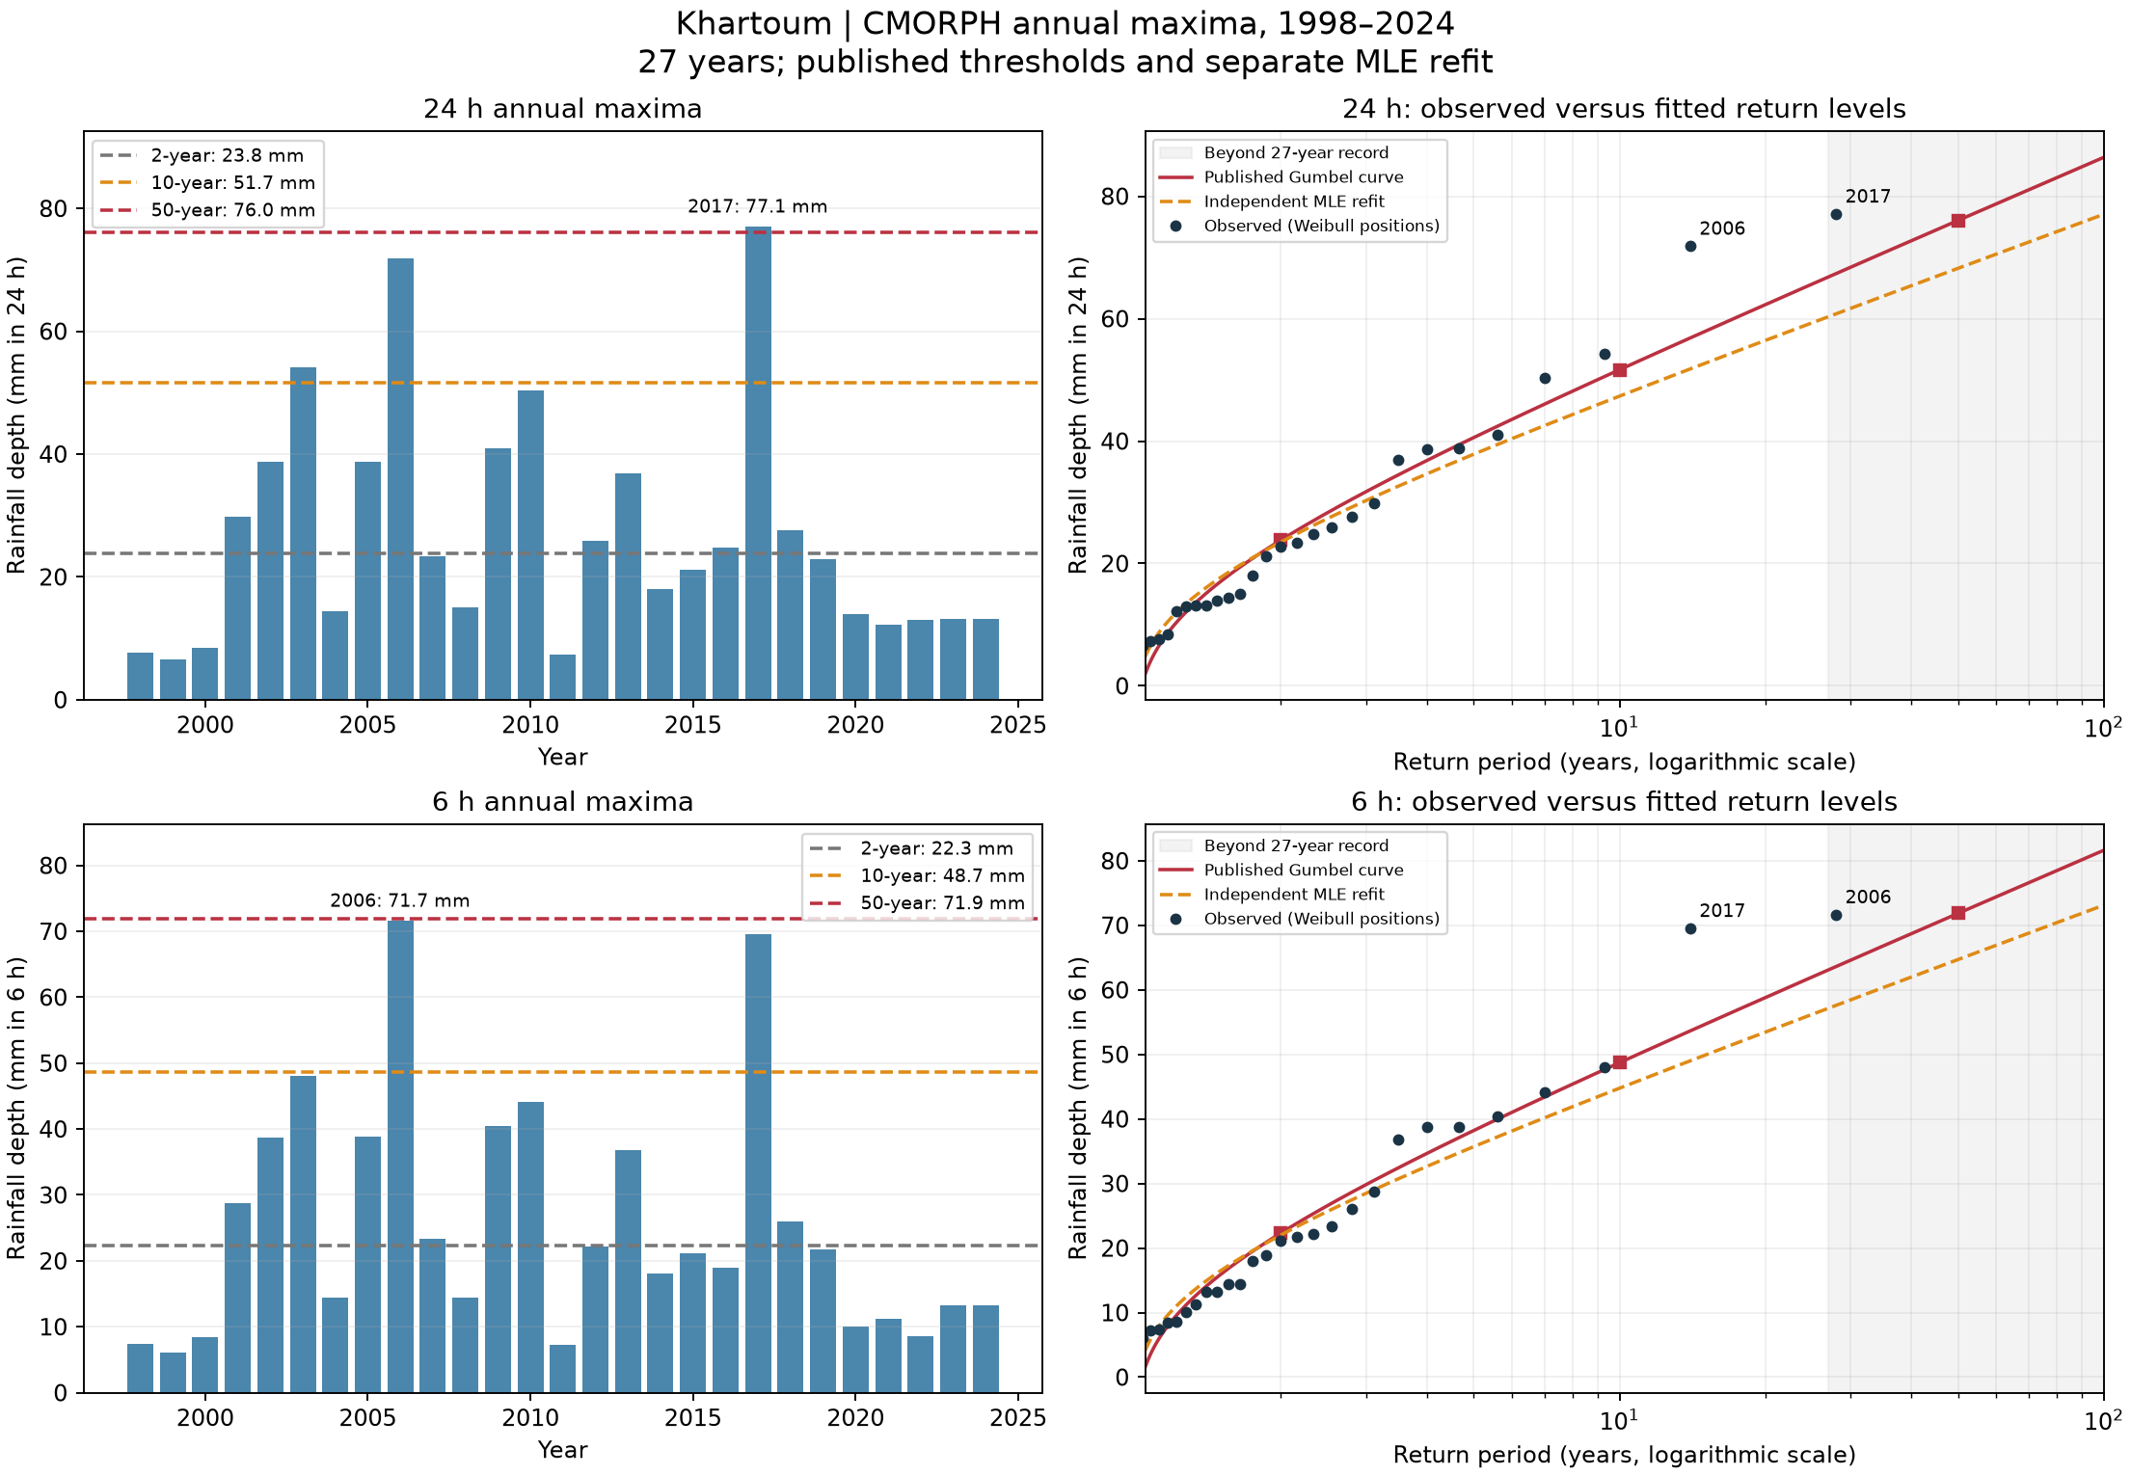
A: observed extremes at Khartoum
27 annual maxima, 1998–2024, at 24 h and 6 h
24 h maximum
77.1 mm in 2017
Largest upper-tail departure
2006: +15.0 mm versus published curve
Remove largest year
50-year MLE changes -9.05%
5
Notes:
Source image: task_A/khartoum_return_levels.png
Generating committed script: task_A/analyze.py
Data and interpretation: task_A/observed_vs_fit_summary.csv and sensitivity.csv. Upper tail uses empirical T≥5 years. Descriptive departures do not establish fit failure.
Retain original plot units and scales. Embedded PNG preserves the original resolution.

Slide 6
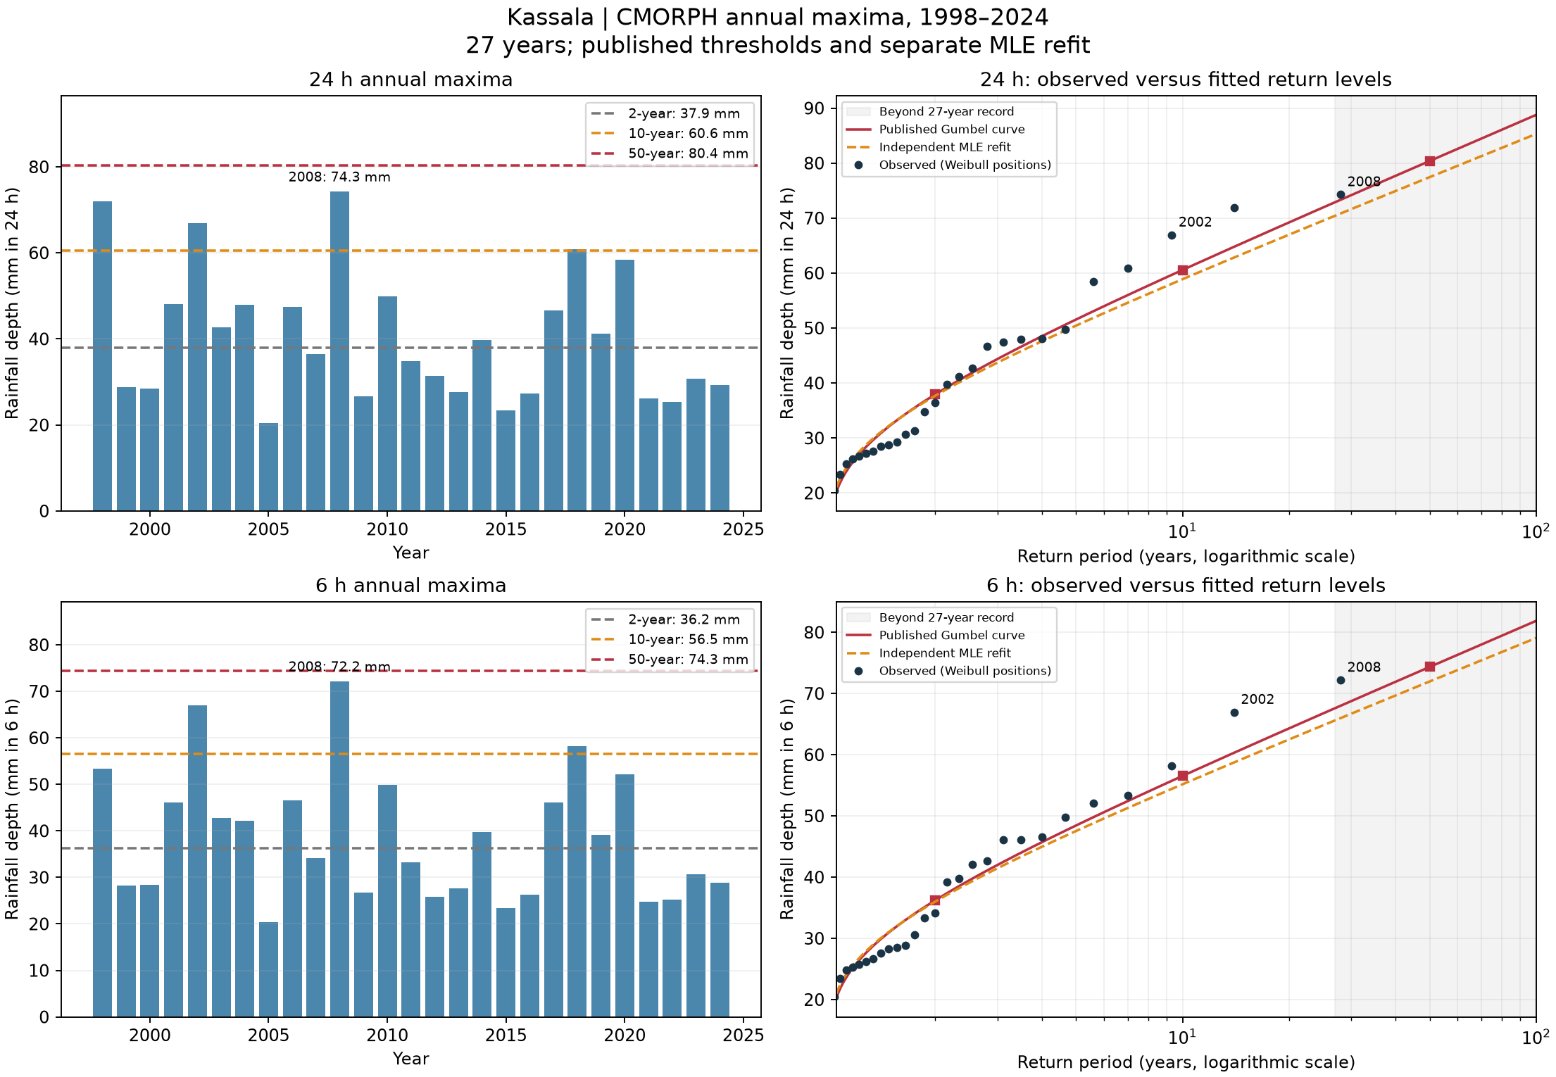
A: observed extremes at Kassala
27 annual maxima, 1998–2024, at 24 h and 6 h
24 h maximum
74.3 mm in 2008
Largest upper-tail departure
2002: +7.3 mm versus published curve
Remove largest year
50-year MLE changes -5.30%
6
Notes:
Source image: task_A/kassala_return_levels.png
Generating committed script: task_A/analyze.py
Data and interpretation: task_A/observed_vs_fit_summary.csv and sensitivity.csv. Upper tail uses empirical T≥5 years. Descriptive departures do not establish fit failure.
Retain original plot units and scales. Embedded PNG preserves the original resolution.

Slide 7
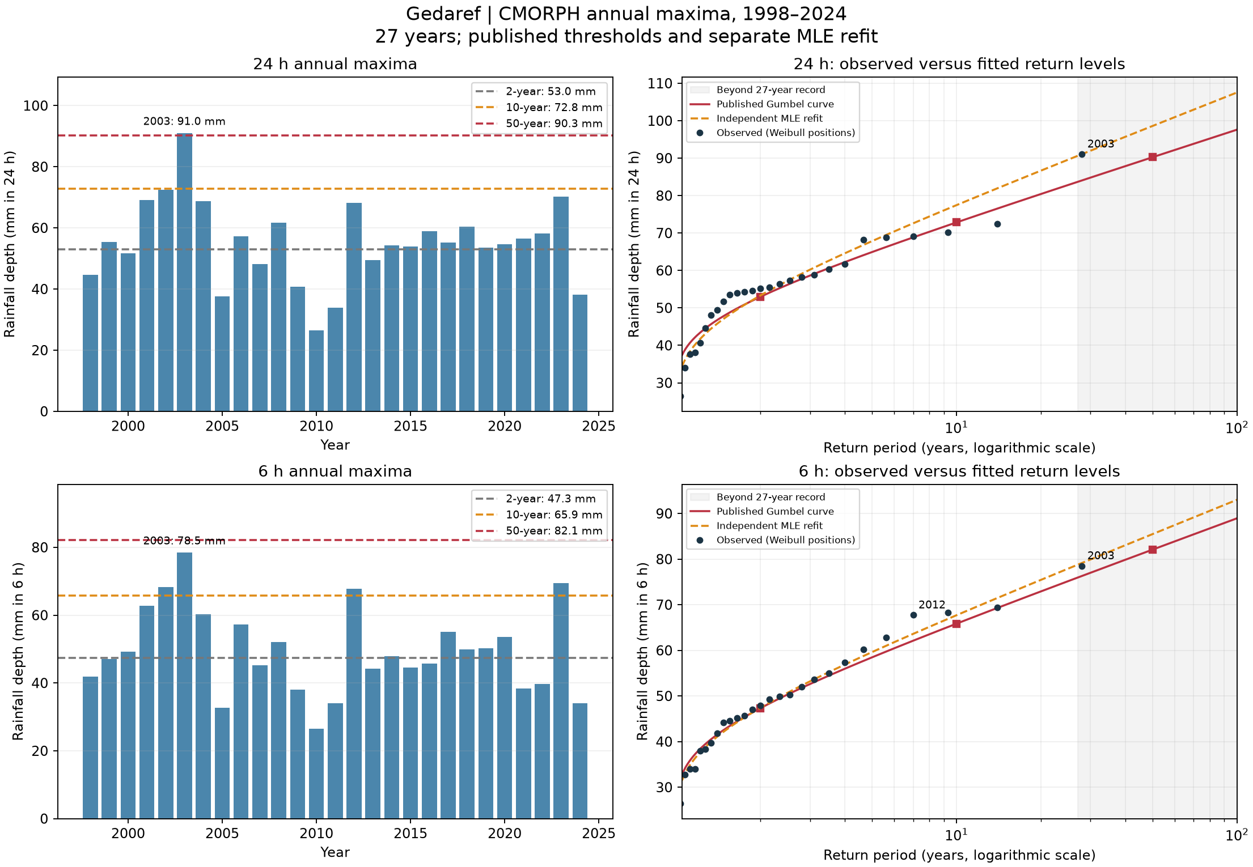
A: observed extremes at Gedaref
27 annual maxima, 1998–2024, at 24 h and 6 h
24 h maximum
91.0 mm in 2003
Largest upper-tail departure
2003: +7.0 mm versus published curve
Remove largest year
50-year MLE changes -3.50%
7
Notes:
Source image: task_A/gedaref_return_levels.png
Generating committed script: task_A/analyze.py
Data and interpretation: task_A/observed_vs_fit_summary.csv and sensitivity.csv. Upper tail uses empirical T≥5 years. Descriptive departures do not establish fit failure.
Retain original plot units and scales. Embedded PNG preserves the original resolution.

Slide 8
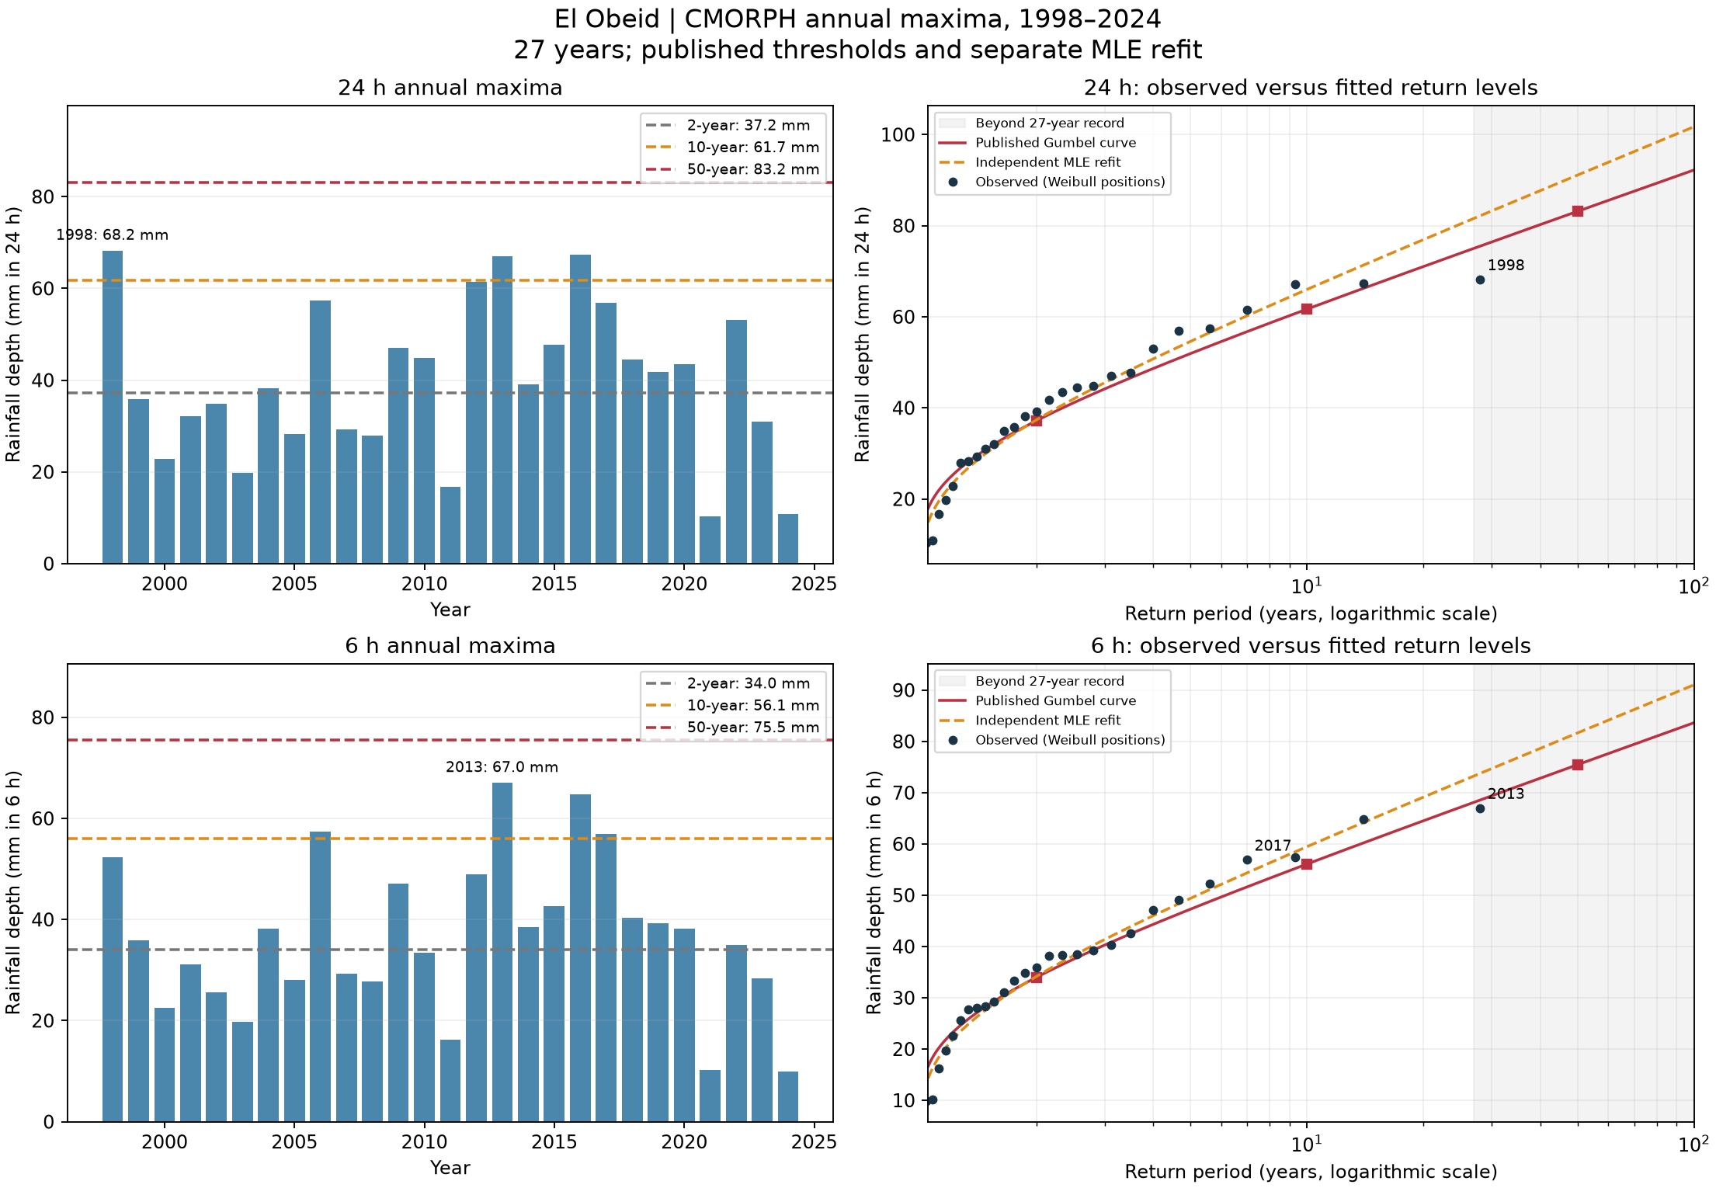
A: observed extremes at El Obeid
27 annual maxima, 1998–2024, at 24 h and 6 h
24 h maximum
68.2 mm in 1998
Largest upper-tail departure
1998: -7.3 mm versus published curve
Remove largest year
50-year MLE changes -3.14%
8
Notes:
Source image: task_A/el_obeid_return_levels.png
Generating committed script: task_A/analyze.py
Data and interpretation: task_A/observed_vs_fit_summary.csv and sensitivity.csv. Upper tail uses empirical T≥5 years. Descriptive departures do not establish fit failure.
Retain original plot units and scales. Embedded PNG preserves the original resolution.

Slide 9
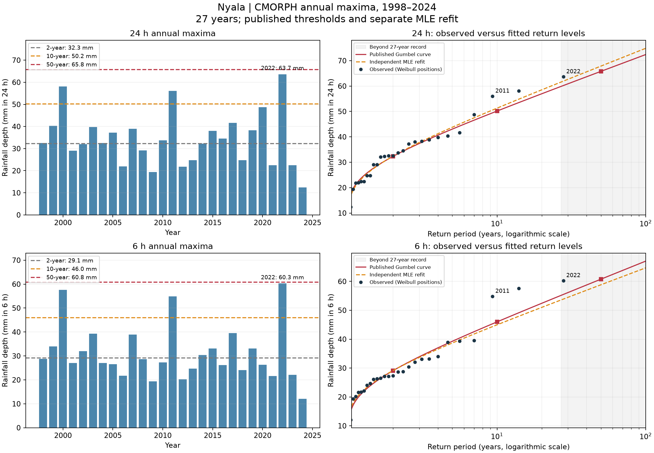
A: observed extremes at Nyala
27 annual maxima, 1998–2024, at 24 h and 6 h
24 h maximum
63.7 mm in 2022
Largest upper-tail departure
2011: +6.6 mm versus published curve
Remove largest year
50-year MLE changes -4.52%
9
Notes:
Source image: task_A/nyala_return_levels.png
Generating committed script: task_A/analyze.py
Data and interpretation: task_A/observed_vs_fit_summary.csv and sensitivity.csv. Upper tail uses empirical T≥5 years. Descriptive departures do not establish fit failure.
Retain original plot units and scales. Embedded PNG preserves the original resolution.

Slide 10
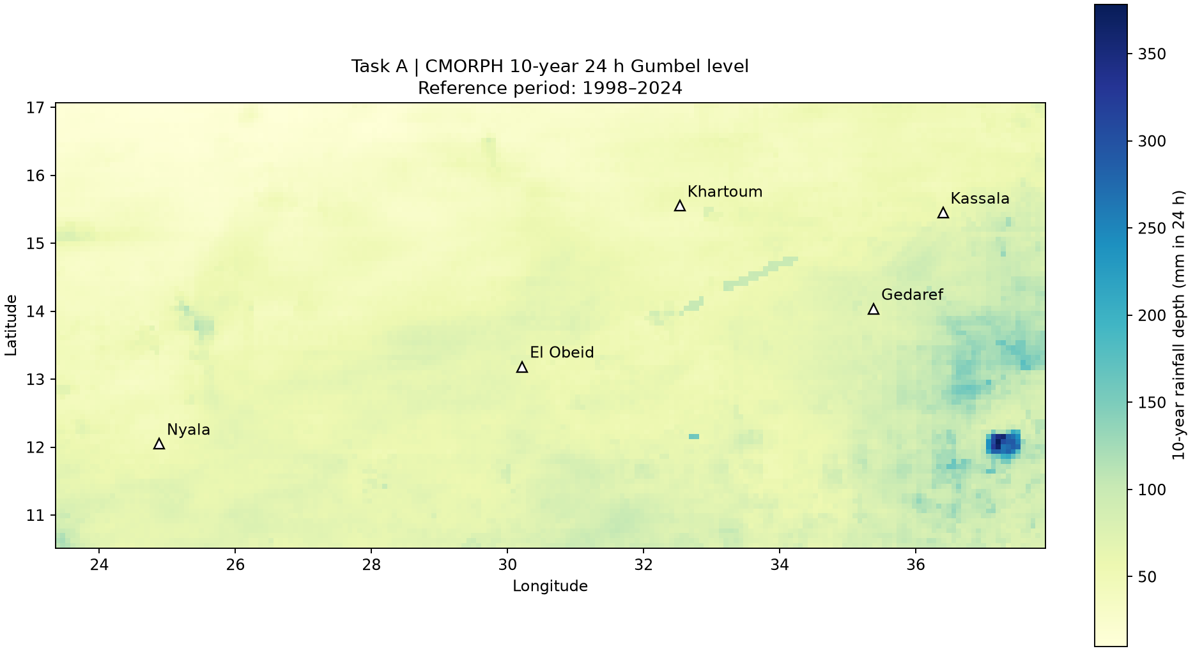
A: regional 10-year rainfall level
Published Gumbel depths from CMORPH 1998–2024
Each map value is a 24-hour rainfall depth in mm. Town thresholds vary with location. Gedaref has the highest 10-year town level: 72.84 mm.
10
Notes:
Source image: task_A/regional_10yr_24hr.png
Generating committed script: task_A/analyze.py
Data and interpretation: task_A/thresholds.csv and regional_10yr_24hr.nc
Retain original plot units and scales. Embedded PNG preserves the original resolution.

Slide 11
A: largest-year sensitivity at 24 h
50-year rainfall estimate in mm, refitted with Gumbel maximum likelihood
Town | Removed | Full MLE | Without | Change
Khartoum | 2017 | 68.23 | 62.05 | -9.05%
Kassala | 2008 | 77.46 | 73.35 | -5.30%
Gedaref | 2003 | 98.60 | 95.15 | -3.50%
El Obeid | 1998 | 91.12 | 88.26 | -3.14%
Nyala | 2022 | 67.86 | 64.80 | -4.52%
Both columns use MLE. Published thresholds can differ because their original fitting estimator is unspecified. A 50-year level extrapolates beyond 27 observed years.
11
Notes:
Source: task_A/sensitivity.csv. Confidence intervals are not estimated.

Slide 12
A: largest-year sensitivity at 6 h
50-year rainfall estimate in mm, refitted with Gumbel maximum likelihood
Town | Removed | Full MLE | Without | Change
Khartoum | 2006 | 64.70 | 58.96 | -8.88%
Kassala | 2008 | 71.97 | 67.90 | -5.65%
Gedaref | 2003 | 85.49 | 82.44 | -3.56%
El Obeid | 2013 | 81.65 | 78.54 | -3.82%
Nyala | 2022 | 58.83 | 55.73 | -5.27%
Both columns use MLE. Published thresholds can differ because their original fitting estimator is unspecified. A 50-year level extrapolates beyond 27 observed years.
12
Notes:
Source: task_A/sensitivity.csv. Confidence intervals are not estimated.

Slide 13
B: threshold choice changes the flagged member-days
16 July 2025 start, ten daily intervals, 510 member-days per town
Town | Above 20 mm | Above 2-year | Above 10-year
Khartoum | 0 | 0 | 0
Kassala | 5 | 0 | 0
Gedaref | 24 | 0 | 0
El Obeid | 9 | 1 | 0
Nyala | 8 | 2 | 0
Counts sum exceedances across members and days. They differ from the number of distinct members with at least one heavy day.
13
Notes:
Source: task_B/summary_counts.csv. Rainfall comparison uses strict >. Member-days are correlated predictions.

Slide 14
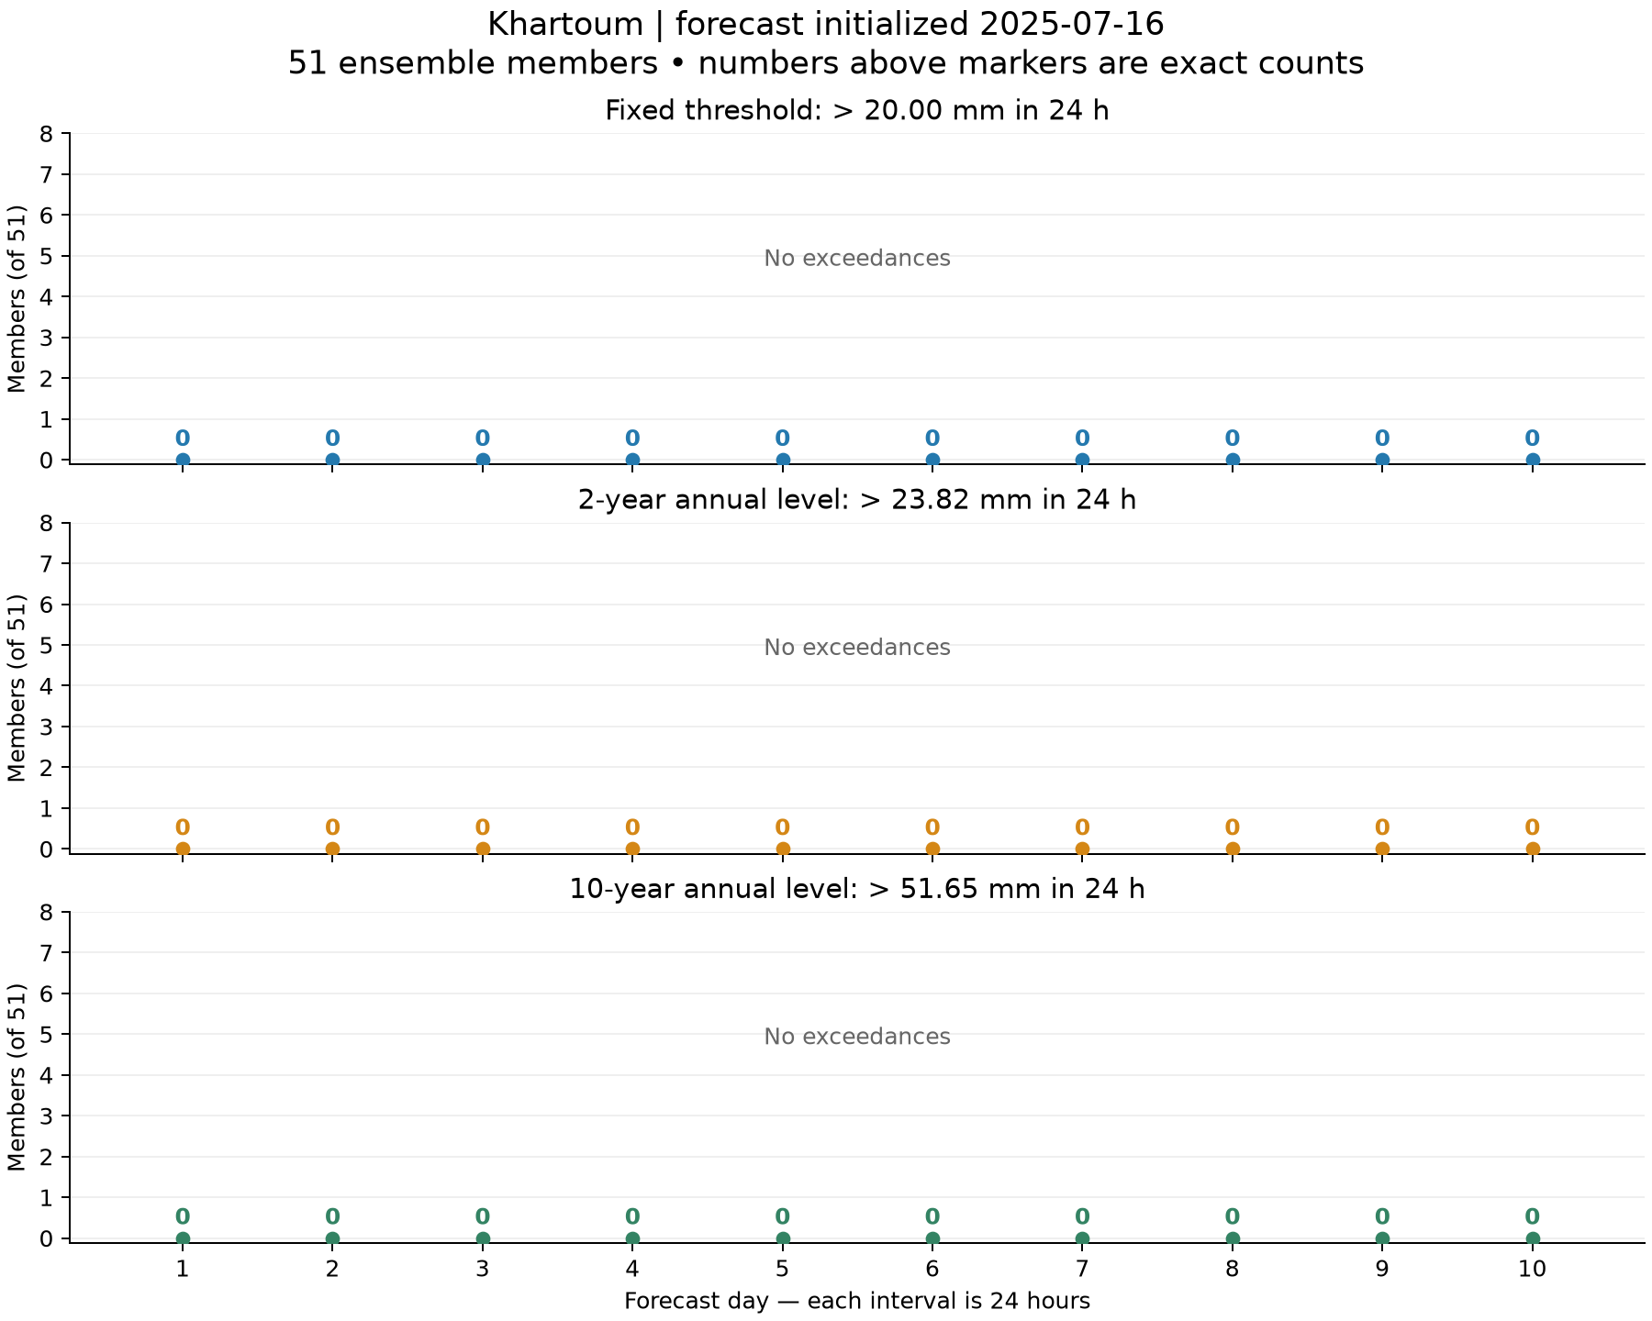
B: warning-threshold comparison at Khartoum
Forecast initialized 16 July 2025, daily counts out of 51 members
Fixed 20 mm level
0 member-days above threshold
Local 2-year level
23.82 mm in 24 h
0 member-days above it
Each panel shows one threshold. Zero labels mean no member exceeds it.
14
Notes:
Source image: task_B/khartoum_threshold_counts.png
Generating committed script: task_B/analyze.py
Data and interpretation: task_B/daily_member_counts.csv and summary_counts.csv
Retain original plot units and scales. Embedded PNG preserves the original resolution.

Slide 15
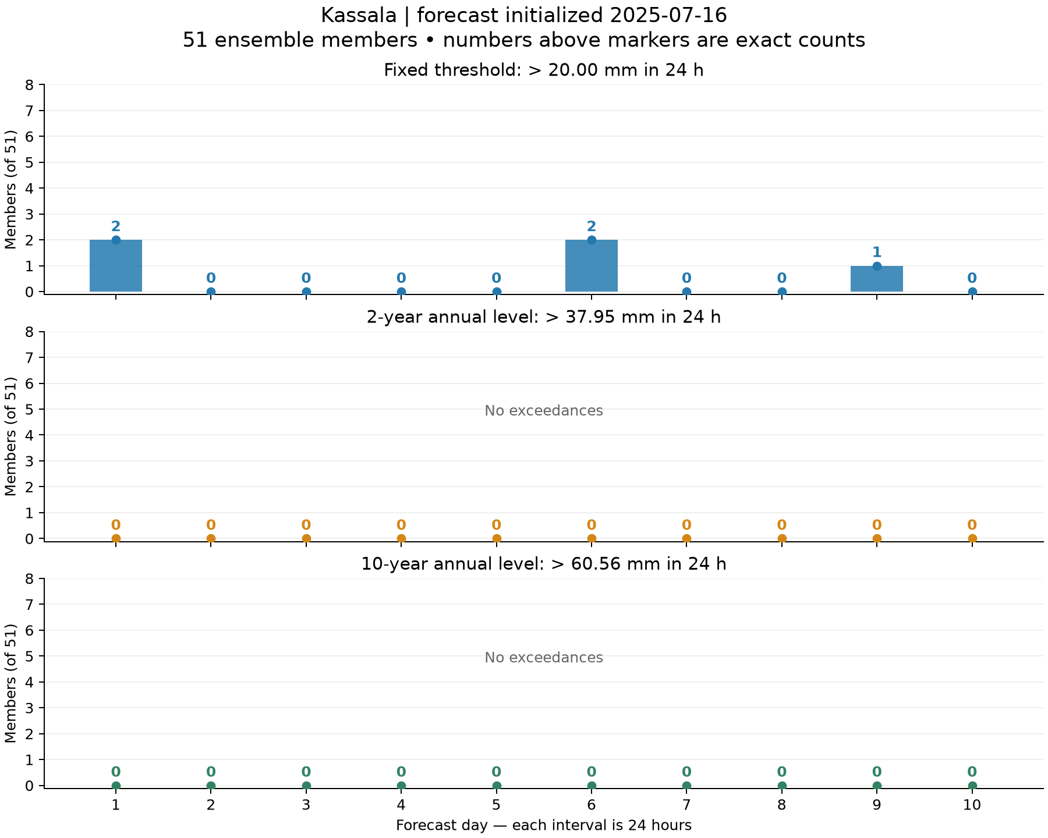
B: warning-threshold comparison at Kassala
Forecast initialized 16 July 2025, daily counts out of 51 members
Fixed 20 mm level
5 member-days above threshold
Local 2-year level
37.95 mm in 24 h
0 member-days above it
Each panel shows one threshold. Zero labels mean no member exceeds it.
15
Notes:
Source image: task_B/kassala_threshold_counts.png
Generating committed script: task_B/analyze.py
Data and interpretation: task_B/daily_member_counts.csv and summary_counts.csv
Retain original plot units and scales. Embedded PNG preserves the original resolution.

Slide 16
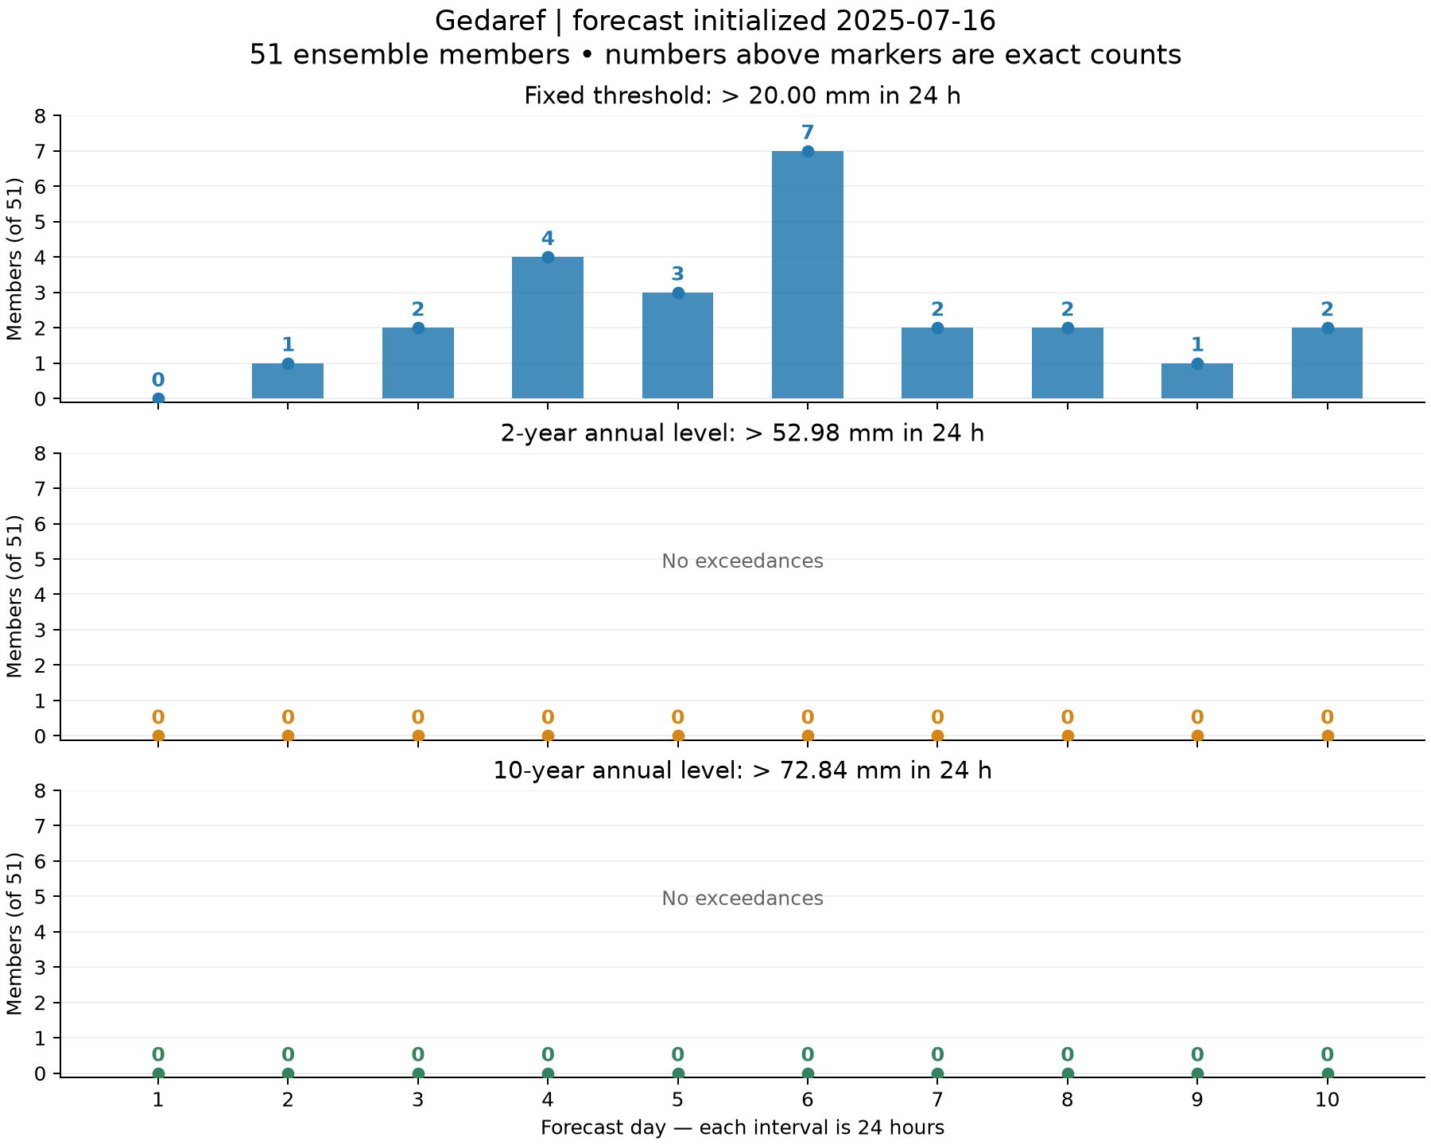
B: warning-threshold comparison at Gedaref
Forecast initialized 16 July 2025, daily counts out of 51 members
Fixed 20 mm level
24 member-days above threshold
Local 2-year level
52.98 mm in 24 h
0 member-days above it
Each panel shows one threshold. Zero labels mean no member exceeds it.
16
Notes:
Source image: task_B/gedaref_threshold_counts.png
Generating committed script: task_B/analyze.py
Data and interpretation: task_B/daily_member_counts.csv and summary_counts.csv
Retain original plot units and scales. Embedded PNG preserves the original resolution.

Slide 17
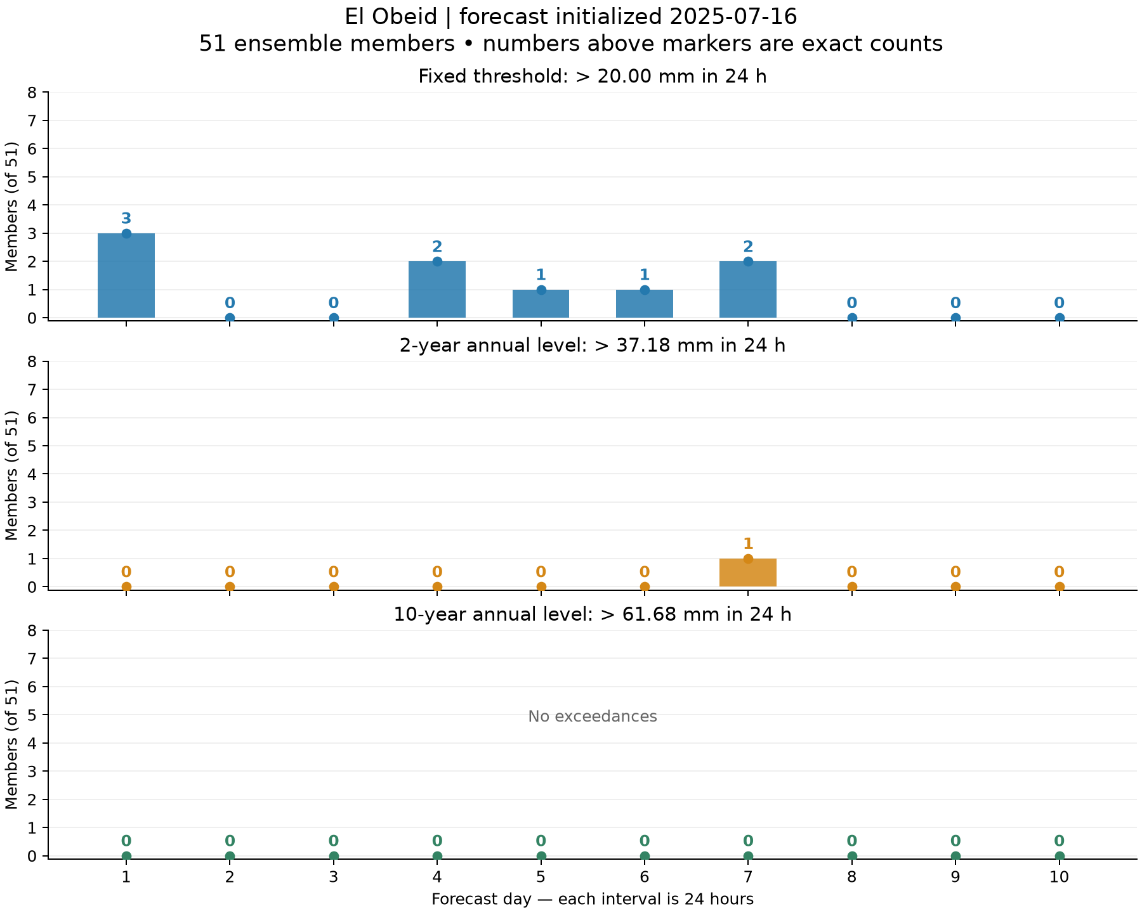
B: warning-threshold comparison at El Obeid
Forecast initialized 16 July 2025, daily counts out of 51 members
Fixed 20 mm level
9 member-days above threshold
Local 2-year level
37.18 mm in 24 h
1 member-days above it
Each panel shows one threshold. Zero labels mean no member exceeds it.
17
Notes:
Source image: task_B/el_obeid_threshold_counts.png
Generating committed script: task_B/analyze.py
Data and interpretation: task_B/daily_member_counts.csv and summary_counts.csv
Retain original plot units and scales. Embedded PNG preserves the original resolution.

Slide 18
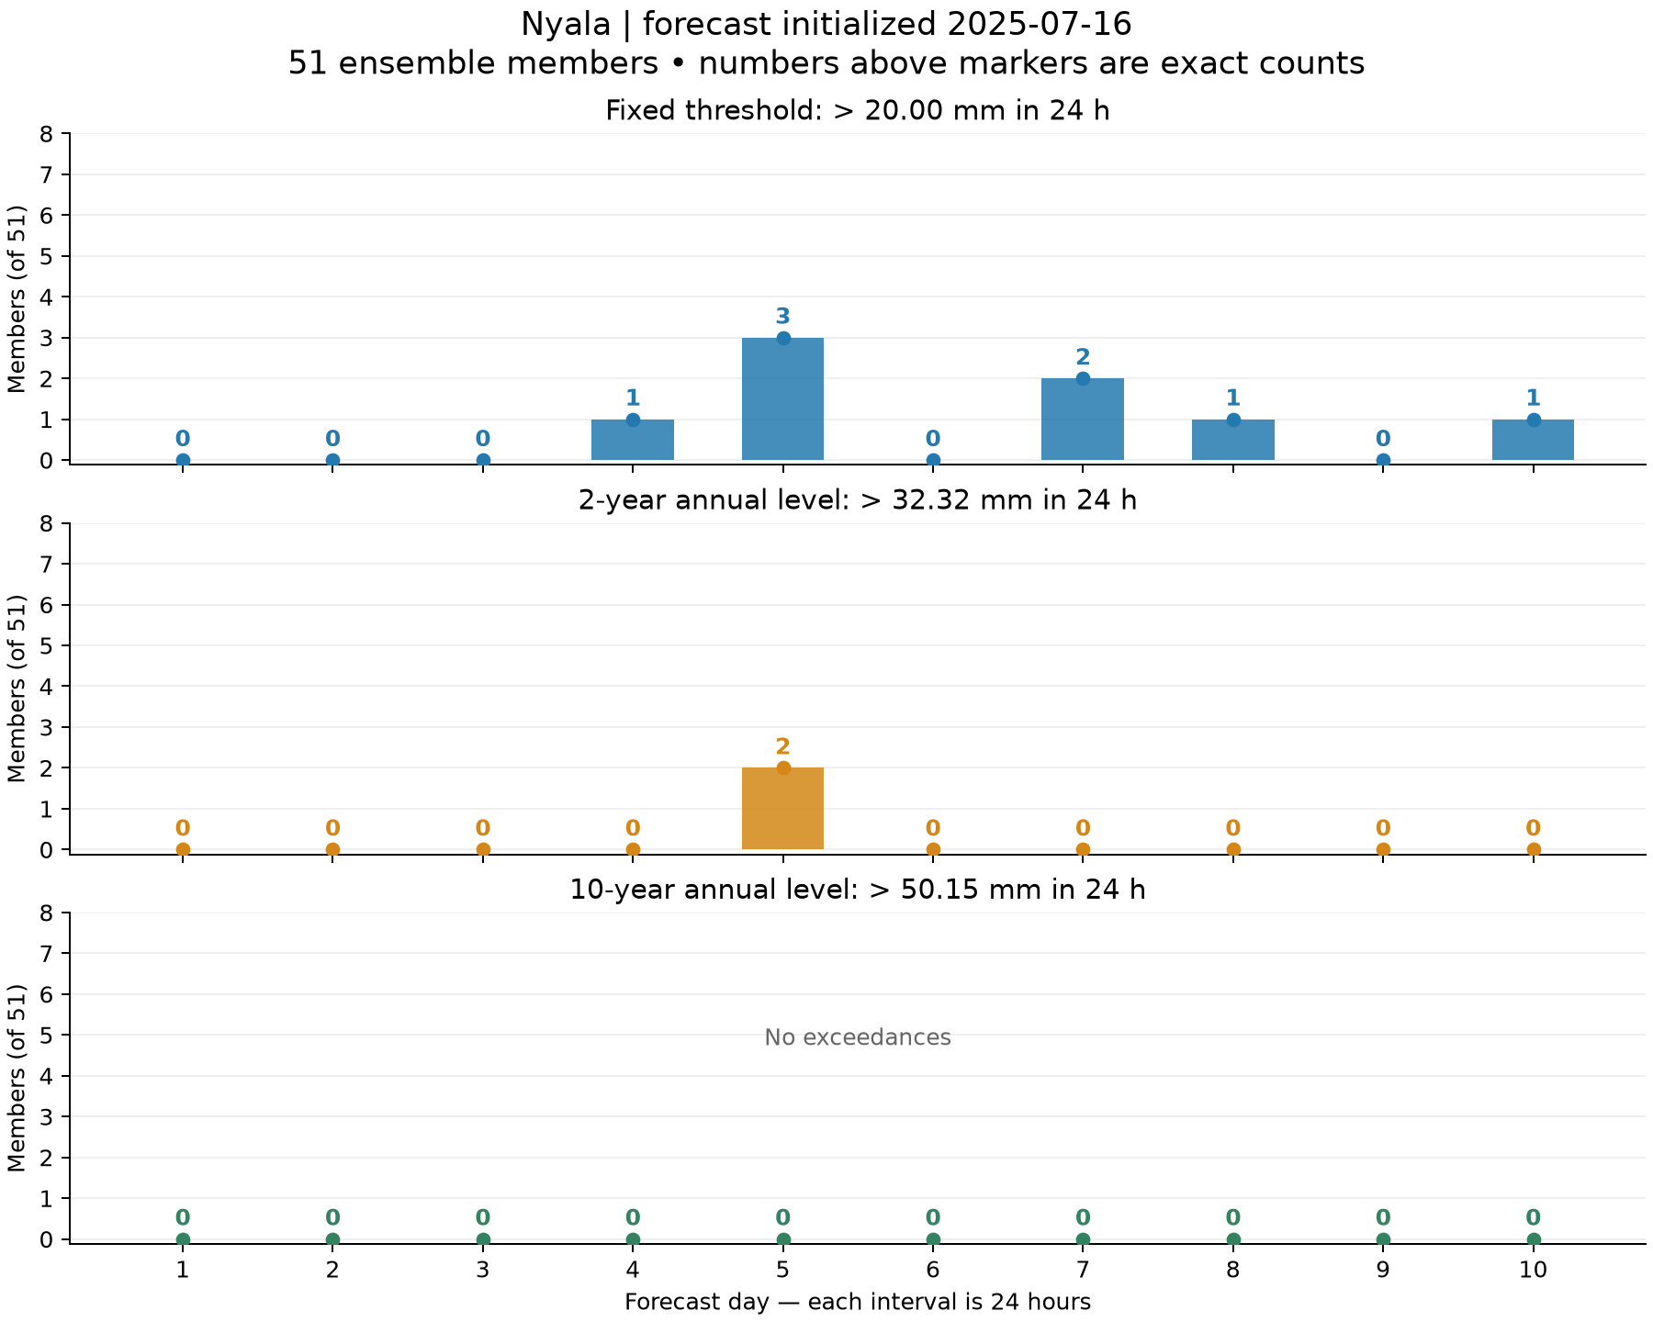
B: warning-threshold comparison at Nyala
Forecast initialized 16 July 2025, daily counts out of 51 members
Fixed 20 mm level
8 member-days above threshold
Local 2-year level
32.32 mm in 24 h
2 member-days above it
Each panel shows one threshold. Zero labels mean no member exceeds it.
18
Notes:
Source image: task_B/nyala_threshold_counts.png
Generating committed script: task_B/analyze.py
Data and interpretation: task_B/daily_member_counts.csv and summary_counts.csv
Retain original plot units and scales. Embedded PNG preserves the original resolution.

Slide 19
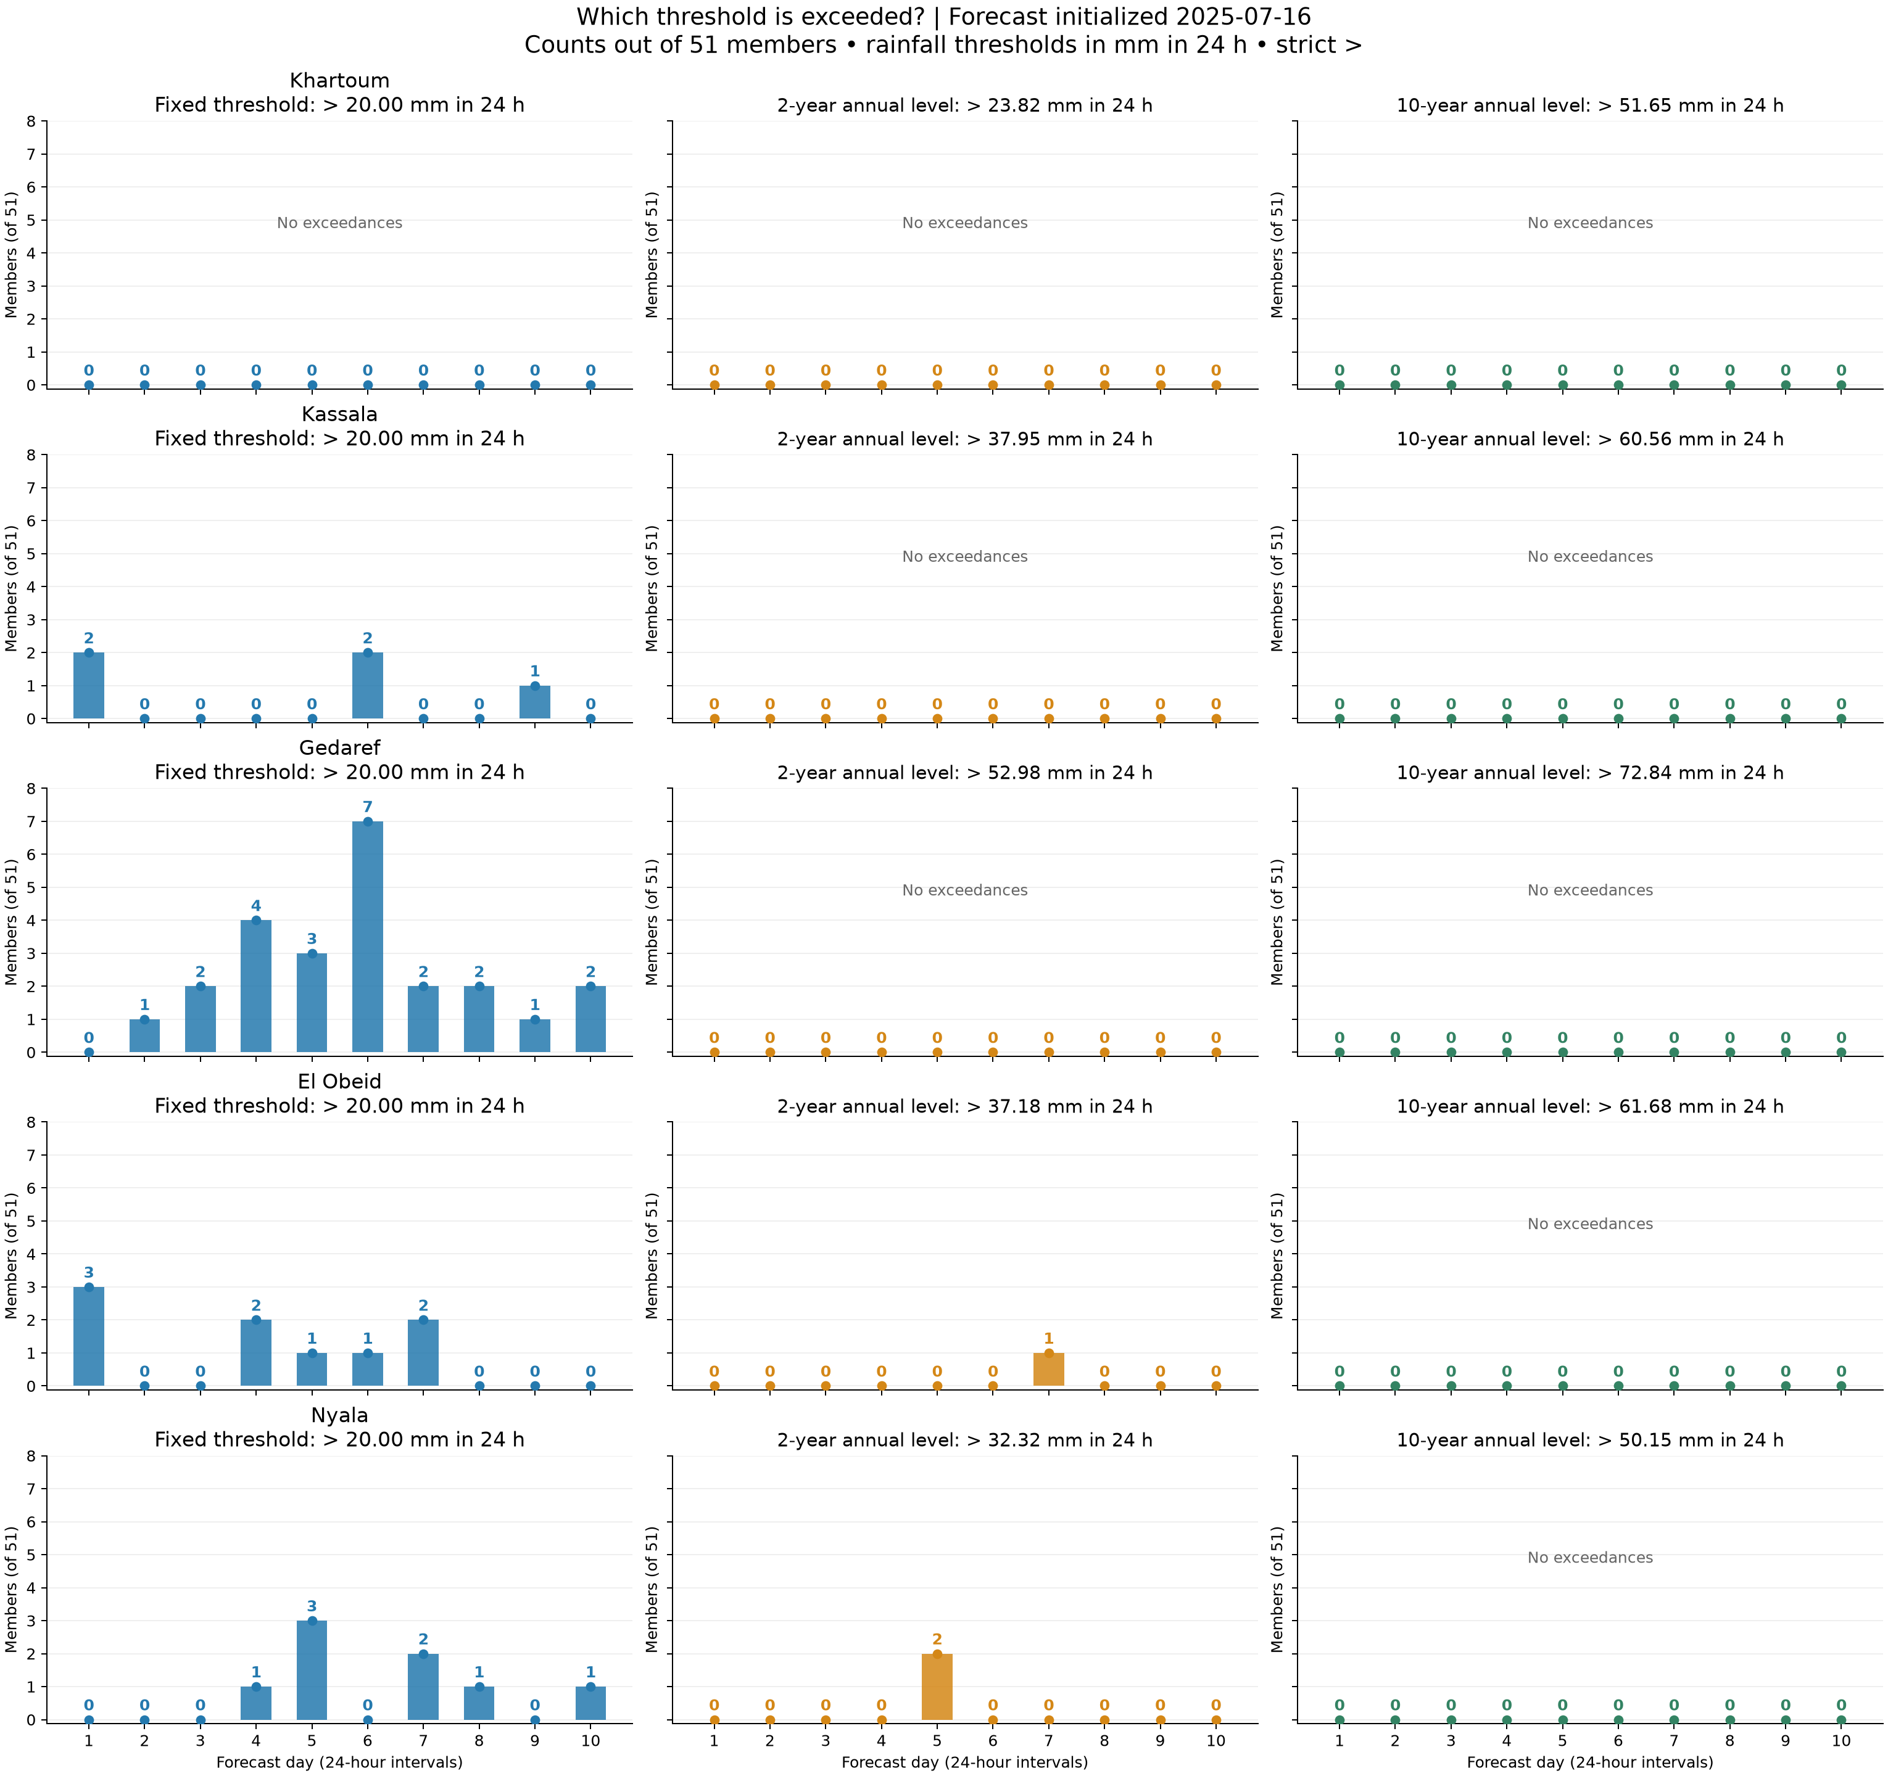
B: all five towns and all three thresholds
Overview of exact daily member counts for the 16 July 2025 start
Gedaref has 24 member-days above 20 mm, the largest fixed-threshold count.
El Obeid has one and Nyala has two member-days above their 2-year levels.
No town exceeds its 10-year level. Individual town slides show the detail.
19
Notes:
Source image: task_B/five_town_threshold_comparison.png
Generating committed script: task_B/analyze.py
Data and interpretation: task_B/daily_counts_short.csv
Retain original plot units and scales. Embedded PNG preserves the original resolution.

Slide 20
B: xclim heavy-rain-day counts
Threshold ≥20 mm in 24 h, measured within the ten-day forecast window
Town | Members ≥1 day | Mean days/member
Khartoum | 0/51 | 0.000
Kassala | 5/51 | 0.098
Gedaref | 22/51 | 0.471
El Obeid | 7/51 | 0.176
Nyala | 7/51 | 0.157
xclim wetdays includes equality (≥). Daily exceedance plots use strict >. All 765 member-level xclim counts match direct counts.
20
Notes:
Source: task_B/xclim_heavy_days.csv and summary_counts.csv. Includes 5 towns × 3 thresholds × 51 members. This table shows the fixed 20 mm threshold.

Slide 21
B: annual return levels and daily warning thresholds
Annual exceedance probability and daily probability answer different questions
A fitted 2-year annual level has a 50% chance of at least one exceedance in a year.
Independent, identical days would imply a daily probability of 0.190%. Rainfall seasonality and dependence limit that illustration.
In this forecast, 2-year exceedances total one member-day at El Obeid and two at Nyala.
Impact records and forecast verification are needed to choose an operational warning threshold.
21
Notes:
Sources: task_B/results.md and annual_vs_daily_comparison.csv. Illustrative p=1−0.5^(1/365). Ensemble member-days do not estimate observed climatological frequency.

Slide 22
C: forecast signals across 21 starts
6–26 July 2025, days 1–10, local 2-year 24 h levels
Town | Peak members | Strongest start | Starts with signal
Khartoum | 3/51 | 2025-07-21 | 19/21
Kassala | 2/51 | 2025-07-23 | 10/21
Gedaref | 1/51 | 2025-07-20 | 2/21
El Obeid | 4/51 | 2025-07-07 | 12/21
Nyala | 4/51 | 2025-07-07 | 20/21
Default exploratory signal: at least one member above the rainfall level. One of 51 members is only 1.96%.
22
Notes:
Source: task_C/town_signal_summary.csv. Strongest start maximizes peak count, then total counts, then earliest date.

Slide 23
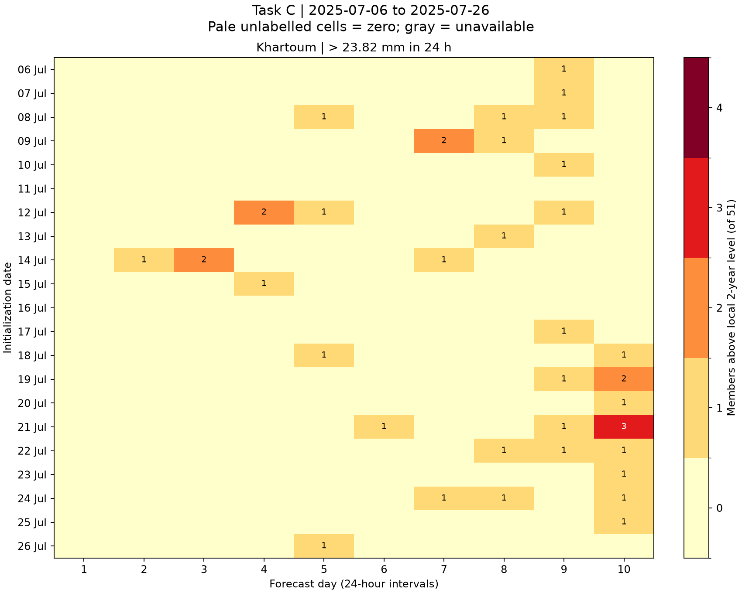
C: signal history at Khartoum
Rows are initialization dates, columns are daily forecast leads
19 of 21 starts show at least one signal.
Peak daily count
3/51 members
Shared color scale across towns. Pale cells are zero. Gray indicates unavailable forecasts.
23
Notes:
Source image: task_C/khartoum_heatmap.png
Generating committed script: task_C/analyze.py
Data and interpretation: task_C/daily_member_counts.csv
Retain original plot units and scales. Embedded PNG preserves the original resolution.

Slide 24
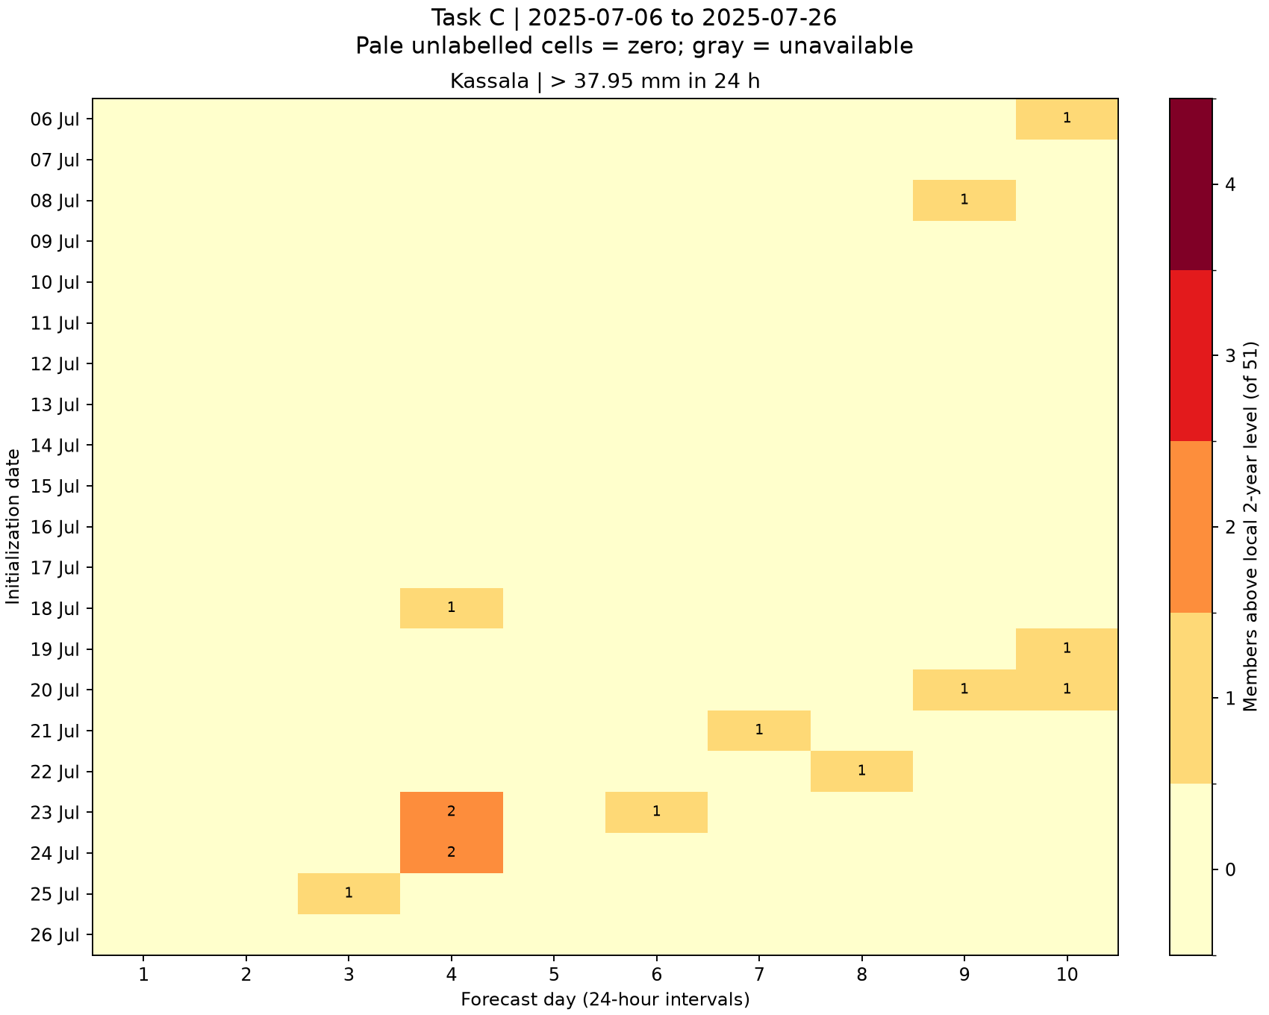
C: signal history at Kassala
Rows are initialization dates, columns are daily forecast leads
10 of 21 starts show at least one signal.
Peak daily count
2/51 members
Shared color scale across towns. Pale cells are zero. Gray indicates unavailable forecasts.
24
Notes:
Source image: task_C/kassala_heatmap.png
Generating committed script: task_C/analyze.py
Data and interpretation: task_C/daily_member_counts.csv
Retain original plot units and scales. Embedded PNG preserves the original resolution.

Slide 25
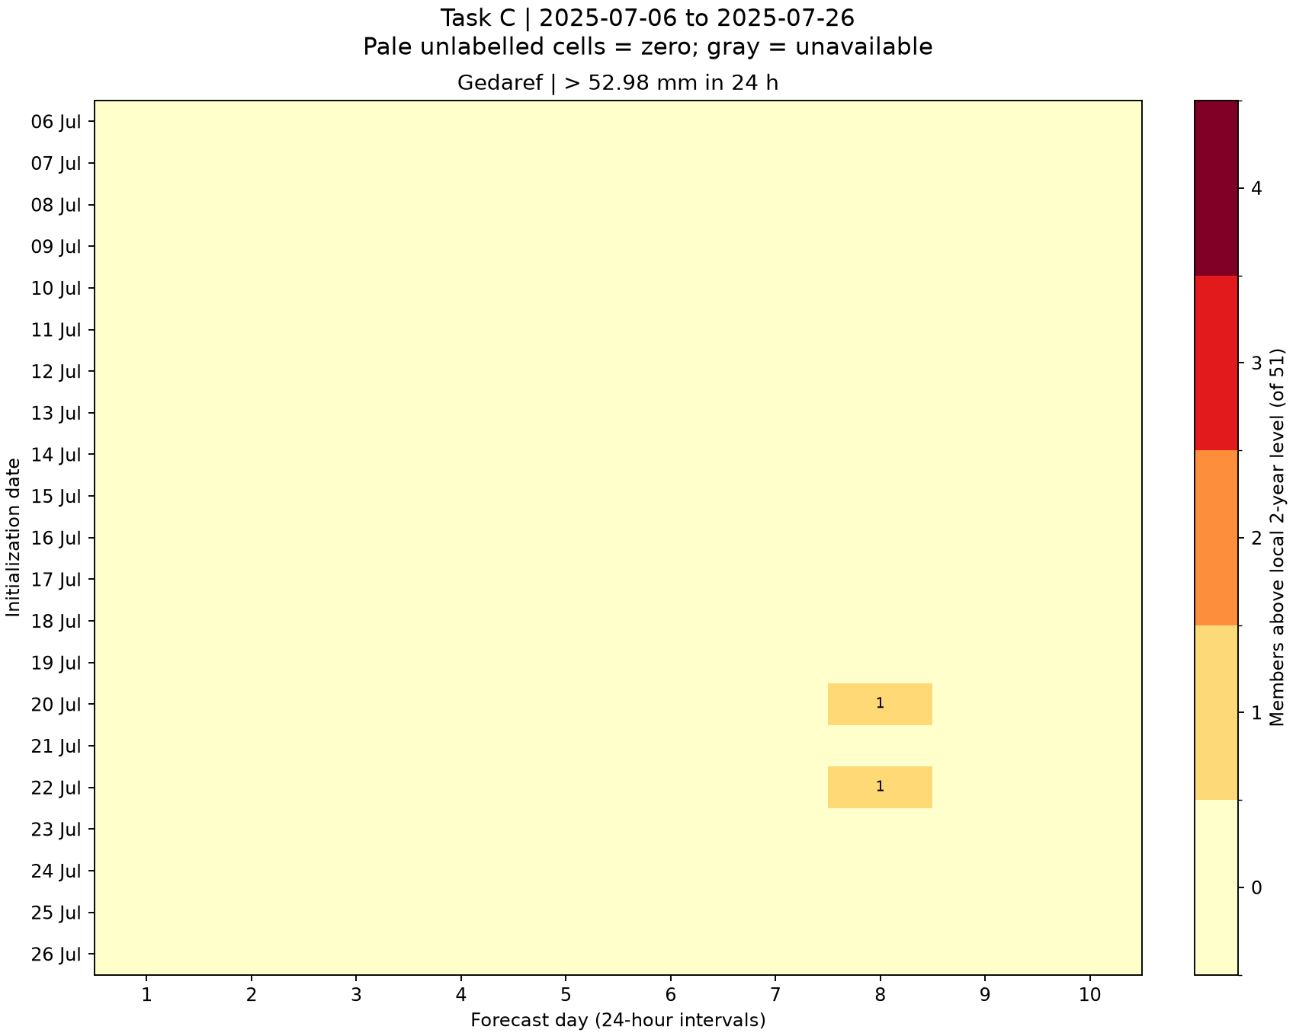
C: signal history at Gedaref
Rows are initialization dates, columns are daily forecast leads
2 of 21 starts show at least one signal.
Peak daily count
1/51 members
Shared color scale across towns. Pale cells are zero. Gray indicates unavailable forecasts.
25
Notes:
Source image: task_C/gedaref_heatmap.png
Generating committed script: task_C/analyze.py
Data and interpretation: task_C/daily_member_counts.csv
Retain original plot units and scales. Embedded PNG preserves the original resolution.

Slide 26
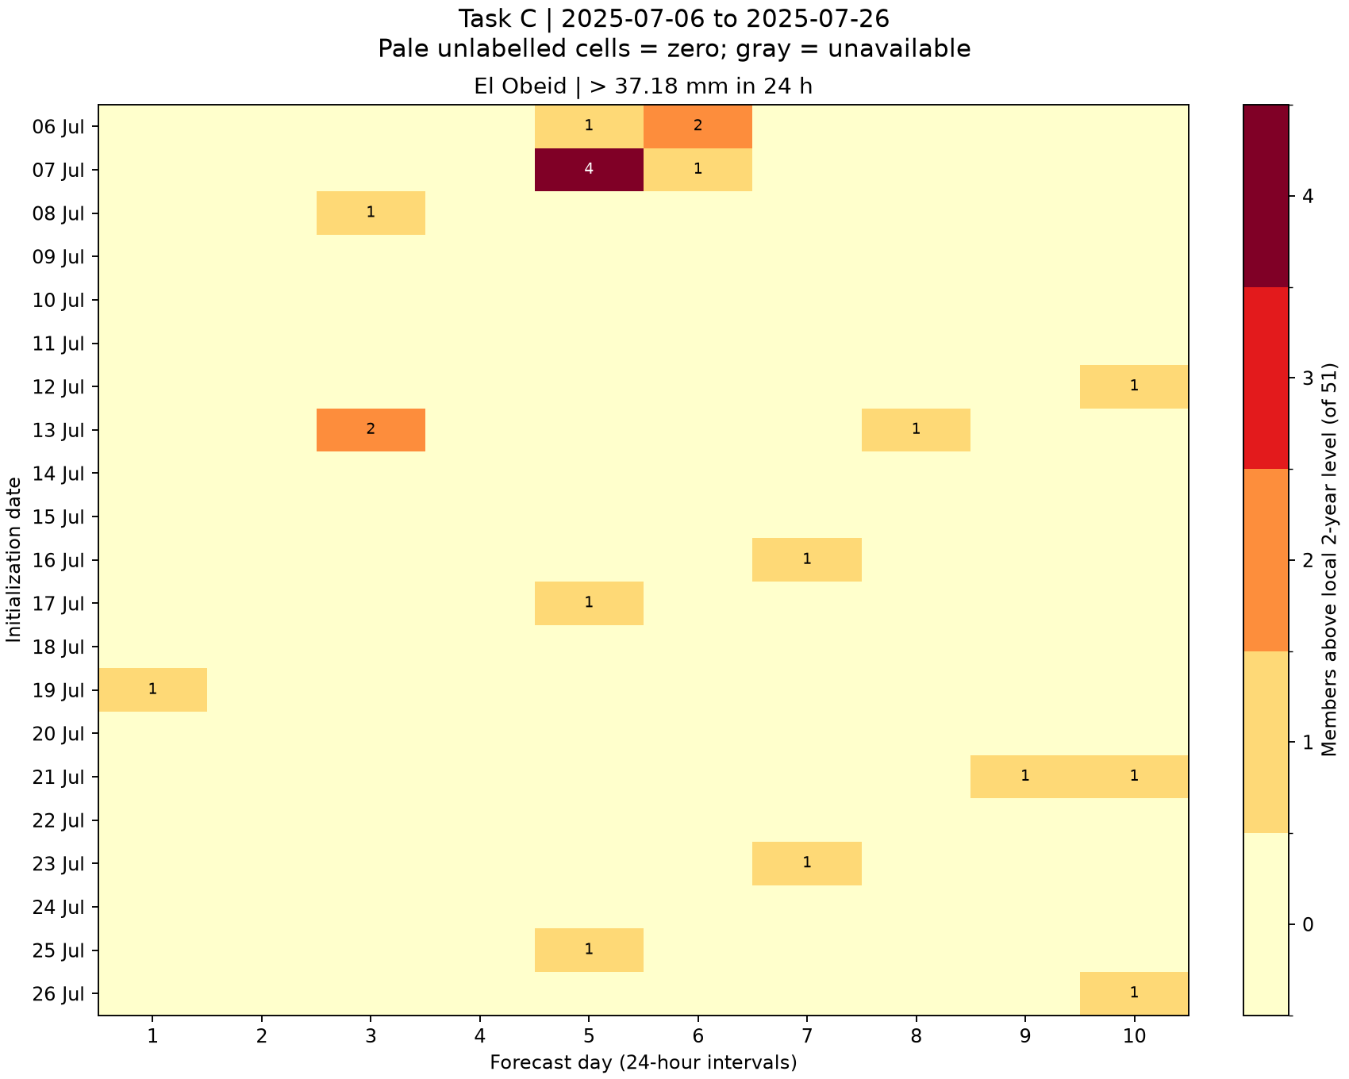
C: signal history at El Obeid
Rows are initialization dates, columns are daily forecast leads
12 of 21 starts show at least one signal.
Peak daily count
4/51 members
Shared color scale across towns. Pale cells are zero. Gray indicates unavailable forecasts.
26
Notes:
Source image: task_C/el_obeid_heatmap.png
Generating committed script: task_C/analyze.py
Data and interpretation: task_C/daily_member_counts.csv
Retain original plot units and scales. Embedded PNG preserves the original resolution.

Slide 27
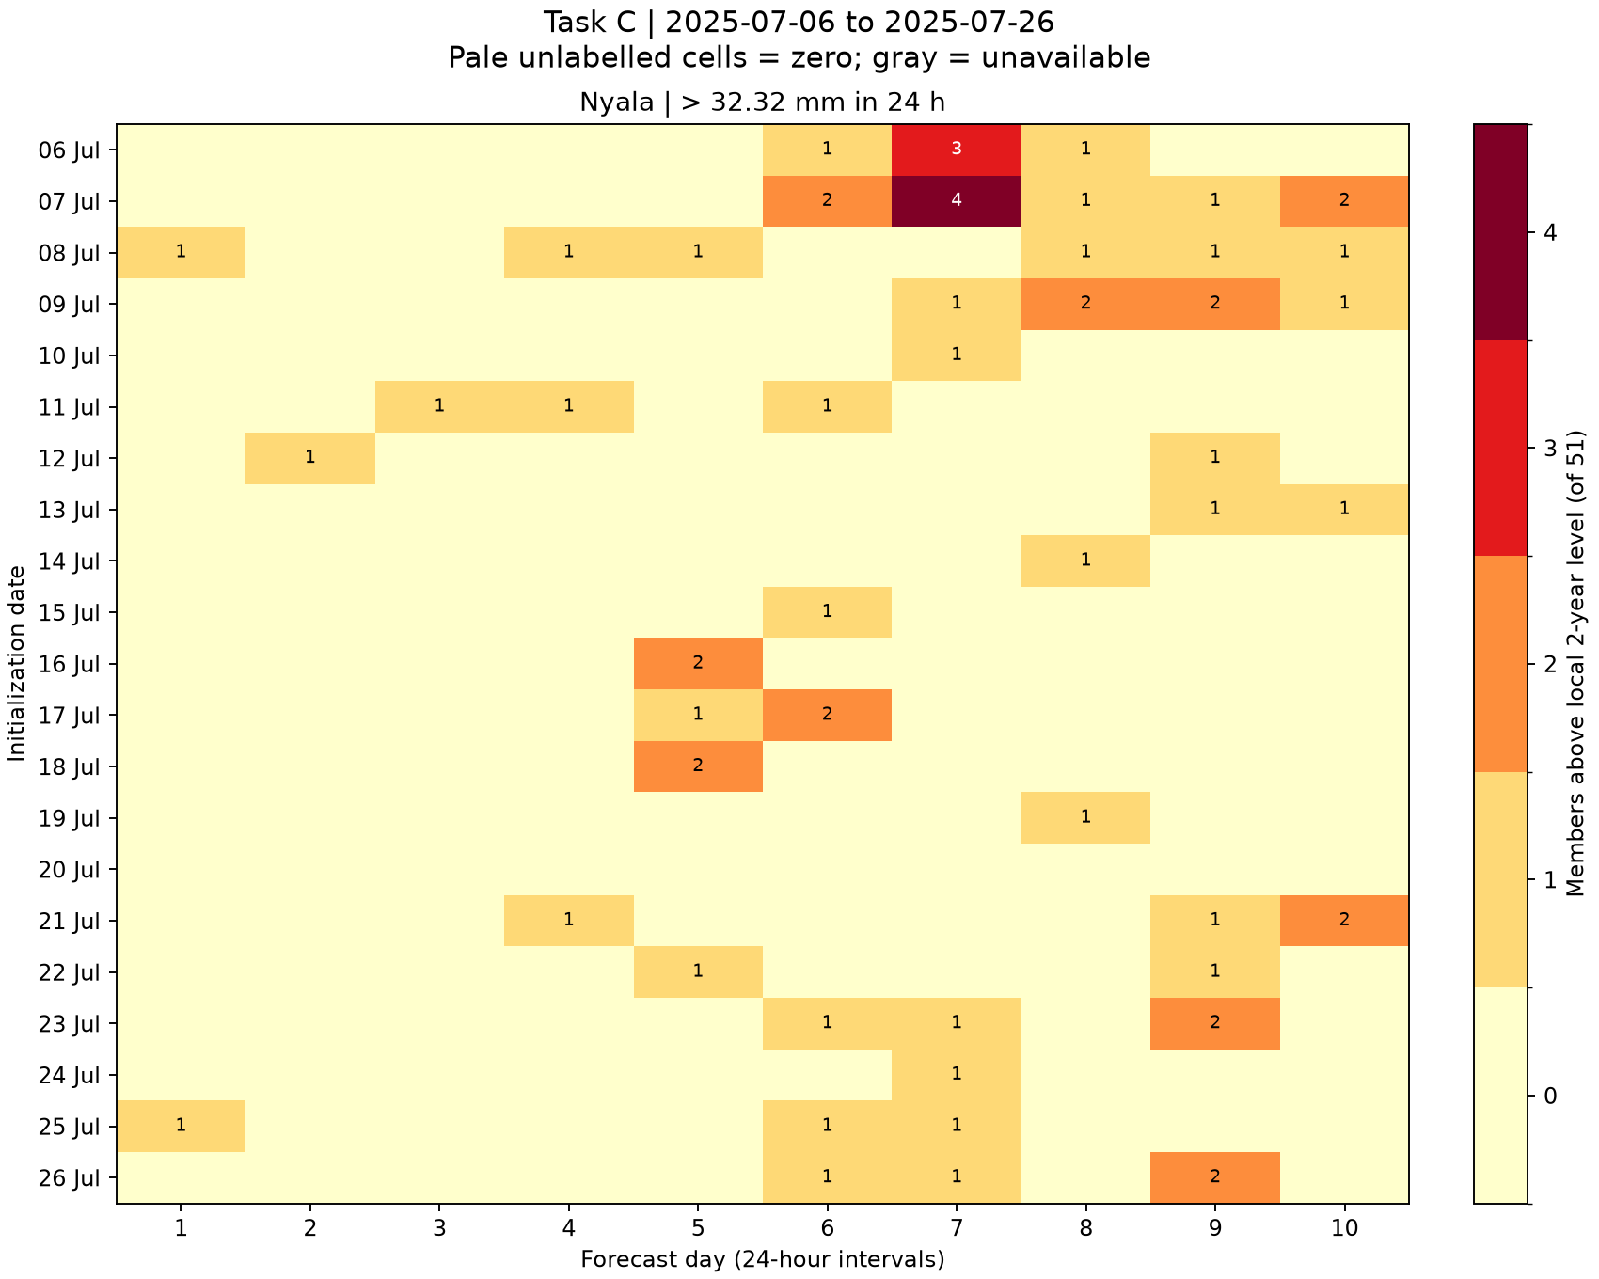
C: signal history at Nyala
Rows are initialization dates, columns are daily forecast leads
20 of 21 starts show at least one signal.
Peak daily count
4/51 members
Shared color scale across towns. Pale cells are zero. Gray indicates unavailable forecasts.
27
Notes:
Source image: task_C/nyala_heatmap.png
Generating committed script: task_C/analyze.py
Data and interpretation: task_C/daily_member_counts.csv
Retain original plot units and scales. Embedded PNG preserves the original resolution.

Slide 28
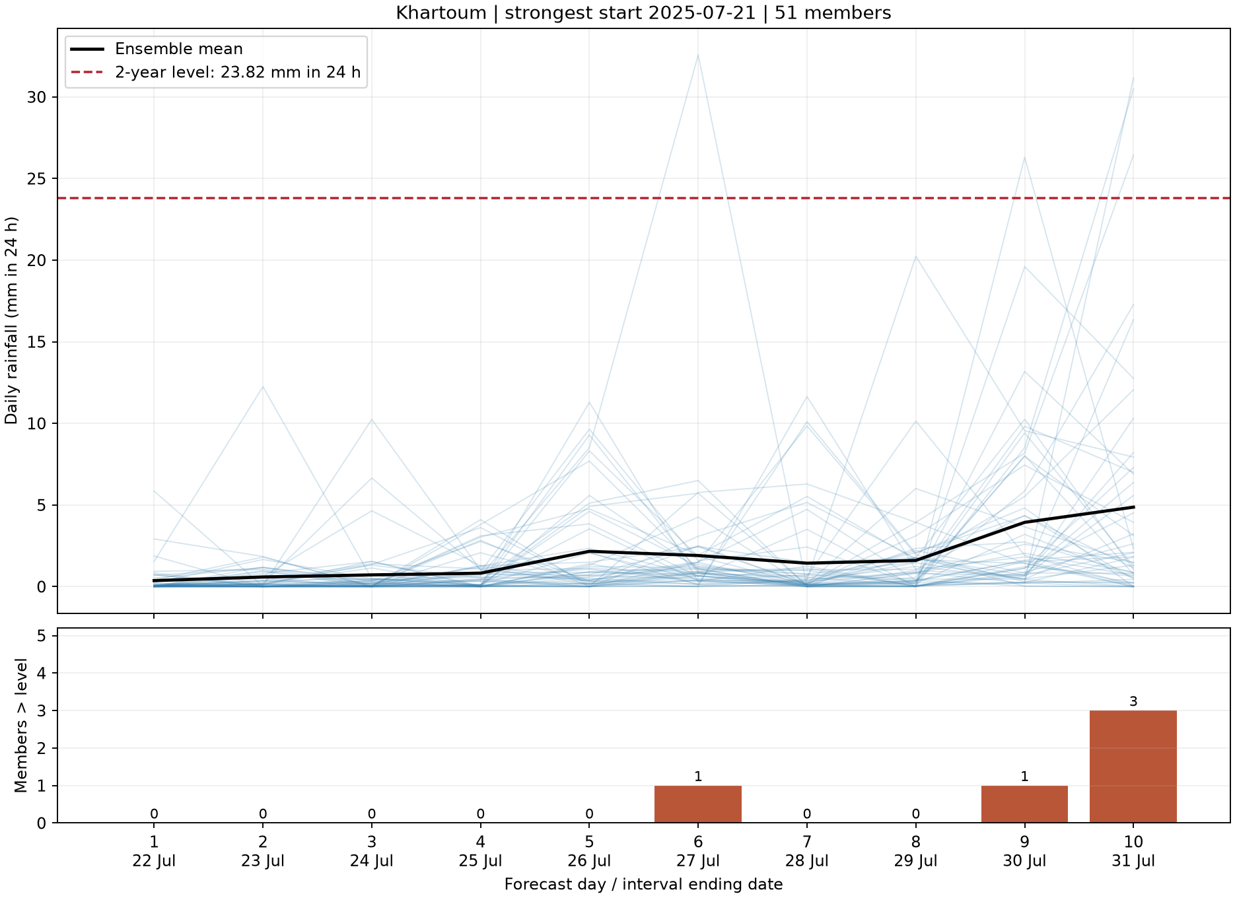
C: strongest forecast at Khartoum
Start 2025-07-21, daily rainfall and exceedance counts
Peak count
3/51 members above the threshold
Blue traces show member rainfall in mm in 24 h. Black shows the ensemble mean.
The lower panel gives daily counts and the ending dates of the 24-hour intervals.
28
Notes:
Source image: task_C/khartoum_strongest_start_plume.png
Generating committed script: task_C/analyze.py
Data and interpretation: task_C/town_signal_summary.csv and daily_member_counts.csv
Retain original plot units and scales. Embedded PNG preserves the original resolution.

Slide 29
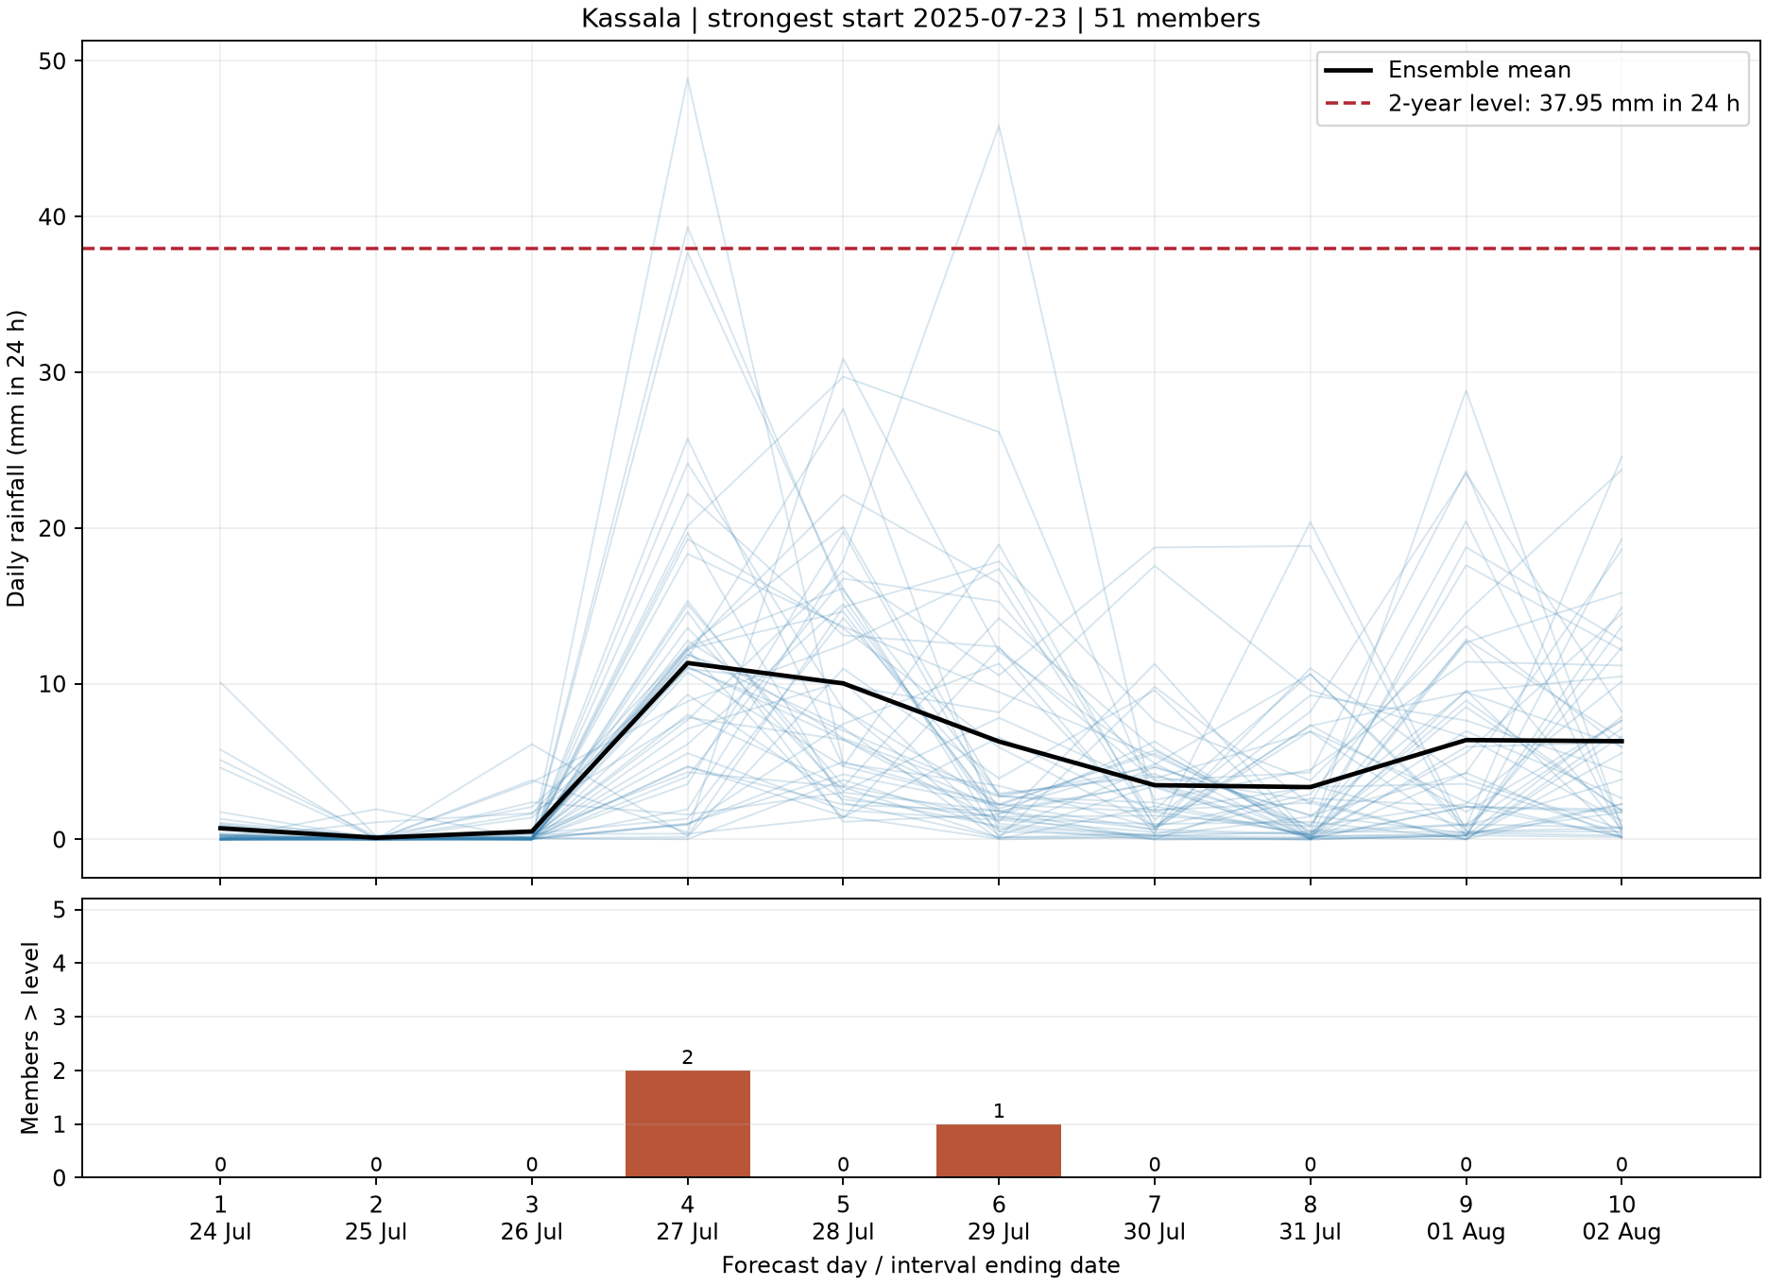
C: strongest forecast at Kassala
Start 2025-07-23, daily rainfall and exceedance counts
Peak count
2/51 members above the threshold
Blue traces show member rainfall in mm in 24 h. Black shows the ensemble mean.
The lower panel gives daily counts and the ending dates of the 24-hour intervals.
29
Notes:
Source image: task_C/kassala_strongest_start_plume.png
Generating committed script: task_C/analyze.py
Data and interpretation: task_C/town_signal_summary.csv and daily_member_counts.csv
Retain original plot units and scales. Embedded PNG preserves the original resolution.

Slide 30
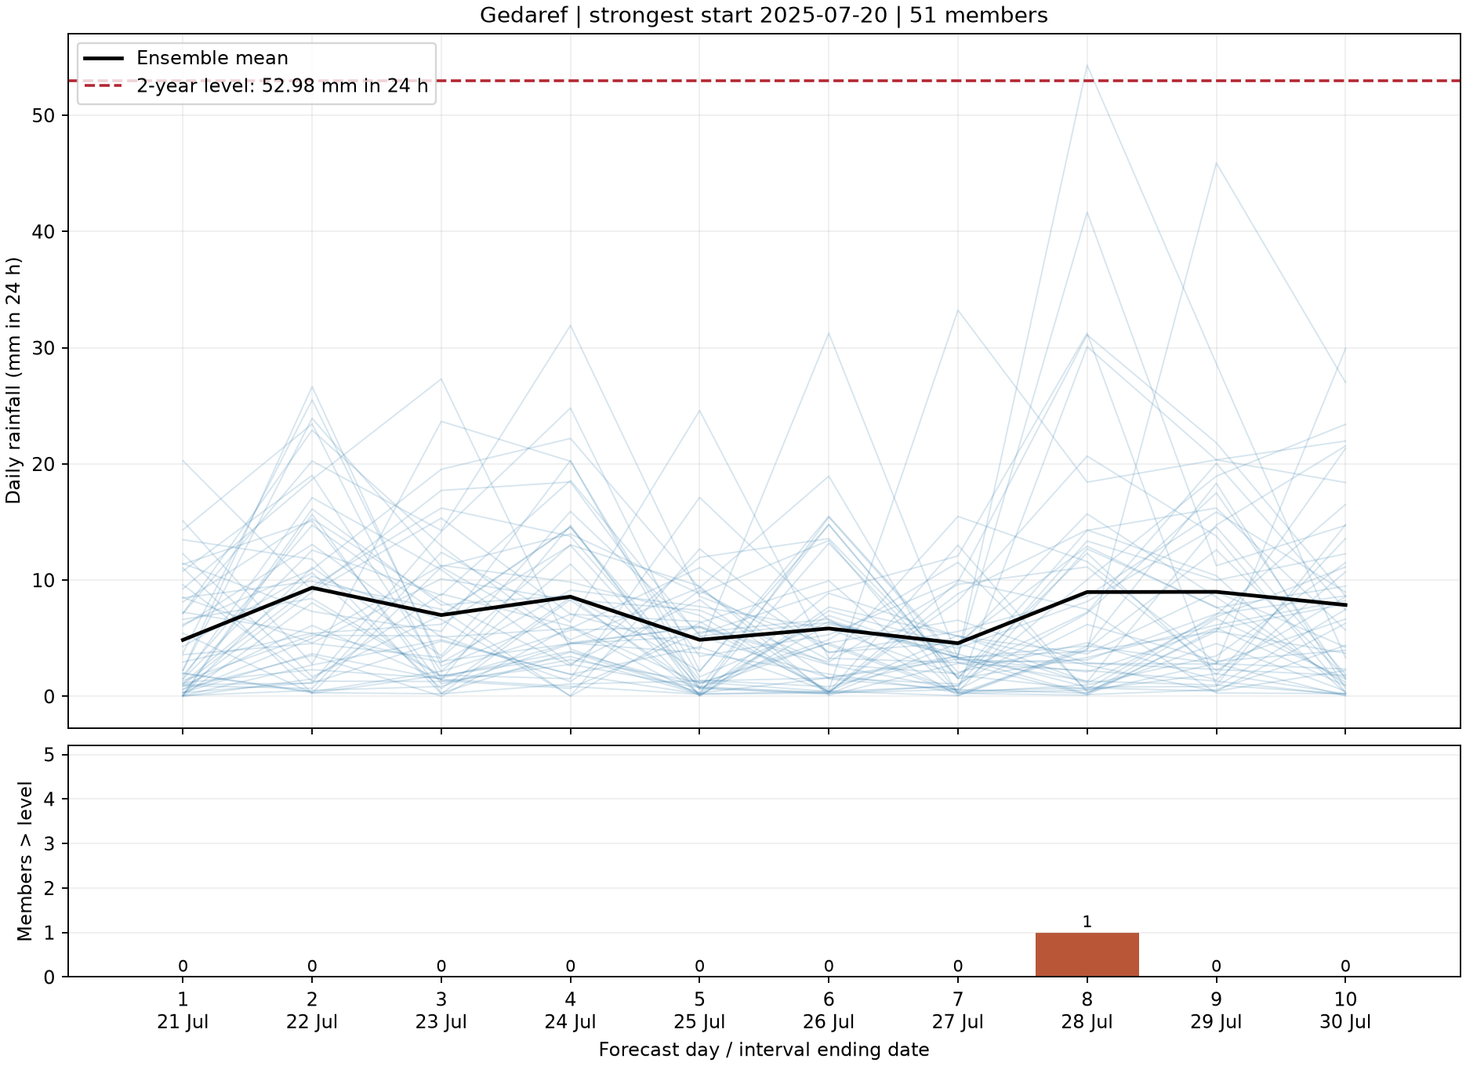
C: strongest forecast at Gedaref
Start 2025-07-20, daily rainfall and exceedance counts
Peak count
1/51 members above the threshold
Blue traces show member rainfall in mm in 24 h. Black shows the ensemble mean.
The lower panel gives daily counts and the ending dates of the 24-hour intervals.
30
Notes:
Source image: task_C/gedaref_strongest_start_plume.png
Generating committed script: task_C/analyze.py
Data and interpretation: task_C/town_signal_summary.csv and daily_member_counts.csv
Retain original plot units and scales. Embedded PNG preserves the original resolution.

Slide 31
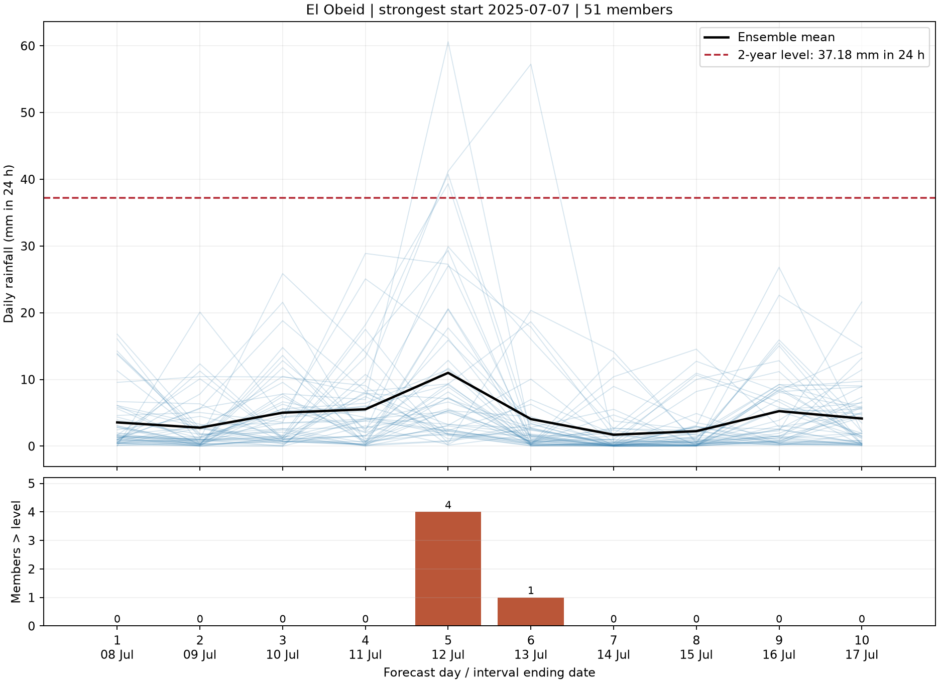
C: strongest forecast at El Obeid
Start 2025-07-07, daily rainfall and exceedance counts
Peak count
4/51 members above the threshold
Blue traces show member rainfall in mm in 24 h. Black shows the ensemble mean.
The lower panel gives daily counts and the ending dates of the 24-hour intervals.
31
Notes:
Source image: task_C/el_obeid_strongest_start_plume.png
Generating committed script: task_C/analyze.py
Data and interpretation: task_C/town_signal_summary.csv and daily_member_counts.csv
Retain original plot units and scales. Embedded PNG preserves the original resolution.

Slide 32
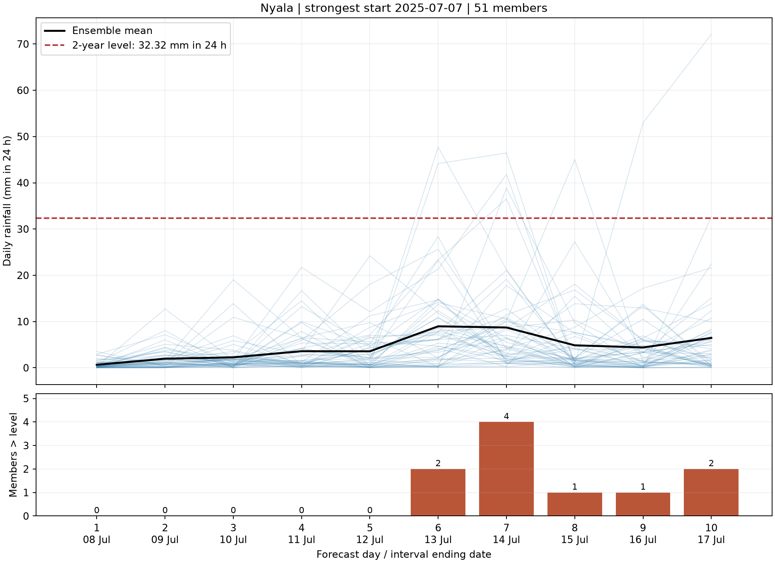
C: strongest forecast at Nyala
Start 2025-07-07, daily rainfall and exceedance counts
Peak count
4/51 members above the threshold
Blue traces show member rainfall in mm in 24 h. Black shows the ensemble mean.
The lower panel gives daily counts and the ending dates of the 24-hour intervals.
32
Notes:
Source image: task_C/nyala_strongest_start_plume.png
Generating committed script: task_C/analyze.py
Data and interpretation: task_C/town_signal_summary.csv and daily_member_counts.csv
Retain original plot units and scales. Embedded PNG preserves the original resolution.

Slide 33
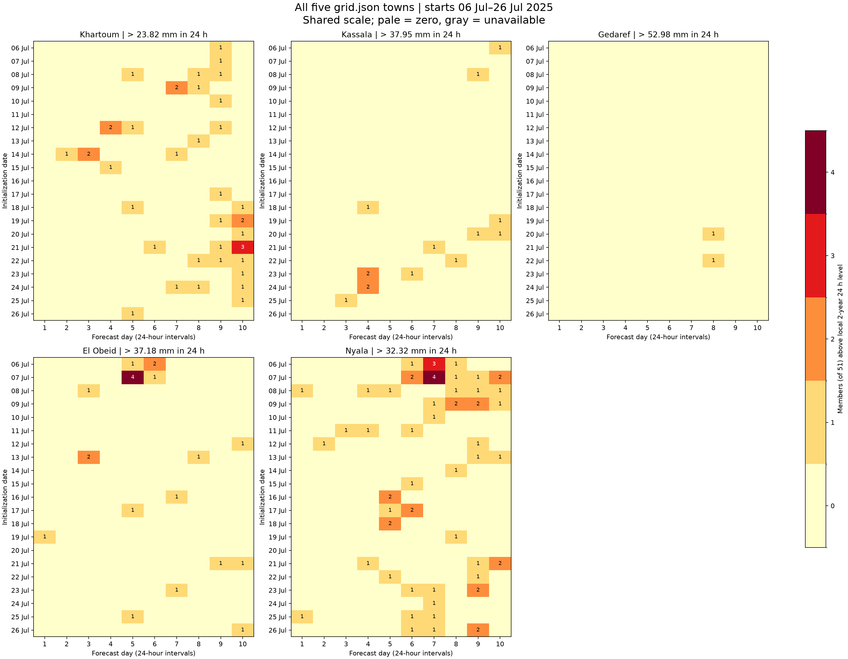
C: five-town signal overview
Shared count scale across the 21 initialization dates
Nyala shows a signal in 20 of 21 starts.
Gedaref shows a signal in 2 of 21 starts.
A signal in many starts differs from repeated signals for the same target day.
33
Notes:
Source image: task_C/five_town_heatmap_comparison.png
Generating committed script: task_C/analyze.py
Data and interpretation: task_C/town_signal_summary.csv
Retain original plot units and scales. Embedded PNG preserves the original resolution.

Slide 34
C: earliest signals refer to specific target days
The 24-hour target interval ends on the date shown
Town | Lead days | Issued on | Target ends
Khartoum | 10 | 2025-07-18 | 2025-07-28
Kassala | 10 | 2025-07-06 | 2025-07-16
Gedaref | 8 | 2025-07-20 | 2025-07-28
El Obeid | 10 | 2025-07-12 | 2025-07-22
Nyala | 10 | 2025-07-07 | 2025-07-17
Four towns tie at ten days, the forecast horizon. Different target days prevent a unique ranking of one common event.
34
Notes:
Source: task_C/town_signal_summary.csv. Ties use the earliest target ending date as a deterministic example. Other tied targets remain in same_valid_day_signals.csv.

Slide 35
C: Nyala has the longest same-target signal streak
A streak requires consecutive starts signaling the same valid 24-hour interval
Town | Consecutive starts | First start | Last start | Target ends
Khartoum | 3 | 2025-07-07 | 2025-07-09 | 2025-07-16
Kassala | 2 | 2025-07-24 | 2025-07-25 | 2025-07-28
Gedaref | 1 | 2025-07-20 | 2025-07-20 | 2025-07-28
El Obeid | 2 | 2025-07-06 | 2025-07-07 | 2025-07-12
Nyala | 5 | 2025-07-07 | 2025-07-11 | 2025-07-17
Nyala’s 7–11 July starts target the interval ending 17 July. Boundary targets have fewer available starts, which limits comparisons.
35
Notes:
Source: task_C/town_signal_summary.csv and same_valid_day_signals.csv. Counts alone cannot establish why towns differ causally.

Slide 36
C: stronger signal criteria reduce the number of flagged starts
Starts with at least one daily interval meeting the member criterion
Town | ≥1 member | ≥3 members | ≥5 members
Khartoum | 19/21 | 1/21 | 0/21
Kassala | 10/21 | 0/21 | 0/21
Gedaref | 2/21 | 0/21 | 0/21
El Obeid | 12/21 | 1/21 | 0/21
Nyala | 20/21 | 2/21 | 0/21
No town reaches five members. Threshold depth, predicted rainfall and ensemble spread jointly affect these weak signals.
36
Notes:
Source: task_C/signal_criterion_sensitivity.csv. Criteria 1/51,3/51,5/51 correspond to 1.96%,5.88%,9.80%.

Slide 37
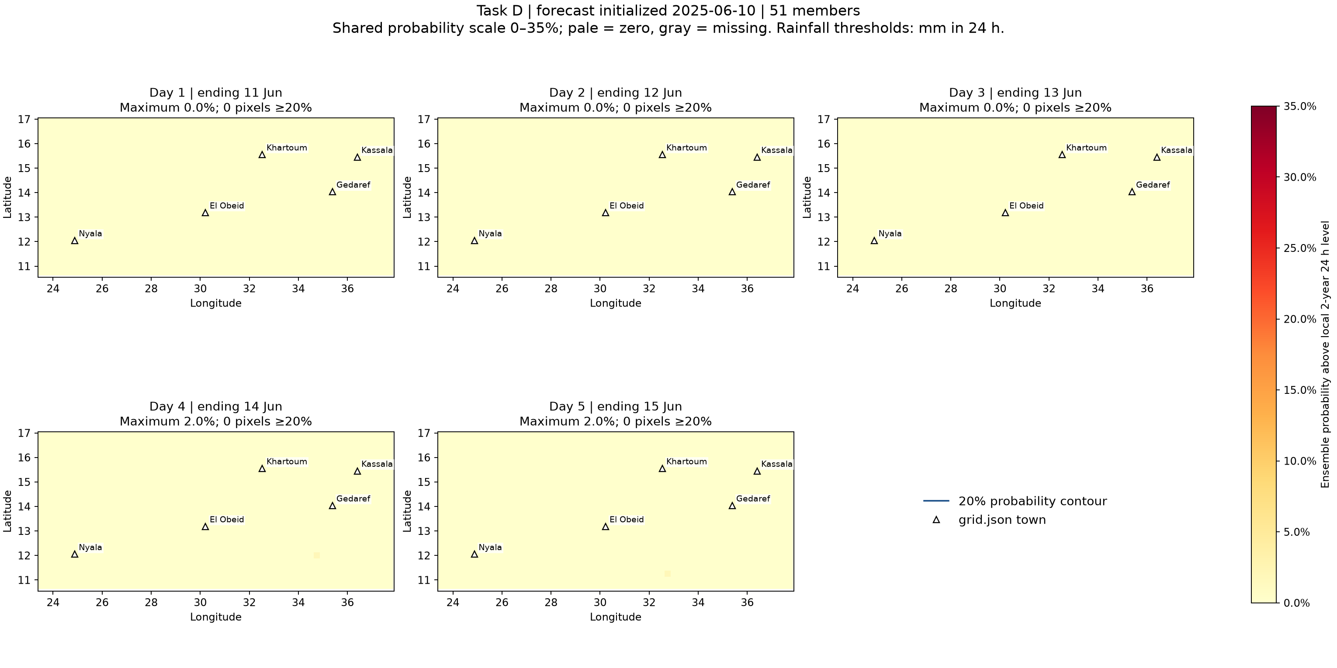
D: regional probabilities for 2025-06-10
Five daily leads, local 2-year 24 h threshold at each forecast pixel
Peak probability: 1.96%. Pixel-intervals reaching 20%: 0. All five towns appear on every map.
37
Notes:
Source image: task_D/probabilities_2025-06-10.png
Generating committed script: task_D/analyze.py
Data and interpretation: task_D/probability_summary.csv. Probability is the fraction of 51 members with rainfall > the local threshold. The 20% decision requires 11 members.
Retain original plot units and scales. Embedded PNG preserves the original resolution.

Slide 38
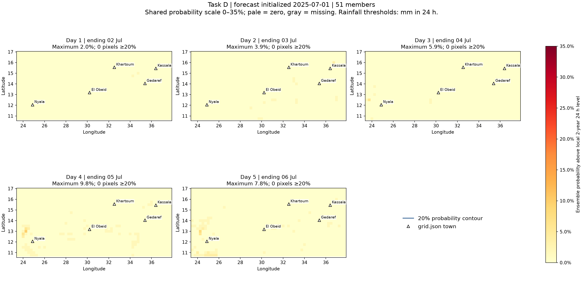
D: regional probabilities for 2025-07-01
Five daily leads, local 2-year 24 h threshold at each forecast pixel
Peak probability: 9.80%. Pixel-intervals reaching 20%: 0. All five towns appear on every map.
38
Notes:
Source image: task_D/probabilities_2025-07-01.png
Generating committed script: task_D/analyze.py
Data and interpretation: task_D/probability_summary.csv. Probability is the fraction of 51 members with rainfall > the local threshold. The 20% decision requires 11 members.
Retain original plot units and scales. Embedded PNG preserves the original resolution.

Slide 39
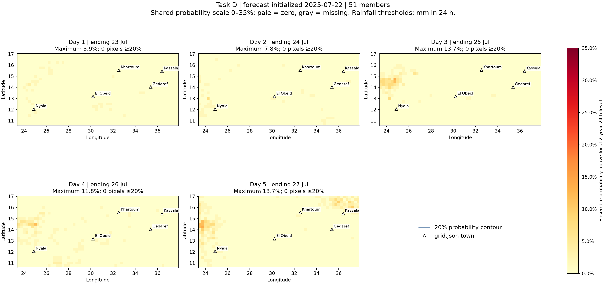
D: regional probabilities for 2025-07-22
Five daily leads, local 2-year 24 h threshold at each forecast pixel
Peak probability: 13.73%. Pixel-intervals reaching 20%: 0. All five towns appear on every map.
39
Notes:
Source image: task_D/probabilities_2025-07-22.png
Generating committed script: task_D/analyze.py
Data and interpretation: task_D/probability_summary.csv. Probability is the fraction of 51 members with rainfall > the local threshold. The 20% decision requires 11 members.
Retain original plot units and scales. Embedded PNG preserves the original resolution.

Slide 40
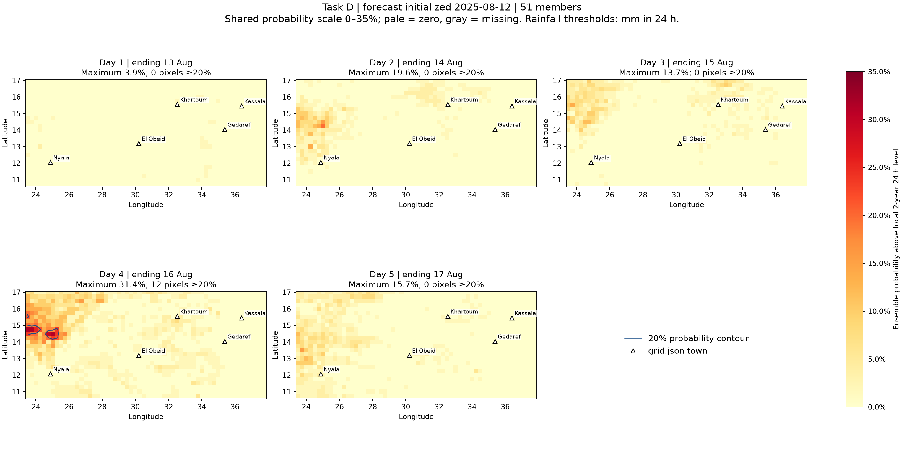
D: regional probabilities for 2025-08-12
Five daily leads, local 2-year 24 h threshold at each forecast pixel
Peak probability: 31.37%. Pixel-intervals reaching 20%: 12. All five towns appear on every map.
40
Notes:
Source image: task_D/probabilities_2025-08-12.png
Generating committed script: task_D/analyze.py
Data and interpretation: task_D/probability_summary.csv. Probability is the fraction of 51 members with rainfall > the local threshold. The 20% decision requires 11 members.
Retain original plot units and scales. Embedded PNG preserves the original resolution.

Slide 41
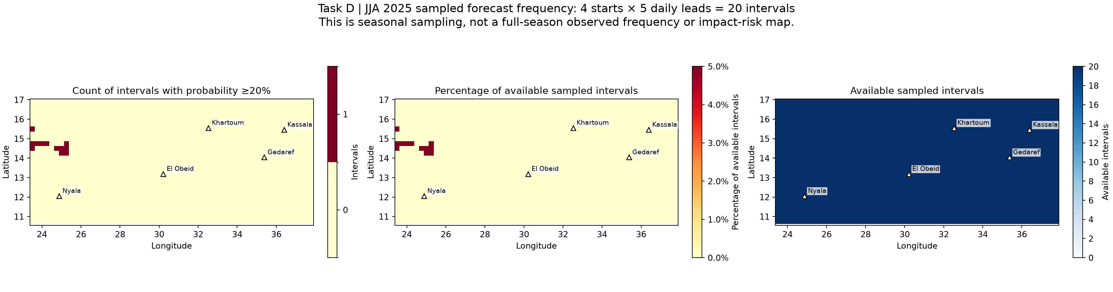
D: frequency across the sampled seasonal forecasts
Four starts and five daily leads give 20 sampled intervals
Twelve regional pixels reach 20% once each. Maximum sampled frequency is 1/20, or 5%.
41
Notes:
Source image: task_D/sampled_season_frequency.png
Generating committed script: task_D/analyze.py
Data and interpretation: task_D/regional_hotspots.csv. All hotspots occur at day 4 of the 12 August start, ending 16 August. This is not full-season frequency.
Retain original plot units and scales. Embedded PNG preserves the original resolution.

Slide 42
D: none of the five town pixels reaches 20%
Regional hotspots lie away from the selected town pixels
Town | Intervals ≥20% | Available | Peak probability
Khartoum | 0 | 20 | 1.96%
Kassala | 0 | 20 | 0.00%
Gedaref | 0 | 20 | 0.00%
El Obeid | 0 | 20 | 0.00%
Nyala | 0 | 20 | 1.96%
Regional peak probability reaches 16/51 = 31.37%. The sampled frequency map and the town table describe different spatial locations.
42
Notes:
Source: task_D/town_frequency.csv and regional_hotspots.csv. At each forecast pixel the rainfall threshold uses its nearest CMORPH pixel, which can differ from direct town-coordinate matching in Tasks A–C.

Slide 43
D: pan chunks make regional maps efficient
One forecast chunk contains one start and lead, all 51 members, and a broad spatial map
Start | Original cloud read | Storage chunks
2025-06-10 | 37.43 s | 6.0
2025-07-01 | 19.49 s | 6.0
2025-07-22 | 21.14 s | 6.0
2025-08-12 | 34.88 s | 6.0
Six cumulative endpoints produce five daily maps. CMORPH threshold read: 10.84 s and one chunk. Local cache timings measure a different operation.
43
Notes:
Source: task_D/read_timings.csv and results.md. Forecast chunks [1,1,51,321,261] in time,step,number,latitude,longitude. Chunk estimates are not exact HTTP request counts. Network and cache conditions affect timing.

Slide 44
Conclusions and limits
Observed extremes and forecast signals provide complementary evidence
A: local thresholds vary substantially, and removing one large year changes extrapolated return levels.
B: 20 mm captures more member-day exceedances than the local annual return levels.
C: Nyala has the most persistent weak signal for one target interval. No town reaches a five-member signal.
D: twelve regional pixels reach 20% in one sampled interval, while all five town pixels remain below 20%.
Observed 2025 rainfall and impacts are required to verify events and assess warning performance.
44
Notes:
Sources: final task_A through task_D results.md files. No observed 2025 event verification is available.

Slide 45
Data sources and reproducibility
All 28 final output figures appear in this deck
CMORPH annual maxima and Gumbel return levels, 1998–2024
ECMWF ensemble forecast store, 49r1-jja2025, with 51 members
Town coordinates and bounds: grid.json in each final task folder
Generating scripts and reports: task_A, task_B, task_C and task_D
Public store: data.source.coop/e4drr-project. Workshop examples: github.com/icpac-igad/python-workshop
45
Notes:
Specific prefixes: observations/cmorph_rp_icechunk and forecasts/ecmwf-ifs-ea-swio-realized-v3/49r1-jja2025. Every figure slide names its source file in speaker notes. Input/script hashes and Git revisions are stored in each task run_metadata.json.

