Slide 1
Sudan rainfall extremes
Observed thresholds and ensemble forecast signals
Five towns from grid.json
Tasks A–D
CMORPH: 1998–2024
ECMWF ensemble: June–August 2025
1
Notes:
All content comes from final task_A through task_D outputs. The 15-slide deck retains all 28 output PNGs.

Slide 2
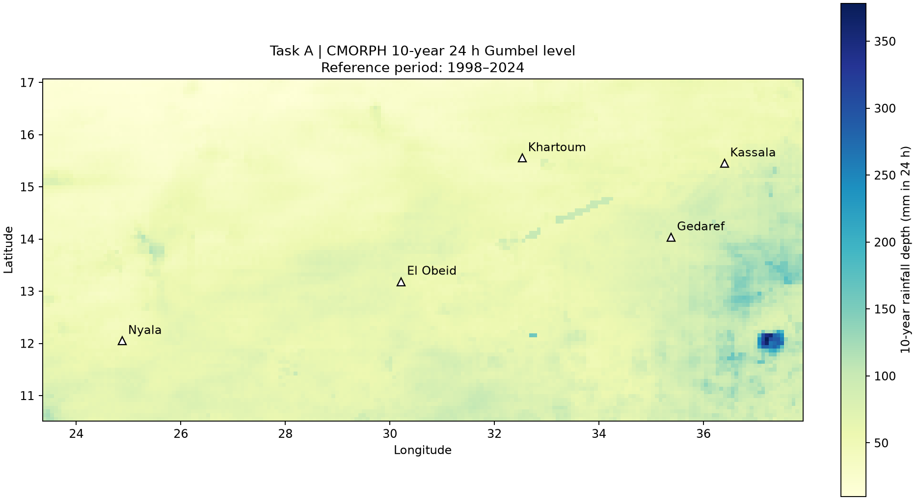
Five towns and the observed rainfall reference
Task A regional 10-year level, in mm accumulated over 24 h
CMORPH annual maxima: 1998–2024, 27 years. Five town coordinates from grid.json.
2
Notes:
Source: task_A/grid.json, regional_10yr_24hr.png and results.md. The forecast latitude descends and CMORPH latitude ascends. Both domains cover the towns.

Slide 3
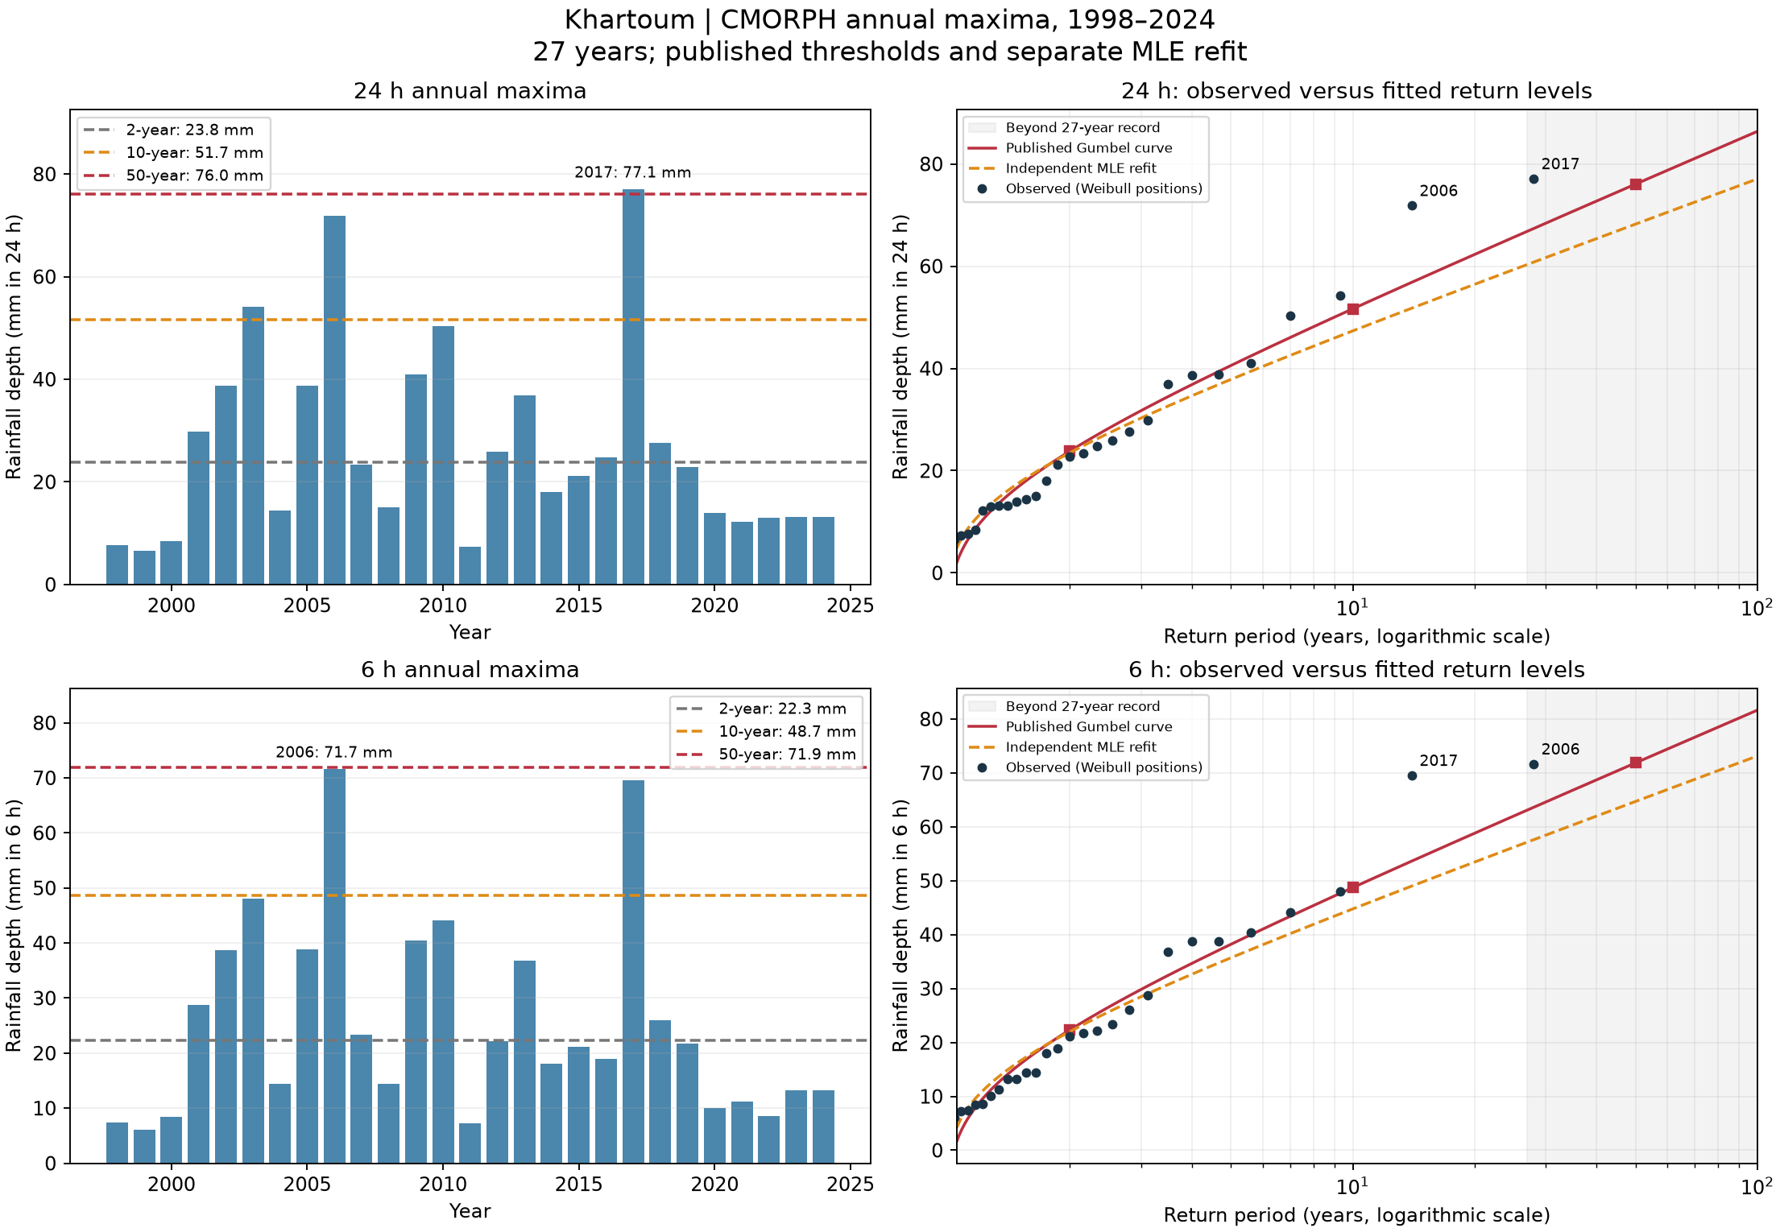
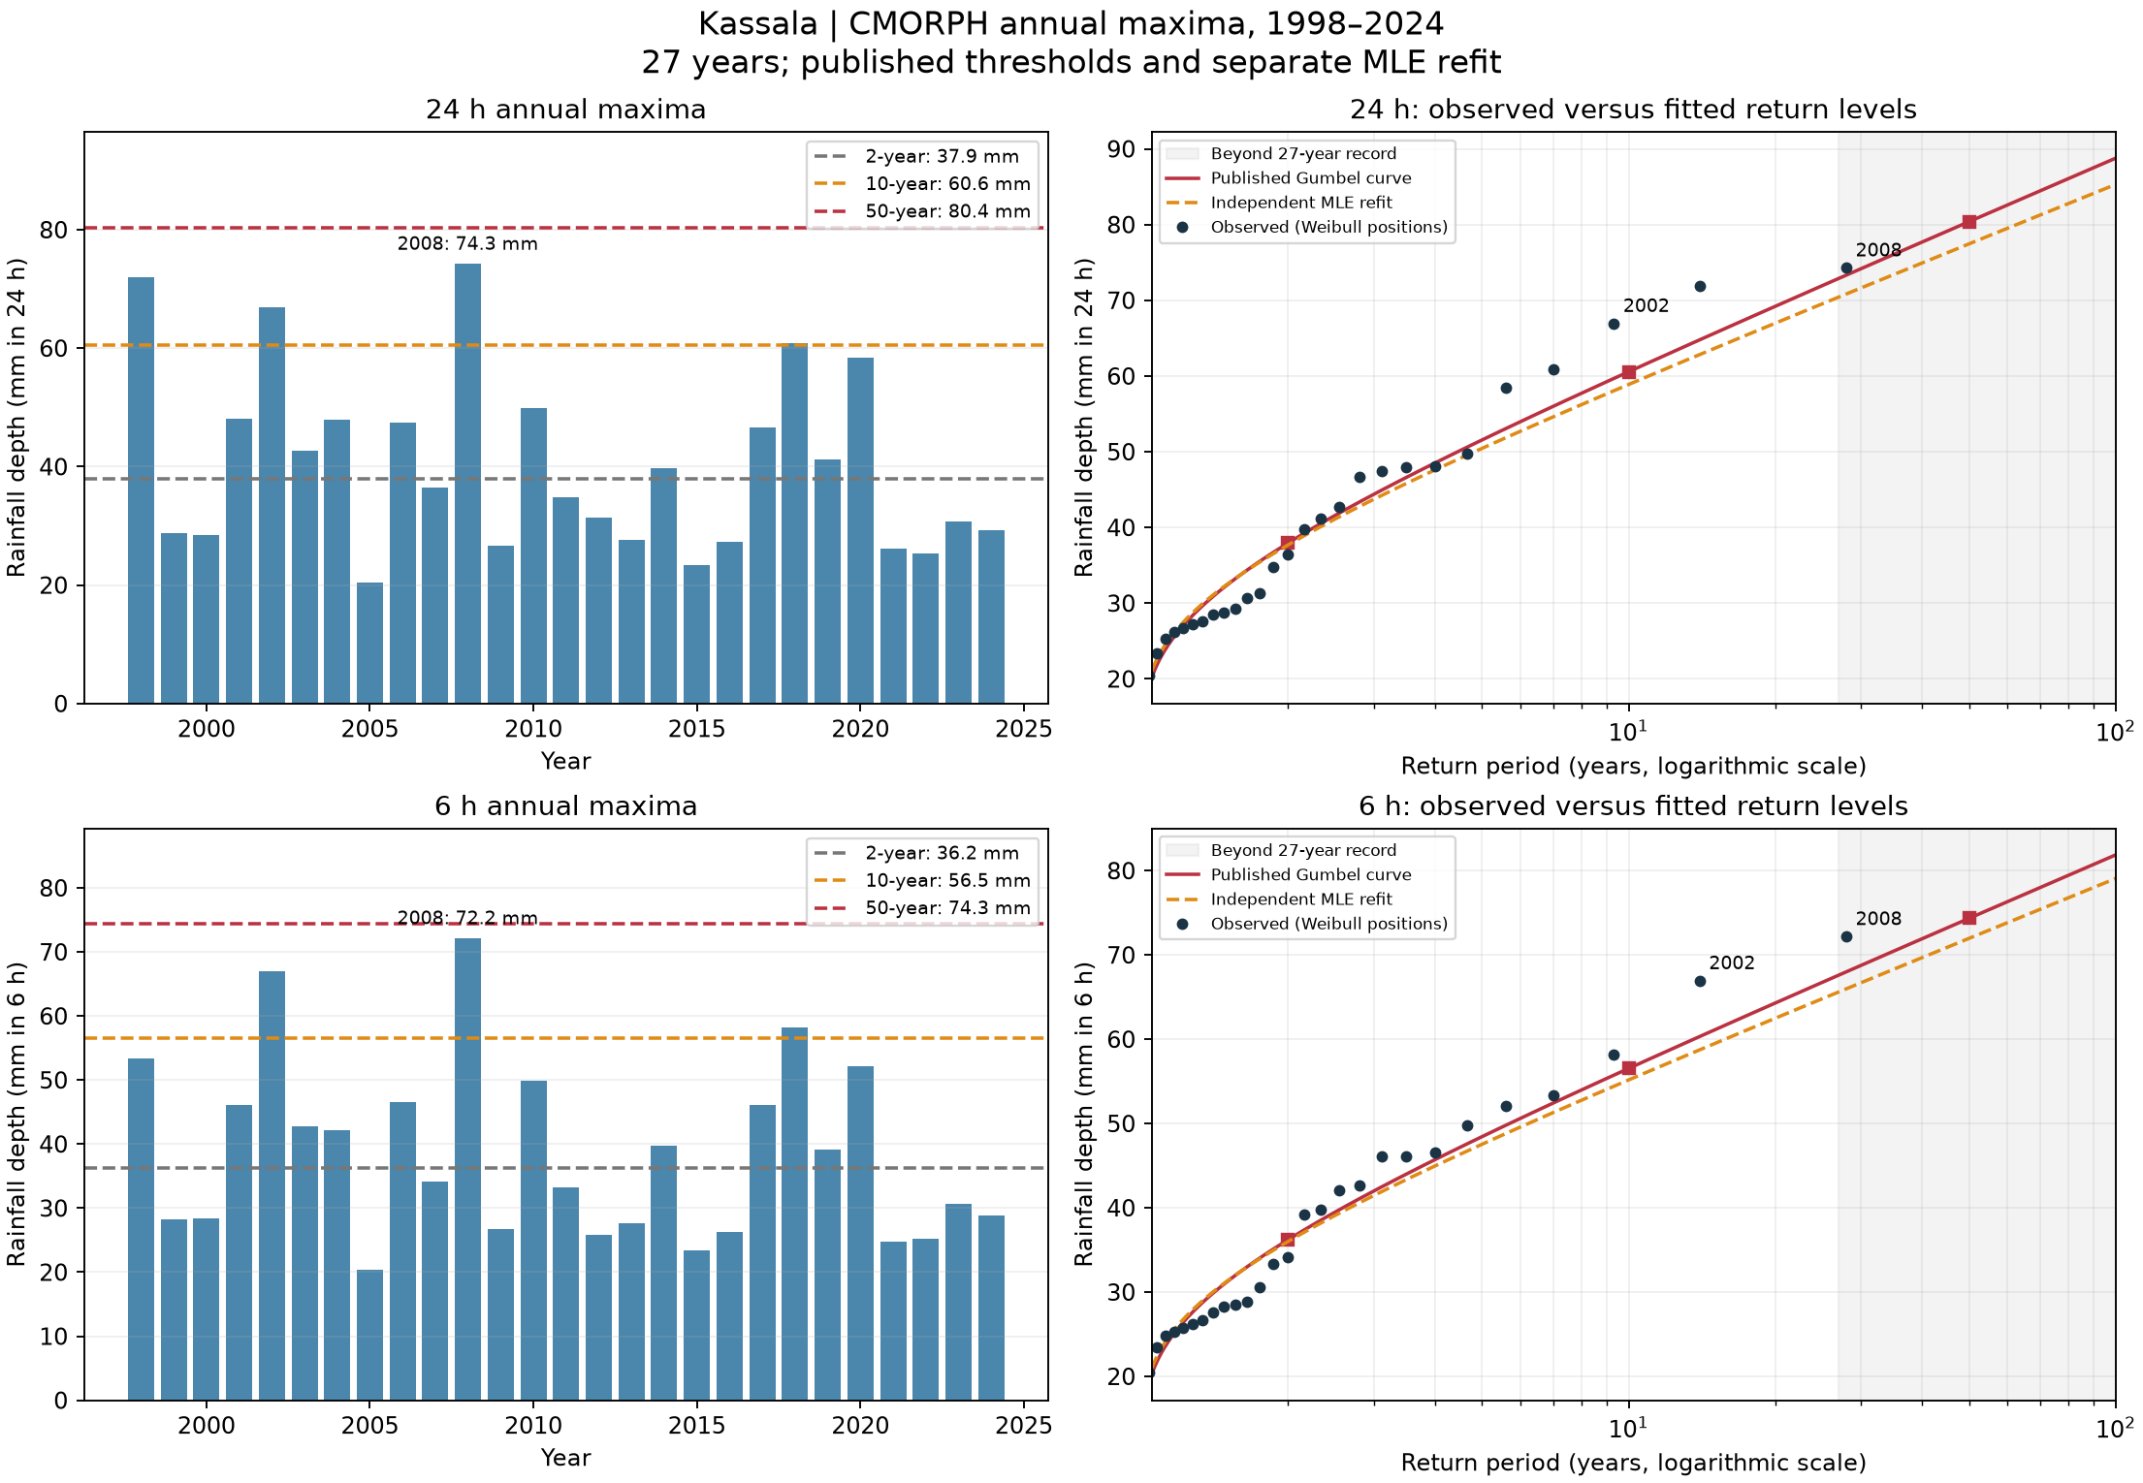
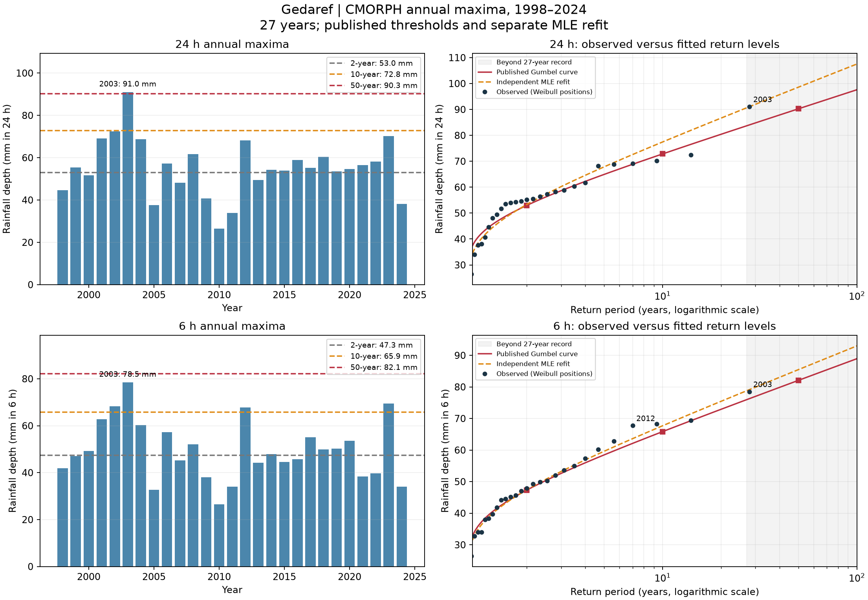
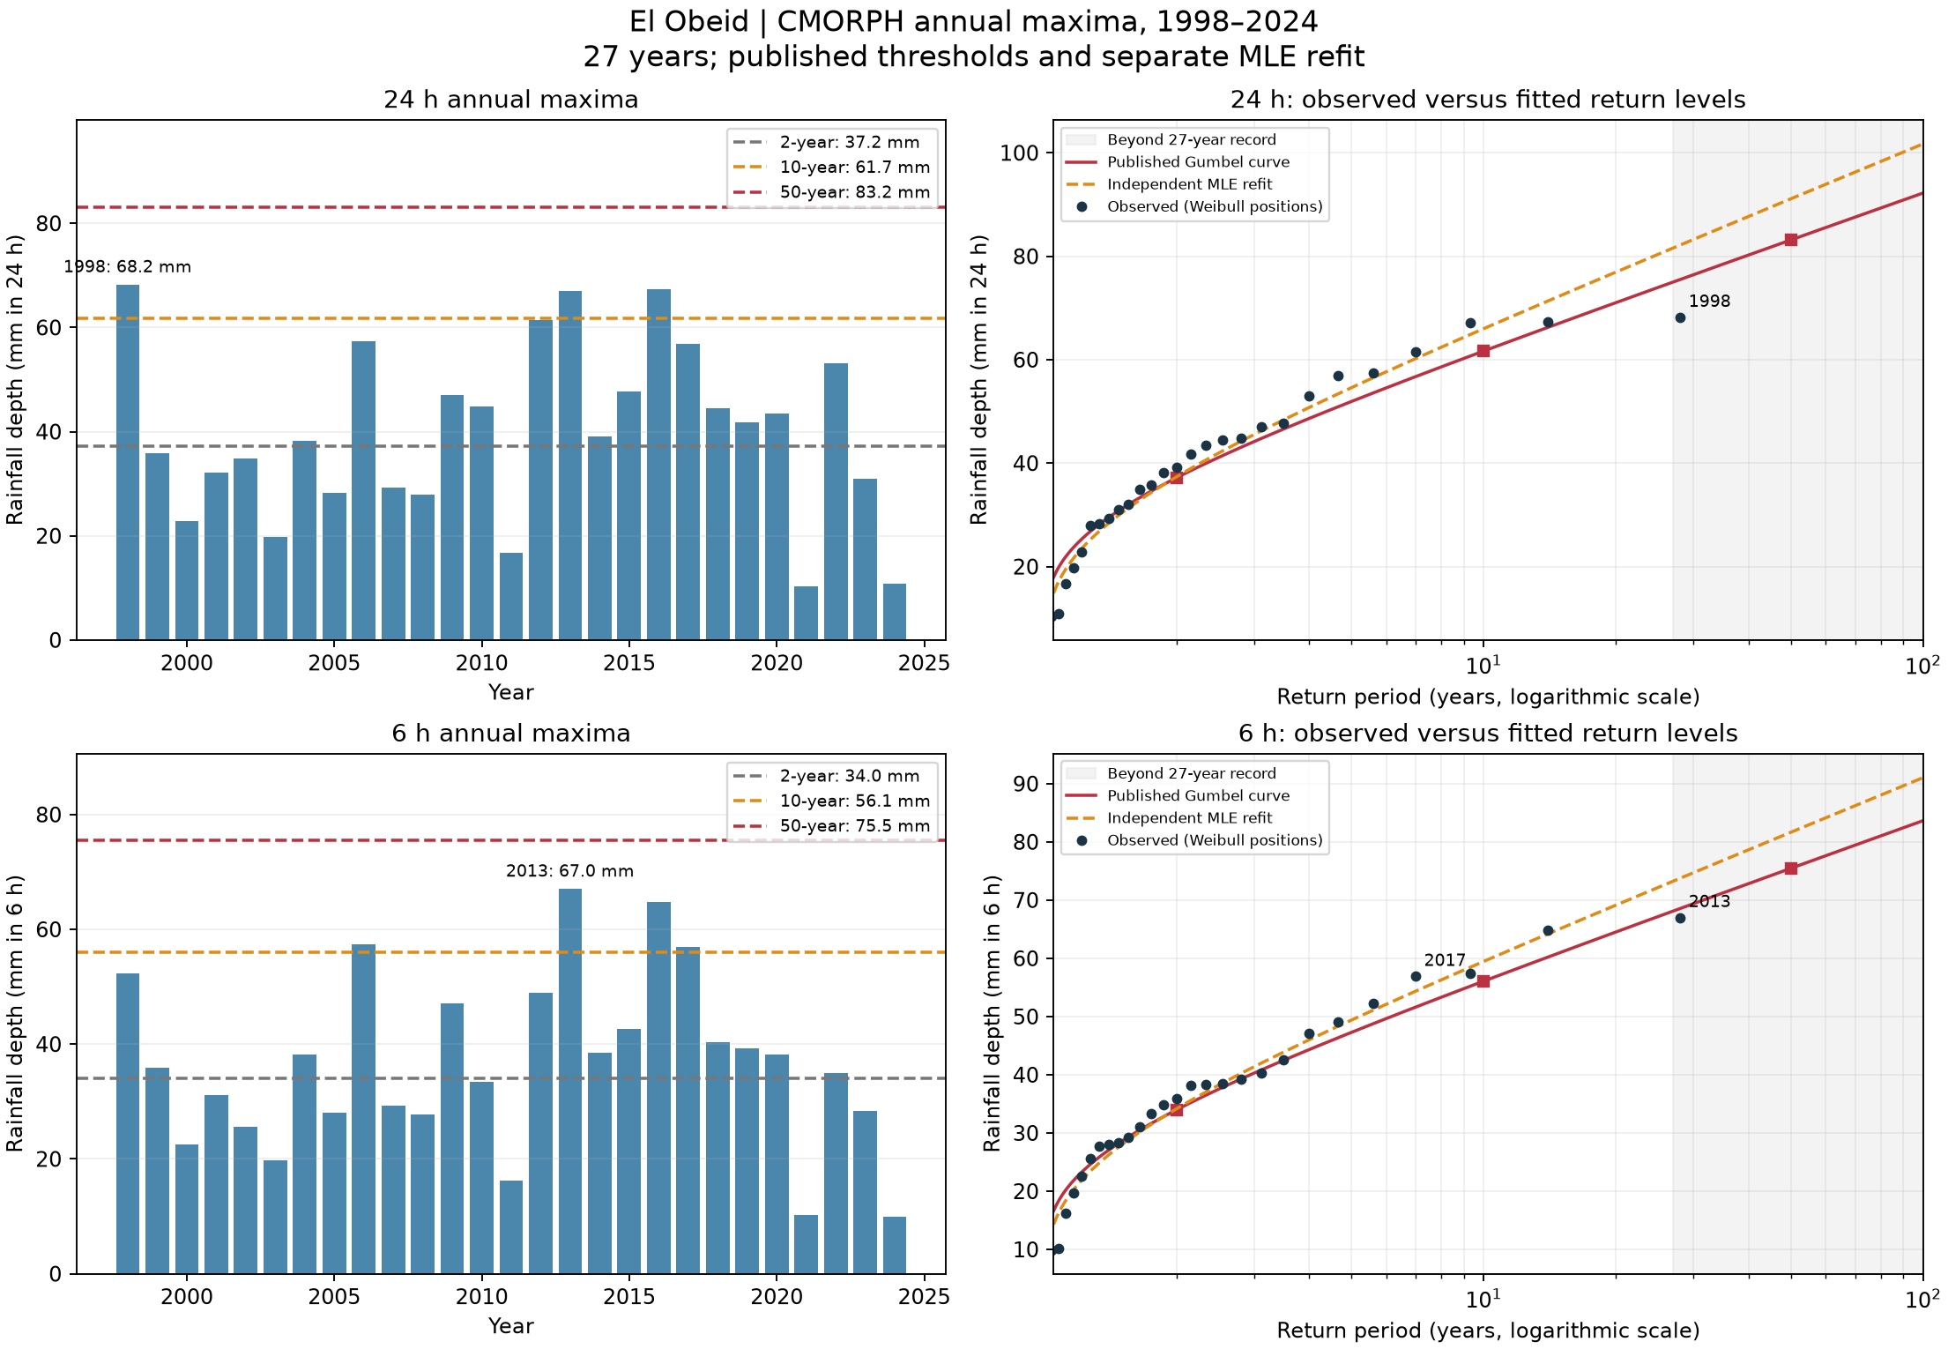
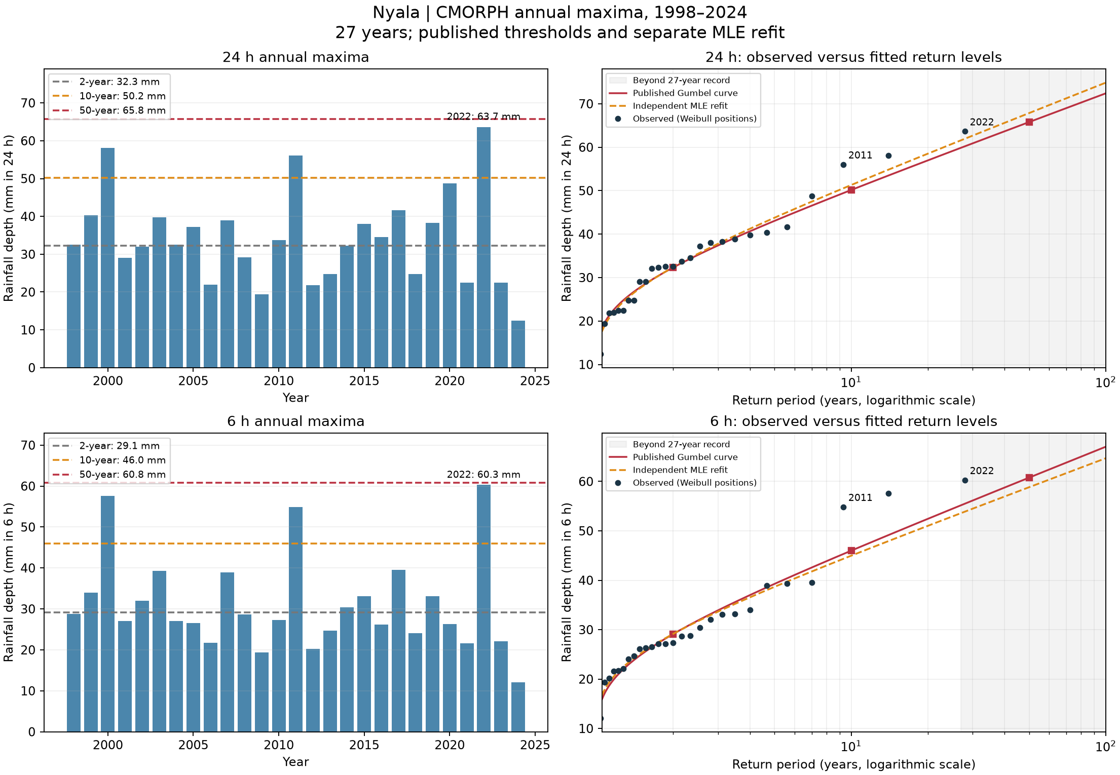
A: observed extremes at every town
Annual maxima and fitted return levels for 24 h and 6 h
The plots distinguish published Gumbel levels from an independent MLE refit. Large departures are descriptive evidence.
3
Notes:
Source figures: task_A/khartoum_return_levels.png, task_A/kassala_return_levels.png, task_A/gedaref_return_levels.png, task_A/el_obeid_return_levels.png, task_A/nyala_return_levels.png
Generating scripts and reports: task_A through task_D. Original PNGs retain full resolution. Grouped slides provide overview; zoom into individual figures for detailed labels.

Slide 4
A: local return levels and largest-year sensitivity
Published 24 h rainfall depths in mm
Town | 2-year | 10-year | 50-year
Khartoum | 23.82 | 51.65 | 76.05
Kassala | 37.95 | 60.56 | 80.39
Gedaref | 52.98 | 72.84 | 90.25
El Obeid | 37.18 | 61.68 | 83.16
Nyala | 32.32 | 50.15 | 65.79
Removing Khartoum’s 2017 maximum lowers its MLE 50-year level from 68.23 to 62.05 mm (−9.05%). Both sensitivity fits use MLE. Fifty-year levels extrapolate beyond 27 observed years.
4
Notes:
Sources: task_A/thresholds.csv and sensitivity.csv. Original 6 h comparisons appear in the previous slide’s five source figures. The published estimator is unspecified; sensitivity compares consistent MLE fits.

Slide 5
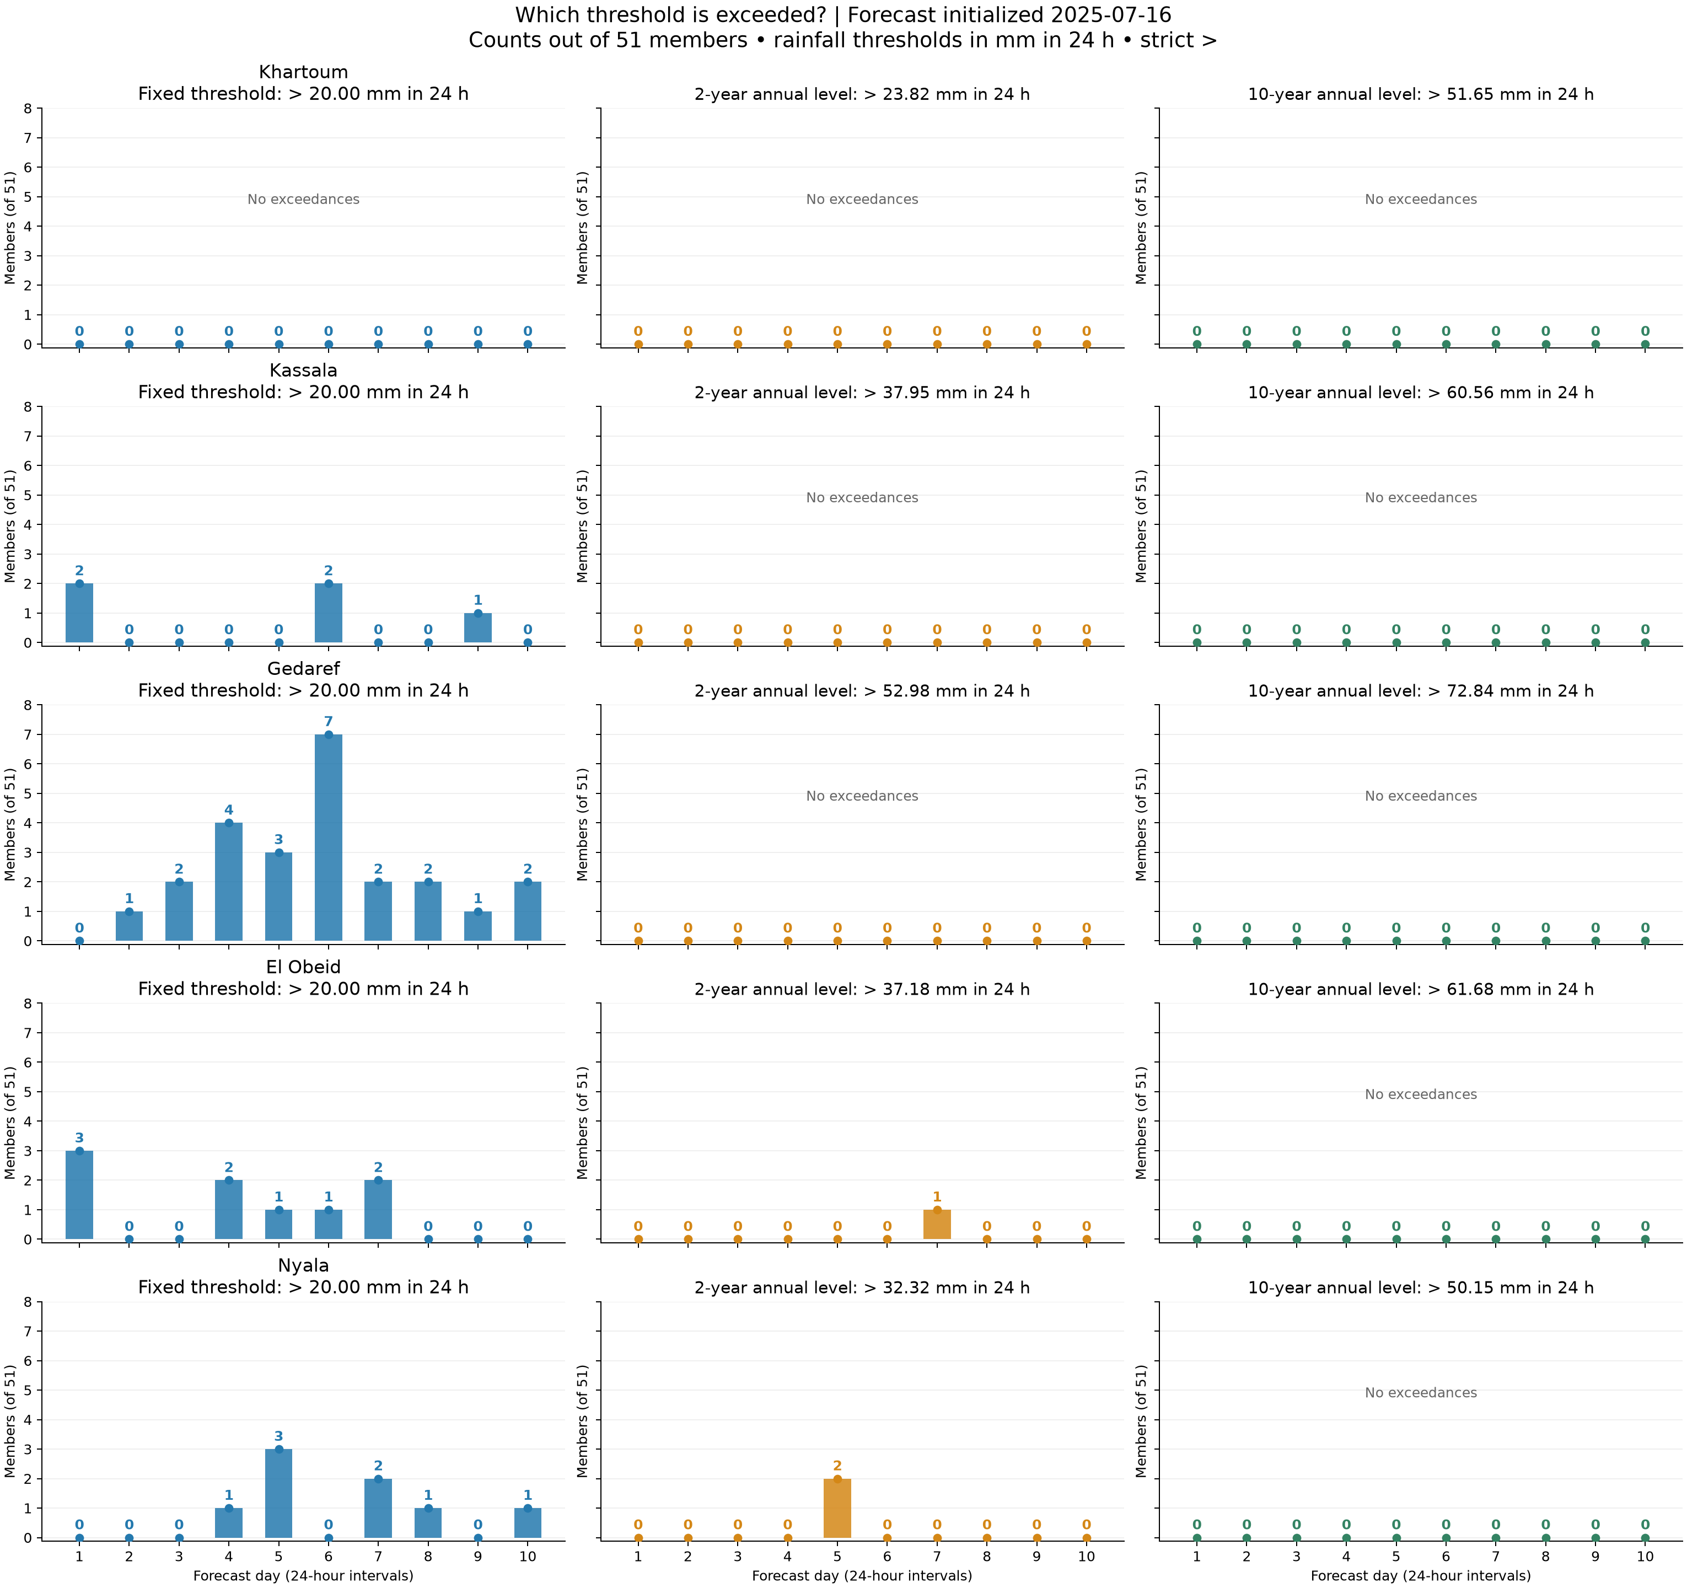
B: three thresholds across five towns
16 July 2025 start, ten daily intervals, 51 members
Fixed threshold: 20 mm in 24 h
Local 2-year and 10-year levels come from Task A.
El Obeid and Nyala alone have 2-year exceedances. No town exceeds a 10-year level.
5
Notes:
Source: task_B/five_town_threshold_comparison.png and summary_counts.csv. Counts use strict >.

Slide 6
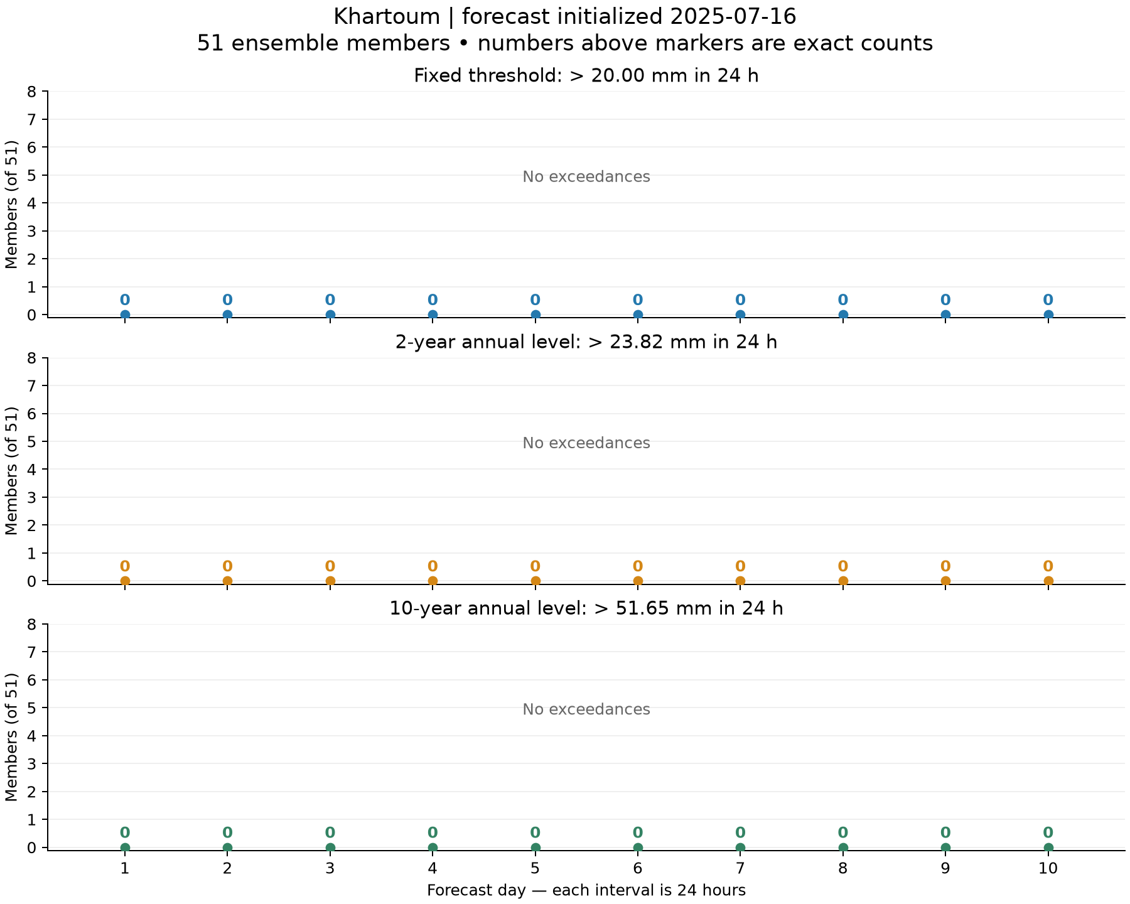
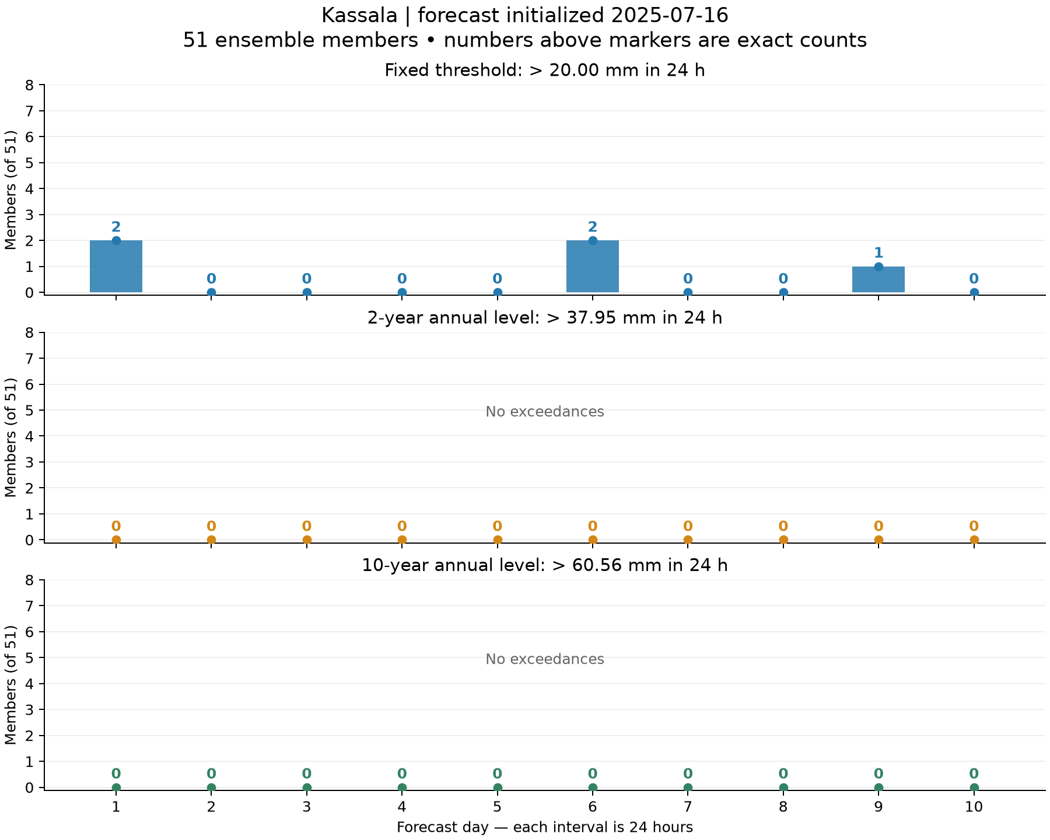
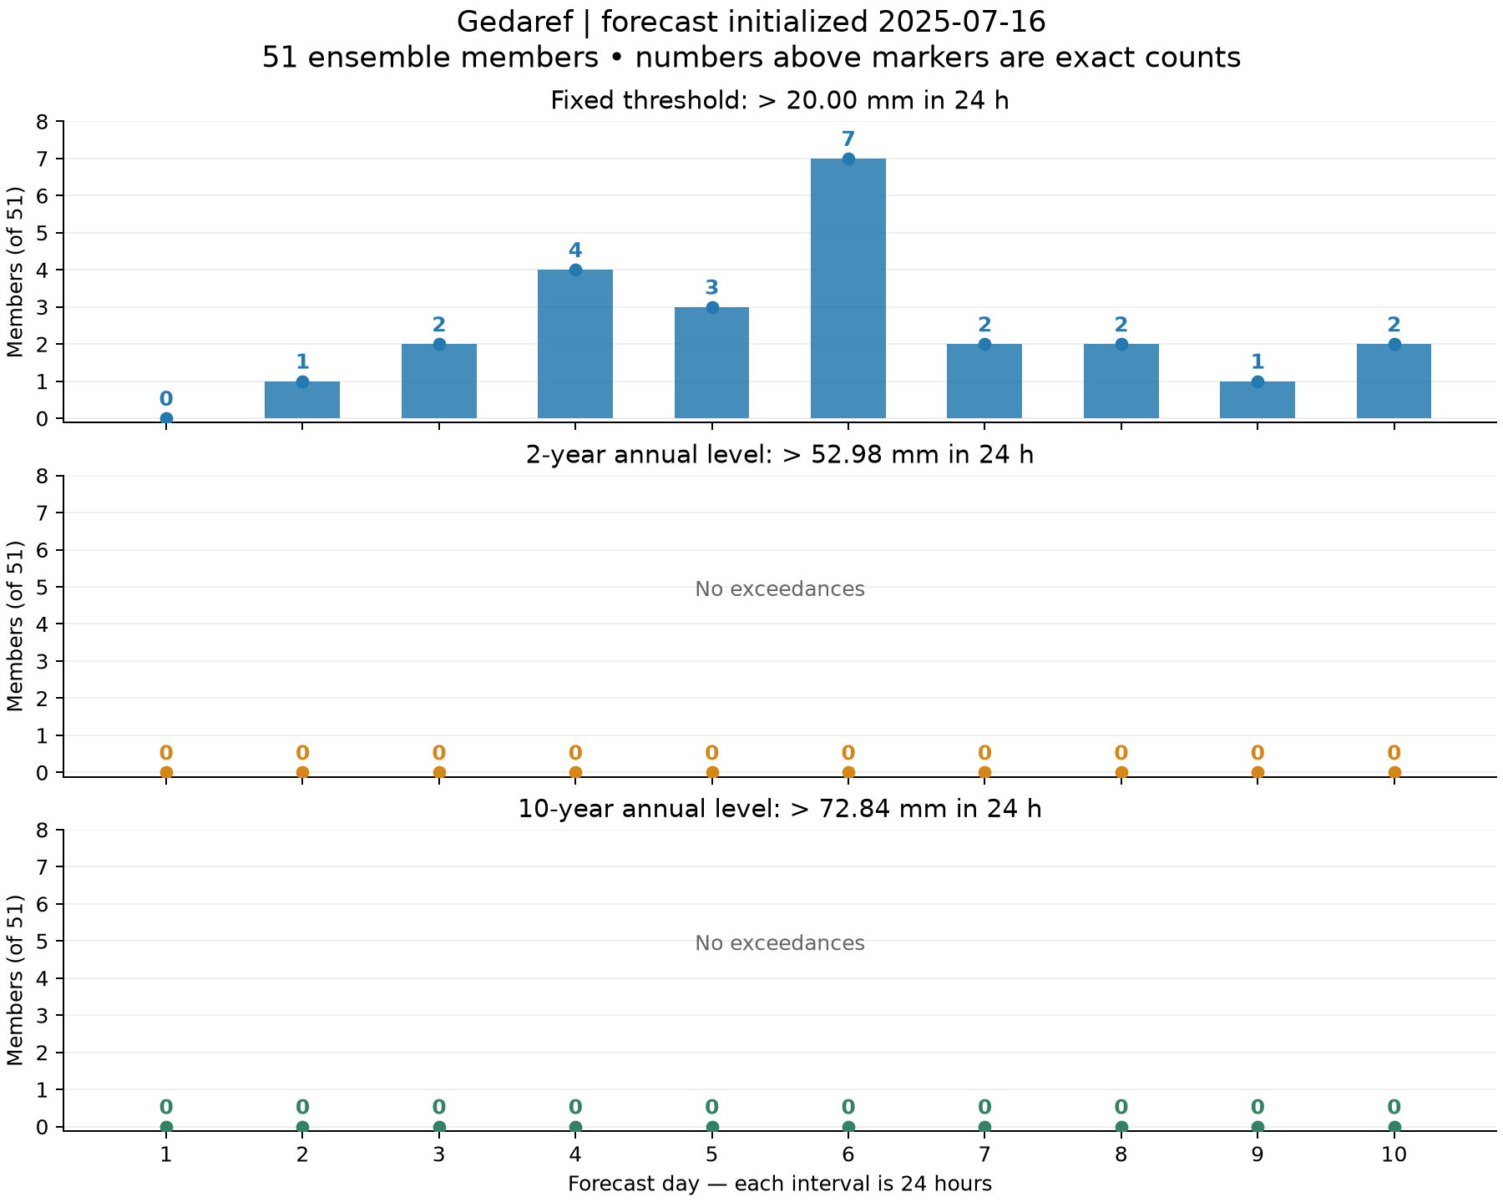
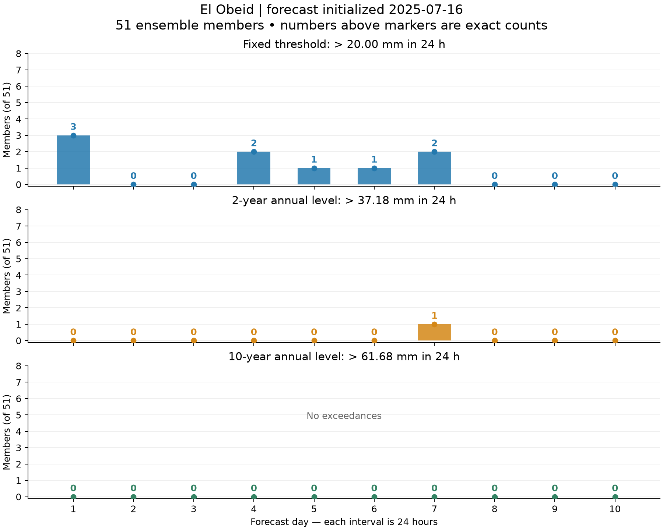
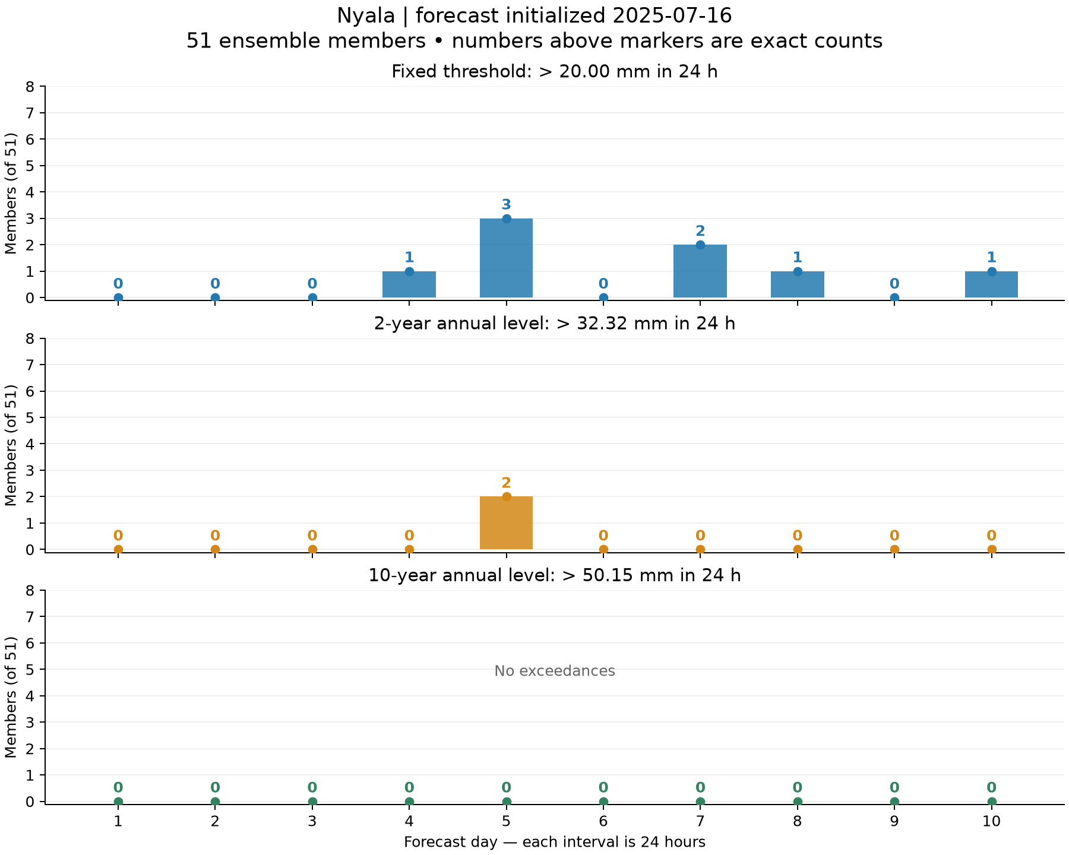
B: daily member counts at each town
Each figure separates the fixed 20 mm, 2-year and 10-year thresholds
Daily counts are out of 51 members. Rainfall thresholds are mm in 24 h. Exact zero labels distinguish no exceedance.
6
Notes:
Source figures: task_B/khartoum_threshold_counts.png, task_B/kassala_threshold_counts.png, task_B/gedaref_threshold_counts.png, task_B/el_obeid_threshold_counts.png, task_B/nyala_threshold_counts.png
Generating scripts and reports: task_A through task_D. Original PNGs retain full resolution. Grouped slides provide overview; zoom into individual figures for detailed labels.

Slide 7
B: threshold sensitivity and xclim counts
First three columns count member-days out of 510 per town. Last column: distinct members at ≥20 mm.
Town | 20 mm | 2-year | 10-year | ≥1 heavy day
Khartoum | 0 | 0 | 0 | 0/51
Kassala | 5 | 0 | 0 | 5/51
Gedaref | 24 | 0 | 0 | 22/51
El Obeid | 9 | 1 | 0 | 7/51
Nyala | 8 | 2 | 0 | 7/51
xclim uses ≥, plots use >. A 2-year annual level implies 50% annual exceedance. The illustrative 0.190% daily probability assumes independent, identical days.
7
Notes:
Sources: task_B/summary_counts.csv and results.md. All 765 xclim counts match direct counts. Member-days are correlated predictions; they do not estimate observed climatological frequency.

Slide 8
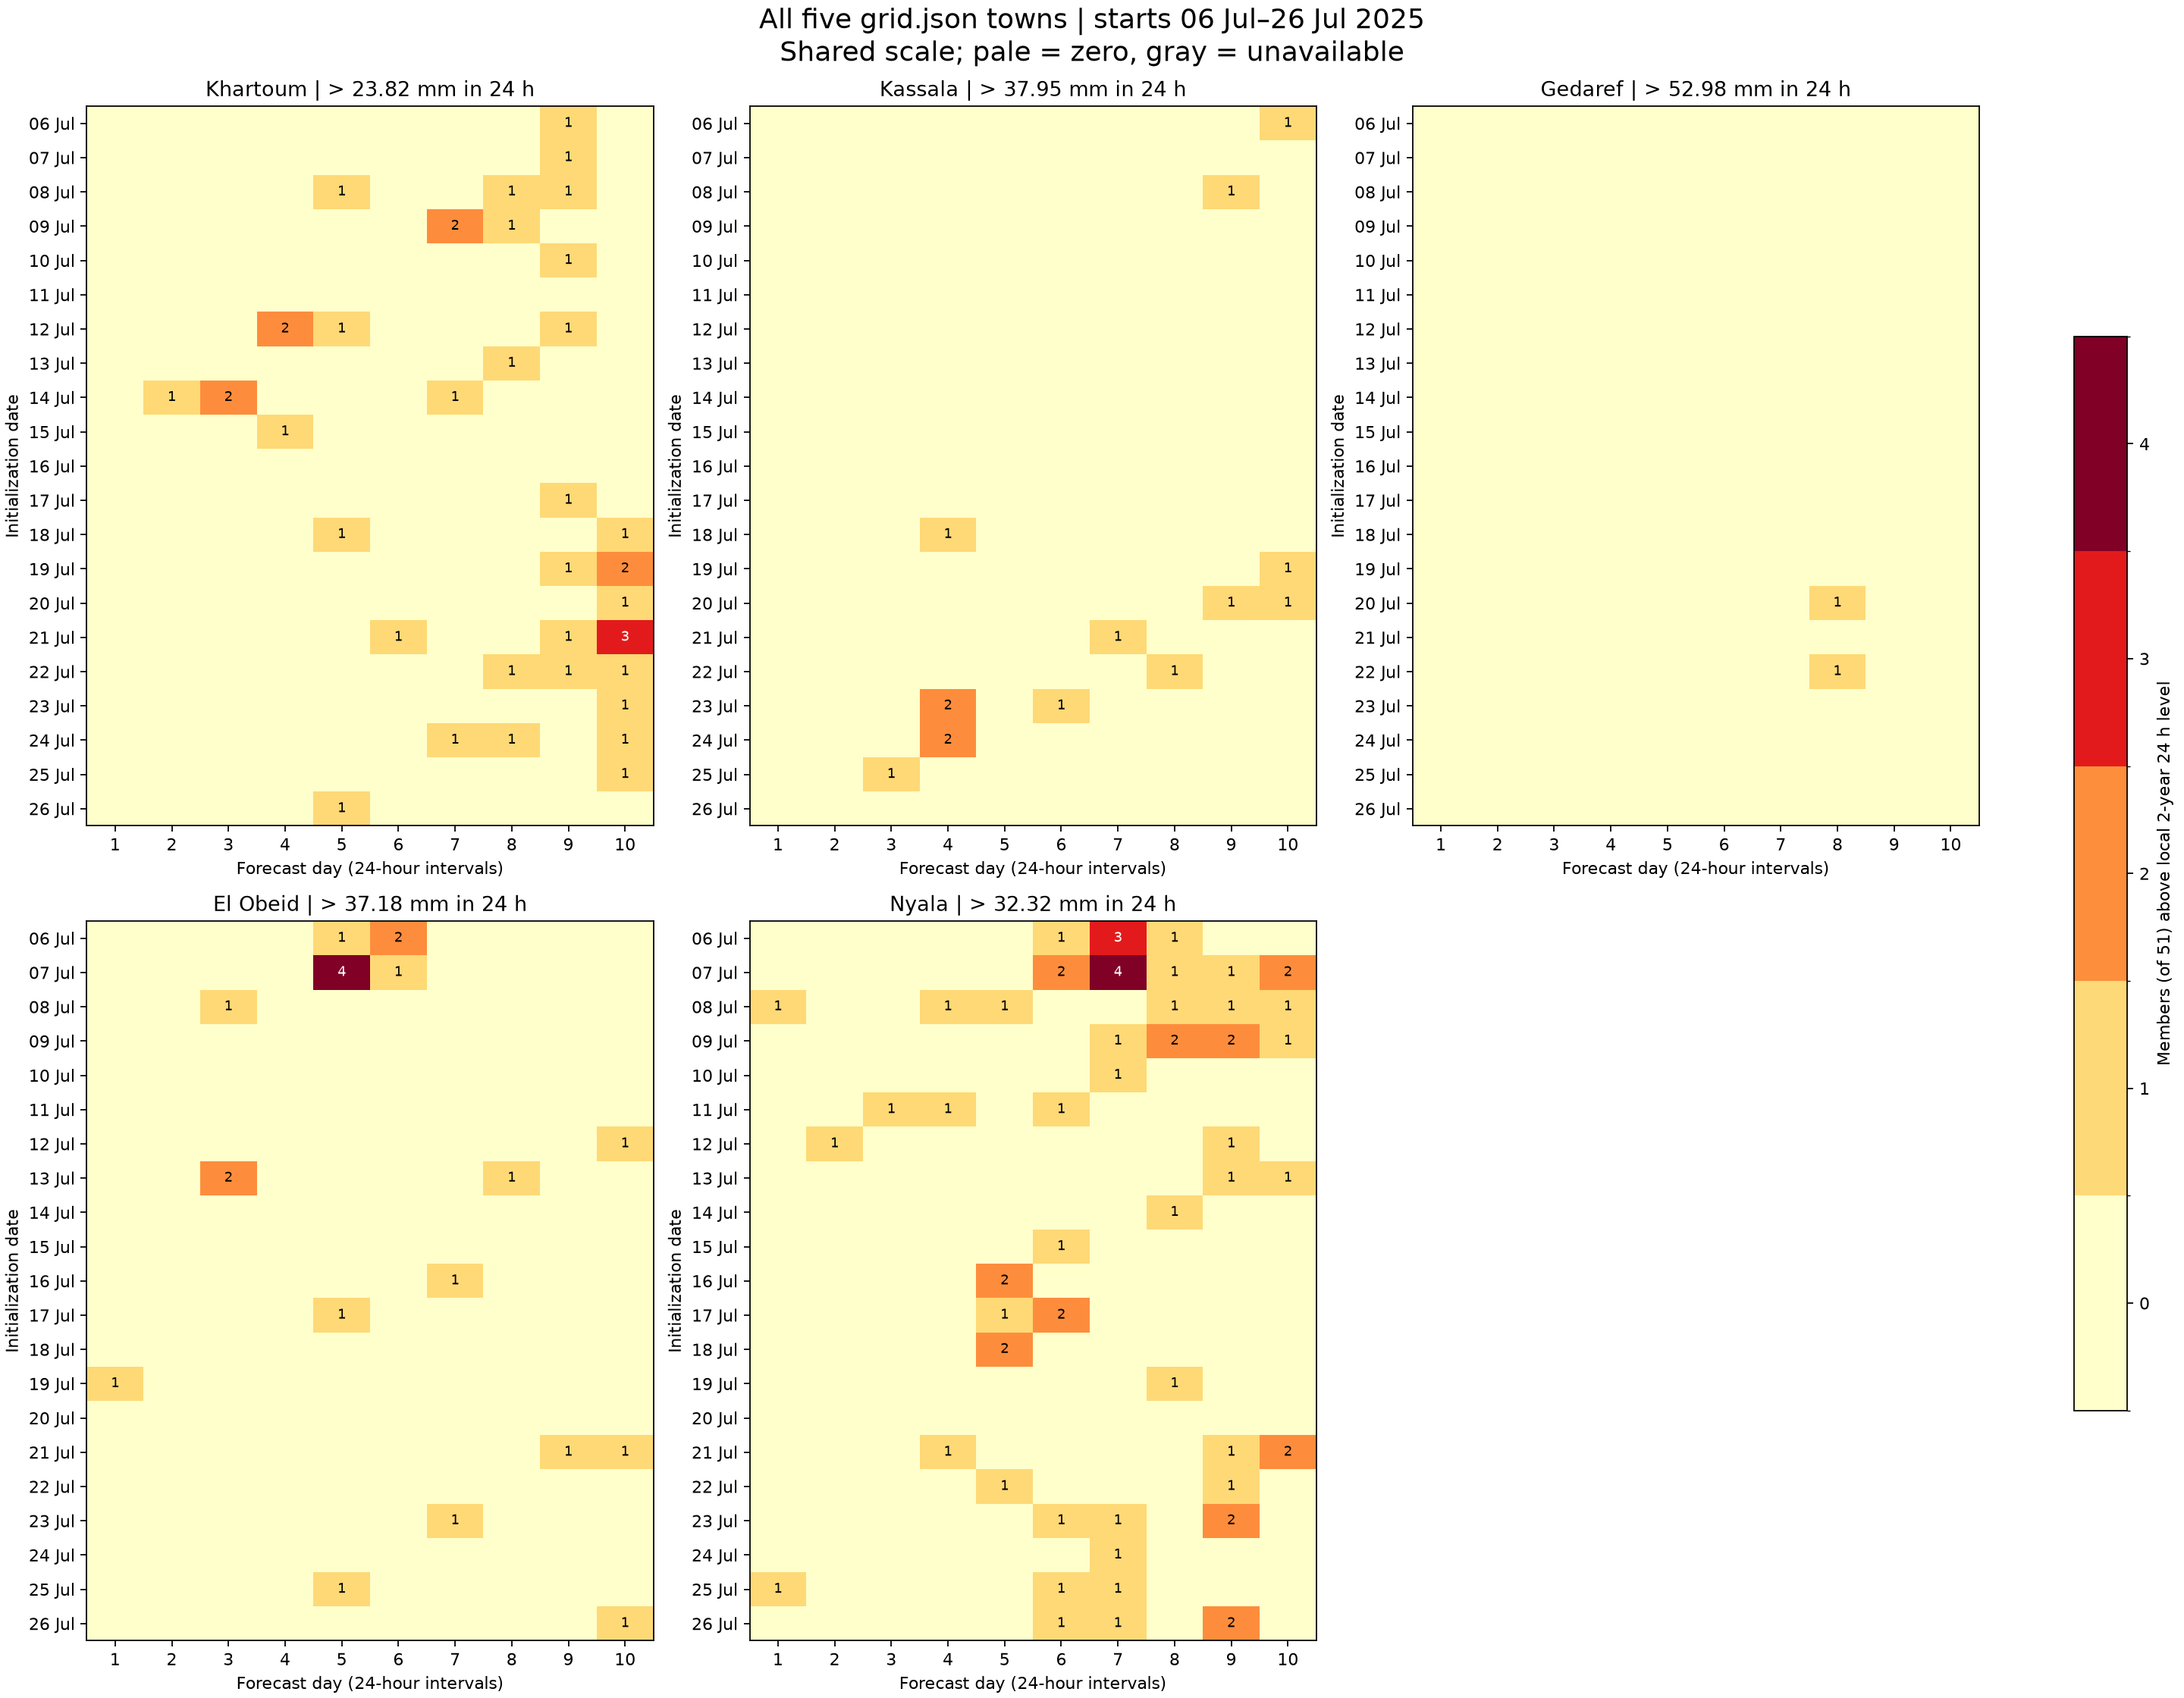
C: forecast signals across 21 starts
6–26 July 2025, ten daily leads at every town
Signal: at least one member above the local 2-year 24 h level.
Nyala: signals in 20/21 starts
Gedaref: signals in 2/21 starts
A one-member signal is only 1.96% of the ensemble.
8
Notes:
Source: task_C/five_town_heatmap_comparison.png and town_signal_summary.csv. Shared integer scale. Pale is zero and gray unavailable.

Slide 9
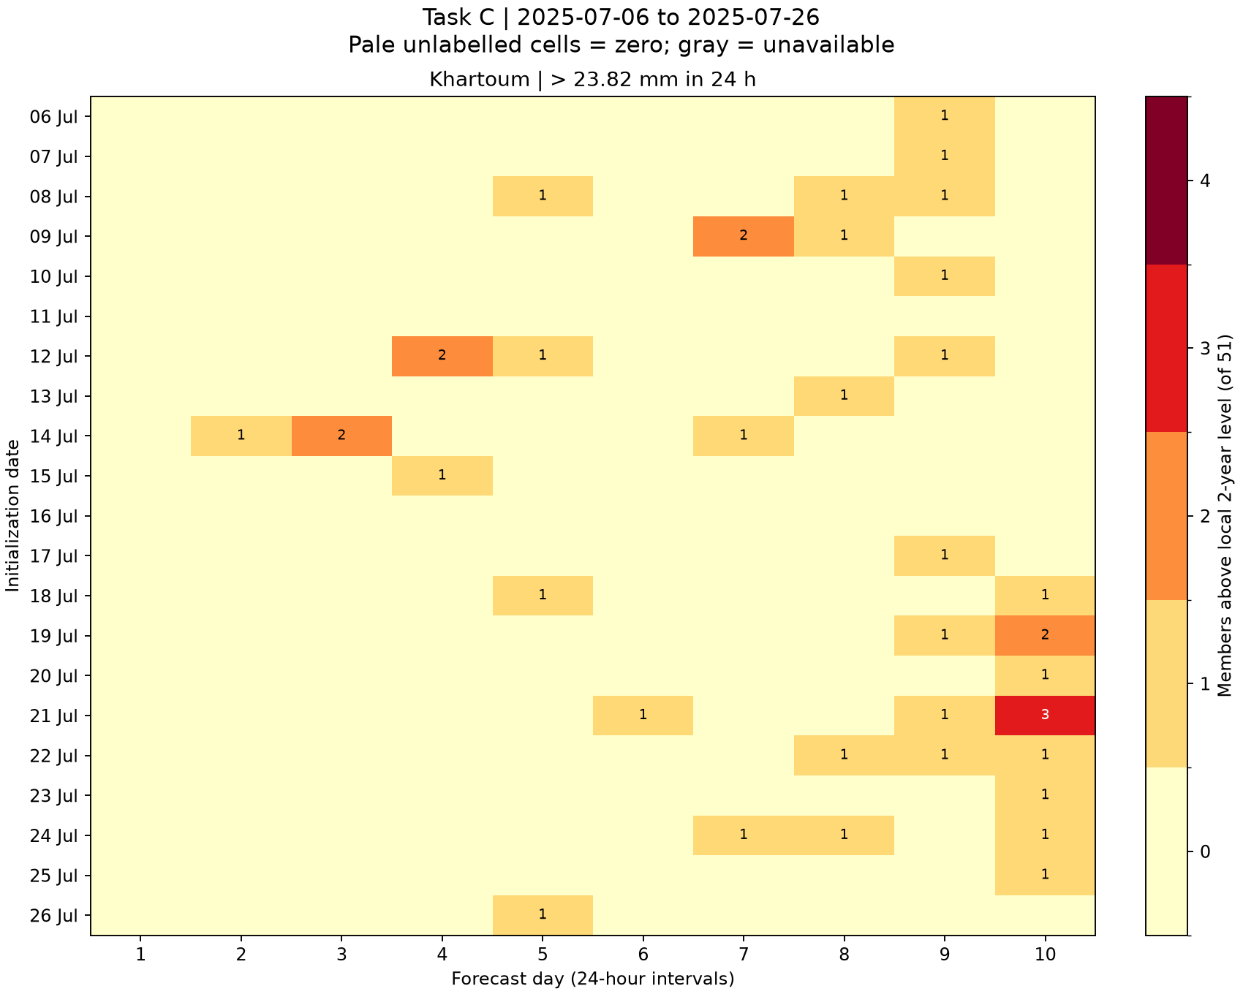
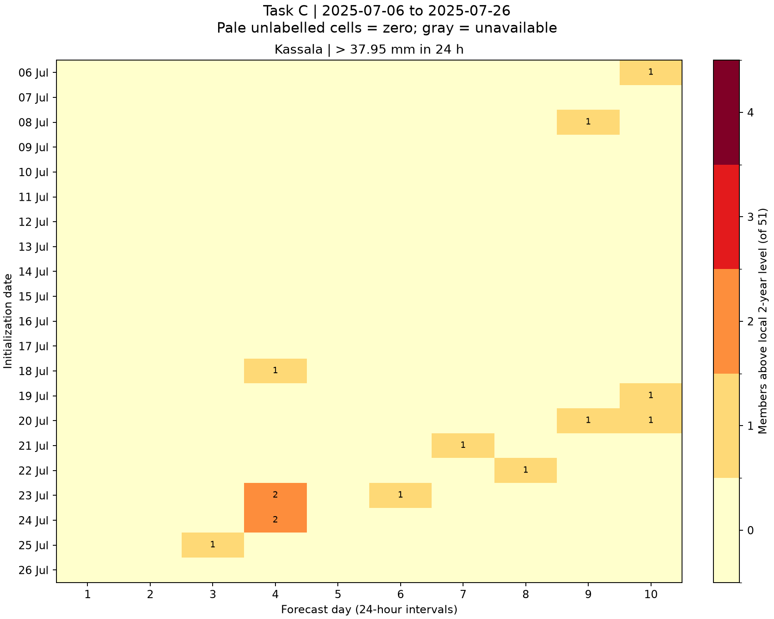
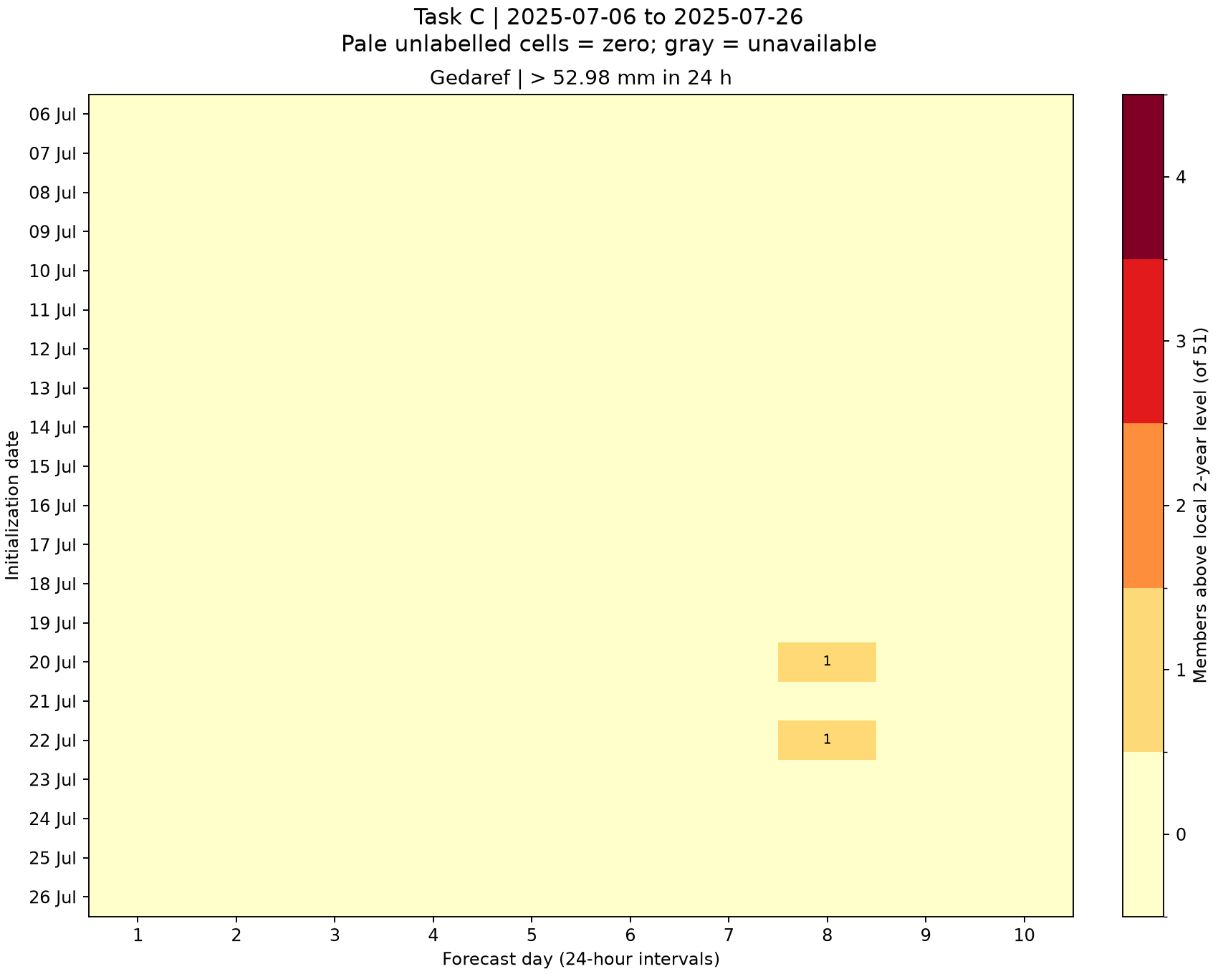
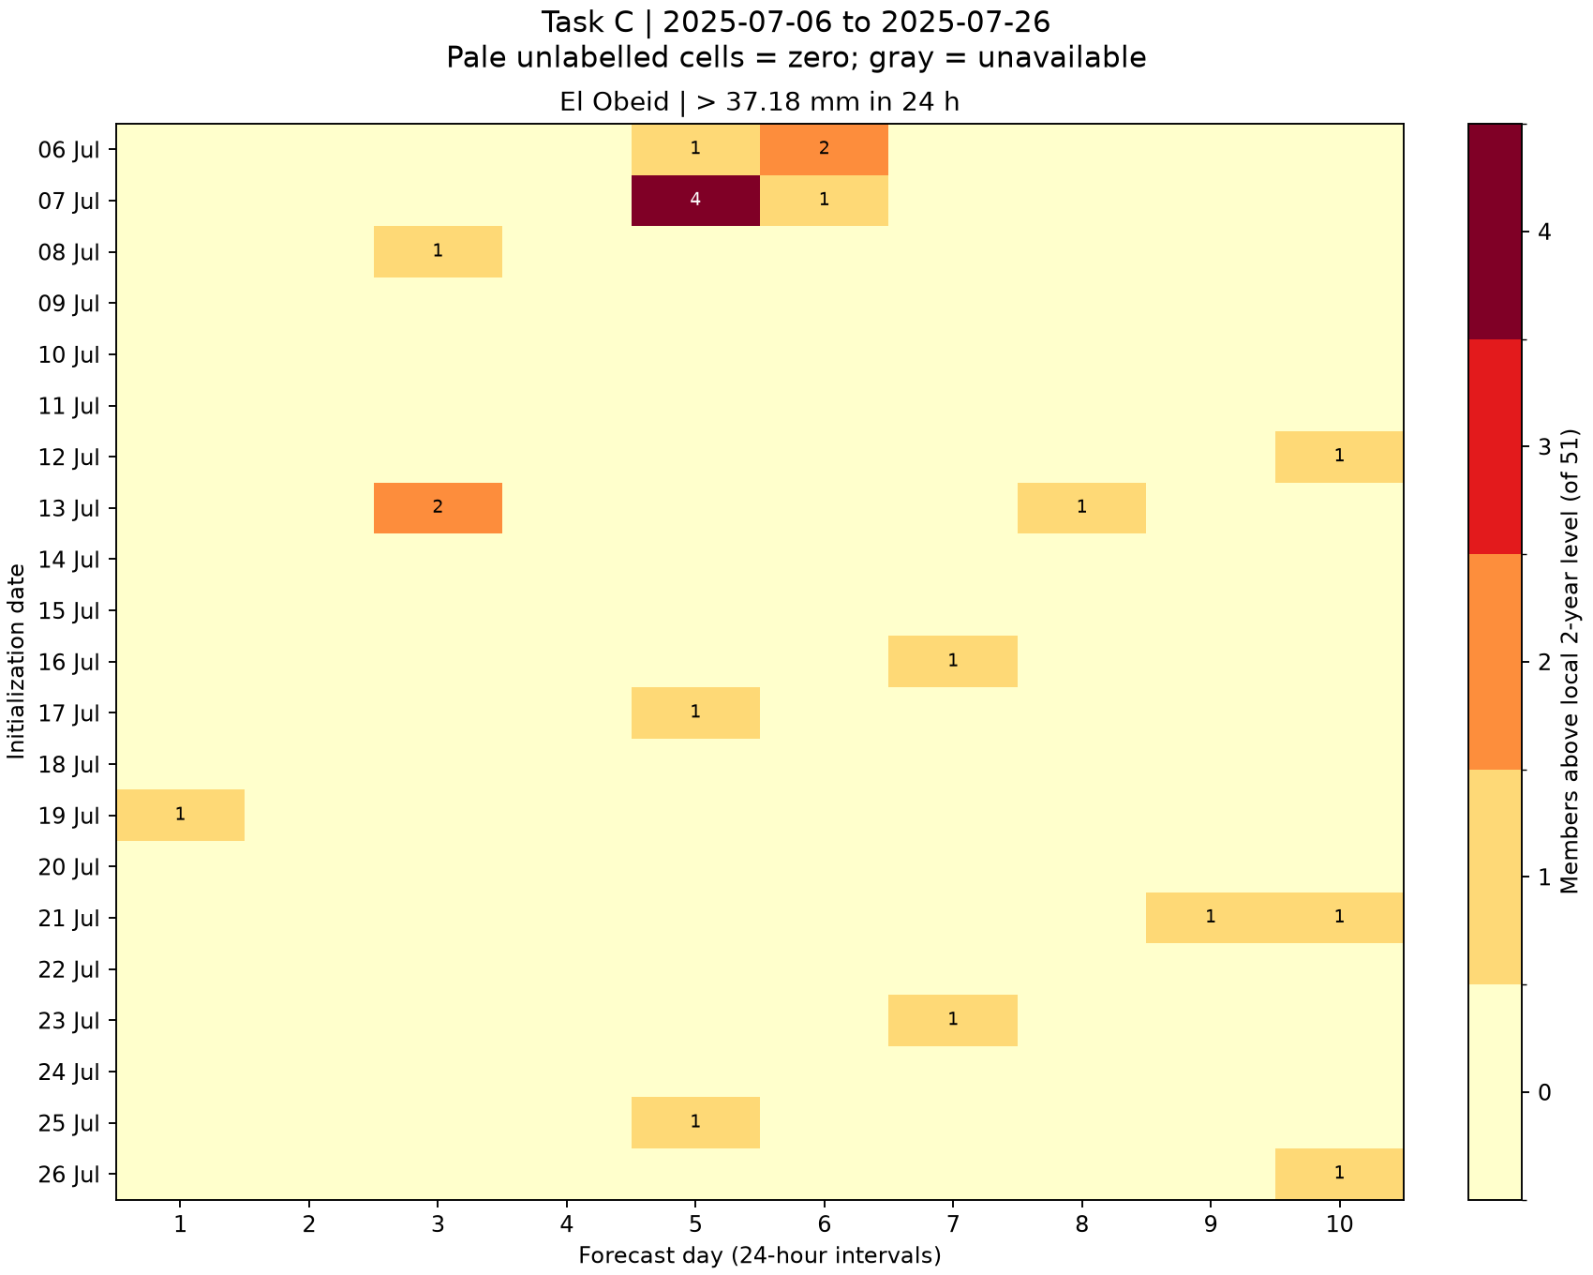
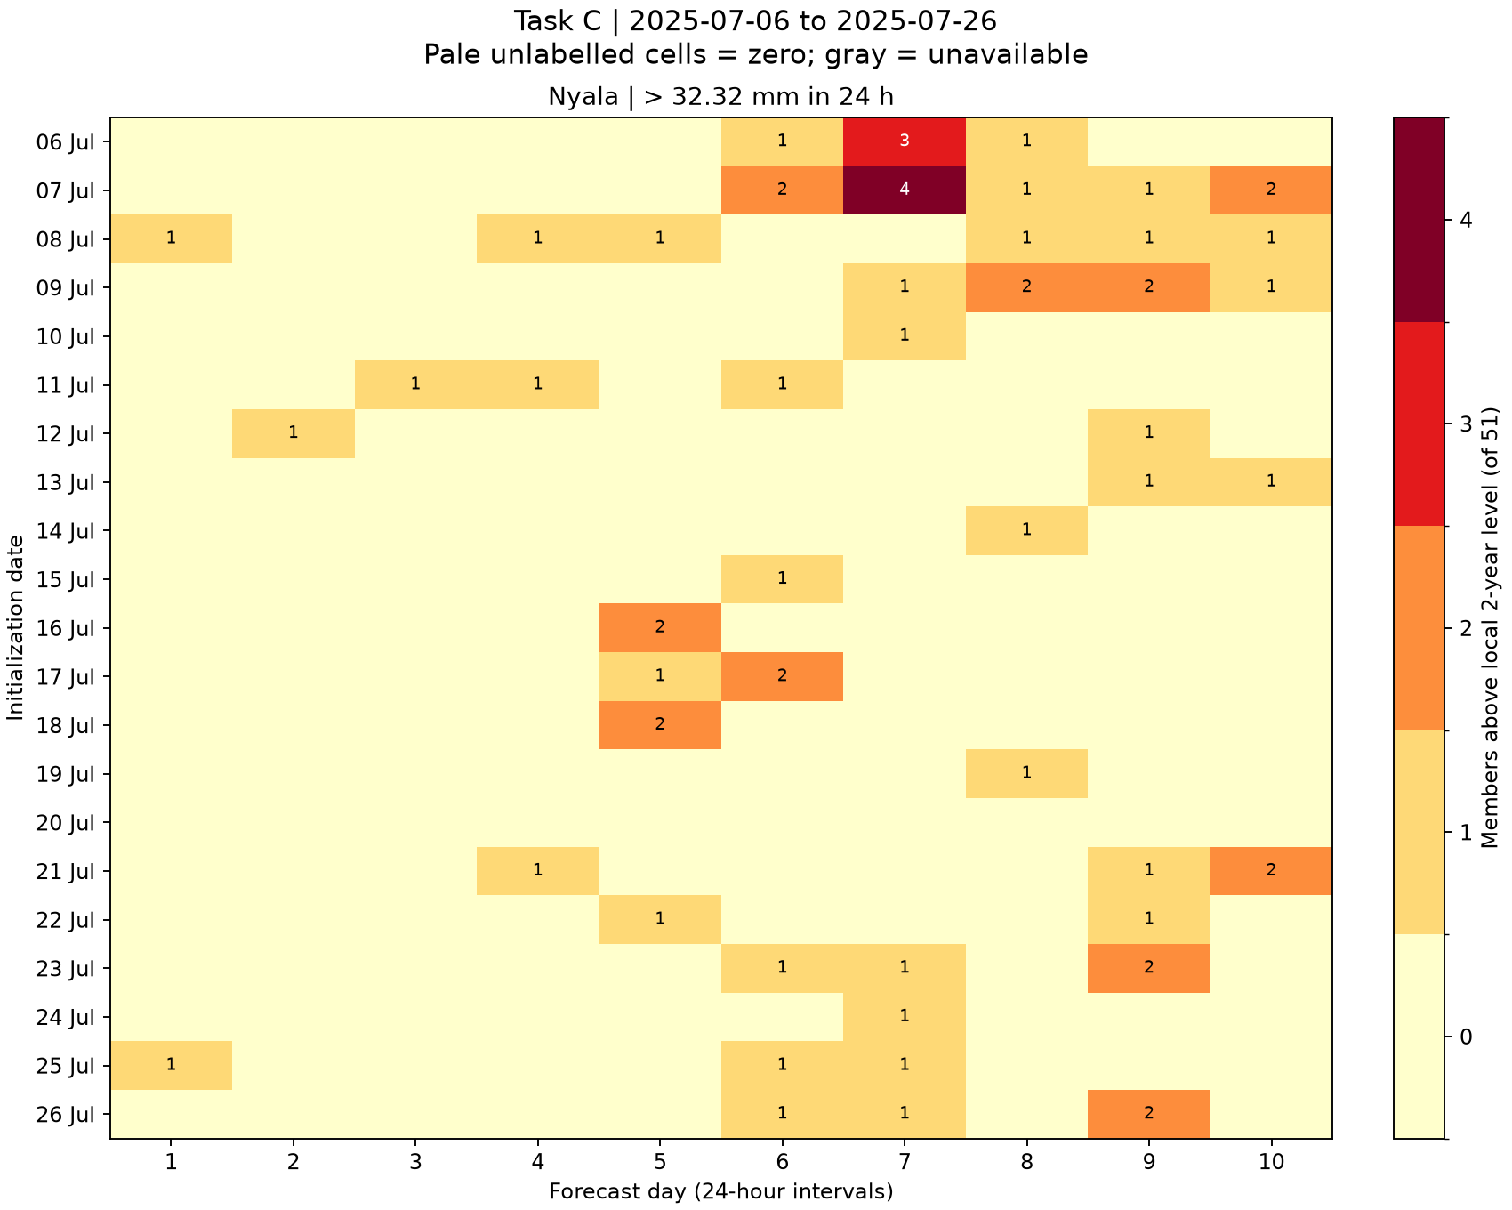
C: complete daily signal histories
Rows are initialization dates, columns are forecast days
Shared member-count scale across towns. Local rainfall thresholds differ. All 1,050 town/start/day cells are available.
9
Notes:
Source figures: task_C/khartoum_heatmap.png, task_C/kassala_heatmap.png, task_C/gedaref_heatmap.png, task_C/el_obeid_heatmap.png, task_C/nyala_heatmap.png
Generating scripts and reports: task_A through task_D. Original PNGs retain full resolution. Grouped slides provide overview; zoom into individual figures for detailed labels.

Slide 10
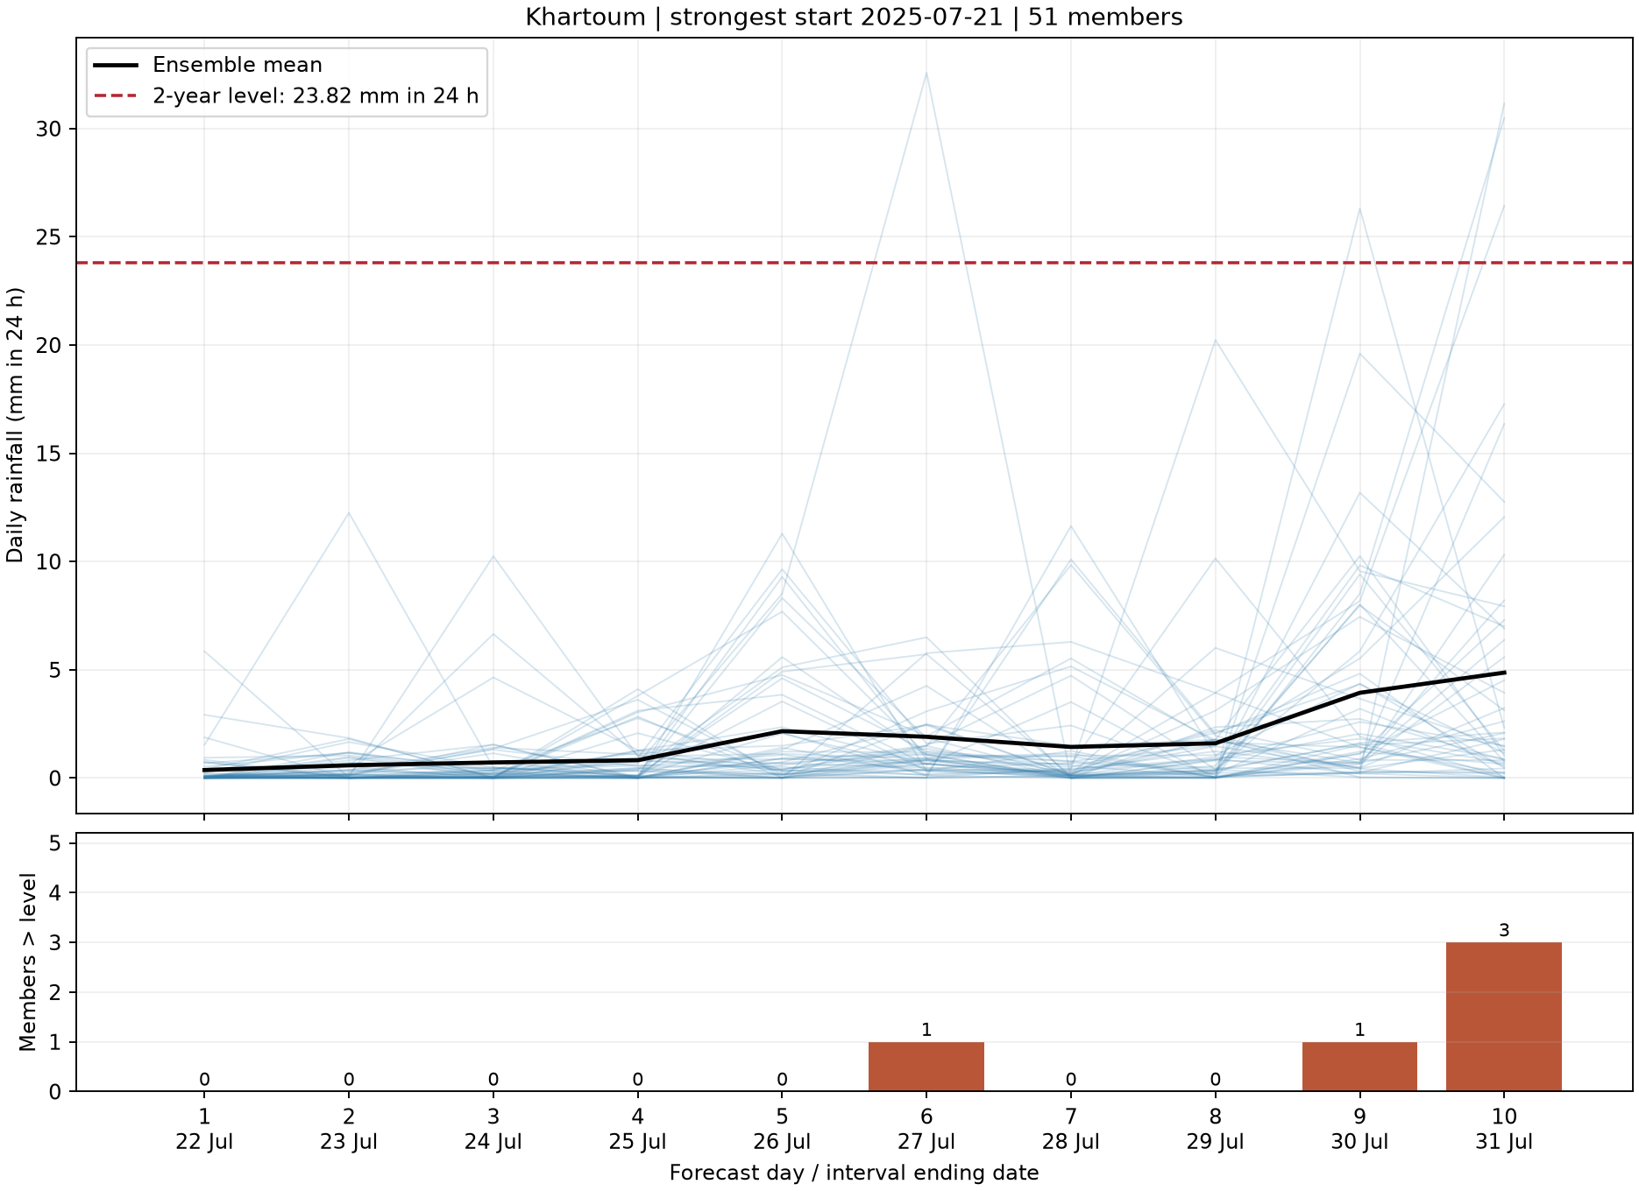
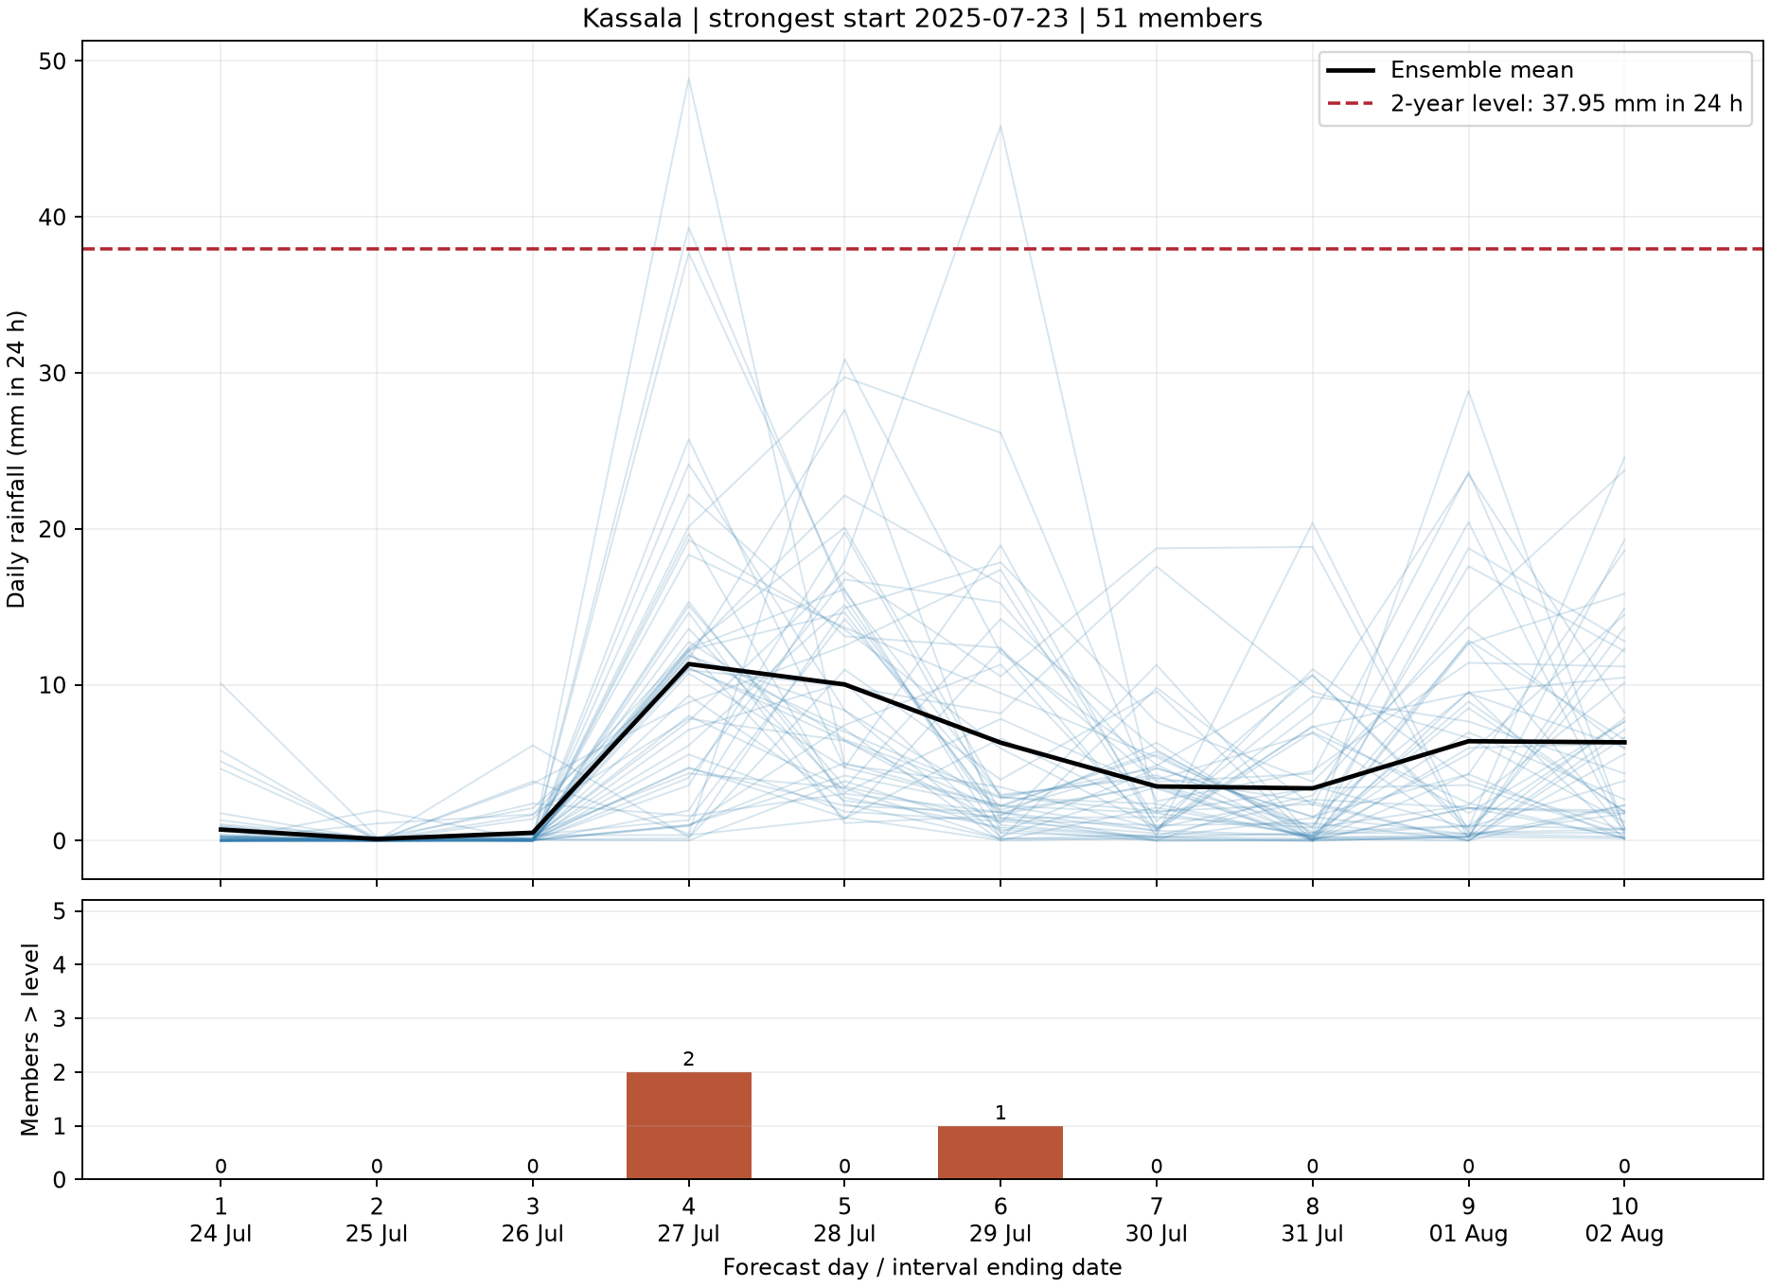
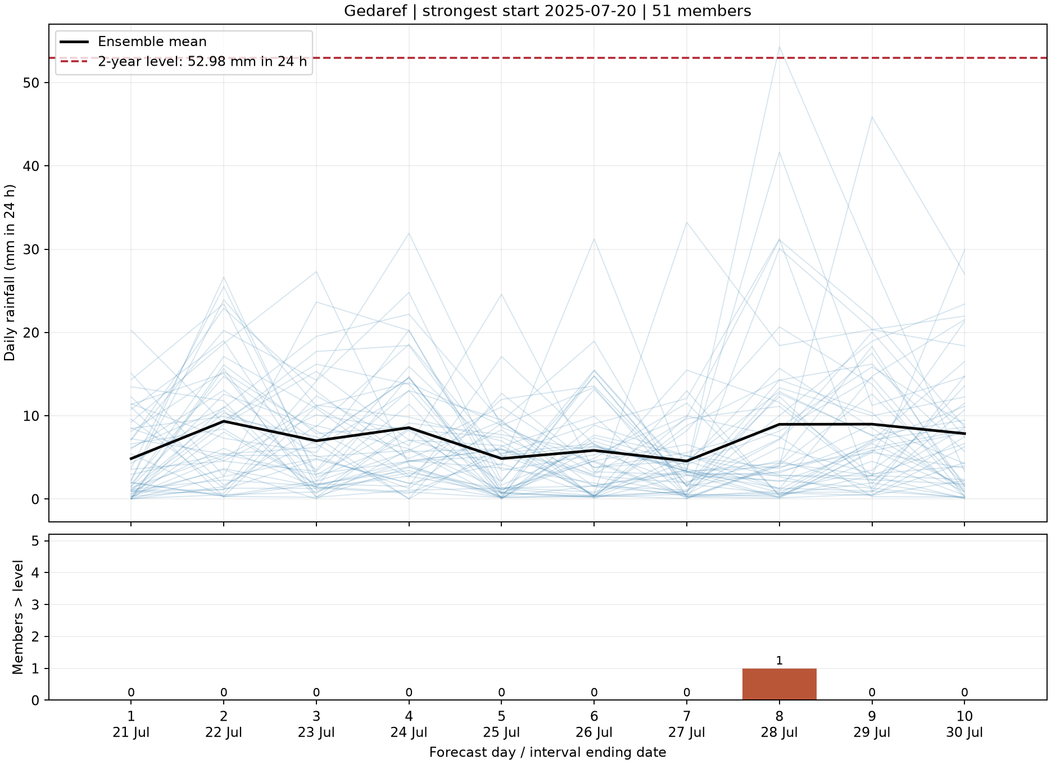
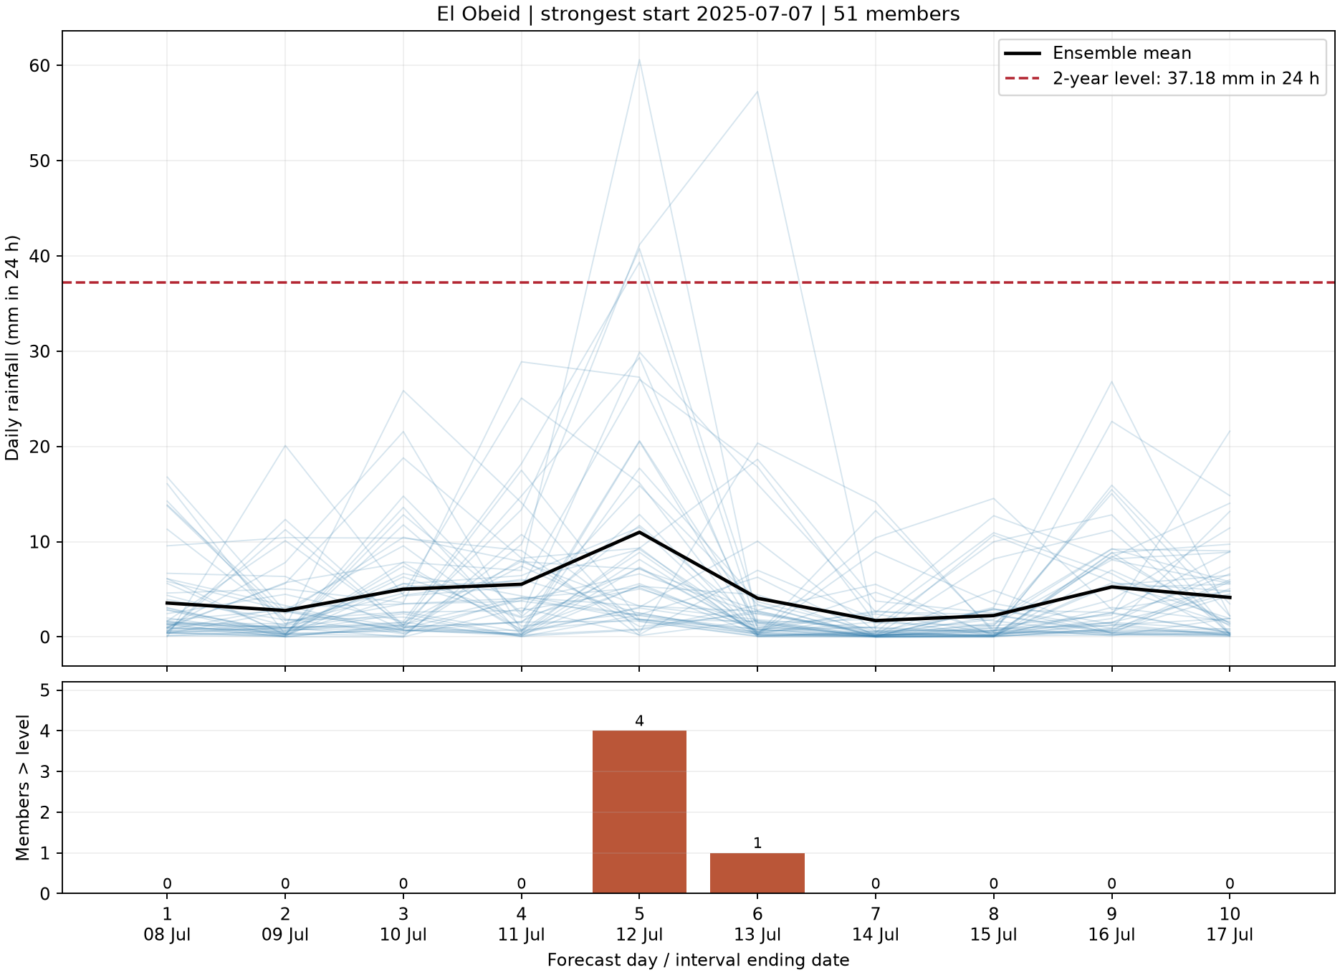
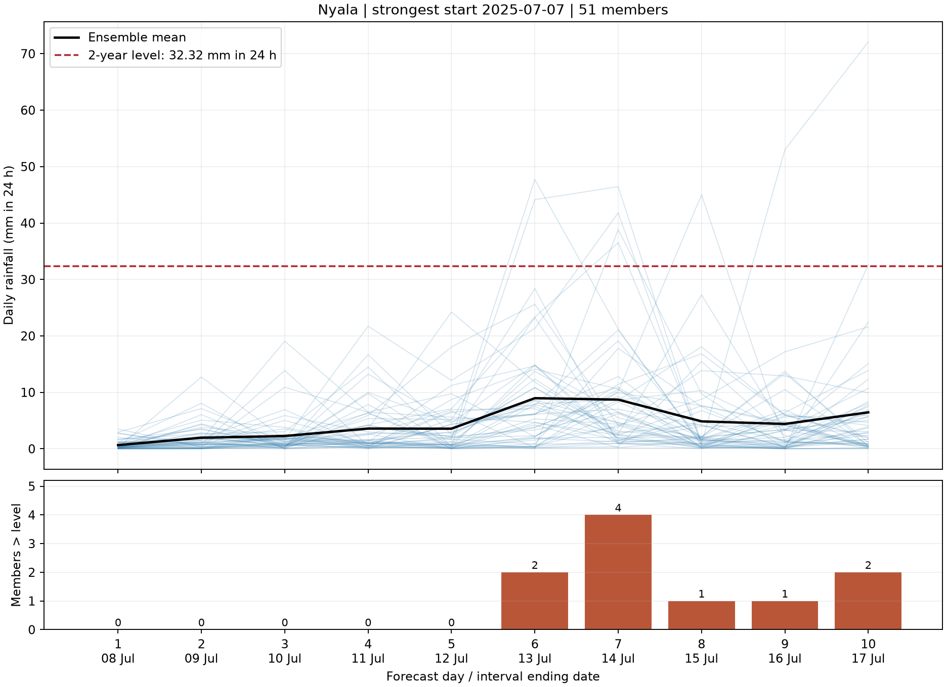
C: the strongest start at each town
Daily rainfall plumes, ensemble mean, local threshold and member counts
Strongest start maximizes peak count, then summed member-day counts, then earliest date. Plume rainfall units: mm in 24 h.
10
Notes:
Source figures: task_C/khartoum_strongest_start_plume.png, task_C/kassala_strongest_start_plume.png, task_C/gedaref_strongest_start_plume.png, task_C/el_obeid_strongest_start_plume.png, task_C/nyala_strongest_start_plume.png
Generating scripts and reports: task_A through task_D. Original PNGs retain full resolution. Grouped slides provide overview; zoom into individual figures for detailed labels.

Slide 11
C: Nyala has the most persistent weak signal
Streaks require consecutive starts signaling the same target interval
Town | Peak | Lead days | Signal streak | Streak target
Khartoum | 3/51 | 10 | 3 starts | 2025-07-16
Kassala | 2/51 | 10 | 2 starts | 2025-07-28
Gedaref | 1/51 | 8 | 1 start | 2025-07-28
El Obeid | 4/51 | 10 | 2 starts | 2025-07-12
Nyala | 4/51 | 10 | 5 starts | 2025-07-17
Nyala’s starts on 7–11 July target the interval ending 17 July. Four towns tie at the ten-day horizon, targeting different dates. No town reaches five members above the threshold.
11
Notes:
Sources: task_C/town_signal_summary.csv and signal_criterion_sensitivity.csv. The Target ends column refers to the longest signal streak; Lead days refers to the earliest-lead example, which may target a different interval. No observed 2025 rainfall is available for event verification.

Slide 12
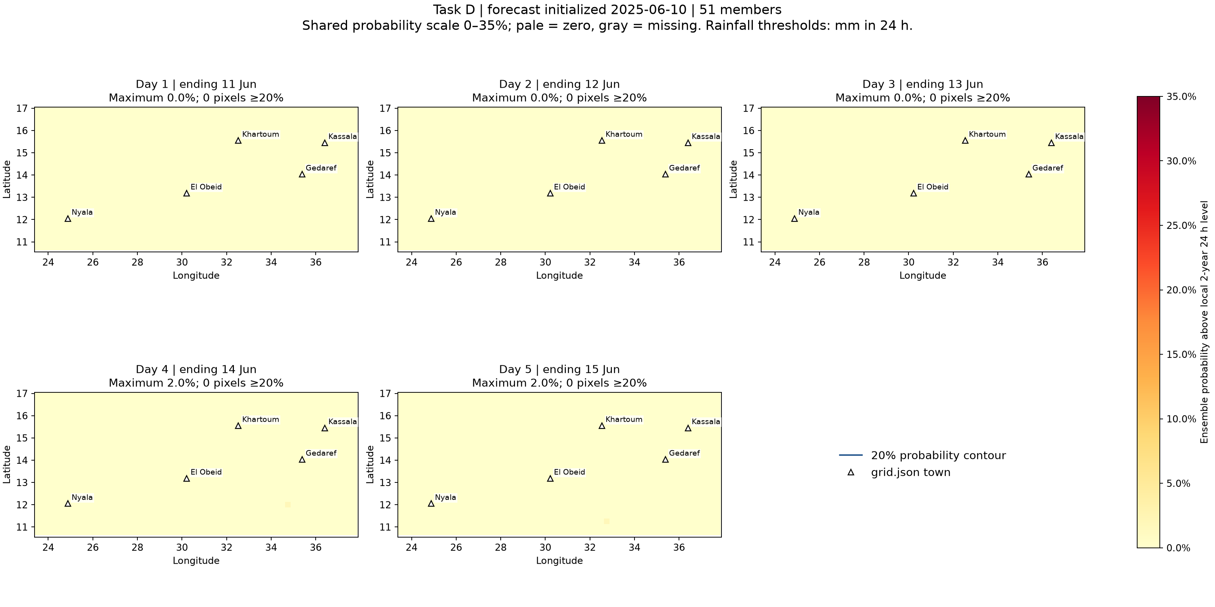
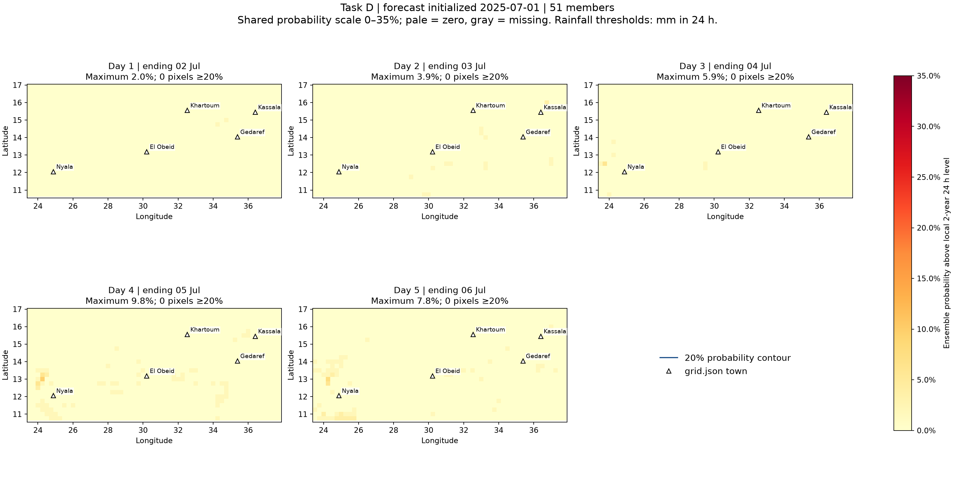
D: probability maps for the early seasonal samples
Local 2-year 24 h thresholds and all five grid.json towns
June 10 peak: 1.96%. July 1 peak: 9.80%. No sampled pixel reaches 20% for these two starts.
12
Notes:
Source figures: task_D/probabilities_2025-06-10.png, task_D/probabilities_2025-07-01.png
Generating scripts and reports: task_A through task_D. Original PNGs retain full resolution. Grouped slides provide overview; zoom into individual figures for detailed labels.

Slide 13
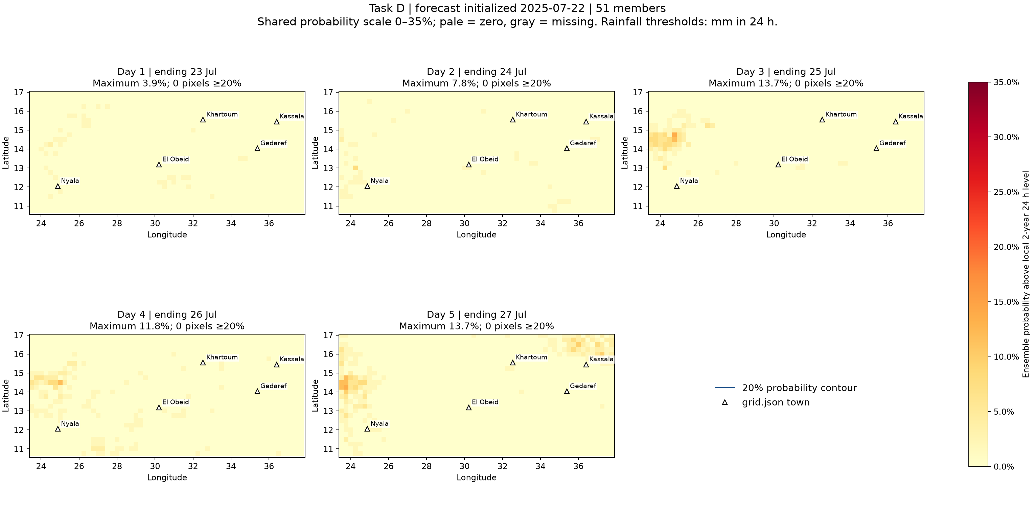
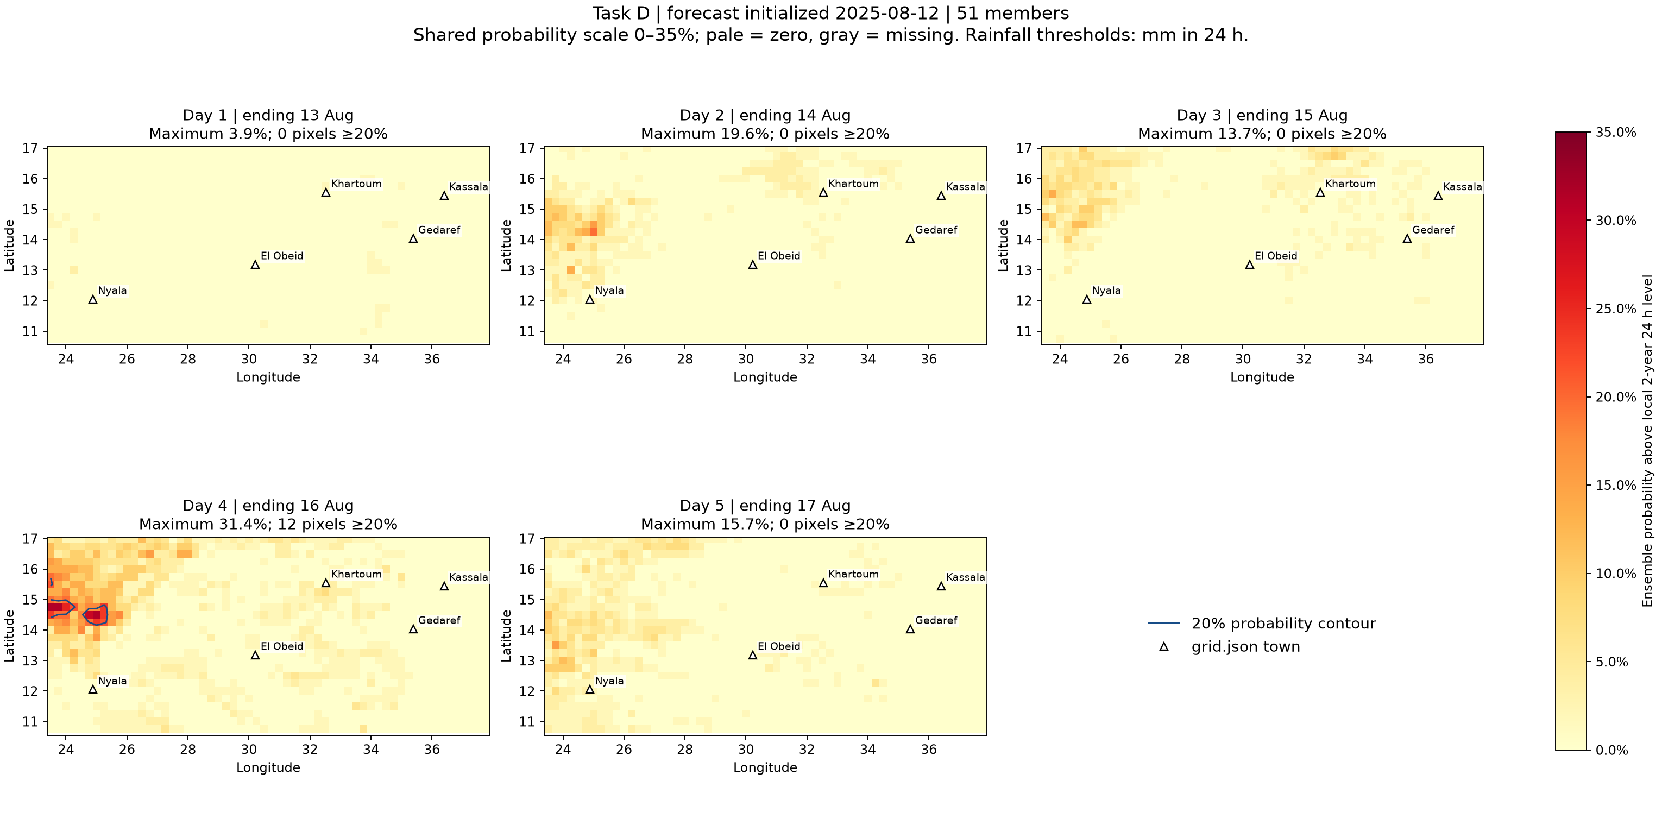
D: the August sample contains the regional hotspot
Probability decision: ≥20%, requiring at least 11 of 51 members
August 12, day 4: 12 pixels reach 20%, with a peak of 16/51 = 31.37%. The target interval ends 16 August.
13
Notes:
Source figures: task_D/probabilities_2025-07-22.png, task_D/probabilities_2025-08-12.png
Generating scripts and reports: task_A through task_D. Original PNGs retain full resolution. Grouped slides provide overview; zoom into individual figures for detailed labels.

Slide 14
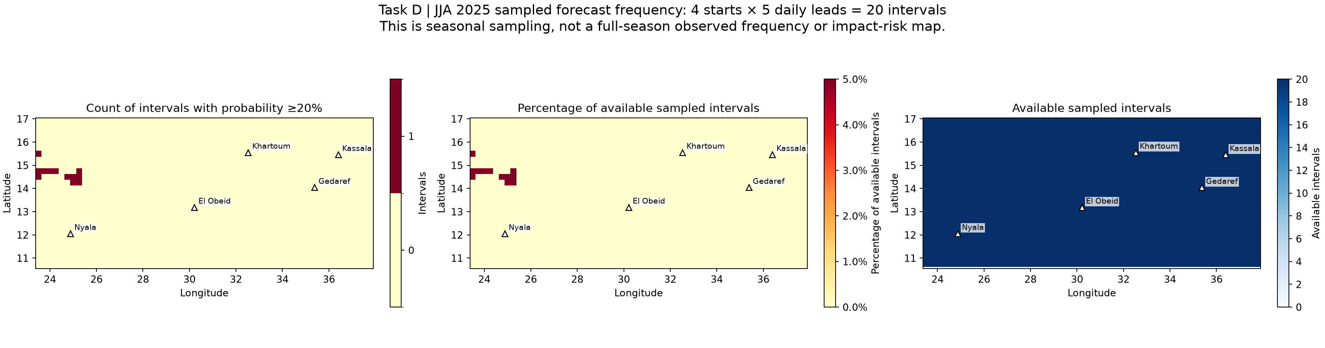
D: sampled frequency and town results
Four starts × five daily leads = 20 sampled forecast intervals
Twelve regional pixels reach 20% once each. Maximum frequency: 1/20 = 5%. All five town pixels remain below 20%.
14
Notes:
Sources: task_D/sampled_season_frequency.png, town_frequency.csv and regional_hotspots.csv. These samples do not cover every JJA day. A forecast pixel uses its nearest CMORPH threshold pixel, which can differ from direct town-coordinate selection in A–C.

Slide 15
Conclusions and the cost of map reads
Pan chunks contain a broad map, all 51 members, and one start/lead
Start | Cloud read | Chunks
2025-06-10 | 37.43 s | 6
2025-07-01 | 19.49 s | 6
2025-07-22 | 21.14 s | 6
2025-08-12 | 34.88 s | 6
Six cumulative endpoints give five daily maps. Threshold read: 10.84 s, one chunk. Local thresholds shape weak signals. Observed 2025 rainfall and impacts are needed to assess warning skill.
15
Notes:
Sources: task_D/read_timings.csv, results.md and task_A through task_C reports. Forecast chunk shape [1,1,51,321,261]. Measurements include transfer, decode and compute. Data: data.source.coop/e4drr-project. Examples: github.com/icpac-igad/python-workshop. All 28 final scientific PNGs appear in this deck.

