Slide 1

Analysing BestBuy Reviews
Yuejia Feng
Ting-Yi Hung
Abhilasha Kanitkar
Brian Peterson

Slide 2
BestBuy Context
Users buy product through the website
Users are classified as verified v. unverified
Reviewers get 25 points per review, 8 reviews per year
Talk about Bestbuy members, elite members, etc.
To verify a purchase, you click a link to an email that you get
Notes:
Brian

Slide 3
The Business question
Are the unverified reviews substantially different from the verified reviews?
We suspect that unverified reviews would be members that haven’t bought the product but want to get the discount points
We want to see if this is the case

Slide 4
2. Our Process
Data Source : Scraped BestBuy website for reviews of product(s). ~3.5K reviews of each product Split the data into Verified vs Unverified Reviews
Products : Canon DSLR Camera, Bose Speakers, Samsung Home Theatre System,
Apple Macbook Pro.
Analysis
Step 1: Evaluating word counts to get a better sense of data. Step 2: Sentiment Analysis on Verified and Unverified Reviews Step 3: Topic Modelling on Verified and Unverified Reviews. Step 4: Data comparison and inference

Slide 5
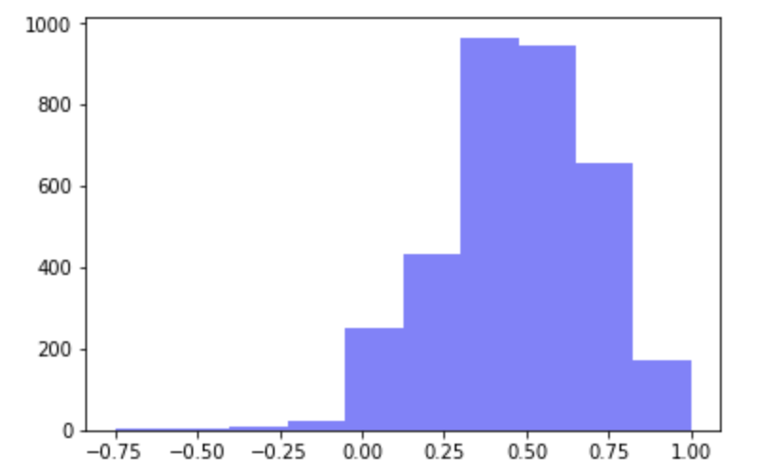
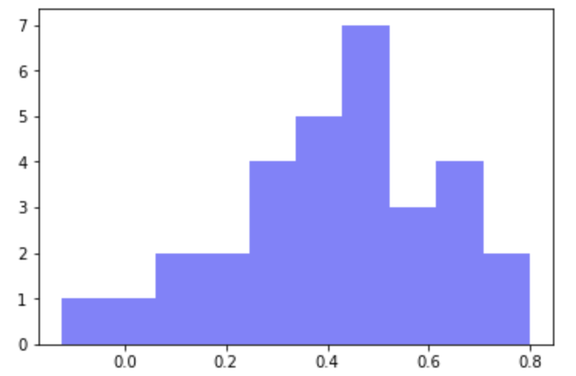
3. Insights : Sentiment Analysis
for DSLR Camera | Score | Sentiment
Verified Purchase | 0.472448 | Positive
Unverified Purchase | 0.415241 | Positive
Verified
Unverified
Conclusions:
Both kinds of reviews are positive.
The reviews of verified purchase are more positive.

Slide 6
3. Insights : Topic Modeling
Verified Purchase
Topic : Use | camera, great, easy, use, pictures, takes, love, quality, good, beginner, price, recommend
Topic : Features | camera, great, canon, lens, one, lenses, good, best, buy, use, price, phone
Topic : Gift | camera, great, pictures, bought, photography, daughter, loves, use, gift, easy, good, get
Unverified Purchase
Topic: Features | quality, pictures, take, video, settings, like, point, shoot, want, auto, cameras, card
Topic: General | camera, great, use, amazing, easy, good, lens, get, canon, lenses, love, would

Slide 7
4. Recommendations
Regardless of results, unverified customers fall into one of 4 segments:
People that are money pinchers and are looking to capitalize on Bestbuys reward structure
People that have strong opinions on a product they bought
People that like to write reviews
Owners/competitors of the products
Of these segments, two of them would be prone to extreme sentiments (owners/
Notes:
Brian

Slide 8
5. Challenges
Scraping challenges
Unsure what labels Bestbuy used to classify authors of reviews. To solve we added these labels to a list that we parse later.
Topic analysis
Identifying the right number of topics for verified vs unverified revuews
Visualization
Making sense of data at each step & deciding further action

