Slide 1
CS 35L Software Construction Lab
Week 2

Slide 2
Some more commands
cat – concatenate and print files.
Examples –
cat 01.txt to display the contents of file 01.txt.
cat 01.txt 02.txt to display the contents of both files.
cat file1.txt file2.txt > file3.txt
reads file1.txt and file2.txt and combines those files to make file3.txt.
cat note5 >> notes
attach note5 to notes.
cat > file1
write content to a new file file1 or overwrite file1 if it exists.
cat >> file1
add additional content to file1.

Slide 3
Some more commands
head - first 10 lines of file, unless otherwise stated.
Example –
head myfile.txt – Would display the first ten lines of myfile.txt.
head -15 myfile.txt – Would display the first fifteen lines of myfile.txt.

Slide 4
Some more commands
tail - display the last 10 lines of file, unless otherwise stated.
Example –
tail myfile.txt – Would display the last ten lines of myfile.txt.
tail -15 myfile.txt – Would display the last fifteen lines of myfile.txt.

Slide 5
Some more commands
grep - “global regular expression print”. It processes text line by line and prints any lines which match a specified pattern.
Example –
ls -l > allFileListing
grep csgrad allFileListing
Alternatively, ls -l | grep csgrad

Slide 6
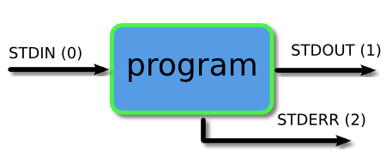
Piping and Redirection
Every program we run on the command line automatically has three data streams connected to it.
STDIN (0) - Standard input (data fed into the program)
STDOUT (1) - Standard output (data printed by the program, defaults to the terminal)
STDERR (2) - Standard error (for error messages, also defaults to the terminal)
Piping and redirection is the means by which we may connect these streams between programs and files to direct data in useful ways.

Slide 7
Pipe
It lets you feed the output from the program on the left as input to the program on the right.
Example –
ls | head -3
barry.txt
bob
example.png
ls | head -3 | tail -1
example.png

Slide 8
Redirection (>,>>,<)
> STDOUT output should be redirected to the file. If the file already exists it will be overwritten.
>> STDOUT output should be redirected to the file but instead of overwriting, append it to the file if it exists.
< Read STDIN/input from the file.
2> Redirect STDERR to the file specified.

Slide 9
sort, comm, cmp and tr
sort: sorts lines of text files
Usage: sort [OPTION]… [FILE]…
comm: compare two sorted files line by line
Usage: comm [OPTION]… FILE1 FILE2
comm -23 file1 file2
cmp: compare two files byte by byte. If a difference is found, it reports the byte and line number where the first difference is found. Exit status is 0 if files identical, 1 if different and 2 if problem encountered.
Usage: cmp [OPTION]… FILE 1 FILE2
tr: translate or delete characters
Usage: tr [OPTION]…SET1 [SET2]
echo "password a1b2c3" | tr -d [:digit:] -> password abc
echo “abc” | tr [:lower:] [:upper:] -> ABC

Slide 10
sed
sed: stream editor, modifies the input as specified by the command(s)
Can be used for:
Printing specific lines or address ranges
sed –n ‘1p’ file.txt
sed –n ‘1,5p’ file.txt
sed –n ‘1~2p’ file.txt
Deleting text
sed '1~2d' file.txt
Substituting text - s/regex/replacement/flags
sed 's/cat/dog/' file.txt
sed 's/cat/dog/g' file.txt
sed 's/<[^>]*>//g' a.html

Slide 11
More sed examples
sed -n 12,18p file.txt
sed 12,18d file.txt
sed '1~3d' file.txt
sed '1,20 s/Johnson/White/g' file.txt
sed '/pattern/d' file.txt
sed '/regexp/!d' file.txt

Slide 12
Regular Expressions
Quantification
- How many times of previous expression?
- Most common quantifiers: ?(0 or 1), *(0 or more), +(1 or more)
Alternation
- Which choices?
- Operators: [] and |
Hello|World [A B C]
Anchors
- Where?
- Characters: ^ (beginning) and $ (end)

Slide 13
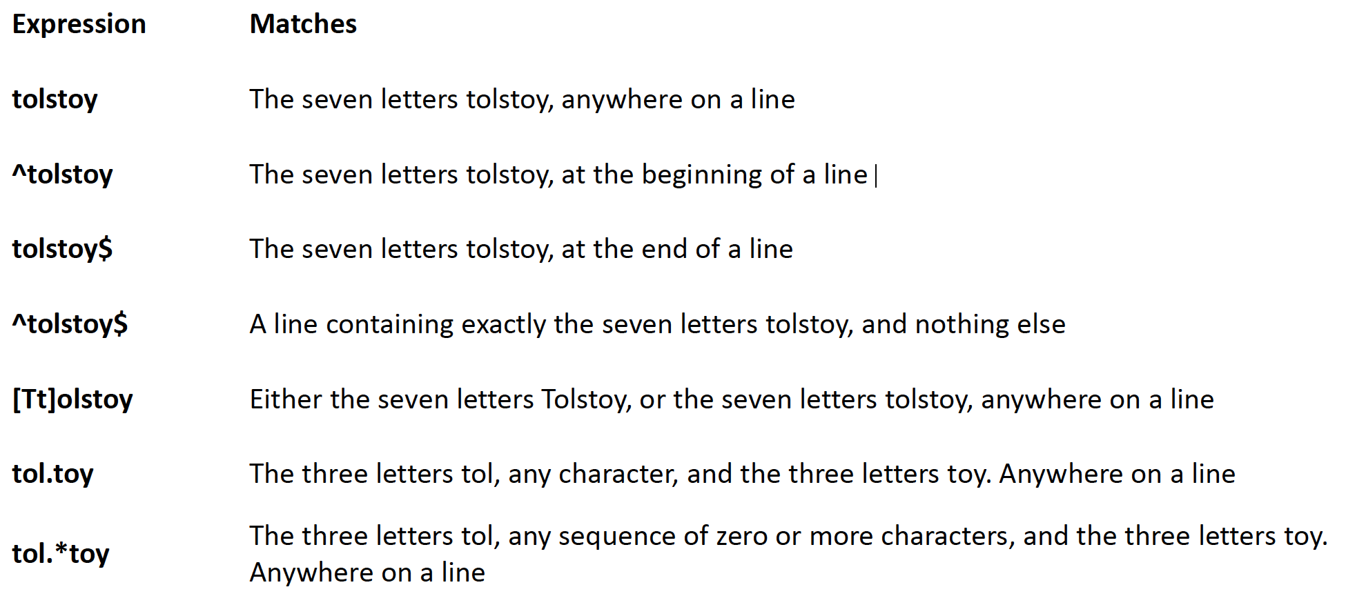
Regular Expressions
^ start of line
$ end of line
\ turn off special meaning of next character
[ ] match any of enclosed characters, use - for range
[^ ] match any characters except those enclosed in []
. match a single character of any value
* match 0 or more occurrences of preceding character/expression
+ match 1 or more occurrences of preceding

Slide 14
Quoting - To preserve literal meaning of special characters
Escape Character \ - Literal value of following character
echo \|
Single Quote - Literal Meaning of all within ‘’
$hello=1
$str=‘$hello’
echo $str -> $hello
Double Quote - Literal meaning except for $, ` and \.
$hello=1
$str=“abc$hello”
echo $str -> abc1
Backquote - execute the command
echo `ls` -> prints result after running ls

Slide 15
Shell Scripting
Shell: The shell provides you with an interface to the UNIX system.
-It gathers input from you and executes programs based on that input.
-When a program finishes executing, it displays that program's output.
Shell-script: A file containing shell commands (and comments - preceded by #) to execute
- The #! First Line (shebang): a way to tell the kernel which shell to use for a script
#!/bin/sh
- Make it executable: chmod +x scriptFile
- Execute: path_to_script/scriptFile or
sh path_to_script/scriptFile

Slide 16
Shell Programming Constructs
Variables
Valid character string [a-zA-Z0-9_] to which a value is assigned
var_name=var_value !!No spaces around =!!
Access using $: echo $var_name
Special Variables: certain characters reserved as special variables
$: PID of current shell
#: number of arguments the script was invoked with
n: nth argument to the script
?: exit status of the last command executed
echo $$; echo $#; echo $2; echo $?;
scalar variable vs array variable:
array_name[index]=value; echo ${array_name[index]}

Slide 17
Accessing Shell Script Arguments
Example:
$ who | grep betsy Where is betsy?
betsy pts/3 Dec 27 11:07
Script:
#! /bin/sh
# finduser --- see if user named by first argument is logged in
who | grep $1
Run it:
$ chmod +x finduser Make it executable
$ ./finduser betsy Test it: find betsy
betsy pts/3 Dec 27 11:07
$ ./finduser benjamin Now look for Ben
benjamin dtlocal Dec 27 17:55

Slide 18
Looping
for var in list_values
do
command 1
..
command n
done
while condition
do
command 1
..
command n
done
ALL=`ls -a $dir | sort`
declare -a ARRAY
let count=0
for FILE in $ALL
do
ARRAY[$count]=$FILE
…..
done
for i in "${ARRAY[@]}”
do
…
done

Slide 19
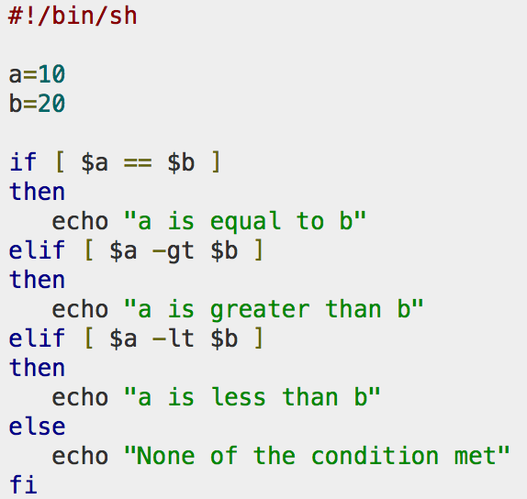
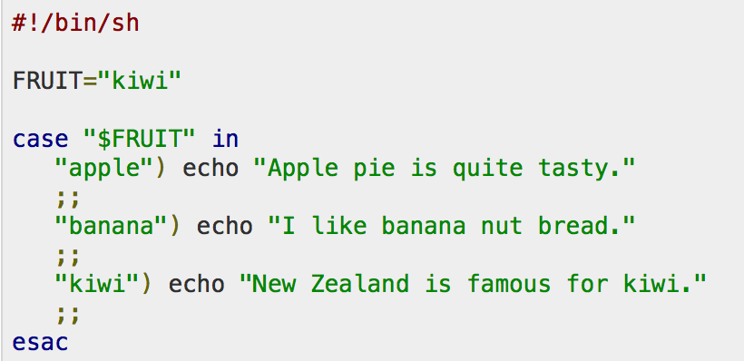
Conditional
if…then…fi
if…then…else…fi
if…then…elif..then…fi
case…esac
Unconditional
break
continue

Slide 20
Lab 2
Extract lines which contain words (Hint: <td> tag)
Get lines with Hawaiian words
Even numbered lines
sed 's/<[^>]*>//g' a.html to remove all HTML tags
Remove leading space
sed 's/^\s*//g’ (\s denots space)
Substitute space in between words to newline
Delete all commas
Delete entries which have any character other than Hawaiian
Sort unique

