Slide 1
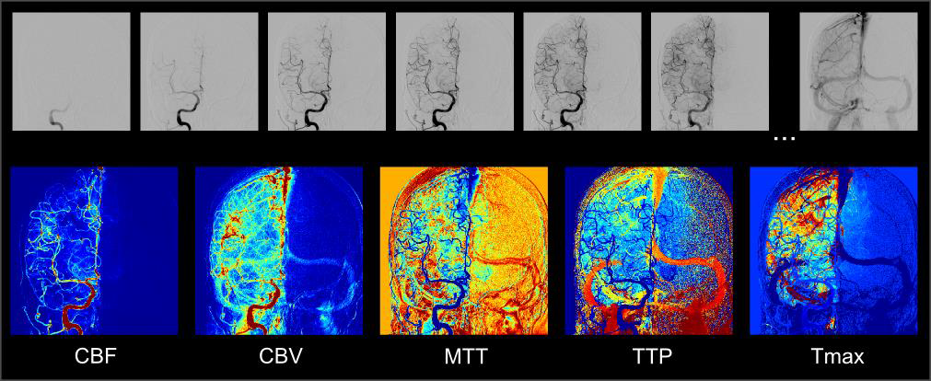

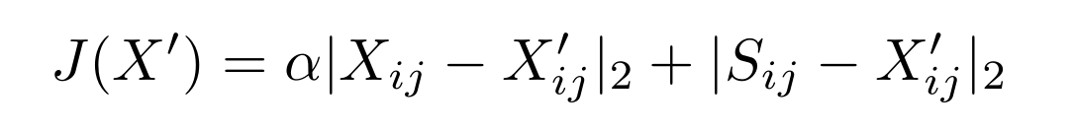
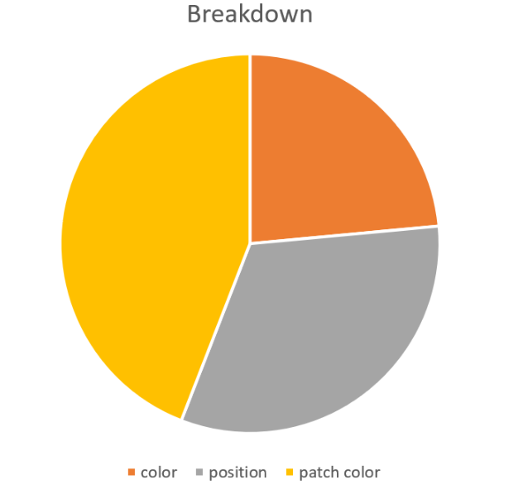
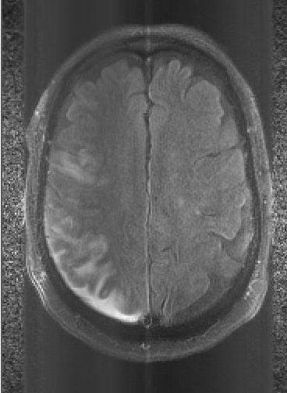
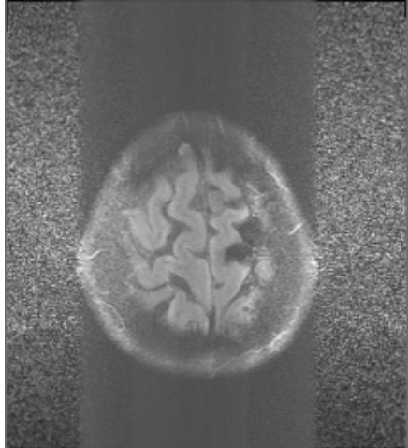
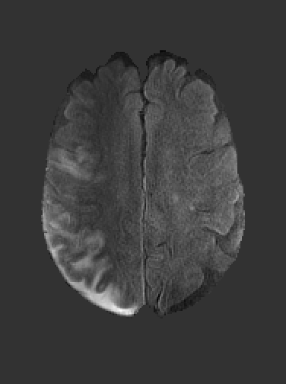
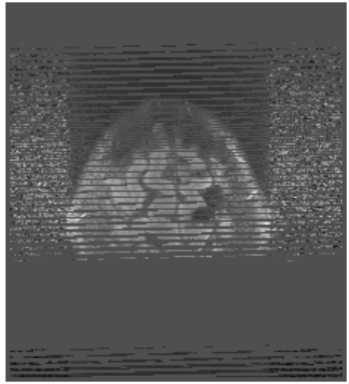
Skull Stripping for MRI: a deep CNN approach
Kaiyuan Chen 60483709 and Jingyue Shen
Department of Computer Science
University of California, Los Angeles
Background
Computer aided diagnosis based on medical images from MRI(magnetic resonance image) has gained ubiquitous usage for its noninvasive, nondestructive, flexible properties
To satisfy the demand for interior and exterior structure of brain structures, MRI can produce cross-sectional images from different angles, for example, top-down, side-to-side and front-to-back
As a preliminary step for further analysis, brain segmentation, i.e. skull stripping, needs both speed and accuracy in practice.
having slices from different angles give a lot of challenges in stripping those tissues which people are interested in, from xtra-cranial or non-brain tissues that has nothing to do with brain diseases such as Alzheimer’s disease, aneurysm in the brain and etc.
Machine learning is a broad concept that include many interesting algorithms that we would like to implement and experiment on. For example, Butman introduced a robust machine learning method that detects the brain boundary by random forest.
Baseline Methods
We model the problem as
and have a loss function of
We experimented on the significance of each feature like local patch, color and position and implemented baseline models like Random Forest, SVM and logistic regression with loss function.
Results
PerfAngio provides unique insights into visualization of features never seen before on DSA. It has been successfully used to retrospectively analyze multi-center datasets. The software demonstrates feasibility and performance to evaluate angiographic outcome in the multicenter trial TREVO2. It was also a useful tool to compare the impact of devices during thrombectomy and the hemodynamic impact of stenting in SAMMPRIS.
Several ongoing research projects at UCLA are currently using PerfAngio to study several questions related to acute Stroke therapy, including identification of futile recanalization, detection of hemorrhagic transformation, correlation with MRI and CT and automatic quantification of reperfusion and collateral flow.
Conclusion
This innovative imaging software can provide insights into Stroke from standard DSA. It is particularly promising for retrospective studies and during clot-retrieval interventions as it offers an objective, continuous measure to characterize angiographic observations.
References
D. Liebeskind, F. Scalzo, N. Sanossian, R. Gupta, T. Jovin, G. Walker, G. Albers, H. Lutsep, W. Smith, R. Nogueira. Perfusion Angiography in TREVO2: Quantitative Reperfusion After Endovascular Therapy in Acute Stroke. Stroke.2013; 44: AWP39.
D. Liebeskind, G. Szilagyi, S. Black , B. Buck. Perfusion Angiography: a novel technique for characterization of perfusion in cerebral ischemia. Stroke.2008,39:576.
Figure 1. the results are successful when the skull is properly aligned and without too much noises. The robustness is compromised when noises are present
Figure 2. A breakdown of the accuracy of random forest model by normalizing the error
Figure 1. Illustration of perfusion angiography applied to a DSA run obtained from a patient with acute ischemic stroke (after successful MCA m1 recanalization).
The DSA run, whose subset of images is shown in the upper row, is used to compute CBV, CBF, MTT, TTP, and Tmax. Results are normalized to match a color-scale.
Tmax > 6 sec is shown in red.

