Slide 1
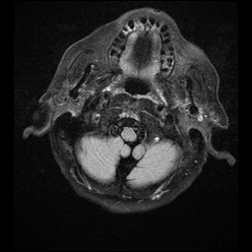
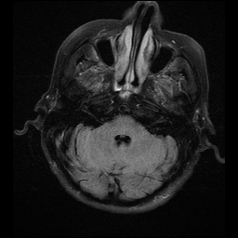
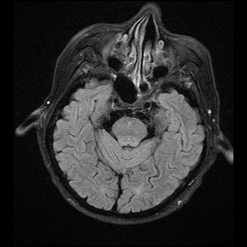
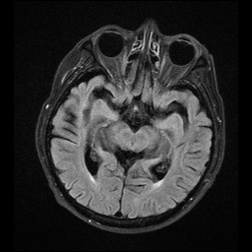
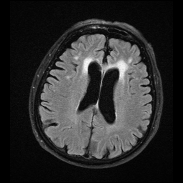
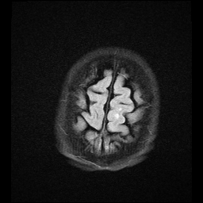
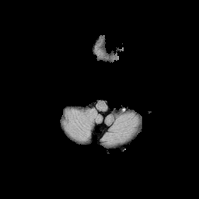
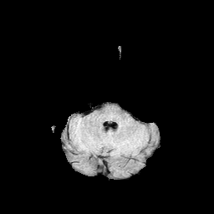
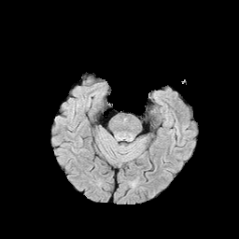
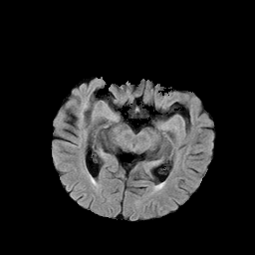
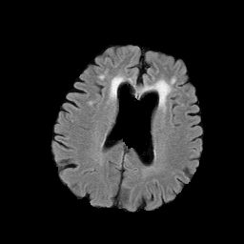
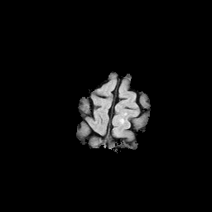
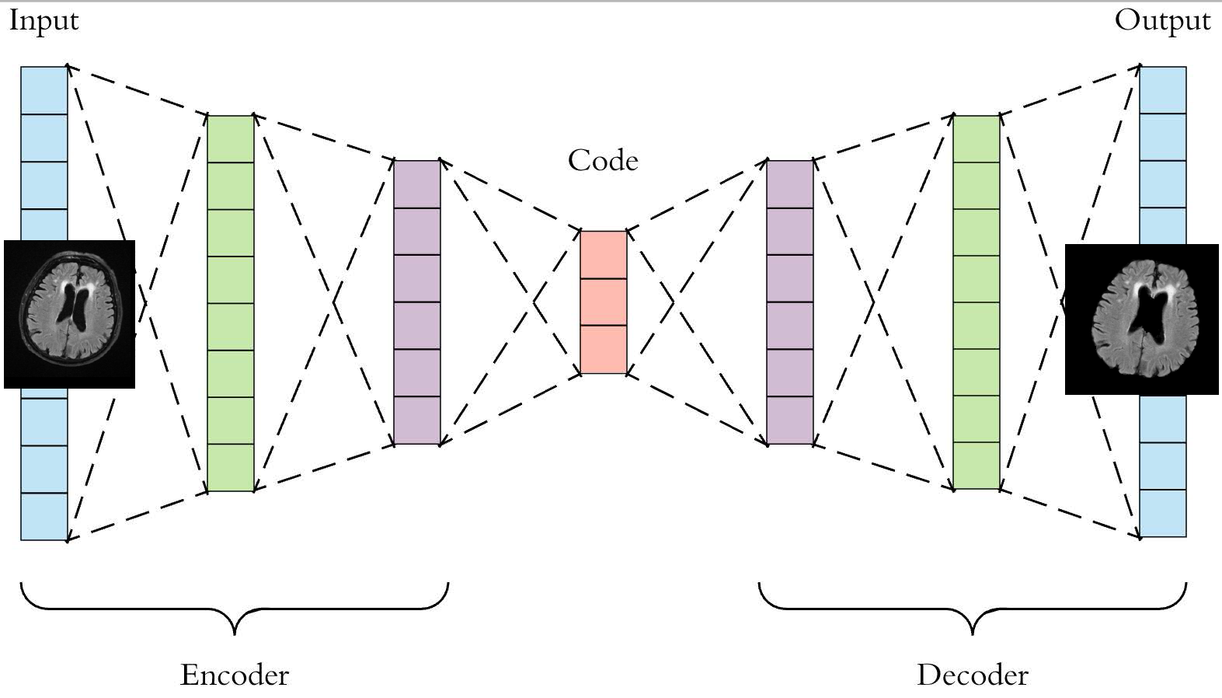
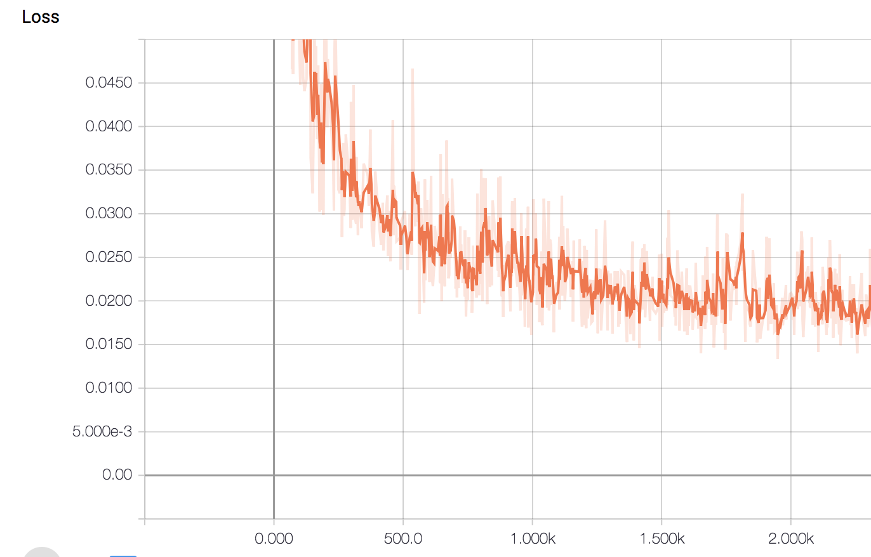


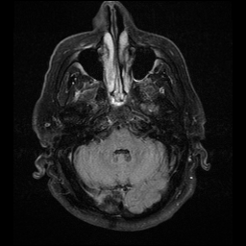
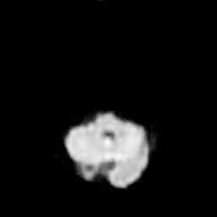
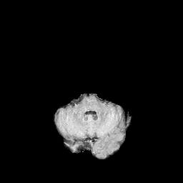
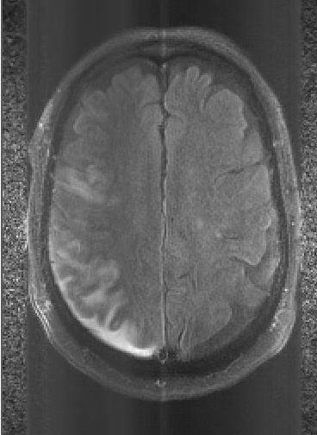
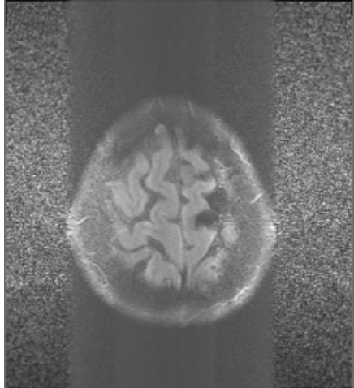
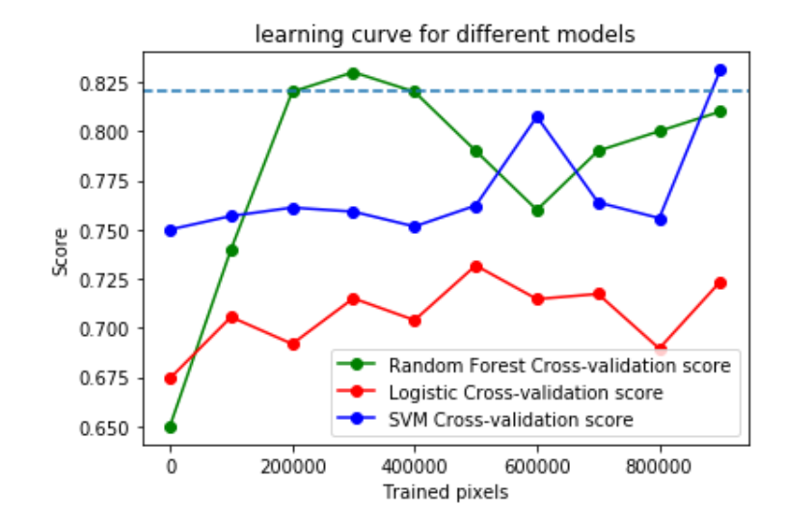
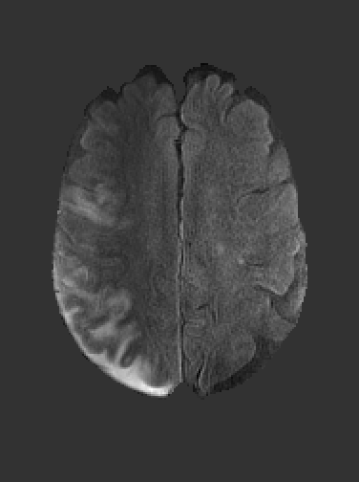
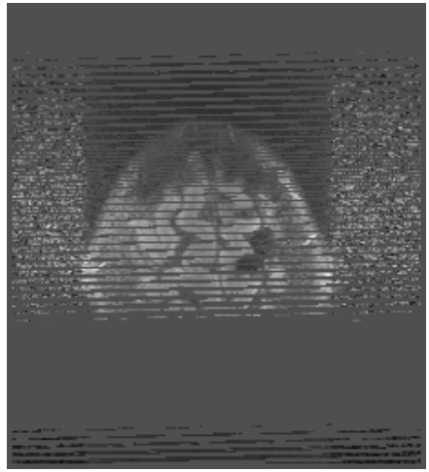
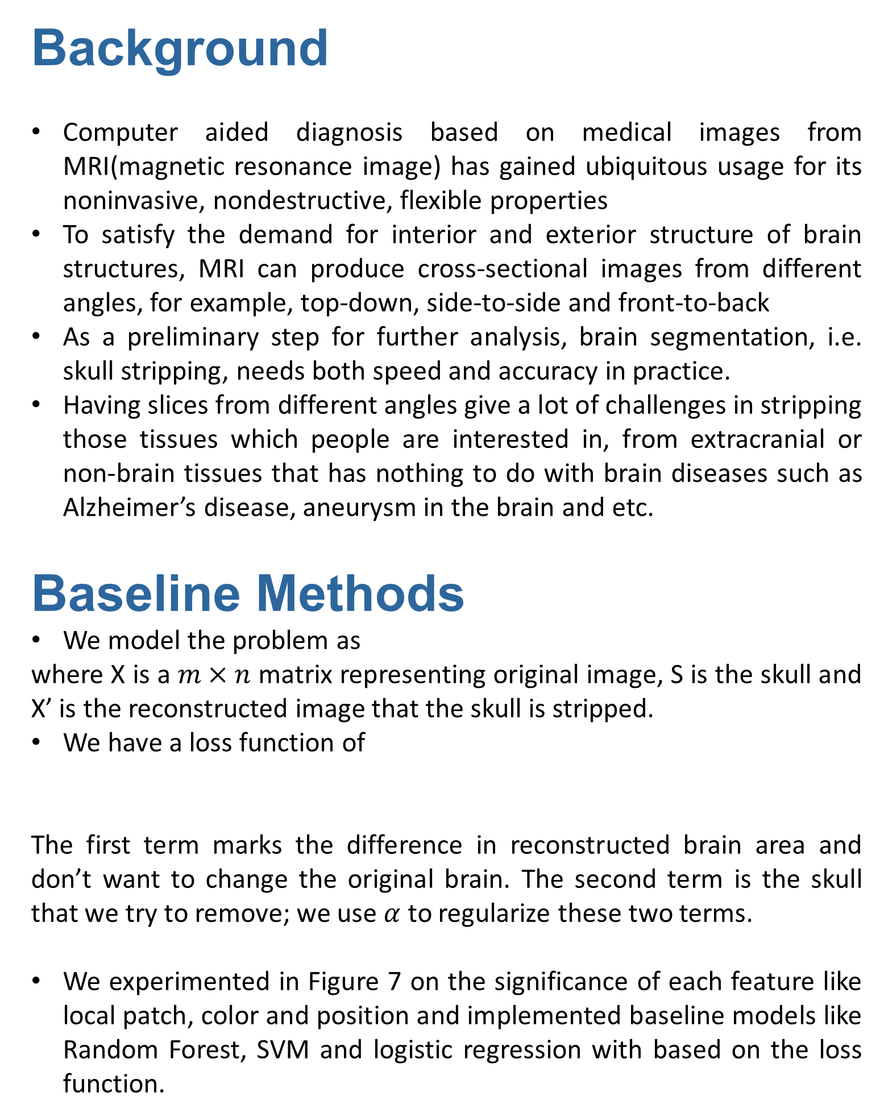
Skull Stripping for MRI: a Deep CNN approach
Kaiyuan Chen 60483709 and Jingyue Shen 704797256
Department of Computer Science
University of California, Los Angeles
Background
Computer aided diagnosis based on medical images from MRI(magnetic resonance image) has gained ubiquitous usage for its noninvasive, nondestructive, flexible properties
To satisfy the demand for interior and exterior structure of brain structures, MRI can produce cross-sectional images from different angles, for example, top-down, side-to-side and front-to-back
As a preliminary step for further analysis, brain segmentation, i.e. skull stripping, needs both speed and accuracy in practice.
Having slices from different angles give a lot of challenges in stripping those tissues which people are interested in, from extracranial or non-brain tissues that has nothing to do with brain diseases such as Alzheimer’s disease, aneurysm in the brain and etc.
Baseline Methods
We model the problem as
where X is a $m×n$ matrix representing original image, S is the skull and X’ is the reconstructed image that the skull is stripped.
We have a loss function of
The first term marks the difference in reconstructed brain area and don’t want to change the original brain. The second term is the skull that we try to remove; we use $α$ to regularize these two terms.
We experimented in Figure 7 on the significance of each feature like local patch, color and position and implemented baseline models like Random Forest, SVM and logistic regression with based on the loss function.
CNN Model
We take a Convolutional Neural Network(CNN) approach in a way that is similar to Autoencoder. By compressing and decompressing the MRI images, our model tries to learn the representative features of the brain structures. In encoder part of the model, we choose three convolution layers with three max pooling layers. For the decoder part, we use three convolution layers, three deconvolution layers and an extra reconstruction layer to reconstruct the input image. Figure 3 below is an illustration of our model.
We trained our model using 700 manually labelled MRI images and its corresponding skull-stripped images with batch size 15, learning rate 0.003 and 50 epochs, by optimizing the equation (1). Figure 4 above is the training loss.
After numerous experiments, we found our model is able to detect the region of brain, but cannot reconstruct the stripped image with resolution as high as the input. Since skull stripping is a preprocessing step for other diagnosis, which requires high resolution brain images, we use reconstructed images as bitmasks applied to unstripped images. As shown below:
Figure 6. test results
Figure 6 are the test results of our model. The first row are original unstripped images. The second row are learned stripped images. As shown in those images, our algorithm can perform skull stripping well on various slices of brains. The overall accuracy of our model is around 92%. One thing worth noting is that most of our model‘s inaccuracy comes from failing to strip a small portion of skull, as shown in the first pair of images in figure 6. The core brain parts remain intact, which is desirable for skull stripping.
The five fold cross validation score is 82. Because training in batch is different and cannot be directly compared with pixel based methods, we treat this score as a benchmark to learning curves of pixel model and the result is in Figure 7.
Conclusion
We compared and analyzed different machine learning models applied to skull stripping, including Logistic Regression, SVM and random forest.
Because of their weakness in strong assumptions in dataset, they are not robust to circumstances with high noises or improperly aligned skulls.
Then we propose a CNN approach that is similar to autoencoder, and with this scheme, we can remove those noises and be robust to new structures.
References
Butman J, Roy S, Pham D. Robust skull stripping using multiple MR
image contrasts insensitive to pathology. NeuroImage . 2017;146:132-147.
Kalavathi,P. and V.B. Surya Prasath. “Methods on Skull Stripping of MRI Head Scan Images – a Review.”Advances in Pediatries., U.S. National Library of Medicine, June 2016, www.ncbi.nlm.nih.gov/pmc/articles/PMC4879034.
Figure 3. An illustration of our model
Figure 4. loss during training
Figure 1. the results are successful when the skull is properly aligned and without too much noises. The robustness is compromised when noises are present
(a). Original image
(b) reconstructed image
(c) after applying reconstructed image as bitmask to original one
Figure.7 A sk-learn comparison of models by cross-validation scores in terms of number of pixels.

