Slide 1
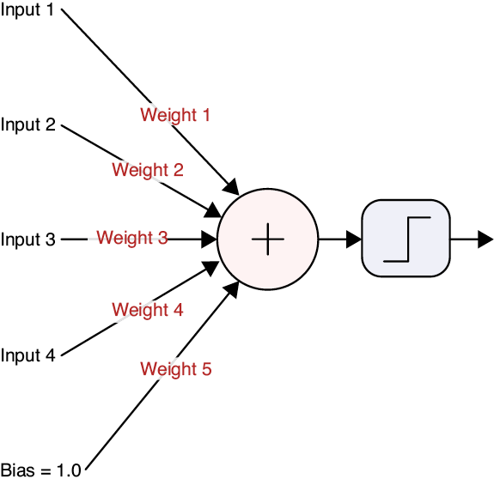
Source: Glassner, A. (2021). Deep learning: A visual approach. San Francisco, CA: No Starch Press. (Chapter 13)

Slide 2
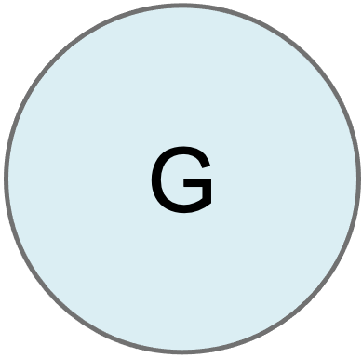
G
G
Notes:
PLEASE ADD A ZOOM-IN FEATURE TO THIS SLIDE WHICH ALLOWS ME TO CLICK ON G AND SHOW THE INSIDE OF THAT NEURON, WITH ITS NET INPUT AND ACTIVATION FUNCTION, AS PICTURED IN THE FIRST SLIDE IN THIS DECK.

Slide 3
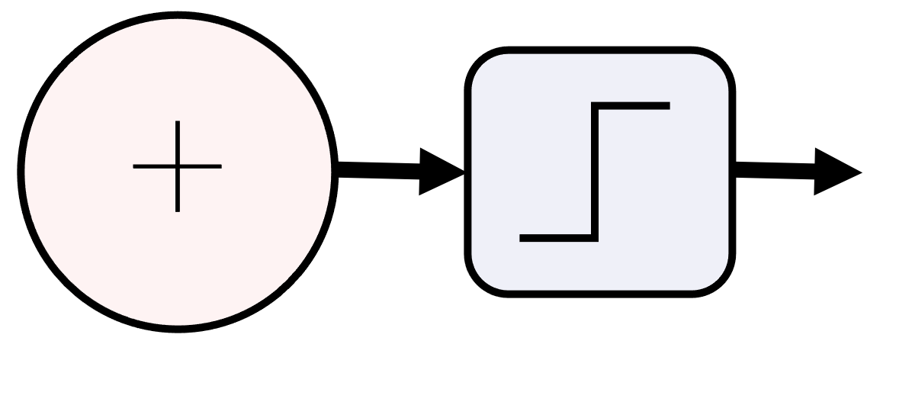

Slide 4
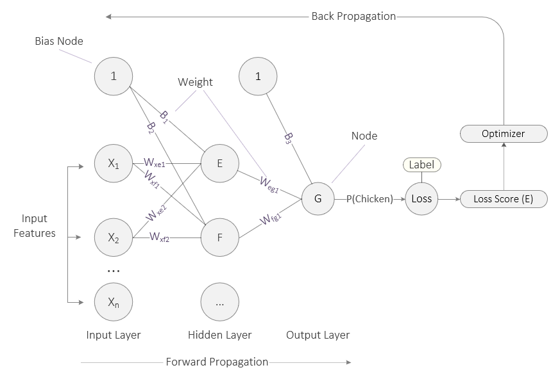
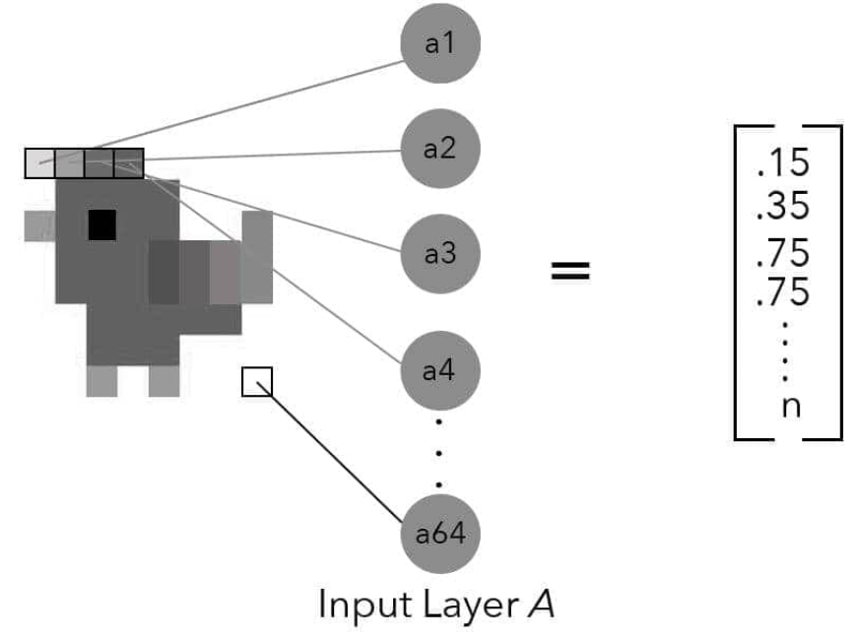
Source: Taylor, M. (2017). Neural networks: A visual introduction for beginners. Vancouver, Canada: Blue Windmill Media.
Notes:
PLEASE ADD HIGHLIGHTS WHICH ALLOW ME TO WALK AN INPUT VALUE THROUGH THE NETWORK, FROM X2 TO F TO G AND THEN TO LOSS.

