Slide 1

Neural Network: Advanced
Notes:
Hello and welcome to the second presentation in the Practicum AI Deep Learning Foundations workshop series. I’m [[YOUR NAME HERE]], and I will act as your guide and mentor for this learning experience. I currently work as an AI Trainer / Consultant in the Research Computing Department at the University of Florida.
Let’s get started…

Slide 2
Module 2 Objectives
Describe the basis of a neural network (neuron).
Identify and describe an artificial neuron (perceptron).
Discuss bias and weights.
Describe and identify activation functions.
Describe and simulate image processing in a small neural network.
Implement and train a perceptron using TensorFlow.

Slide 3
Neural Network Neurons

Slide 4
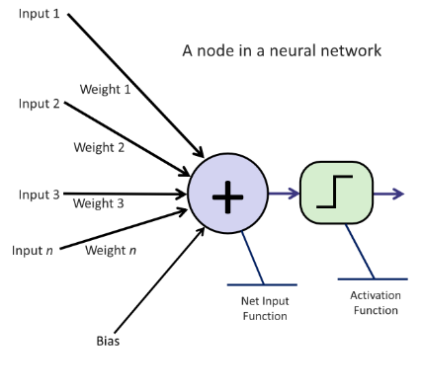
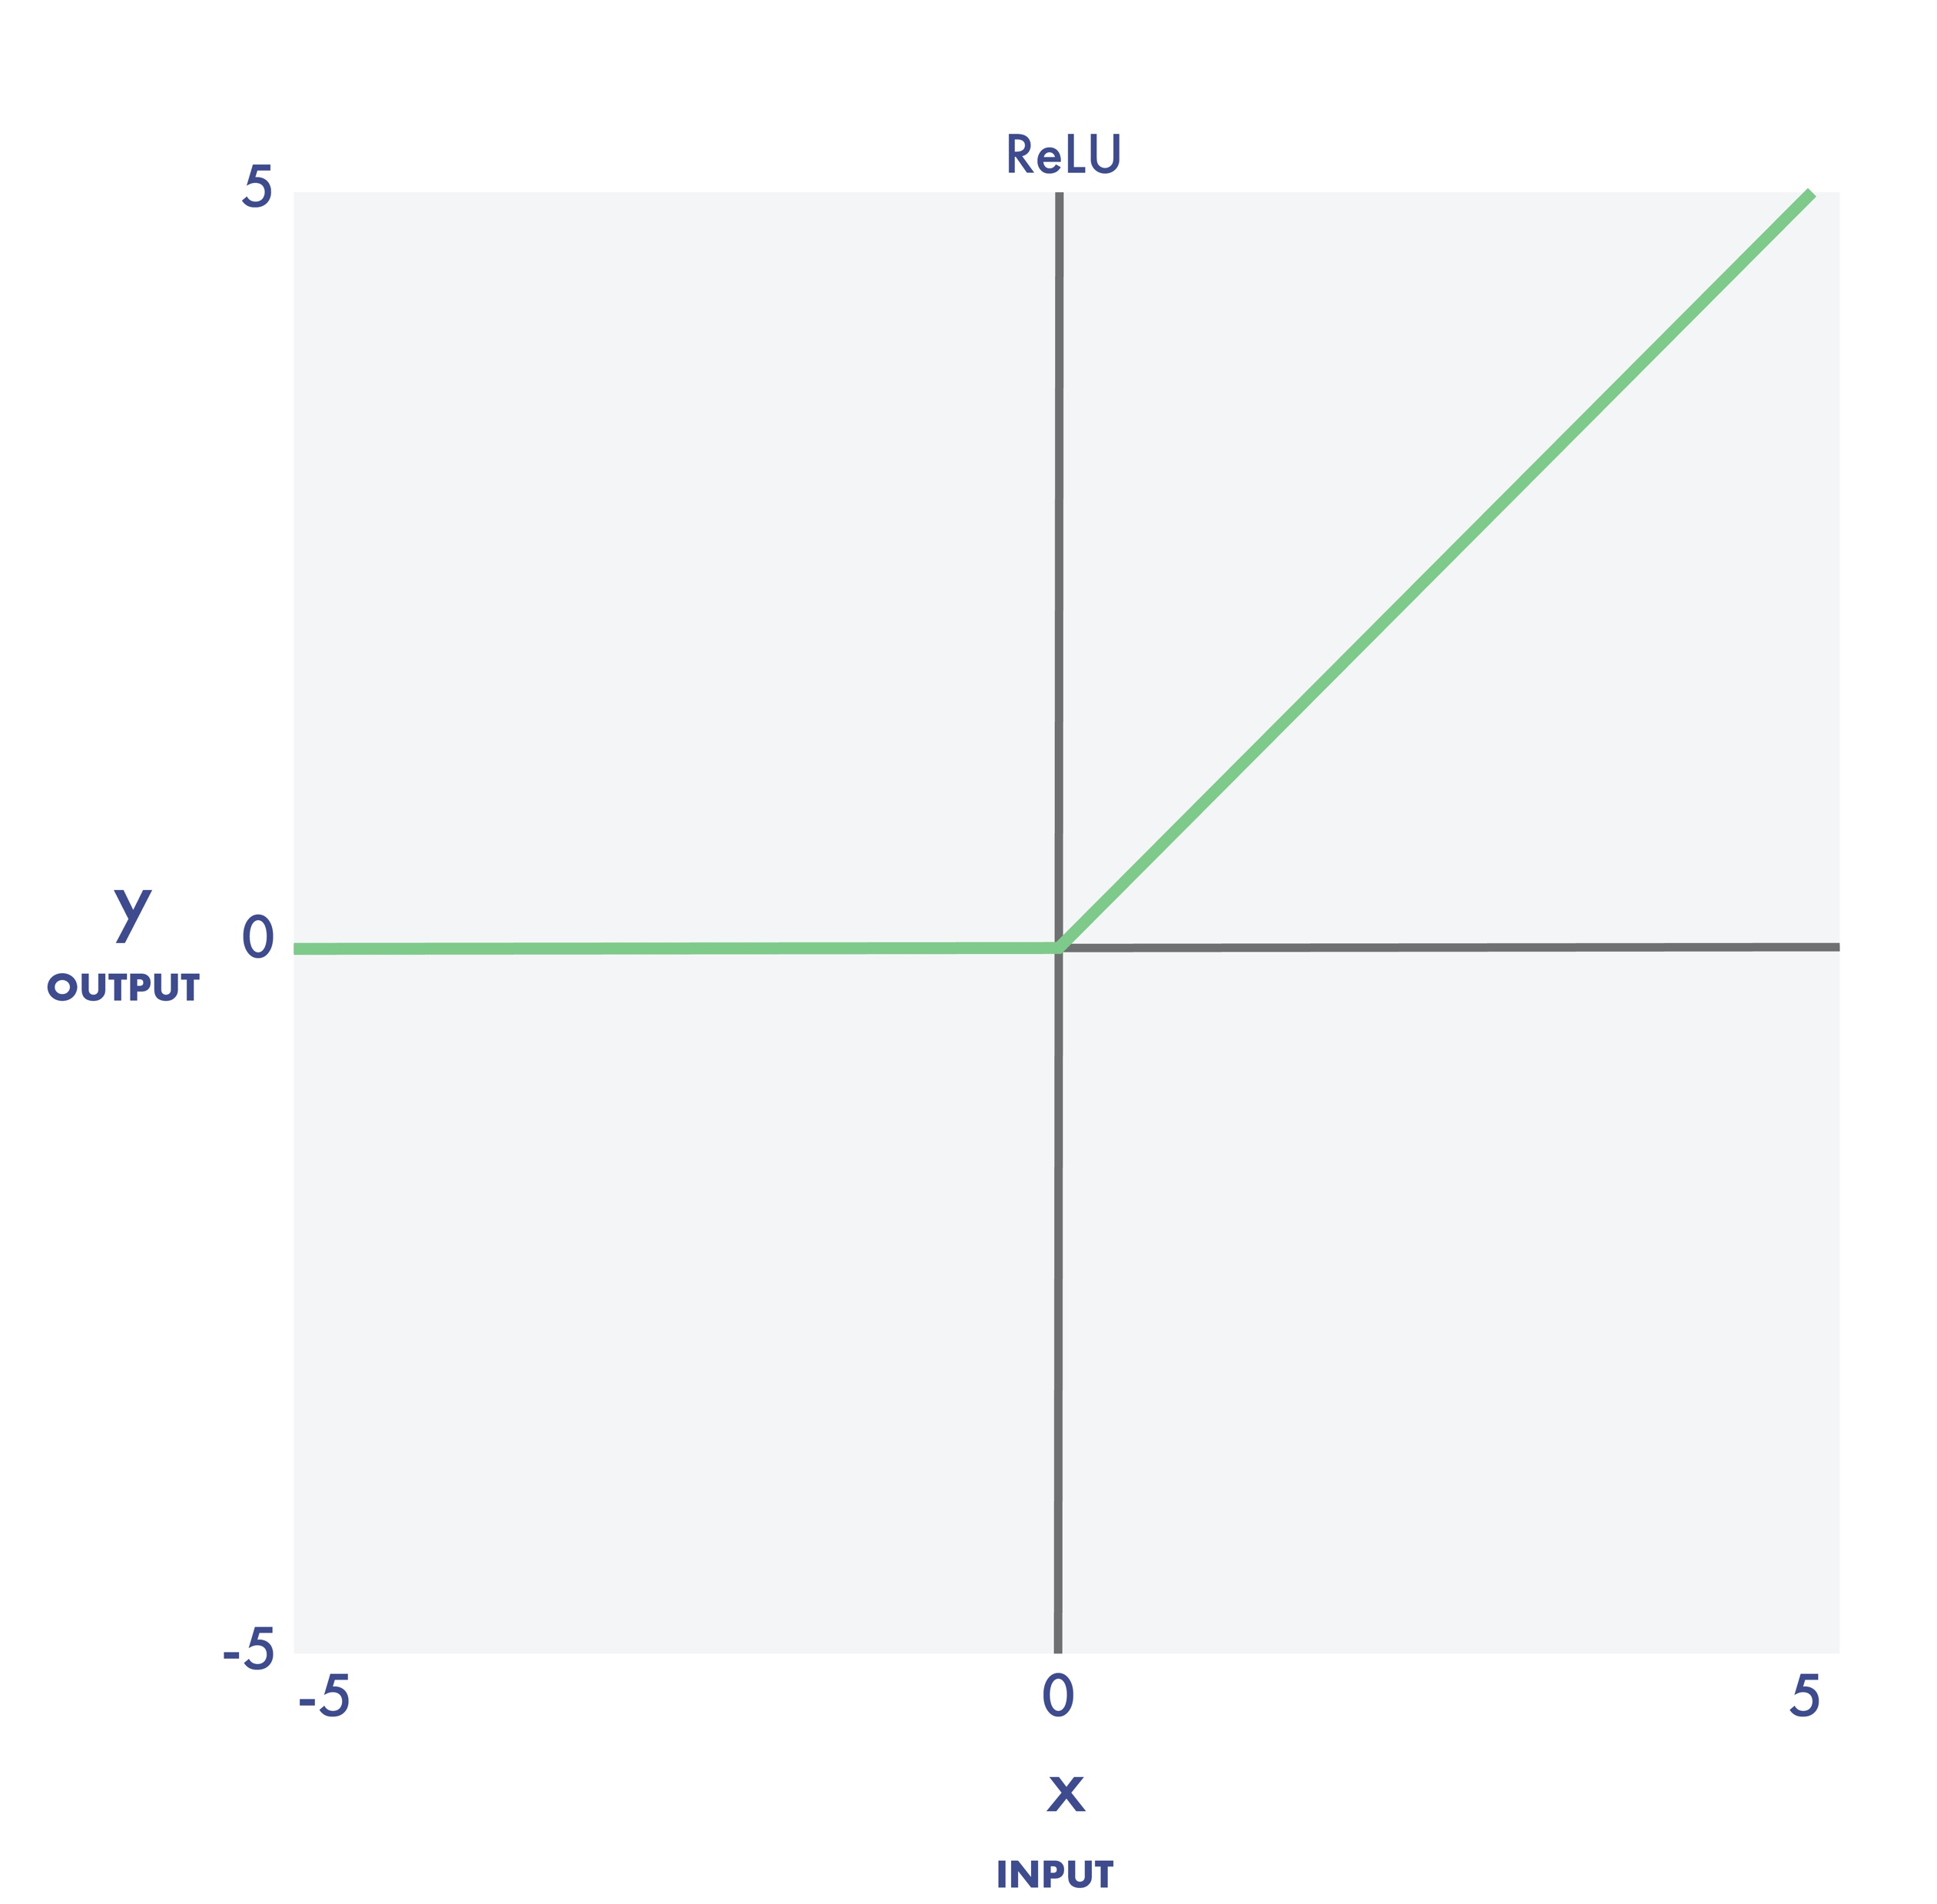
Remember The Node?
1. Linear Transformation
$$Sum=w_{1} ×x_{1}+ w_{2} ×x_{2}+⋯+w_{n} ×x_{n}+bias$$
2. Activation Function
Notes:
Inputs: Each neuron receives one or more inputs. These can be raw data values (in the input layer) or the outputs from neurons in previous layers.
Weights: Associated with each input is a weight. Weights are crucial numerical parameters in neural networks and determine the importance or influence of a particular input on the neuron's output. They are adjusted during the training process (specifically, during back-propagation) to minimize the error in the network's predictions. Back-propagation and training in general are explained in more detail later in this module. The inputs and weights are multiplied and added together.
Bias: This numerical parameter is added to the sum of all the input by weight products. The bias allows the neuron to shift its sum, enabling more complex representations. It is like an intercept in linear regression.
Activation Function: After summing the weighted inputs and the bias, the result is passed through an activation function. This function can introduce non-linearity to the model, allowing the network to capture complex relationships in the data.

Slide 5
Functions, ACTIVATE!

Slide 6
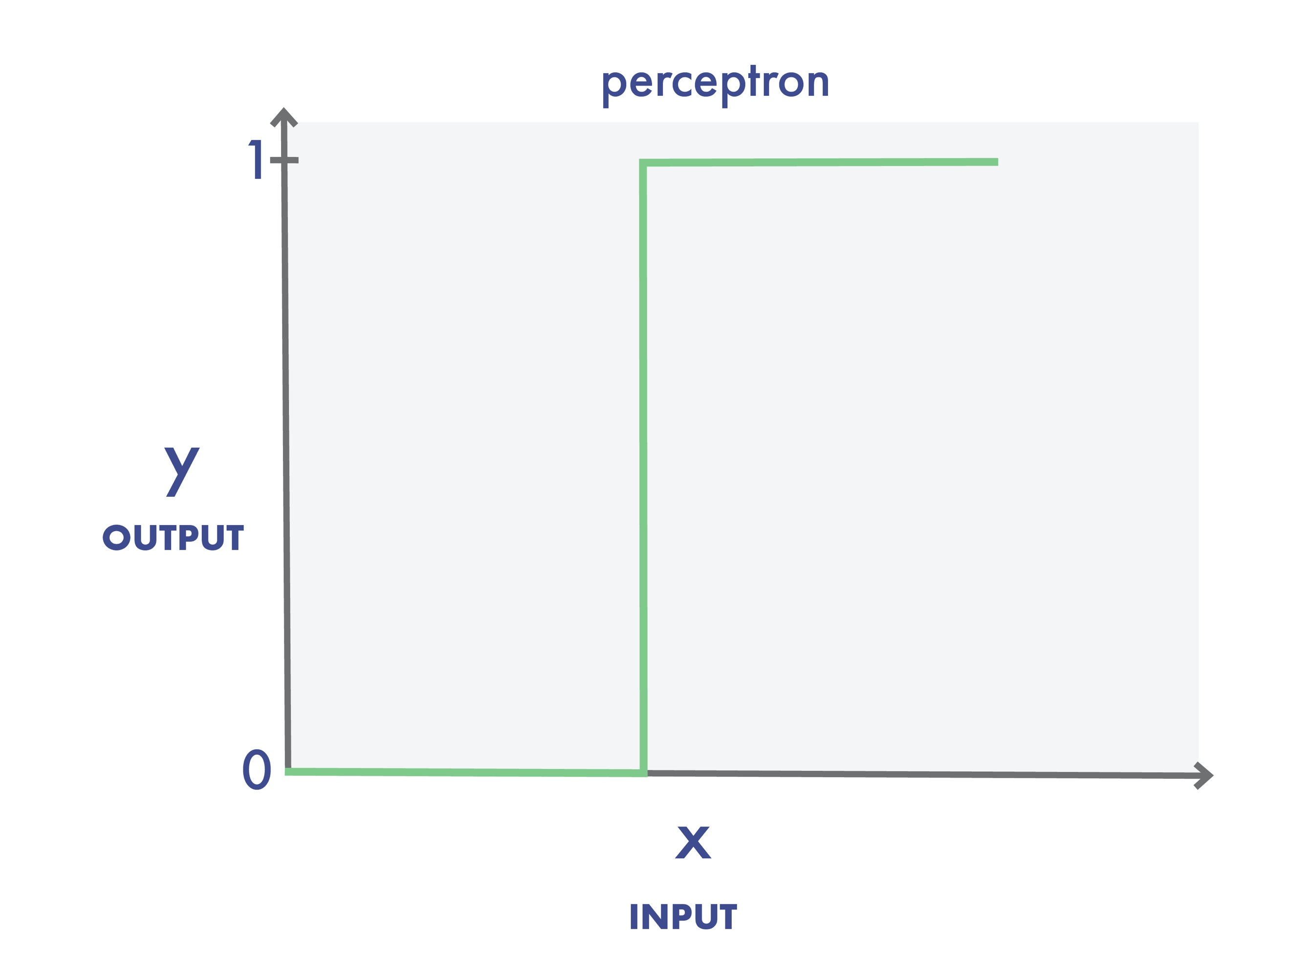
What do Activation Functions do?
Notes:
Activation functions introduce non-linearity to the model, allowing neural networks to capture complex relationships and patterns in the data. Without them, no matter how deep the network, it would behave like a linear model, limiting its predictive power. As an analogy, imagine building a complex structure out of blocks. If you only use straight pieces, you're limited in what shapes you can create. But introduce some curved or angled pieces (akin to activation functions), and suddenly, you can build intricate and varied designs.
Our first activation function is the simple perceptron or step function. When its input is less than or equal to zero, the perceptron outputs 0. If the input becomes positive – even by a tiny amount – the perceptron outputs a 1. But this sudden and extreme transition is not ideal for training. Essentially, the neuron has no finesse – it’s either yelling or its silent.
Think about it like this. In real life, learning is generally incremental, consisting of a series of small steps towards mastery. Complete understanding rarely happens in an instant. The same holds true in deep learning. Ideally, we’d like to move along a gradient, capable of reflecting small learning adjustments.

Slide 7
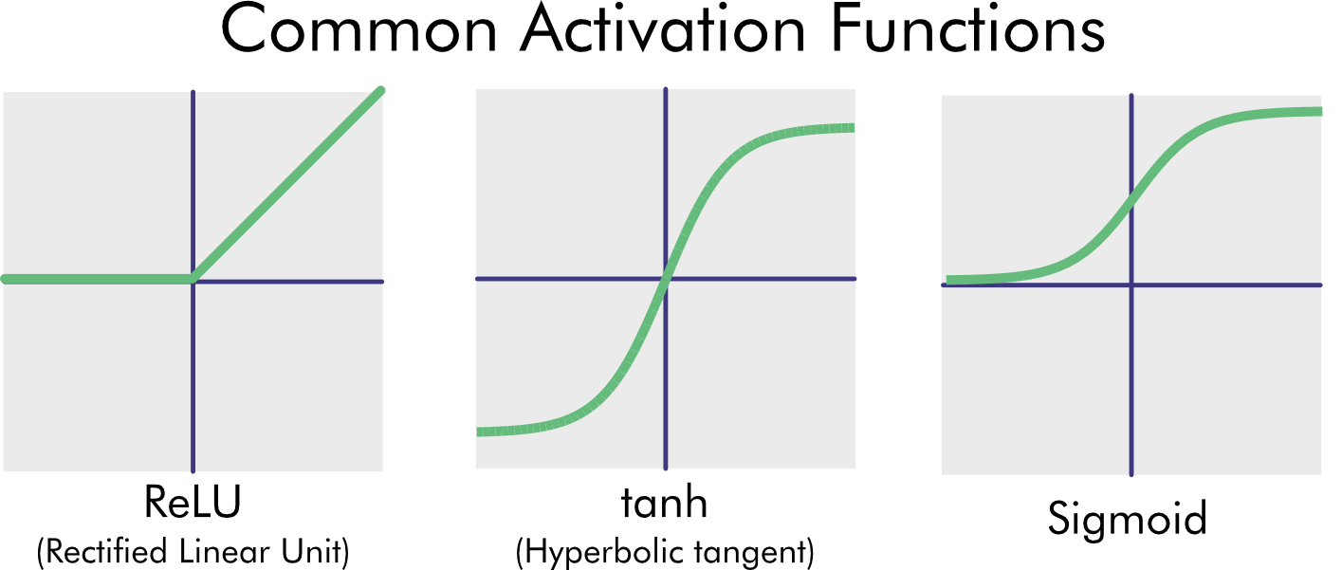
Notes:
The step function has largely been replaced by some other common activation functions:
ReLU (Rectified Linear Unit) Function: The ReLU (rectified linear unit) function outputs 0 for all negative inputs; otherwise, the output is the input. The ReLU activation function has recently become quite popular because it’s simple and trains exceptionally well. The angles it outputs allow it to model linear functions and make excellent approximations of curves if there is enough capacity in the network.
tanh Function: The output of the tanh is a hyperbolic tangent and looks like the sigmoid function. It has that same S-shape. But there are differences. For example, the TANH function returns a value of −1 for extremely negative inputs.
Sigmoid (or Logistic) Function: The sigmoid function – also known as the logistic function – returns a 0 value for extremely negative inputs and a value of 1 for extremely positive inputs. This function is called sigmoid because it resembles the curve of an S shape. Because of its binary output, this function works well for binary classifiers that are separated by a curved line rather than a straight one.

Slide 8
Where Do Initial Weights and Biases Come From?

Slide 9
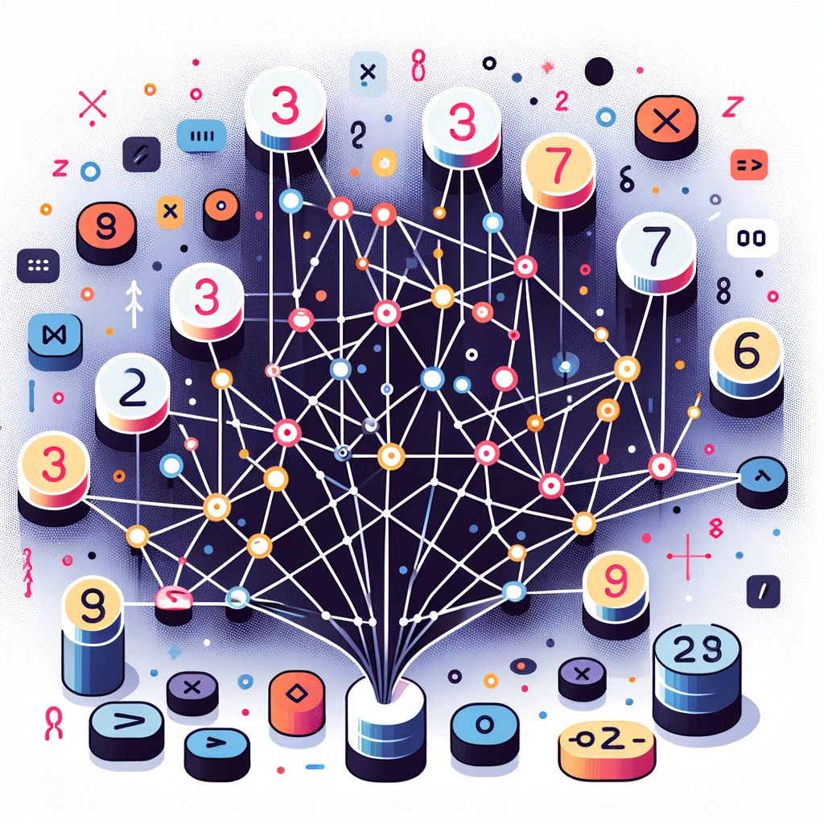
They’re Random (Usually…)
This image was generated using AI tools
Notes:
We make them up! At first, at least. Weights and biases are initialized, often with some form of randomness, and then iteratively adjusted using the training data to minimize the network's prediction error. This adjustment process uses the gradients derived from the loss function to guide the updates.
Random Initialization: Weights are typically initialized with small random values. This breaks the symmetry, ensuring that each neuron learns something different from the start. If all weights started with the same value, all neurons in each layer would update identically, making them redundant.
Bias Initialization: Biases can be initialized to zero or small values. Starting with zero is often acceptable since the random weights already introduce the asymmetry.

Slide 10

We Can Also Use What We’ve “Learned”
Output
Output
Fully Connected Softmax
New Shallow Classifier
Layer N
Layer N
Transfer
Layer 2
Layer 2
Layer 1
Layer 1
Input Data
Input Data
Source: Sarkar, D, et al. (2018). Hands-on transfer learning with Python. Birmingham, UK: Packt Publishing. (Chapter 4)
Notes:
There are methods for initializing starting weights and biases that aren’t random, but we won’t go into that much here. Later, we will explore the powerful concept of Transfer Learning. Transfer Learning is a method of using the starting weights from a pre-trained model, and then doing a training pass with a new, additional dataset and/or new model layers!

Slide 11
A Closer Look at The Training Process

Slide 12


Bias Node
X₀
G₀
X₀
G₀
Network Output
W_{xg0}
W_{gf0}
X₁
W_{xg0}
W_{gf0}
X₁
W_{xg1}
W_{xg1}
Q
G
F
E
G($δ$)
F($δ$)
E
W_{gf1}
W_{gf1}
Error
Input Features
Error
W_{xg2}
X₂
X₂
W_{xg2}
y_{truth}
Input Layer
Hidden Layer
Output Layer
Error/Loss Function
Input Layer
Hidden Layer
Output Layer
Optimizer
Error/Loss Function
Forward Propagation
Back Propagation
Notes:
We’ve briefly covered network training in previous modules. Here’s a closer look at the process:
Forward Pass: Input data is passed through the network layer by layer, using the current weights and biases to produce a prediction. In the last module, we had a model that could predict the class of a picture fed to it. During the training process, the forward pass was feeding images into the model and letting it guess what it “thought” it was “seeing.”
Loss Calculation: The network's prediction is compared to the actual target values using a loss function, quantifying how far off the predictions are. In the pizza recognizer example, if the model guessed that a picture of a pizza was a “cat,” the loss function would tell the model it needed to adjust its weights and biases and try again.
Backward Pass (Backpropagation): The gradient of the loss function concerning each weight and bias is computed. We aren’t going to dive into the details, but this uses partial differential equations (from that Calculus class you may have taken long ago) to find the gradients (or tangents). These gradients indicate the direction and magnitude to adjust each parameter (weights and biases) to minimize the loss calculated by the loss function.
Optimization: Weights and biases are adjusted to decrease the loss. The learning rate, a hyperparameter, determines the size of the adjustments. This step is the secret sauce for how networks learn: With each backward pass, the network (hopefully) gets a little more accurate with its predictions.
Iterative Process: The forward pass, loss calculation, backpropagation, and optimization steps are repeated multiple times (epochs) on the training data until the network converges to an optimal set of weights and biases or until a set number of epochs is reached.

Slide 13
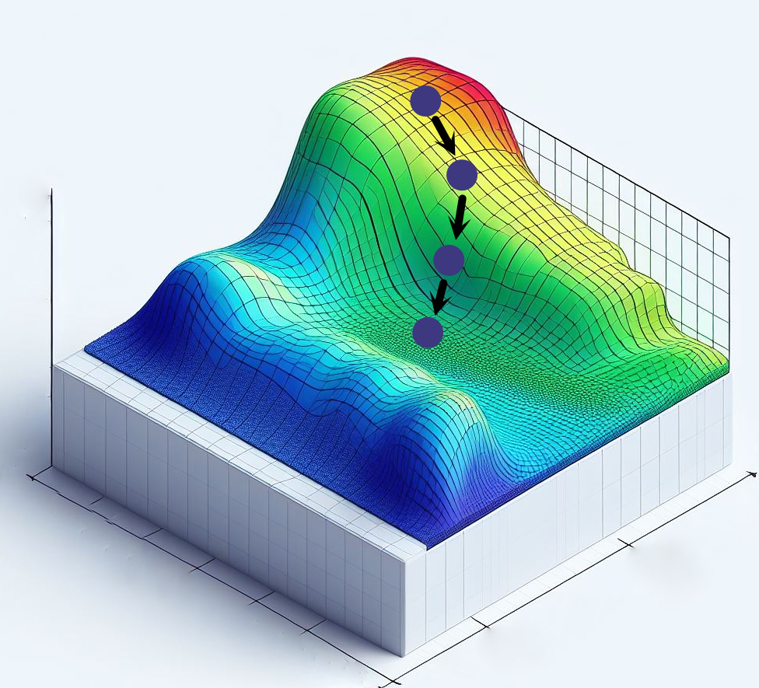
The Low Down
This image was generated using AI tools
Notes:
The 3D surface in this figure represents the loss surface for different sets of weights. While we draw this in 3D, this surface is highly dimensional, with as many dimensions as there are parameters (millions!). At each epoch, the loss is calculated. Each blue dot is the position on the loss surface at an epoch. The gradient and learning rate are used to calculate the direction and amount each parameter should be adjusted. The training data are re-evaluated, and the new loss is calculated. This process iterates repeatedly until the loss reaches a satisfactory level.
Once a model is trained with its parameters adjusted, it can be deployed. The model is made available in a production environment to make predictions on new, unseen data, fed as input to the trained model. This could be on a server in a Jupyter Notebook, a cloud platform, a mobile app, or any system where real-time or batch predictions are needed based on the model.

Slide 14
WHY do we use Neural Networks?

Slide 15
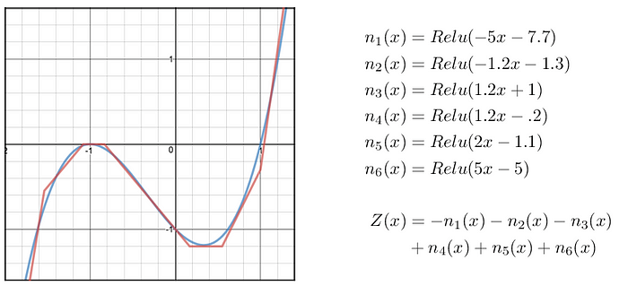
Universal Approximation!
Source: Fortuner, B (2017). Can neural networks solve any problem? Medium.com: Towards Data Science
Notes:
Individual neurons' simplicity and adaptability make them incredibly powerful when combined in layers to form neural networks. One of the most remarkable properties of neural networks is their ability to serve as "universal approximators." Theoretically, a neural network (even with a single hidden layer, given enough neurons) can approximate any continuous function to a desired level of accuracy. In other words, they can model and represent a vast range of intricate patterns, behaviors, and relationships in data.
The concept of universal approximation underscores the potential and versatility of neural networks. By adjusting the weights and biases during training, a neural network doesn't just adapt—it can model complex, non-linear relationships in the data, making it a tool of choice for numerous applications ranging from image recognition to financial forecasting.

Slide 16
The Perceptron or AI’s Humble Beginnings

Slide 17
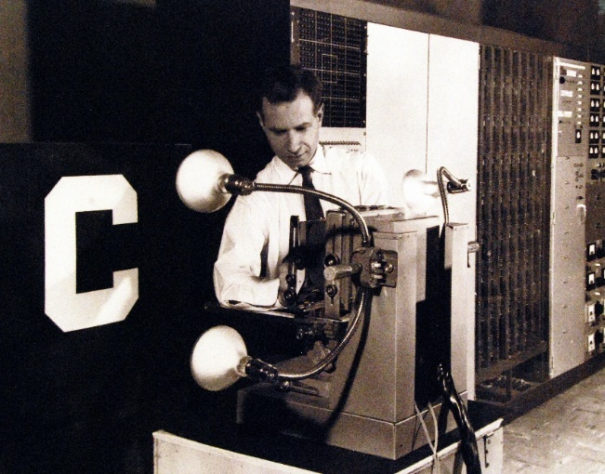
The Lonely Node
Source: Fortuner, B (2017). Can neural networks solve any problem? Medium.com: Towards Data Science
Notes:
As we mentioned in our Getting Started with AI course, the perceptron was developed by Frank Rosenblatt in the late 1950s and is one of the simplest forms of a neural network. It can be considered the building block or the "atom" of more complex neural networks. It’s essentially a single-layer neural network. Functionally, perceptrons work as binary classifiers, meaning they can categorize inputs into one of two classes. This is because, with a single neuron, perceptrons can't handle data that can’t be separated by a single straight line (or hyperplane in higher dimensions). This limitation in network capacity inspired the creation of linking perceptrons together, creating networks... Neural networks! In this module’s exercise, we will create our own perceptron and take it for a spin!

Slide 18
The Perceptron
02_code_a_perceptron.ipynb
This notebook will walk you through building and training your own binary classification model, then using it to make predictions!

Slide 19
Network Capacity
Notes:
Network Capacity: Network capacity refers to the complexity or flexibility of a neural network to capture patterns in data. A network with higher capacity can model more intricate relationships but is also more prone to overfitting, meaning it might perform well on training data but poorly on unseen data. Factors affecting capacity include:
The number of layers
The number of neurons in each layer
The type of activation functions used

Slide 20
Look at This
03_mnist_classifier.ipynb
This notebook will walk you through training an image classification model using a full neural network.

Slide 21
Questions?
(QR CODE FOR SURVEY!)

