Slide 1

Anatomy of a Neural Network

Slide 2
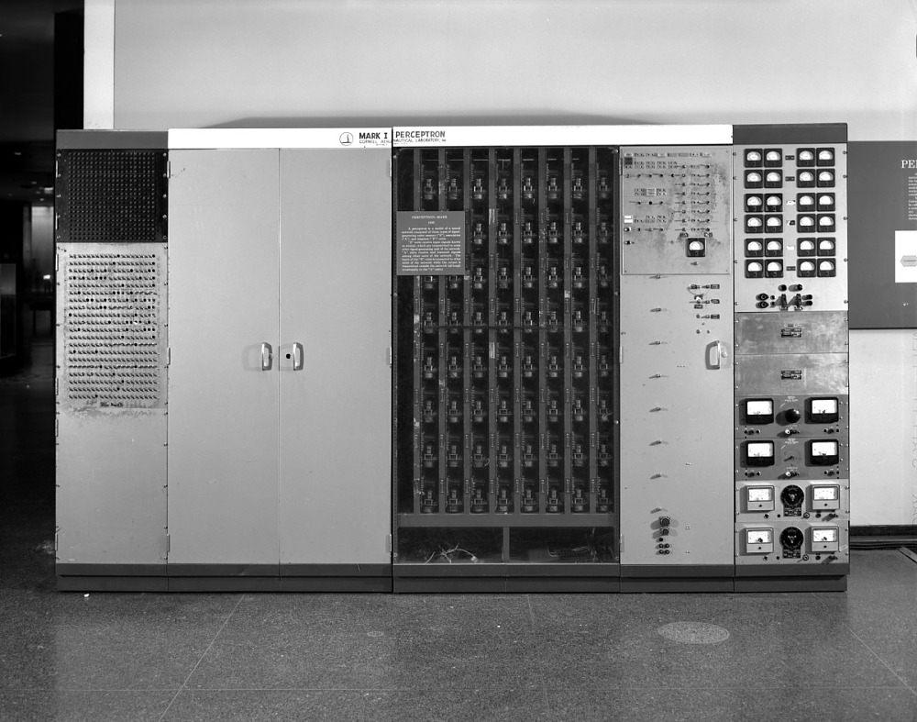
Image Credit: https://americanhistory.si.edu/collections/search/object/nmah_334414
Notes:
Let’s begin with a little background…
The history of neural networks began in 1943, with the publication of a paper by McCulloch and Pitts. In this article, they presented a massively simplified abstraction of a neuron’s basic functions and described how multiple instances of this object could be connected into a network, or net.
In 1957 Frank Rosenblatt proposed the perceptron as a simplified mathematical model of a neuron (Rosenblatt 1962). And the following year (1958), a perceptron-based computer was built at Cornell University. It was the size of a refrigerator and called the Mark I Perceptron (Wikipedia 2020c). The device was built to process and classify simple images. Its grid of 400 photocells could digitize an image at a resolution of 20 by 20 pixels. Enthusiasm for the perceptron, however, was short lived.
In 1969, Marvin Minsky and Seymour Papert wrote a book in which they argued that Rosenblatt’s perceptron technique was severely limited. Soon, a popular consensus formed that neural networks were a dead end. Enthusiasm, interest, and funding all dried up. The first AI Winter had begun. However, all that changed about 10 years ago. Big data combined with powerful hardware made it possible to create complex neural networks, capable of doing interesting things.
Source: Glassner, A. (2021). Deep learning: A visual approach. San Francisco, CA: No Starch Press

Slide 3
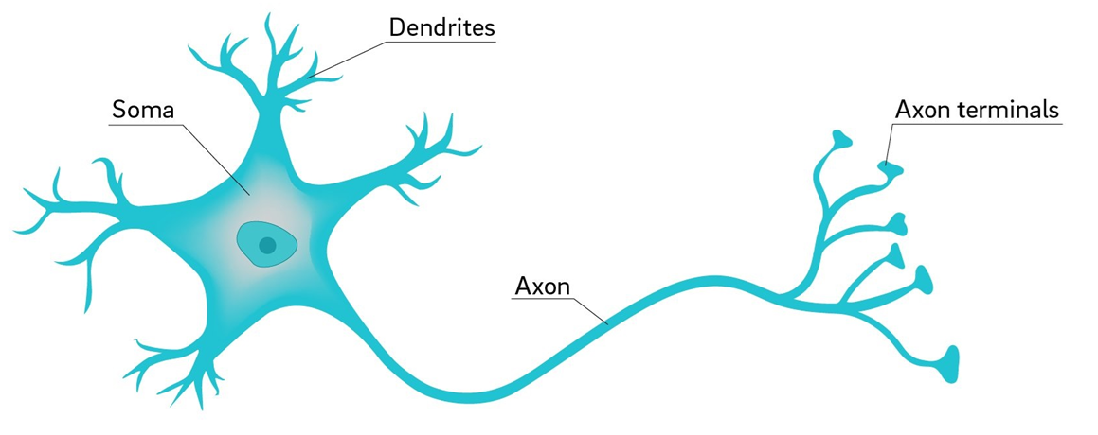
Image Credit: https://ucsdnews.ucsd.edu/pressrelease/why_are_neuron_axons_long_and_spindly
Notes:
Rosenblatt’s perceptron, of course, was inspired by the anatomy and workings of the human neuron.
As shown here, a neuron is comprised of Dendrites, a cell body (labeled here as the Soma), and an extended Axon with multiple branches, tipped with Axon terminals. The Axon terminals, in turn, connect to Dendrites from other neurons. Hence, the flow of electrical impulses is from Dendrite to Soma to Axon and then to Axon terminal. And finally, the strength of the electrical impulse sent to the Axon depends on the combined strength of impulses coming into the Soma. As we will soon see, neural networks operate in a similar manner.

Slide 4
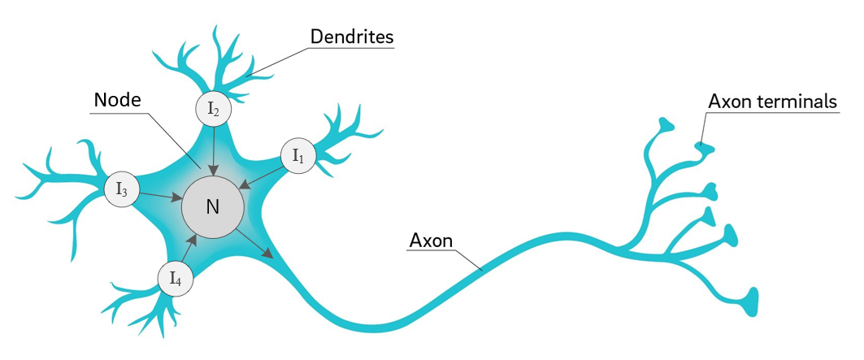
Image Credit: https://ucsdnews.ucsd.edu/pressrelease/why_are_neuron_axons_long_and_spindly
Notes:
The process of creating an artificial neuron begins by diagramming basic operations. First, we’ll use the term node or neuron – instead of Soma or cell body – to denote a centralized location which collects incoming signals and then outputs a value. Second, let’s label each of our inputs as I1, I2, I3, and I4. In this case, the arrows indicate signal direction, with four coming into the Node and one leaving as output.
Now, let’s take another step towards a computational abstraction.

Slide 5
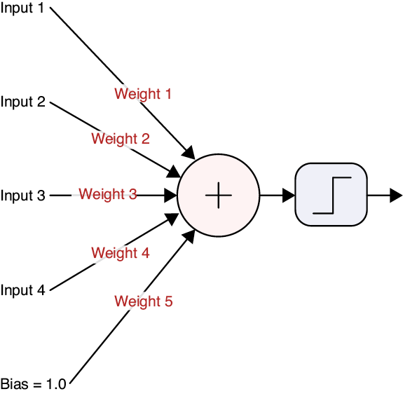
Source: Glassner, A. (2021). Deep learning: A visual approach. San Francisco, CA: No Starch Press. (Chapter 13)
Notes:
The biological underpinnings have now disappeared, though we still see our 4 inputs on the left, with the addition of a bias value. Each input value is multiplied by its associated weight before it is fed into the net input function. And from there, the net input function’s output is passed to an activation function. We will talk more about these two functions shortly. Of course, the number of inputs coming into a node is not limited to four. We can have as many as we like.

Slide 6
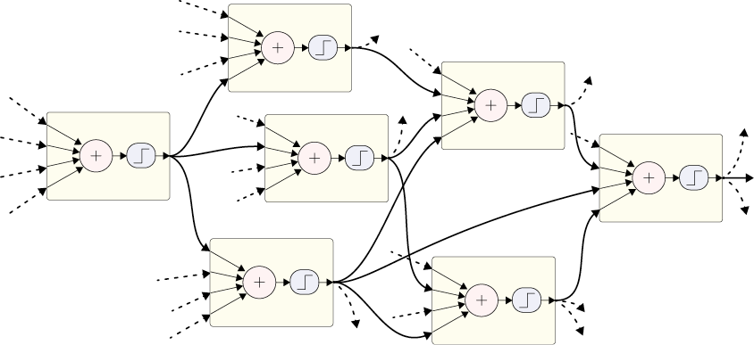
Source: Glassner, A. (2021). Deep learning: A visual approach. San Francisco, CA: No Starch Press. (Chapter 13)
Notes:
Like real neurons, artificial neurons can be wired up into networks, where each input comes from the output of another neuron. When we connect neurons together into networks, we draw lines to connect one neuron’s output to one or more other neurons’ inputs, as shown here. The goal of a network like the one pictured here is to produce one or more values as outputs.

Slide 7
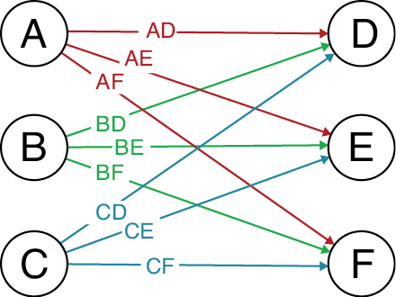
Source: Glassner, A. (2021). Deep learning: A visual approach. San Francisco, CA: No Starch Press. (Chapter 13)
Notes:
Even though we don’t usually draw the weights, it’s sometimes useful to refer to individual weights by name. A common convention used to identify specific weights is illustrated here. Here we see six nodes or neurons. For convenience, we’ve labeled each with a letter. Each weight corresponds to how the output of one specific neuron is changed on its way to another specific neuron, shown as lines. To name a weight, we combine the name of the output neuron with the input neuron. For example, the weight that multiplies the output of A before it’s used by D is called AD.

Slide 8
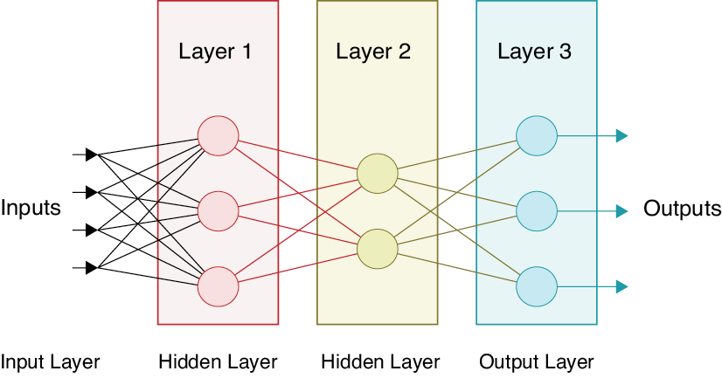
Source: Glassner, A. (2021). Deep learning: A visual approach. San Francisco, CA: No Starch Press. (Chapter 13)
Notes:
Of the many possible ways to organize neurons in a network, placing them in a series of layers has proven to be both flexible and extremely powerful. Typically, neurons within a layer aren’t connected to one another. Their inputs come from the previous layer, and their outputs go to the next layer. In fact, the phrase deep learning comes from this structure.

Slide 9

Deep
Wide
Image Credit: https://sugargeekshow.com/recipe/rainbow-cake/
Notes:
Consider a layered cake. If we lay the cake on its side, with many layers side-by-side, we say the network is wide. But if we stand the cake up and look at it from above, we say it is deep. And that’s what deep learning means: a network composed of a series of layers – often drawn vertically.

Slide 10
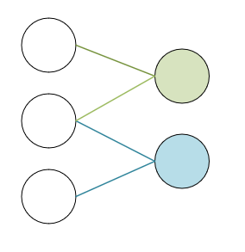
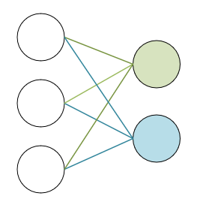
Fully Connected
Partially Connected
Notes:
Layers can be fully connected or partially connected. In a fully connected layer - the Keras API calls these dense layers – every neuron in the layer receives an input from every neuron in the previous layer. That is not the case in a partially connected network where some of the network connections are dropped. Interestingly, model training with partially connected layers is often faster and more effective.

Slide 11

Notes:
Alright – let’s put everything we’ve discussed so far into a single image / example.
Pictured here is a complete, albeit small, neural network. As such, it consists of an input layer, a single hidden layer, and an output layer.
Input features are fed to the input layer, one feature per node. And depending on the size of the input example, the number of input nodes varies. The input data can be structured data (such as a CSV file) or unstructured data, such as an image. Feature engineering, as it’s called, is an important component of any deep learning project.
During forward propagation, the flow of numbers is from left to right. That flow is reversed in back propagation, to be discussed in our next presentation.
We now label each of our weights. During forward propagation, the output from each node is multiplied by its corresponding weight before becoming input to the downstream node. So, for example, the output from (G) is multiplied by weight Wgf1 before becoming input to node (F).
A bias node is typically associated with each layer – the function of bias nodes will be discussed in just a few minutes.
In this example, the network’s output is passed from node (F) to an error function which calculates the network’s total error, the difference between ground truth (labelled y) and the output. A more complete explanation of the error function will be discussed in our next workshop when we explain the back propagation / gradient descent process.

Slide 12
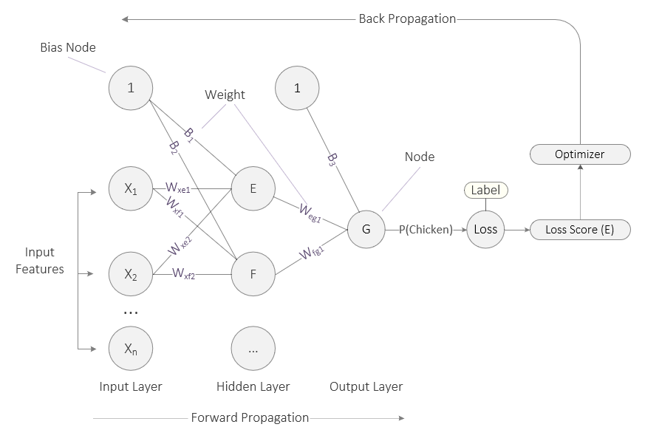
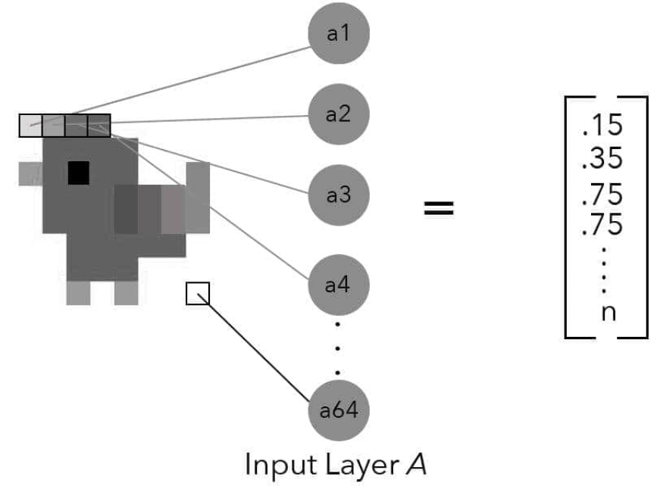
Source: Taylor, M. (2017). Neural networks: A visual introduction for beginners. Vancouver, Canada: Blue Windmill Media.
Notes:
And finally, let’s simulate the forward propagation process with another simple example. Here we feed an image to a small neural network, and it outputs the probability that the image is a chicken. Again, this network consists of an input layer, a single hidden layer, and an output layer.
Each example of input data is fed to the input layer. In this example, a greyscale image of a chicken 8 pixels by 8 pixels has been converted into a vector of 64 numbers, each one representing the intensity of the color at that point. These features are then fed to the input layer, one feature per node. In this case, X sub 2 is the second value in the vector.
The value in X sub 2 is then multiplied by weight xf2.
At node F, the net input function sums up all incoming values and passes that value to its activation function which then calculates the output value.
The output value from node F is then multiplied by weight wfg1.
At node G, the net input function sums up all incoming values and passes that value to its activation function. Because node G is the only node in the output layer, its output is the probability P() that the input image is a chicken. That value is then passed to the loss function which compares it to the label and calculates a loss score (E). The optimizer then takes that loss score and uses that to adjust the weights in the backpropagation phase – this is where the network “learns.”
Before we end this mini-lecture, we still have a mystery to clear up. Why does our network contain bias nodes? What’s their purpose? Let’s answer that question…
====
We note that the input layer is fully connected to the hidden layer, consisting of two nodes. And as you can see, each weight on the connecting lines is labelled. During forward propagation, the output from each node is multiplied by the weights before becoming input to the downstream node. The numbers flow from left to right. However, the flow is reversed during backpropagation, and this is where the neural network ‘learns.’ The backpropagation process is fully described in our next presentation, including the loss function, total error, and optimizer.

Slide 13
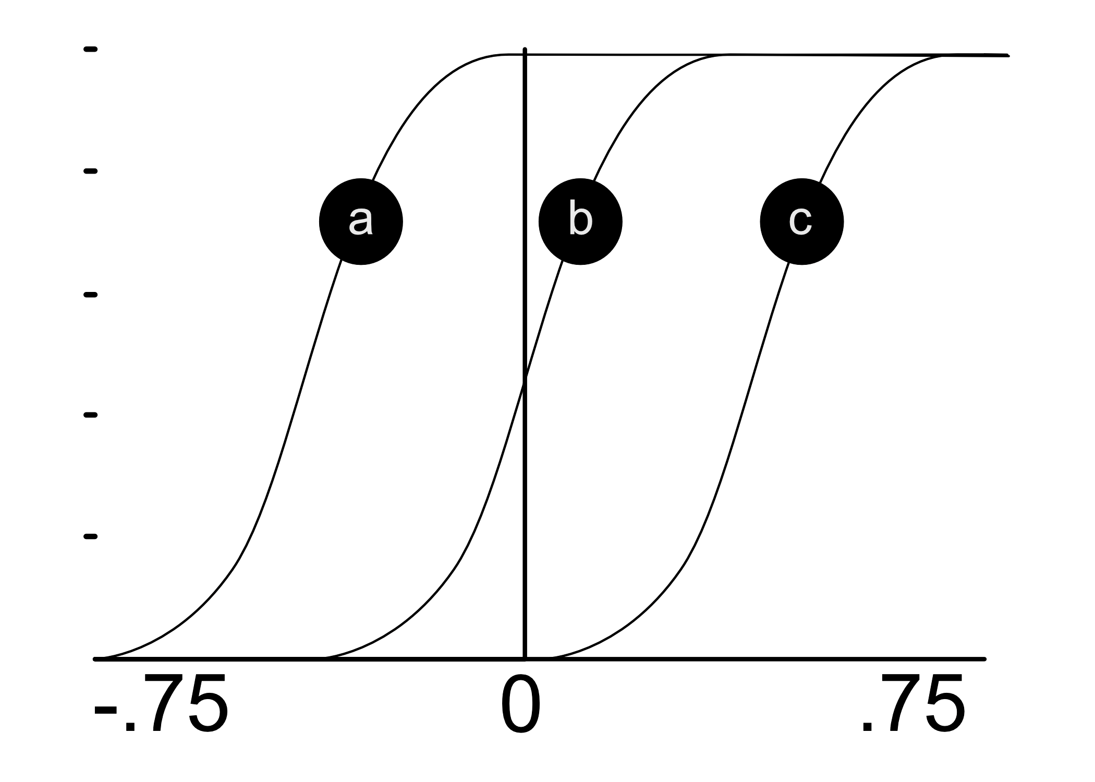
Source: Taylor, M. (2017). Neural networks: A visual introduction for beginners. Vancouver, Canada: Blue Windmill Media.
Notes:
Let’s now justify and explain the existence of the bias nodes. Technically, bias provides every node in a neural network with a trainable constant value (1 or -1). But why do we need them? Well – on a practical level – input from the bias node enables an activation function to be shifted to the left or right. In this case, what looks like a sigmoid function can be shifted to the left (position A) or to the right (position C). In addition to the adjustment of weights which occurs during backpropagation, this ‘shifting’ can be important and critical for successful learning.

Slide 14
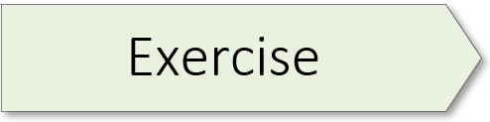
(Rosenblatt’s Perceptron) 02.1_perceptron.ipynb
Notes:
The learning experience for this workshop starts on page 55 of the textbook. For additional information, please watch the exercise 2.01 orientation video.

Slide 16

Notes:
Link: https://teachablemachine.withgoogle.com
Link: https://developers.google.com/machine-learning/glossary#e

Slide 17
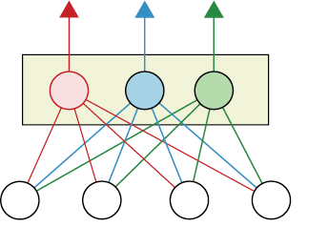

Slide 18

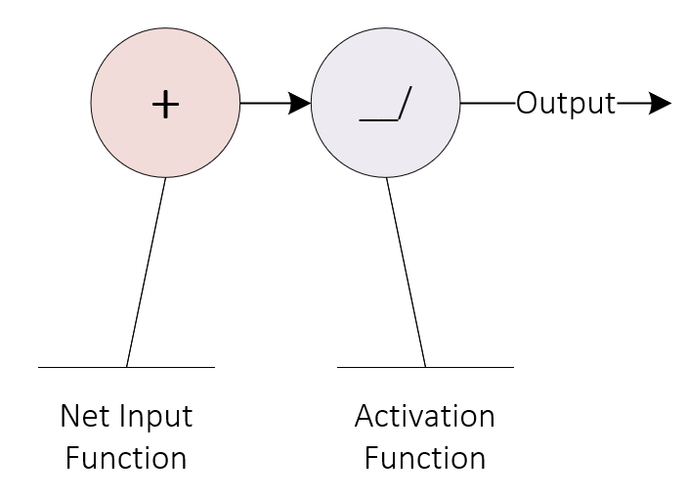
Notes:
As presented in an earlier slide, each node or neuron in a network is activated in a two-step process. First, the net input function sums up the incoming input, consisting of numbers. Here the plus sign indicates that operation, though an upper-case Sigma (Greek letter) is frequently used in the literature. And second, the net input function is tightly coupled to its corresponding activation function which, in turn, produces the node’s output. Keep in mind that an activation function can output a positive or negative number, or even zero.

