Slide 1

Gradient Descent
Notes:
In our last presentation, I briefly noted that the backpropagation process adjusts the network’s weights. We now need to take a closer look at how backprop works, how it adjusts those weights, using gradient descent and the chain rule from calculus. But do not fear, this presentation does not use mathematical formulas but focuses instead on visualizing the underlying process.

Slide 2
Notes:
Alright – let’s start with a quick review of a couple key points from the forward propagation slide as presented in our anatomy of a neural network presentation.
During forward propagation, the flow of numbers is from left to right. That flow, however, is reversed in back propagation as we will see in the next slide.
The network’s output is passed from node (F) to an error function (also called a loss function) which calculates the network’s total error, the difference between ground truth (labelled y) and the network output.
We now reverse that process in backpropagation…

Slide 3
o δ
Output (o) (δ) Delta
Notes:
With backpropagation, we start with the error function and work backward. It first passes its calculation of the network’s total error to the optimizer which oversees the backpropagation process.
The goal of the optimizer is to minimize the network’s error, in a process called gradient descent. At this point, the network needs to adjust all its weights such that the total error is minimized. More concretely, the network must calculate the individual contribution of each weight to the total error and then proceed to adjust each (up / down) in relation to its contribution to the total error.
To adjust a weight, we need the output from the originating neuron as well as the delta from its downstream connection. We will discuss the weight update process in just a bit.
But first, let’s take a closer look at inner workings of the error/loss function…

Slide 4
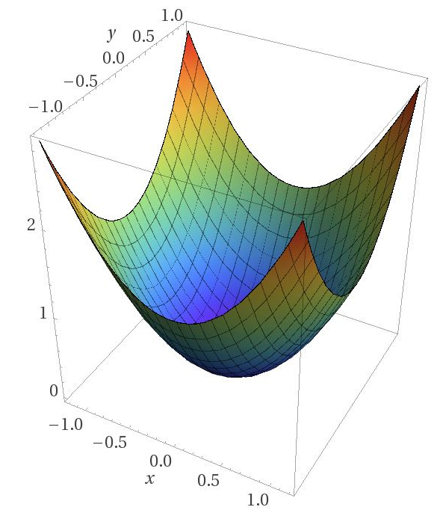
Start
End
Image Credit: https://blog.paperspace.com/intro-to-optimization-in-deep-learning-gradient-descent/
Notes:
The total error calculated by our error (loss) function can be plotted as a contour in 3 dimensions (x, y, and z), as shown here.. Naturally, this example has been greatly simplified – the real world is often much more complex, though the underlying logic holds. Now at the start of training, the network’s error is typically high, with a large difference between its output and the desired value. In this example, the initial error value is located at a point in one of the corners of the contour labelled Start, far from the global minimum labelled End. So, what we want to do is “walk” down this slope or gradient, from an initial starting point to an end point where the error is minimized. And because the network is moving down a gradient, the process is called gradient descent. But this raises an interesting question. How does the neural network figure out which way to go? How does it know which way is down?
Let’s start with an additional simplification…

Slide 5
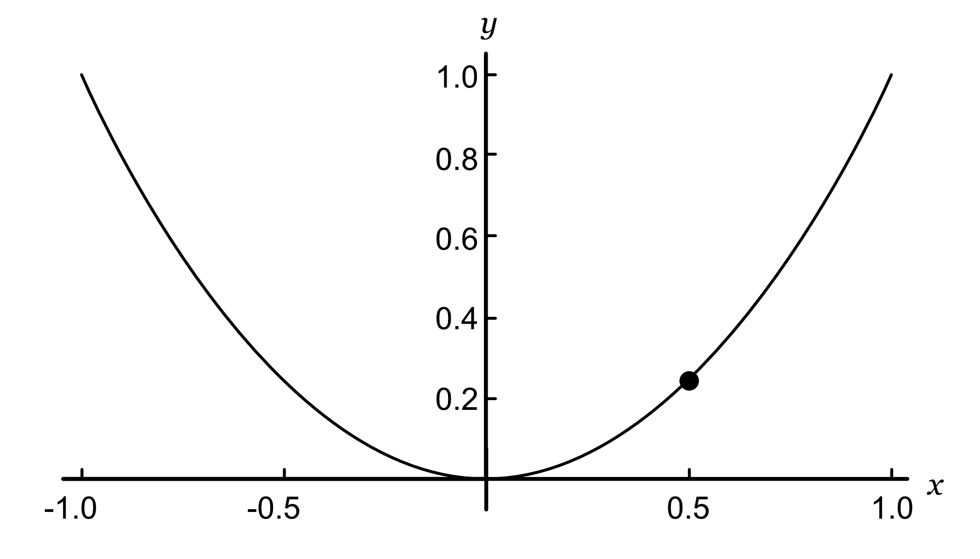
Notes:
… let’s reduce our 3-dimensional contour to two dimensions and add a point to indicate our current location. Now, imagine you are standing on this point and a dense fog surrounds you, making it impossible to see the bottom of the valley, the lowest point (global minimum) of this curve. All you can feel is the slope of the ground below your feet. A good strategy to get to the bottom of the valley quickly is to go downhill in the direction of the steepest slope. And to calculate that slope, we…

Slide 6
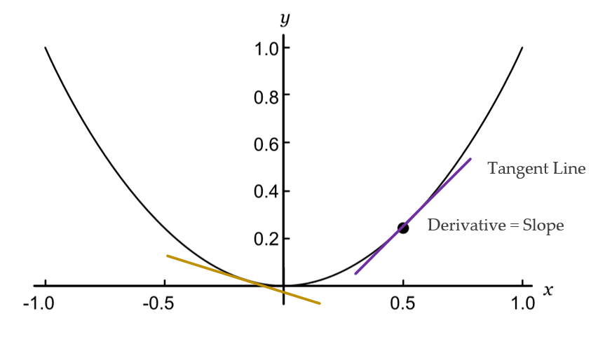
Source: Glassner, A. (2021). Deep learning: A visual approach. San Francisco, CA: No Starch Press. (page 355)
Notes:
… we draw a tangent line through a given point and then calculate its slope as the derivative of a partial differential equation. In other words, the derivative is the slope of the gradient at a particular point. If the gradient directly above the weight is positive (that is, the line goes up as we move to the right), then increasing the value of the weight (moving it to the right) causes the error to go up. Similarly, and more usefully, decreasing the value of the weight (moving it to the left) causes the error to go down, as is the case with the purple line. If the slope of the error is negative, the situation is reversed, as is the case with the gold line.
The error curve for every weight in the network is different because every weight has a different effect on the final error. But if we can find the gradient for a specific weight, we’ve solved the problem of guessing whether it needs to increase or decrease in order to reduce the error. If we can find the gradients for all the weights, we can adjust them all at once, rather than one by one. And this is what backprop does.
Also note that the slope varies depending on your location. For example, the slope of the gold tangent line is smaller than the purple one. What that means is this: as you approach the global minimum at the bottom, the slope gets smaller and smaller until it’s zero. In short, that’s how the neural network ‘knows’ it has found the best possible solution and minimized the network’s total error.

Slide 7
The learning rate is too small
Source: Geron, A. (2021). Hands-On Machine learning with Sci-Kit Learn, Keras & Tensorflow. Sebastopol, CA: O’Reilly. (Chapter 4)
Notes:
With the slope of our current location calculated, we know which way to go. Now the question is: What size of step should we take in that direction? This question highlights the importance of the learning rate, an important hyperparameter in Gradient Descent. If the learning rate is too small, the algorithm will have to go through many iterations to arrive at the global minimum, taking an inordinate amount of time to get there, as shown here.

Slide 8
The learning rate is too large
Source: Geron, A. (2021). Hands-On Machine learning with Sci-Kit Learn, Keras & Tensorflow. Sebastopol, CA: O’Reilly. (Chapter 4)
Notes:
On the other hand, if the learning rate is too high, you might jump across the valley and end up on the other side, possibly even higher up than you were before. A big learning rate might cause the algorithm to diverge, unable to find the global minimum as it jumps around it.

Slide 9
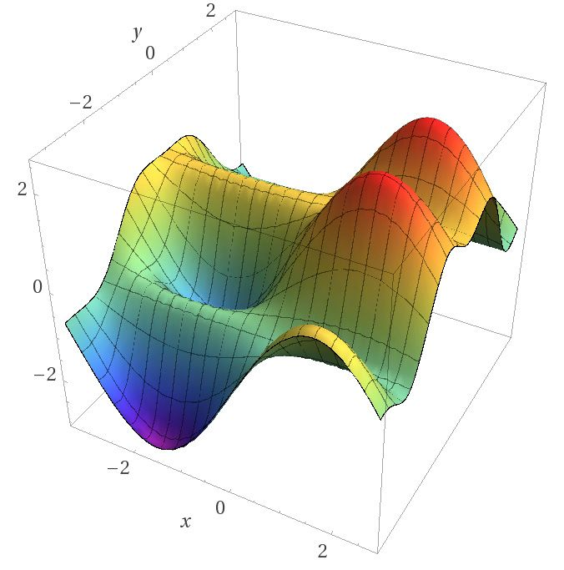
Image Credit: https://blog.paperspace.com/intro-to-optimization-in-deep-learning-gradient-descent/
Notes:
Another complicating factor is the fact that the loss function’s contour may not look like a nice, regular bowl. So far, I have used a simple example to facilitate a foundational understanding. But reality is often much more complex. A contour may have holes, ridges, plateaus, and all sorts of irregular terrains, making convergence to the minimum difficult to achieve, as shown here.

Slide 10
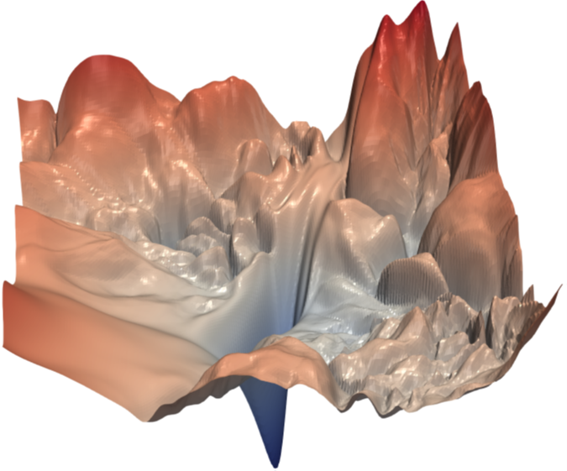
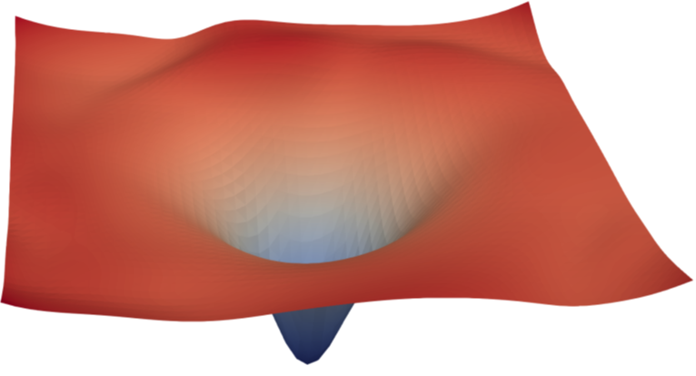
ResNet-56 Model
(a) with skip connections
(b) without skip connections
Source: Li, H., et. al. (2018). Visualizing the Loss Landscape of Neural Nets. NeurIPS 2018, Montreal, CA
Notes:
The architecture of the model determines the contour of the loss function. Here we see the loss surface of a ResNet-56 model, with and without skip connections. (Skip connections allow us to jump over some of the layers in a neural network. They act as short-cuts.) As we see, a slight change in model architecture often has a dramatic effect on the loss contour and whether a model is or is not trainable.
Article Link: https://proceedings.neurips.cc/paper/2018/file/a41b3bb3e6b050b6c9067c67f663b915-Paper.pdf

Slide 11
Gradient Descent pitfalls
Source: Geron, A. (2021). Hands-On Machine learning with Sci-Kit Learn, Keras & Tensorflow. Sebastopol, CA: O’Reilly. (Chapter 4)
Notes:
In complex cases like this, finding the global minimum can be a challenge. Consider this image. If the start point is on the left, then gradient descent will converge to a local minimum, which is not as good as the global minimum. If the starting point is on the right, then it may take a long time to cross the plateau. And if you stop too early, you will never reach the global minimum. So, is there a solution to this problem?

Slide 12
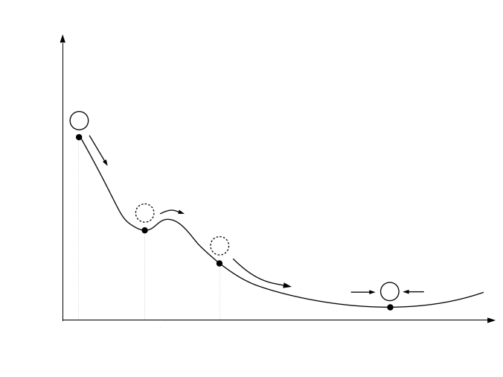
Source: Geron, A. (2021). Hands-On Machine learning with Sci-Kit Learn, Keras & Tensorflow. Sebastopol, CA: O’Reilly. (Chapter 4)
Notes:
Thankfully, a lot of research has been done on the best way to adjust the learning rate to find the global minimum when a given loss function has a complex contour, one with ridges, valleys, and plateaus. Finding that minimum is the job of the optimizer.
For instance, a popular optimizer is Adam (Adaptive momentum). Imagine our loss curve as a mountain and our current position as a marble. If we drop a marble on top of a mountain, it will pick up speed, jumping over trenches (local minima) before hopefully landing at a lower minima.

Slide 13
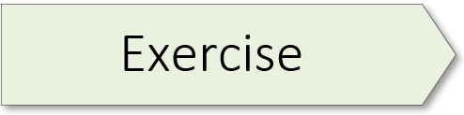
(A Keras Classifier) 03.1_keras_classifier.ipynb
Notes:
The learning experience for this workshop starts on page 79 of the textbook. For additional information, please watch the exercise 2.01 orientation video.

Slide 14
δ
o δ
Output (o) (δ) Delta
Notes:
Now that we’ve examined backpropagation from the perspective of the error function (its contour, and gradient descent) let’s circle back to the weight update process. We start with a key observation: When the output of any neuron in our network changes, the network’s total error – as calculated by the error function – changes by a proportional amount. Thus, the connection between any change in a given neuron’s output and the resulting change in the total error is simply the neuron’s change multiplied by some number.
This number goes by various names, but the most popular is the lowercase Greek letter δ (delta), though sometimes the uppercase version, Δ, is used. Mathematicians often use the delta character to mean “change” of some sort, so this was a natural (if terse) choice of name.
As stated in an earlier slide – to adjust a given weight, we need the output from the originating neuron as well as the delta from its downstream connection.
In the slides which follow, we’re going to examine the update process for Weight gf1 – bookmark that in your memory.
To better understand what delta is, let’s take a closer look at what happens inside an artificial neuron.

Slide 15
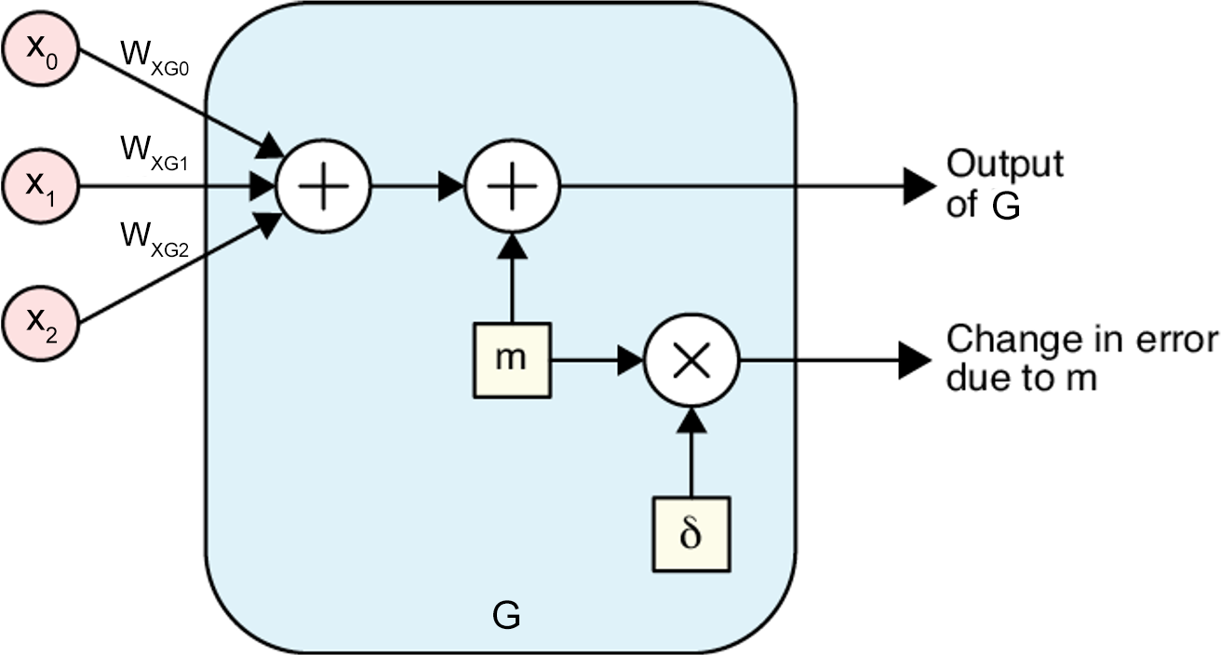
Source: Glassner, A. (2021). Deep learning: A visual approach. San Francisco, CA: No Starch Press. (Chapter 14)
Notes:
So, every neuron has a delta, or δ, associated with it as a result of evaluating the current network with the current sample. This is a real number that can be big or small, positive or negative. Assuming the network’s input doesn’t change, and the rest of the network is frozen, if a neuron’s output changes by a particular amount, we can multiply that change by the neuron’s delta to see how the entire network’s output will change.
To illustrate the idea, let’s focus on the output from G, the single node in the hidden layer of our simple network from the previous slide. Now, let’s add some arbitrary value to G’s output just before that value emerges. As shown here, we use the letter m (for ‘modification’) as the name of the variable that holds this extra value.
Because the output will change by m, we know the change in the final error is m times the neuron’s δ.
Source: Deep Learning: A Visual Approach (p. 357)

Slide 16
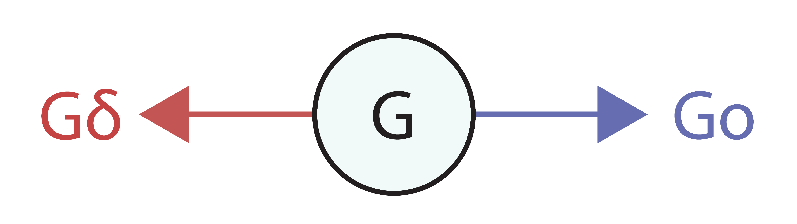
Notes:
Because network training includes both forward and backpropagation processes, each node in a neural network has two outputs. Node G, for example, produces an output to the right, during forward propagation, and an output to the left, during backpropagation. Here the output to the right (forward prop) is called Go while the output to the left (backprop) is called Gδ.
Now with this naming convention established, the process for finding the updated value for weight Wgf1 can be summarized as follows.,,

Slide 17
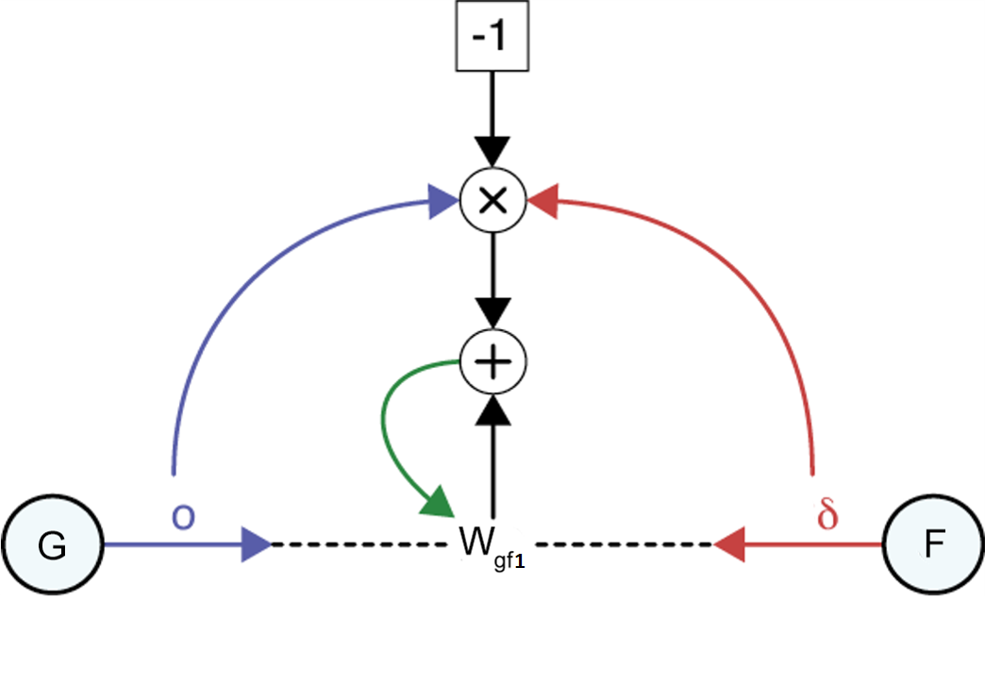
Go
Fδ
Source: Glassner, A. (2021). Deep learning: A visual approach. San Francisco, CA: No Starch Press. (Chapter 14)
Notes:
The entire process for finding the updated value for weight Wgf1 is pictured here. Let’s walk through this figure. We start with the output Go from neuron G and the delta Fδ from output neuron F. We first multiply these two numbers together, as shown by the multiplication sign. We then multiply that value by -1 and add that to weight Wgf1. The green arrow is the update step, where this result becomes the new value of Wgf1.
Source: Deep Learning: A Visual Approach (p. 367)
===========================================================
Showing subtraction in a diagram like this is hard, because if we have a “minus” node with two incoming arrows, it’s not clear which value is being subtracted from the other (that is, if the inputs are o and δ, do we compute o − δ or δ − o?). So, to sidestep that problem, we first multiply (Go × Fδ), multiply that by -1, and then add that result to Wgf1.

Slide 18
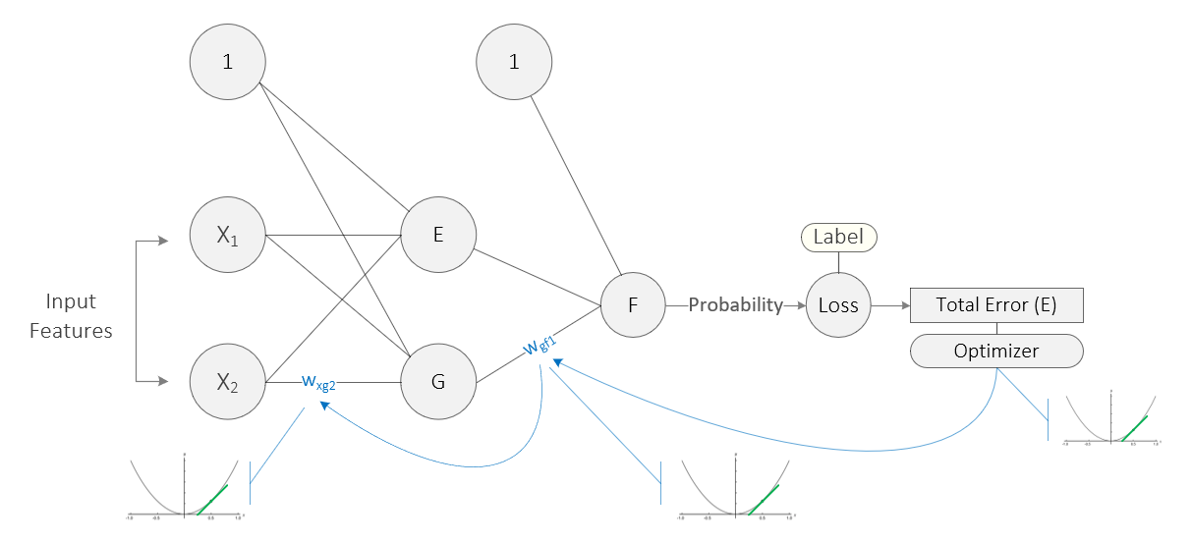
Source: Taylor, M. (2017). Neural networks: A visual introduction for beginners. Vancouver, Canada: Blue Windmill Media.
Notes:
Now that we understand how individual weights are updated, one final issue remains. Network weights are linked together, and this creates an additional complication. Consider this simple network. Weight Wxg2 is linked to weight Wgf1 which, in turn, is linked to the Total Error. Once the error (loss) function calculates the total error, its location on the gradient, and the slope (derivative) at that location, the optimizer then walks this error back through all the linked weights, calculating the slope (derivative) of each, and then adjusting the weights in the direction indicated. Calculus provides a way of managing these linked weights. It’s called the chain rule. As its name suggests, the chain rule is the way in which gradient descent calculates the contribution of each weight to the total error in relation to the other weights. In this example, the chain rule follows the blue arrows backwards, from Total error to weight Wgf1 and then weight Wxg2. The same logic applies to all the other weights, including bias.

Slide 19
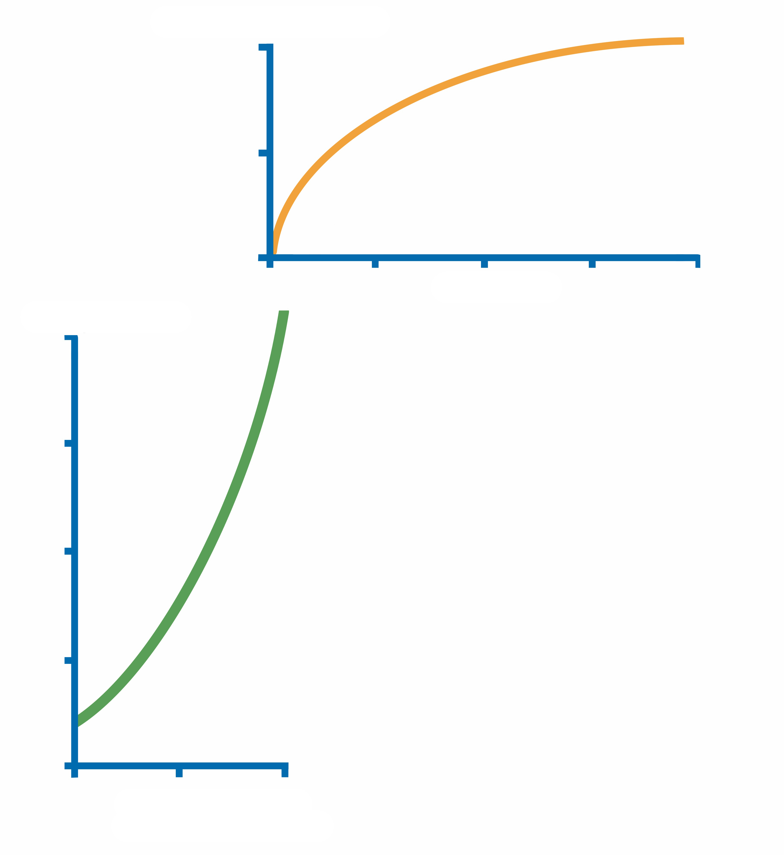
w_{xg2}
w_{gf1}
w_{gf1}
Total Error

Slide 20
w_{xg2}
w_{gf1}
w_{gf1}
Total Error

Slide 21
w_{xg2}
w_{gf1}
w_{gf1}
Total Error

Slide 22
w_{xg2}
w_{gf1}
w_{gf1}
Total Error

Slide 23
w_{xg2}
w_{gf1}
w_{gf1}
Total Error

Slide 24
w_{xg2}
w_{gf1}
w_{gf1}
Total Error

Slide 25
w_{xg2}
w_{gf1}
w_{gf1}
Total Error

Slide 26
Source: https://medium.com/swlh/introduction-to-deep-learning-using-keras-and-tensorflow-part2-284746ab4442
Notes:
And finally, let’s zoom out and consider the training process from the perspective of the overall model. Here we see the training process (the process of model convergence) simulated for a linear regression model. As our model converges to a global minimum – that is, the model’s fit improves as the regression line moves – our training loss drops and adjustments to our parameters (weights and biases) levels off.

Slide 27
Summary
Error (Loss) Function
Gradient Descent & Partial Derivatives
Complex Gradients
Optimizers
Chain Rule
Notes:
Well, we have covered a lot of territory in this presentation. First, we discussed the loss function and a network’s total error. That was followed by an in-depth look at gradient descent and the use of partial differential equations to calculate the derivative or slope at a given point on the gradient. We also learned that most loss functions exhibit complex contours, featuring hills, values, and plateaus, making it difficult to locate the global minimum. And finally, I discussed how backpropagation employs the chain rule to determine the contribution of each weight to the total error in relation to the other weights.

Slide 28
(MNIST Exercise)
MNISTExercise.pdf
Notes:
MNIST (Modified National Institute of Standards and Technology) is a famous dataset of handwritten digits with 60,000 examples in the training set and 10,000 in the test set. MNIST was created in 1998 – a long, long time ago in AI time. Creating a deep learning model to correctly classify a given image is equivalent to writing a “Hello World” program in AI.

Slide 30
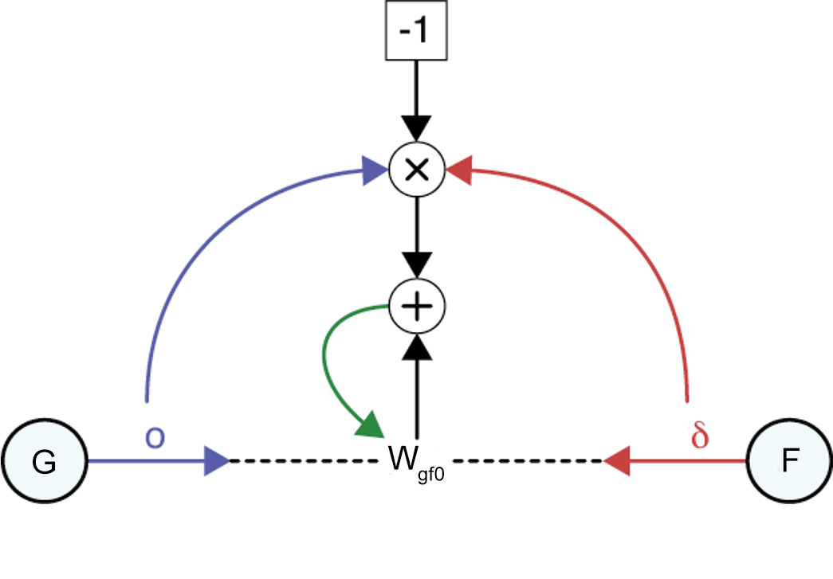

Slide 31
Notes:
Gradient Descent is a generic optimization algorithm capable of finding optimal solutions to a wide range of problems. The general idea of Gradient Descent is to tweak parameters (weights) iteratively in order to minimize a cost function. Suppose you are lost in the mountains in a dense fog, and you can only feel the slope of the ground below your feet. A good strategy to get to the bottom of the valley quickly is to go downhill in the direction of the steepest slope. This is exactly what Gradient Descent does: it measures the local gradient of the error function with regard to each weight in the network, and it goes in the direction of descending gradient. Weights are often combined into a parameter vector θ, pictured here at the Minimum. Once the gradient is zero, you have reached a minimum! Concretely, you start by filling θ with random values (this is called random initialization). Then you improve it gradually, taking one baby step at a time, each step attempting to decrease the cost function (e.g., the MSE), until the algorithm converges to a minimum.

Slide 32
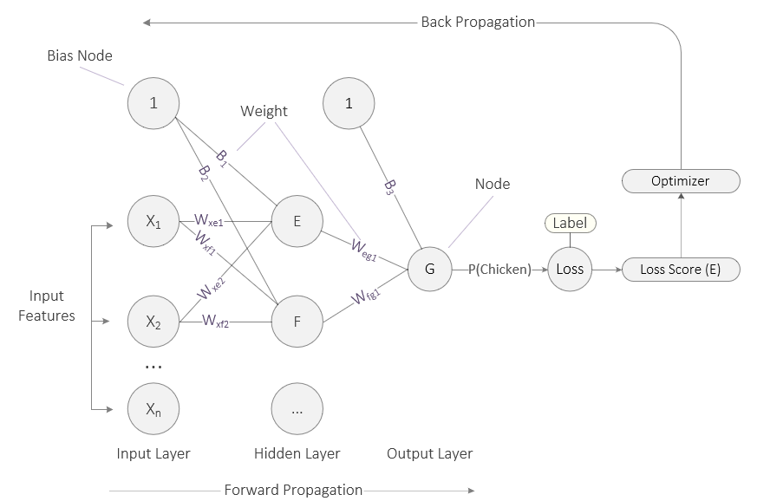
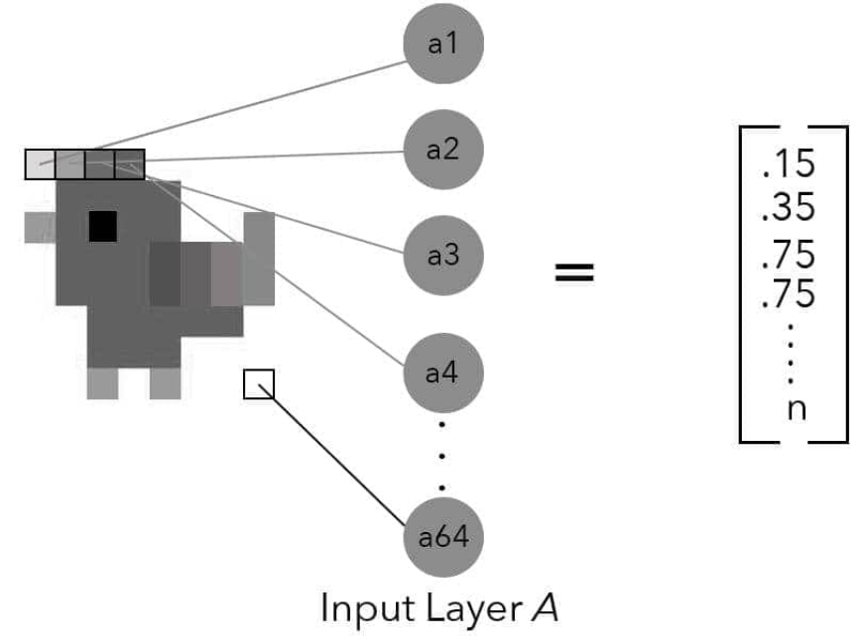
Source: Taylor, M. (2017). Neural networks: A visual introduction for beginners. Vancouver, Canada: Blue Windmill Media.
Notes:
We begin with the image of our small classification network from the last presentation. Let’s quickly review a couple points. In this example, the network’s output layer consists of a single node (G). Like the nodes before, it sums up its inputs, passes that value to its activation function which then generates a final output (the probability that the image is a chicken). This final output is then fed to a loss function, often called a cost or error function in the literature. The loss function compares the network’s prediction to the label attached to the example. So, if the label attached to this image is 1 (it’s 100% certain that this is a chicken) but our network outputs a probability of 10%, we have a large discrepancy. With that discrepancy, the loss function calculates the network’s total error. This is the penalty the network must pay for arriving at an answer other than the ground truth. If the network’s prediction closely matches the label, the total error is minimal.
And finally, the loss function passes the total error to the optimizer which oversees the backpropagation process. It is during backprop that weights are adjusted. Hence, the goal of the system is to minimize its error, in a process called gradient descent. At this point, the network needs to adjust all of its weights such that the total error is minimized. More concretely, the network needs to calculate the individual contribution of each weight to the total error and then proceed to adjust each weight (up or down) in relation to its contribution to the total error. So, how does it do that during backpropagation? Let’s start with a 3-dimensional plot…

