Slide 1

Gradient Descent
Notes:
Welcome to Practicum AI Foundations of Deep Learning – Gradient Descent.

Slide 2
Lesson Overview
1. The Big Picture
2. The Loss Function
3. A Race to the Bottom
4. Optimizers
Notes:
In this lesson, we will:
Introduce the backpropagation process – its basic parts and the relation of those parts to each other.
Take a closer look at the loss (error) function, more specifically its contour.
Present the logic of learning and how one finds the bottom of a loss function contour in relation to the learning rate hyperparameter.
Consider the key role optimizers play in real-world neural network learning

Slide 3
Notes:
So, let’s begin with a quick review of forward propagation. A couple points.
During forward propagation, the flow of numbers is from left to right.
In this small network, all roads lead to node F, the single node in our output layer. Node F then passes the network’s final prediction (output) to an error function, also known as a loss function. The loss function, in turn, calculates the network’s total error, being the difference between ground truth (labelled Y) and the network’s prediction.
We now reverse direction in back propagation…

Slide 4
o δ
Output (o) (δ) Delta
Notes:
With backpropagation, we start with the error function and move the other way. First, the error function passes its calculation of the network’s total error to the optimizer.
Now, the job of the optimizer is to minimize that error, in a process called gradient descent. What we want to do is adjust all the network’s weights such that our total error is minimized. More concretely, the network must calculate the individual contribution of each weight to the total error and then adjust each (up / down) in relation to its contribution to that error.
To adjust a weight, we need two things: the output from the originating neuron (o) as well as the delta from its downstream connection.
We will discuss the weight update process in just a moment. But first, let’s take a closer look at the error/loss function…

Slide 5
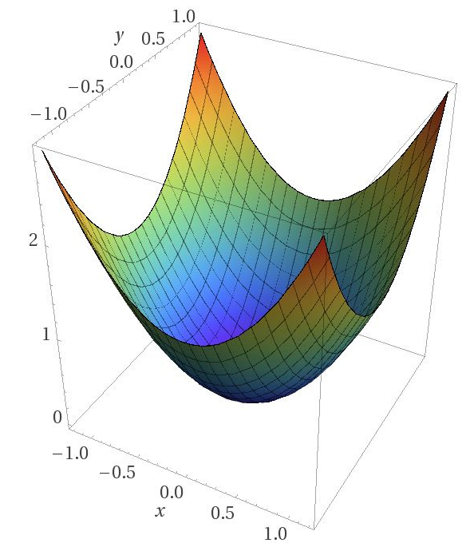
Image Credit: https://blog.paperspace.com/intro-to-optimization-in-deep-learning-gradient-descent/
Notes:
We begin by plotting the contour of our error/loss function in 3-dimensions (x, y, and z).
Of course, this example has been greatly simplified to facilitate understanding. Even so, the underlying logic holds, whether the contour is simple or complex. Now at the start of training, a network’s total error is usually high, with a large difference between its prediction and what we expect (ground truth).
In this simulation – the error / loss function…
2. … calculated an initial error located near one of the contour’s tips…
3. … far from the bottom or global minimum.
4. So, what we want to do is “walk” down this slope or gradient, from that initial starting point to the end point at the bottom. And because the network is
moving down a gradient, the process is called gradient descent.
But this raises an interesting question. How does the network figure out which way to go? How does it know which way is down?
To answer that question…

Slide 6
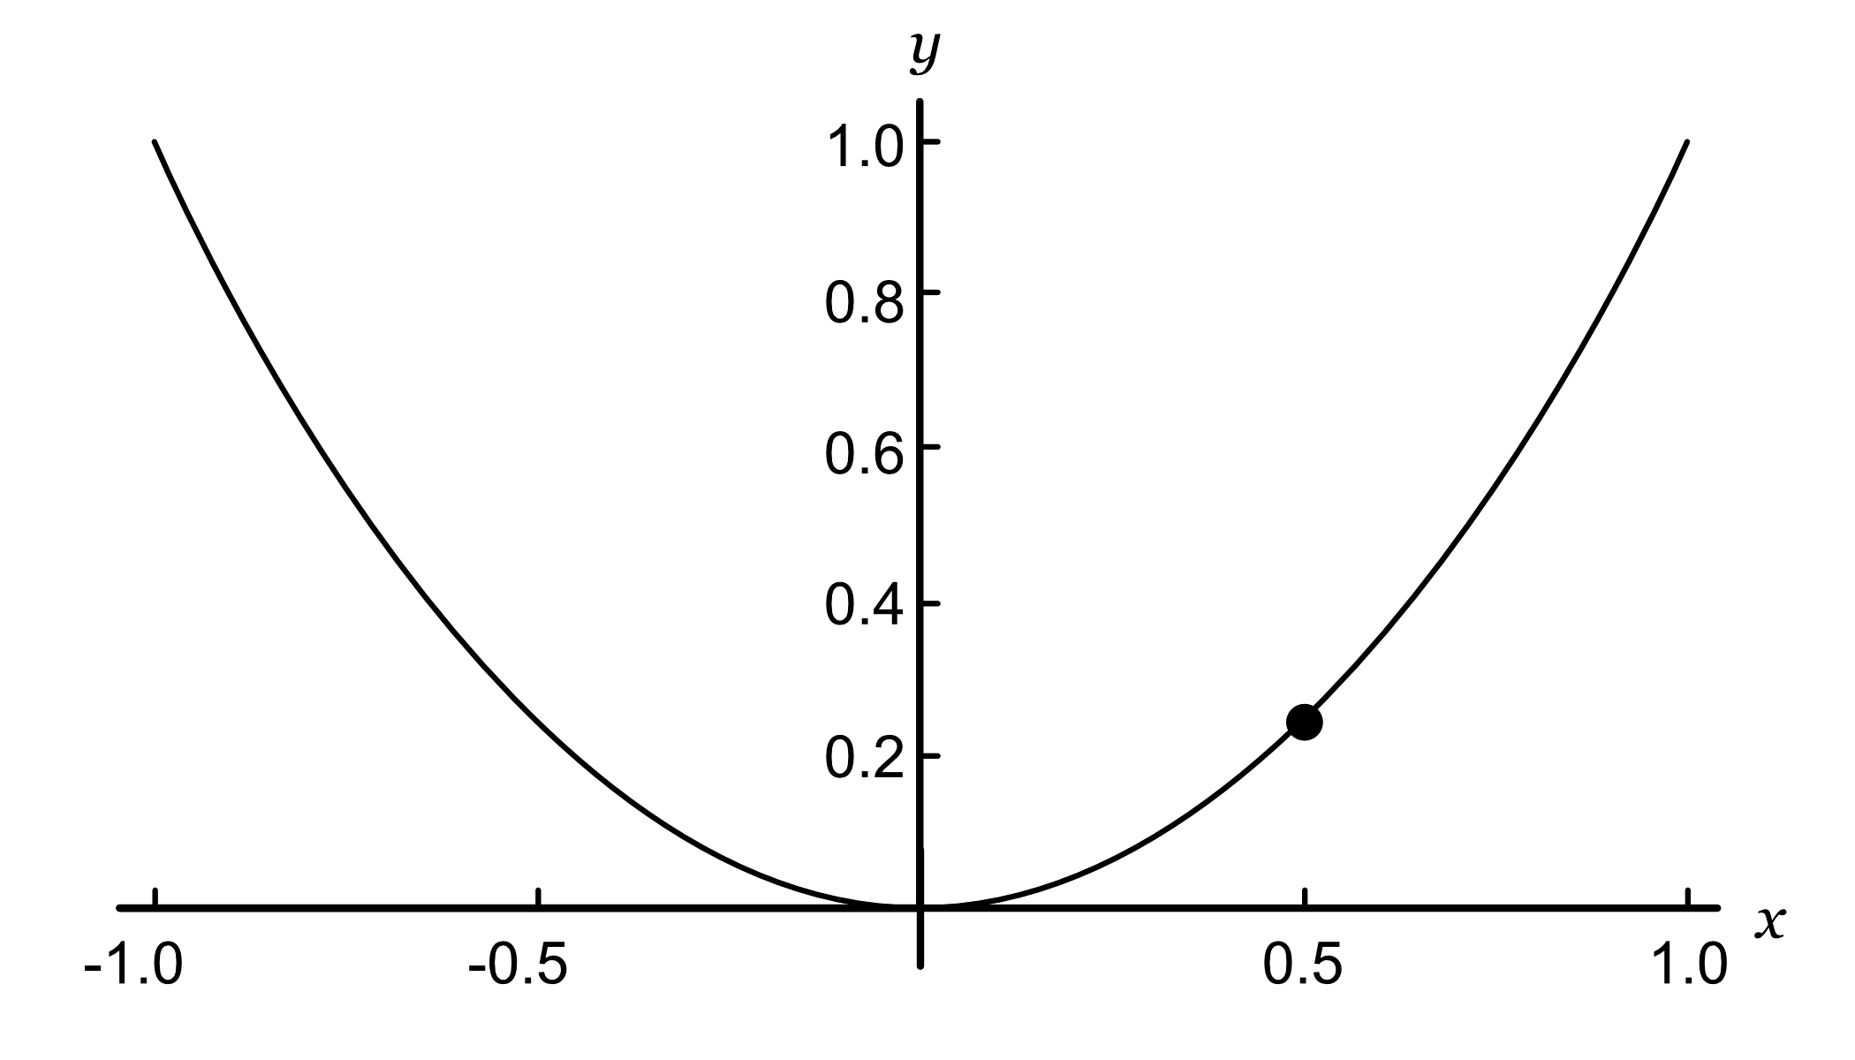
Notes:
… let’s reduce our 3-dimensional contour to two dimensions and add a point to indicate our current location. Now, imagine you are standing on this point and a dense fog surrounds you, making it impossible to see the bottom of the valley. All you can feel is the slope of the ground below your feet. So, how would you proceed? Well, just take a step downhill in the direction indicated by the steepest slope.
And to calculate that slope, we…

Slide 7
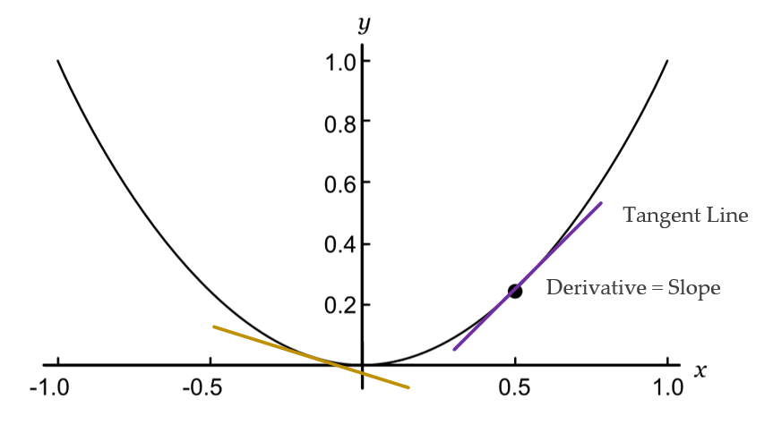
Source: Glassner, A. (2021). Deep learning: A visual approach. San Francisco, CA: No Starch Press. (page 355)
Notes:
… we draw a tangent line through a given point and then calculate its slope as the derivative of a partial differential equation. In other words, the derivative is the slope of the gradient at a particular point. If the gradient directly above the weight is positive (the line goes up as we move to the right), then increasing the value of the weight (moving it to the right) causes the error to go up. Likewise, decreasing the value of the weight (moving it to the left) causes the error to go down. We see that with the purple line. But if the slope of the error is negative (the line goes down as we move to the right), the logic is reversed. We see that with the gold line.
A couple key points –
The error curve for each weight in a network is different because each weight has a different effect on the total error. But if we can calculate the gradient for a specific weight, we know whether it should increase or decrease. And if we can calculate the gradients for all the weights, we can adjust them all at once, rather than one by one. That’s what backprop does.
The slope of a tangent line varies depending on its location. For example, the slope of the gold line is smaller than the purple one. In other words – as you approach the global minimum at the bottom – the slope gets smaller and smaller until it’s zero. When that happens, the neural network ‘knows’ it has found the best possible solution.

Slide 8
The learning rate is too small
Source: Geron, A. (2021). Hands-On Machine learning with Sci-Kit Learn, Keras & Tensorflow. Sebastopol, CA: O’Reilly. (Chapter 4)
Notes:
Once we know the slope at our current location, we know which way to go. So, our next question is: What size of step should we take? The model’s learning rate answers that question. It tells the optimizer how big or small each step should be. This is an important hyperparameter, one of those adjustable settings you need to keep an eye on. If our learning rate is too small, it takes a long time (many iterations) to arrive at the global minimum.
On the other hand, …

Slide 9
The learning rate is too large
Source: Geron, A. (2021). Hands-On Machine learning with Sci-Kit Learn, Keras & Tensorflow. Sebastopol, CA: O’Reilly. (Chapter 4)
Notes:
… if the learning rate is too high, you might jump across the valley and end up on the other side, possibly at a location higher up than before. So, a large learning rate might cause the algorithm to diverge, unable to find the global minimum as it jumps around it.

Slide 10
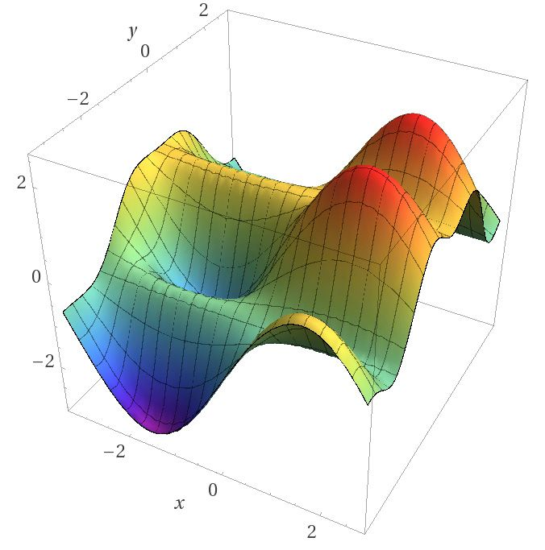
Image Credit: https://blog.paperspace.com/intro-to-optimization-in-deep-learning-gradient-descent/
Notes:
Another complicating factor is the fact that the loss function’s contour may not look like a nice, regular bowl. So far, I’ve used a simple example to facilitate a foundational understanding. But reality is often much more complex. A contour may have holes, ridges, plateaus, and all sorts of irregular terrains, making convergence to the global minimum difficult to achieve, if not impossible.

Slide 11
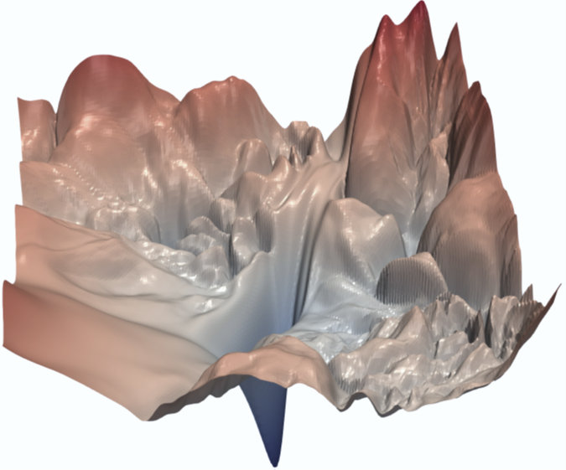
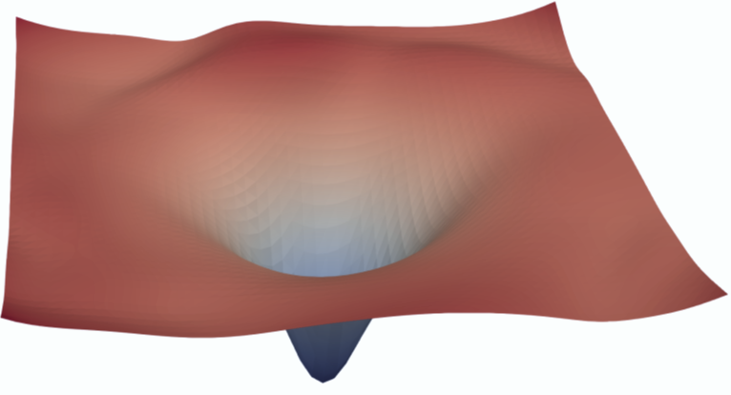
ResNet-56 Model
(a) with skip connections
(b) without skip connections
Source: Li, H., et. al. (2018). Visualizing the Loss Landscape of Neural Nets. NeurIPS 2018, Montreal, CA
Notes:
The architecture of the model and its trainable weights determines the contour of the loss function. Here we see the loss surface of a ResNet-56 model, with and without skip connections. (A skip connection allows us to jump over some of the layers in a neural network) As we see here, a slight change in model architecture can have a dramatic effect on the loss contour and whether a model is or is not trainable. Keep in mind that what we’re doing here is reducing a high-dimensional space to 3-dimensions. And yes, this is a complex and highly mathematical process, well beyond the scope of this learning experience.
Article Link: https://proceedings.neurips.cc/paper/2018/file/a41b3bb3e6b050b6c9067c67f663b915-Paper.pdf

Slide 12
Gradient Descent pitfalls
Source: Geron, A. (2021). Hands-On Machine learning with Sci-Kit Learn, Keras & Tensorflow. Sebastopol, CA: O’Reilly. (Chapter 4)
Notes:
With complex contours, it can be hard to find a global minimum. Consider this image. If we start on the left, then gradient descent might converge to a local minimum that is not as good as the global minimum. If we start, however, on the right, it might take too long to cross the plateau. In that case, stop too early and one never finds the global minimum. Can we overcome this problem?

Slide 13
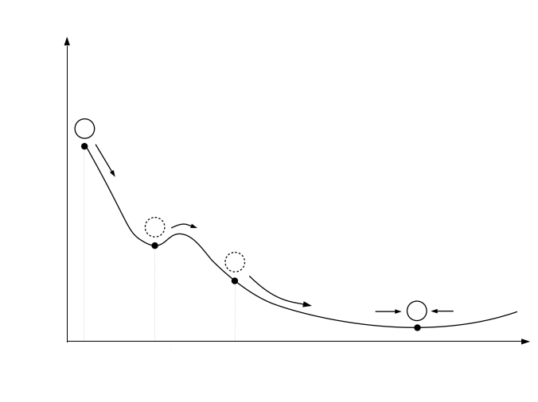
Source: Geron, A. (2021). Hands-On Machine learning with Sci-Kit Learn, Keras & Tensorflow. Sebastopol, CA: O’Reilly. (Chapter 4)
Notes:
Well, a lot of research has focused on the problem of adjusting the learning rate when a loss function contour has many ridges, valleys, and plateaus. It’s the optimizer’s job to find that global minimum.
The ADAM (Adaptive momentum) optimizer is a popular choice. ADAM’s basic strategy can be described like this:
First, imagine a marble placed near the top of a hill.
We then release the marble, and it begins to roll downhill, picking up speed as it goes. Hopefully, the marble’s momentum is enough for it to “jump” over trenches (local minima)…
… before ending up at the bottom.

Slide 14
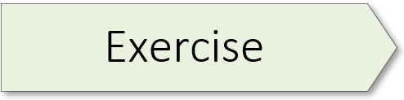
(A Keras Classifier) 03.1_keras_classifier.ipynb
Notes:
The learning experience for this workshop starts on page 79 of the textbook. For additional information, please watch the exercise 2.01 orientation video.

Slide 15
δ
o δ
Output (o) (δ) Delta
Notes:
Now that we’ve examined backpropagation from the perspective of the error function (its contour, and gradient descent) let’s circle back to the weight update process. We start with a key observation: When the output of any neuron in our network changes, the network’s total error – as calculated by the error function – changes by a proportional amount. Thus, the connection between any change in a given neuron’s output and the resulting change in the total error is simply the neuron’s change multiplied by some number.
This number goes by various names, but the most popular is the lowercase Greek letter δ (delta), though sometimes the uppercase version, Δ, is used. Mathematicians often use the delta character to mean “change” of some sort, so this was a natural (if terse) choice of name.
As stated in an earlier slide – to adjust a given weight, we need the output from the originating neuron as well as the delta from its downstream connection.
In the slides which follow, we’re going to examine the update process for Weight gf1 – bookmark that in your memory.
To better understand what delta is, let’s take a closer look at what happens inside an artificial neuron.

Slide 16
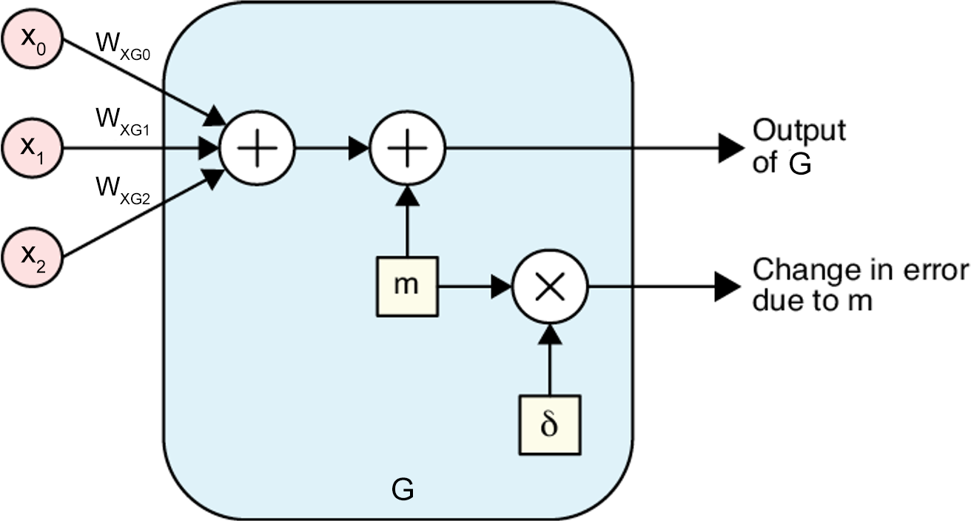
Source: Glassner, A. (2021). Deep learning: A visual approach. San Francisco, CA: No Starch Press. (Chapter 14)
Notes:
So, every neuron has a delta, or δ, associated with it as a result of evaluating the current network with the current sample. This is a real number that can be big or small, positive or negative. Assuming the network’s input doesn’t change, and the rest of the network is frozen, if a neuron’s output changes by a particular amount, we can multiply that change by the neuron’s delta to see how the entire network’s output will change.
To illustrate the idea, let’s focus on the output from G, the single node in the hidden layer of our simple network from the previous slide. Now, let’s add some arbitrary value to G’s output just before that value emerges. As shown here, we use the letter m (for ‘modification’) as the name of the variable that holds this extra value.
Because the output will change by m, we know the change in the final error is m times the neuron’s δ.
Source: Deep Learning: A Visual Approach (p. 357)

Slide 17
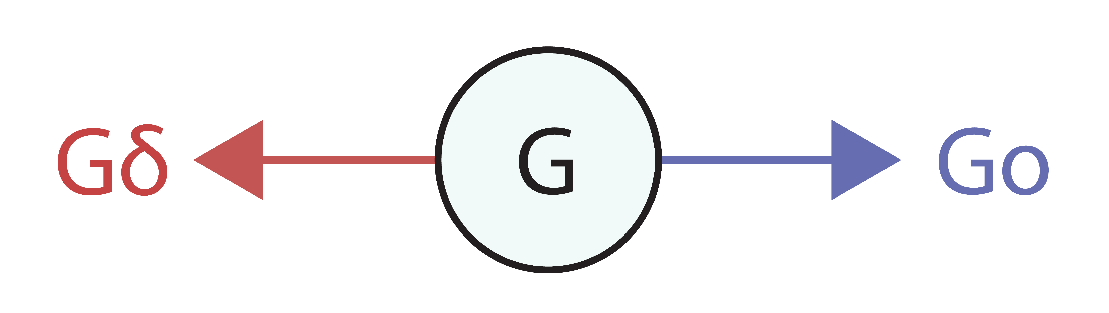
Notes:
Because network training includes both forward and backpropagation processes, each node in a neural network has two outputs. Node G, for example, produces an output to the right, during forward propagation, and an output to the left, during backpropagation. Here the output to the right (forward prop) is called Go while the output to the left (backprop) is called Gδ.
Now with this naming convention established, the process for finding the updated value for weight Wgf1 can be summarized as follows.,,

Slide 18
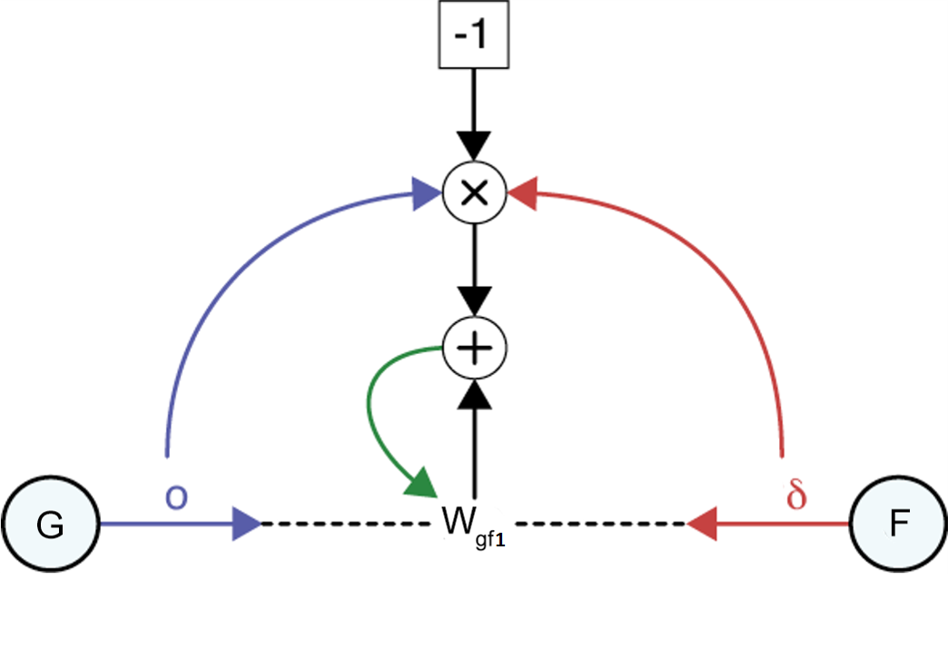
Go
Fδ
Source: Glassner, A. (2021). Deep learning: A visual approach. San Francisco, CA: No Starch Press. (Chapter 14)
Notes:
The entire process for finding the updated value for weight Wgf1 is pictured here. Let’s walk through this figure. We start with the output Go from neuron G and the delta Fδ from output neuron F. We first multiply these two numbers together, as shown by the multiplication sign. We then multiply that value by -1 and add that to weight Wgf1. The green arrow is the update step, where this result becomes the new value of Wgf1.
Source: Deep Learning: A Visual Approach (p. 367)
===========================================================
Showing subtraction in a diagram like this is hard, because if we have a “minus” node with two incoming arrows, it’s not clear which value is being subtracted from the other (that is, if the inputs are o and δ, do we compute o − δ or δ − o?). So, to sidestep that problem, we first multiply (Go × Fδ), multiply that by -1, and then add that result to Wgf1.

Slide 19
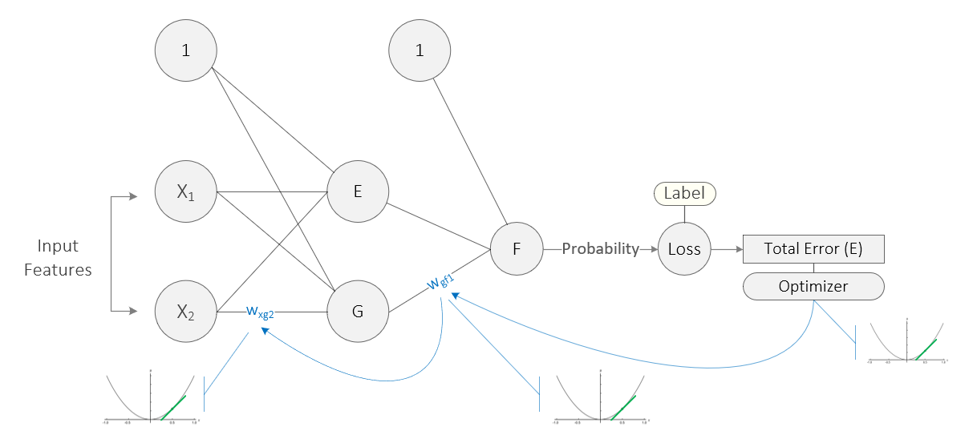
Source: Taylor, M. (2017). Neural networks: A visual introduction for beginners. Vancouver, Canada: Blue Windmill Media.
Notes:
Now that we understand how individual weights are updated, one final issue remains. Network weights are linked together, and this creates an additional complication. Consider this simple network. Weight Wxg2 is linked to weight Wgf1 which, in turn, is linked to the Total Error. Once the error (loss) function calculates the total error, its location on the gradient, and the slope (derivative) at that location, the optimizer then walks this error back through all the linked weights, calculating the slope (derivative) of each, and then adjusting the weights in the direction indicated. Calculus provides a way of managing these linked weights. It’s called the chain rule. As its name suggests, the chain rule is the way in which gradient descent calculates the contribution of each weight to the total error in relation to the other weights. In this example, the chain rule follows the blue arrows backwards, from Total error to weight Wgf1 and then weight Wxg2. The same logic applies to all the other weights, including bias.

Slide 20
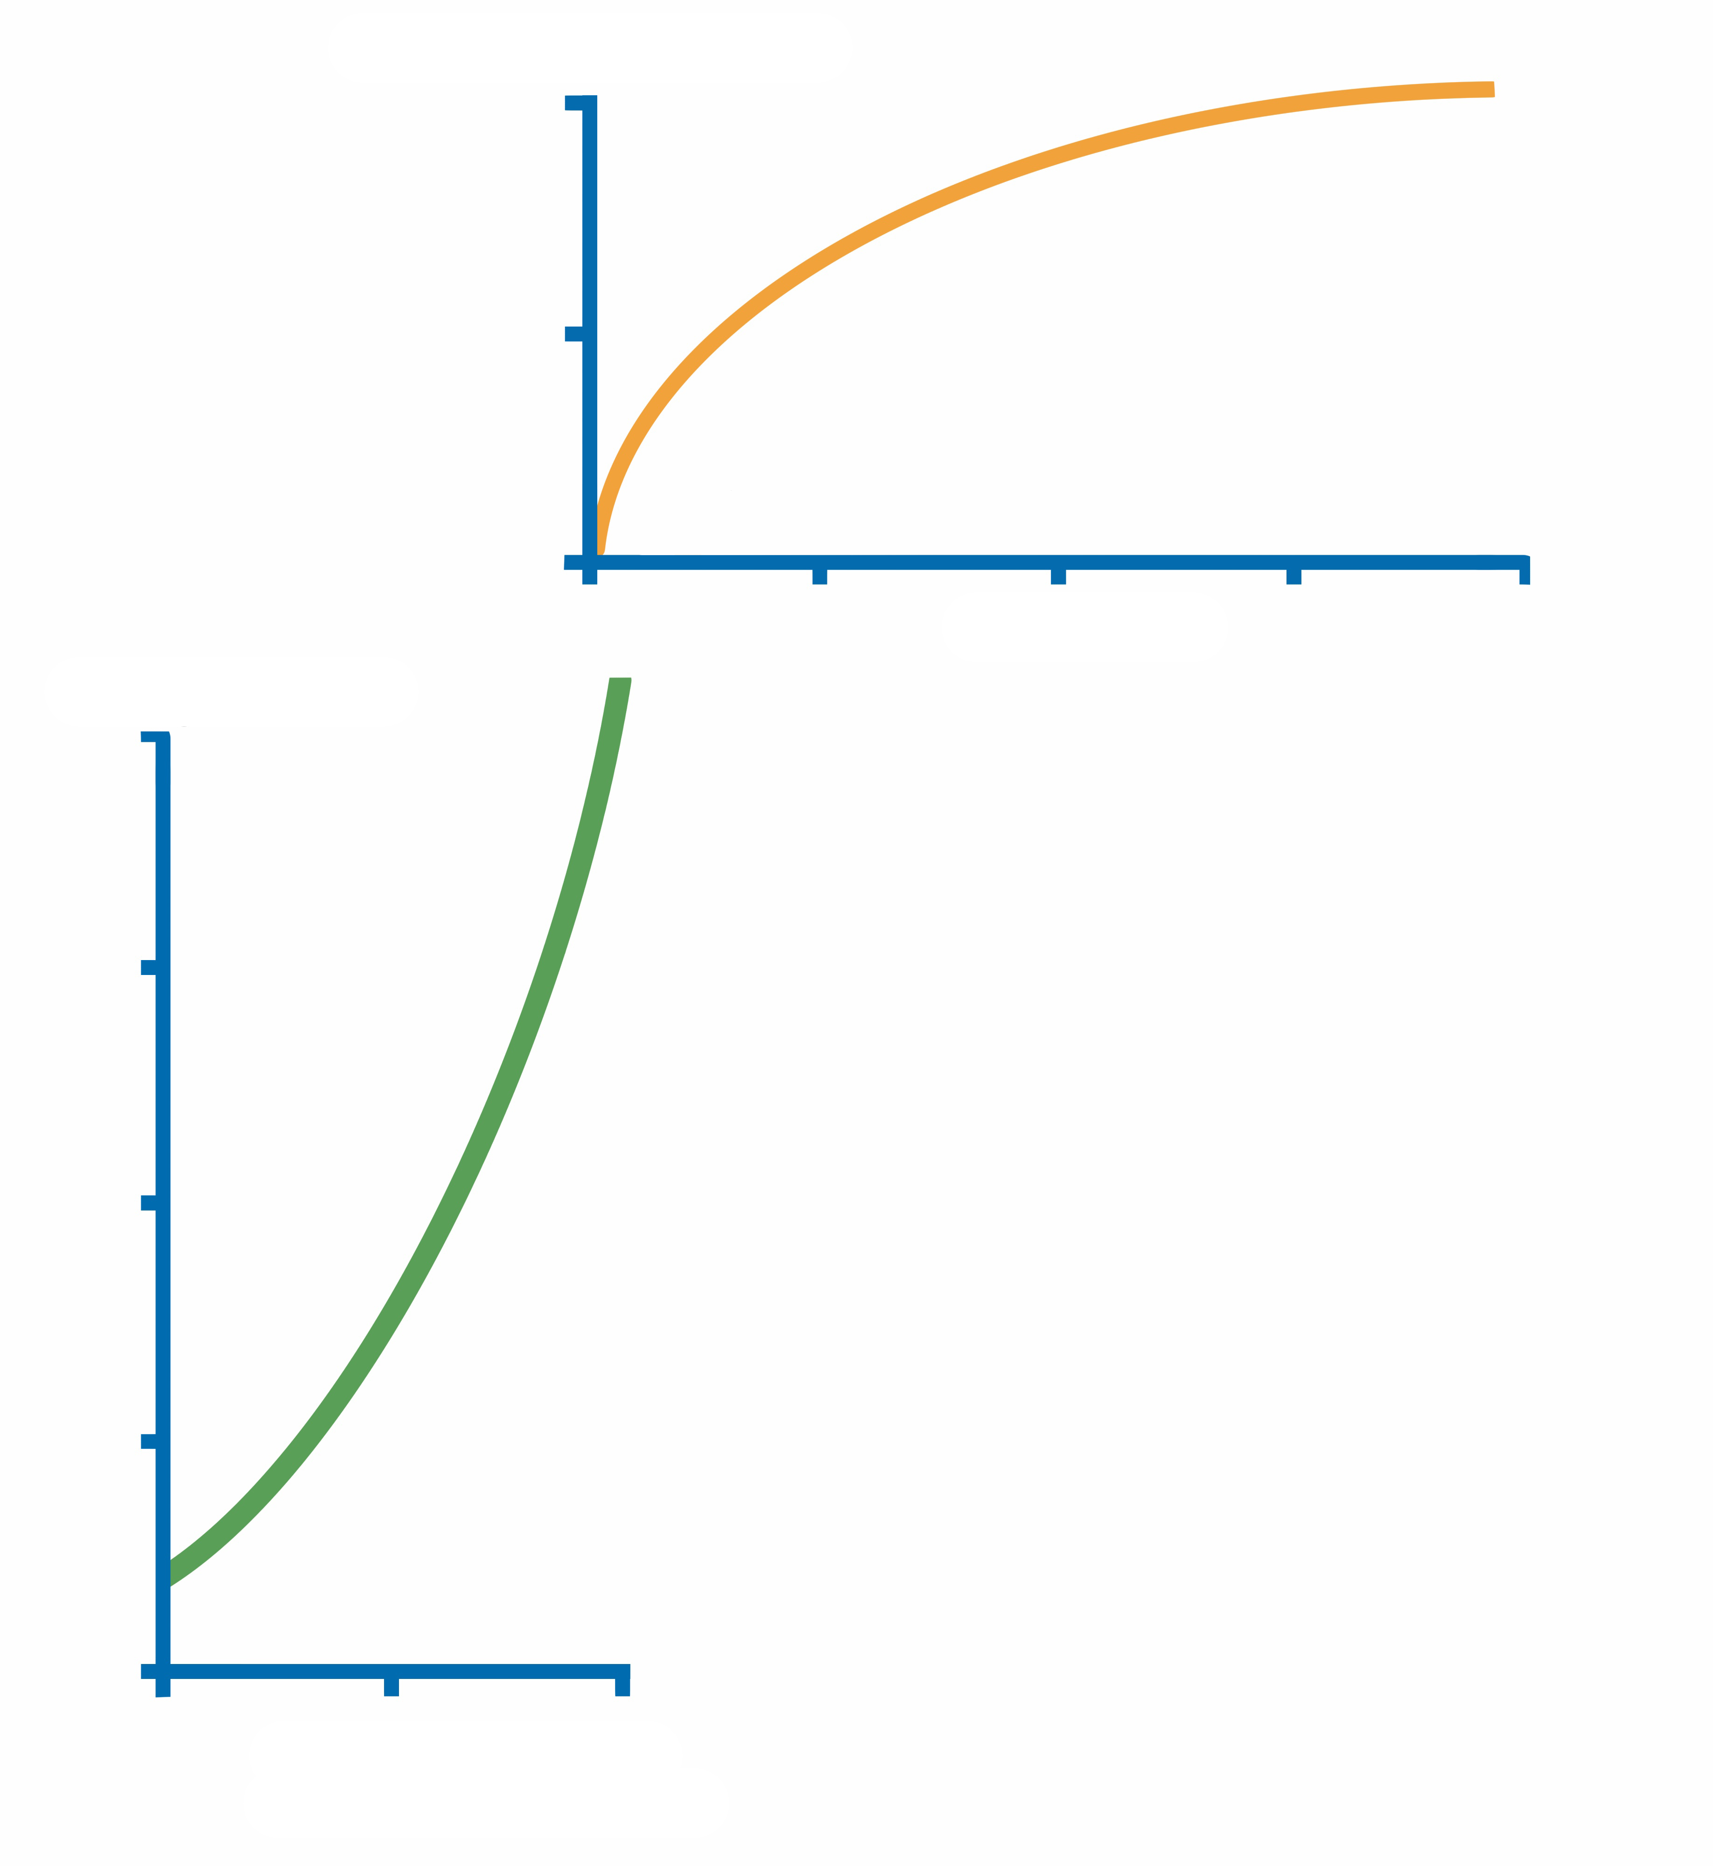
w_{xg2}
w_{gf1}
w_{gf1}
Total Error

Slide 21
w_{xg2}
w_{gf1}
w_{gf1}
Total Error

Slide 22
w_{xg2}
w_{gf1}
w_{gf1}
Total Error

Slide 23
w_{xg2}
w_{gf1}
w_{gf1}
Total Error

Slide 24
w_{xg2}
w_{gf1}
w_{gf1}
Total Error

Slide 25
w_{xg2}
w_{gf1}
w_{gf1}
Total Error

Slide 26
w_{xg2}
w_{gf1}
w_{gf1}
Total Error

Slide 27
Source: https://medium.com/swlh/introduction-to-deep-learning-using-keras-and-tensorflow-part2-284746ab4442
Notes:
And finally, let’s zoom out and consider the training process from the perspective of the overall model. Here we see the training process (the process of model convergence) simulated for a linear regression model. As our model converges to a global minimum – that is, the model’s fit improves as the regression line moves – our training loss drops and adjustments to our parameters (weights and biases) levels off.

Slide 28
Summary
Error (Loss) Function
Gradient Descent & Partial Derivatives
Complex Gradients
Optimizers
Chain Rule
Notes:
Well, we have covered a lot of territory in this presentation. First, we discussed the loss function and a network’s total error. That was followed by an in-depth look at gradient descent and the use of partial differential equations to calculate the derivative or slope at a given point on the gradient. We also learned that most loss functions exhibit complex contours, featuring hills, values, and plateaus, making it difficult to locate the global minimum. And finally, I discussed how backpropagation employs the chain rule to determine the contribution of each weight to the total error in relation to the other weights.

Slide 29
(MNIST Exercise)
MNISTExercise.pdf
Notes:
MNIST (Modified National Institute of Standards and Technology) is a famous dataset of handwritten digits with 60,000 examples in the training set and 10,000 in the test set. MNIST was created in 1998 – a long, long time ago in AI time. Creating a deep learning model to correctly classify a given image is equivalent to writing a “Hello World” program in AI.

Slide 31
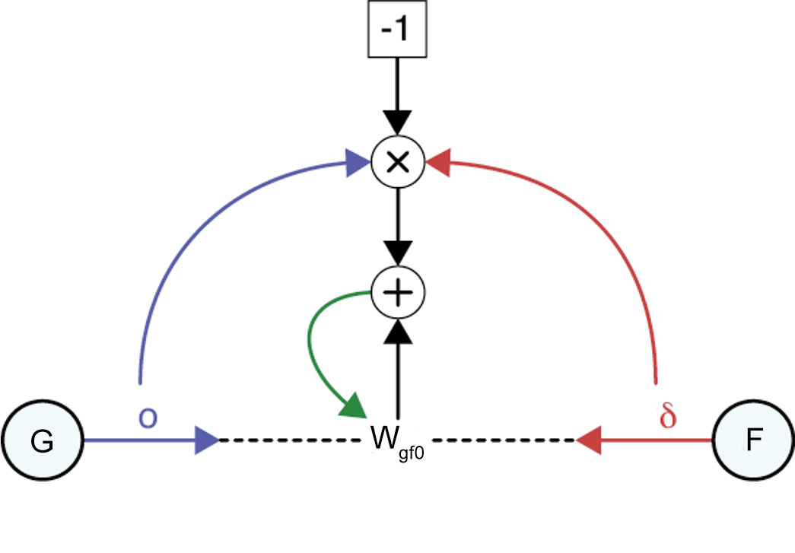

Slide 32
Notes:
Gradient Descent is a generic optimization algorithm capable of finding optimal solutions to a wide range of problems. The general idea of Gradient Descent is to tweak parameters (weights) iteratively in order to minimize a cost function. Suppose you are lost in the mountains in a dense fog, and you can only feel the slope of the ground below your feet. A good strategy to get to the bottom of the valley quickly is to go downhill in the direction of the steepest slope. This is exactly what Gradient Descent does: it measures the local gradient of the error function with regard to each weight in the network, and it goes in the direction of descending gradient. Weights are often combined into a parameter vector θ, pictured here at the Minimum. Once the gradient is zero, you have reached a minimum! Concretely, you start by filling θ with random values (this is called random initialization). Then you improve it gradually, taking one baby step at a time, each step attempting to decrease the cost function (e.g., the MSE), until the algorithm converges to a minimum.

Slide 33
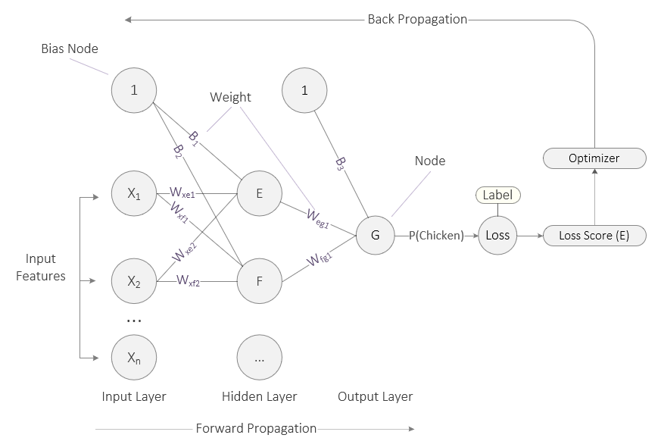
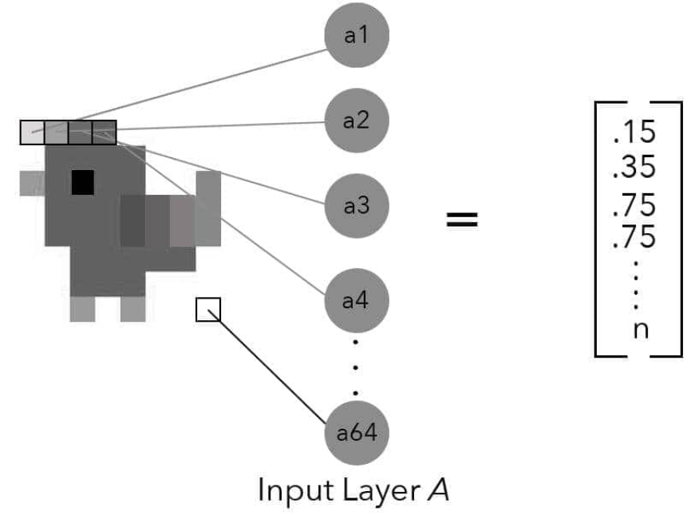
Source: Taylor, M. (2017). Neural networks: A visual introduction for beginners. Vancouver, Canada: Blue Windmill Media.
Notes:
We begin with the image of our small classification network from the last presentation. Let’s quickly review a couple points. In this example, the network’s output layer consists of a single node (G). Like the nodes before, it sums up its inputs, passes that value to its activation function which then generates a final output (the probability that the image is a chicken). This final output is then fed to a loss function, often called a cost or error function in the literature. The loss function compares the network’s prediction to the label attached to the example. So, if the label attached to this image is 1 (it’s 100% certain that this is a chicken) but our network outputs a probability of 10%, we have a large discrepancy. With that discrepancy, the loss function calculates the network’s total error. This is the penalty the network must pay for arriving at an answer other than the ground truth. If the network’s prediction closely matches the label, the total error is minimal.
And finally, the loss function passes the total error to the optimizer which oversees the backpropagation process. It is during backprop that weights are adjusted. Hence, the goal of the system is to minimize its error, in a process called gradient descent. At this point, the network needs to adjust all of its weights such that the total error is minimized. More concretely, the network needs to calculate the individual contribution of each weight to the total error and then proceed to adjust each weight (up or down) in relation to its contribution to the total error. So, how does it do that during backpropagation? Let’s start with a 3-dimensional plot…

