Slide 1


Activation Functions

Slide 2

Input 1
Input 2
Weight 1
Weight 2
+
Input 3
Weight 3
Weight 4
Input 4
Weight 5
Net Input
Function
Activation
Function
Bias = 1.0
Source: Glassner, A. (2021). Deep learning: A visual approach. San Francisco, CA: No Starch Press. (Chapter 13)
Notes:
Alright, we met this diagram in our first mini-lecture.
In this presentation, I want to take a closer look at the activation function and some of the options available to us. The choice of activation function is important as it can have a major impact on how well a deep model learns.

Slide 3
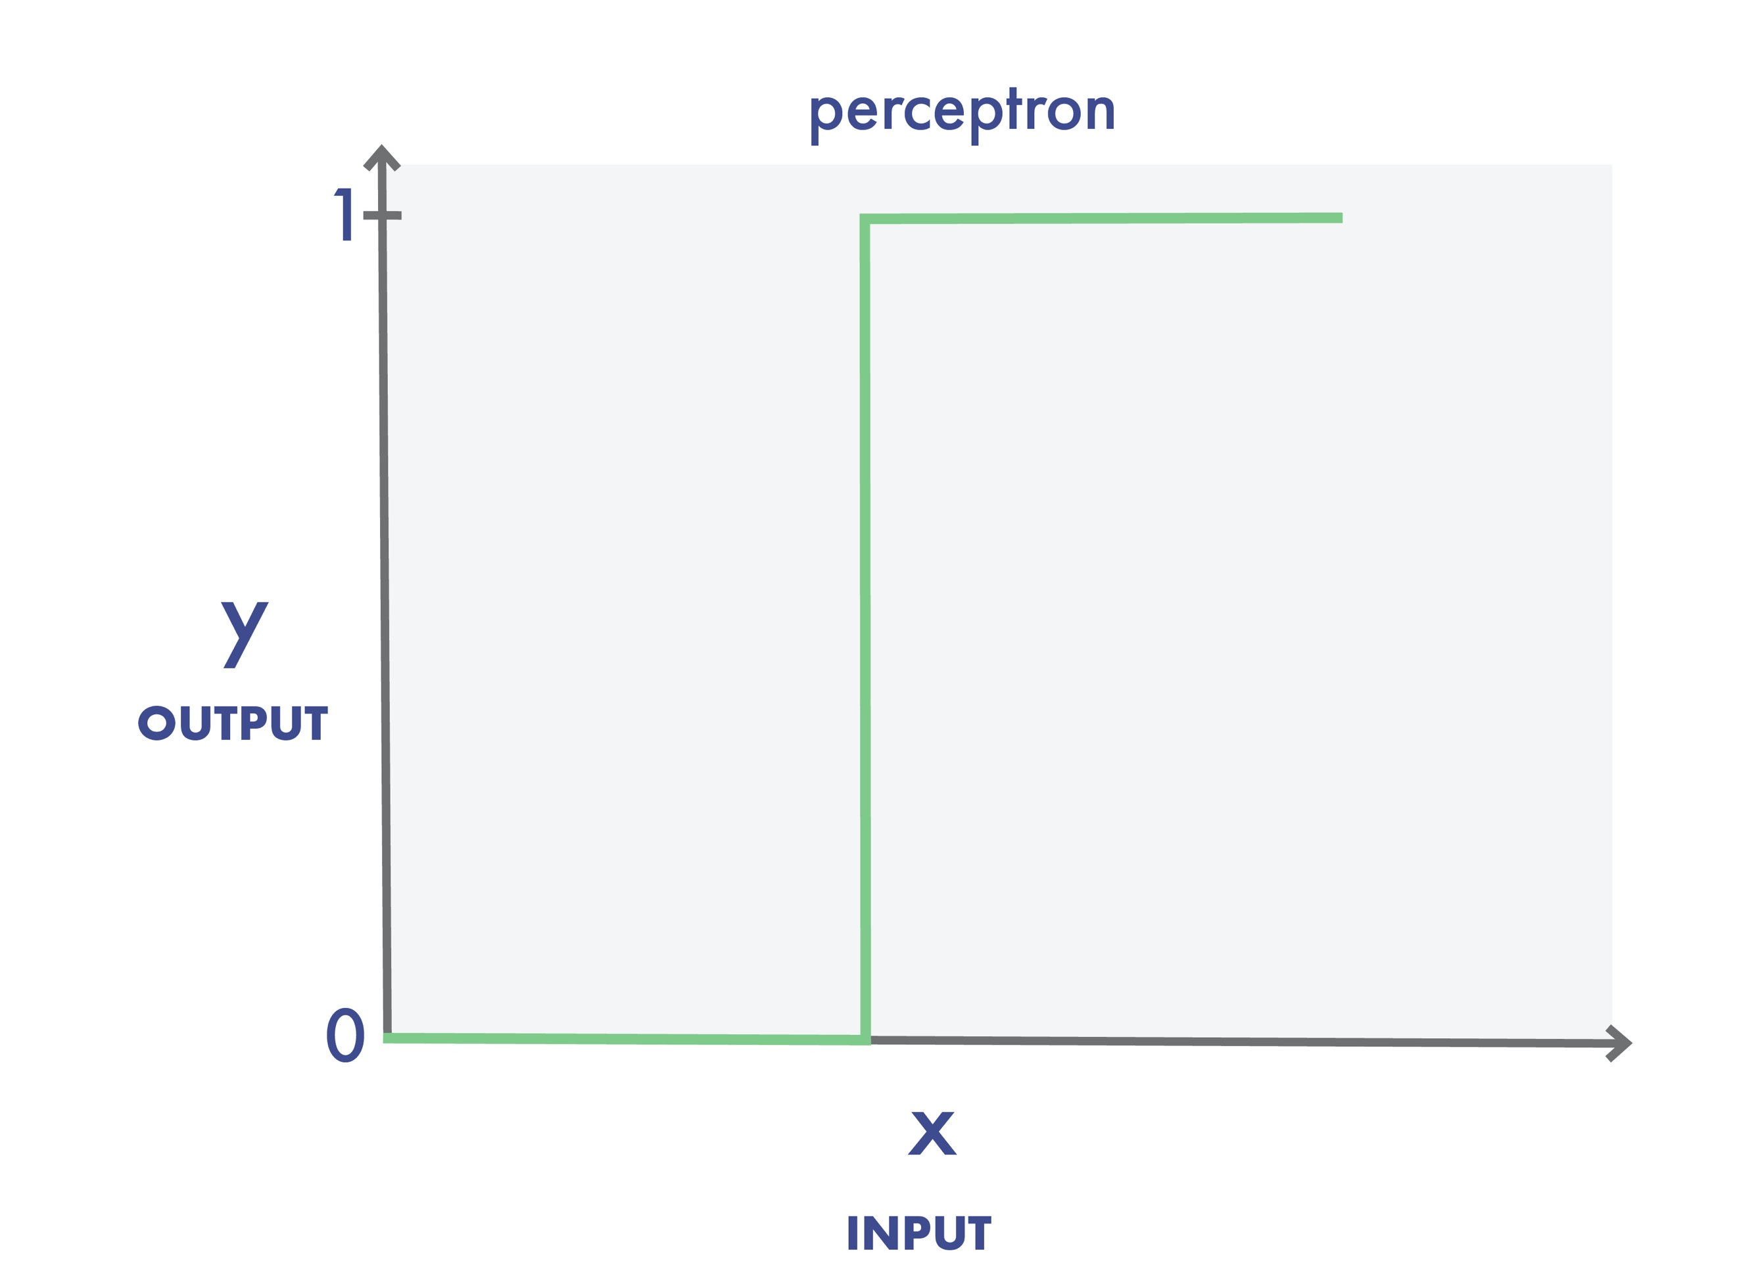
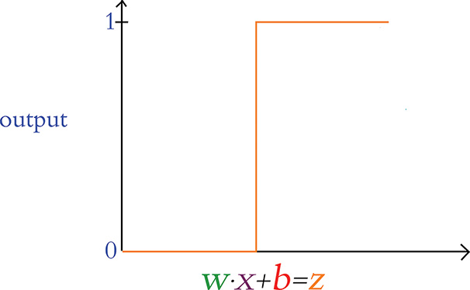
perceptron
y
output
x
input
Source: Krohn, J. et al (2020). Deep learning illustrated: A visual, interactive guide to AI. New York, NY: Addison-Wesley. (Chapter 6)
Notes:
Rosenblatt’s original perceptron was a simple animal. When z was any value less than or equal to zero, the perceptron output 0. If z became positive to even the tiniest extent, the perceptron outputs 1. But this sudden and extreme transition is not optimal during training. Essentially, the neuron has no finesse – it’s either yelling or its silent.
Think about it like this. In real life, learning is generally incremental, consisting of a series of small steps towards mastery. It’s rarely the case that complete understanding occurs in an instant, at a moment in time. The same holds true in deep learning. Ideally, we’d like to move along a gradient, capable of reflecting small learning adjustments.

Slide 4
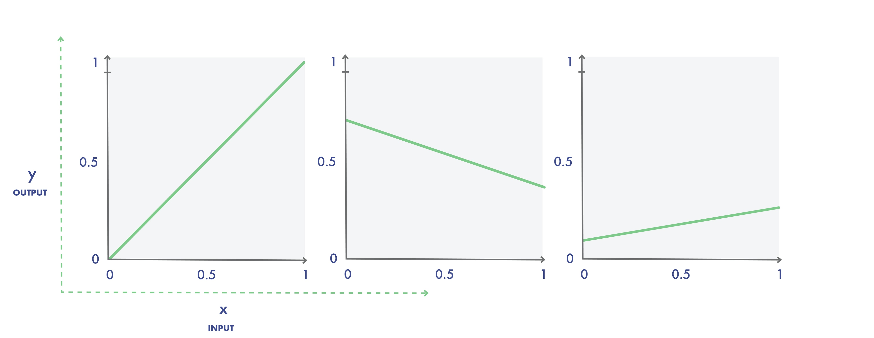
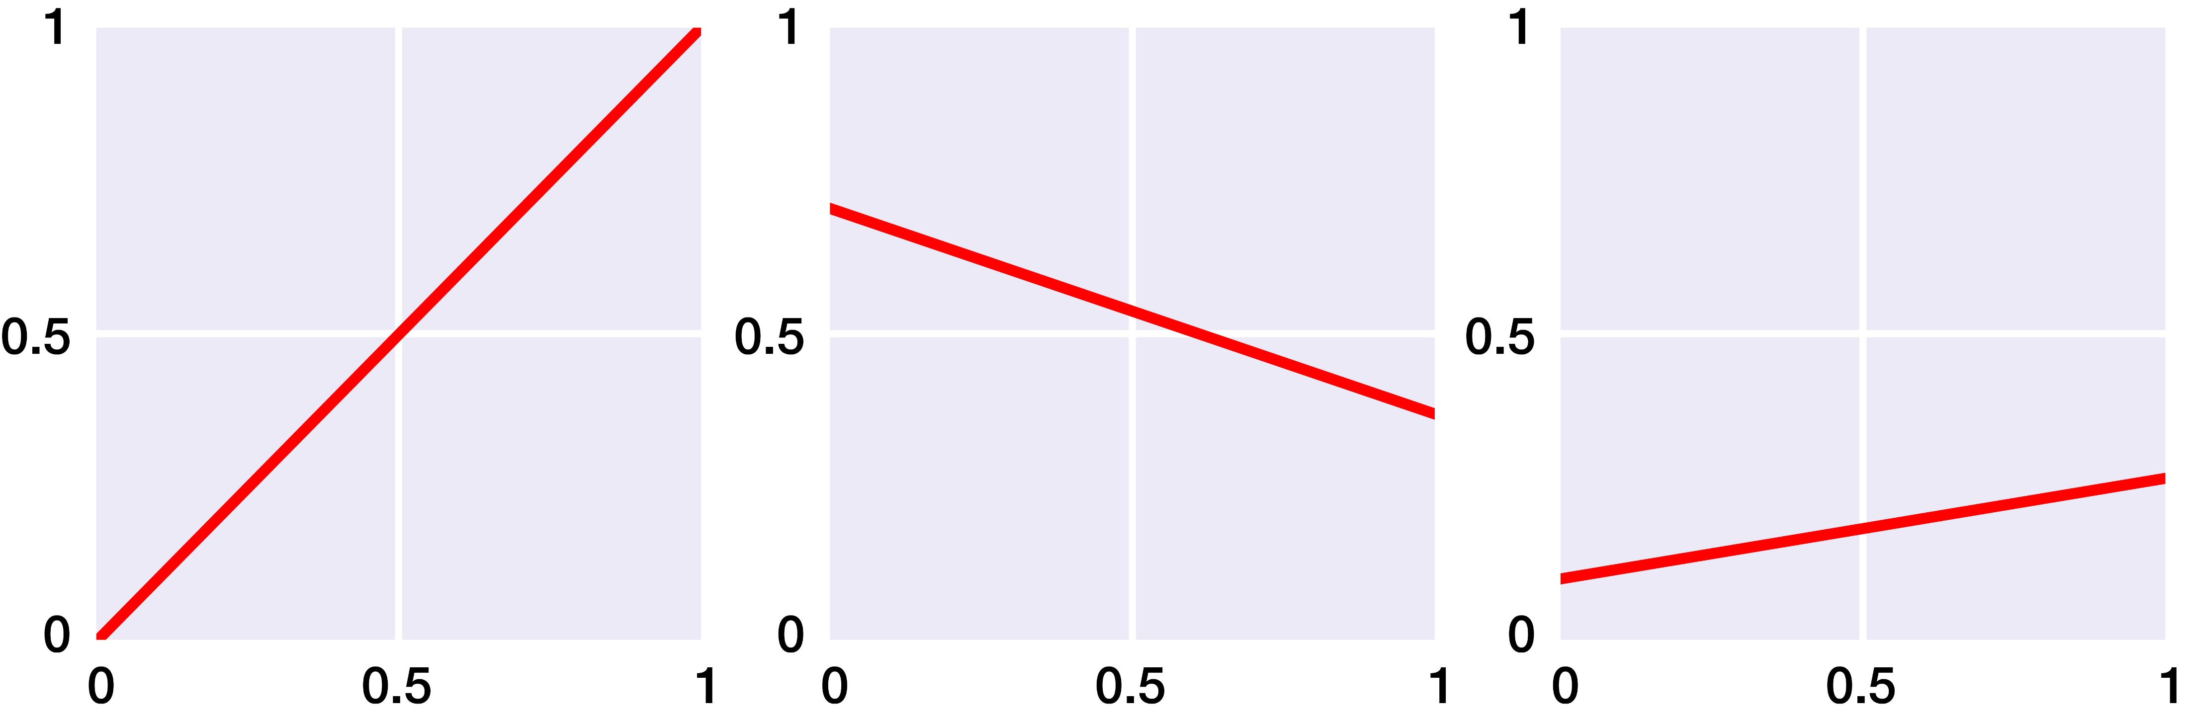
y
y
output
x
x
input
y = f(x)
Source: Glassner, A. (2021). Deep learning: A visual approach. San Francisco, CA: No Starch Press. (Chapter 13)
Notes:
Let’s first consider activation functions comprised of one or more straight lines, also known as linear functions.
Now in Python, a function is a named block of code that only runs when it is called. Most functions allow you to pass data – called parameters – into them. Most functions also return a value once they’ve been executed. Here we see a simple function called f, with one parameter called x. When we pass a value on the x-axis to this function, it returns a value that is then assigned to a variable named y.
Pictured here are graphs for three different linear functions. In the case of the graph on the left, if we pick any point on the X axis, and go vertically up until we hit the line, the value of that intersection on the Y axis is the same as the value on the X axis. That is, the output, or y value, of this curve is always the same as the input, or x value. We call this the identity function.
With the other two graphs, the lines are tilted, reflecting different slopes. This is typically what we see in simple linear regression.

Slide 5
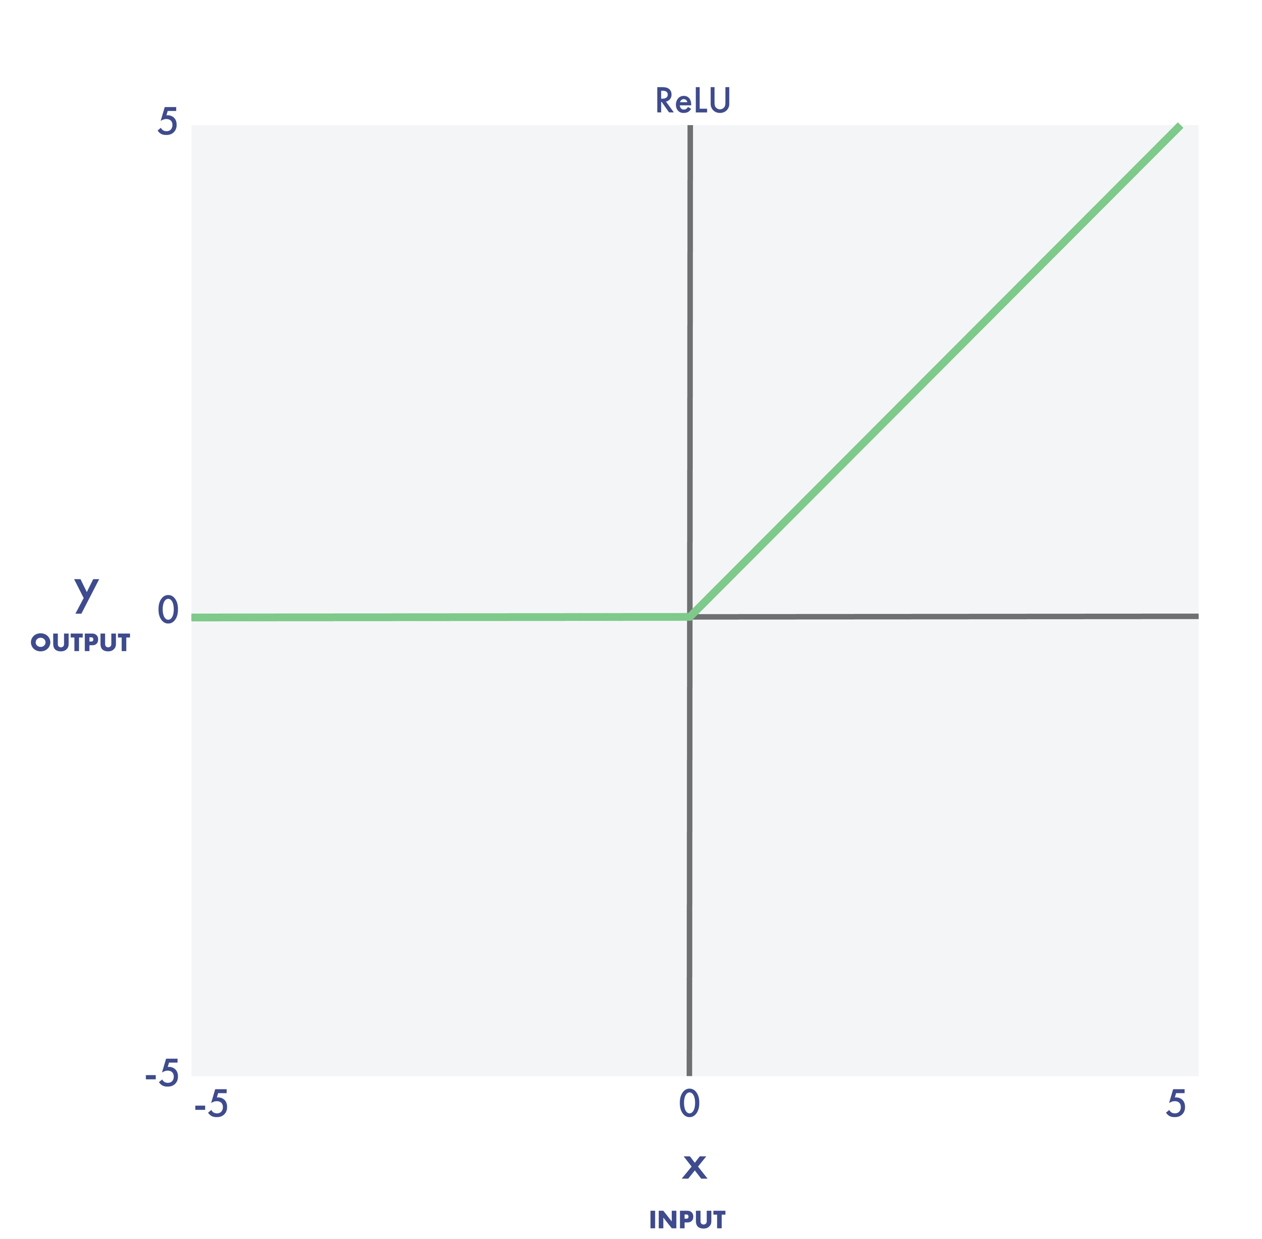
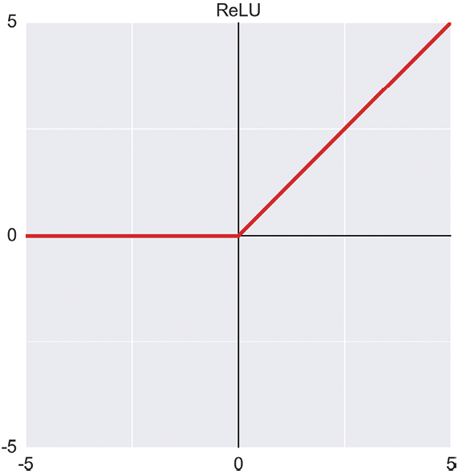
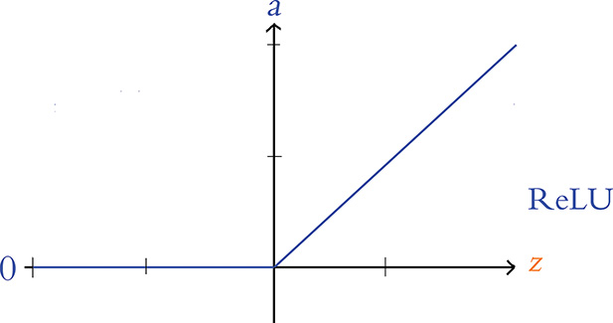
ReLU
y
output
x
input
Source: Glassner, A. (2021). Deep learning: A visual approach. San Francisco, CA: No Starch Press. (Chapter 13)
Notes:
The ReLU, or rectified linear unit outputs 0 for all negative inputs, otherwise the output is the input.
The ReLU activation function is popular because it’s simple and trains well.

Slide 6
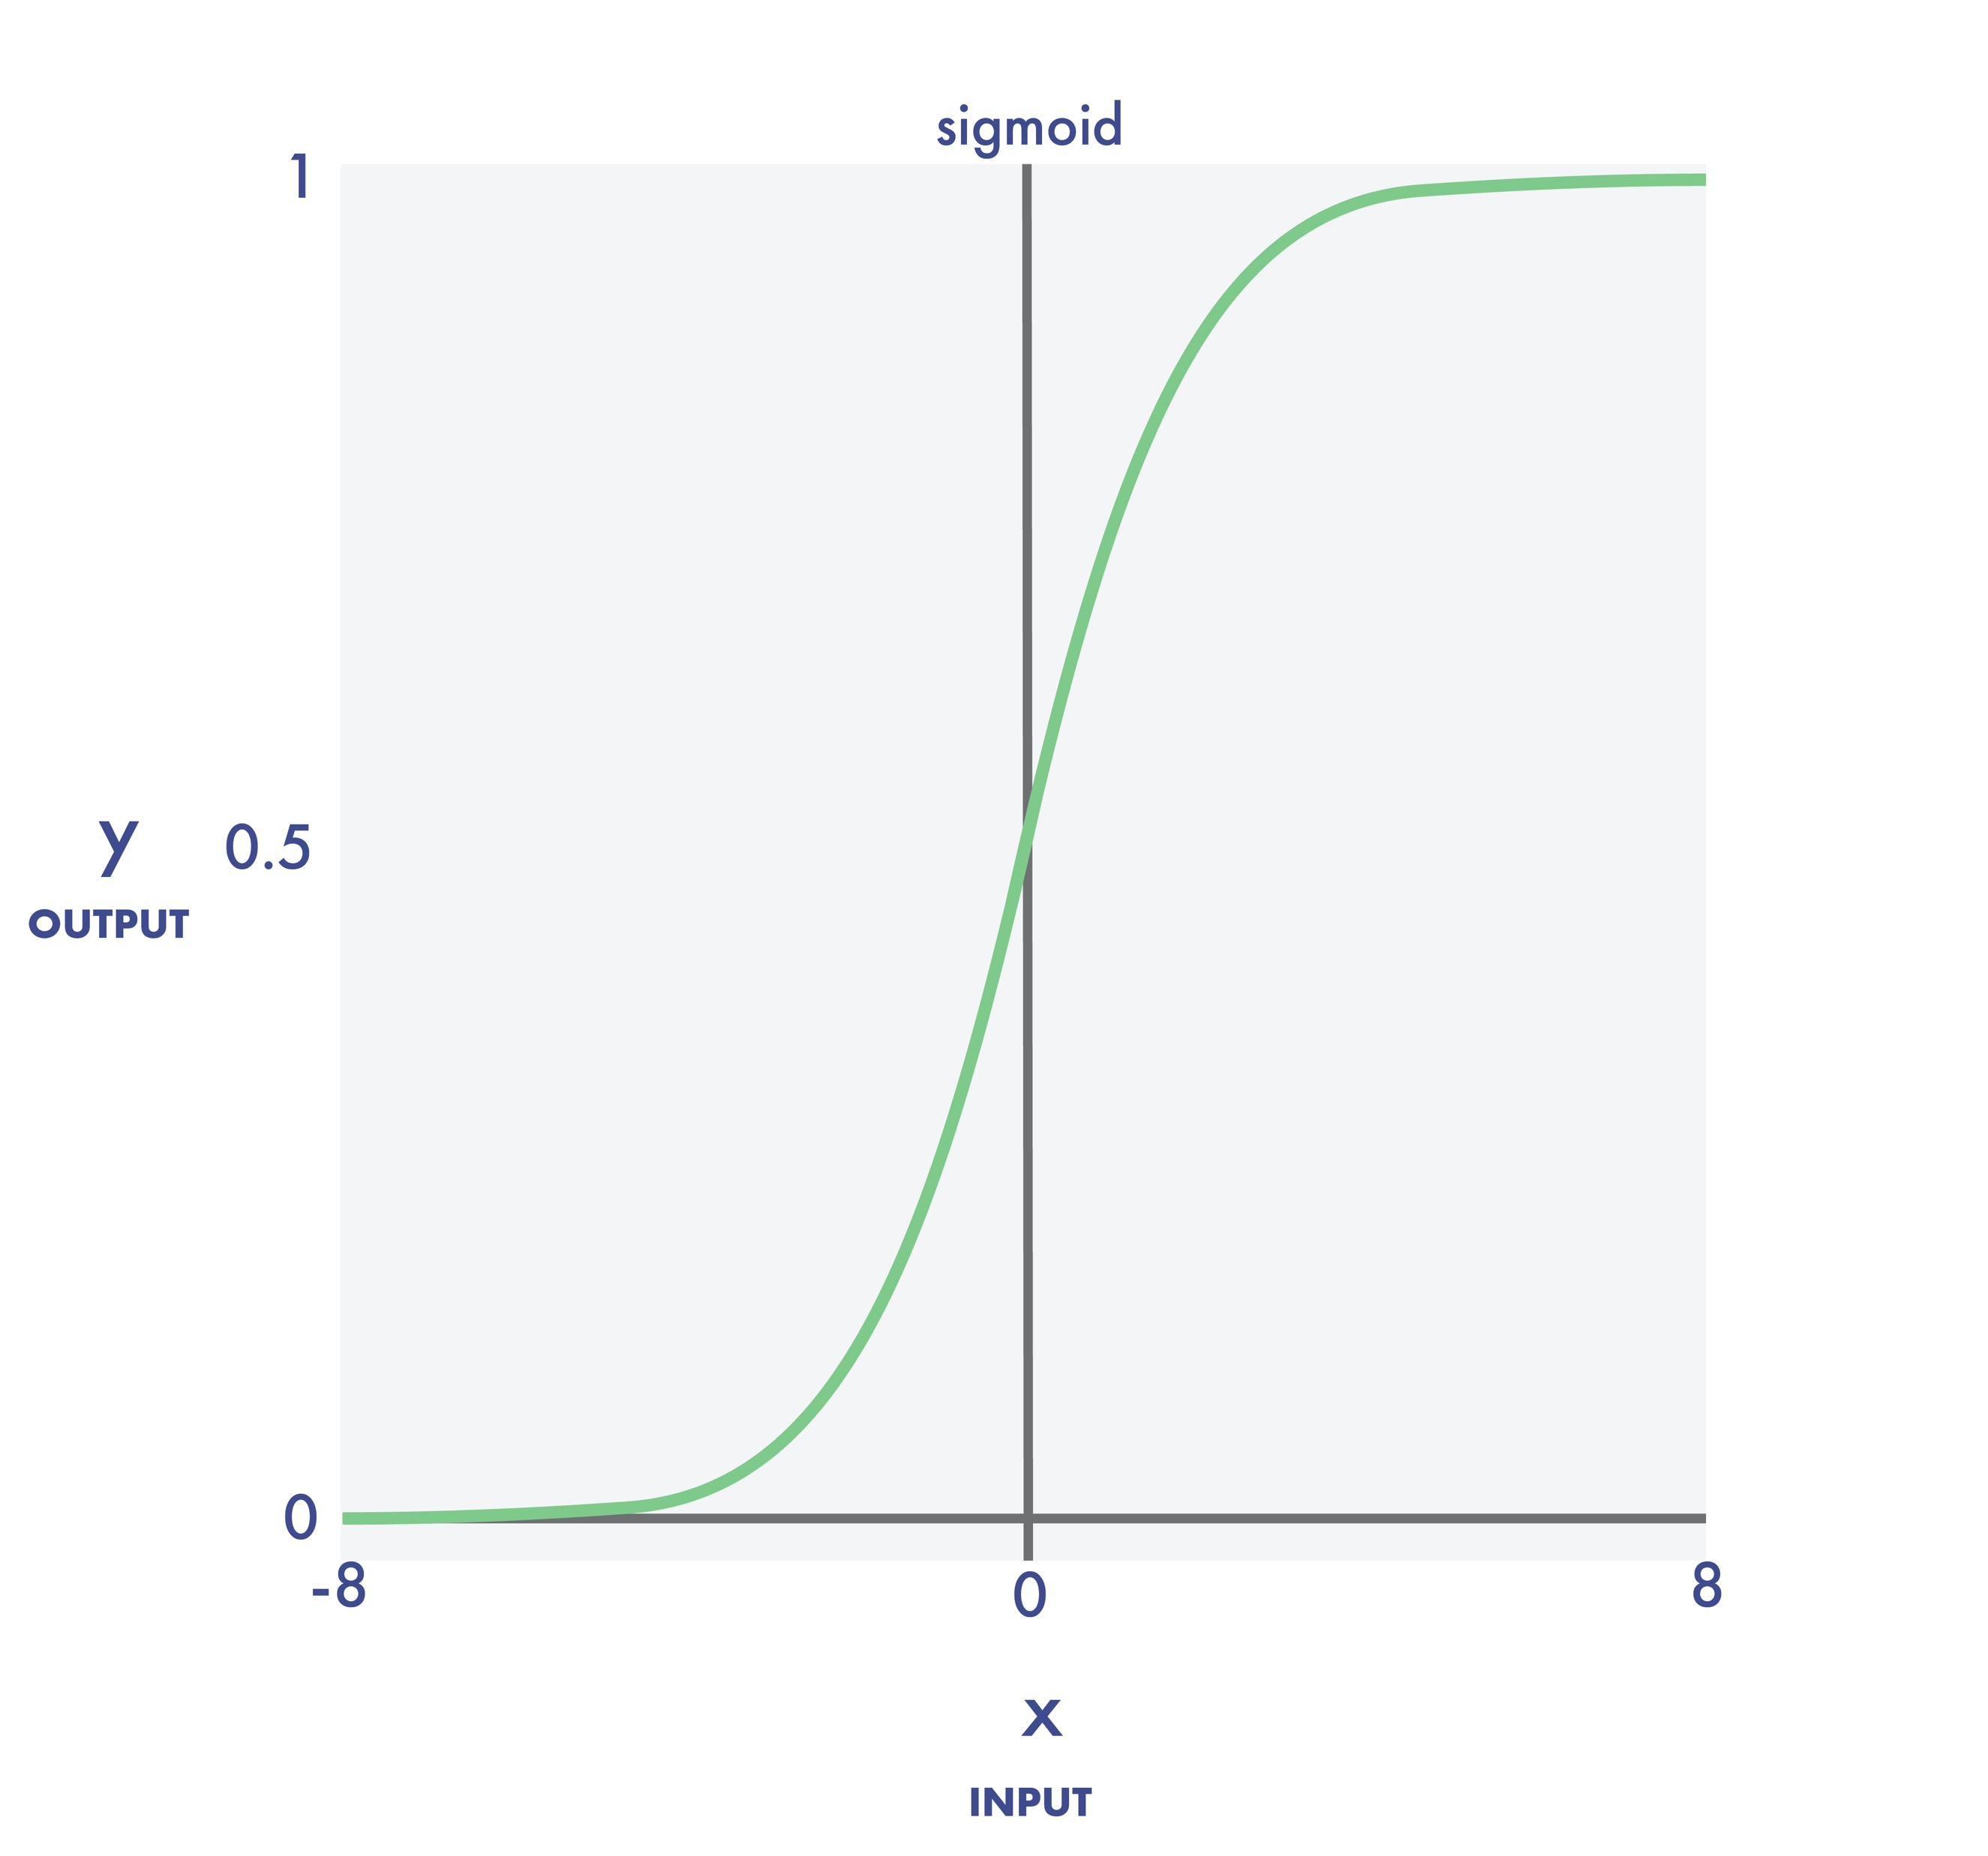
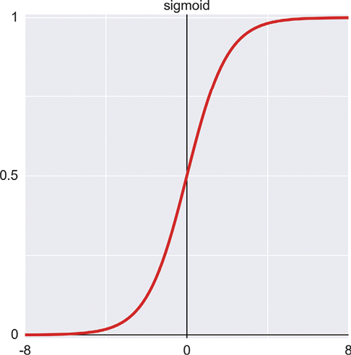
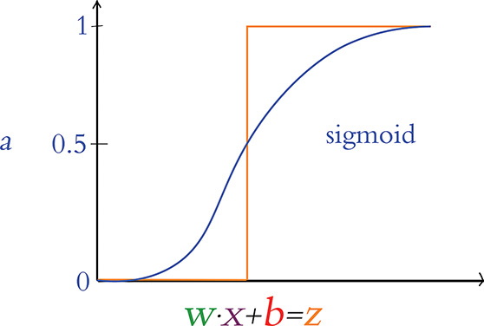
sigmoid
y
output
x
input
Source: Glassner, A. (2021). Deep learning: A visual approach. San Francisco, CA: No Starch Press. (Chapter 13)
Notes:
The S-shaped sigmoid function is also called the logistic function or logistic curve. It has a value of 0 for very negative inputs, and a value of 1 for very positive inputs. In this example, we see a smooth transition between 0 and 1 for x values ranging from -6 to 6. The name sigmoid comes from the resemblance of the curve to an S shape,

Slide 7
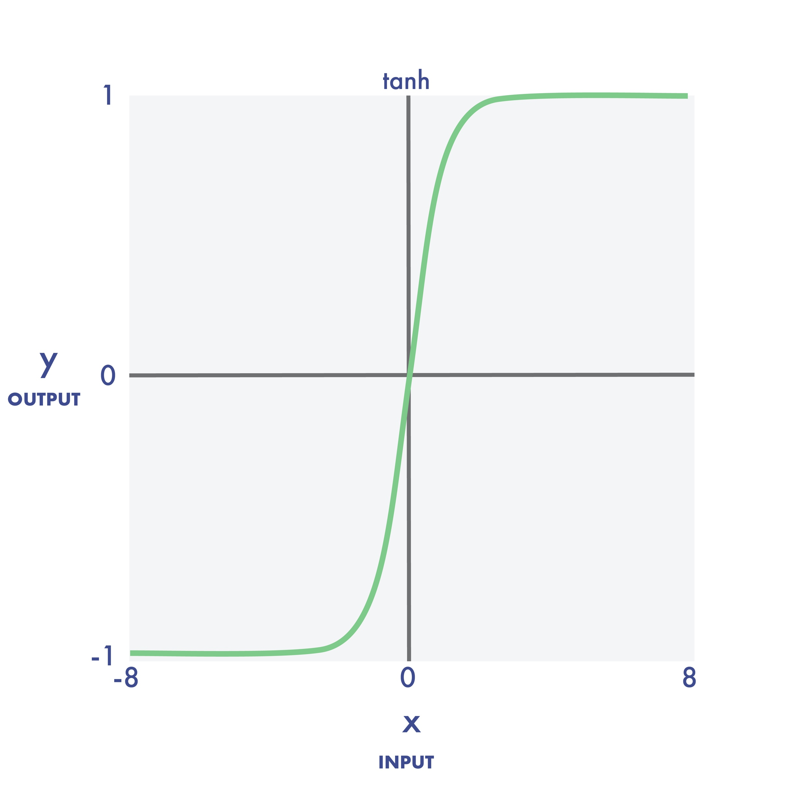
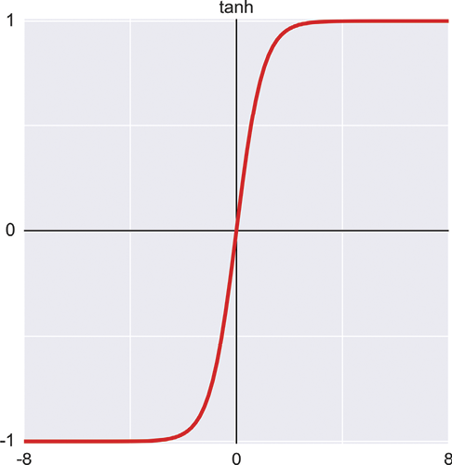
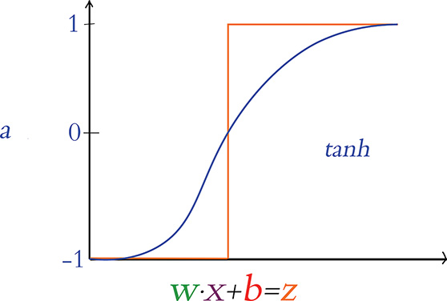
tanh
y
output
x
input
Source: Glassner, A. (2021). Deep learning: A visual approach. San Francisco, CA: No Starch Press. (Chapter 13)
Notes:
The hyperbolic tangent function, written tanh, is S-shaped like the sigmoid. The key differences are that it returns a value of −1 for very negative inputs, and the transition zone is a bit narrower.

Slide 8
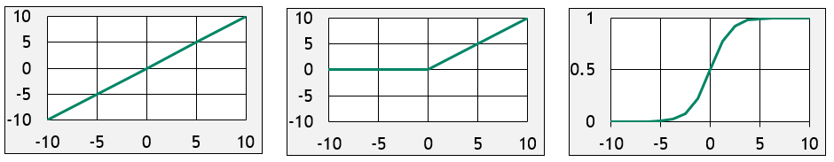
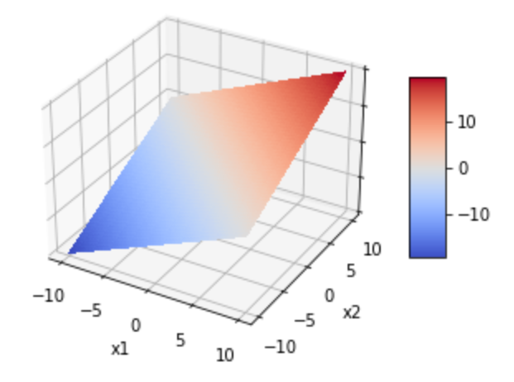
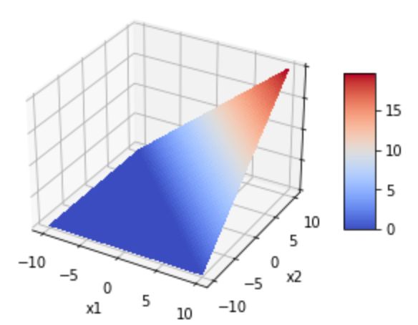
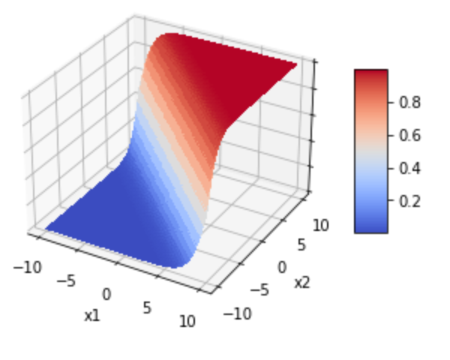
Linear
ReLU
Sigmoid
Notes:
Before moving on, let’s visualize the Linear, ReLu, and Sigmoid activation functions in three-dimensional space. We’ve already seen the graphs for these functions, so the first line is no surprise. On the second, however, we see their three-dimensional equivalents. Linear is just a plane, like a sheet of paper. ReLU is like a wedge. And Sigmoid is like a surf wave.

Slide 9
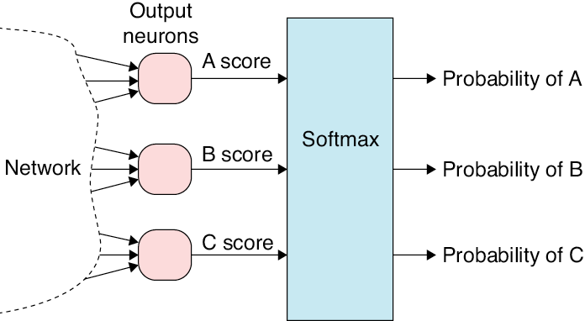
Output Neurons
Output
neurons
A score
Probability of A
Network
B score
Softmax
Probability of B
C score
Probability of C
Source: Glassner, A. (2021). Deep learning: A visual approach. San Francisco, CA: No Starch Press. (Chapter 13)
Notes:
There’s an operation that we typically apply only to the output neurons of a classifier neural network, and even then, only if there are two or more output neurons.
It’s not an activation function in the sense that we’ve been using the term because it takes as input the outputs of all the output neurons simultaneously. It processes them together and then produces a new output value for each neuron. Though it’s not quite an activation function, it’s similar enough to include it in this discussion.
The technique is called softmax. The purpose of softmax is to turn the numbers that come out of a classification network into class probabilities where all the probabilities add up to 1.

Slide 10
Activation Function Recommendations
The Perceptron
The Sigmoid
The Tanh
The ReLU
Source: Krohn, J. (2020). Deep learning Illustrated. New York, NY: Addison-Wesley. (p. 96)
Notes:
The following recommendations come from Jon Krohn’s wonderful book: Deep Learning Illustrated:
Because it’s either all on or off, the perceptron is not a practical consideration for deep neural networks.
The Sigmoid is an acceptable option, but neural networks comprised of sigmoid functions tend to train slower than those with Tanh or ReLU functions. Limit the use of sigmoid functions to situations where the neuron needs to provide output within the range of 0 – 1.
The Tanh is a solid choice as the 0 centered output helps networks train rapidly.
According to Krohn, the best choice is the ReLU (Rectified Linear Unit) because of its computation efficiency. This function tends to lead to well-calibrated neural networks in the shortest training time.
In recent years, Keras has released a variety of advanced activation functions. Leaky ReLU, parametric ReLU, and exponential linear unit are all derived from the basic ReLU function. Refer to the Keras documentation for more information about these options.

Slide 11

Exercise
Notes:
Tensorflow Playground: https://playground.tensorflow.org/

Slide 12

Exercise
Notes:
Source: Google Teachable Machine: https://teachablemachine.withgoogle.com
Two Locations for the Hanfu/Hanbok dataset
https://drive.google.com/file/d/1q3RIgIoeePNW-fEgNyCgh45gBvMAdeOU/view
https://drive.google.com/file/d/1WbZPzunh6u9f0leymbzmVrJjSxq6JW5w/view?usp=sharing

Slide 13
(Perceptron as Binary Classifier) 02.2_binary_classifier.ipynb
Practice
(Multi-class Classification Using a Perceptron) 02.3_multi_classifier.ipynb

Slide 15
Exercise
(Rosenblatt’s Perceptron) 02.1_perceptron.ipynb
Notes:
The learning experience for this workshop starts on page 55 of the textbook. For additional information, please watch the exercise 2.01 orientation video.

