Slide 1

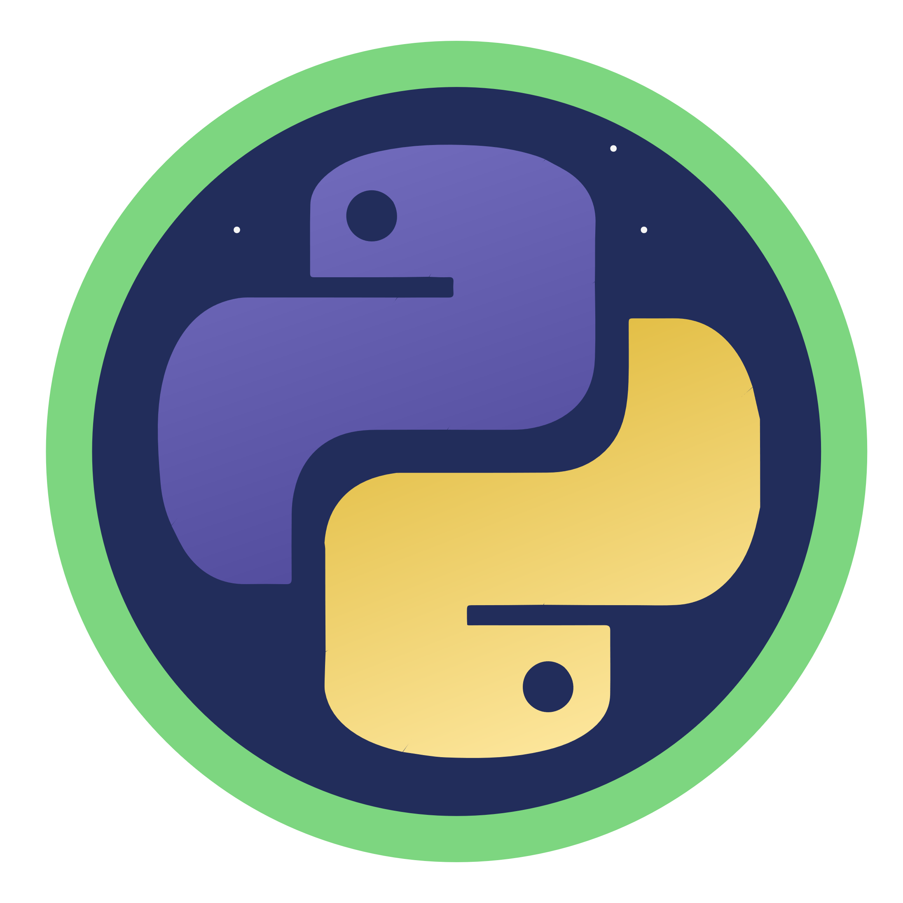
Python for AI
Notes:
Hello and welcome to this Practicum AI recording.
I’m Dan Maxwell. I work as an AI Trainer for Research Computing, here at the University of Florida.
In this briefing, I am going to introduce you to the Python programming language.
[NEXT SLIDE]

Slide 2
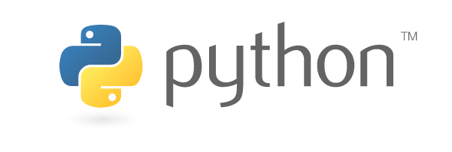

Notes:
So, let’s begin by asking a rather simple question. Why Python? Why not learn C++ or a tool like MatLab or SAS? Well, the answer is that over time Python has become the de-facto language of AI. In fact, the most important AI frameworks – SciKit-Learn, TensorFlow, and Pytorch – are all Python based. And though we can’t teach you everything about Python, we hope to provide a foundation so that you can execute your own AI project.

Slide 3
Six Learning Strategies
Notes:
Now that I’ve talked about what you’ll learn in this workshop series, I’d like to take a couple minutes to talk about how to learn. Mastering a new skill can be hard. But the 6 learning strategies I’m going to share with you now will help!
[NEXT SLIDE]

Slide 4
1
Focus
Notes:
Strategy # 1: Focus
So often, students think they can learn to program while multi-tasking -- posting on Facebook, texting friends or watching TikTok. If anything, these kinds of activities will slow you down. Instead, you'll learn Python much faster if you can devote focused time to practice.
[NEXT SLIDE]

Slide 5
2
Avoid “Copy and Paste”
Notes:
Strategy # 2: Avoid the “copy and paste” approach to writing code
The copy and past approach to writing code may sound like a good idea, but it can impede learning for these two reasons:
When you type out a line of code, chances are you’re going to make a typing mistake or two. And that’s a good thing! You will learn much faster as you read, understand, and then fix errors. None of this will happen if you take a copy and paste approach to writing code.
When you copy and paste code, you may think you know what you are doing. When, in fact, you don’t. In the beginning, you want to avoid the illusion of mastery.
[NEXT SLIDE]

Slide 6
3
Study Code Block-by-Block / Line-by-Line
Notes:
Strategy # 3: Study code block-by-block, line-by-line
This means running one block of code at a time. Do you understand the output? If things aren’t clear, spend more time with the code. Consider these tips:
Break a line of code into its components and try to understand the individual pieces. Sometimes functions are nested within functions.
Document, document, document! Remember: the documentation you write today is for the future you. That’s the you who’s trying to figure out what this block of code is doing, six months or a year from now.
Perform mini experiments. Simplify the code and then tinker with it to see what happens.
[NEXT SLIDE]

Slide 7
4
Use the Internet to Find Answers
Notes:
Strategy # 4: Use the internet to find answers
When faced with a strange error, take a minute to search the internet because someone has probably asked (and received useful answers) to the problem you now face. Also, I recommend that you bookmark your trusted resources. Stack Overflow, for example, is the go-to place for technical answers to coding questions. The site provides support for a wide variety of programming languages, including Python.
[NEXT SLIDE]

Slide 8
5
Ask for Help
Notes:
Strategy # 5: Ask for Help
There’s no shame in asking for help. We’re all learning. And some days, I feel like I’m the one who has the most to learn.
[NEXT SLIDE]

Slide 9
6
Take Your Time
Notes:
Strategy # 6: Take your time
It takes time to master any subject, including a programming language. Rome wasn’t built in a day. So, don’t rush to get things done. Expect some level of struggle and frustration. However, as your skill grows, you’ll be amazed at what you can do.
[NEXT SLIDE]

Slide 10
Resources
Notes:
Hello and welcome to this Practicum AI recording.
I’m Dan Maxwell. I work as an AI Trainer for Research Computing, here at the University of Florida.
In this briefing, I am going to introduce you to additional AI resources.
[NEXT SLIDE]

Slide 11
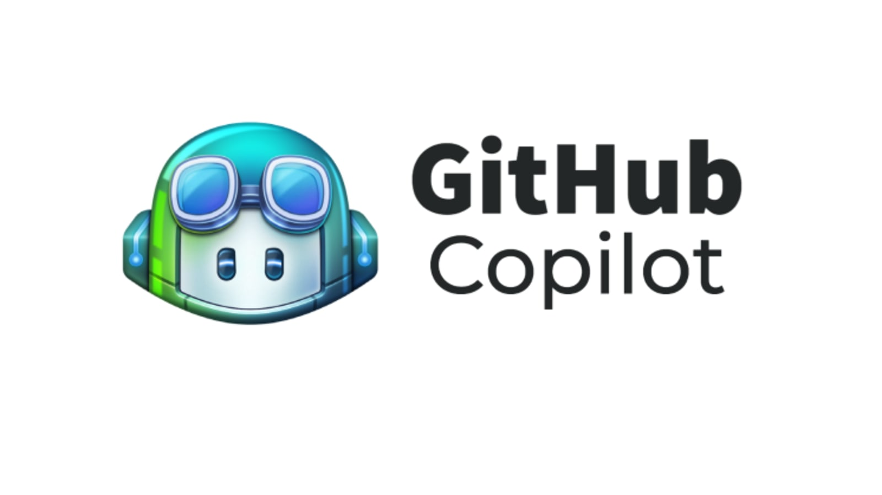

Notes:
Large language models such as GitHub CoPilot and ChatGPT can now write expert-level code. However, the prompt you provide must clearly state what the code will do. Going forward, Python skills will still be important. You may not write as much code. But modifying generated code, testing it, and then deploying a well-designed system are skills that will never be automated.

Slide 12
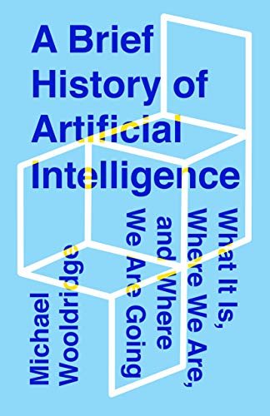
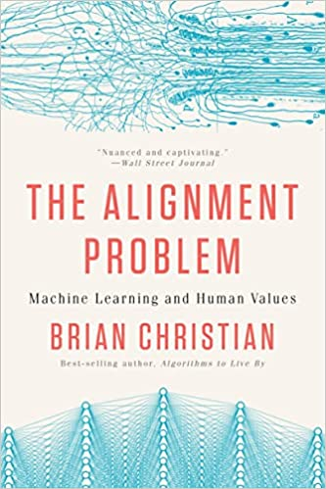
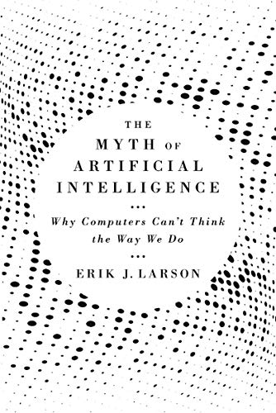
Additional Resources
Notes:
Well, you’re now ready to start your learning journey. But before you do, I encourage you to go beyond the technical details. Take some time to see the big picture. These three books will help you do that.
A Brief History of Artificial Intelligence by Michael Wooldridge is a wonderful introduction to the field. I especially like Michael’s NO hype approach.
The Alignment Problem by Brian Christian is probably the best book I’ve ever read on AI ethics.
The Myth of Artificial Intelligence by my friend Erik Larson discusses the challenges of achieving artificial General Intelligence (AGI).

